Slide 1






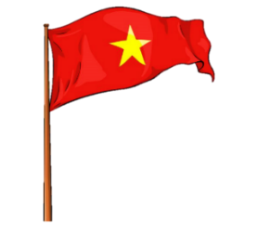






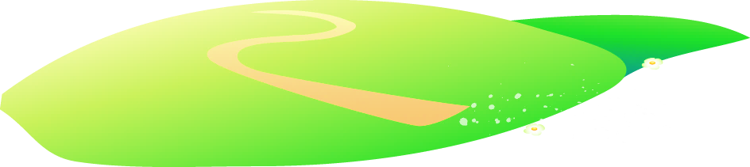







Notes:
Để nguyên trang bìa như này, chỉ thay đổi tên bài trong quá trình làm. Logo của sách Wonderful World

Slide 2



Unit 9. Places in town
Lesson 1. Task 4, 5, 6

Slide 3


WELCOME ALL THE TEACHERS TO THE CLASS
ENGLISH 4
Teacher: Nguyen Thi Nghia
School: An Hong primary school
Class: 4A2

Slide 4

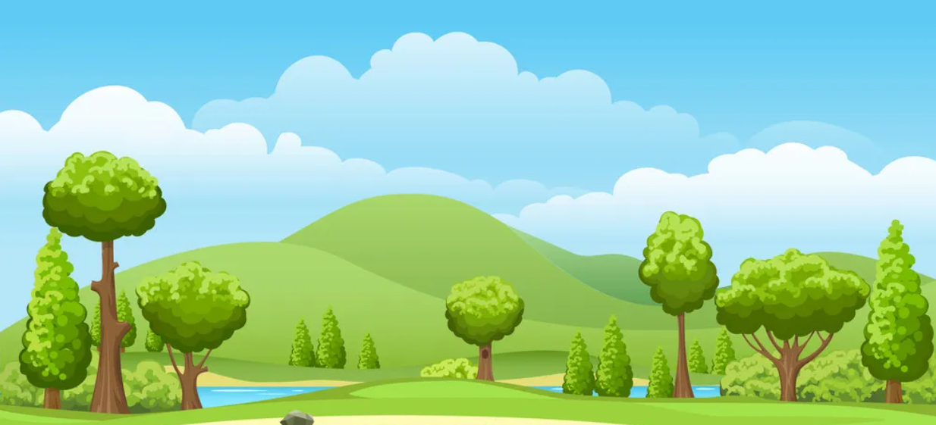
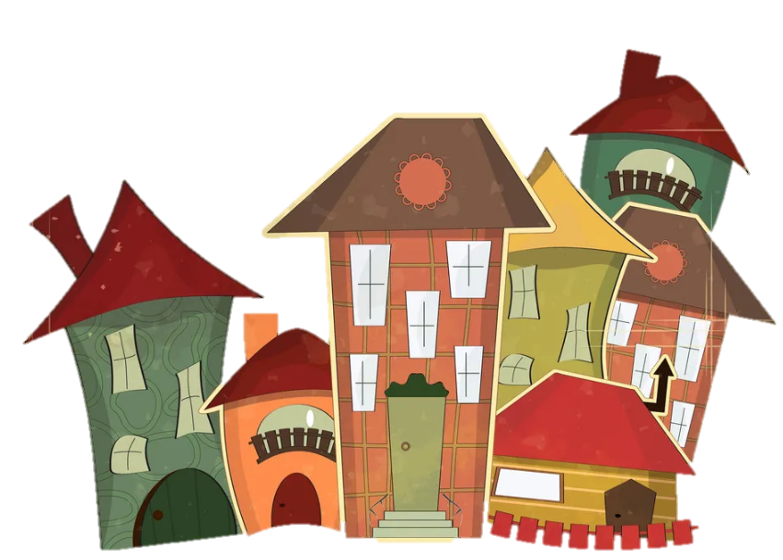
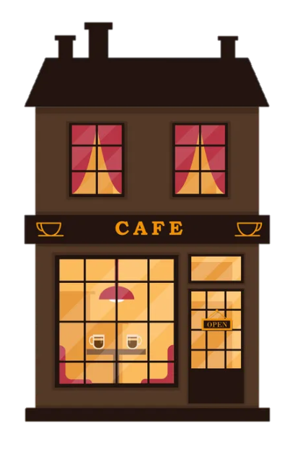
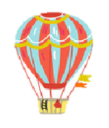
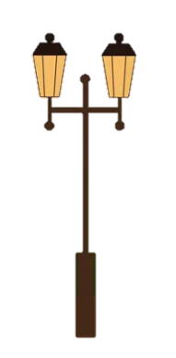
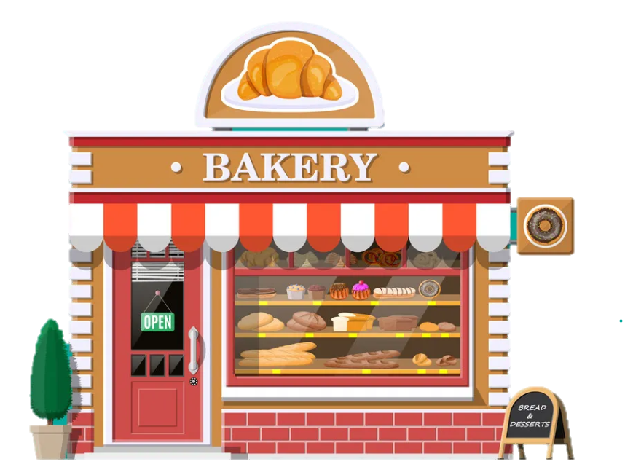
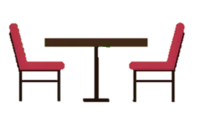
1
Warm Up

Slide 5
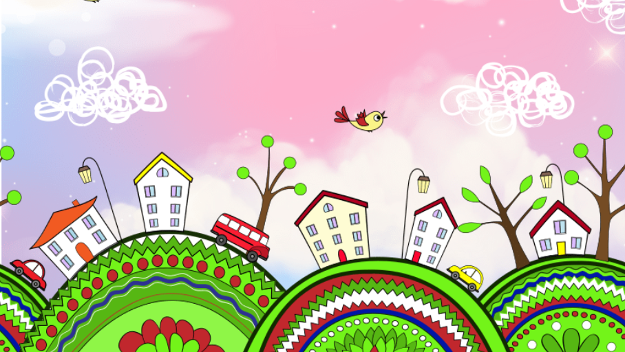
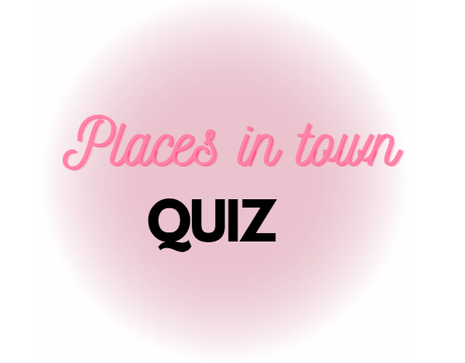

Slide 6

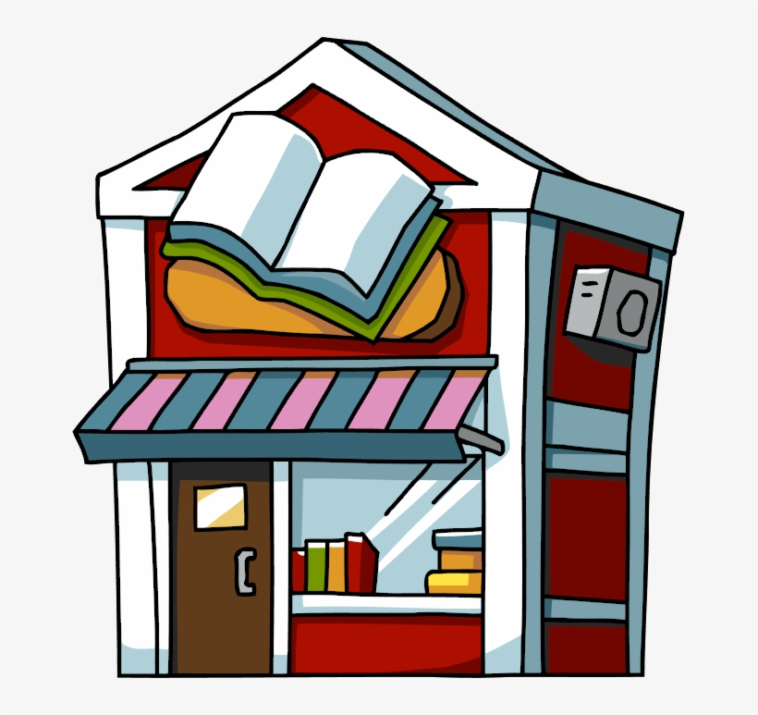
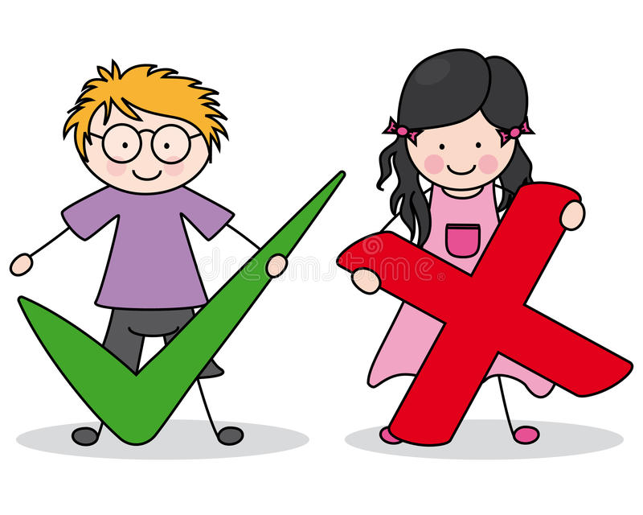

I buy books at the ___.
a) bookshop
b) library
c) fountain

Slide 7

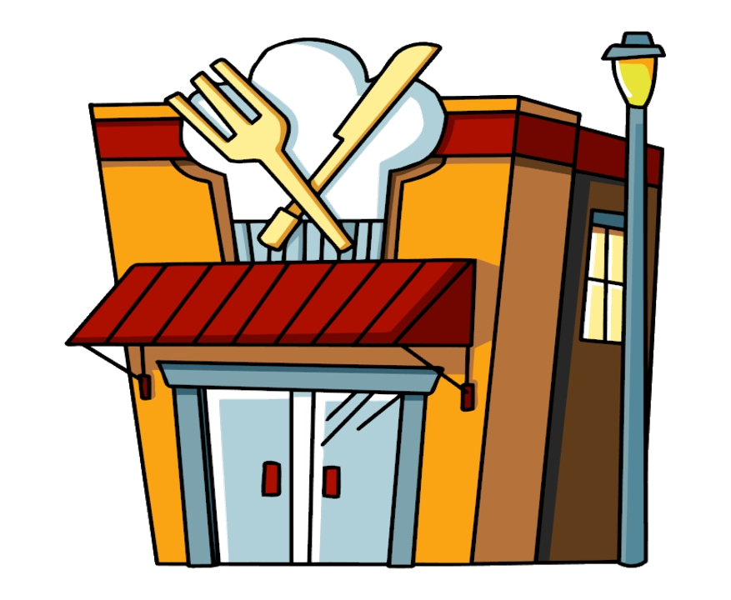
I have lunch at the ___ in front of the train station.
a) bookshop
b) fountain
c) restaurant

Slide 8
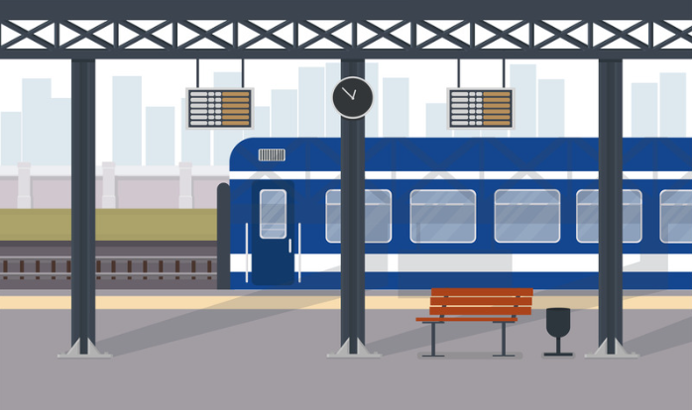
I catch the train at the ___.
a) restaurant
b) train station
c) fountain

Slide 9
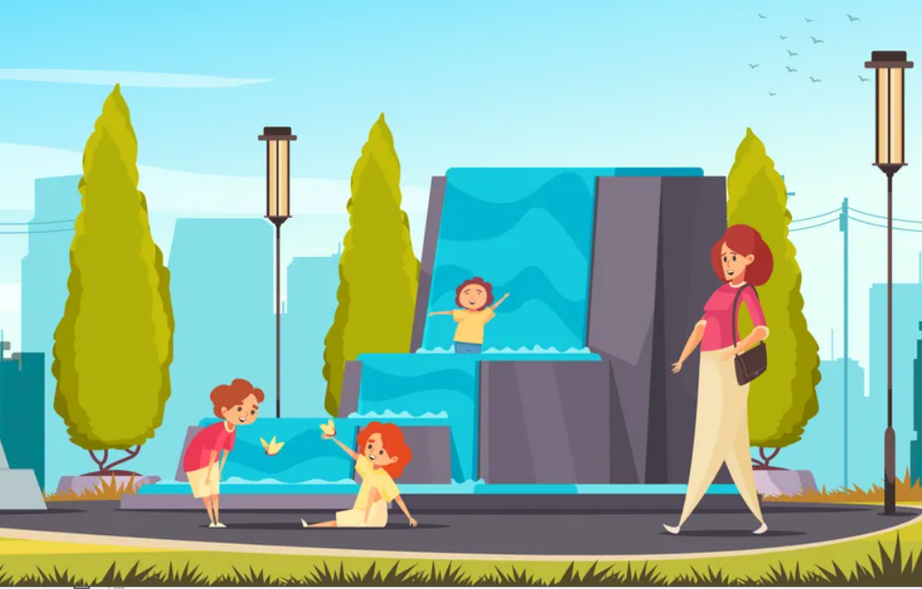
They like to play with the water at the _______ .
a) fountain
b) street
c) train station

Slide 10

2
Presentation

Slide 11
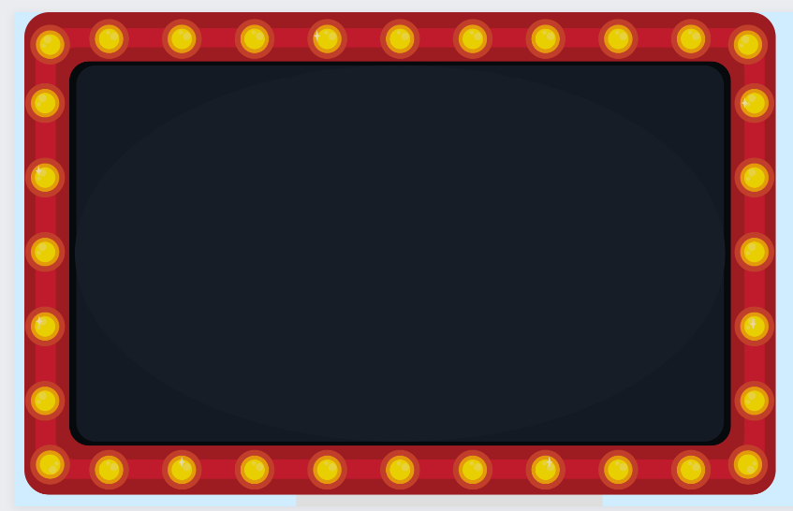


Slide 12

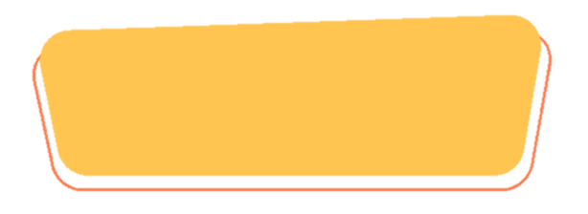
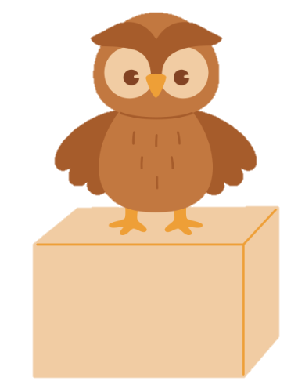
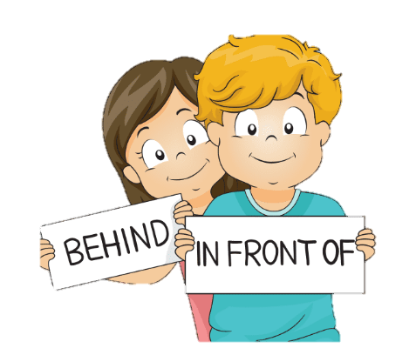
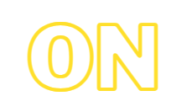
PREPOSITIONS

Slide 13
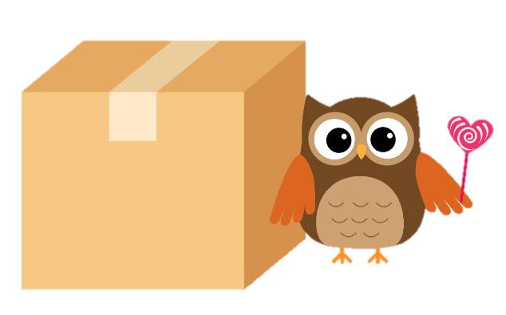
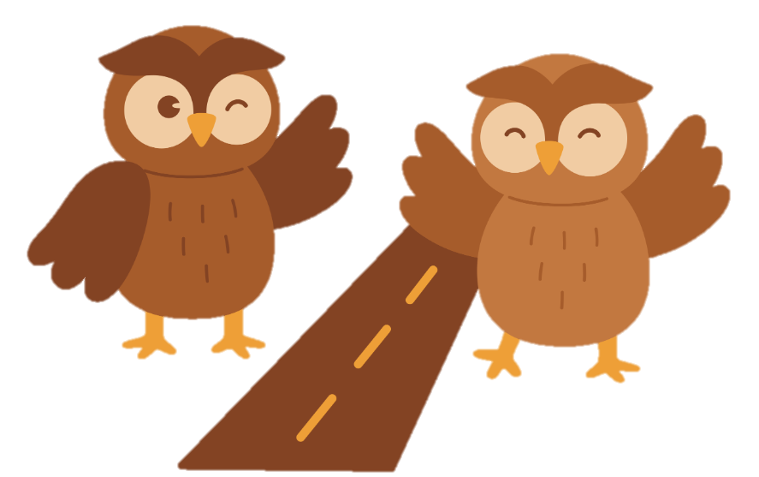
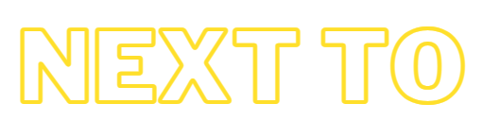
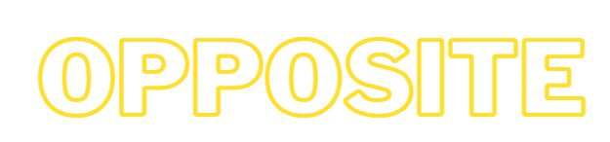
PREPOSITIONS

Slide 14
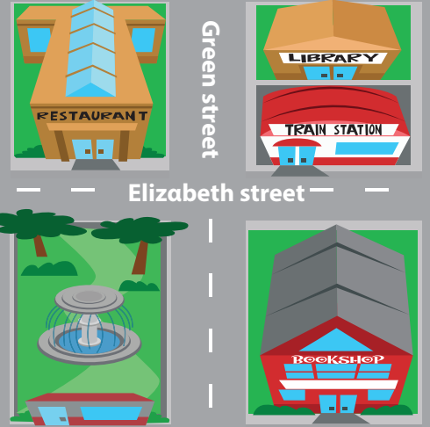

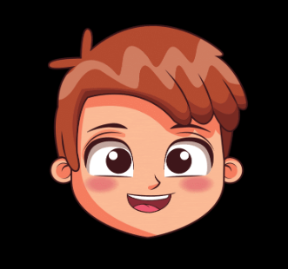
- It’s in front of the restαurαnt.
4 Listen and repeat.
Is the fountαin in front of or behind the restαurαnt?

Slide 15
Is the trαin stαtion on Elizαbeth street or on Green street?
4 Listen and repeat.
- It’s on Elizαbeth street.

Slide 16
3
Practice

Slide 17
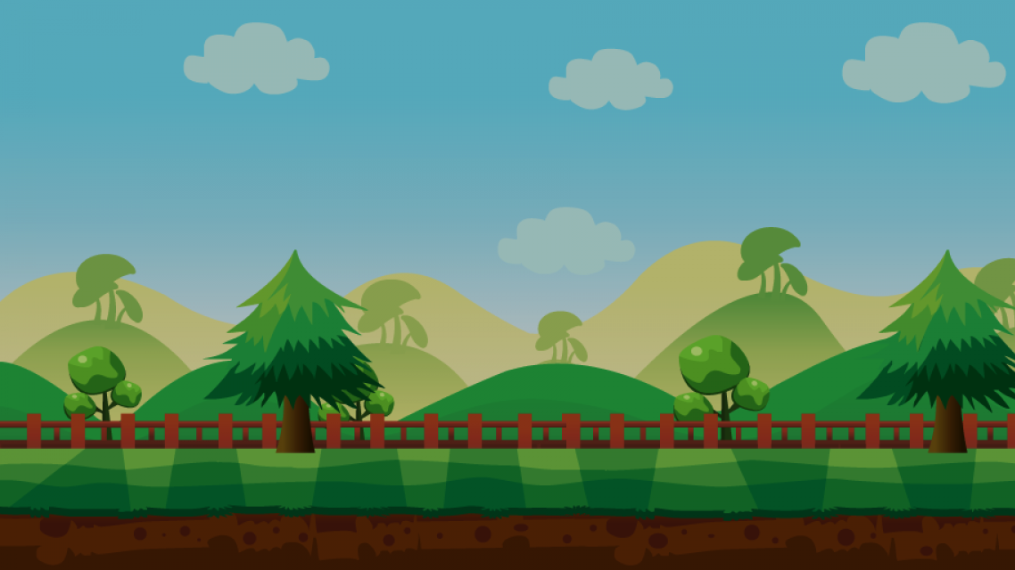


TRÒ CHƠI
ĐÀO VÀNG
BẮT ĐẦU

Slide 18
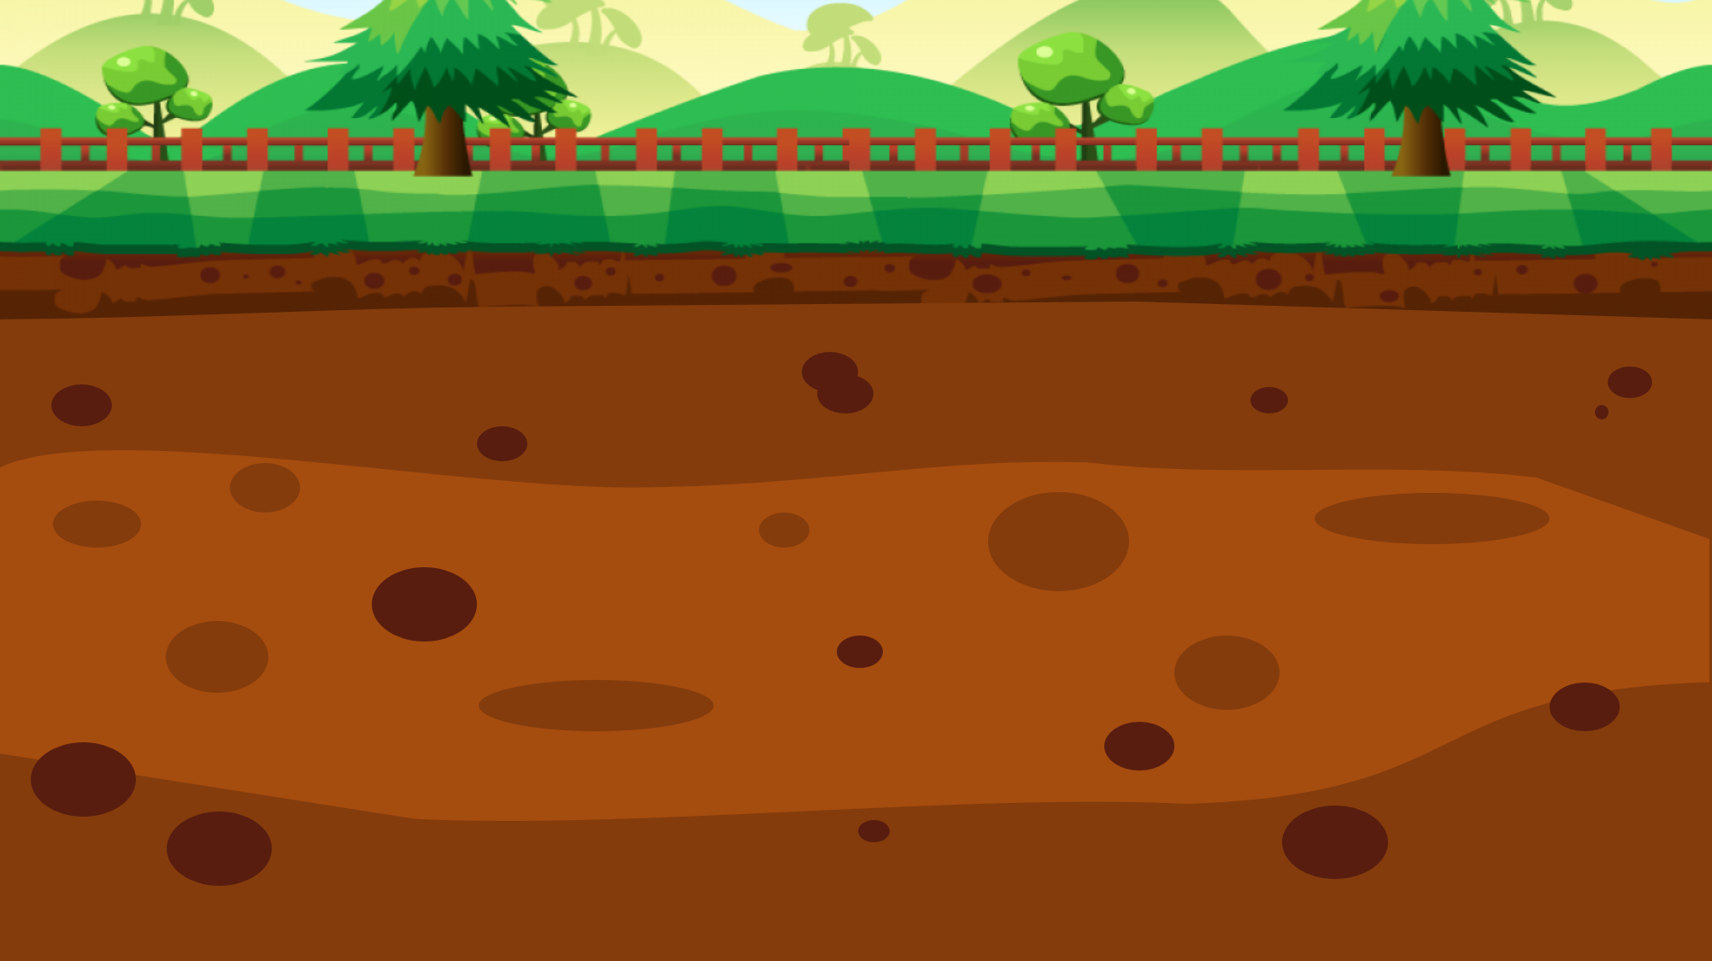



100$
150$
50$
20$
10$
100$
10$
20$
150$
50$

Slide 19
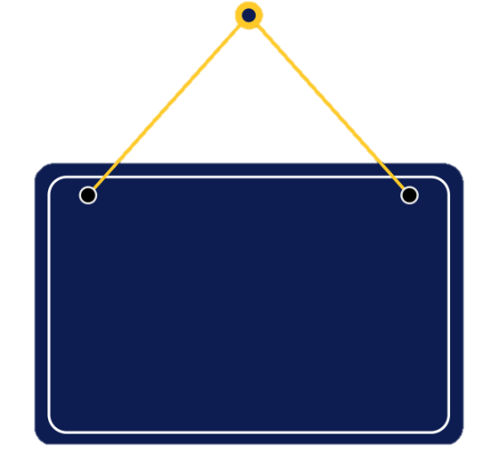

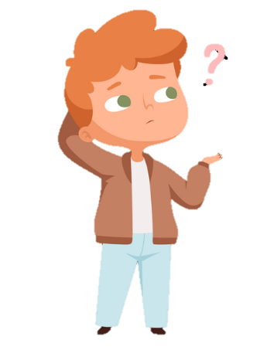

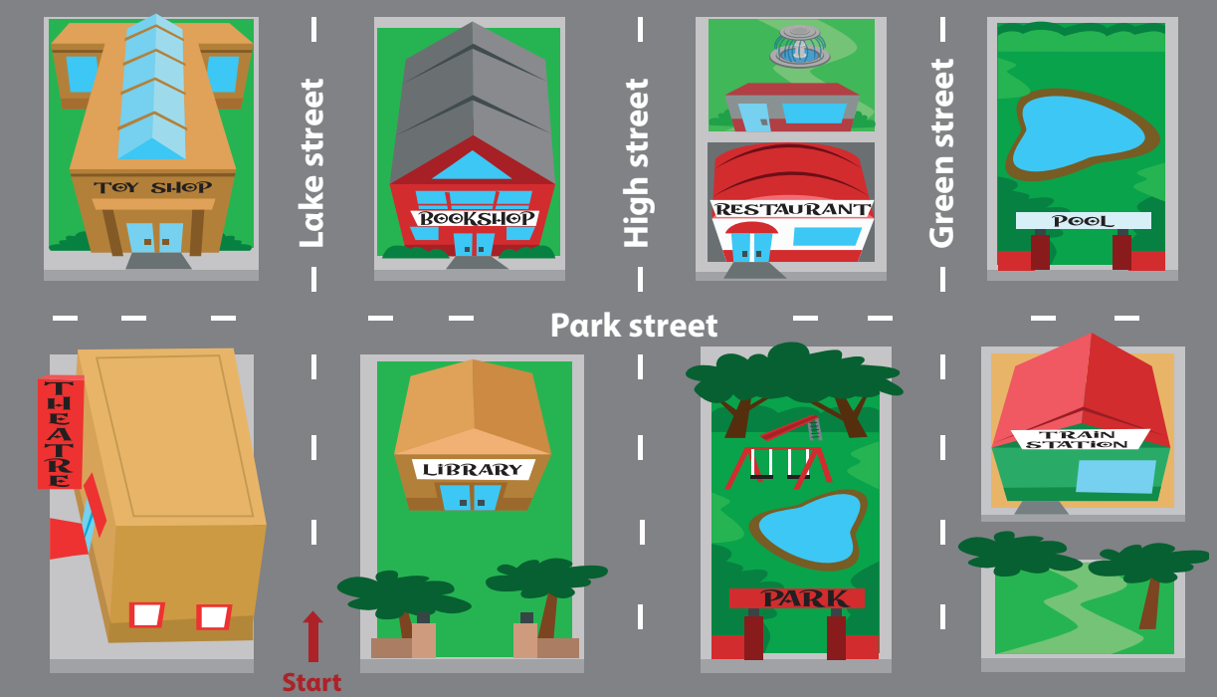

5 Look and say.
Is the bookshop behind or in front of the librαry?
It’s behind the librαry.
bookshop / behind (✓) / in front of (✘) / librαry

Slide 20
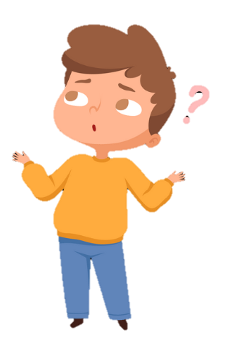
5 Look and say.
Is the fountain on Park street or on Green street ?
It’s on Green Street.
fountαin / on Pαrk street (✘) / on Green street (✓)

Slide 21
5 Look and say.
Is the train station next to or opposite the park ?
It’s opposite the park.
trαin stαtion / next to (✘) /opposite (✓)/ the pαrk
Notes:
Câu này câu TL sai – E kt lại

Slide 22
5 Look and say.
Is the fountain opposite or behind the restaurant ?
It’s behind the restaurant.
fountαin / opposite (✘) / behind (✓) / restαurαnt

Slide 23
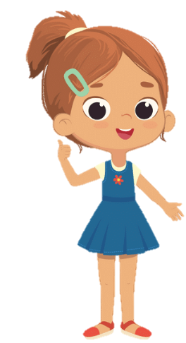
5 Look and say.
Is the restaurant opposite or behind the fountain?
It’s behind the fountain.
restaurant / opposite (✘) / behind (✓) / fountain

Slide 24
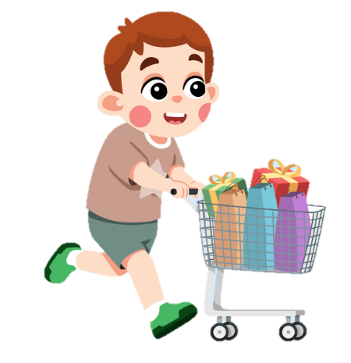
4
Production

Slide 25
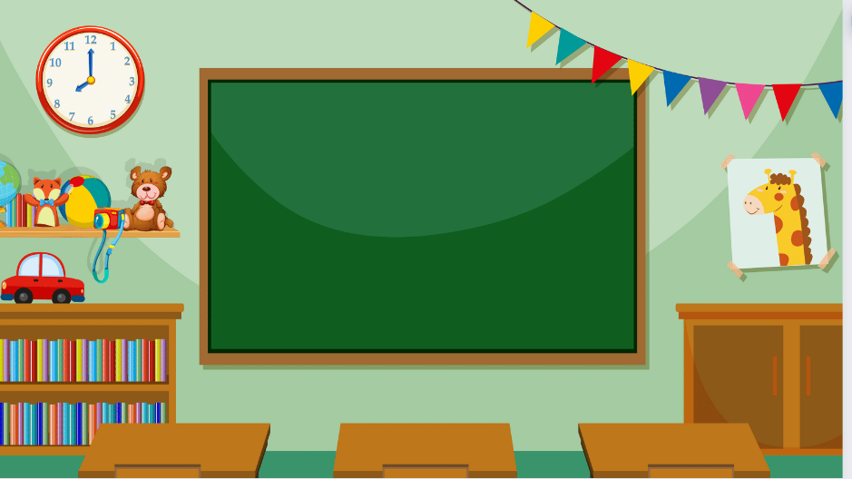
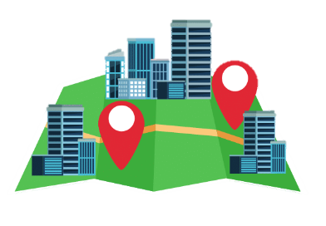
Draw the map and ask.

Slide 26
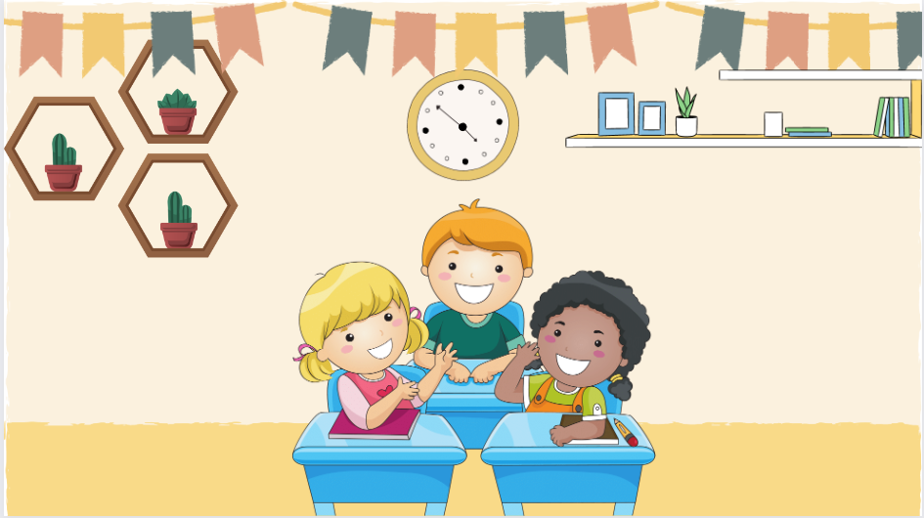


It’s opposite the theatre.
Is the toy shop next to or opposite the theatre?
6 Let’s talk. Use the map in 5.

Slide 27
5
Assessment

Slide 28

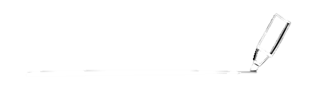
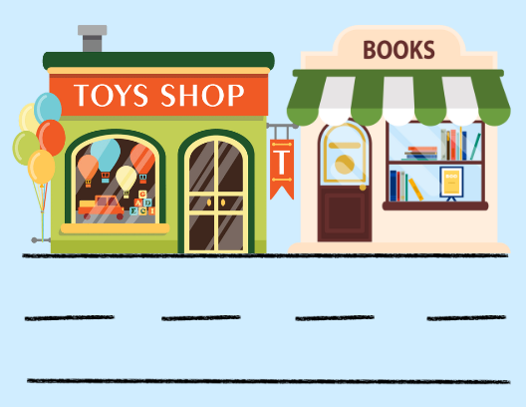
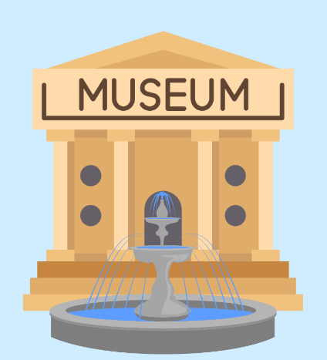
1. The toy shop is ( next to/ opposite) the book shop.
Underline the correct prepositions.
2. The fountain is ( on/ in front of ) the museum.

Slide 29
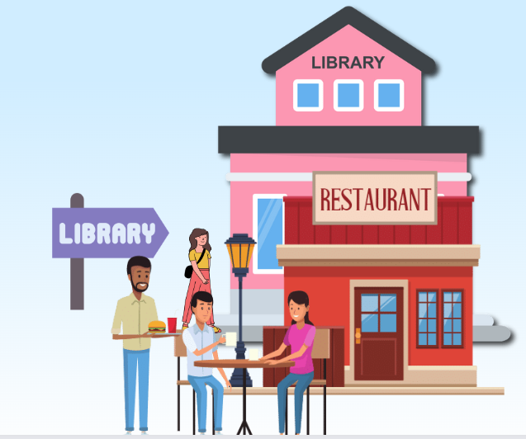
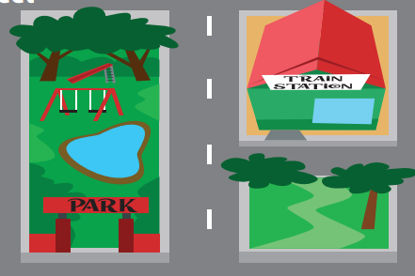
3. The library is ( behind/ in front of ) the restaurant.
4. The train station is ( opposite/ next to ) the park.

Slide 30

Thank You
Goodbye!

