Slide 1


WELCOME ALL THE TEACHERS TO THE CLASS
ENGLISH 4
Teacher: Nguyen Thi Nghia
School: An Hong primary school
Class: 4A1

Slide 2






















Slide 3


Unit 8 - Lesson 1 – Period 1

Slide 4

2 Presentation
Task 1 Listen and point.
Notes:
Dấu câu

Slide 5
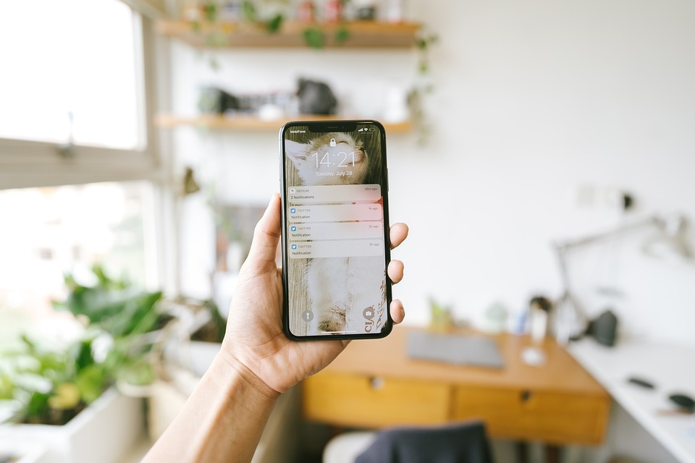
smartphone
What is it?

Slide 6
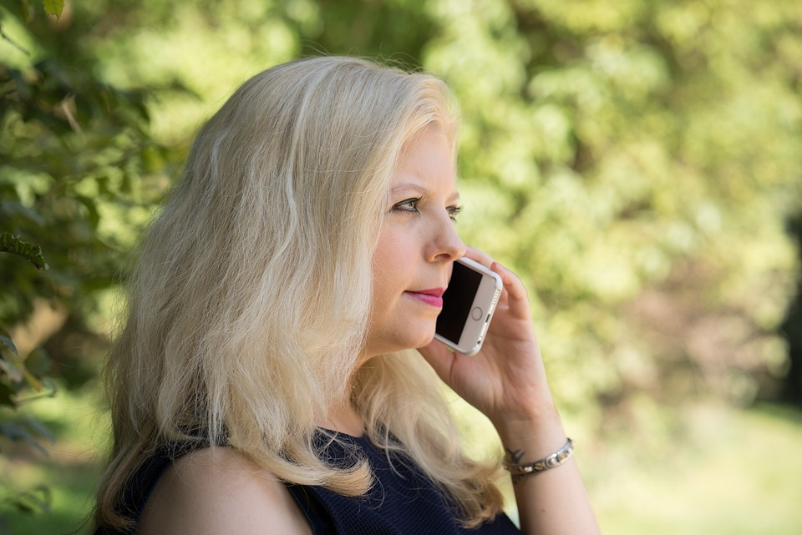
Make phone calls
What can you do?

Slide 7
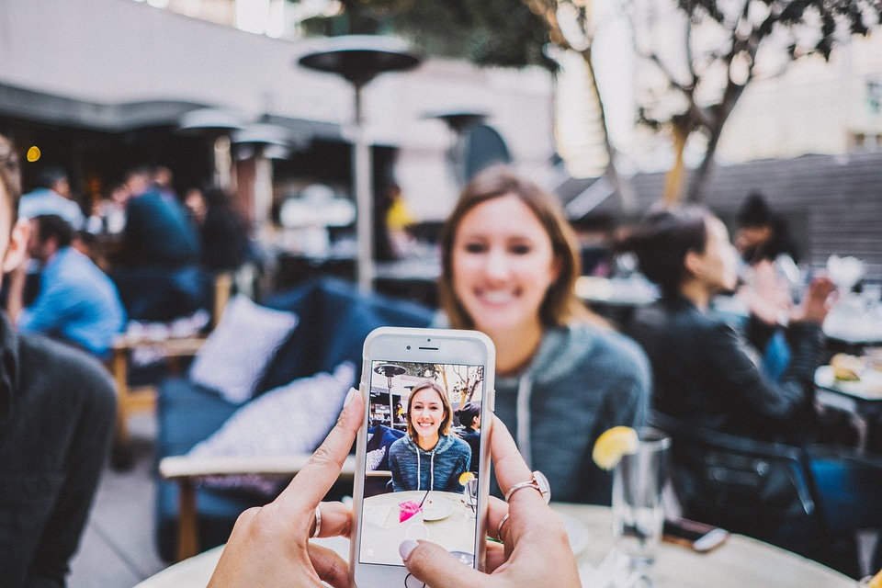
Make videos
What can you do?

Slide 8
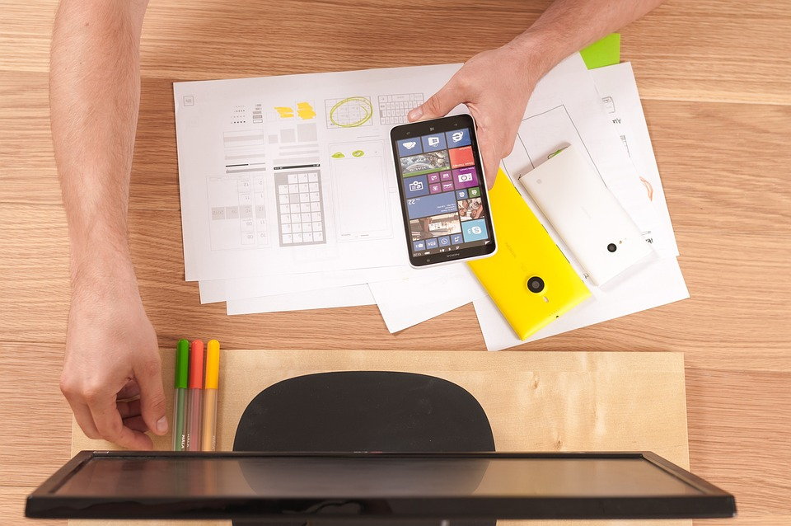
Write emails
What can you do?

Slide 9




1 Listen and point. Repeat.
Make phone calls
Write emails
Smartphone
Make videos

Slide 10
Practice
Task 2 Listen and read.Write.
Notes:
Dấu câu

Slide 11




2
Listen and read. Write.
It’s my new smartphone.
Whose phone is it? It’s nice!
Linh
Luna
Wow! What can you do on your smartphone?

Slide 12
2
Listen and write.
I can take photos and make videos on my phone.
Cool! Can we write emails on a smartphone?
Linh
Luna
Yes, we can. I sometimes write emails on my phone.

Slide 13
2
Listen and write
Linh
Luna
What can Luna do on her smartphone?
- She can take _____, make _____and write _______.
photos
videos
emails

Slide 14
3 Practice
Task 3 Look.
Ask and answer
Notes:
Dấu câu

Slide 15



3
Look. Ask and answer
What can we
do on a
smartphone/ computer?

Slide 16

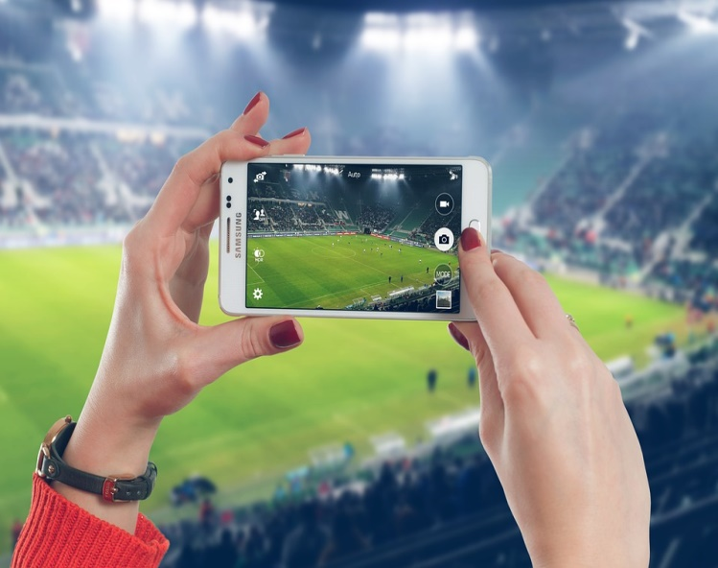



We can … .
1. take photos
3. make phone calls
2. learn English
4. make videos
Notes:
Ấn vào bức tranh để xem cuộc hội thoại. Ấn vào tên lửa sang mục tiếp theo

Slide 17



3
Look. Ask and answer.
We can
take photos.
What can we do on a smartphone?
BACK

Slide 18
3
Look. Ask and answer.
We can
learn English.
What can we do on a computer?
BACK

Slide 19
3
Look. Ask and answer.
We can make
phone calls.
What can we do on a smartphone?
BACK

Slide 20

3
Look. Ask and answer.
We can make
videos.
What can we do on a computer?
BACK

Slide 21




Thank you
& goodbye!

