Slide 1

An Thang Primary School
WELCOME TO
OUR CLASS 3
Teacher: Nguyen Thi Canh
Notes:
MADE BY FACEBOOK :TRAN THI THANH TAM

Slide 2

Sing a song
Notes:
Made by Facebook: TRAN THI THANH TAM

Slide 3
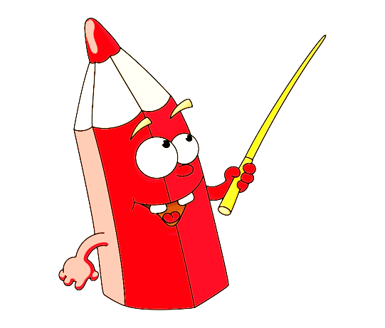

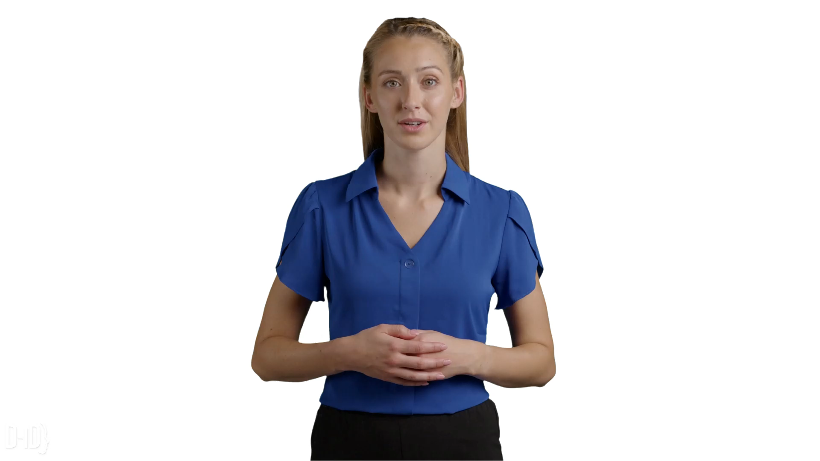

Sentence puzzle
pen.
have
I
a
I
have
a
pen.
Notes:
Wait for the clock to count down.
Click anywhere to show the answer.

Slide 4

Sentence puzzle
book.
have
a
I
I
have
a
book.
Notes:
Wait for the clock to count down.
Click anywhere to show the answer.

Slide 5

Sentence puzzle
schoolbag.
have
I
a
I
have
a
schoolbag.
Notes:
Wait for the clock to count down.
Click anywhere to show the answer.

Slide 6

Sentence puzzle
I
have
an
eraser.
I
have
an
eraser.
Notes:
Wait for the clock to count down.
Click anywhere to show the answer.

Slide 7




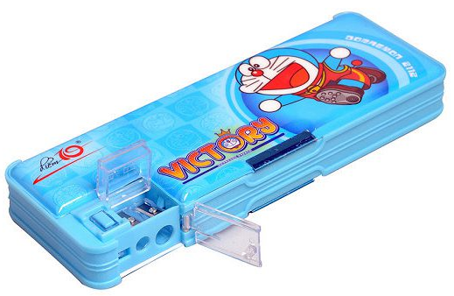


SCHOOL THINGS

Slide 8





8
3
Part 4.5.6

Slide 9

4
Read and complete.

Slide 10
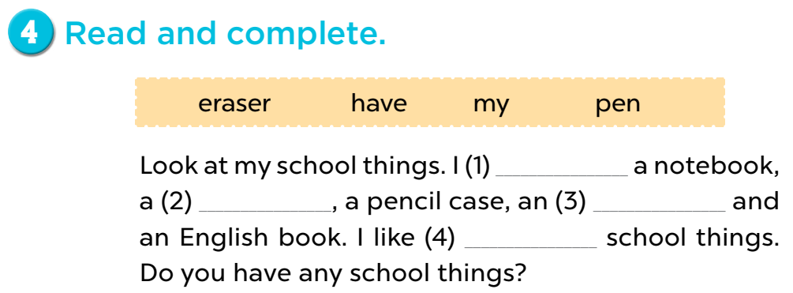
have
pen
eraser
my

Slide 11
5
Let’s write.

Slide 12
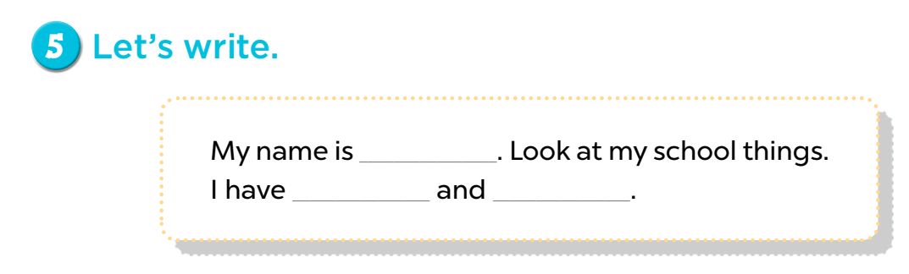



Mary
a book
a pencil

Slide 13

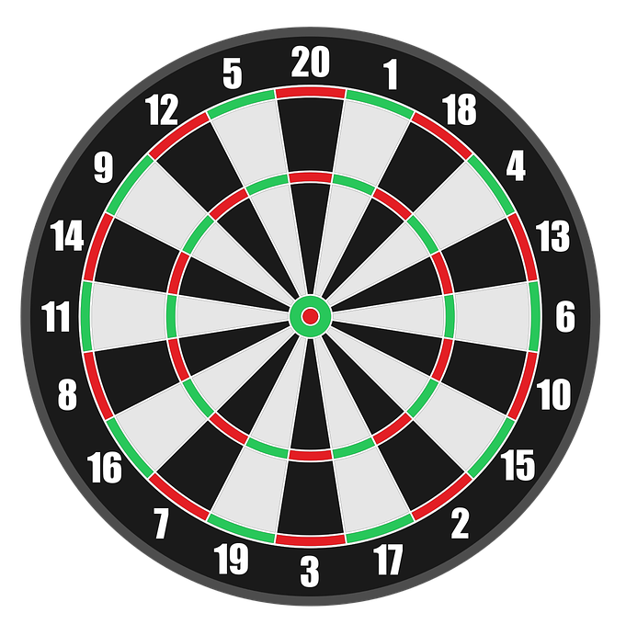


PLAY

Slide 14




I have _______.
+5
a pencil
a school bag and a pencil
an school bag
Next
Abc.xyz789
Notes:
Ms Huyền Phạm - 0936.082.789 – YOUTUBE: MsPham. Facebook: Dạy và học cùng công nghệ.

Slide 15

I have _______.
+1
an pen
a ruler
a ruler and a pen
Next
Abc.xyz789
Notes:
Ms Huyền Phạm - 0936.082.789 – YOUTUBE: MsPham. Facebook: Dạy và học cùng công nghệ.

Slide 16
I have ___ book and a notebook.
+1
a
is
an
Next
Abc.xyz789
Notes:
Ms Huyền Phạm - 0936.082.789 – YOUTUBE: MsPham. Facebook: Dạy và học cùng công nghệ.

Slide 17


______ have a school bag.
+1
my
I
I’m
Next
Abc.xyz789
Notes:
Ms Huyền Phạm - 0936.082.789 – YOUTUBE: MsPham. Facebook: Dạy và học cùng công nghệ.

Slide 18
I _______two pens .
+1
am
do
have
Next
Abc.xyz789
Notes:
Ms Huyền Phạm - 0936.082.789 – YOUTUBE: MsPham. Facebook: Dạy và học cùng công nghệ.

Slide 19

I _______.
+5
have a pen and book
have a book
a book and a pen
Next
Abc.xyz789
Notes:
Ms Huyền Phạm - 0936.082.789 – YOUTUBE: MsPham. Facebook: Dạy và học cùng công nghệ.

Slide 20
WELL DONE!
EXIT
Notes:
Ms Huyền Phạm - 0936.082.789 – YOUTUBE: MsPham. Facebook: Dạy và học cùng công nghệ.

Slide 21
Game: Spin the wheel
Notes:
- Divide the class into 4 groups.
- A pupil from each group comes to the board, spin the wheel, look at the chosen picture, then write the answer on the board.

Slide 22
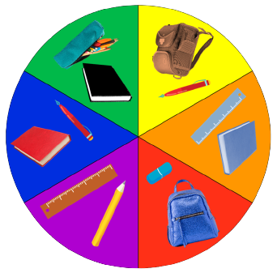
SPIN THE WHEEL
I have ……… and ……… .

Slide 23
6
Project

Slide 24

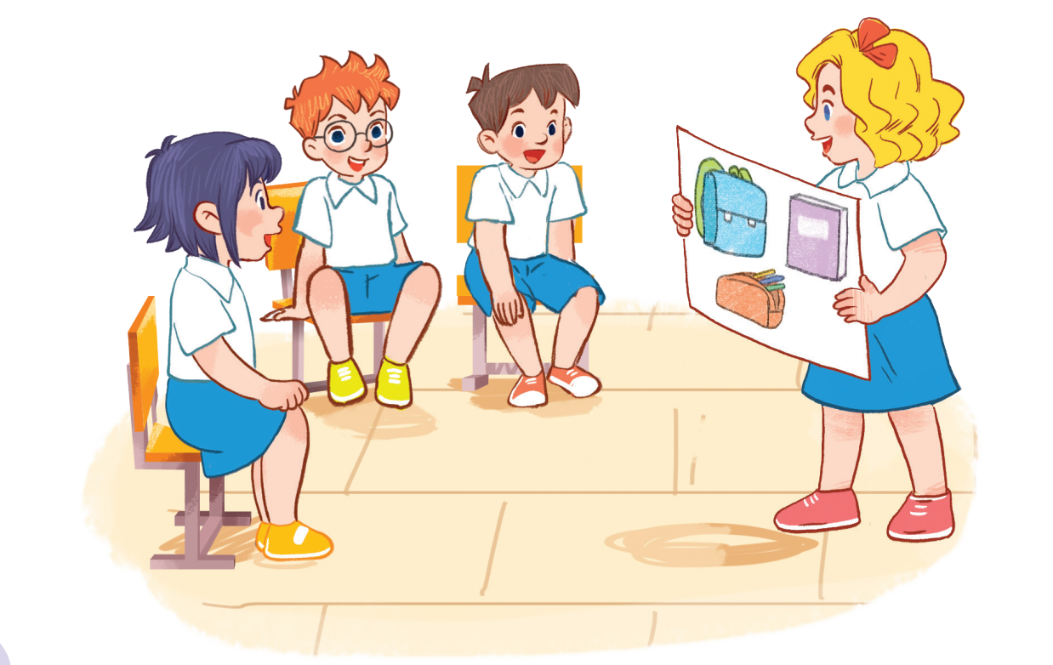

Slide 25

GAME

Slide 26
PASSING BALL

Slide 28
Game: HOW DO YOU SPELL…?
Notes:
Game: HOW DO YOU SPELL…?
Divide the class into four groups. Ask pupils to look at the letters and spell the words.

Slide 29

HOW DO YOU SPELL…?
BOOK
?

Slide 30
HOW DO YOU SPELL…?
PEN
?

Slide 31
HOW DO YOU SPELL…?
PENCIL
?
?

Slide 32
HOW DO YOU SPELL…?
ERASER
?
?

