Slide 1


Nguyen Du Primary School
WELCOME TO
OUR CLASS 5
Teacher: Trần Thị Thanh Tâm

Slide 2

UNIT 12: OUR TET HOLIDAY
LESSON 2 ( 1, 2, 3)
Notes:
MADE BY FACEBOOK :TRAN THI THANH TAM

Slide 3

CONTENTS
1
WARM -UP
2
LOOK, LISTEN AND REPEAT
3
VOCABULARY
4
LISTEN, POINT AND SAY
5
LET’S TALK
6
PLAY GAME
Notes:
MADE BY FACEBOOK :TRAN THI THANH TAM

Slide 4

Warm - up
Notes:
MADE BY FACEBOOK :TRAN THI THANH TAM

Slide 5




PLAY GAME
WHISPER GAME
Notes:
Step 2: Have groups put the posters on the desk and practice the presentation. Encourage all members in the group to present. Go around the classroom and offer help where necessary.

Slide 6



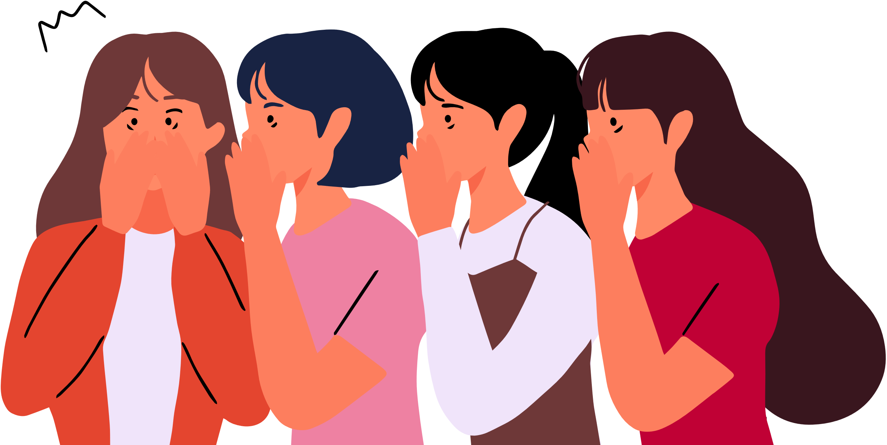


Will you make spring roll for Tet?
Notes:
Step 5: Invite a few pairs to point at the pictures and say the questions and answers in front of the class.

Slide 7
Will you do the shopping for Tet?
Notes:
Step 5: Invite a few pairs to point at the pictures and say the questions and answers in front of the class.

Slide 8
I will buy a branch of peach blossoms for Tet.
Notes:
Step 5: Invite a few pairs to point at the pictures and say the questions and answers in front of the class.

Slide 9
My father will make banh chung for Tet.
Notes:
Step 5: Invite a few pairs to point at the pictures and say the questions and answers in front of the class.

Slide 10


GOOD JOB!

Slide 11

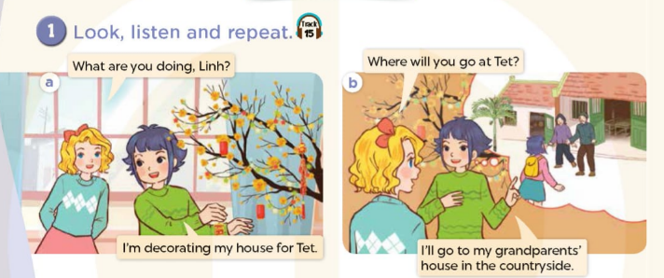

Notes:
MADE BY FACEBOOK :TRAN THI THANH TAM

Slide 12

Notes:
MADE BY FACEBOOK :TRAN THI THANH TAM

Slide 13


fireworks show /ˈfaɪəwɜːks ʃəʊ/
: màn trình diễn pháo hoa
Notes:
MADE BY FACEBOOK :TRAN THI THANH TAM

Slide 14
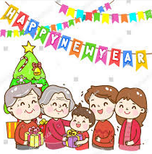
New Year party /njuː jɪə(r) ˈpɑːti/
: tiệc năm mới
Notes:
MADE BY FACEBOOK :TRAN THI THANH TAM

Slide 15

flower festival /ˈflaʊə ˈfestɪvl/
: hội chợ hoa
Notes:
MADE BY FACEBOOK :TRAN THI THANH TAM

Slide 16

VOCABULARY
Fireworks show:màn trình diễn pháo hoa
New year party: tiệc năm mới
Flower festival: hội chợ hoa

Slide 17

Let's play
MATCHING
Notes:
Made by Facebook: TRAN THI THANH TAM

Slide 18
1.New year party
A
B
2.Flower festival
C
3.Fireworks show
D
Notes:
MADE BY FACEBOOK :TRAN THI THANH TAM

Slide 19
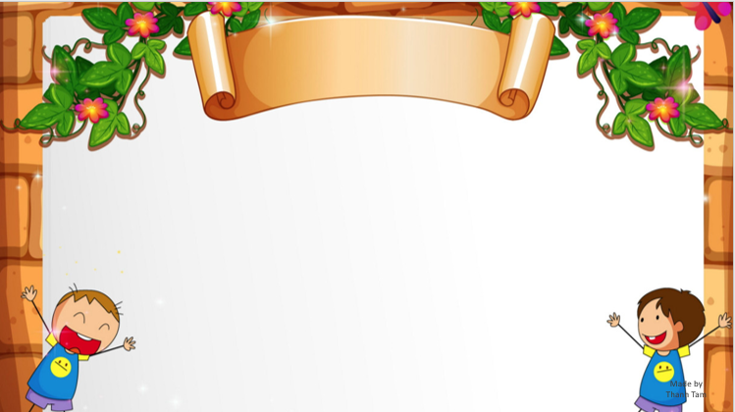
SENTENCE PATTERN
Notes:
MADE BY FACEBOOK :TRAN THI THANH TAM

Slide 20

Hỏi xem ai đó sẽ đi đâu vào dịp tết
Where will you go at Tet?
( Bạn sẽ đi đâu vào dịp tết? )
I’ll go to my grandparents’ house.
(Tôi sẽ đến nhà ông bà.)
Notes:
MADE BY FACEBOOK :TRAN THI THANH TAM

Slide 21
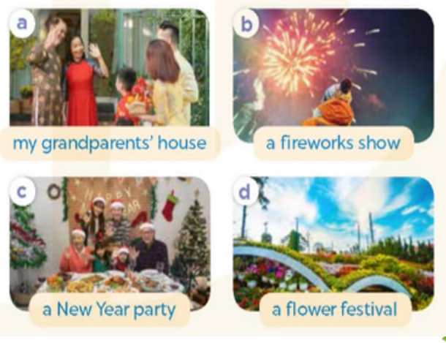
2.Listen, point and say
Where will you go at Tet?
my grandparents’ house
I’ll go to..................…..................
Notes:
MADE BY FACEBOOK :TRAN THI THANH TAM

Slide 22

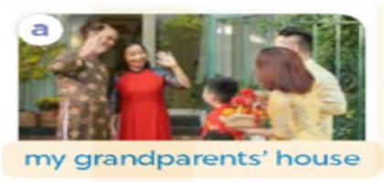
Where will you go at Tet?
my grandparents’ house
I’ll go to................…..................
Notes:
MADE BY FACEBOOK :TRAN THI THANH TAM

Slide 23
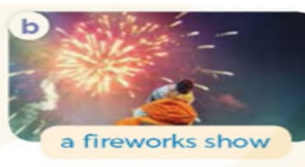
Where will you go at Tet?
a fireworks show
I’ll go to................…..................
Notes:
MADE BY FACEBOOK :TRAN THI THANH TAM

Slide 24
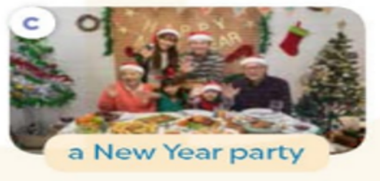
Where will you go at Tet?
a New Year party
I’ll go to................…..................
Notes:
MADE BY FACEBOOK :TRAN THI THANH TAM

Slide 25

Where will you go at Tet?
a flower festival
I’ll go to................…..................
Notes:
MADE BY FACEBOOK :TRAN THI THANH TAM

Slide 26
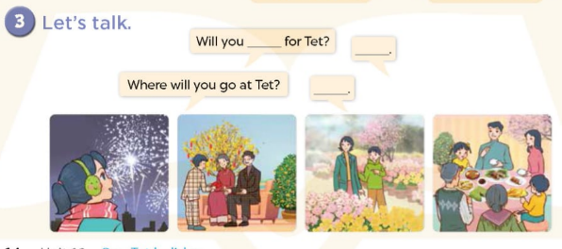
Notes:
MADE BY FACEBOOK :TRAN THI THANH TAM

Slide 27


Let's play
Made by Thanh Tam
Notes:
Made by Facebook: TRAN THI THANH TAM

Slide 28

PLAY GAME
RING THE GOLDEN BELL
Notes:
MADE BY FACEBOOK :TRAN THI THANH TAM

Slide 29

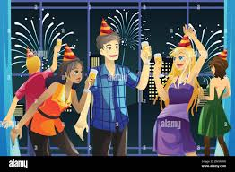
10
2
3
4
7
8
5
6
9
0
1
Game
RINGING THE GOLDEN BELL
Where will you go at Tet?
a New Year party
I’ll go to................…..................
Notes:
MADE BY FACEBOOK :TRAN THI THANH TAM

Slide 30
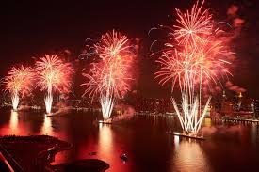
10
2
3
4
7
8
5
6
9
0
1
Game
RINGING THE GOLDEN BELL
Where will you go at Tet?
a fireworks show
I’ll go to................…..................
Notes:
MADE BY FACEBOOK :TRAN THI THANH TAM

Slide 31

10
2
3
4
7
8
5
6
9
0
1
Game
RINGING THE GOLDEN BELL
Where will you go at Tet?
a flower festival
I’ll go to................…..................
Notes:
MADE BY FACEBOOK :TRAN THI THANH TAM

Slide 32
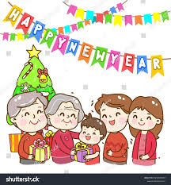
10
2
3
4
7
8
5
6
9
0
1
Game
RINGING THE GOLDEN BELL
Where will you go at Tet?
my grandparents’ house
I’ll go to................…..................
Notes:
MADE BY FACEBOOK :TRAN THI THANH TAM

Slide 33
SUMMARY
1.Vocabulary:
Fireworks show:màn trình diễn pháo hoa
New year party: tiệc năm mới
Flower festival: hội chợ hoa
2. Sentence pattern:
-Where will you go at Tet?
(Bạn sẽ đi đâu vào dịp tết vậy?)
-> I’ll go to my grandparents’ house.
(Tôi sẽ đến nhà ông bà.)

Slide 34

Homework:
- Learn by heart vocabulary and sentence pattern
- Prepare Unit 12- lesson 2 ( 4, 5, 6)
Notes:
MADE BY FACEBOOK :TRAN THI THANH TAM

Slide 35

Notes:
MADE BY FACEBOOK :TRAN THI THANH TAM

