Slide 1


UNIT 11:FAMILY TIME
LESSON 3 (1, 2, 3)
Notes:
MADE BY FACEBOOK :TRAN THI THANH TAM

Slide 2
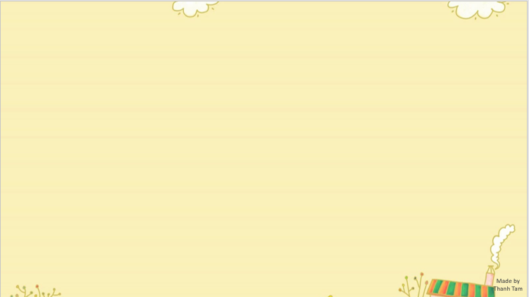

CONTENTS
1
WARM -UP
2
LISTEN AND REPEAT
3
LISTEN AND UNDERLINE ONE MORE STRESSED WORD. THEN REPEAT
4
LET’S CHANT
5
PLAY GAME
Notes:
MADE BY FACEBOOK :TRAN THI THANH TAM

Slide 3

Warm - up
Notes:
MADE BY FACEBOOK :TRAN THI THANH TAM

Slide 4


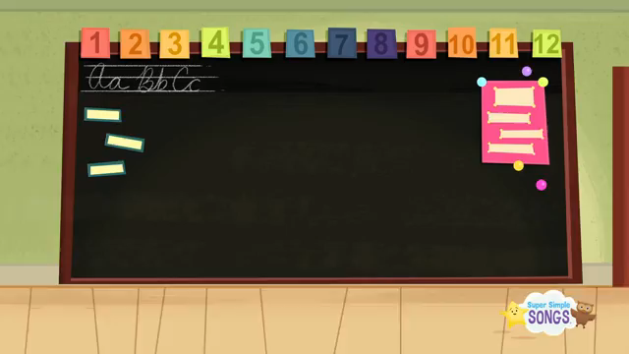


Sing and do actions
Notes:
https://www.youtube.com/watch?v=tVlcKp3bWH8

Slide 5


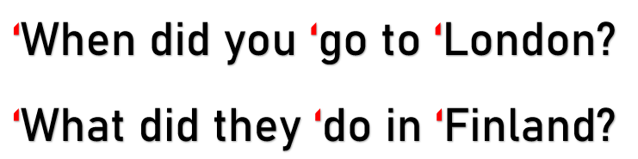
1.Listen and repeat
Notes:
MADE BY FACEBOOK :TRAN THI THANH TAM

Slide 6
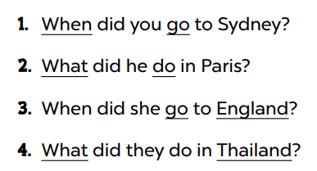
3. Listen and underline one more stressed word. Then repeat
Notes:
MADE BY FACEBOOK :TRAN THI THANH TAM

Slide 7
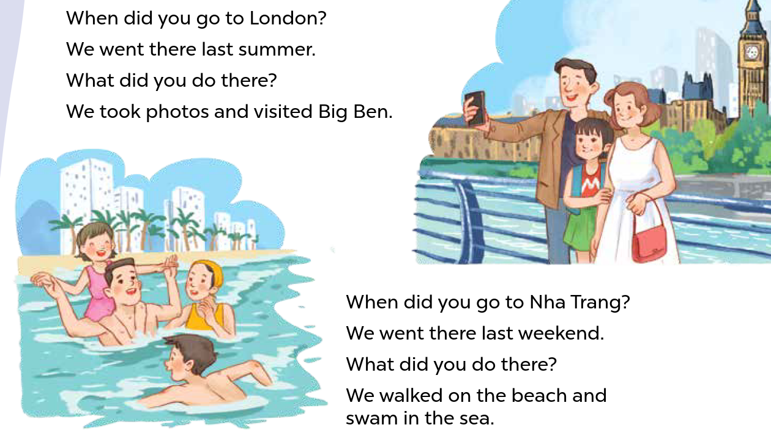
3. Let’s chant
Notes:
MADE BY FACEBOOK :TRAN THI THANH TAM

Slide 8


LET’S PLAY
TRUE OR FALSE GAME

Slide 9





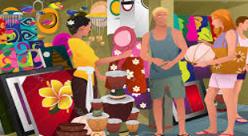
We bought souvenirs yesterday.
TRUE
FALSE

Slide 10
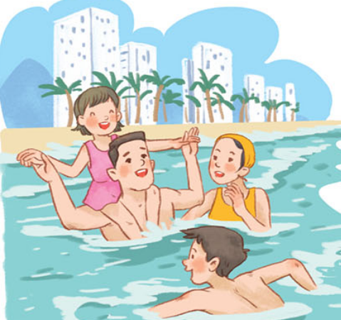

We swam in the sea last Sunday.
TRUE
FALSE

Slide 11

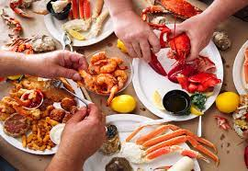
We ate seafood in Nha Trang last summer.
TRUE
FALSE

Slide 12
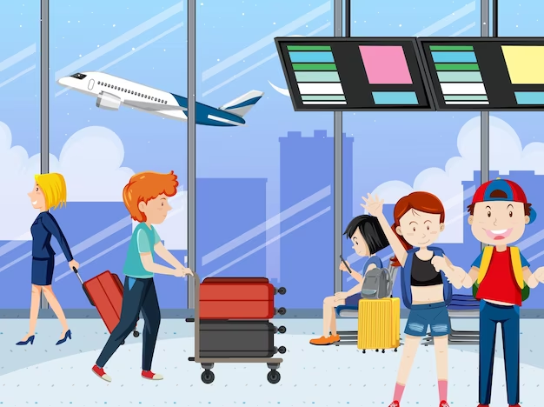
We took a boat trip last month.
TRUE
FALSE

Slide 13






Slide 14

Homework:
- Practice more at home
- Prepare Unit 11- lesson 3 ( 4, 5, 6)
Notes:
MADE BY FACEBOOK :TRAN THI THANH TAM

Slide 15

Notes:
MADE BY FACEBOOK :TRAN THI THANH TAM

Slide 16




The bye bye song
Bye, bye.
See you tomorrow.
Bye, bye.
See you tomorrow.
Bye, bye.
See you tomorrow.
Bye, bye. Bye, bye.
The bye bye song
Made by Thanh Tam
Notes:
MADE BY FACEBOOK :TRAN THI THANH TAM

