Slide 1


UNIT 11:FAMILY TIME
LESSON 1 ( 1, 2, 3)
Notes:
MADE BY FACEBOOK :TRAN THI THANH TAM

Slide 2

CONTENTS
1
WARM -UP
2
LOOK, LISTEN AND REPEAT
3
VOCABULARY
4
LISTEN, POINT AND SAY
5
LET’S TALK
6
PLAY GAME
Notes:
MADE BY FACEBOOK :TRAN THI THANH TAM

Slide 3

Warm - up
Notes:
MADE BY FACEBOOK :TRAN THI THANH TAM

Slide 4


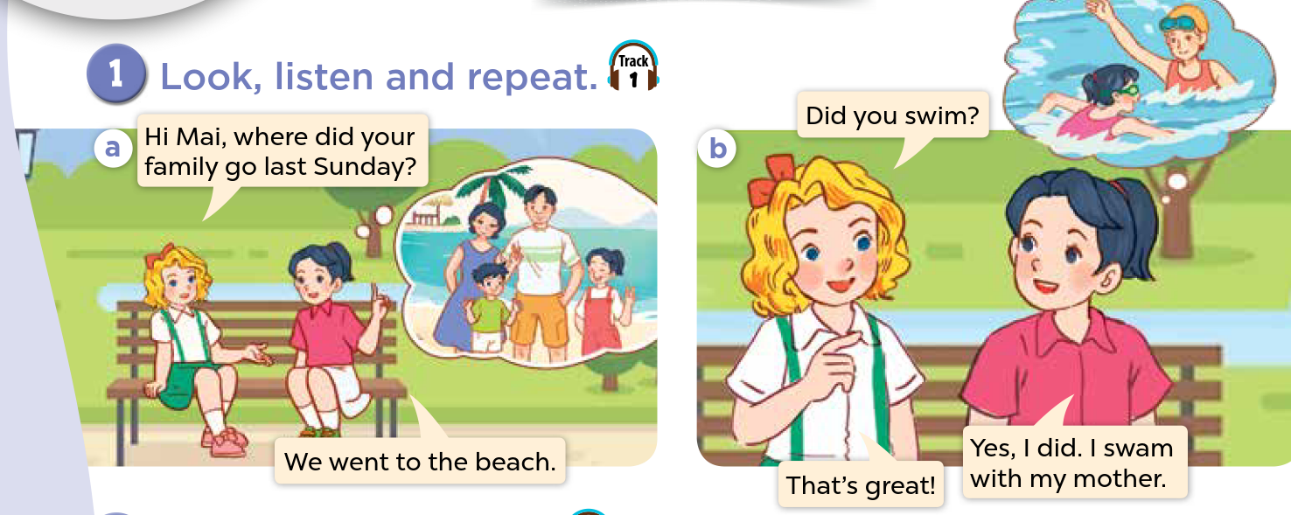
1.Look, listen and repeat.
Notes:
MADE BY FACEBOOK :TRAN THI THANH TAM

Slide 5

Notes:
MADE BY FACEBOOK :TRAN THI THANH TAM

Slide 6

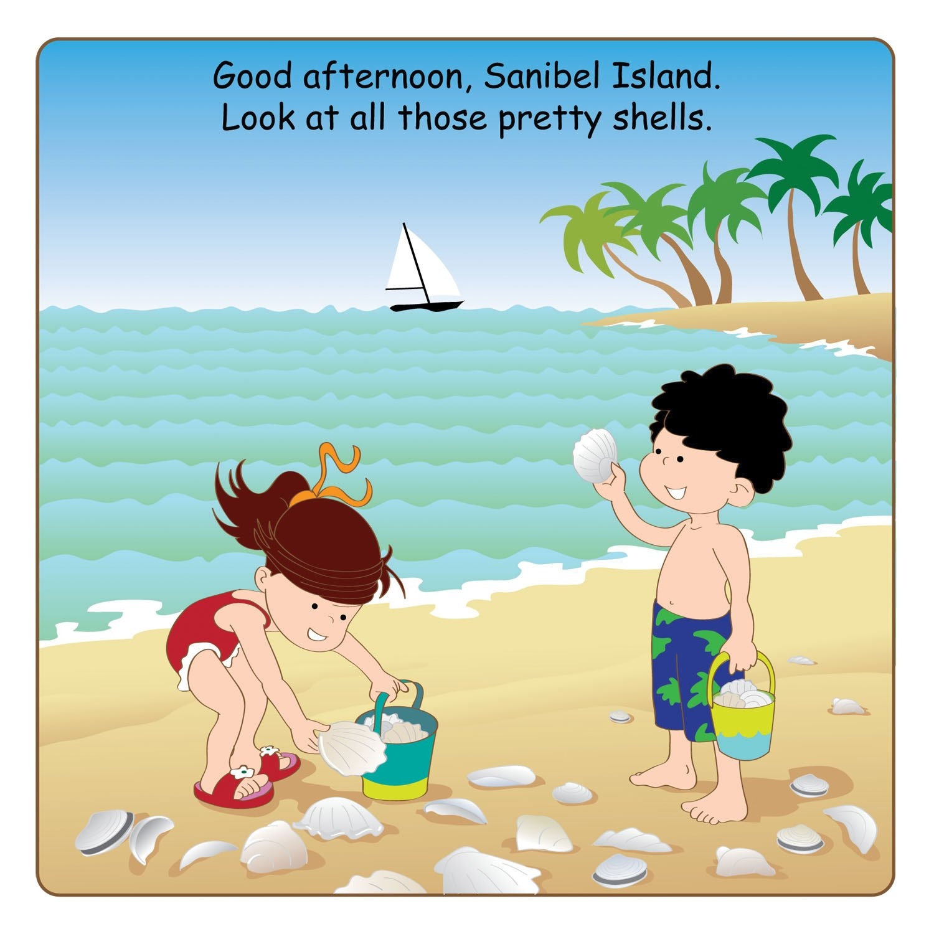
collect seashells/kəˈlektˈsiːʃelz/
thu lượm, đi lấy vỏ sò
Notes:
MADE BY FACEBOOK :TRAN THI THANH TAM

Slide 7
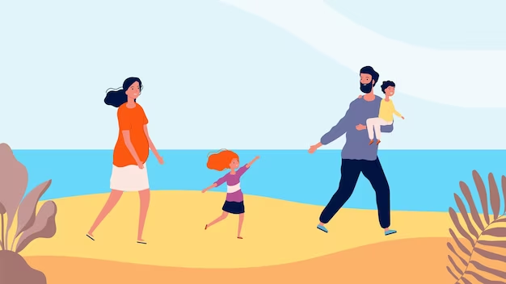
walk on the beach/ wɔːk ɒn ðə biːtʃ/
đi bộ trên bãi biển
Notes:
MADE BY FACEBOOK :TRAN THI THANH TAM

Slide 8
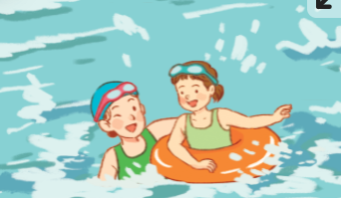
Swim:/swɪm/:bơi
Notes:
MADE BY FACEBOOK :TRAN THI THANH TAM

Slide 9
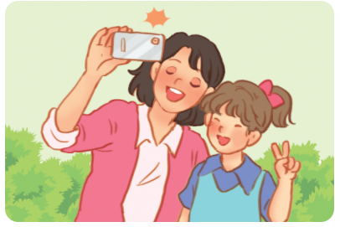
Take photos /teɪk ˈfəʊ.təʊ s/
:chụp ảnh
Notes:
MADE BY FACEBOOK :TRAN THI THANH TAM

Slide 10

VOCABULARY
Swim: bơi
- Take photos: chụp ảnh
Collect seashells:thu lượm, đi lấy vỏ sò
Walk on the beach: đi bộ trên bãi biển

Slide 11

Let's play
Check vocabulary
Guessing game
Notes:
Made by Facebook: TRAN THI THANH TAM

Slide 12
Guessing
Guessing?
swim
Notes:
MADE BY FACEBOOK :TRAN THI THANH TAM

Slide 13
Guessing
Guessing?
Take photos
Notes:
MADE BY FACEBOOK :TRAN THI THANH TAM

Slide 14
Guessing
Guessing?
walk on the beach
Notes:
MADE BY FACEBOOK :TRAN THI THANH TAM

Slide 15
Guessing
Guessing?
collect seashells
Notes:
MADE BY FACEBOOK :TRAN THI THANH TAM

Slide 16
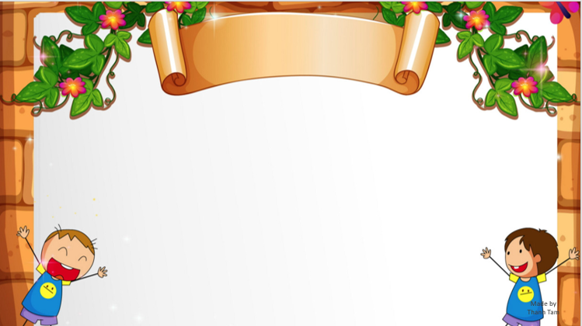
SENTENCE PATTERN
Notes:
MADE BY FACEBOOK :TRAN THI THANH TAM

Slide 17
Hỏi và trả lời xem có phải ai đó đã làm gì không
Did you swim?
( Bạn đã đi bơi phải không?)
Yes, I did. I swam with my mother.
( Vâng. Tôi đã đi bơi với mẹ tôi.)

Slide 18
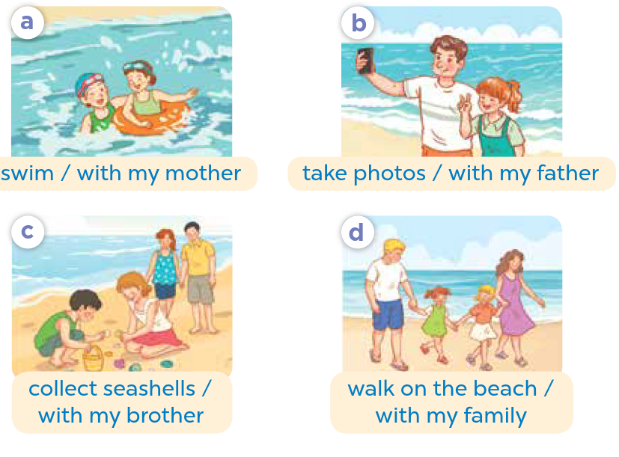
2.Listen, point and say
swim
Did you..................?
swam with my mother
Yes, I did. I…………………..............
Notes:
MADE BY FACEBOOK :TRAN THI THANH TAM

Slide 19
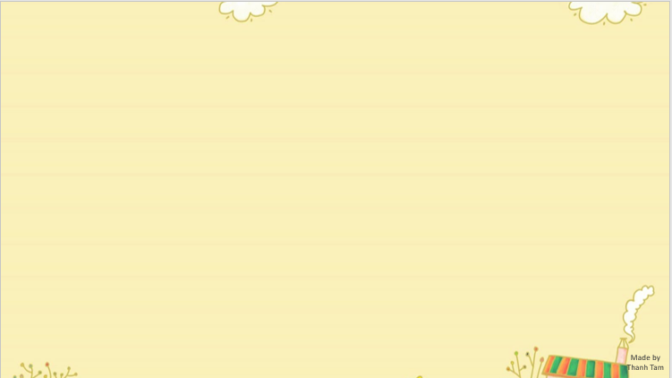
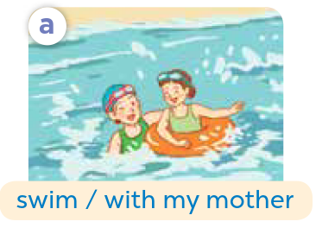
swim
Did you..................?
swam with my mother
Yes, I did. I…………………..............
Notes:
MADE BY FACEBOOK :TRAN THI THANH TAM

Slide 20
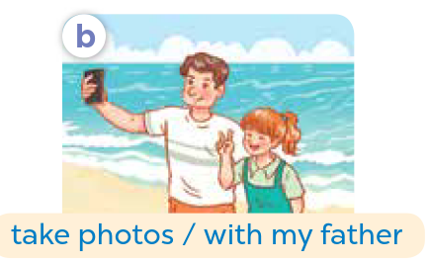
take photos
Did you……..................?
took photos with my father
Yes, I did. I………………………..............
Notes:
MADE BY FACEBOOK :TRAN THI THANH TAM

Slide 21
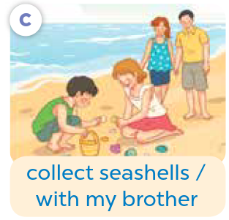
collect seashells
Did you….……...................?
collected seashells with my mother
Yes, I did. I…………..….………………..............
Notes:
MADE BY FACEBOOK :TRAN THI THANH TAM

Slide 22
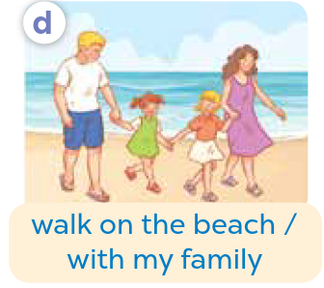
walk on the beach
Did you…………..................?
walked on the beach with my family
Yes, I did. I………………………………..............
Notes:
MADE BY FACEBOOK :TRAN THI THANH TAM

Slide 23
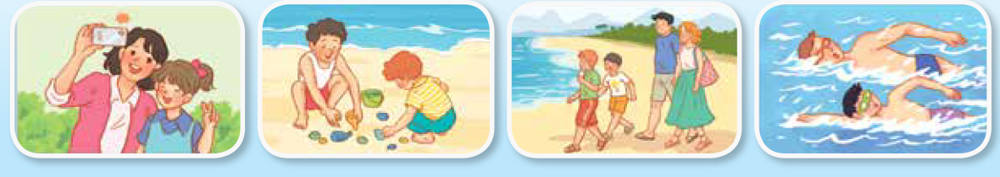
3. Let’s talk
swim
Did you..................?
swam with my mother
Yes, I did. I…………………..............
Notes:
MADE BY FACEBOOK :TRAN THI THANH TAM

Slide 24

Let's play
CHOOSE PRESENTS
Notes:
MADE BY FACEBOOK :TRAN THI THANH TAM

Slide 25





CHOOSE PRESENTS
NEXT
Notes:
MADE BY FACEBOOK :TRAN THI THANH TAM

Slide 26

walk on the beach
Did you…………..................?
BACK
walked on the beach with my family
Yes, I did. I………………………………..............
Notes:
MADE BY FACEBOOK :TRAN THI THANH TAM

Slide 27
BACK
Notes:
MADE BY FACEBOOK :TRAN THI THANH TAM

Slide 28
take photos
Did you……..................?
BACK
took photos with my mother
Yes, I did. I………………………..............
Notes:
MADE BY FACEBOOK :TRAN THI THANH TAM

Slide 29
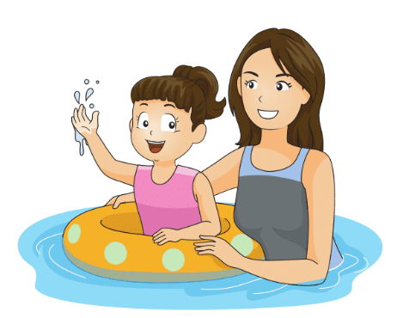
swim
Did you..................?
BACK
swam with my mother
Yes, I did. I…………………..............
Notes:
MADE BY FACEBOOK :TRAN THI THANH TAM

Slide 30
BACK
Notes:
MADE BY FACEBOOK :TRAN THI THANH TAM

Slide 31
collect seashells
Did you….……...................?
BACK
collected seashells with my brother
Yes, I did. I…………..….………………..............
Notes:
MADE BY FACEBOOK :TRAN THI THANH TAM

Slide 32
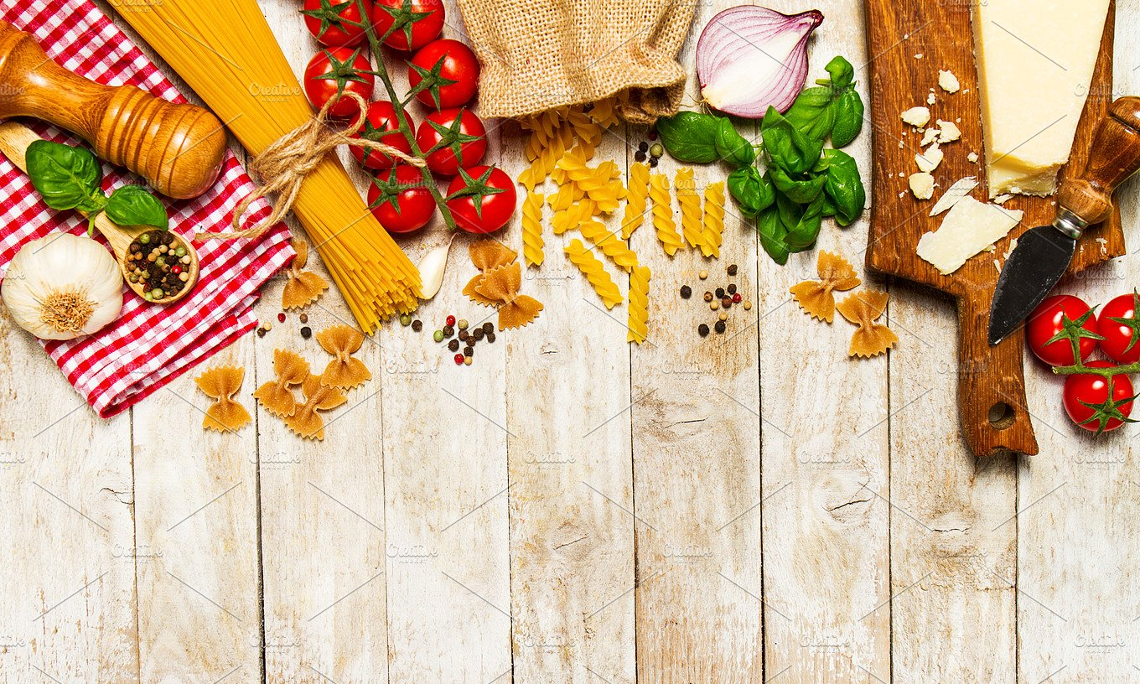
SUMMARY

Slide 33
SUMMARY
1.Vocabulary:
Swim: bơi
- Take photos: chụp ảnh
Collect seashells:thu lượm, đi lấy vỏ sò
Walk on the beach: đi bộ trên bãi biển
2. Sentence pattern:
-Did you swim?
(Bạn đã đi bơi phải không ?)
-> Yes, I did. I swam with my mother.
(Vâng. Tôi đã đi bơi với mẹ tôi)

Slide 34

Homework:
- Learn by heart vocabulary and sentence pattern
- Prepare Unit 11- lesson 1 ( 4, 5, 6)

Slide 35

Notes:
MADE BY FACEBOOK :TRAN THI THANH TAM

