Slide 1


Nguyen Du Primary School
WELCOME TO
OUR CLASS 5
Teacher: Trần Thị Thanh Tâm

Slide 2

UNIT 17: STORIES FOR CHILDREN
LESSON 3 (1, 2, 3)
Notes:
MADE BY FACEBOOK :TRAN THI THANH TAM

Slide 3
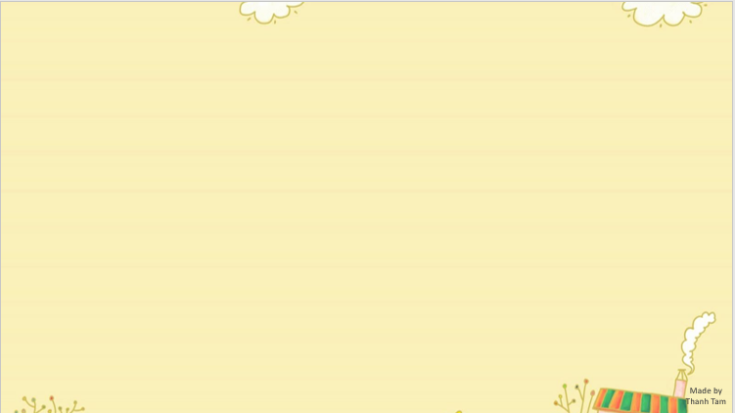

CONTENTS
1
WARM -UP
2
LISTEN AND REPEAT
3
LISTEN AND UNDERLINE ONE MORE STRESSED WORD. THEN REPEAT
4
LET’S CHANT
5
PLAY GAME
Notes:
MADE BY FACEBOOK :TRAN THI THANH TAM

Slide 4
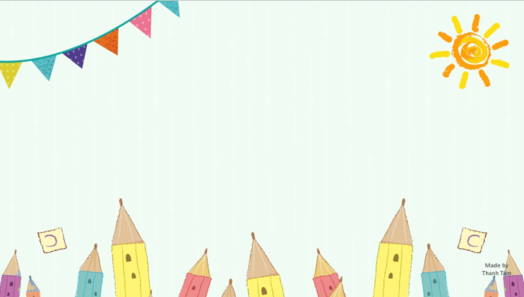
Warm - up
Notes:
MADE BY FACEBOOK :TRAN THI THANH TAM

Slide 5


BRAINSTORMING

Slide 6

Let’s tell about characters that you have learnt

Slide 7

?
?
?
Characters
?
?
?
?

Slide 8
fox
tortoise
crow
Characters
ant
hare
grasshopper
Snow White
Seven dwarfs

Slide 9

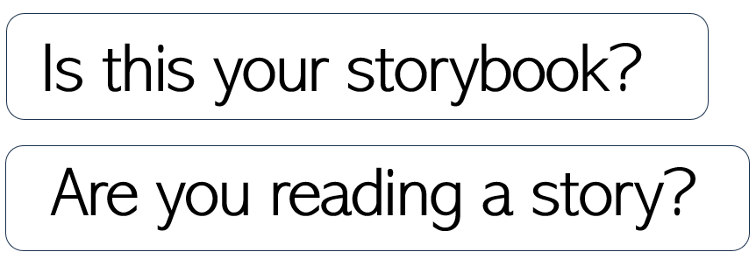
1.Listen and repeat
Notes:
MADE BY FACEBOOK :TRAN THI THANH TAM

Slide 10
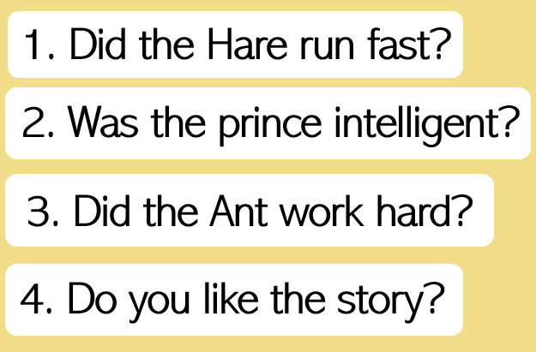
2. Listen and repeat. Pay attention to the intonation.
Notes:
MADE BY FACEBOOK :TRAN THI THANH TAM

Slide 11
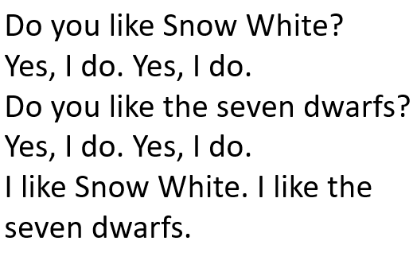
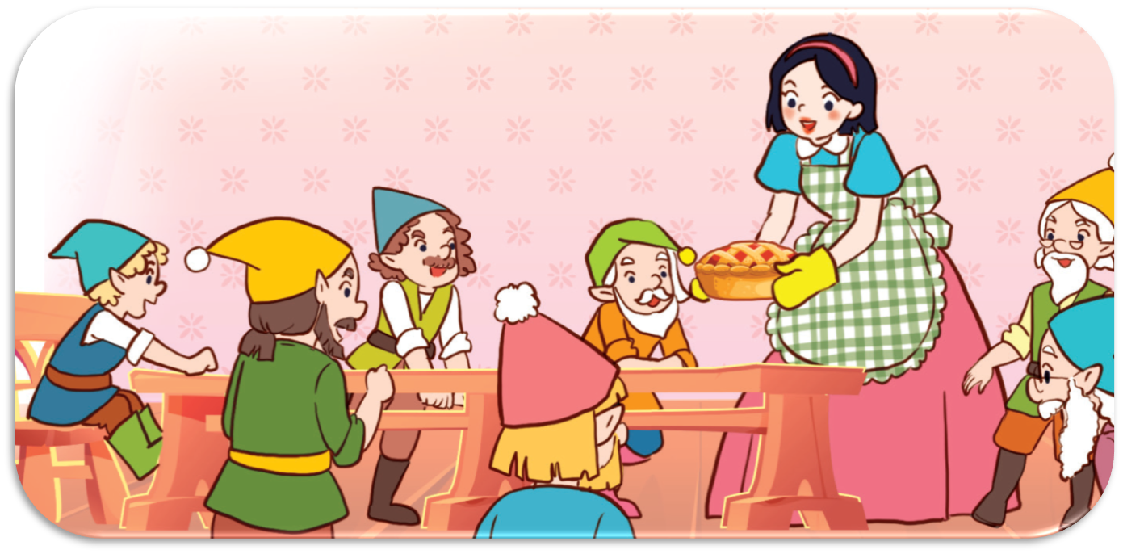
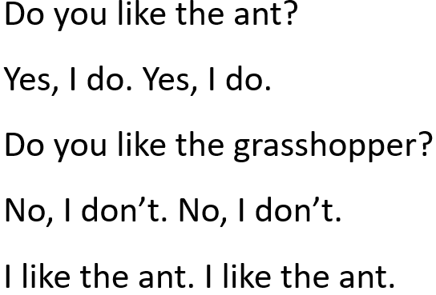
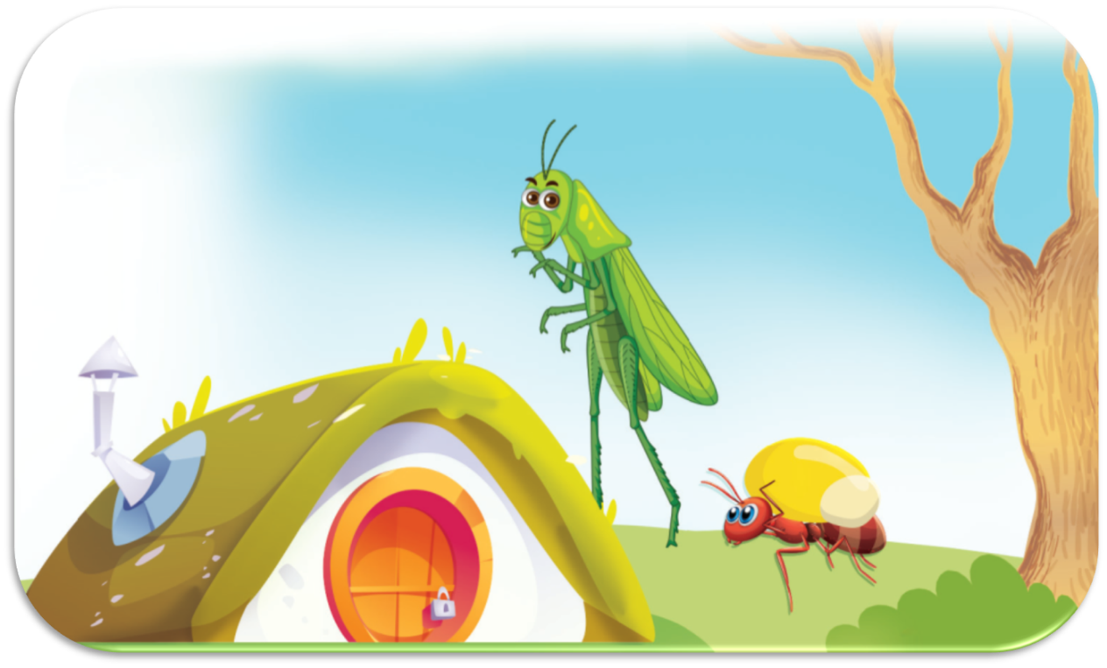
3. Let’s chant
Notes:
MADE BY FACEBOOK :TRAN THI THANH TAM

Slide 12
LET’S PLAY
TRUE OR FALSE GAME

Slide 13



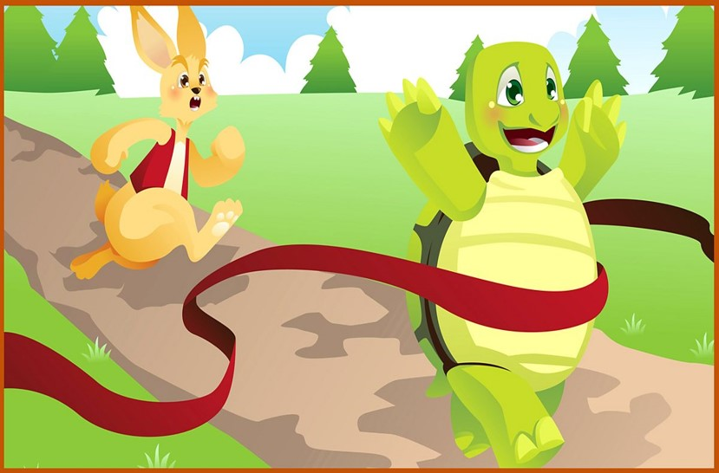

The main characters are the hare and the tortoise.
TRUE
FALSE

Slide 14
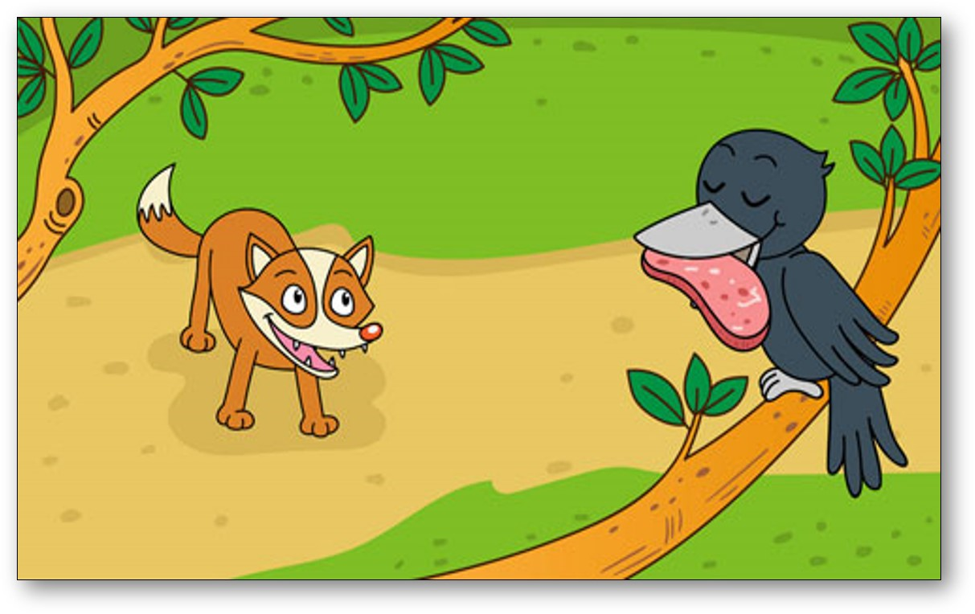
The main characters are fox and ant.
TRUE
FALSE

Slide 15
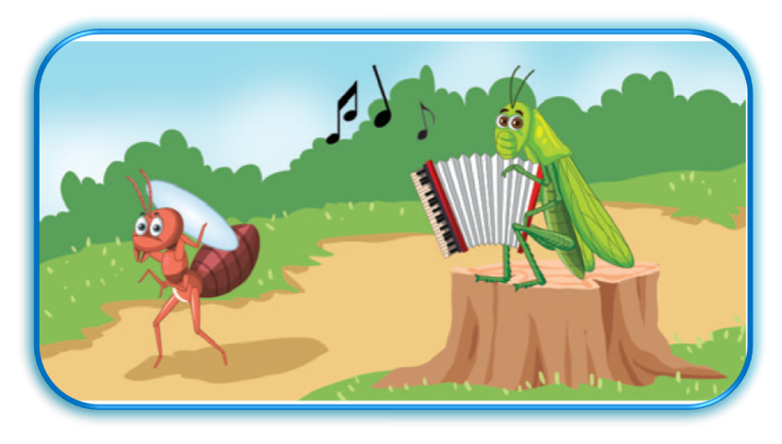

The main characters are the ant and the grasshopper.
TRUE
FALSE

Slide 16
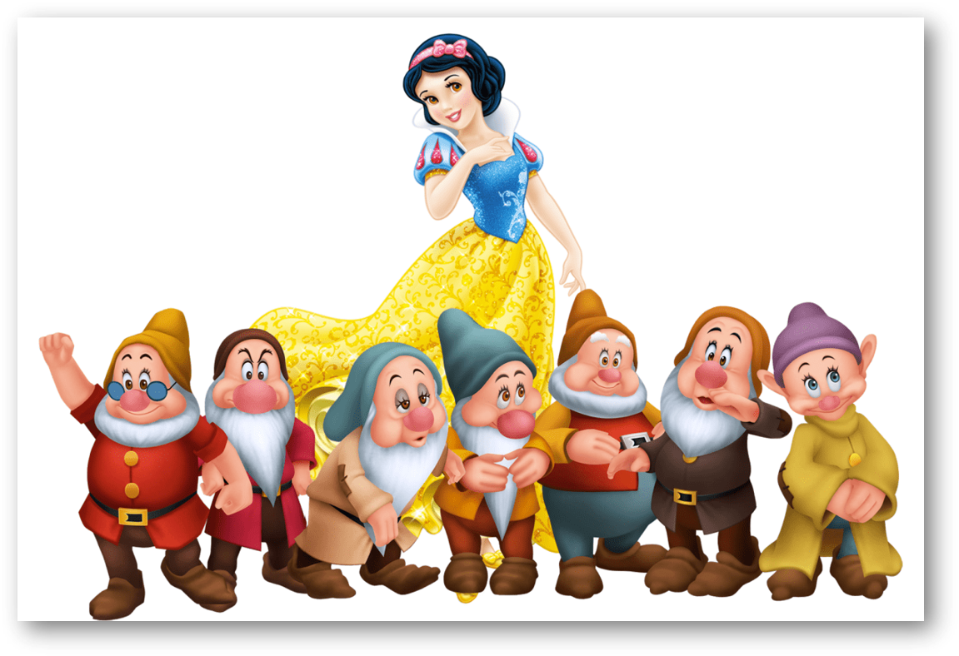
The main characters are Snow White and the six dwarfs.
TRUE
FALSE

Slide 17






Slide 18

Homework:
- Practice more at home
- Prepare Unit 17- lesson 3 ( 4, 5, 6)
Notes:
MADE BY FACEBOOK :TRAN THI THANH TAM

Slide 19

Notes:
MADE BY FACEBOOK :TRAN THI THANH TAM

Slide 20




The bye bye song
Bye, bye.
See you tomorrow.
Bye, bye.
See you tomorrow.
Bye, bye.
See you tomorrow.
Bye, bye. Bye, bye.
The bye bye song
Made by Thanh Tam
Notes:
MADE BY FACEBOOK :TRAN THI THANH TAM

