Slide 1
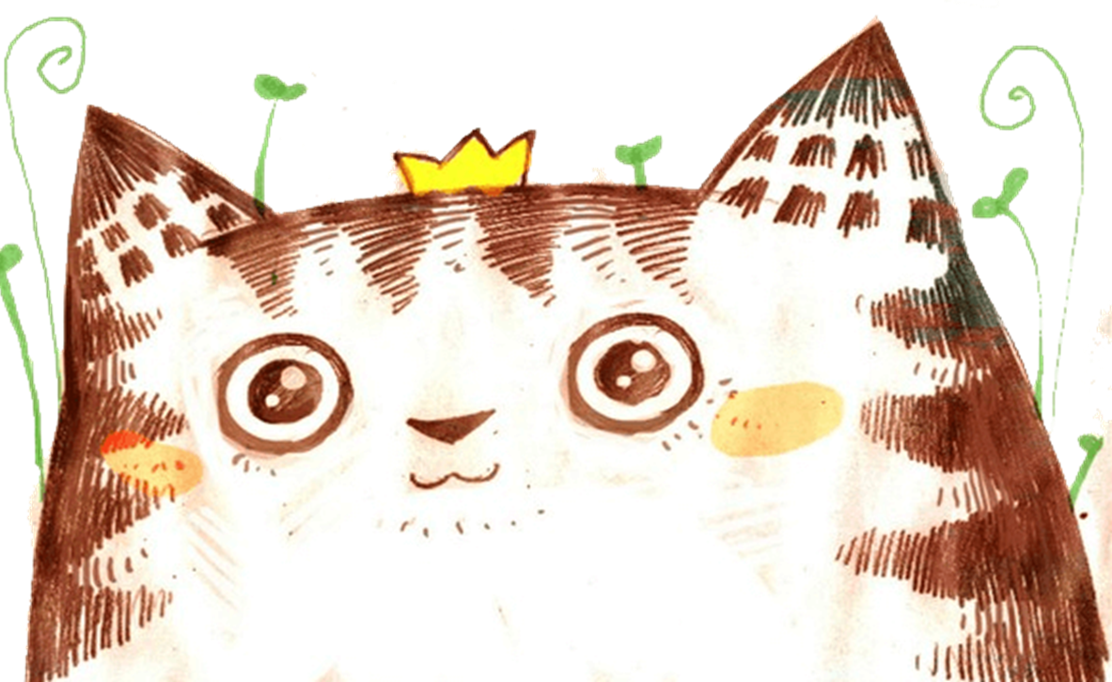



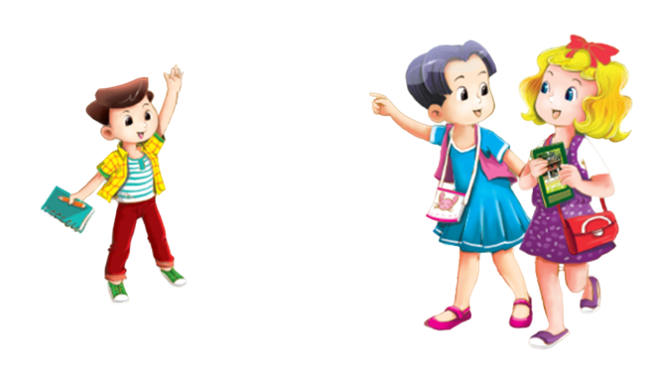



Extension Activity
MsPham
0936082789

Slide 2


Warm - up
Play

Slide 3

MsPham
0936082789

Slide 4





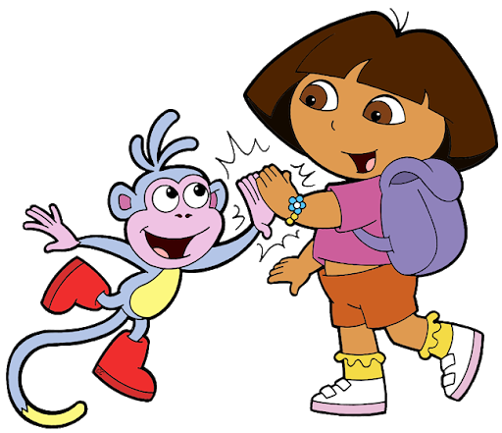
START
Notes:
Ms Huyền Phạm - 0936.082.789 – YOUTUBE: MsPham. Facebook: Dạy và học cùng công nghệ.

Slide 5

Where are you _____?
I am _____ America.
at
doing
from
Notes:
Ms Huyền Phạm - 0936.082.789 – YOUTUBE: MsPham. Facebook: Dạy và học cùng công nghệ.

Slide 6

Where ______ Mary from?
She _____ from Australia.
is
are
am
Notes:
Ms Huyền Phạm - 0936.082.789 – YOUTUBE: MsPham. Facebook: Dạy và học cùng công nghệ.

Slide 7
What time is it?
It is 4:45.
four forty
four forty-five
four fourty-five
Notes:
Ms Huyền Phạm - 0936.082.789 – YOUTUBE: MsPham. Facebook: Dạy và học cùng công nghệ.

Slide 8
What day is it _____?
It is Thursday.
today
tomorrow
yesterday
Notes:
Ms Huyền Phạm - 0936.082.789 – YOUTUBE: MsPham. Facebook: Dạy và học cùng công nghệ.

Slide 9
What does Bill do on Sundays?
He ______ housework.
do
does
dos
Notes:
Ms Huyền Phạm - 0936.082.789 – YOUTUBE: MsPham. Facebook: Dạy và học cùng công nghệ.

Slide 10
What time do you go home?
I go home _____ five o’clock.
on
in
at
Notes:
Ms Huyền Phạm - 0936.082.789 – YOUTUBE: MsPham. Facebook: Dạy và học cùng công nghệ.

Slide 11
When’s your birthday?
It’s _____ February.
in
on
at
Notes:
Ms Huyền Phạm - 0936.082.789 – YOUTUBE: MsPham. Facebook: Dạy và học cùng công nghệ.

Slide 12
What do you want to eat?
I want _____ grapes.
a
some
an
Notes:
Ms Huyền Phạm - 0936.082.789 – YOUTUBE: MsPham. Facebook: Dạy và học cùng công nghệ.

Slide 13
What do you want ______ drink?
I want some lemonade.
some
do
to
Notes:
Ms Huyền Phạm - 0936.082.789 – YOUTUBE: MsPham. Facebook: Dạy và học cùng công nghệ.

Slide 14

Welldone!
END
Notes:
Ms Huyền Phạm - 0936.082.789 – YOUTUBE: MsPham. Facebook: Dạy và học cùng công nghệ.

Slide 15
Practice

Slide 16


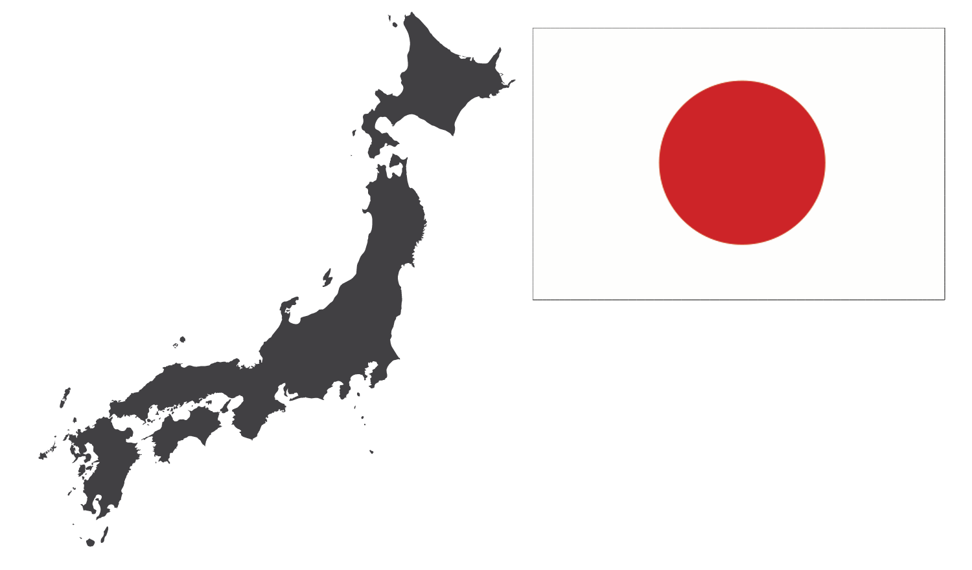


1
Look and write.
MsPham
0936082789
1. Viet Nam
2. ____________
3. ____________
Britain
Japan
4. ____________
5. ____________
Australia
America

Slide 17
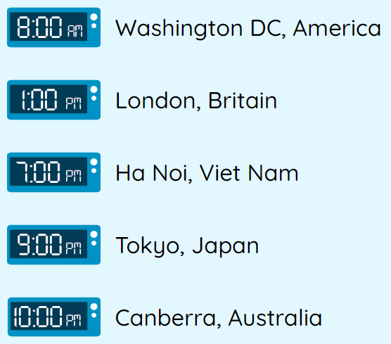
2
Let’s write.
1. In America, it’s _____________.
2. In Britain, it's _____________.
3. In Viet Nam, it's _____________.
4. In Japan, _____________.
5. In Australia, it's _____________.
eight o'clock
one o'clock
MsPham
0936082789
seven o'clock
nine o'clock
ten o'clock

Slide 18
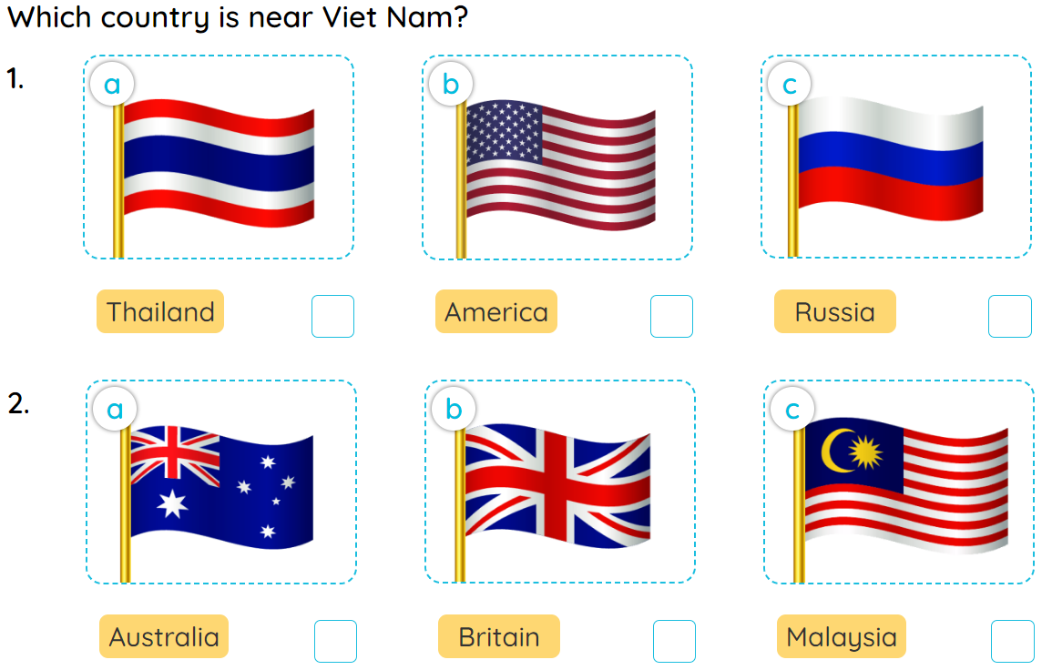
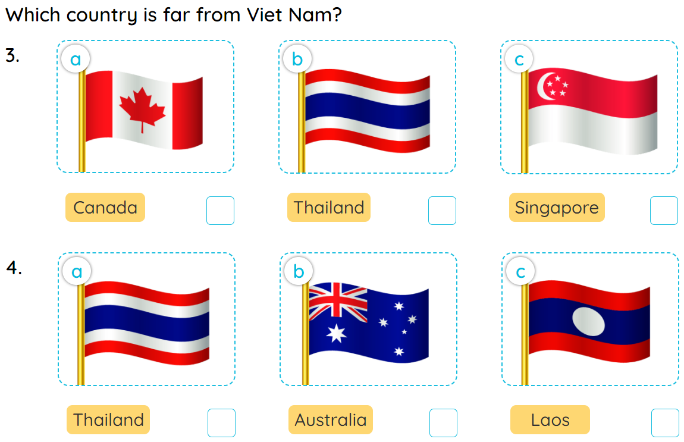
3
Read the questions. Then tick the answers.
MsPham
0936082789

Slide 19
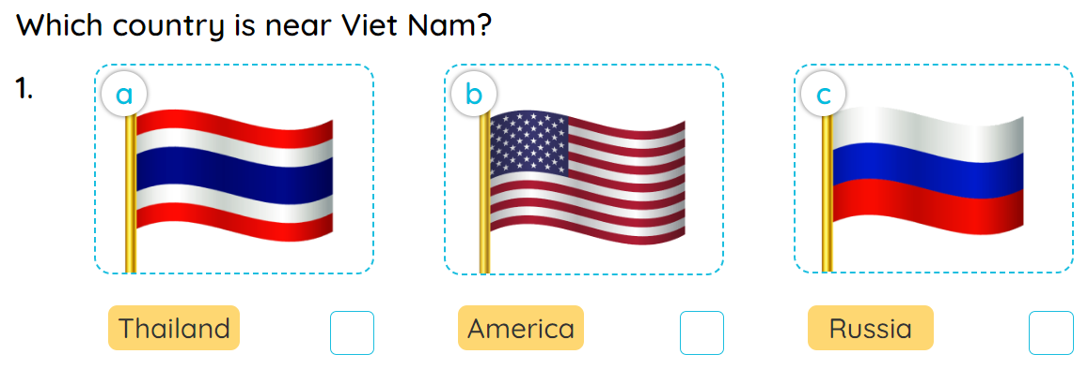

3
Read the questions. Then tick the answers.
MsPham
0936082789

Slide 20
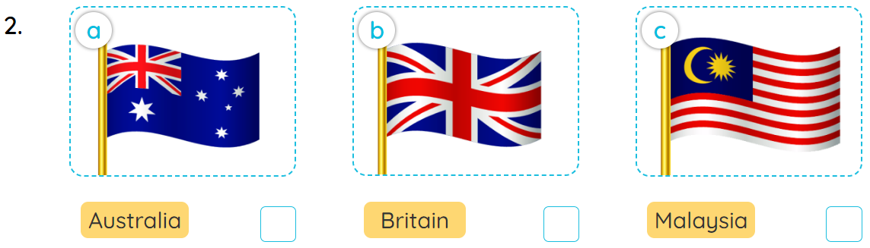
3
Read the questions. Then tick the answers.
MsPham
0936082789

Slide 21
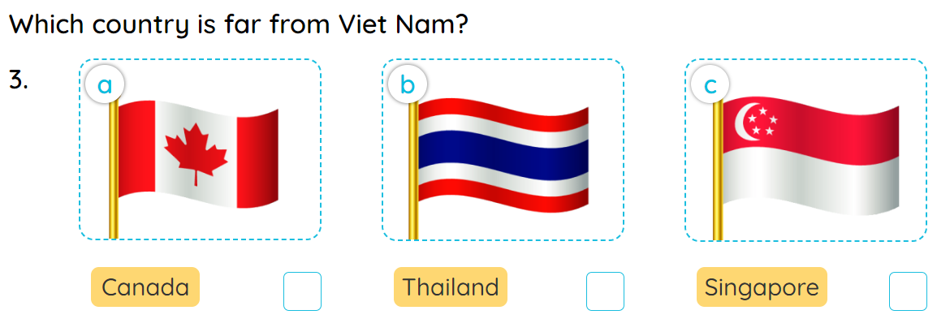
3
Read the questions. Then tick the answers.
MsPham
0936082789

Slide 22
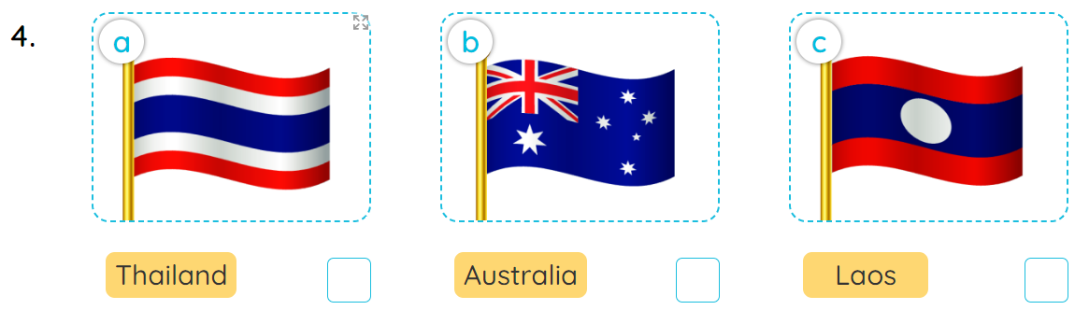
3
Read the questions. Then tick the answers.
MsPham
0936082789

Slide 23
3
Read the questions. Then tick the answers.
MsPham
0936082789

Slide 24
Thank you!
MsPham
0936082789

