Slide 1
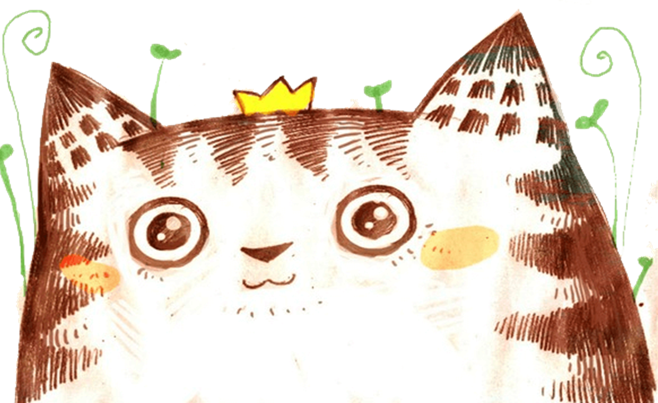



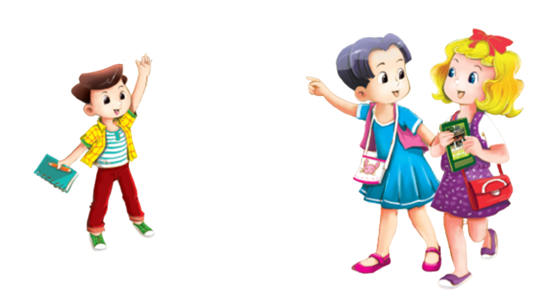



Review 1
MsPham
0936082789
Part 2

Slide 2


Warm - up
Play

Slide 3

MsPham
0936082789

Slide 4
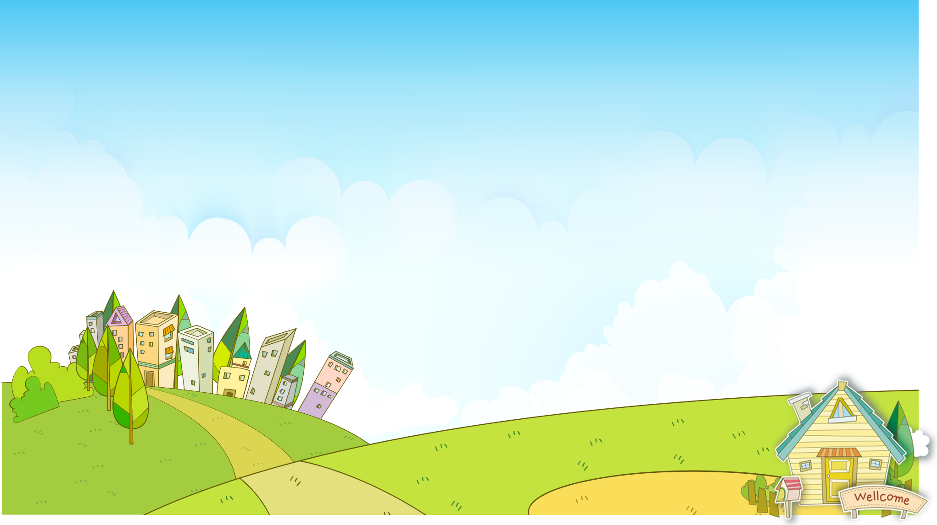




Odd one out
PLAY

Slide 5
Odd one out
April
Monday
Sunday
Tuesday
Next

Slide 6
Odd one out
sing
juice
swim
draw
Next

Slide 7
Odd one out
May
January
America
March
Next

Slide 8
Odd one out
hello
goodbye
hi
roller skate
Next

Slide 9
Odd one out
Go to school
Fly a kite
Nine o’clock
Play the guitar
Next

Slide 10
Odd one out
He
She
I
Is
Next

Slide 11
Odd one out
skip
piano
housework
football
Next

Slide 12




Great job!
End

Slide 13
Practice

Slide 14
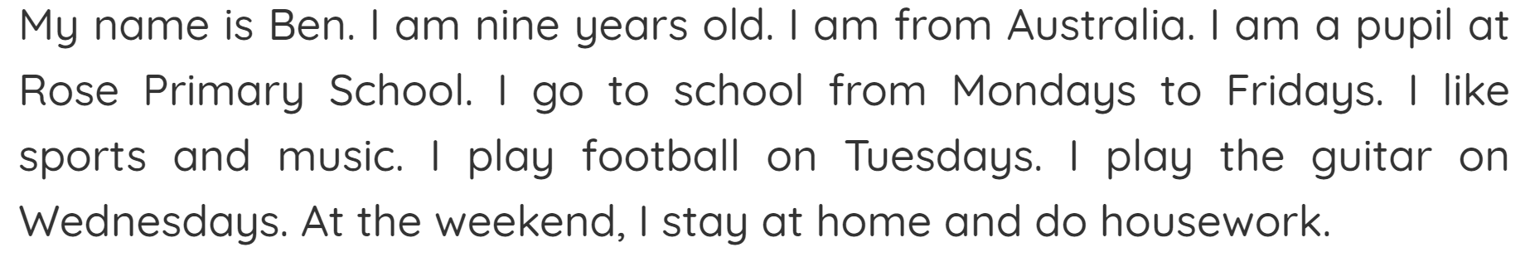

4
Read and complete.
This is Ben. He is from (1) Australia . He is at school
from Mondays to (2) Fridays . His hobbies are sports
and music. He can play football. He can play the (3)
guitar . He is at home on (4) Saturdays and Sundays.
4
4
MsPham
0936082789
4
4

Slide 15

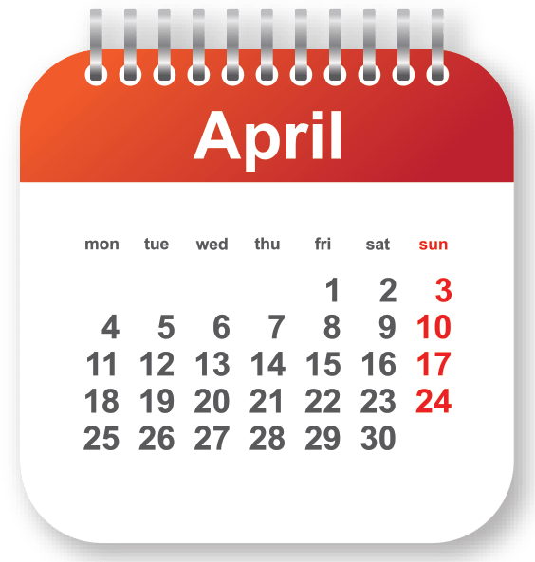


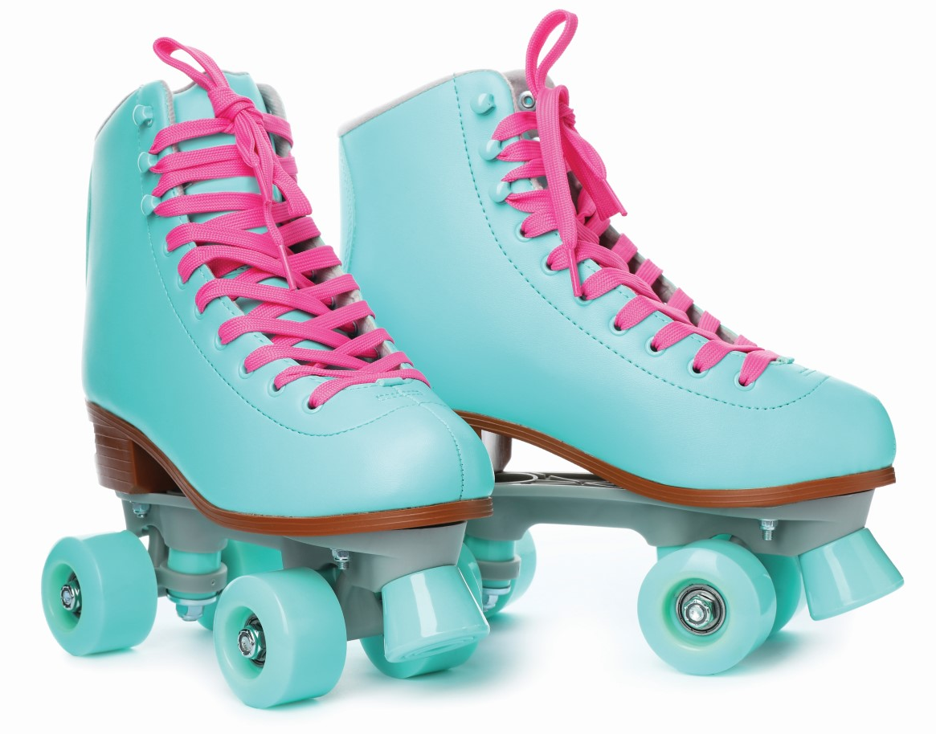
5
Let’s write.
MsPham
0936082789
I have a friend. Her name is Ann. She is from (1) ___________. Her birthday is in (2) ___________. She can (3) _______ and (4) _______, but she can’t (5) ___________.
America
April
sing
draw
roller skate

Slide 16
Thank you!
MsPham
0936082789

