Slide 1


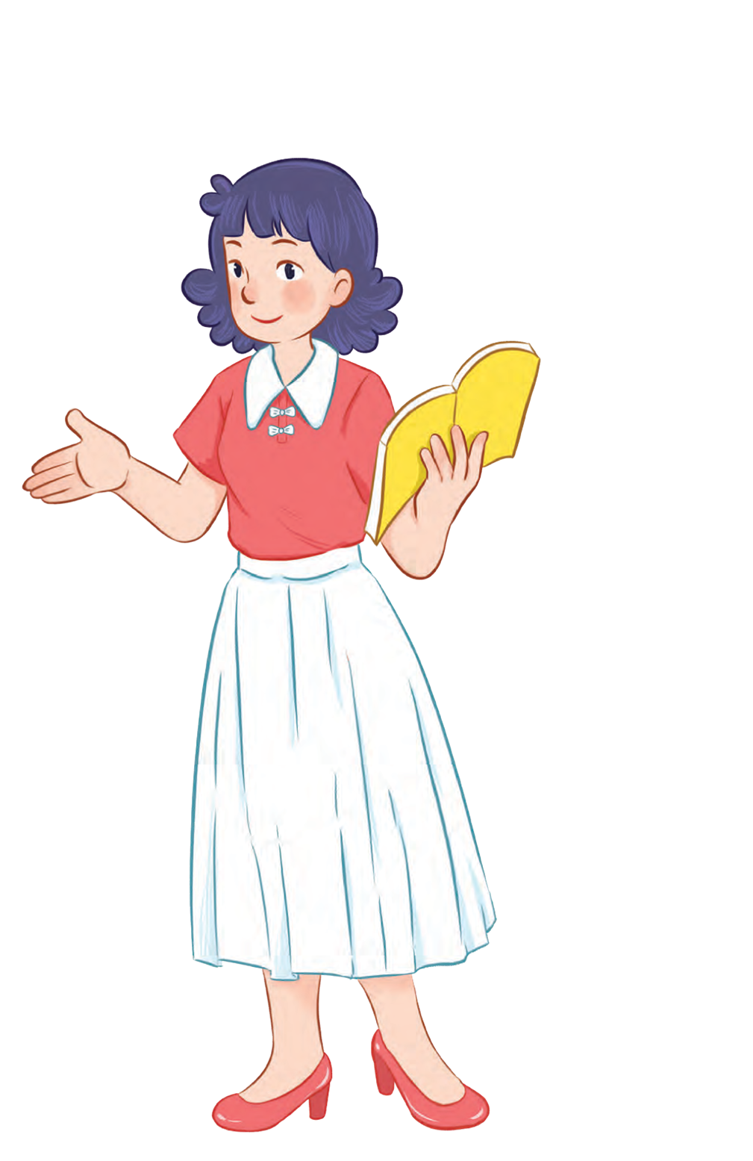
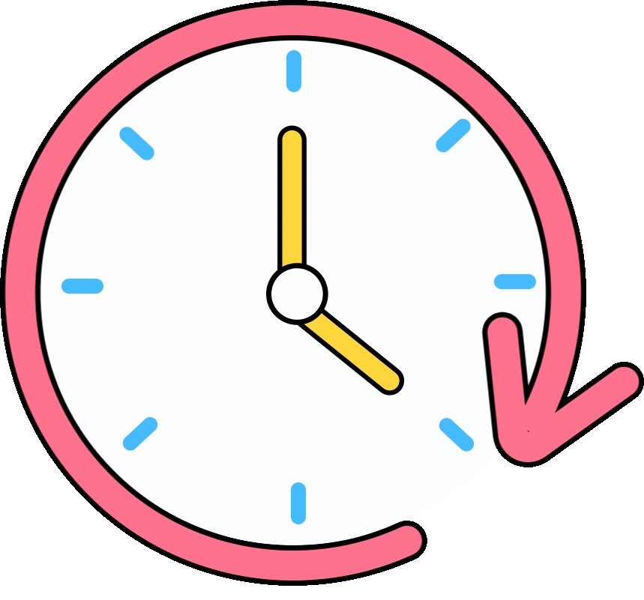


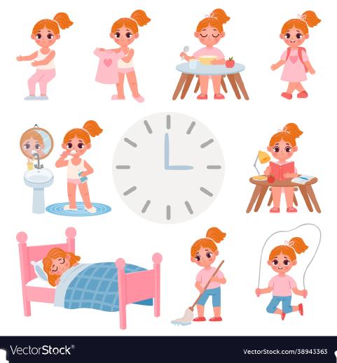


Unit 2
Time and
daily routine
MsPham
0936082789
Lesson 1 – Period 2

Slide 2

Warm up

Slide 3



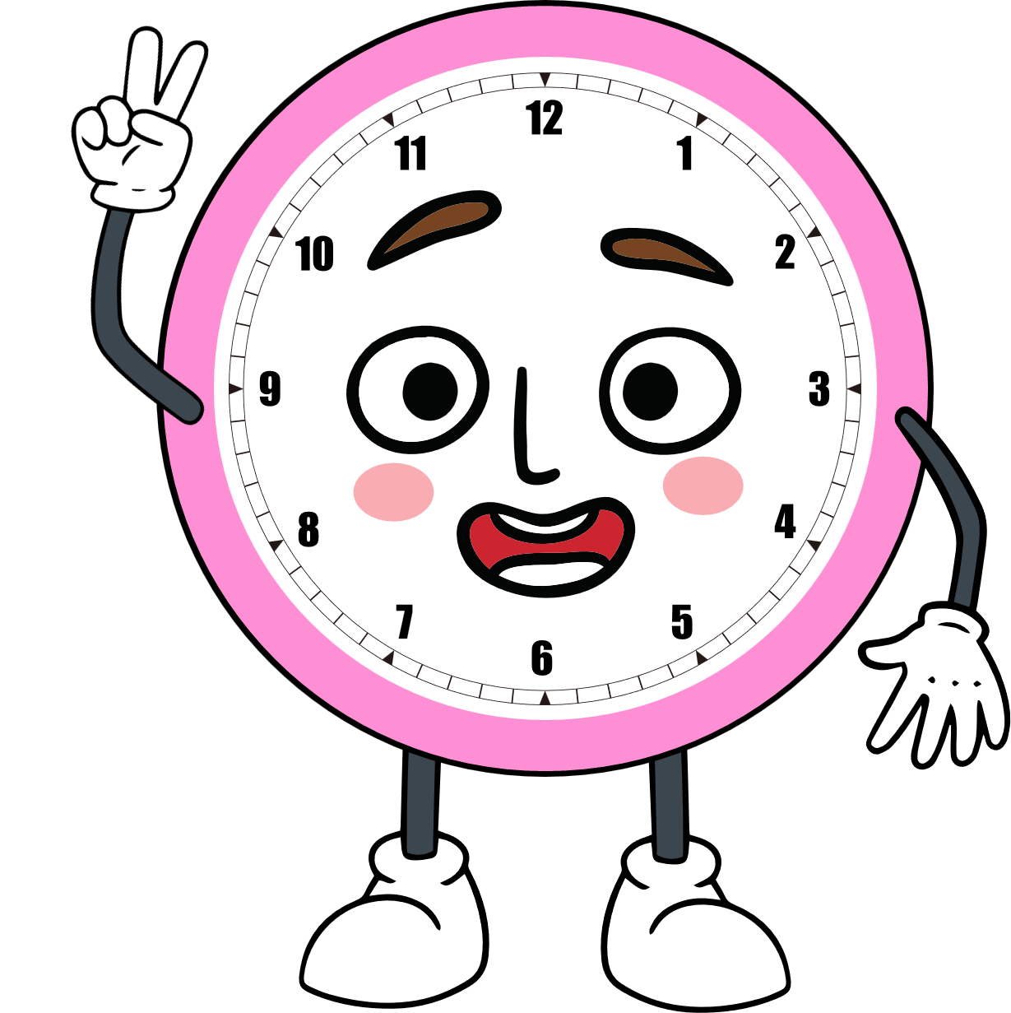







What time is it?

Slide 4







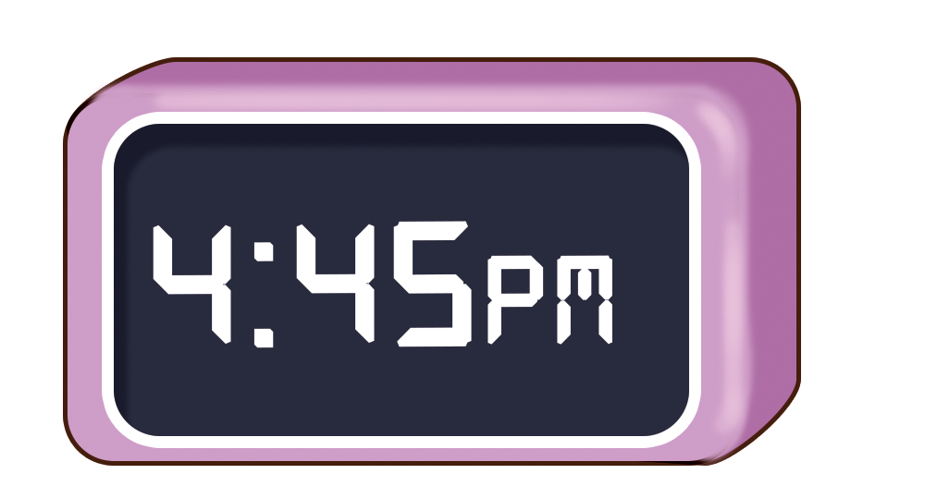




Click the best answer.
What time is it?
It’s four forty-five.

Slide 5


Click the best answer.
What time is it?
It’s nine o’clock.

Slide 6
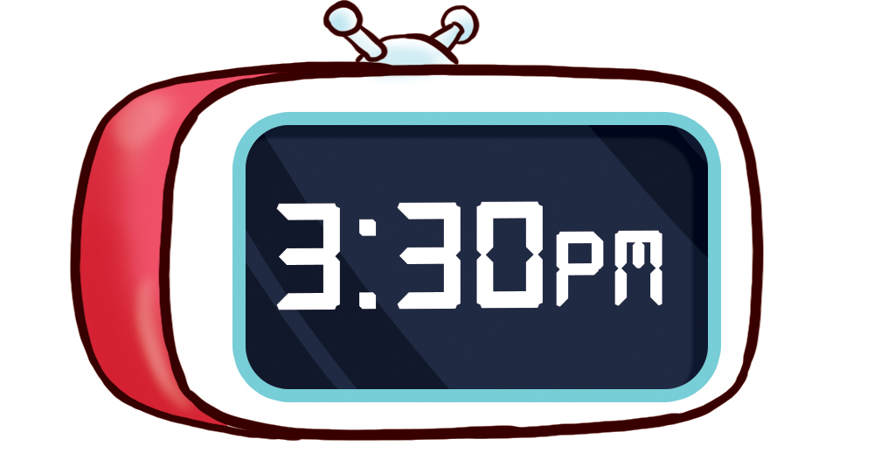
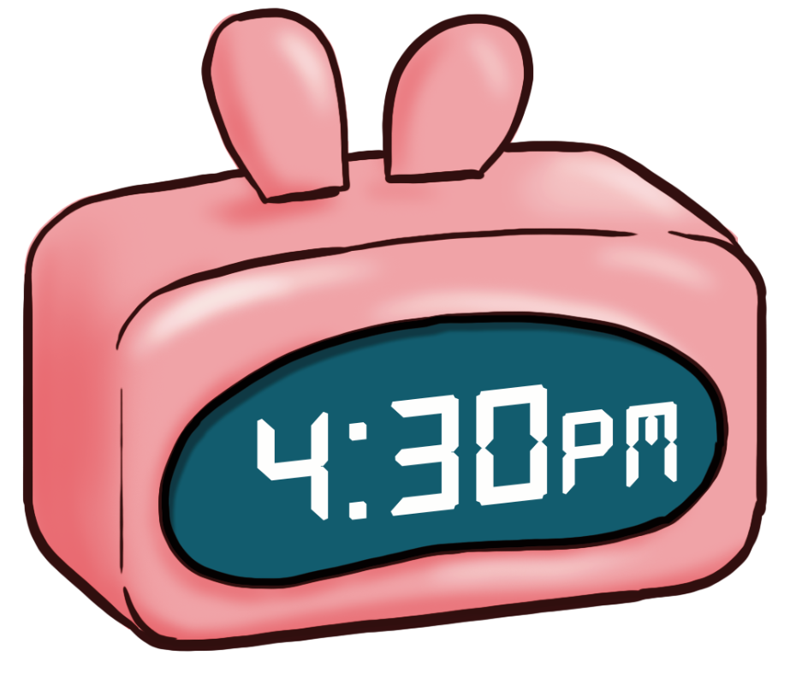
Click the best answer.
What time is it?
It’s three thirty.

Slide 7


Click the best answer.
What time is it?
It’s one fifteen.

Slide 8


Click the best answer.
What time is it?
It’s ten o’clock.

Slide 9
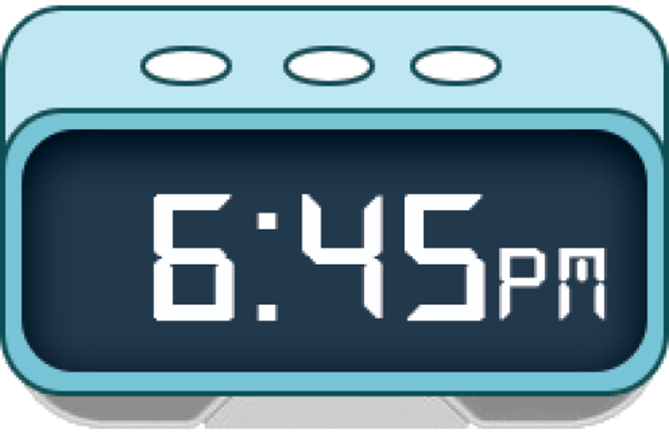
Click the best answer.
What time is it?
It’s four thirty.

Slide 10
Click the best answer.
What time is it?
It’s nine fifteen.

Slide 11
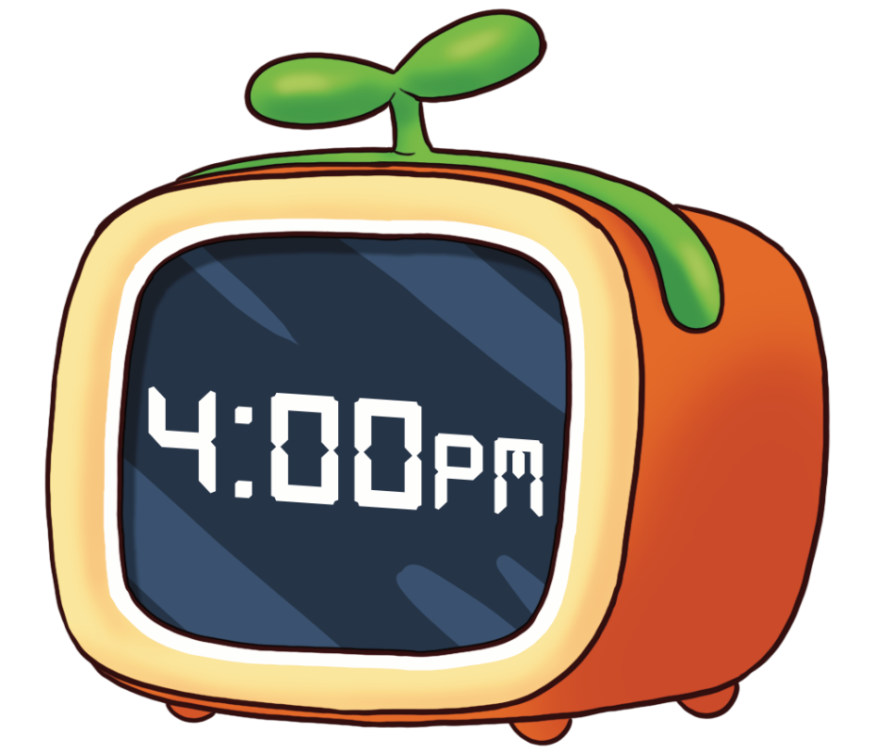
Click the best answer.
What time is it?
It’s four o’clock.

Slide 12




Welldone!
Do you have any questions for us?
End

Slide 13
MsPham
0936082789
MsPham
0936082789
Review

Slide 14

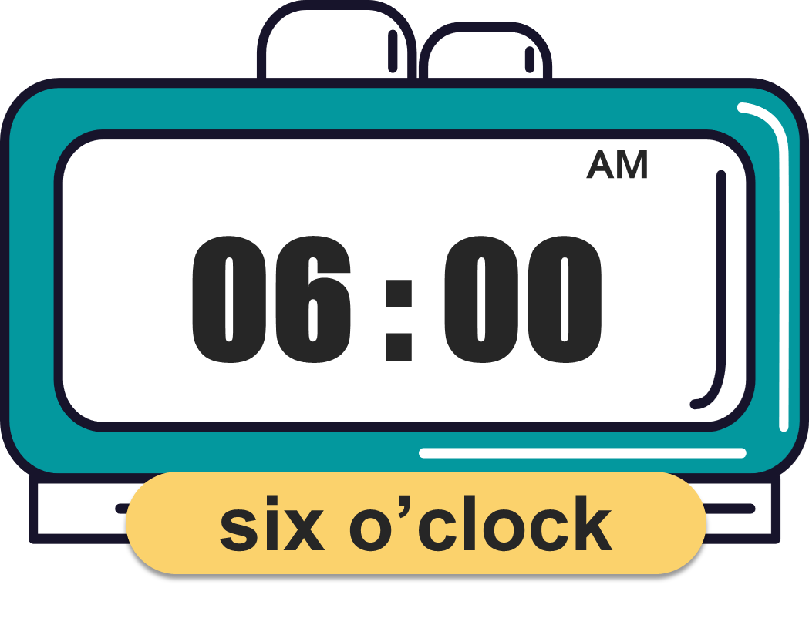
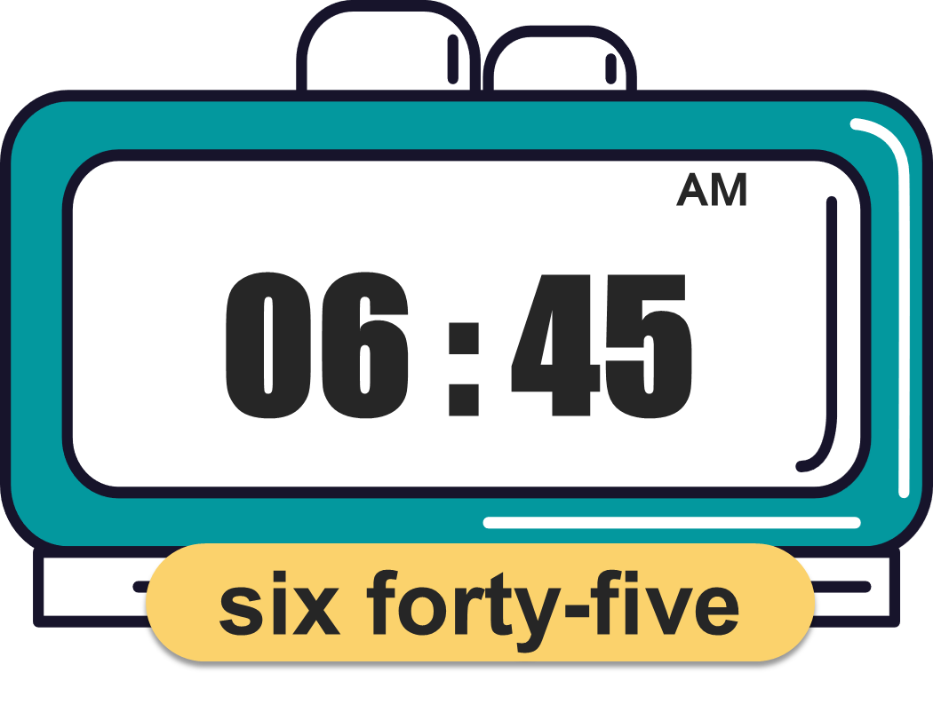
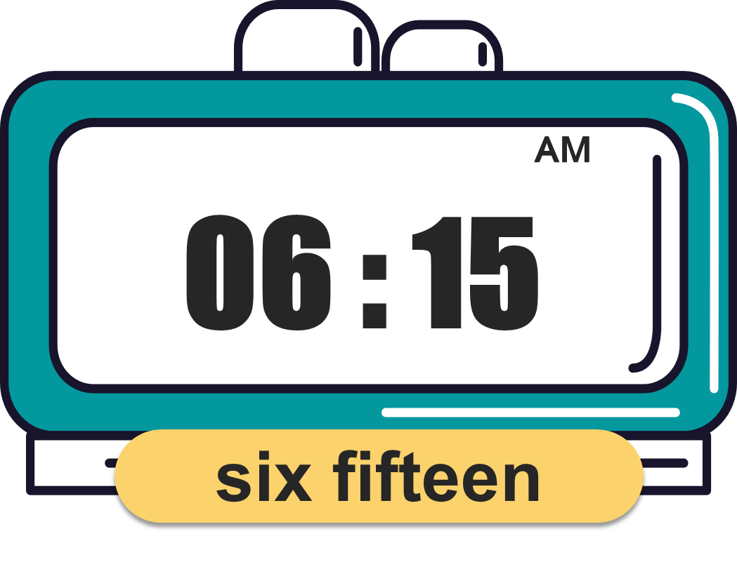
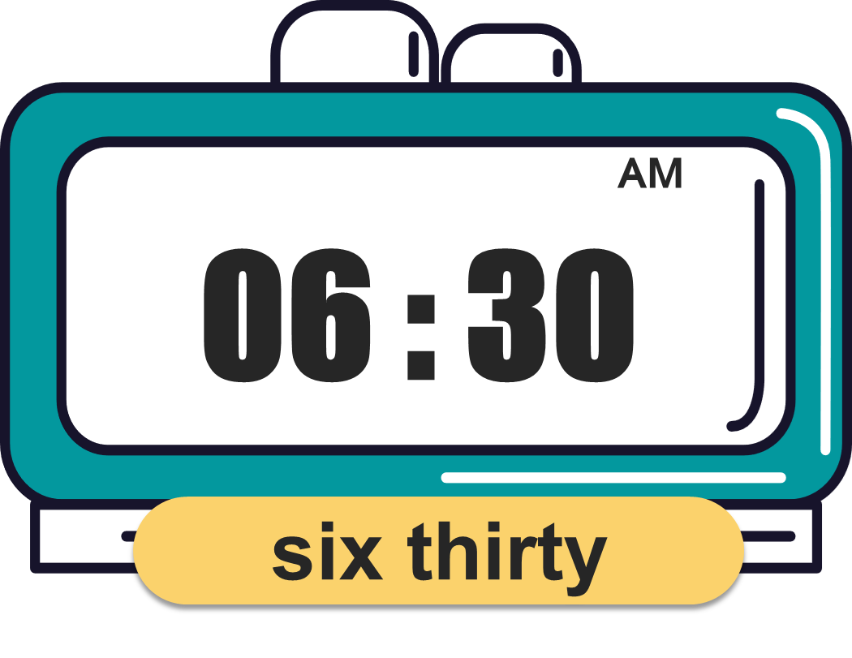
What time is it?
(Mấy giờ rồi?)
MsPham
0936082789
It’s _________.
(____)
MsPham
0936082789

Slide 15
MsPham
0936082789
MsPham
0936082789
Practice

Slide 16

4
Listen and tick.
a
b
1
✓
a
b
2
✓

Slide 17
5
Look, complete and read.
1
2
is it
A: What time is it?
B: It’s _______ o’clock.
A: What time _______?
B: It’s one fifteen.
ten
3
4
What time
What time
A: _____________ is it?
B: It’s three _______.
A: _____________ is it?
B: It’s ________________.
thirteen
four forty-five

Slide 18
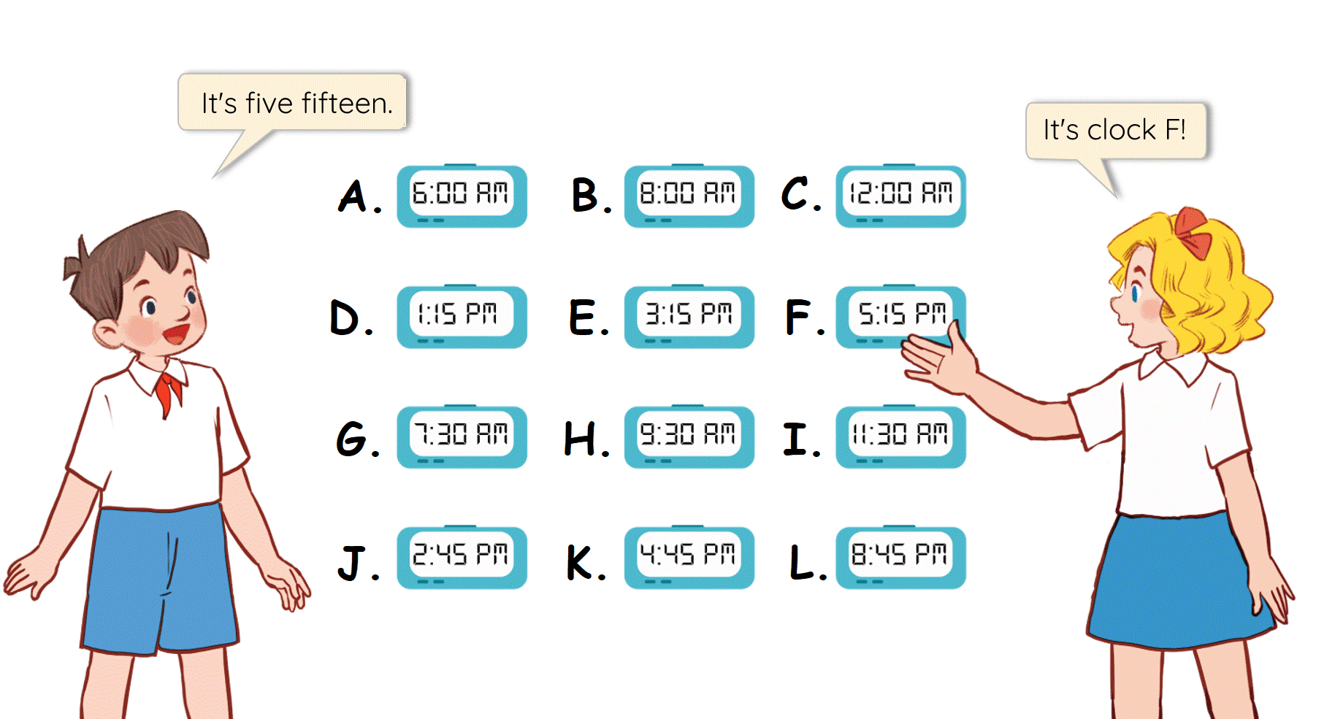
6
Let’s play.

Slide 19
MsPham
0936082789
Thank you!

