Slide 1


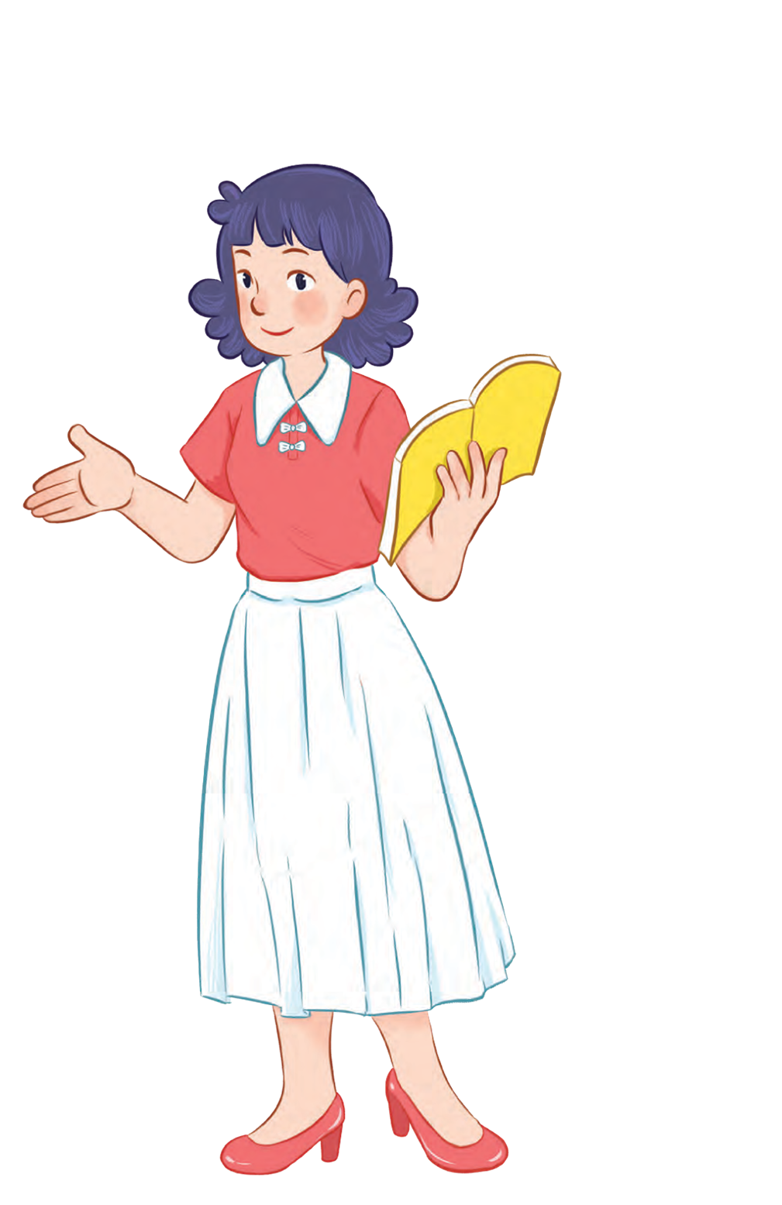
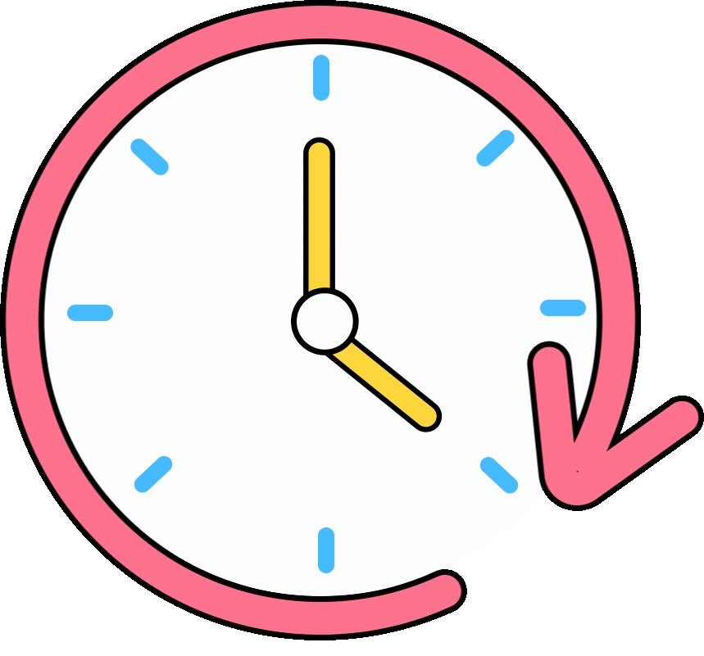


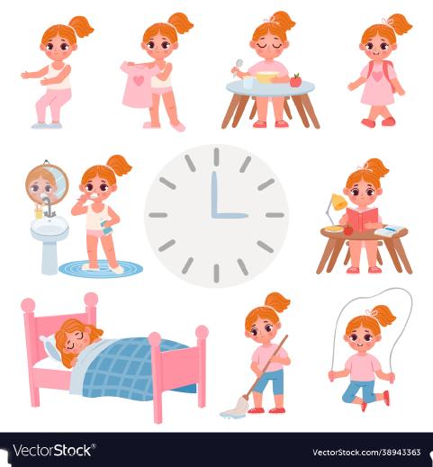


Unit 2
Time and
daily routine
MsPham
0936082789
Lesson 2 – Period 1

Slide 2

Warm up

Slide 3
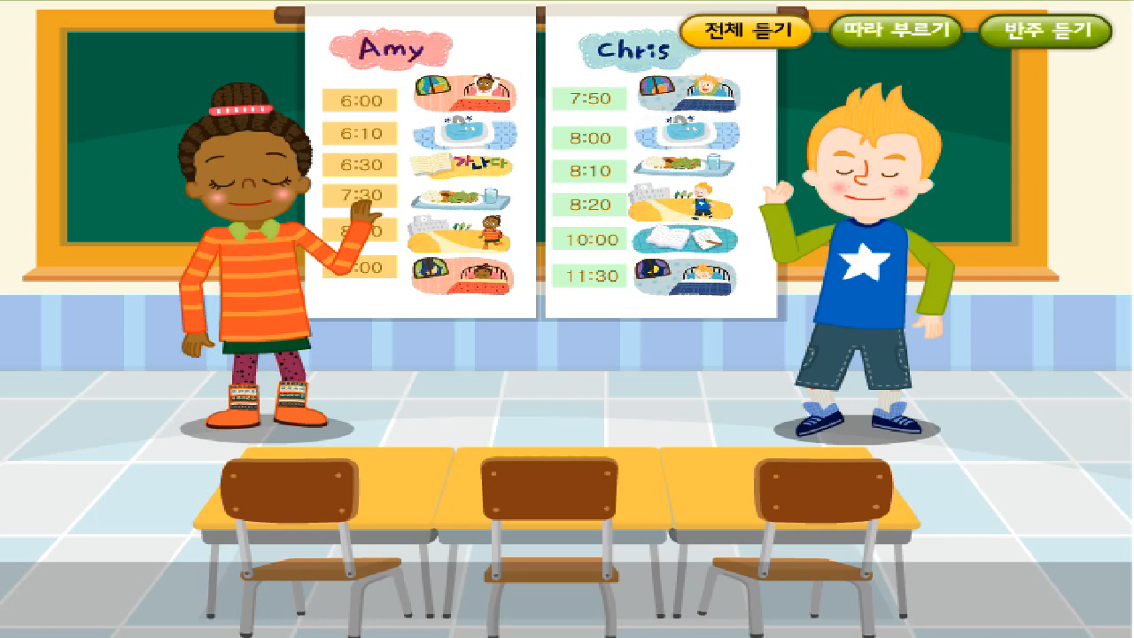

Slide 4
MsPham
0936082789
MsPham
0936082789
Vocabulary

Slide 5
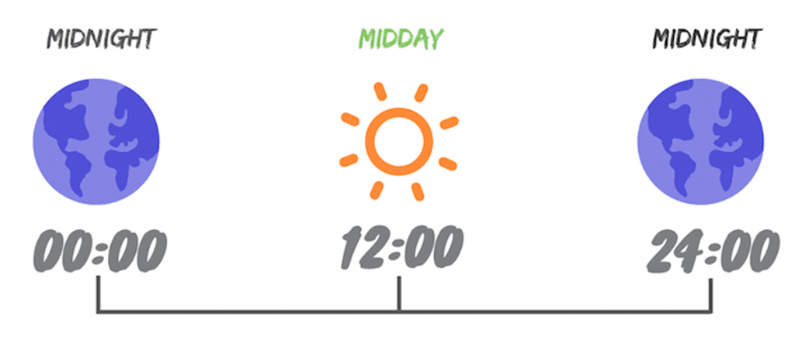
MsPham
0936082789
A.M
P.M

Slide 6
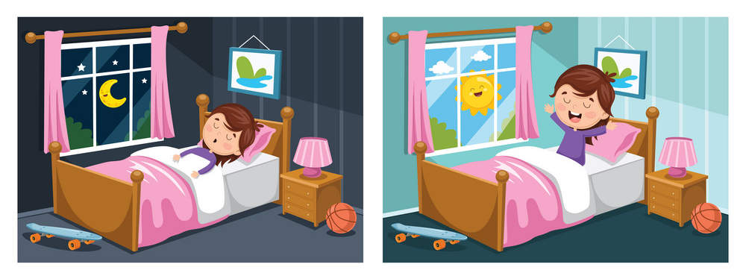
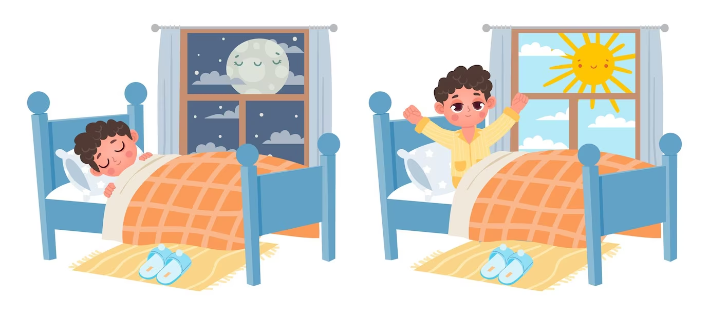
MsPham
0936082789
get up
go to bed
/ɡɛt ʌp/
/ɡəʊ tə bɛd/
Thức dậy
Đi ngủ

Slide 7


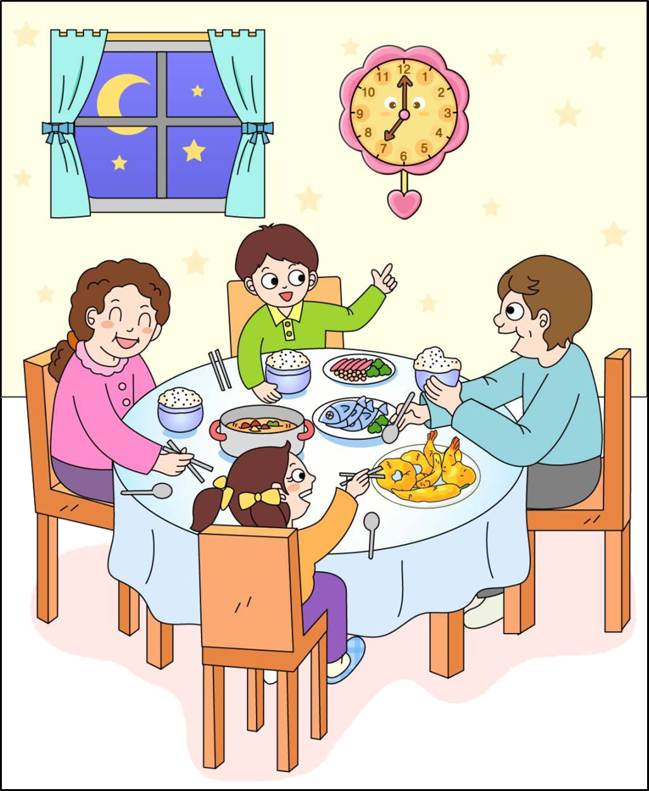
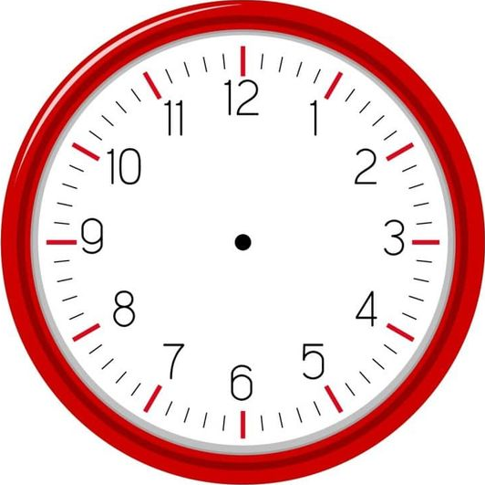

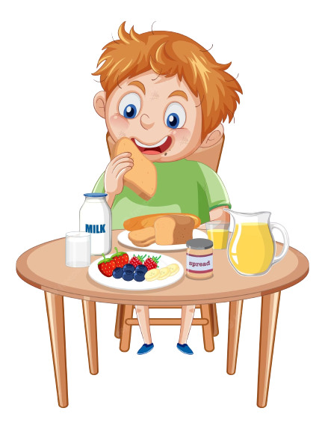
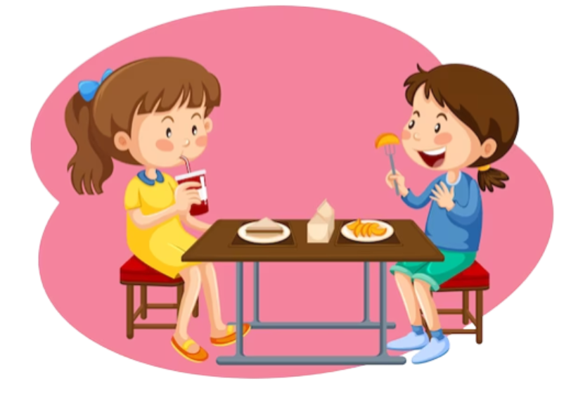
MsPham
0936082789
have breakfast
have lunch
have dinner
/həv ˈbrɛkfəst/
/həv lʌnʧ/
/ həv ˈdɪnə/
Ăn sáng
Ăn trưa
Ăn tối

Slide 8
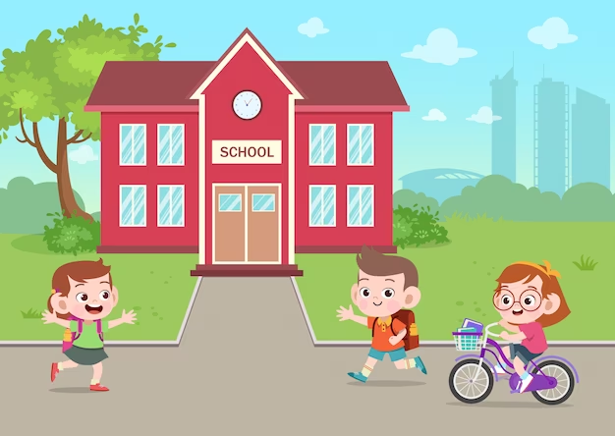
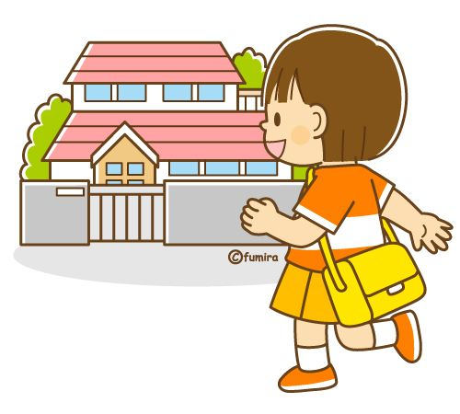

MsPham
0936082789
go to school
go home
do homework
/ ɡəʊ tə skuːl/
/ɡəʊ həʊm/
/dʊ ˈhəʊmˌwɜ:k/
Đi học
Về nhà
Làm bài tập

Slide 9
Vocabulary
get up
: Thức dậy
go to bed
: Đi ngủ
have breakfast
: Ăn sáng
MsPham
0936082789
have lunch
: Ăn trưa
have dinner
: Ăn tối
go to school
: Đi học
go home
: Về nhà
do homework
: Làm bài tập

Slide 10
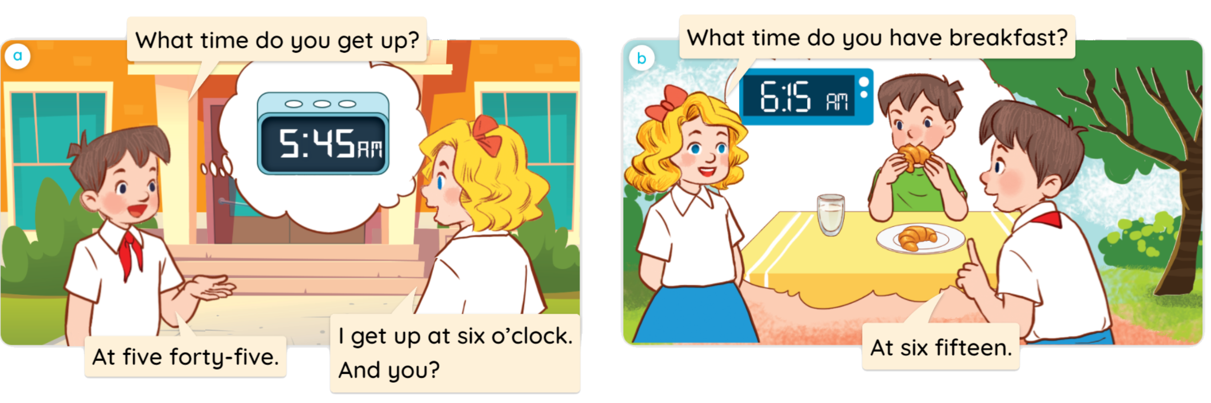


1
Look, listen and read.

Slide 11
MsPham
0936082789
MsPham
0936082789
Structure

Slide 12

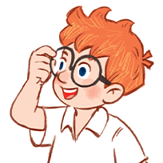
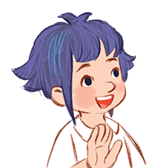
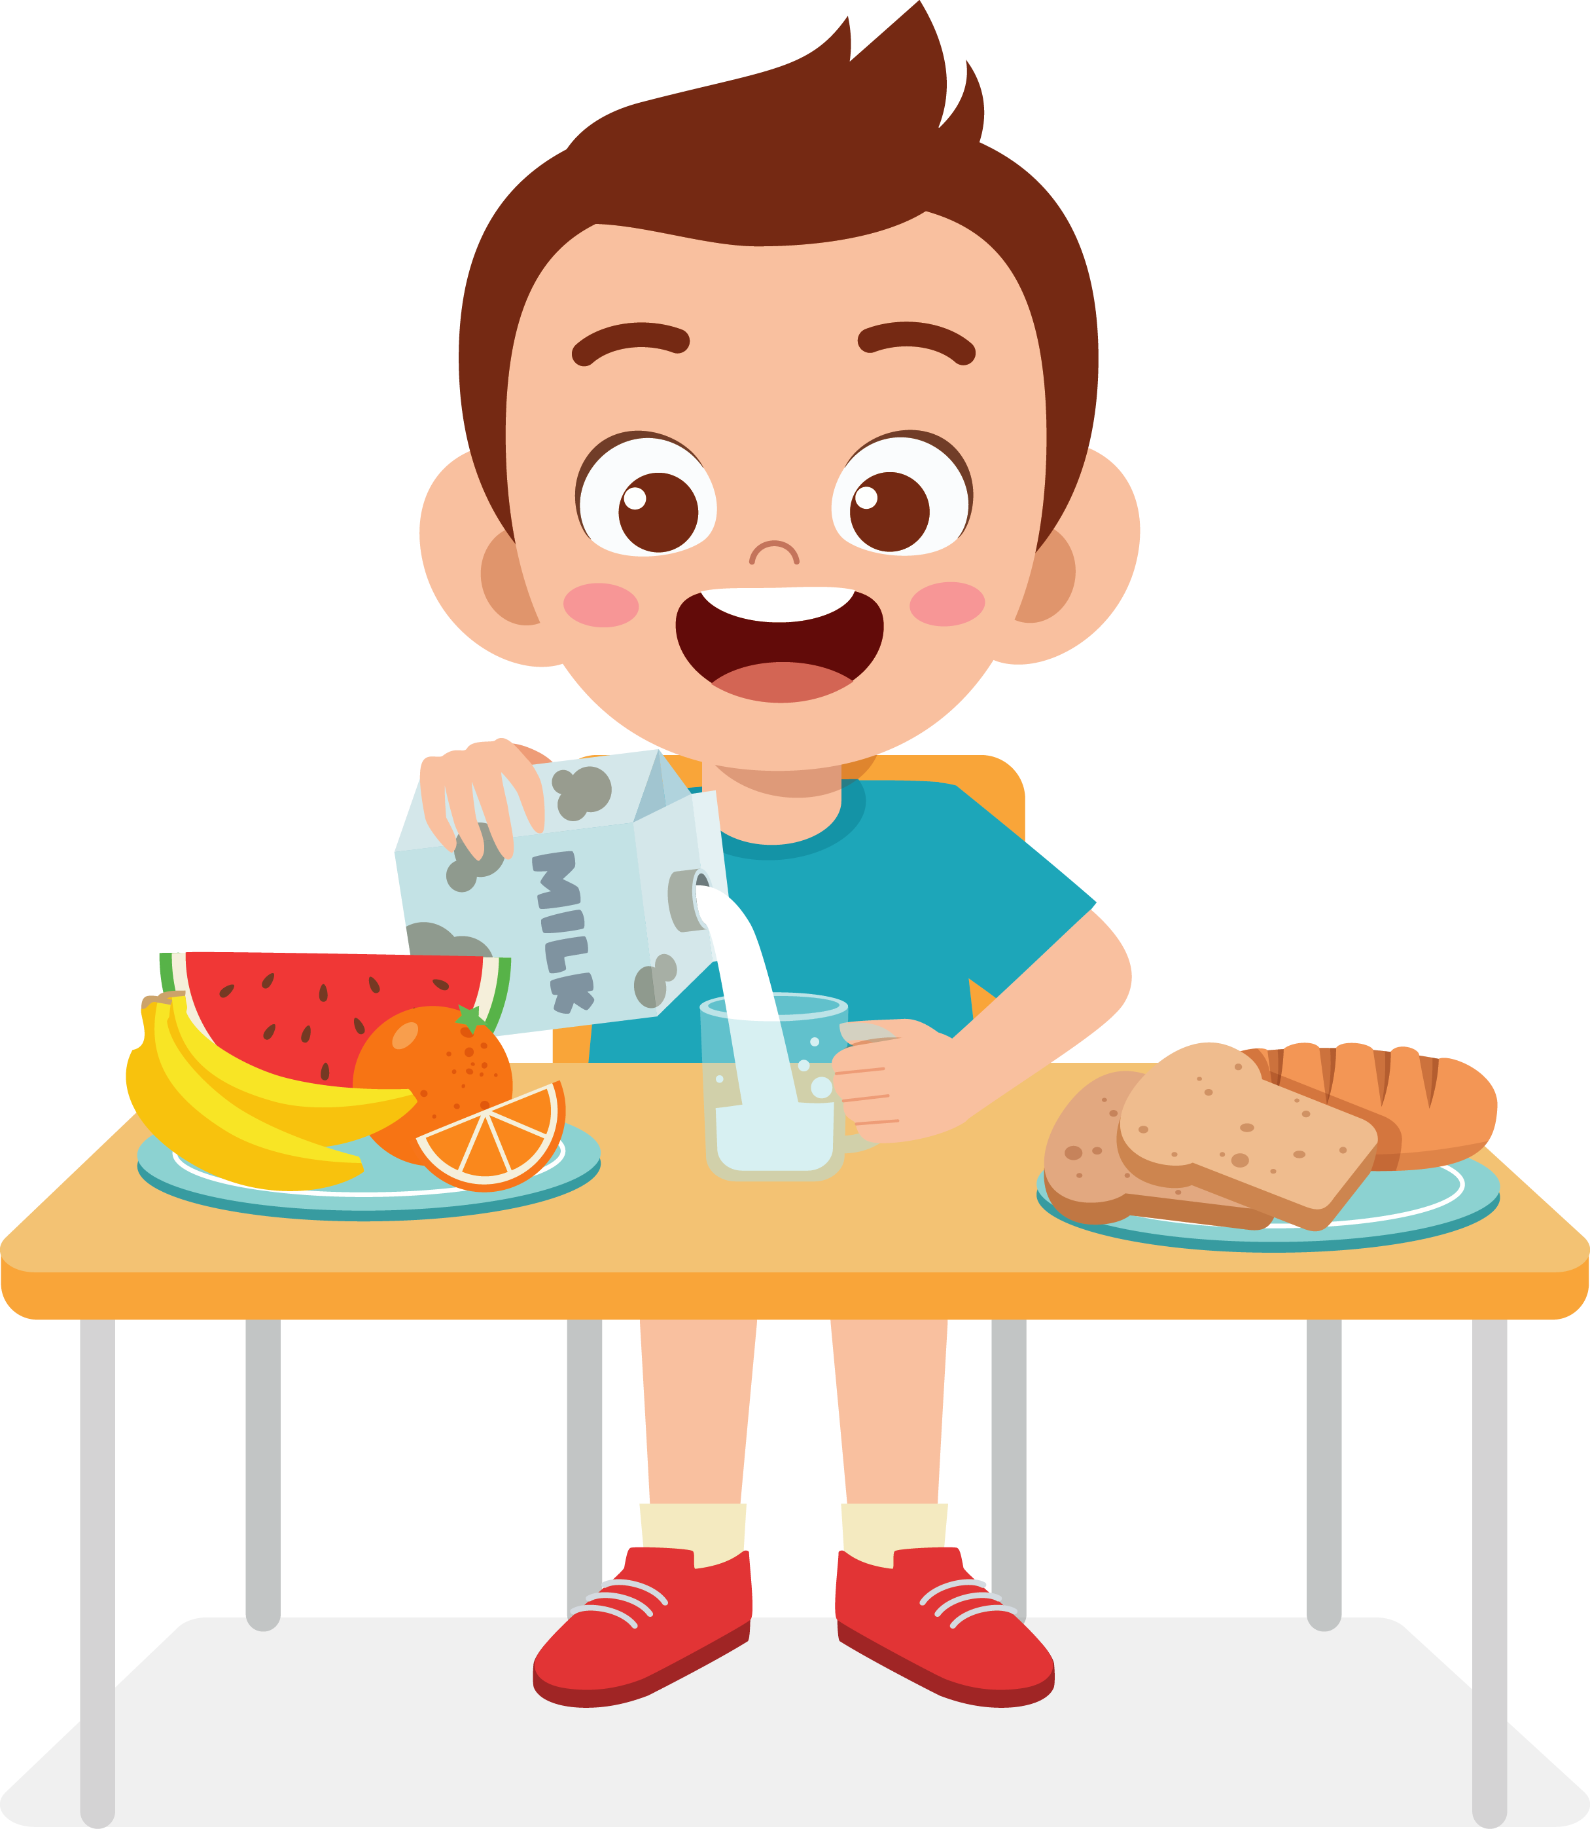
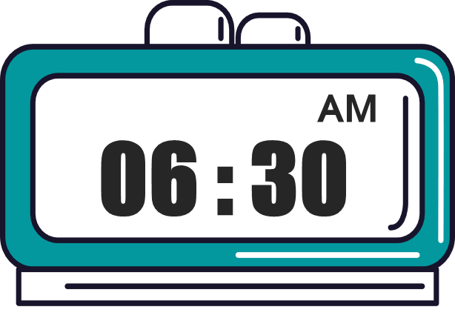
2
Cách hỏi bạn làm gì vào lúc mấy giờ.
What time do you _______?
(+ hoạt động)
I ________ at + ______.
(+ hoạt động)
(+ giờ)
Ex:
What time do you have breakfast?
MsPham
0936082789
I have breakfast at six thirty.

Slide 13
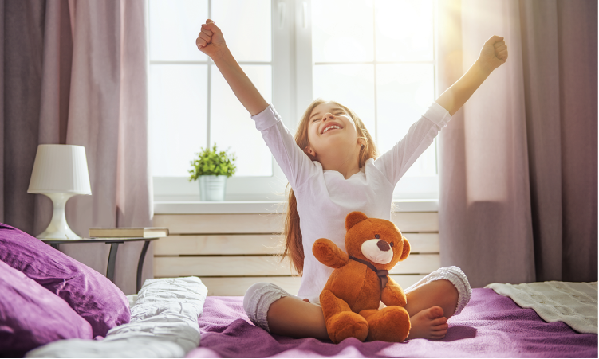
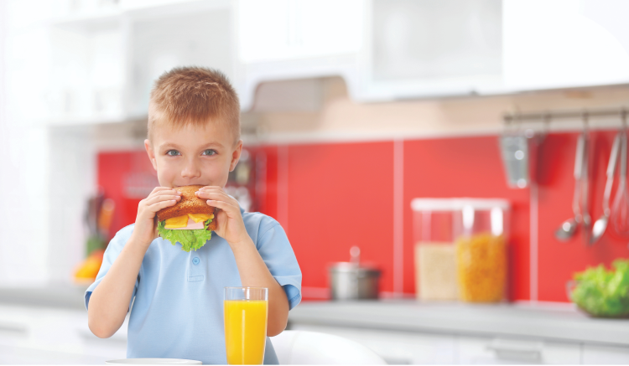
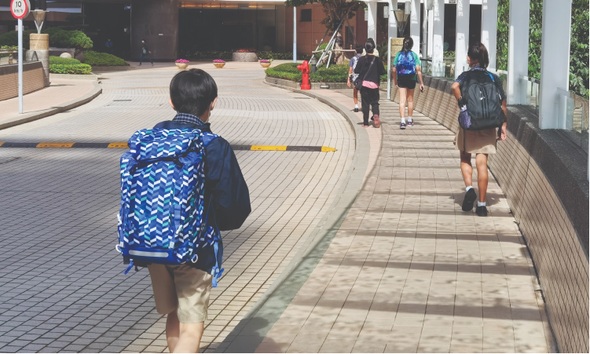
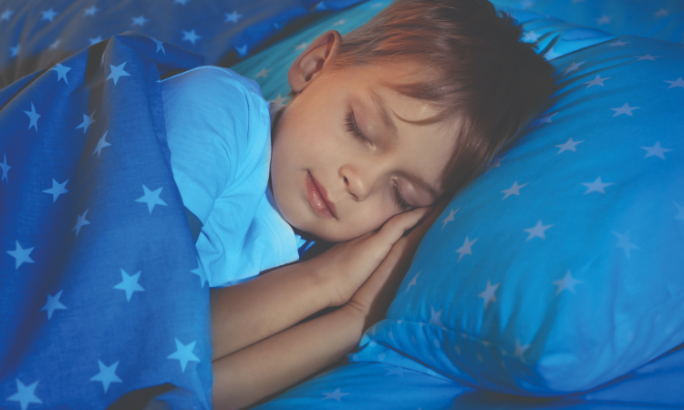
2
Listen, point and say.
a
b
get up
have breakfast
c
d
go to school
go to bed

Slide 14
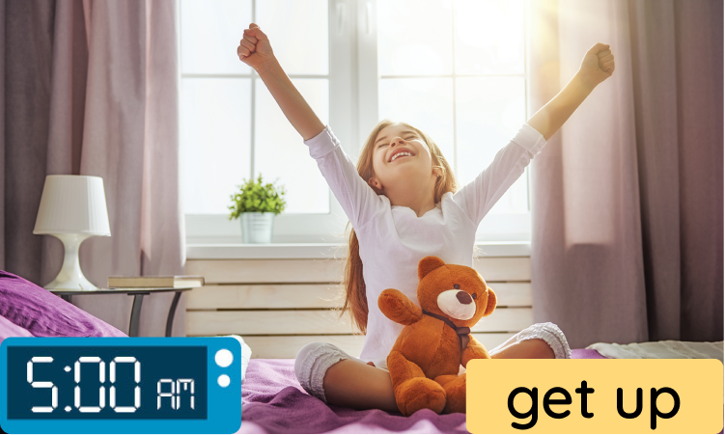
2
Listen, point and say.
What time do you get up?
I get up at five o’clock.
a
MsPham
0936082789

Slide 15
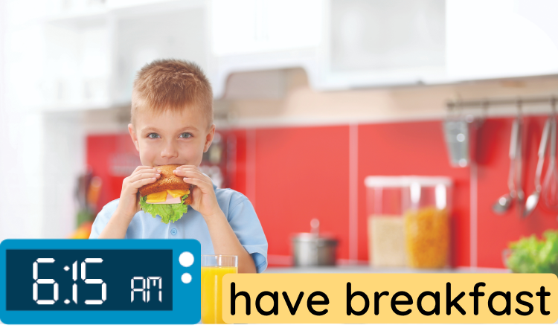
2
Listen, point and say.
What time do you have breakfast?
I have breakfast at six fifteen.
a
MsPham
0936082789

Slide 16
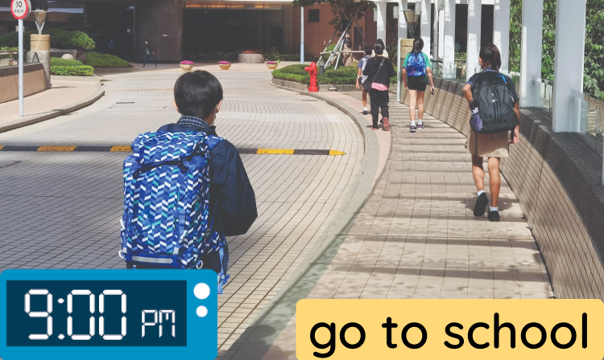
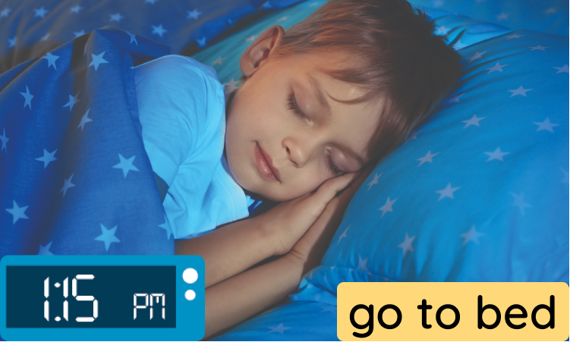
2
Listen, point and say.
What time do you go to school?
I go to school at one fifteen.
a
MsPham
0936082789

Slide 17
2
Listen, point and say.
What time do you go to bed?
I go to bed at nine o’clock.
a
MsPham
0936082789

Slide 18
2
Listen, point and say.
a
b
get up
have breakfast
c
d
go to school
go to bed

Slide 19





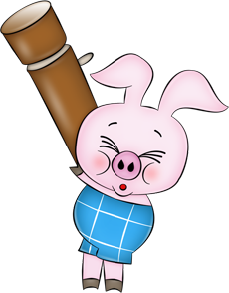
BALLOONS
START
Notes:
Click quả bóng để chọn câu trả lời đúng, sai quả bóng sẽ nổ. Đúng dc cộng điểm

Slide 20
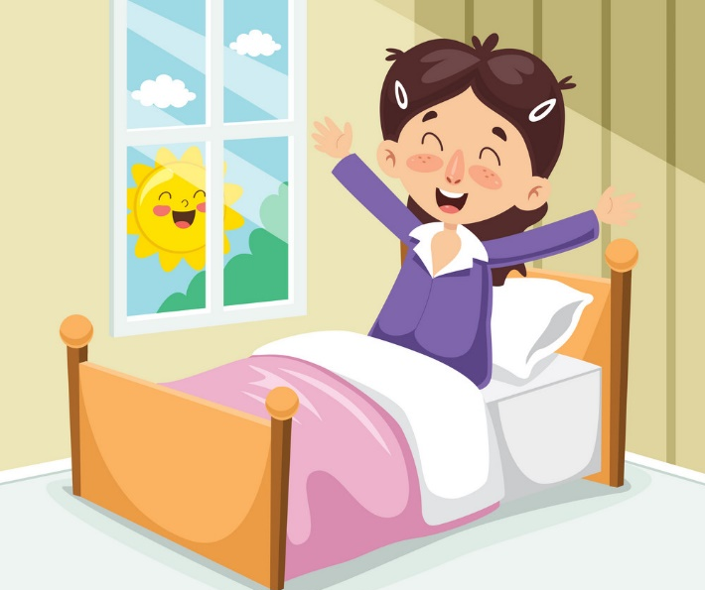
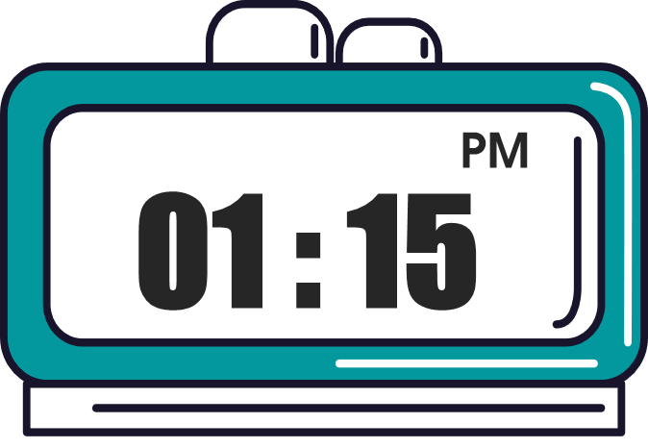
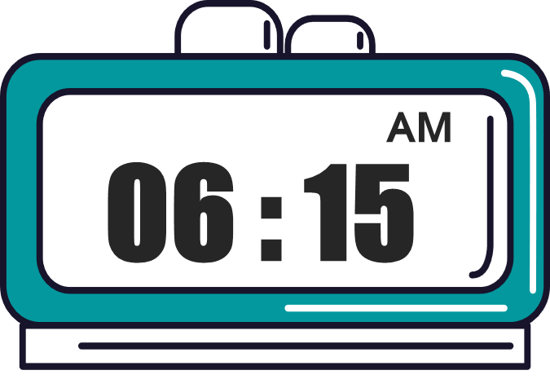
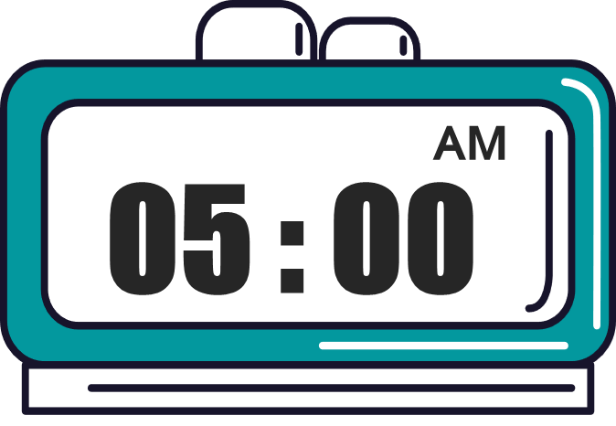

face
What time do you get up?
I get up at five o’clock.
face

Slide 21
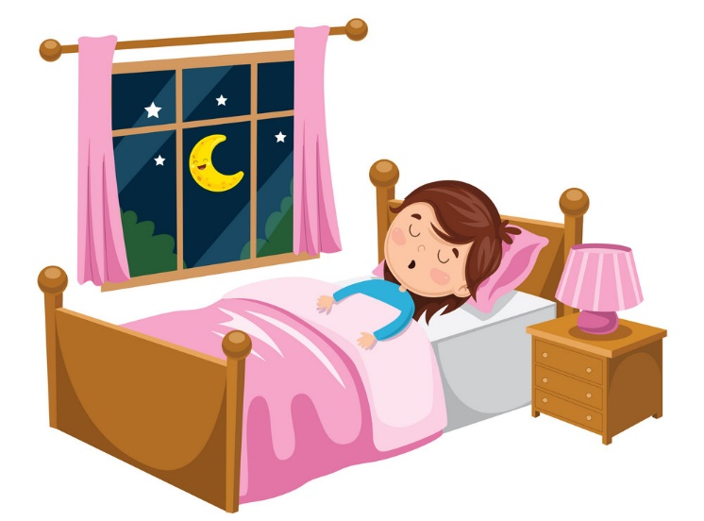

What time do you have breakfast?
I have breakfast at six fifteen.
blond hair.

Slide 22
ears
What time do you go to school?
I go to school at one fifteen.
ears

Slide 23
nose
What time do you go to bed?
I go to bed at nine o’clock.
nose

Slide 24
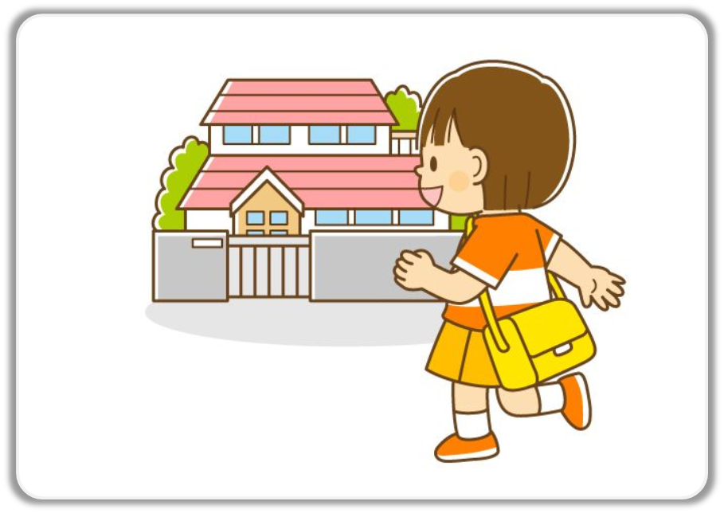
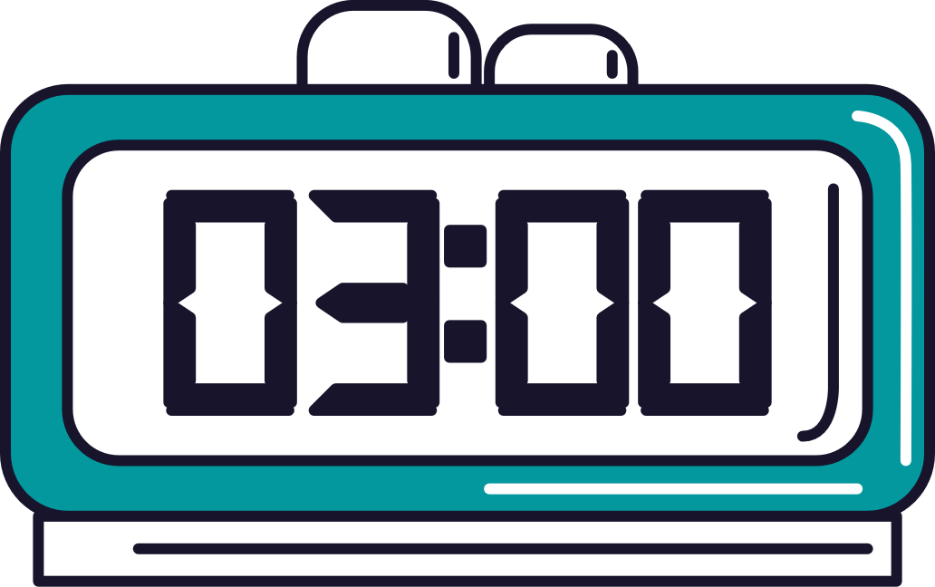
I go home at seven o’clock.
I go home at seven fifteen.
I go home at seven forty-five.
What time do you go home?
PM
07 : 45
MsPham
0936082789
MsPham
0936082789
brown eyes

Slide 25
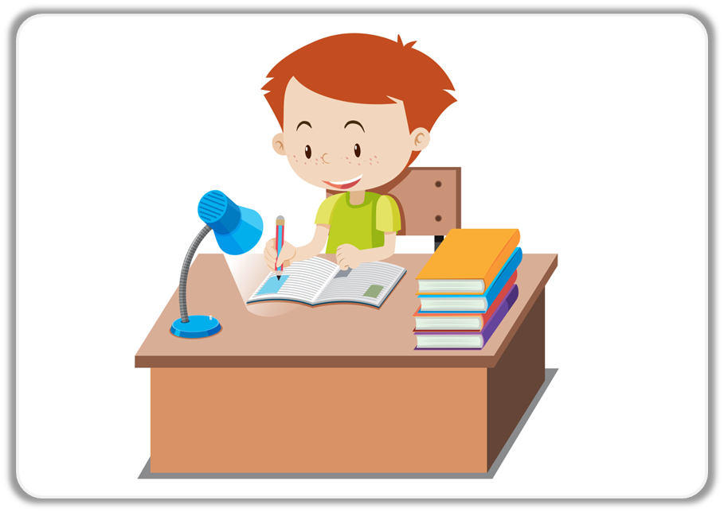
I do homework
at eight fifteen.
I do homework
at eight forty-five.
I do homework
at eight thirty.
What time do you do homework?
AM
08 : 15
MsPham
0936082789
MsPham
0936082789
ears

Slide 26

What time do you have lunch?
What time is it?
What time do you have dinner?
I have dinner at seven o’clock.
PM
07 : 00
MsPham
0936082789
MsPham
0936082789
mouth

Slide 27
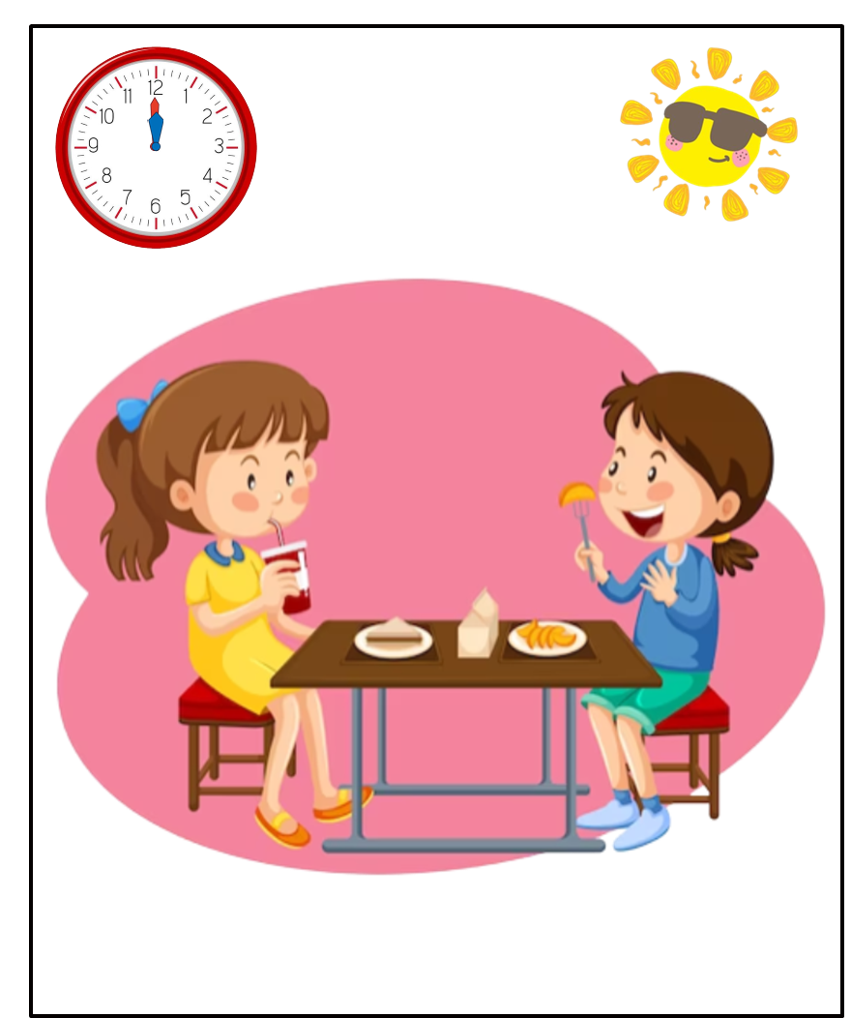
I have lunch at eleven o’clock.
I have lunch at eleven thirty.
I have dinner at eleven fifty.
What time do you have lunch?
AM
11 : 30
MsPham
0936082789
MsPham
0936082789
nose

Slide 28
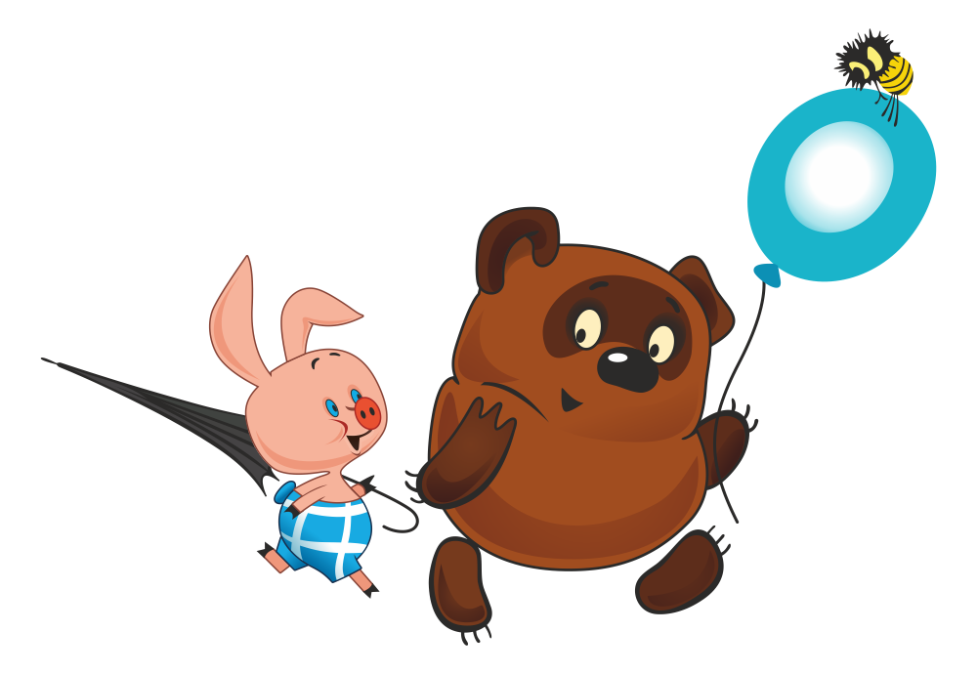
Well done!
END

Slide 29
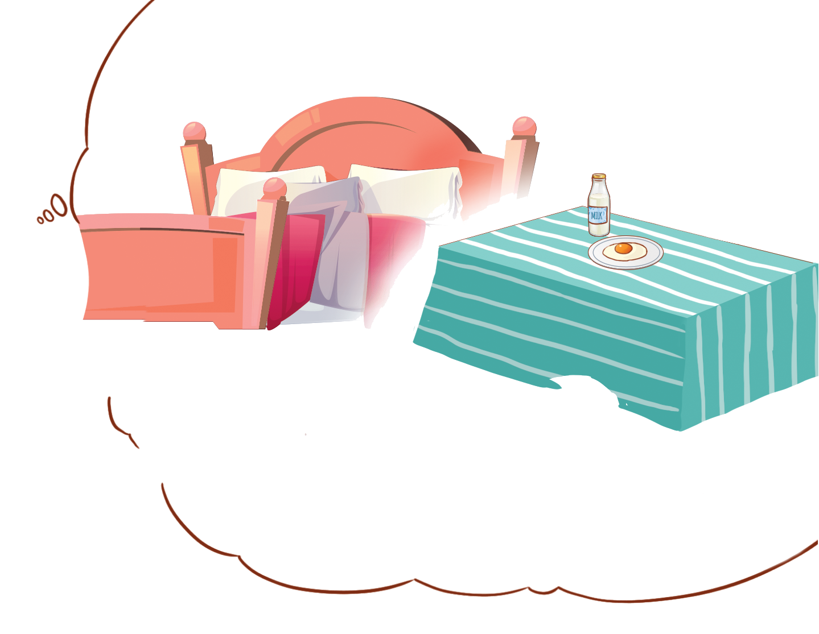
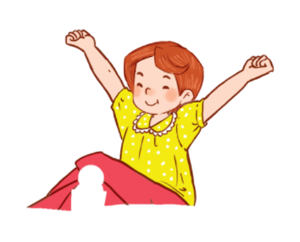

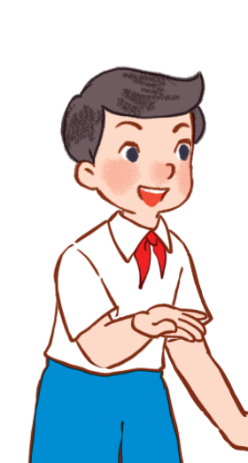

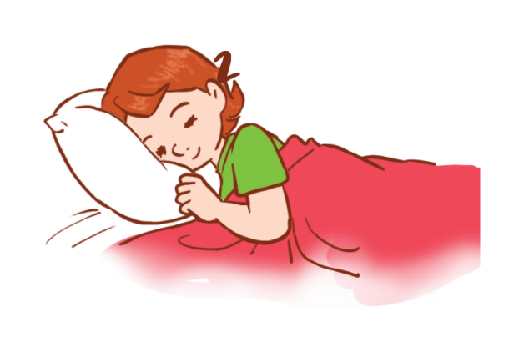
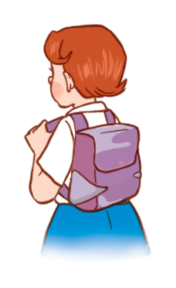
3
Let’s talk.
What time do you _______?
I ________ at ____________.

Slide 30
MsPham
0936082789
MsPham
0936082789
Review

Slide 31
What time do you _______?
I ________ at ________.
MsPham
0936082789
get up
go to bed
have breakfast
go to school

Slide 32
MsPham
0936082789
Thank you!

