Slide 1


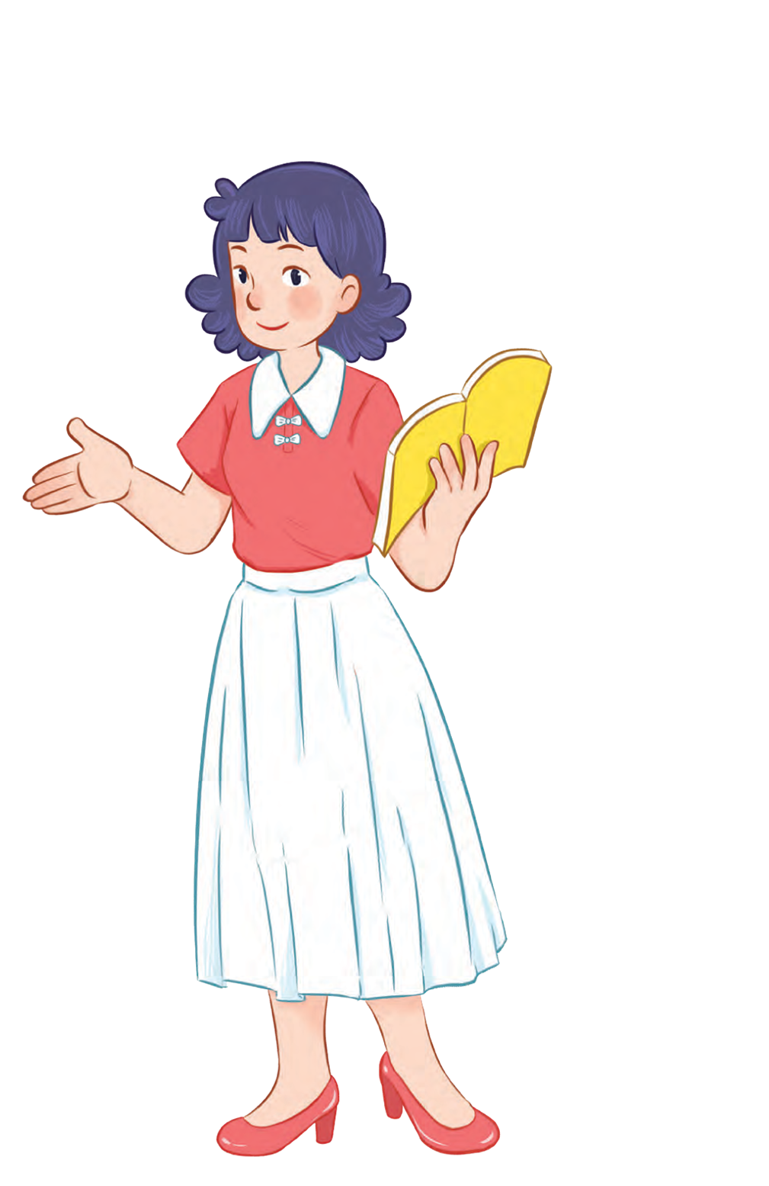
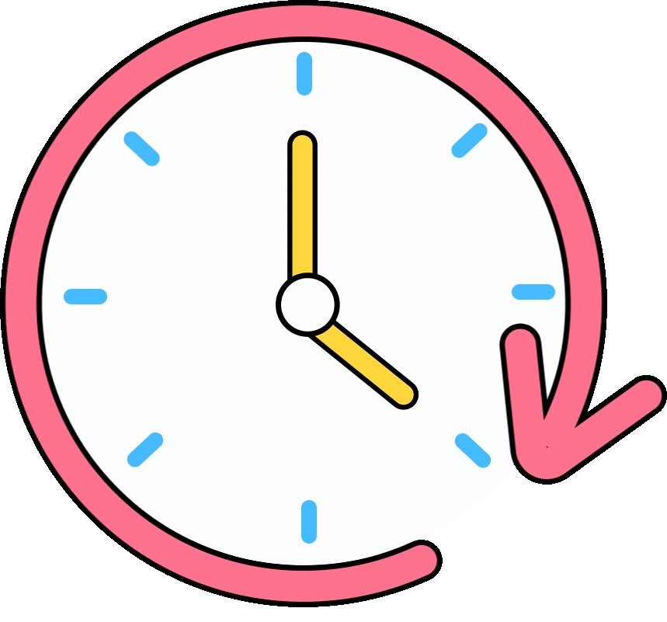


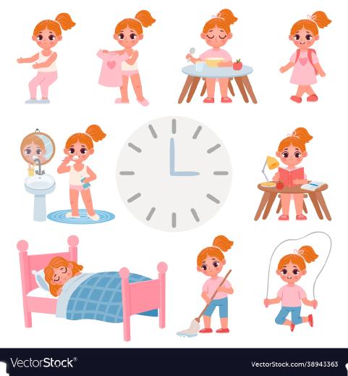


Unit 2
Time and
daily routine
MsPham
0936082789
Lesson 2 – Period 2

Slide 2
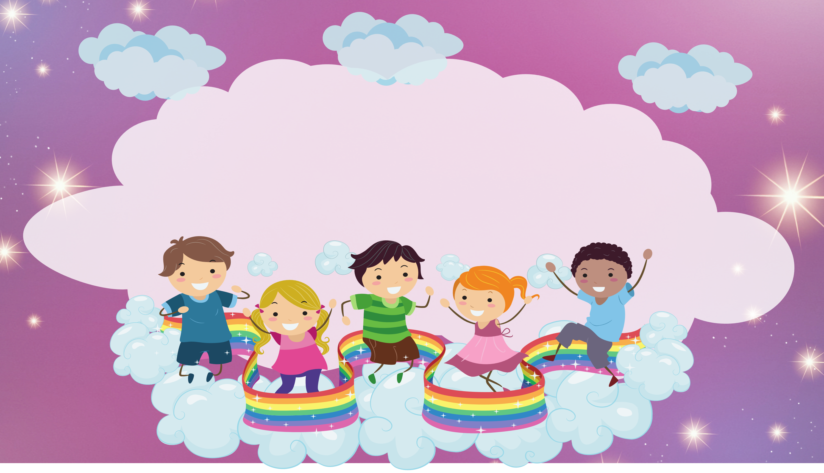
Warm up

Slide 3

Let’s check!
PLAY
Notes:
Ms Huyền Phạm - 0936.082.789 – YOUTUBE: MsPham. Facebook: Dạy và học cùng công nghệ.

Slide 4
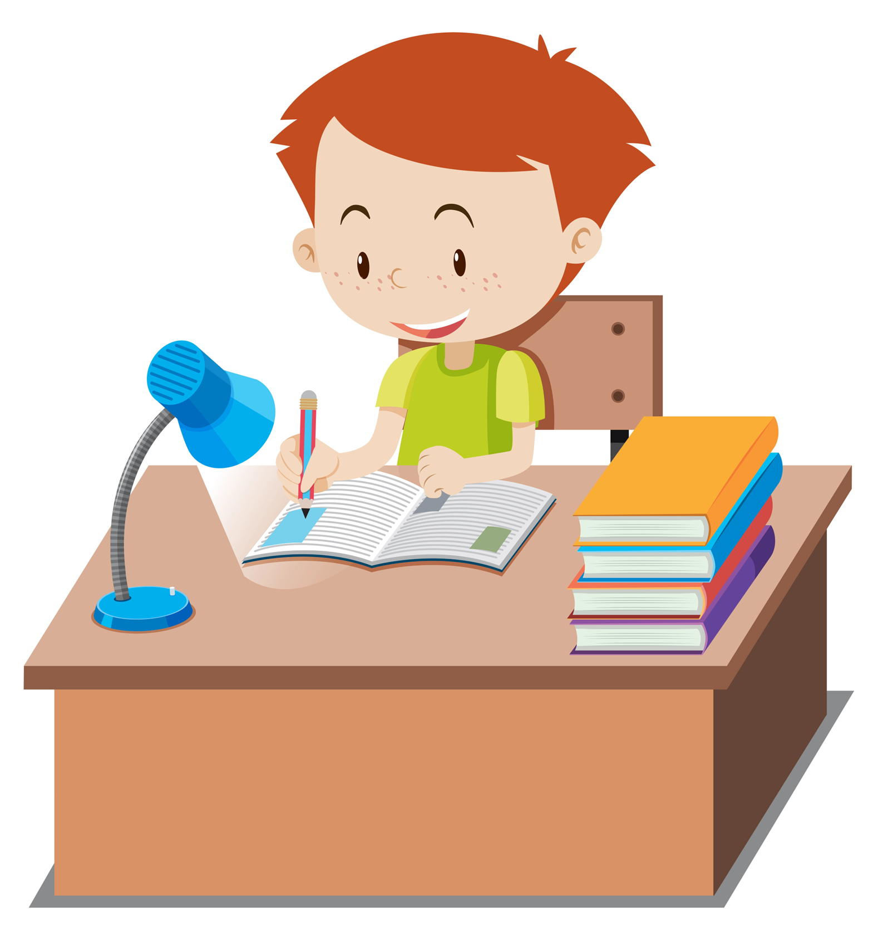
What is the word missing?
__ __ homework
d o
Answer
Next

Slide 5
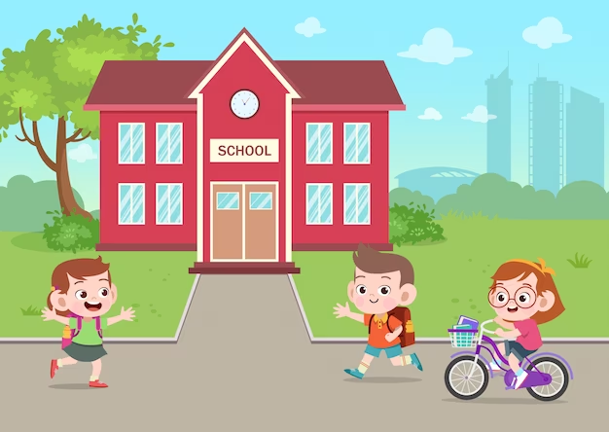
What is the word missing?
__ __ to school
g o
Answer
Next

Slide 6
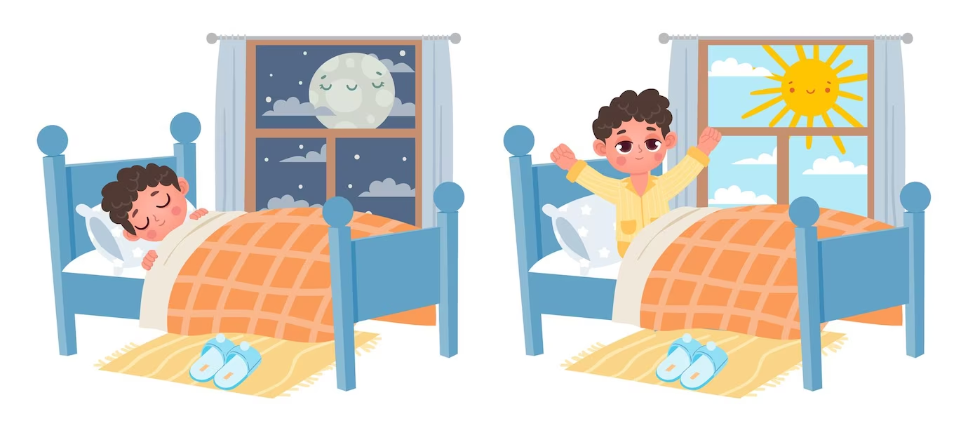
What is the word missing?
go to __ __ __
b e d
Answer
Next

Slide 7
What is the word missing?
__ __ __ up
g e t
Answer
Next

Slide 8
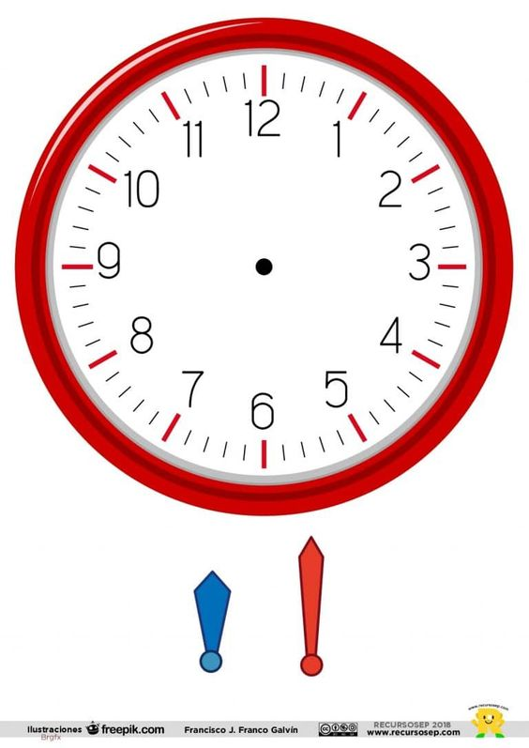


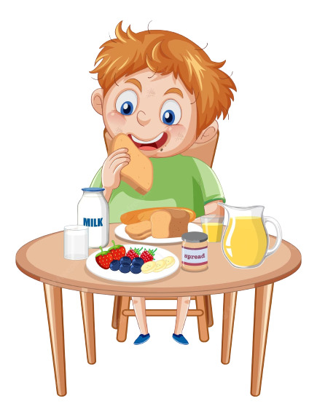
What is the word missing?
__ __ __ __ breakfast
h a v e
Answer
Next

Slide 9
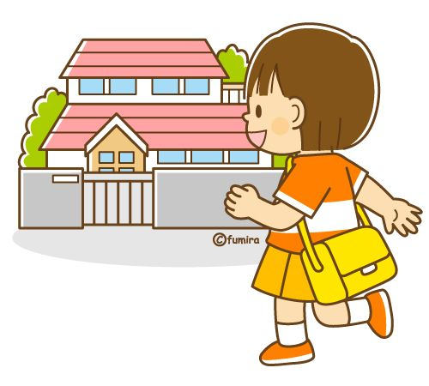
What is the word missing?
go __ __ __ __
h o m e
Answer
Next

Slide 10

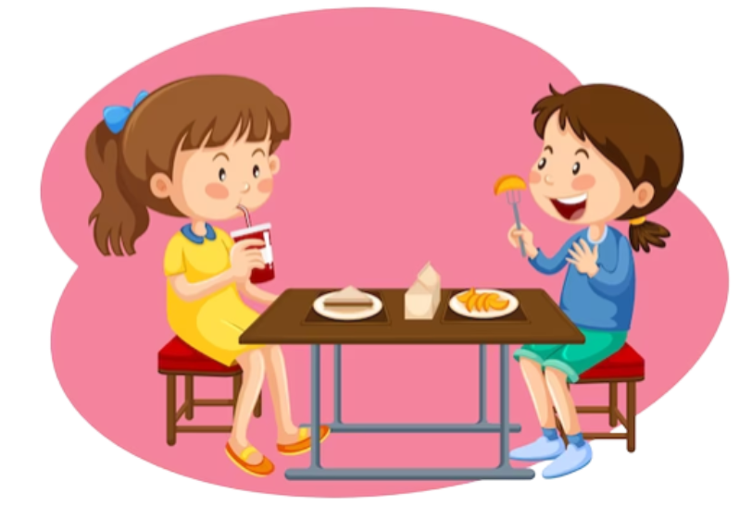
What is the word missing?
have __ __ __ __ __
l u n c h
Answer
Next

Slide 11
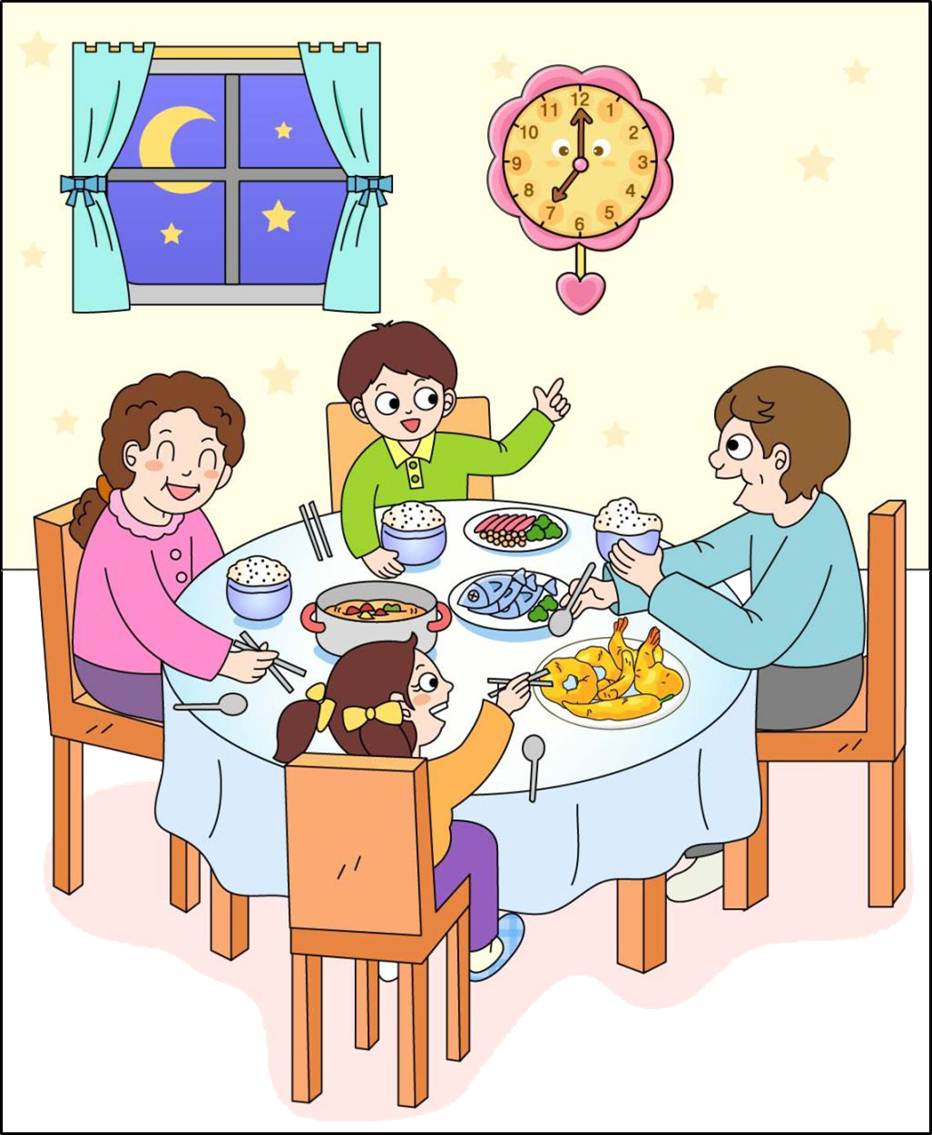
What is the word missing?
have __ __ __ __ __ __
d i n n e r
Answer
Next

Slide 12
Great job!
s
EXIT
Notes:
Ms Huyền Phạm - 0936.082.789 – YOUTUBE: MsPham. Facebook: Dạy và học cùng công nghệ.

Slide 13
MsPham
0936082789
MsPham
0936082789
Review

Slide 14
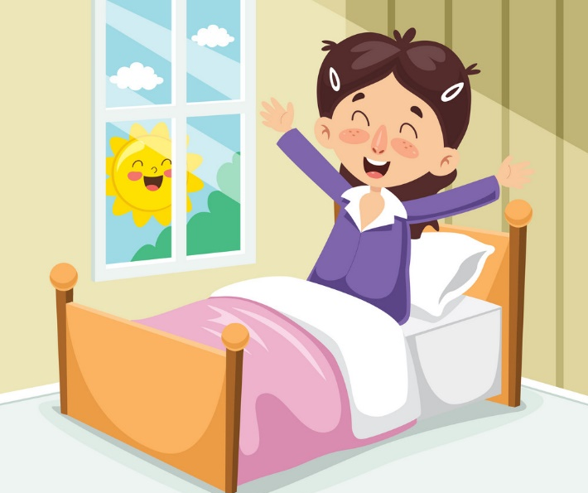
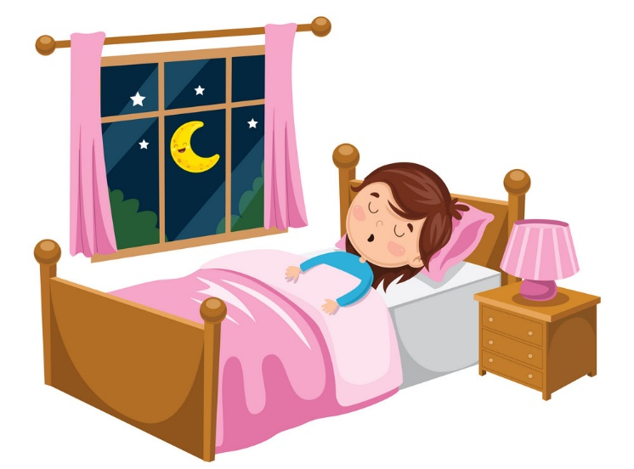
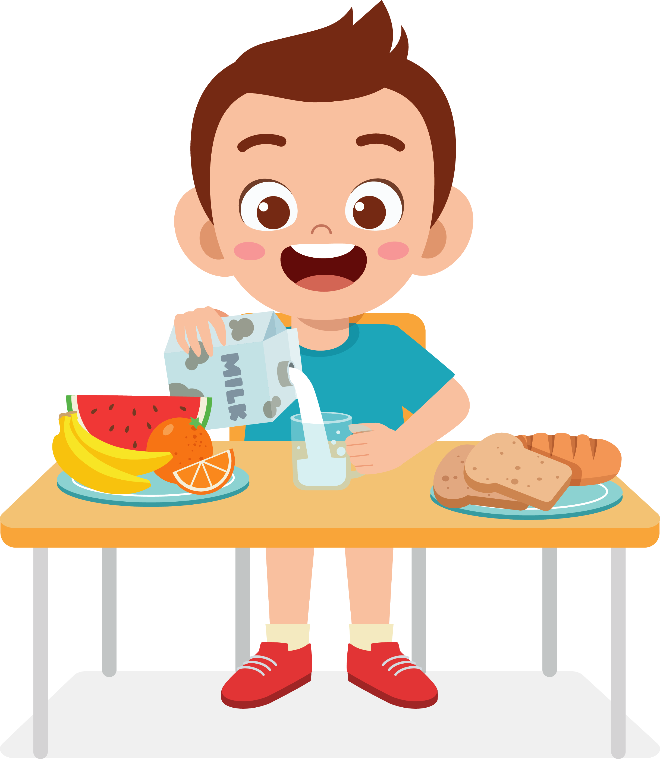
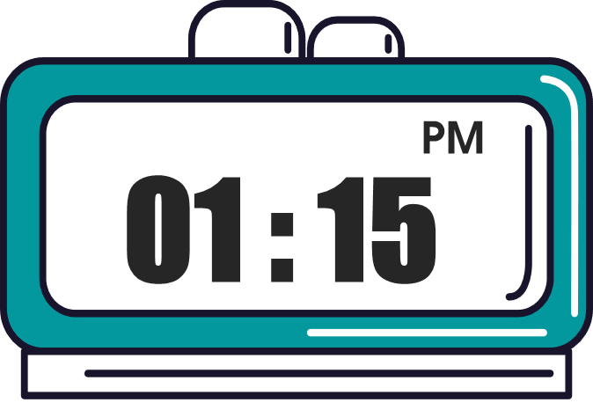
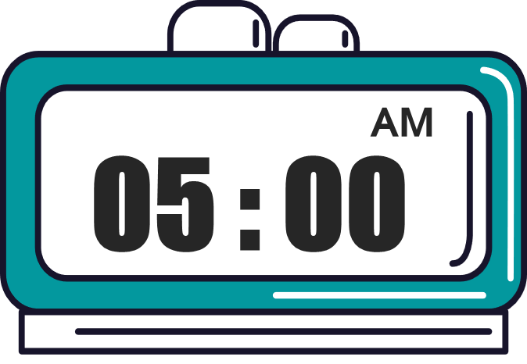

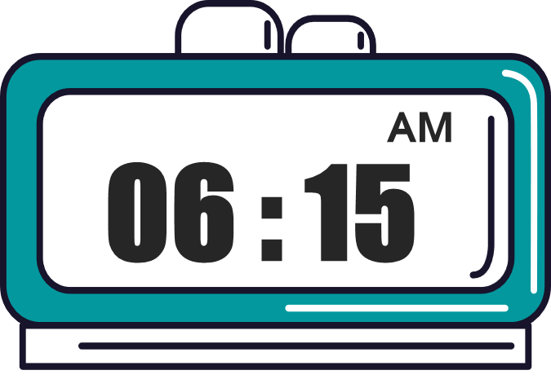
What time do you _______?
I ________ at ________.
MsPham
0936082789
get up
go to bed
have breakfast
go to school

Slide 15
MsPham
0936082789
MsPham
0936082789
Practice

Slide 16
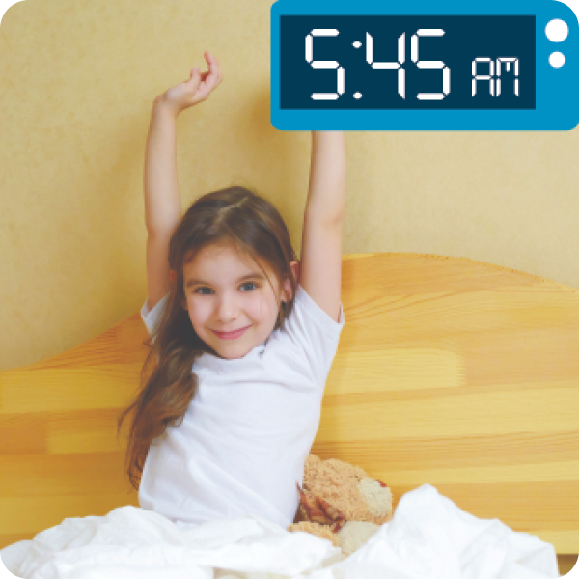
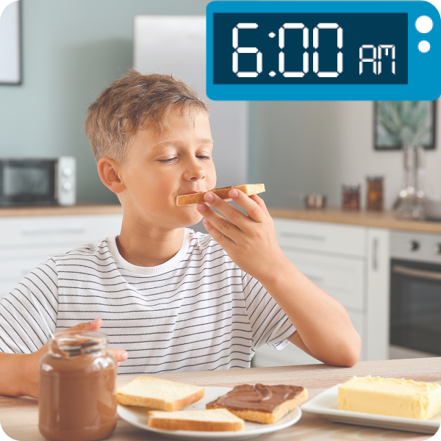
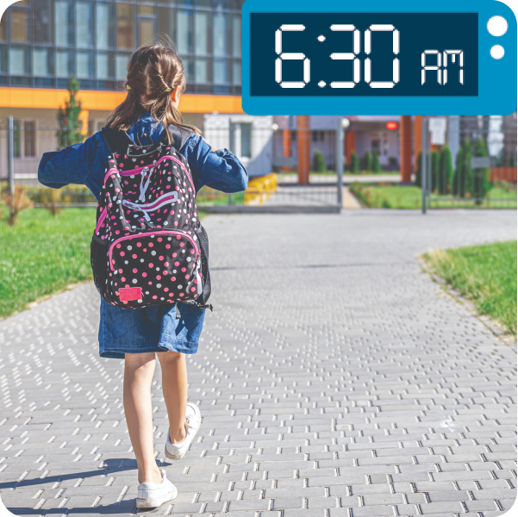
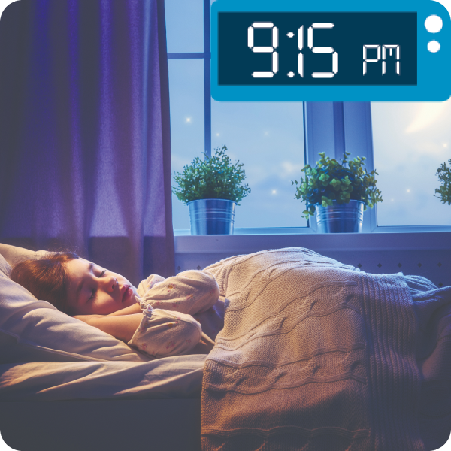

4
Listen and number.
a
3
b
4
c
2
d
1
1
2
3
4

Slide 17
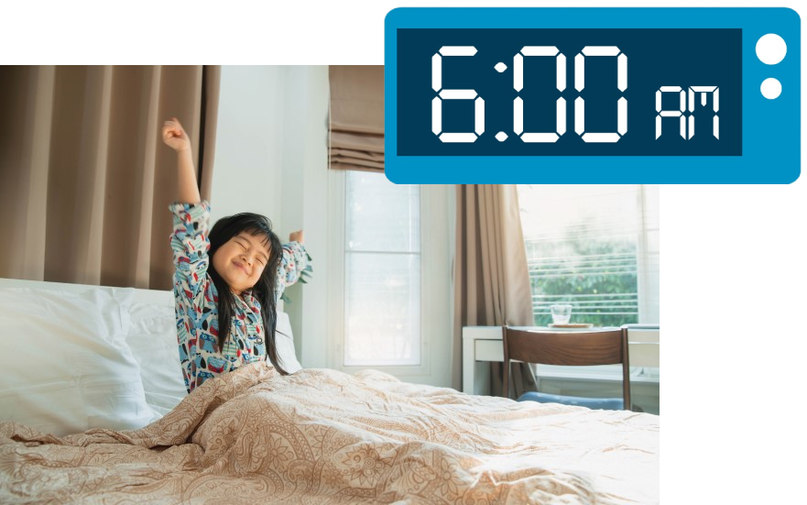
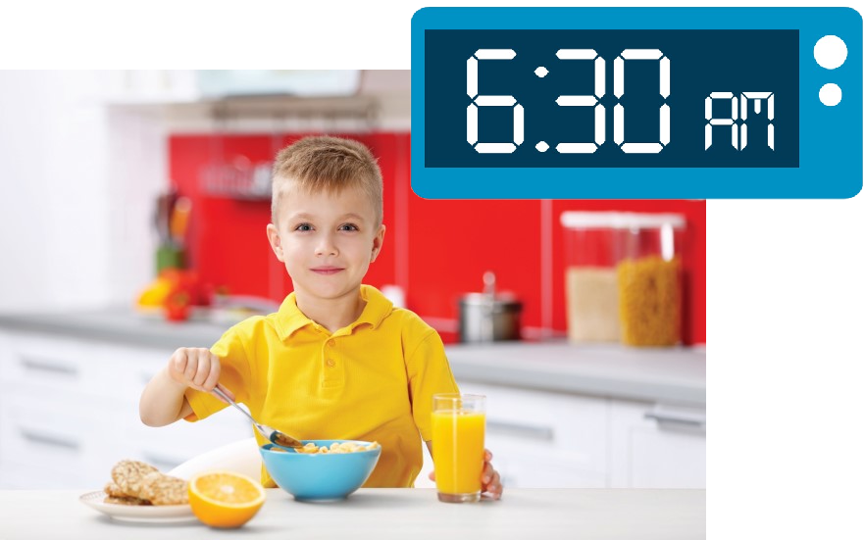
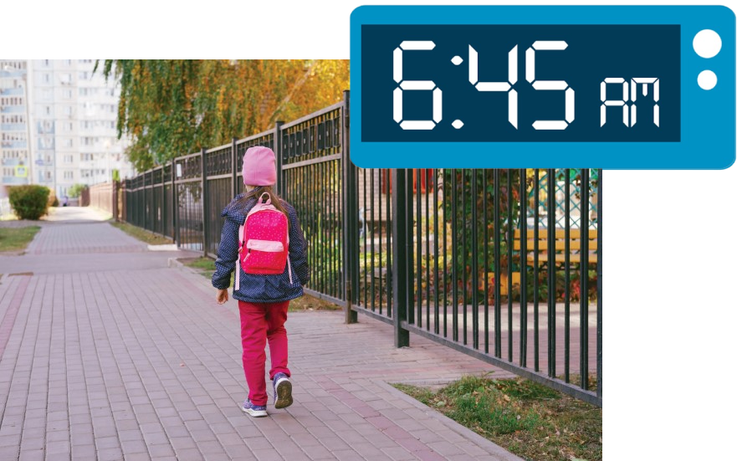
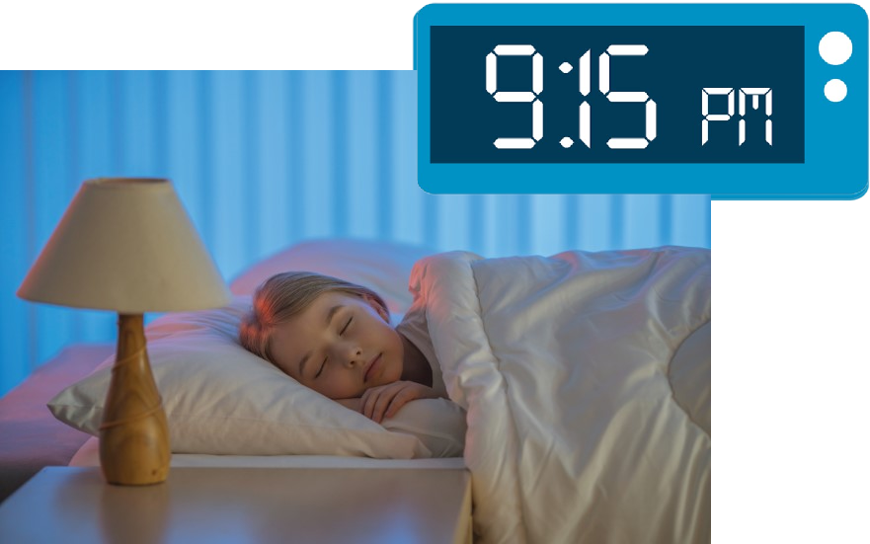
5
Look, complete and read.
1.
2.
A: What time do you get up?
B: I get up at ___________.
A: What time do you have breakfast?
B: I have breakfast at ___________.
six o’clock
six thirty
3.
4.
What time
go to bed
A: _________do you go to school?
B: I go to school at ____________.
A: What time do you __________?
B: I _________ at ___________.
six forty-five
go to bed
nine fifteen

Slide 18
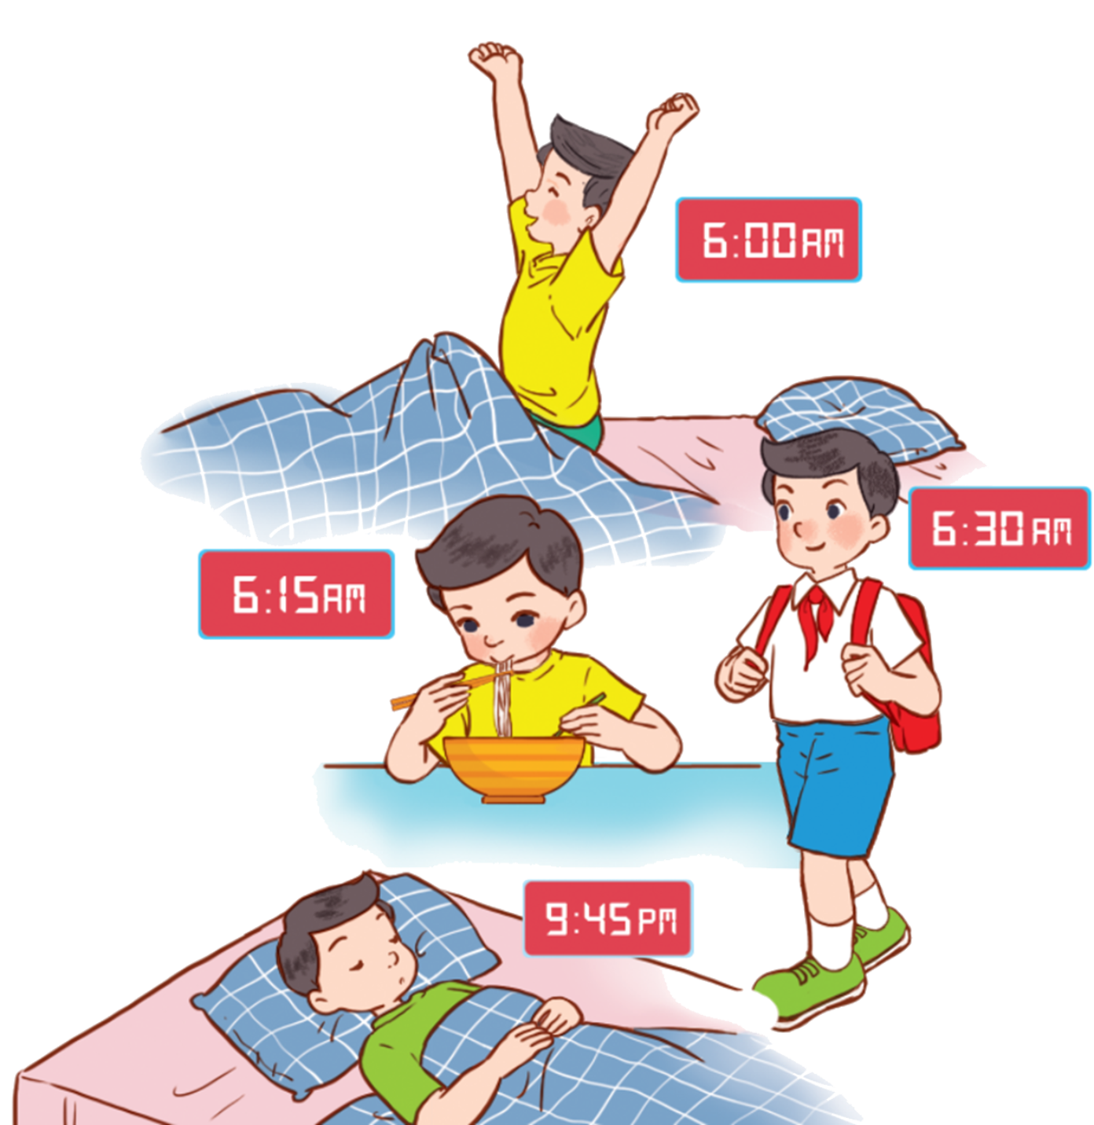
6
Let’s sing.
What time do you go to school?
What time do you get up?
What time do you get up?
What time do you get up?
What time do you get up?
I get up at six o’clock.
I get up at six o’clock.
I get up at six o’clock.
I get up at six o’clock.
What time do you have breakfast?
What time do you have breakfast?
What time do you have breakfast?
What time do you have breakfast?
I have breakfast at six fifteen.
I have breakfast at six fifteen.
I have breakfast at six fifteen.
I have breakfast at six fifteen.
What time do you go to school?
What time do you go to school?
What time do you go to school?
What time do you go to school?
I go to school at six thirty.
I go to school at six thirty.
I go to school at six thirty.
I go to school at six thirty.
What time do you go to bed?
What time do you go to bed?
What time do you go to bed?
What time do you go to bed?
I go to bed at nine forty-five.
I go to bed at nine forty-five.
I go to bed at nine forty-five.
I go to bed at nine forty-five.
Hind

Slide 19
6
Let’s sing.
What time do you go to school?
What time do you get up?
What time do you get up?
I get up at six o’clock.
I get up at six o’clock.
What time do you have breakfast?
What time do you have breakfast?
I have breakfast at six fifteen.
I have breakfast at six fifteen.
What time do you go to school?
What time do you go to school?
I go to school at six thirty.
I go to school at six thirty.
What time do you go to bed?
What time do you go to bed?
I go to bed at nine forty-five.
I go to bed at nine forty-five.

Slide 20
MsPham
0936082789
Thank you!

