Slide 1


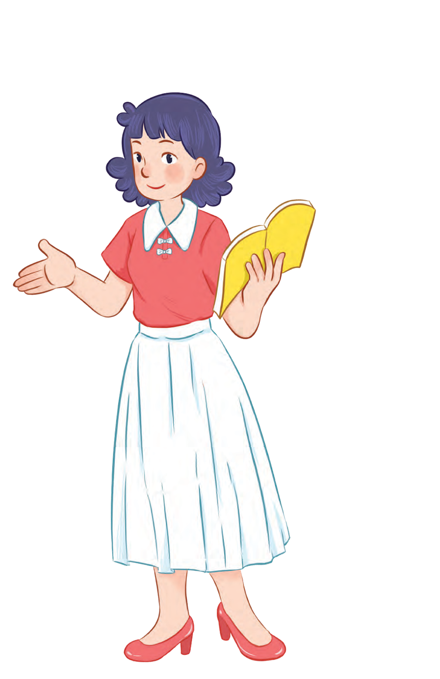



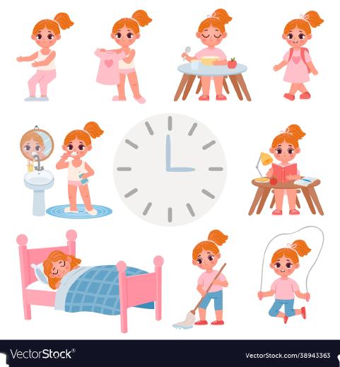


Unit 2
Time and
daily routine
MsPham
0936082789
Lesson 3 – Period 2

Slide 2

Warm up

Slide 3



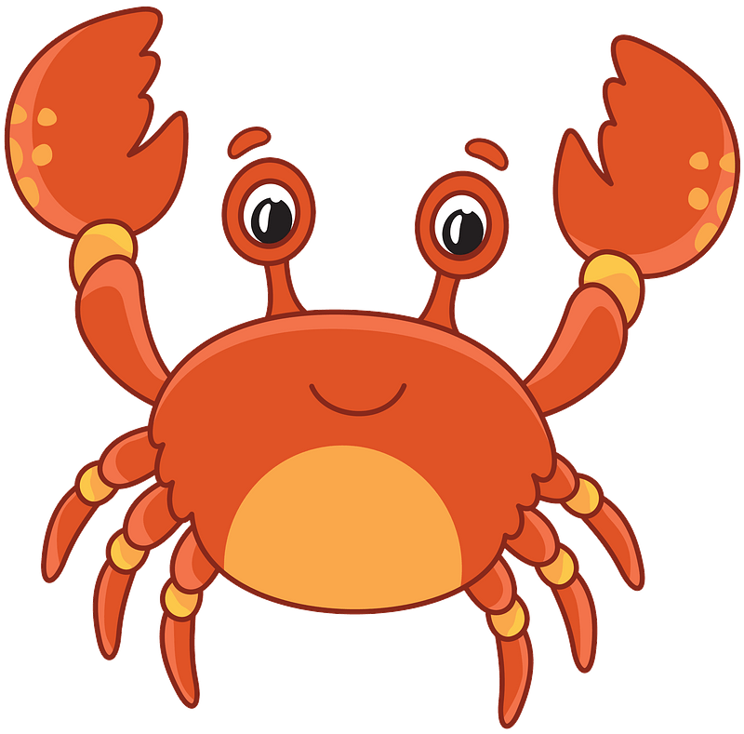



THE FUNNY CRAB
MsPham-0936082789
START

Slide 4
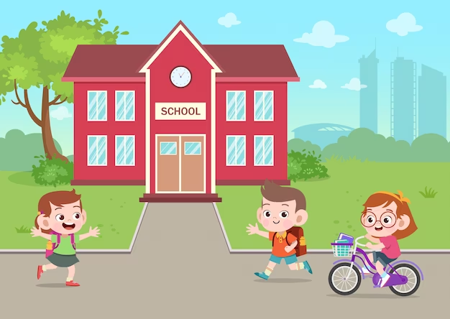

MsPham-0936082789
MsPham-0936082789
go to school
I ___________ at seven fifteen.
Next
Check

Slide 5
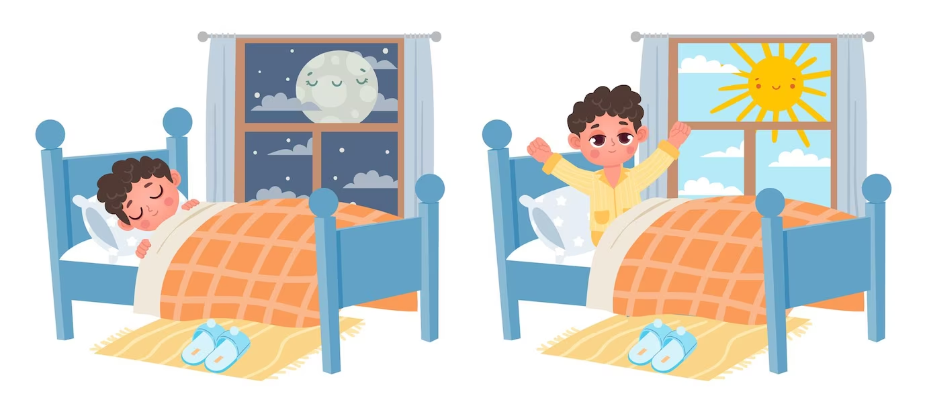
MsPham-0936082789
MsPham-0936082789
go to bed
I ___________ at nine thirty.
Next
Check

Slide 6
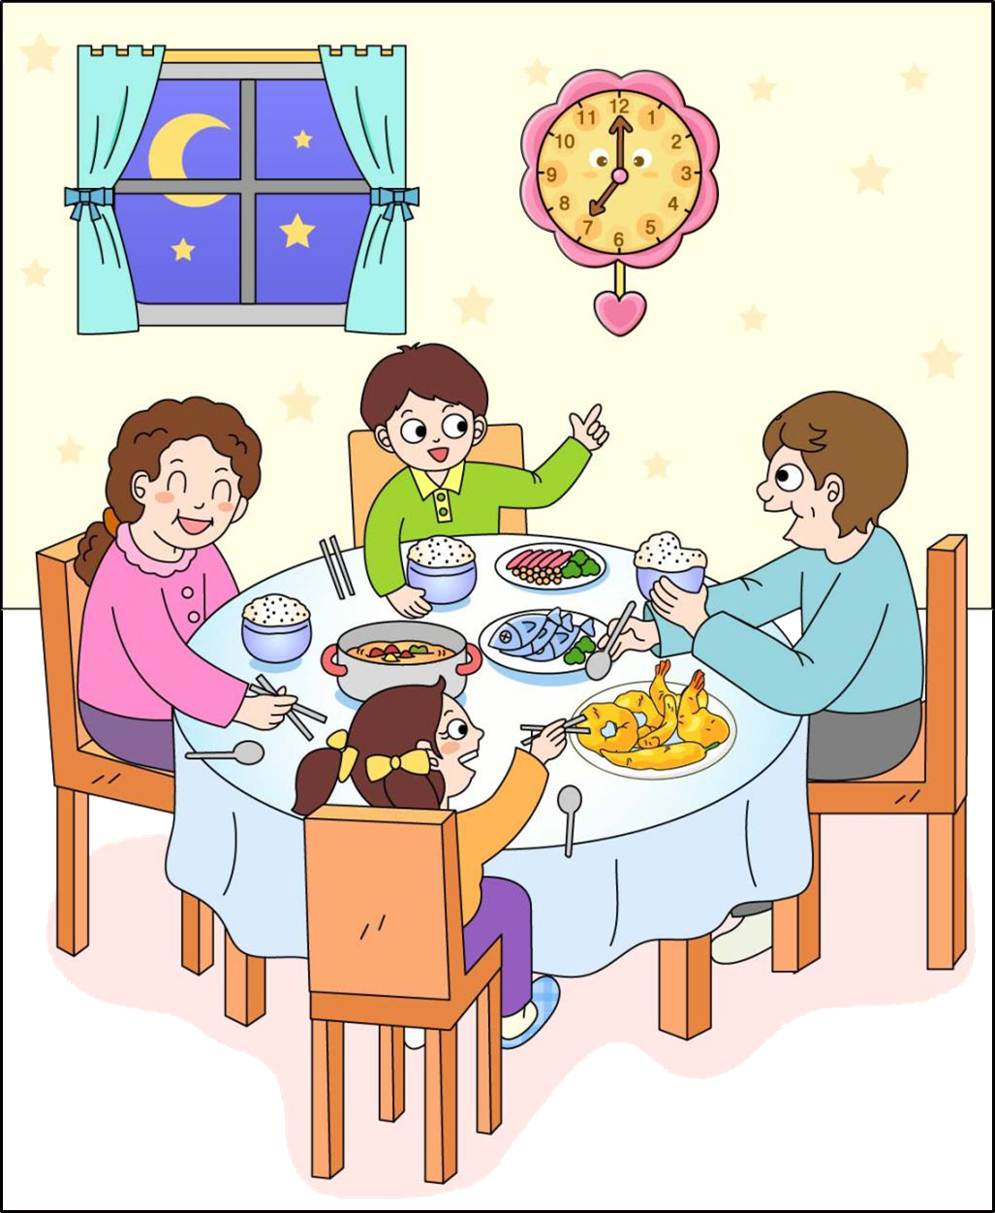
MsPham-0936082789
MsPham-0936082789
I have dinner.
I ___________ at seven o’clock.
Next
Check

Slide 7
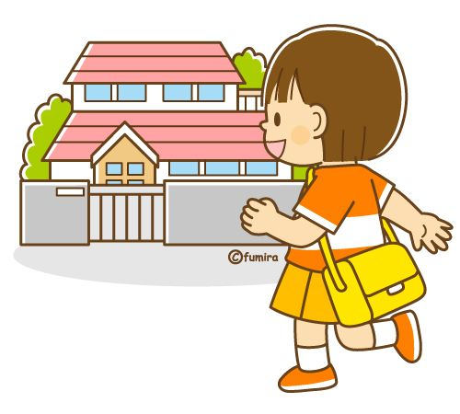
MsPham-0936082789
MsPham-0936082789
go home
I ___________ at five forty-five.
Next
Check

Slide 8


MsPham-0936082789
MsPham-0936082789
I do homework at seven thirty.
What time do you do homework?
Next
Check

Slide 9
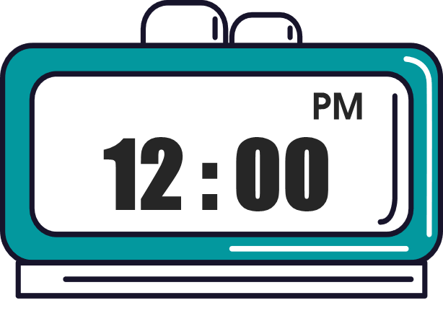


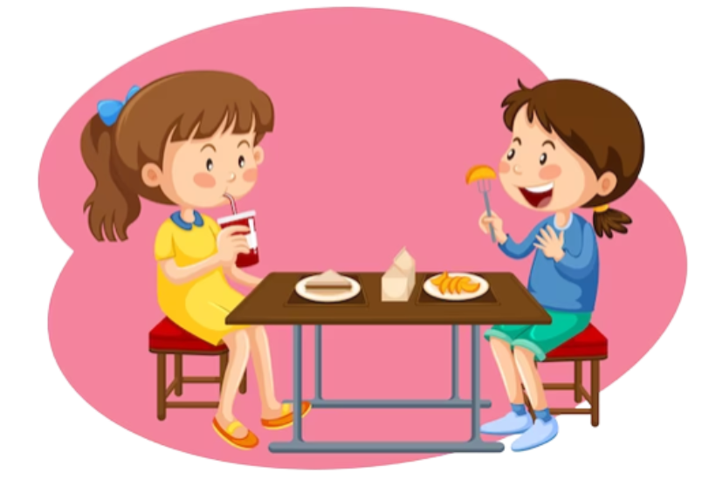
MsPham-0936082789
MsPham-0936082789
I have lunch at twelve o’clock.
What time do you have lunch?
Next
Check

Slide 10
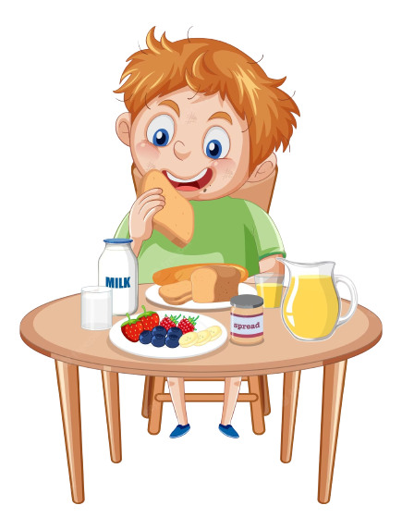
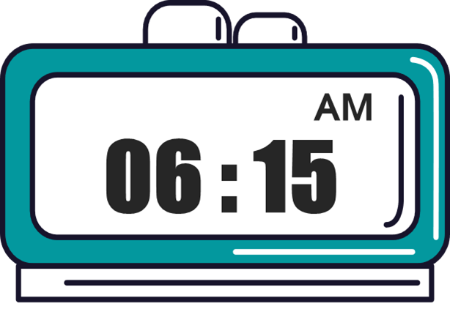
MsPham-0936082789
MsPham-0936082789
I have breakfast at six fifteen.
What time do you have breakfast?
Next
Check

Slide 11
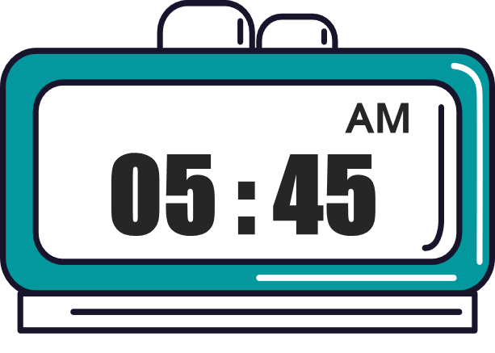
MsPham-0936082789
MsPham-0936082789
I get up at five forty-five.
What time do you get up?
Next
Check

Slide 12
Goodjob!
MsPham-0936082789
Exit

Slide 13
MsPham
0936082789
MsPham
0936082789
Review

Slide 14
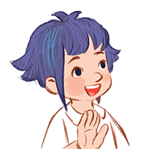
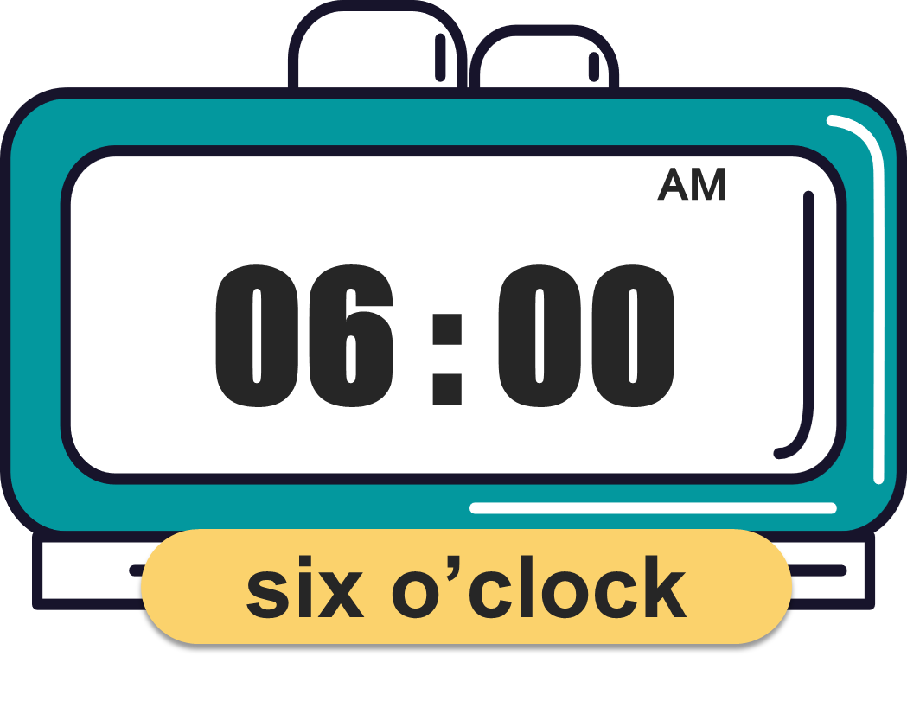
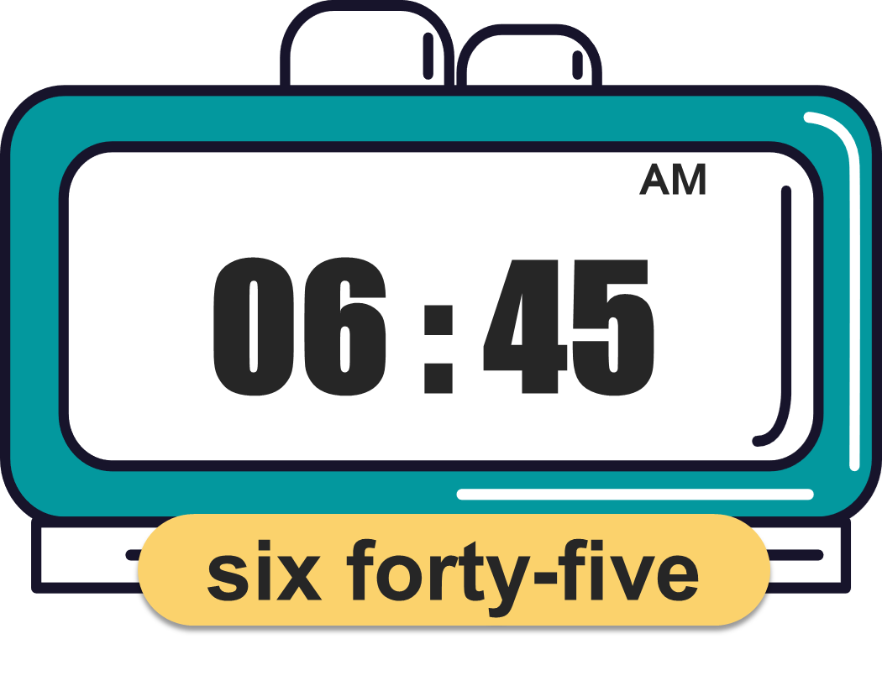
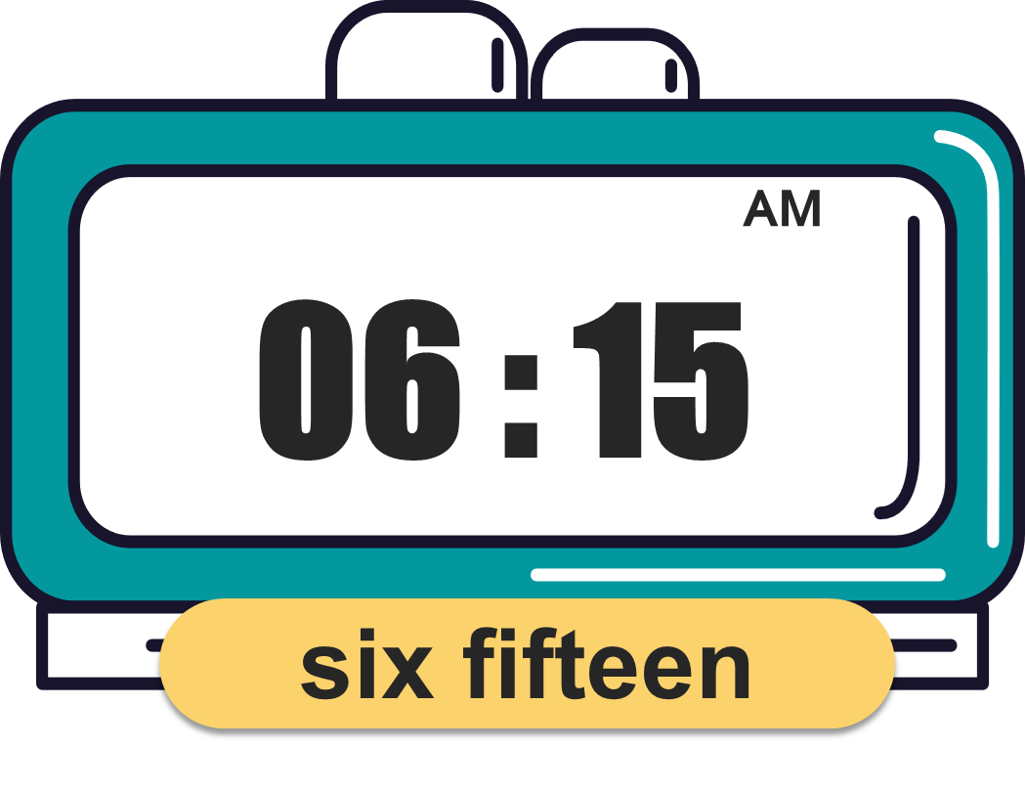
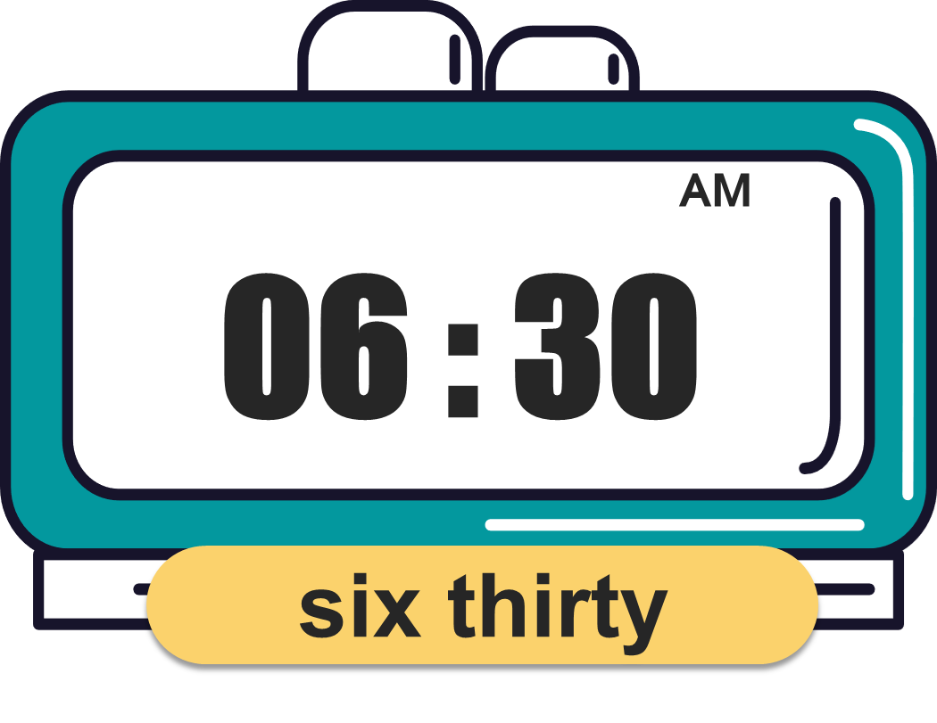
What time is it?
(Mấy giờ rồi?)
MsPham
0936082789
It’s _________.
(____)
MsPham
0936082789

Slide 15
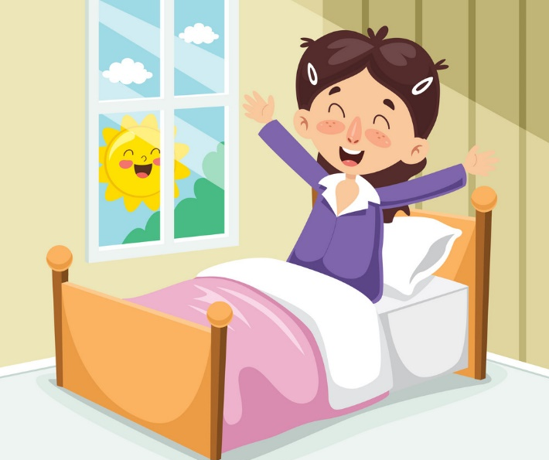
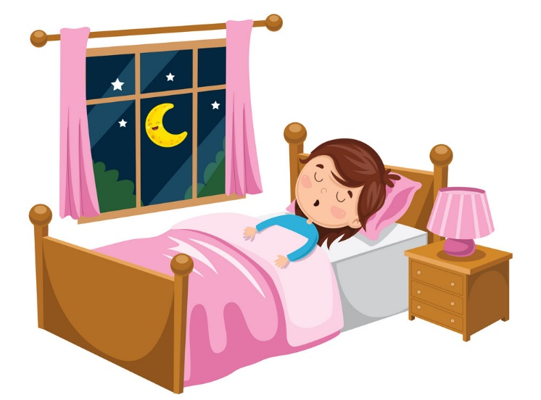

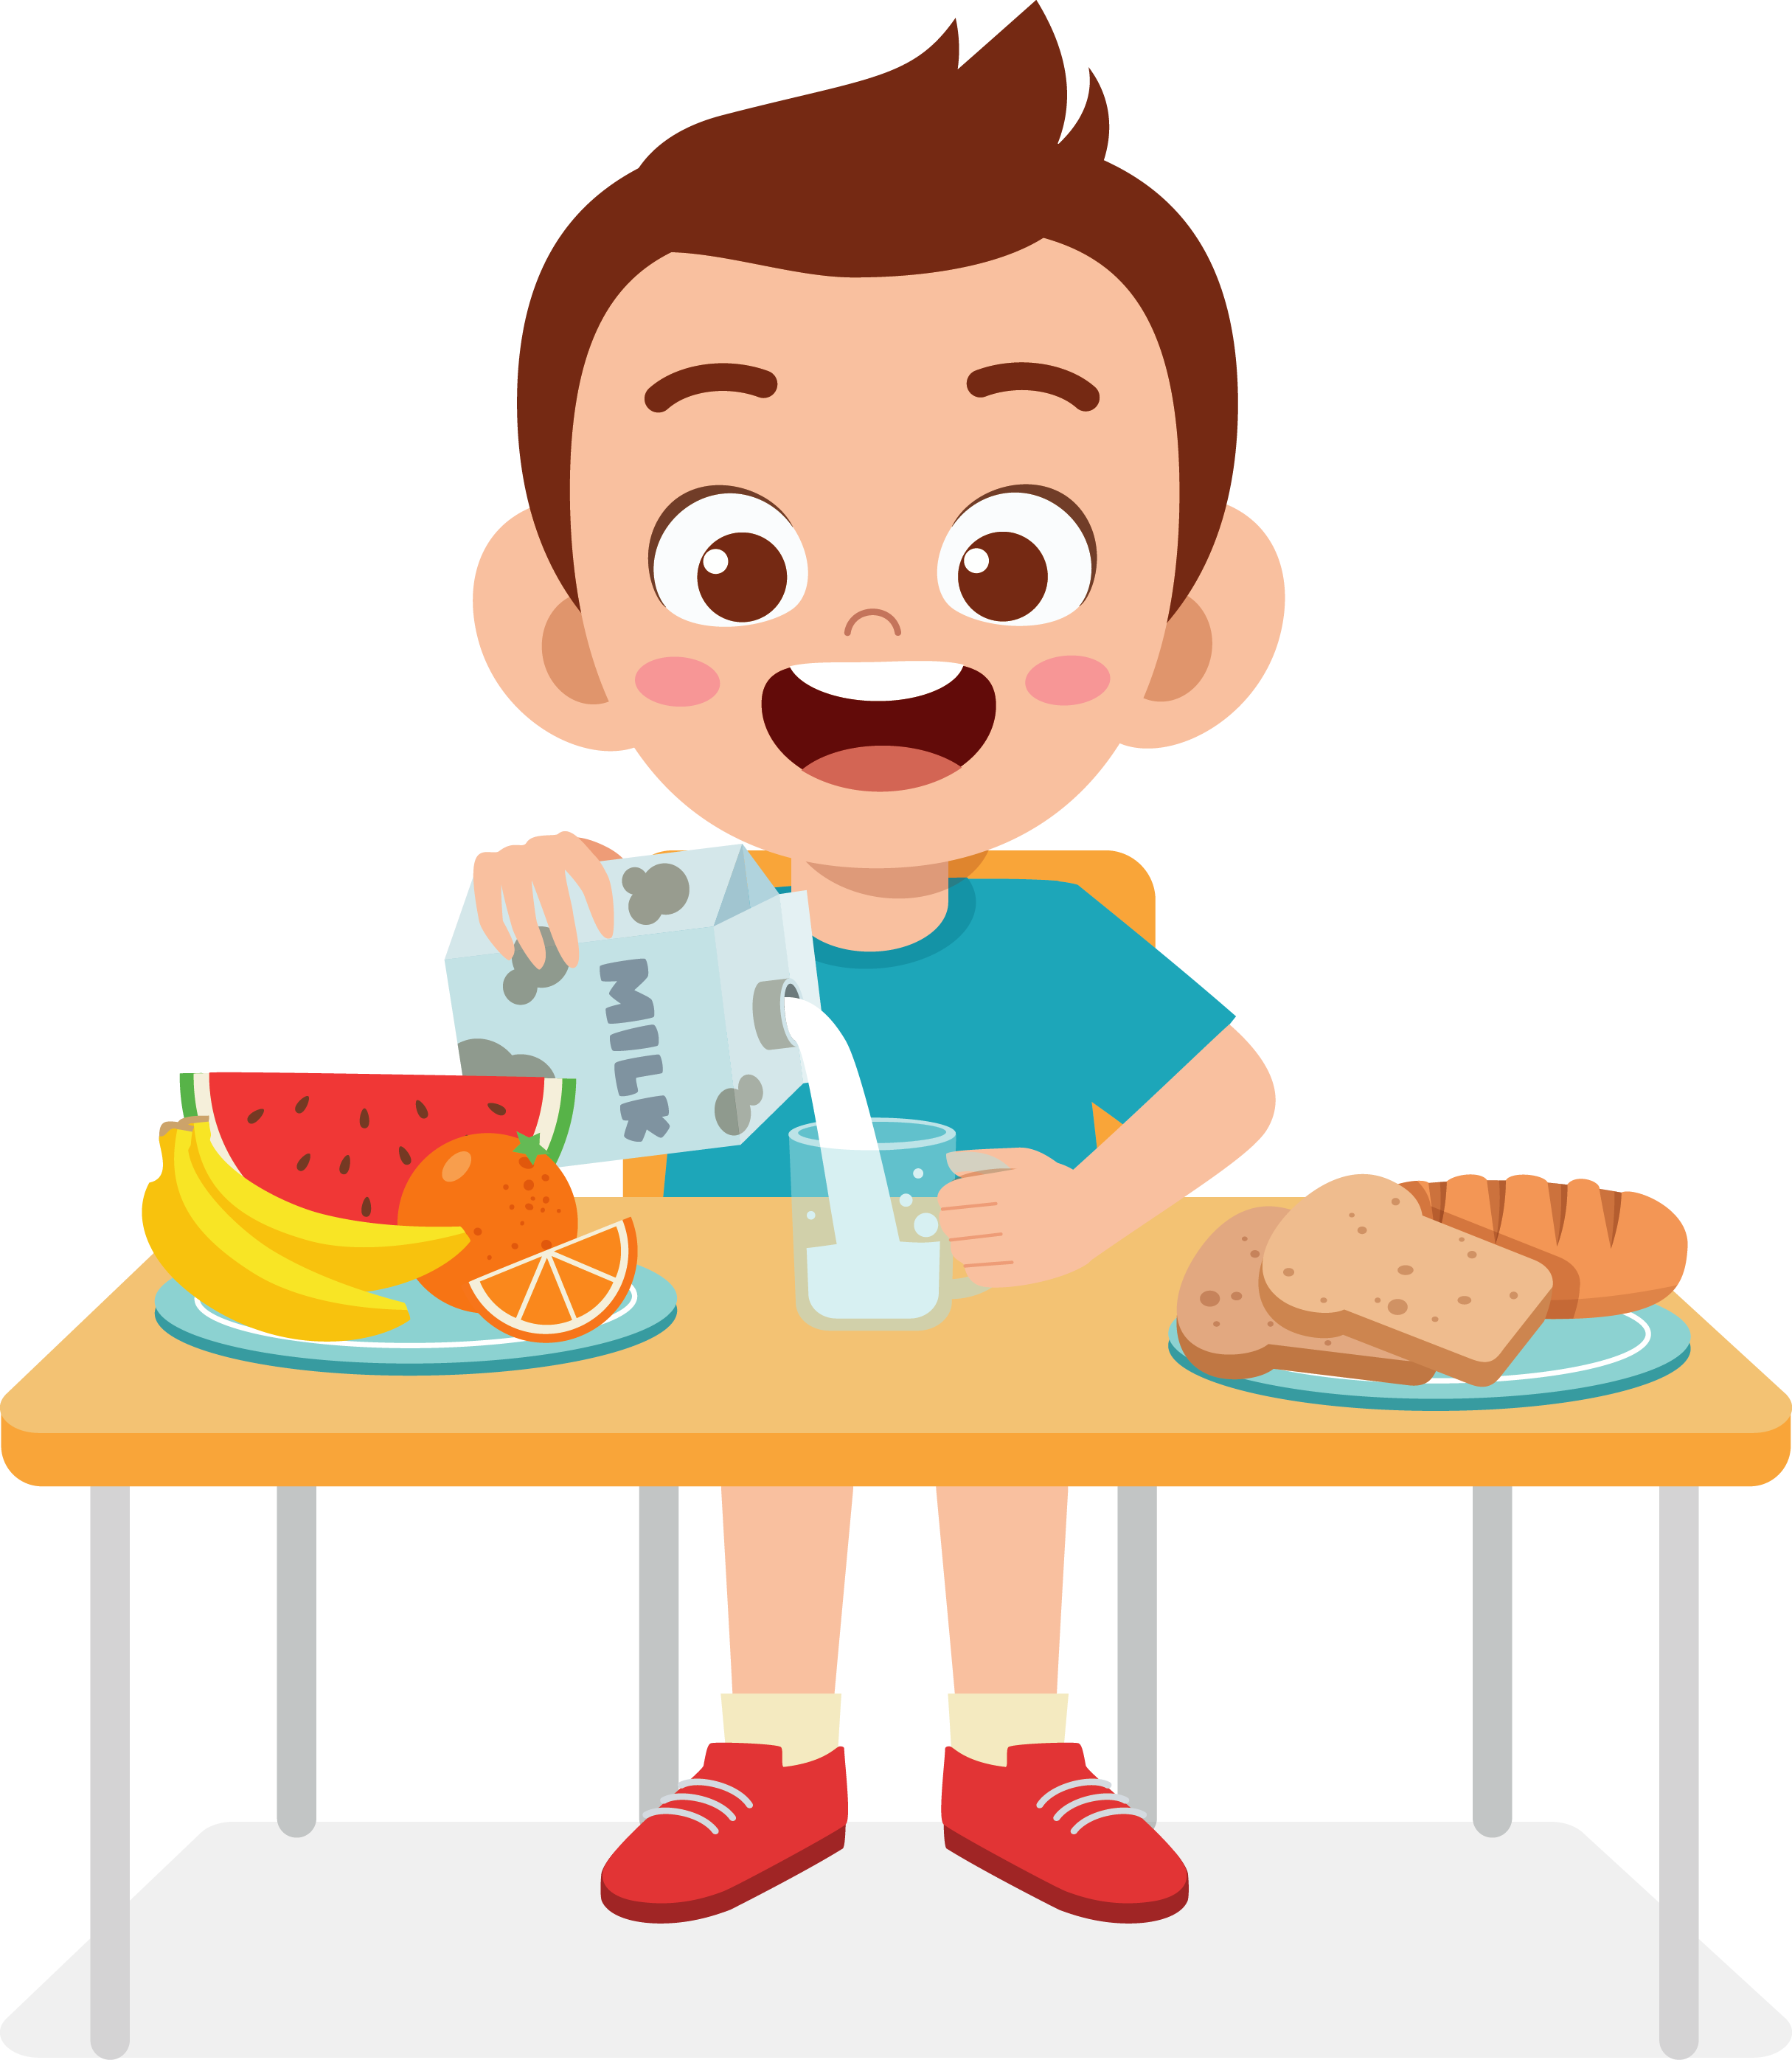




What time do you _______?
I ________ at ________.
MsPham
0936082789
get up
go to bed
have breakfast
go to school

Slide 16
MsPham
0936082789
MsPham
0936082789
Practice

Slide 17



4
Read and match.
I am a pupil at Hoa Lan Primary School. I get up at six o'clock. I wash my face and clean my teeth. Then I have breakfast at six fifteen. I go to school at seven o'clock. I have lunch at school. I have dinner at home at seven thirty. I do my homework and go to bed at nine forty-five.
1. I get up
2. I go to school
3. I have dinner
4. I go to bed.
a.
b.
c.
d.

Slide 18
5
Let’s write.
I get up at ____________. I have breakfast at ____________. I go to school at ____________.
What about you? What time do you go to school?

Slide 19
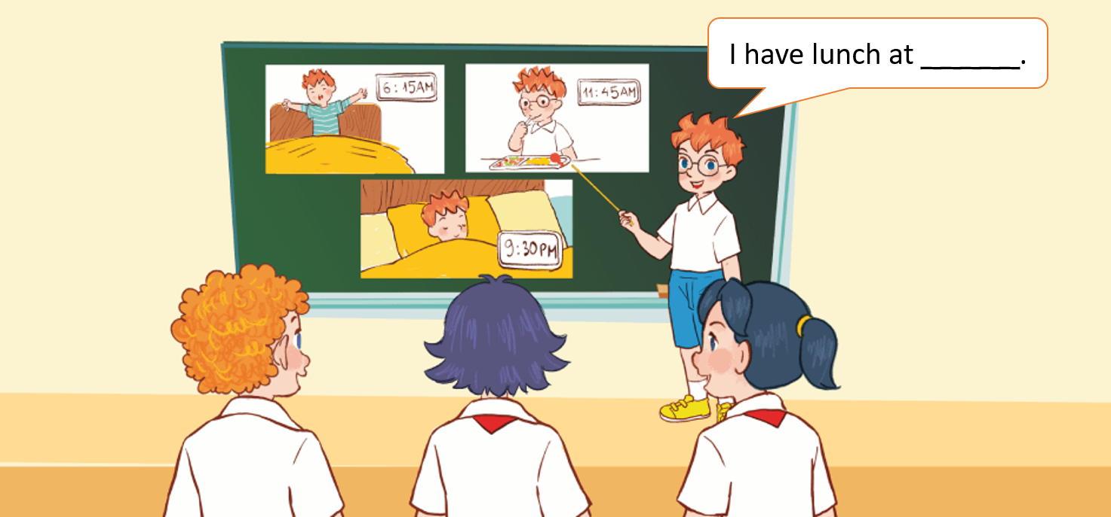
6
Project
My daily routine

Slide 20
MsPham
0936082789
Extra
Structure
MsPham
0936082789

Slide 21



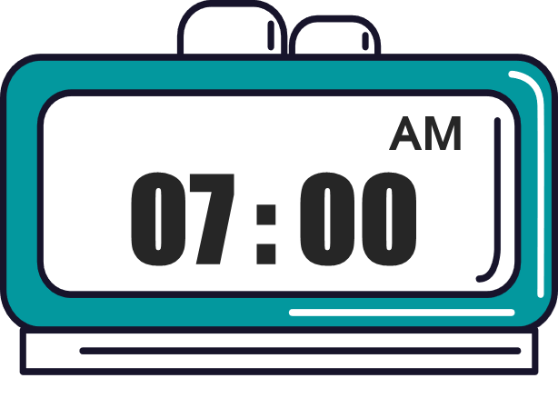
2
Cách hỏi 1 người nào đó làm gì vào lúc mấy giờ.
What time does he /she _______?
(+ hoạt động)
He/ She ________ at ______.
+ V(s/es)
(+ giờ)
Ex:
What time does he have breakfast?
He has breakfast at six thirty.
What time does she go to school?
She goes to school at seven o’clock.

Slide 22
3
Cách thêm s/es vào sau động từ (V).
V
Vs/es
get up
gets up
MsPham
0936082789
read a book
reads a book
Activities
(Các hoạt động)
have breakfast
has breakfast
play football
plays football
go to bed
goes to bed
do homework
does homework
watch TV
watches TV
Notes:
Note: Nhắc học sinh quy tắc thêm s/es cơ bản: - Duy nhất have – has. Các V có tận cùng là chữ o, ch, sh nhớ thêm es. V có tận cùng là 1 phụ âm + y thì bỏ y thêm ies (study). Còn lại thêm s.

Slide 23
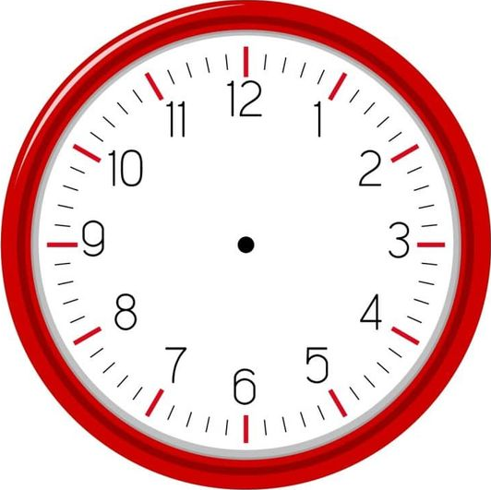
4
Cách hỏi nhiều người làm gì vào lúc mấy giờ.
What time do they _______?
(+ hoạt động)
They ________ at ______.
(+ hoạt động)
(+ giờ)
Ex:
What time do they go to school?
They go to school at seven o’clock.

Slide 24



Lucky wheel
20
10
30
1
2
3
x2
50
4
5
6
100
7
8
Notes:
Click vào mũi tên để quay nhận điểm
Chọn các số 1-8 để trả lời câu hỏi. Trả lời đúng dc nhận số điểm vừa quay được.

Slide 25
What time ____ you get up?
do
Back
Check

Slide 26
What time ____ he have breakfast?
does
Back
Check

Slide 27
What time ____ she have breakfast?
does
Back
Check

Slide 28
______ do you go to school?
What time
Back
Check

Slide 29
What time does she get up?
___________ at six o’clock.
She gets up
Back
Check

Slide 30
What time does he have breakfast?
___________ at six thirty.
He has breakfast
Back

Slide 31
What time does your sister go to school?
___________ at seven o’clock.
She goes to school
Back
Check

Slide 32
What time do you go to bed?
___________ at ten fifteen.
I go to bed
Back
Check

Slide 33
MsPham
0936082789
Thank you!

