Slide 1




Unit 1
My Friends
MsPham
0936082789
MsPham
0936082789
Lesson 2 – period 1

Slide 2

WARM UP

Slide 3











Listen and choose.
MsPham
0936082789
Australia

Slide 4
Listen and choose.
MsPham
0936082789
America

Slide 5
Listen and choose.
MsPham
0936082789
Vietnam

Slide 6
Listen and choose.
MsPham
0936082789
Britain

Slide 7
Listen and choose.
Australia
America
MsPham
0936082789
Vietnam
Vietnam
Britain

Slide 8
Listen and choose.
America
Vietnam
MsPham
0936082789
America
Australia
Britain

Slide 9
Listen and choose.
Britain
Vietnam
MsPham
0936082789
America
Australia
Australia

Slide 10
Listen and choose.
America
Britain
MsPham
0936082789
Britain
Australia
Vietnam

Slide 11

MsPham
0936082789
Well done!

Slide 12

Vocabulary
MsPham
0936082789

Slide 13

Vocabulary
Singapore
/ˌsɪŋəˈpɔː(r)/
MsPham
0936082789
Nước Singapo

Slide 14

Vocabulary
Malaysia
/məˈleɪʒə/
MsPham
0936082789
Nước Ma-lai-si-a

Slide 15

Vocabulary
Thailand
/ˈtaɪlænd/
MsPham
0936082789
Nước Thái Lan

Slide 16

Vocabulary
Japan
/dʒəˈpæn/
MsPham
0936082789
Nước Nhật

Slide 17
Vocabulary
Malaysia
/məˈleɪʒə/
: Nước Ma-lai-si-a
MsPham
0936082789
Singapore
/ˌsɪŋəˈpɔː(r)/
: Nước Singapo
Thailand
/ˈtaɪlænd/
: Nước Thái Lan
Japan
/dʒəˈpæn/
: Nước Nhật Bản

Slide 18
Look, read and match
1
a
Japan
2
b
Thailand
3
c
Malaysia
4
d
Singapore

Slide 19
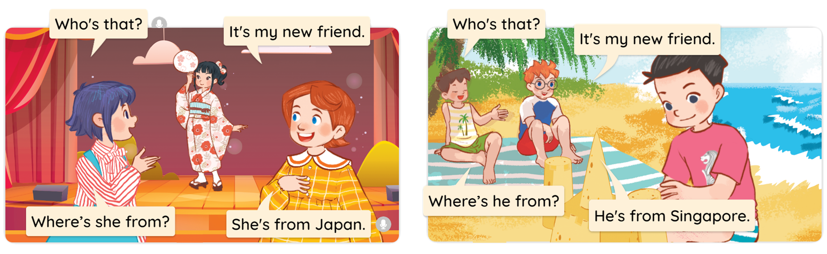


1
Look, listen and read.

Slide 20
Structure
MsPham
0936082789

Slide 21




2
Cách hỏi một người nào đó đến từ đâu
Where’s he/she from?
(Anh ấy / Cô ấy đến từ đâu?)
He’s/She’s from ________.
(Anh ấy / Cô ấy đến từ ____.)
Note:
is = ’s
Ex:
MsPham
0936082789
Where’s he from?
Where’s she from?
He’s from Singapore.
She’s from Thailand.

Slide 22
Practice
MsPham
0936082789

Slide 23




2
Listen, point and say.
Where is he/she from?
He’s/She’s from _________.
a
b
Singapore
Malaysia
c
d
Thailand
Japan

Slide 24


2
Listen, point and say.
a
MsPham
0936082789
Singapore
Where’s he from?
He’s from Singapore.

Slide 25
2
Listen, point and say.
b
MsPham
0936082789
Malaysia
Where’s he from?
He’s from Malaysia.

Slide 26
2
Listen, point and say.
c
MsPham
0936082789
Thailand
America
Where’s she from?
She’s from Thailand.

Slide 27
2
Listen, point and say.
d
MsPham
0936082789
Japan
Where’s she from?
She’s from Japan.

Slide 28
2
Listen, point and say.
Where is he/she from?
He’s/She’s from _________.
a
b
Singapore
Malaysia
c
d
Thailand
Japan

Slide 29





START

Slide 30






Where’s she from?
She’s from ______.
Singapore
Malaysia
Japan

Slide 31

Where’s he from?
He’s from ______.
Thailand
Singapore
Japan
Next

Slide 32

Where’s he from?
He’s from ______.
Thailand
Malaysia
Japan

Slide 33

Where’s she from?
She’s from ______.
Malaysia
Singapore
Thailand

Slide 34
Where’s he from?
He’s from Singapore.
She’s from Singapore.
I’m from Singapore.
Next

Slide 35
Where’s she from?
He’s from Malaysia.
I’m from Malaysya.
She’s from Malaysia.

Slide 36
Where are you from?
She’s from Japan.
I’m from Japan.
He’s from Japan.

Slide 37
She’s from Thailand.
Where’s he
from?
Where are you from?
Where’s she from?

Slide 38





Slide 39





3
Let’s talk
Where is he/she from?
He’s/She’s from _________.

Slide 40

3
Let’s talk
Where is he from?
He’s from Singapore.

Slide 41
3
Let’s talk
Where is he from?
He’s from Malaysia.

Slide 42
3
Let’s talk
Where is she from?
She’s from Japan.

Slide 43
3
Let’s talk
Where is she from?
She’s from Thailand.

Slide 44
3
Let’s talk
Where is he/she from?
He’s/She’s from _________.

Slide 45
Review

Slide 46


Where are you from?
(Bạn đến từ đâu?)
MsPham
0936082789
I’m from _________.
(Tớ đến từ ____)
I am = I’m
Vietnam
MsPham
0936082789
Australia
America
Britain

Slide 47

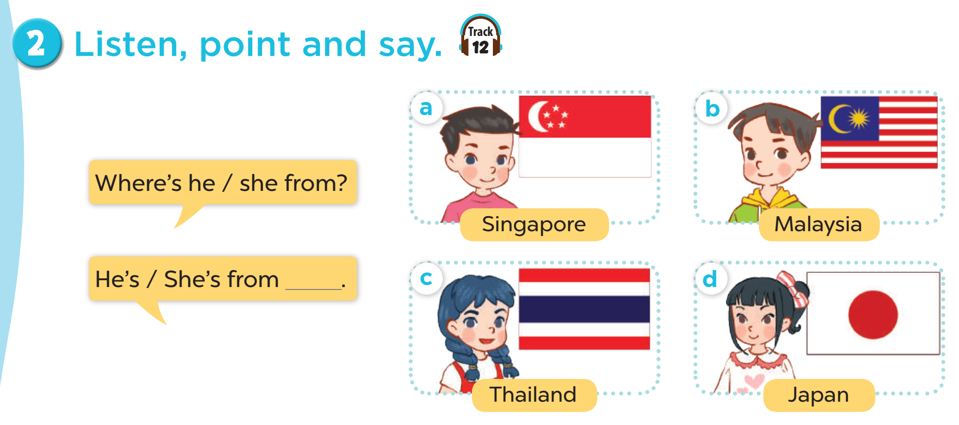
MsPham
0936082789
Where’s he/she from?
He’s/She’s from ________.
is = ’s
Thailand
Japan
MsPham
0936082789
Malaysia
Singapore

Slide 48
MsPham Powerpoint
Thank you
Mspham
MsPham
0936082789
For joining!

