Slide 1




Unit 1
My Friends
MsPham
0936082789
MsPham
0936082789
Lesson 2 – period 1

Slide 2

WARM UP
Look, remember.
Then ask and answer.

Slide 3




NUTCRACKER
RIDDLES
START

Slide 4


Where’s she from?
She’s from Thailand.
Open
Check

Slide 5

Where’s he from?
He’s from Malaysia.
Open
Check

Slide 6

Where’s he from?
He’s from Singapore.
Open
Check

Slide 7

Where’s she from?
She’s from Japan.
Open
Check

Slide 8

Where’s she from?
She’s from Austrailia.
Open
Check

Slide 9

Where’s she from?
She’s from America.
Open
Check

Slide 10

Where’s he from?
He’s from Vietnam.
Open
Check

Slide 11

Where’s he from?
He’s from Britain.
Open
Check

Slide 12
Well done!
End

Slide 13

Review

Slide 14


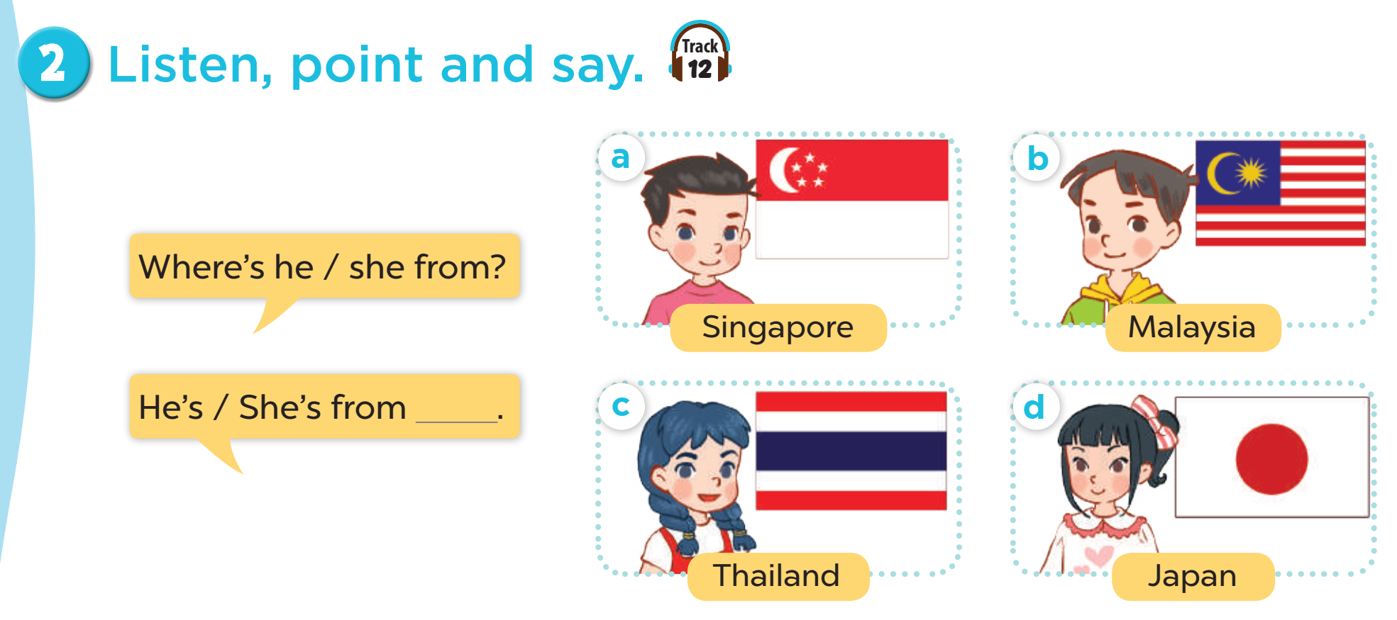

MsPham
0936082789
Where’s he/she from?
He’s/She’s from ________.
is = ’s
Thailand
Japan
MsPham
0936082789
Malaysia
Singapore

Slide 15





4
Listen and tick.
a
b
1
MsPham
0936082789
✓
a
b
2
✓

Slide 16




5
Look, complete and read.
MsPham
0936082789
1
2
A: Where’s she from?
B: She’s from __________.
A: Where’s he from?
B: He’s __________________.
Japan
from Singapore
4
4
Where’s
he from
A: ___________ she from?
B: She’s __________________.
A: Where’s ________________?
B: ______________ Malaysia.
from Thailand
He’s from

Slide 17
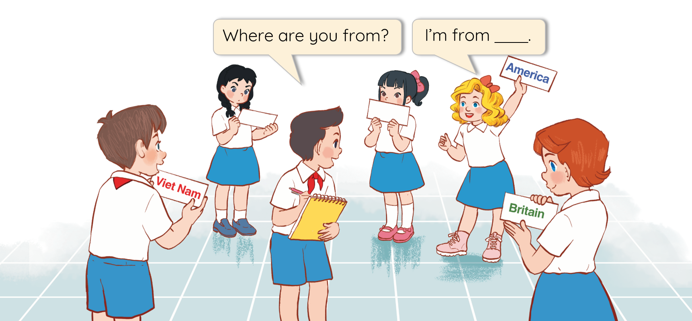
6
Let’s play.
MsPham
0936082789

Slide 18
MsPham Powerpoint
Thank you
Mspham
MsPham
0936082789
For joining!

