Slide 1




Unit 1
My Friends
MsPham
0936082789
MsPham
0936082789
MsPham English Class

Slide 2


LET’S PLAY!
Look and guess
Play

Slide 3


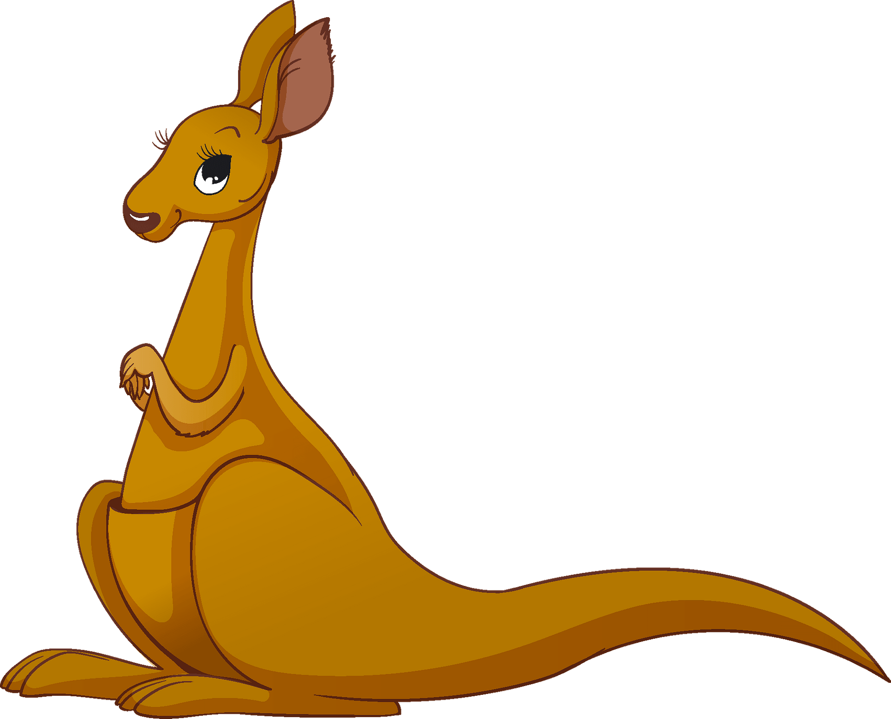

is
Check
?
Next
Where are from?
___________________.
I’m from Australia

Slide 4



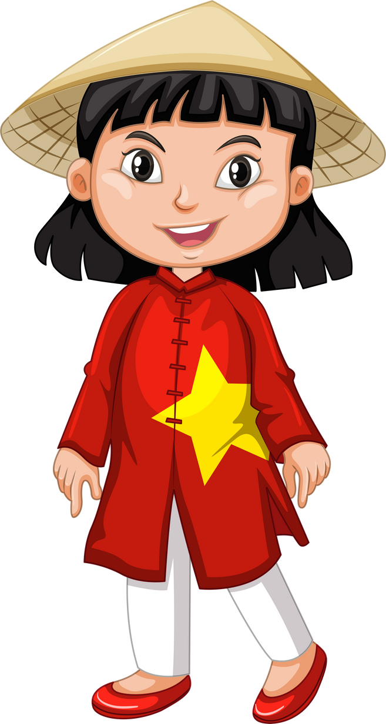
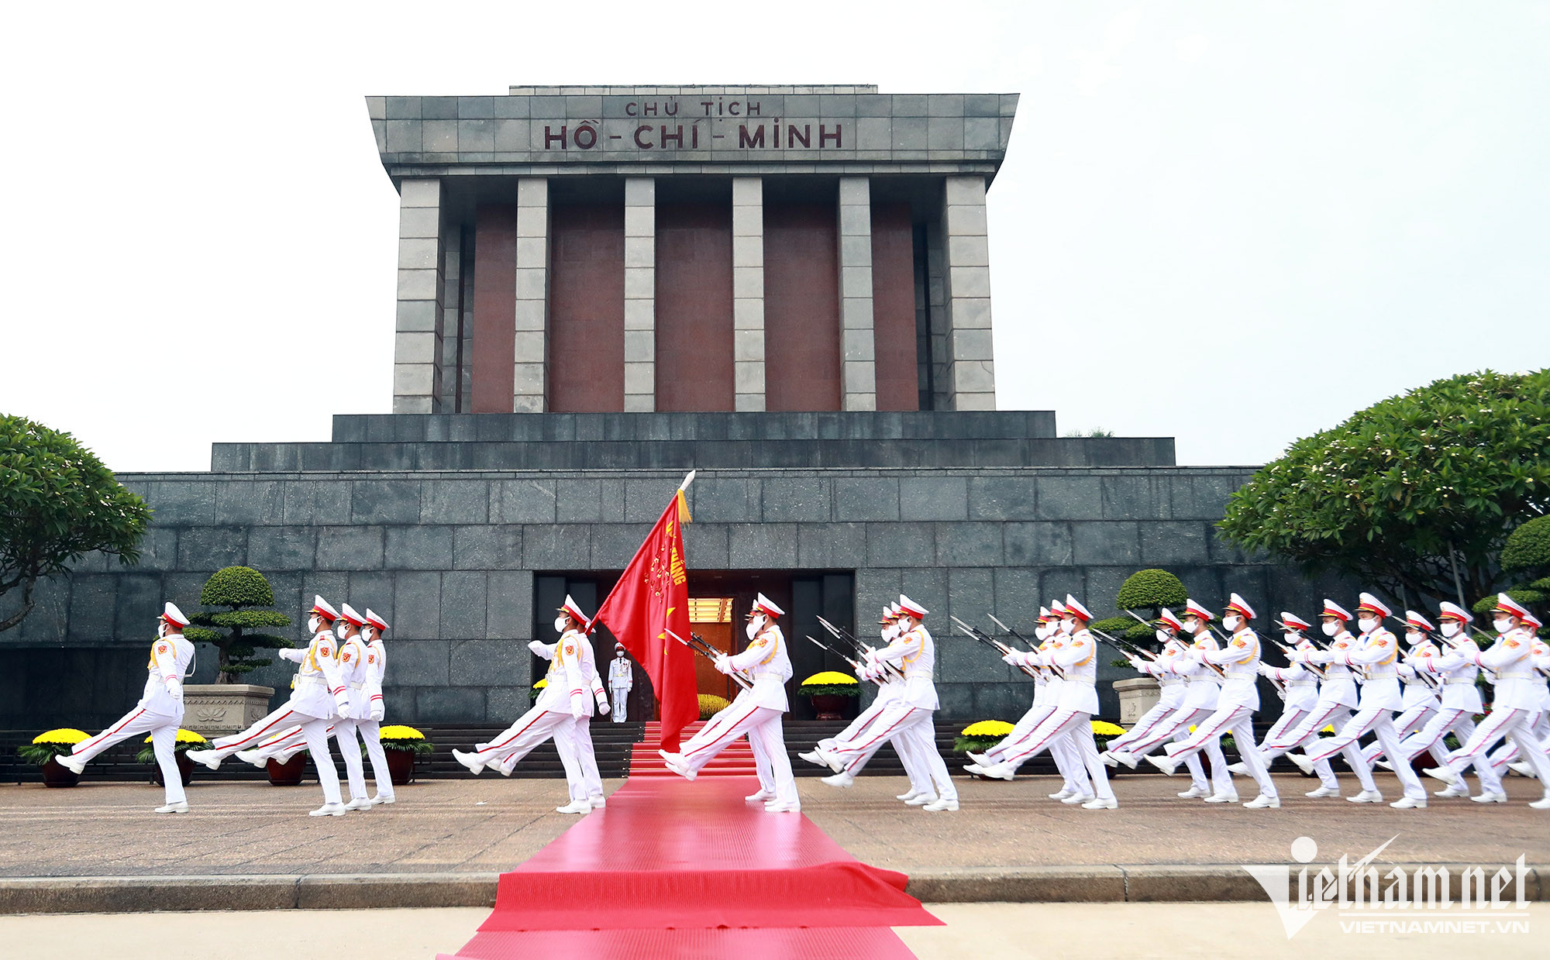
Check
Next
Where are you from?
______________.
is
I’m from Vietnam

Slide 5

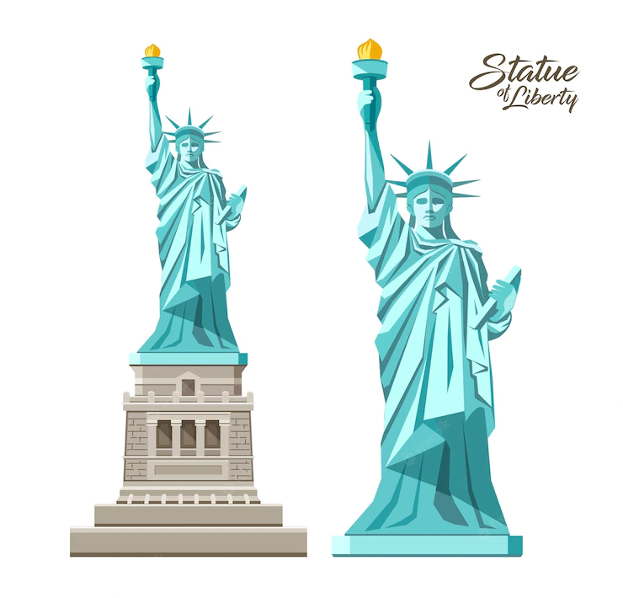

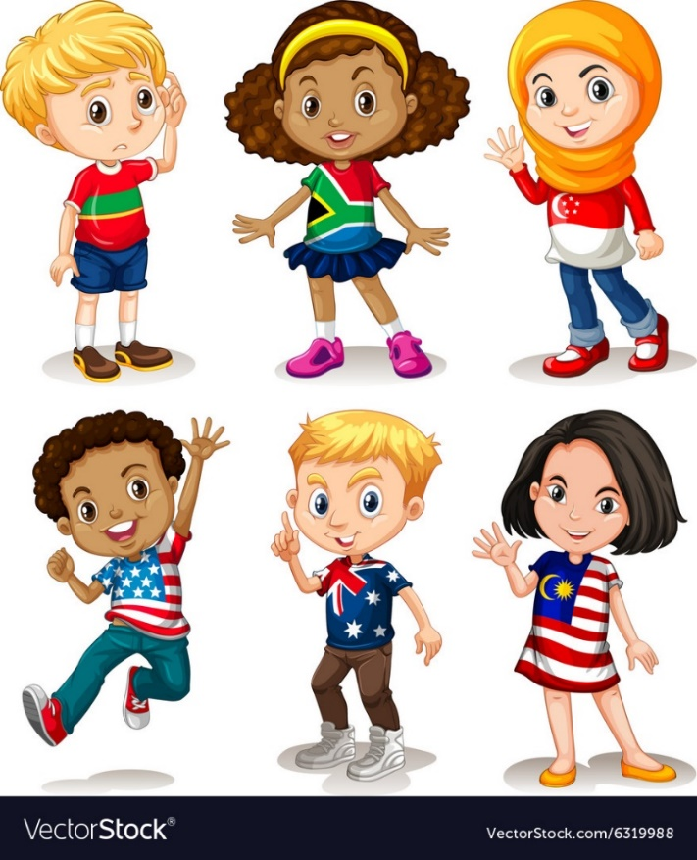
Check
Next
is
Where is he from?
______________.
He’s from America

Slide 6


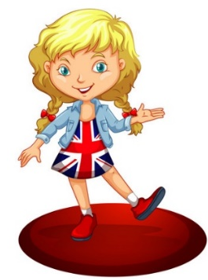
?
Check
Next
is
Where is she from?
______________.
She’s from Britain

Slide 7


?
Check
Next
is
Where is he from?
________________.
He’s from Malaysia

Slide 8




Check
Next
is
Where is she from?
______________.
She’s from Japan

Slide 9
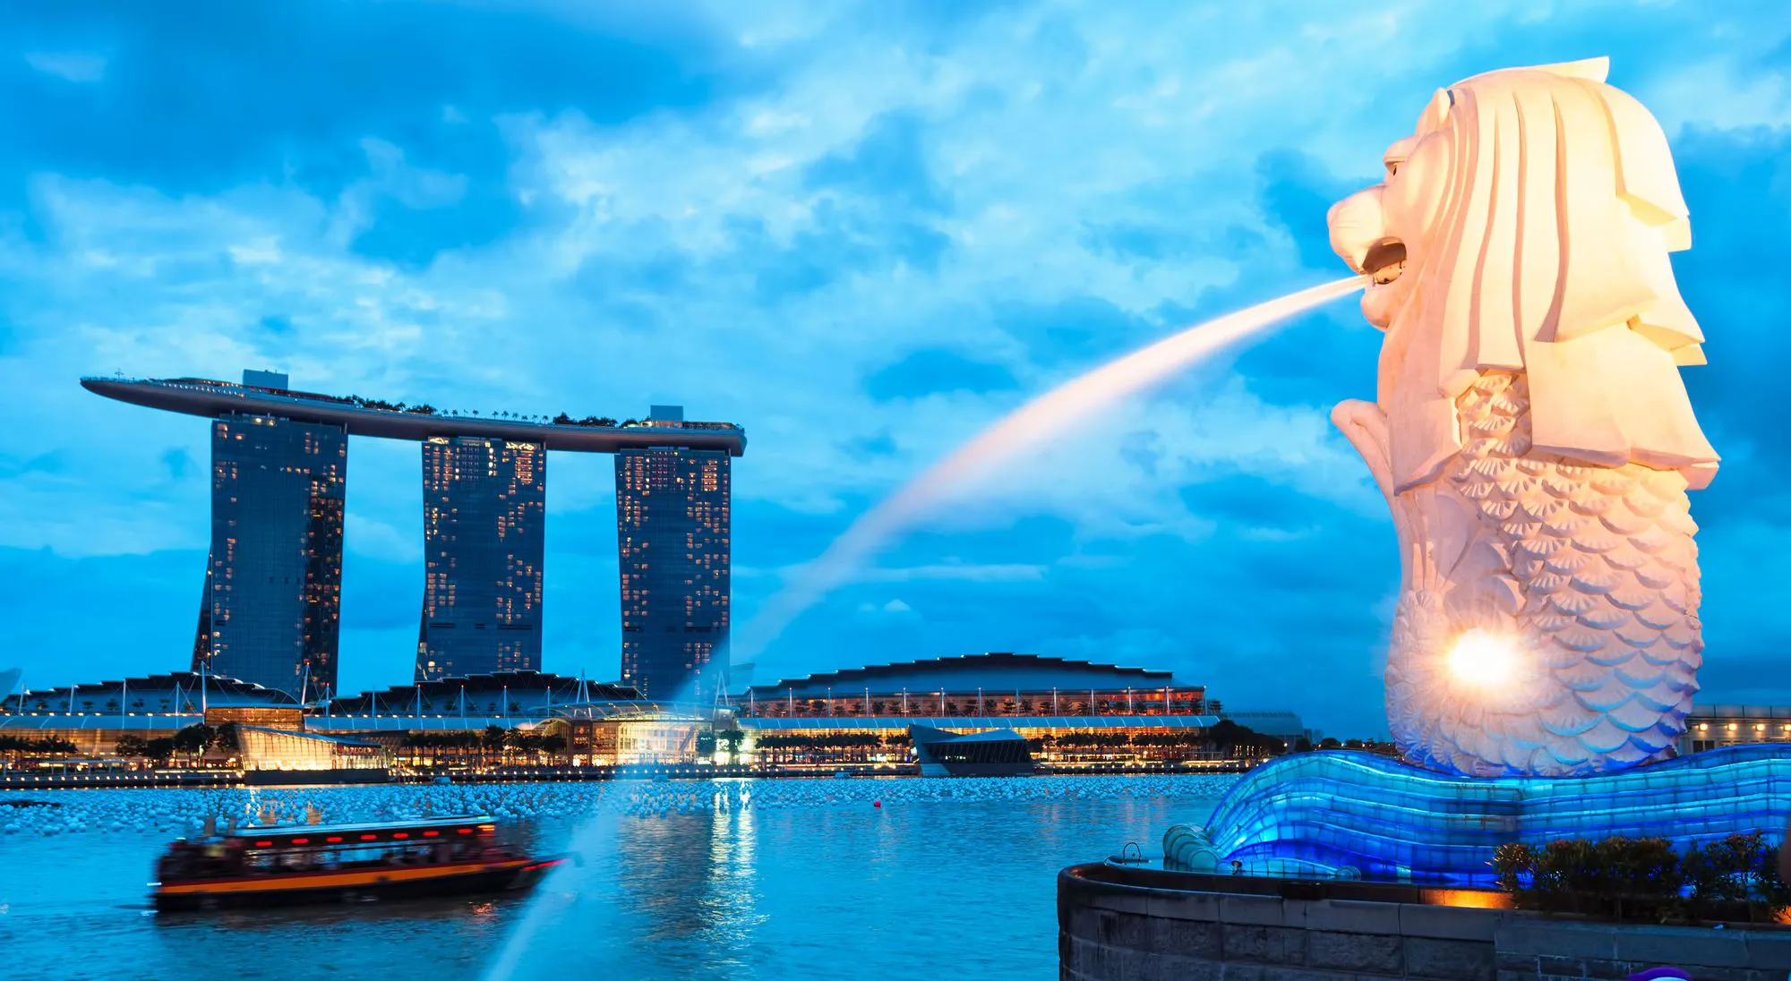

?
Check
Next
is
Where is she from?
__________________.
She’s from Singapore

Slide 10

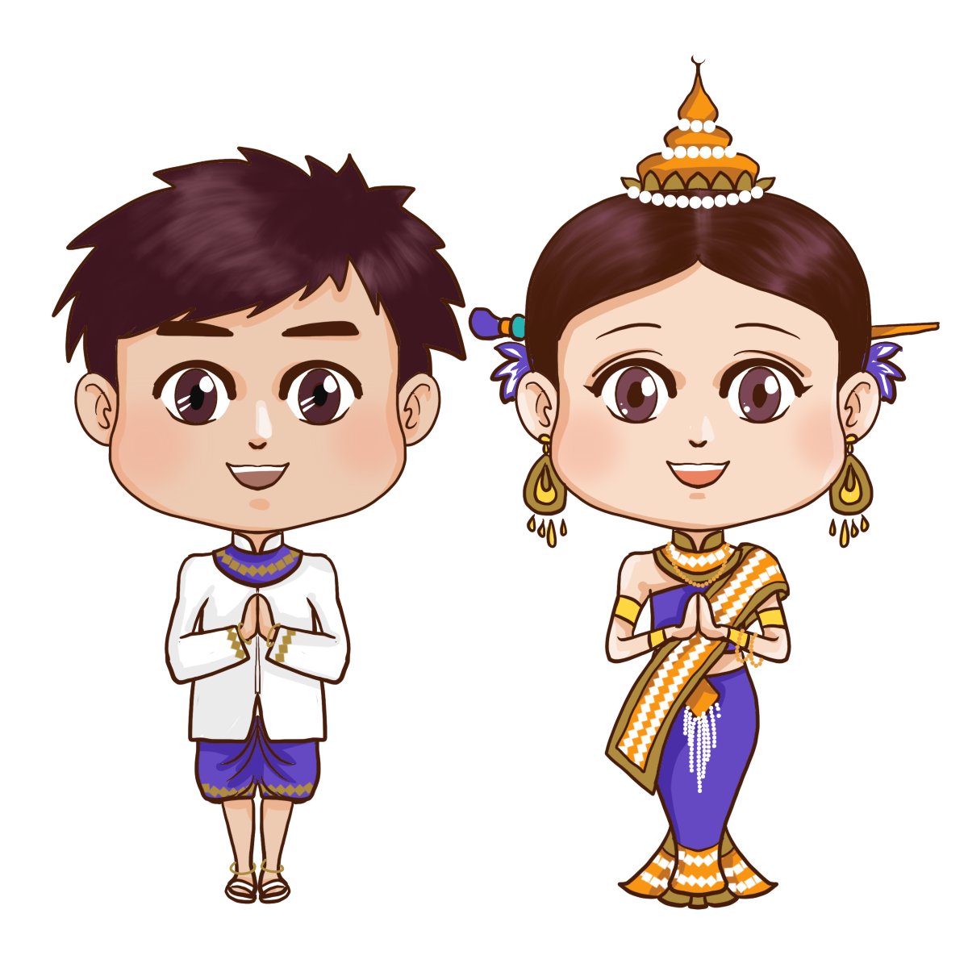

Check
Next
is
Where are they from?
___________________.
They’re from ThaiLand

Slide 11
You’re welldone!

Slide 12
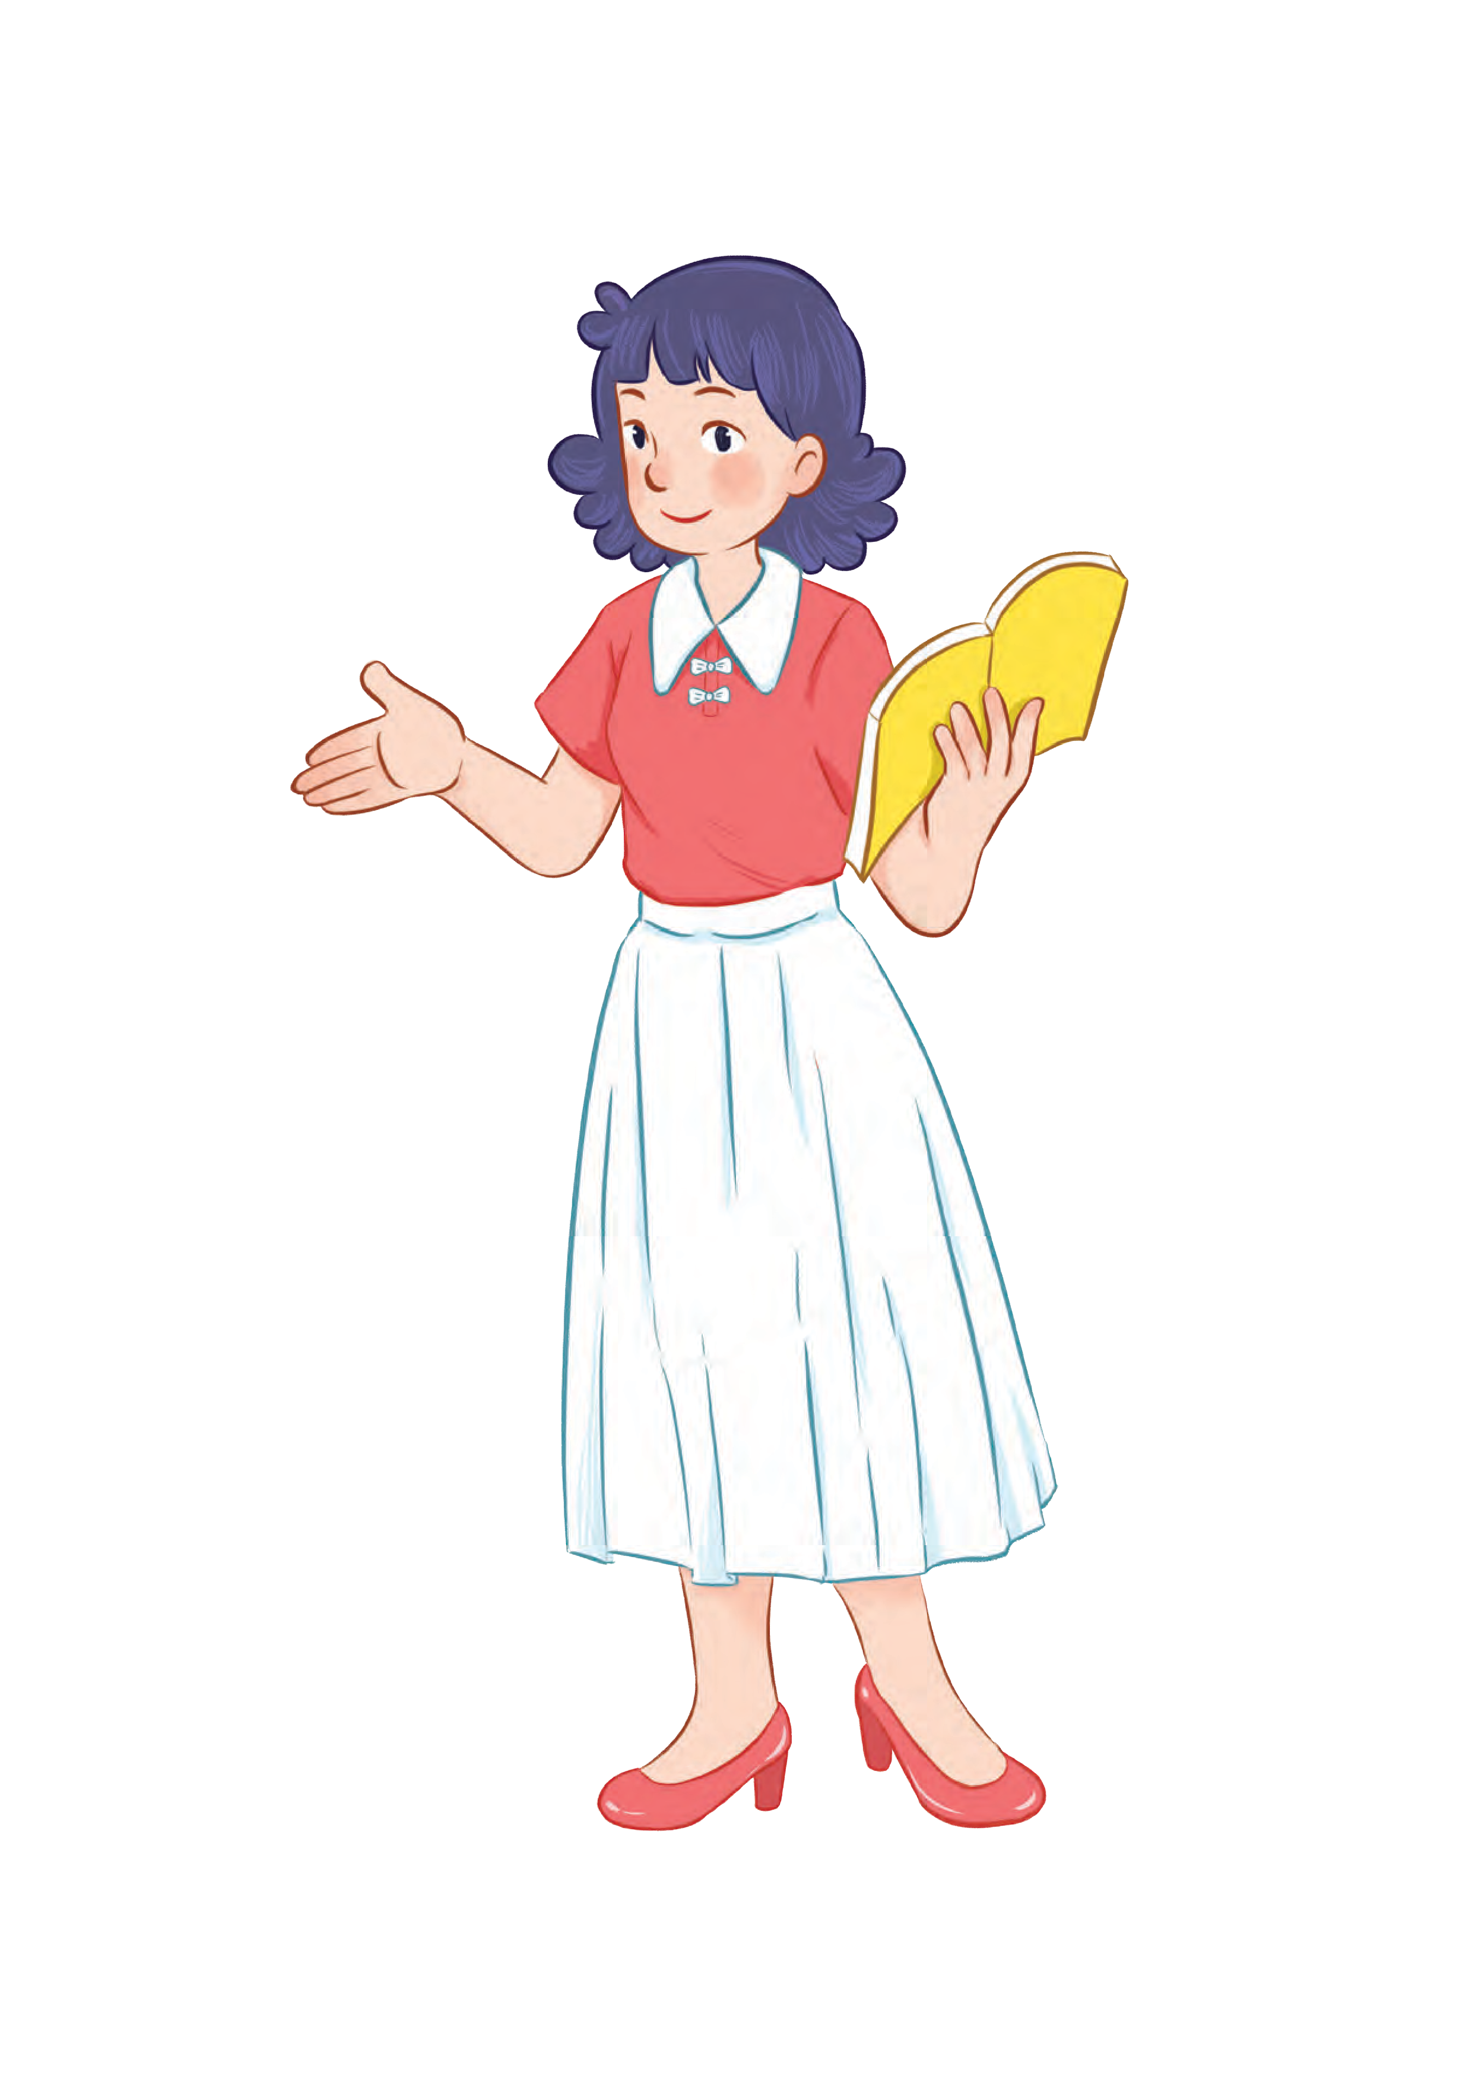
Review

Slide 13




Where are you from?
(Bạn đến từ đâu?)
MsPham
0936082789
I’m from _________.
(Tớ đến từ ____)
I am = I’m
Vietnam
MsPham
0936082789
Australia
America
Britain

Slide 14


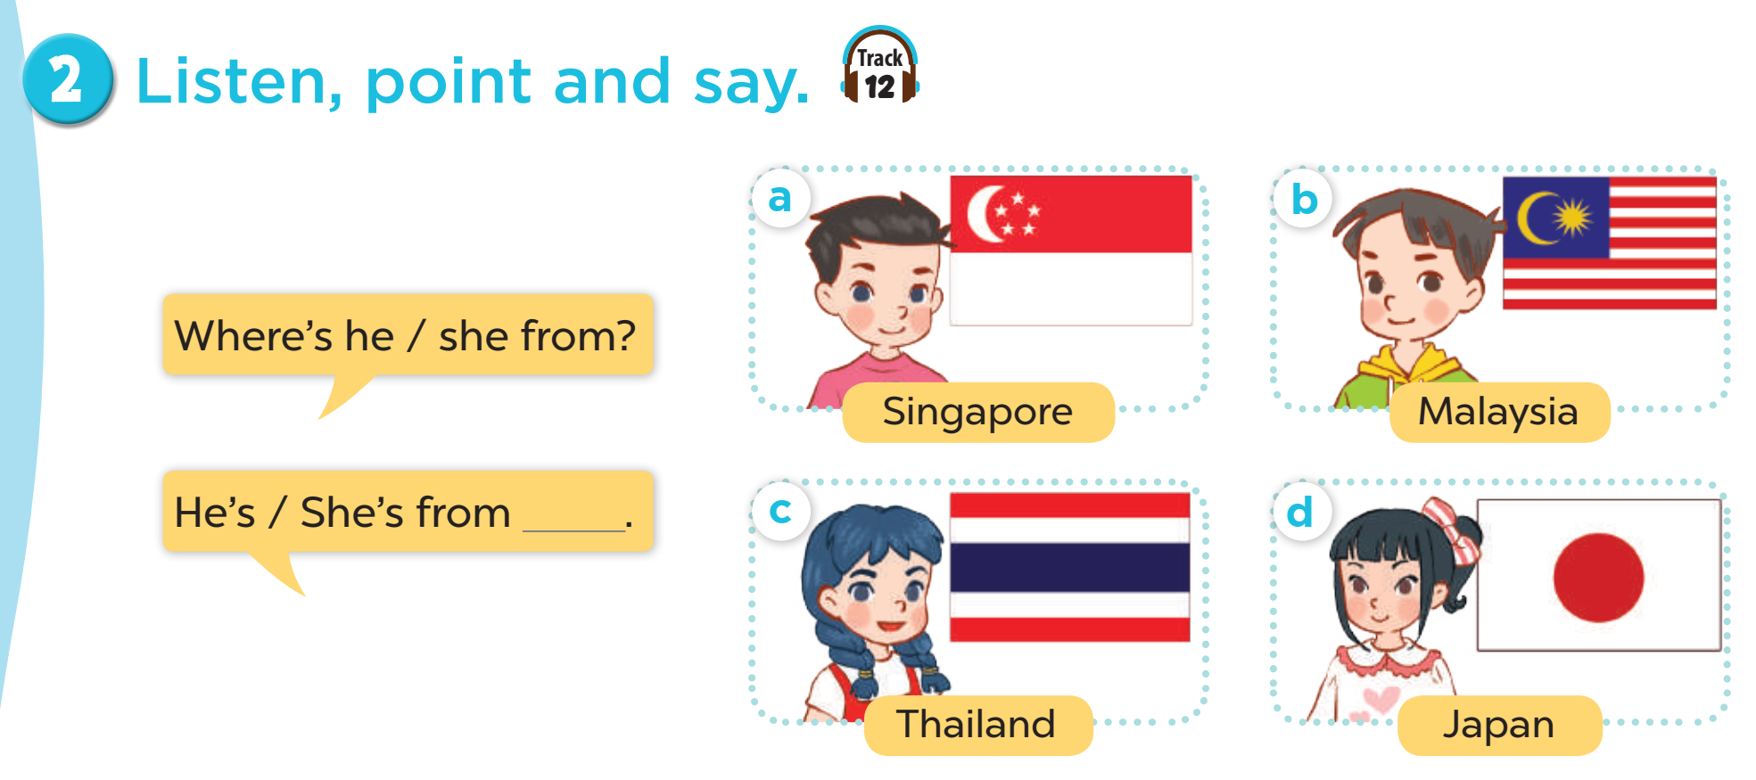



MsPham
0936082789
Where’s he/she from?
He’s/She’s from ________.
is = ’s
Thailand
Japan
MsPham
0936082789
Malaysia
Singapore

Slide 15
Phonics
MsPham
0936082789

Slide 16


Slide 17

Phonics
America
a
/ə/
/əˈmerɪkə/
England
/ˈɪŋɡlənd/
Japan
/dʒəˈpæn/

Slide 19



Phonics
India
ia
/iə/
/ˈɪndiə/
Cambodia
/kæmˈbəʊdiə/
Australia
/ɒˈstreɪliə/

Slide 20
Practice
MsPham
0936082789

Slide 21

1
Listen and repeat.
a
America
I’m from America
ia
Australia
She’s from Australia

Slide 22
2
Listen and circle.
1.
I’m from _________.
a. America b. Australia c. Malaysia
2.
He’s from _________.
a. Canada b. Australia c. America

Slide 23



3
Let’s chant.
America, America
America, America
America, America
Mary’s from America.
Mary’s from America.
Mary’s from America.
She’s from America.
She’s from America.
She’s from America.
Australia, Australia
Australia, Australia
Australia, Australia
Ben’s from Australia.
Ben’s from Australia.
Ben’s from Australia.
He’s from Australia.
He’s from Australia.
He’s from Australia.

Slide 24

3
Let’s chant.
America, America
America, America
America, America
Mary’s from America.
Mary’s from America.
Mary’s from America.
She’s from America.
She’s from America.
She’s from America.
Australia, Australia
Australia, Australia
Australia, Australia
Ben’s from Australia.
Ben’s from Australia.
Ben’s from Australia.
He’s from Australia.
He’s from Australia.
He’s from Australia.

Slide 25
Review
MsPham
0936082789

Slide 26
Phonics
a
/ə/
ia
/iə/

Slide 27
MsPham Powerpoint
Thank you
Mspham
MsPham
0936082789
For joining!

