Slide 1




Unit 1
My Friends
MsPham
0936082789
MsPham
0936082789
MsPham English Class

Slide 2










MsPham
0936082789
True
or
False
Play

Slide 3


MsPham
0936082789
America
/ə/
Next

Slide 4
MsPham
0936082789
Cambodia
/ə/
Next

Slide 5
MsPham
0936082789
Australia
/ə/
Next

Slide 6
MsPham
0936082789
India
/iə/
Next

Slide 7
MsPham
0936082789
Japan
/iə/
Next

Slide 8
MsPham
0936082789
England
/iə/
Next

Slide 9
MsPham
0936082789
Good job!
Play

Slide 10

Review

Slide 11



Phonics
America
a
/ə/
/əˈmerɪkə/
England
/ˈɪŋɡlənd/
Japan
/dʒəˈpæn/

Slide 12



Phonics
India
ia
/iə/
/ˈɪndiə/
Cambodia
/kæmˈbəʊdiə/
Australia
/ɒˈstreɪliə/

Slide 13







Where are you from?
(Bạn đến từ đâu?)
MsPham
0936082789
I’m from _________.
(Tớ đến từ ____)
I am = I’m
Vietnam
MsPham
0936082789
Australia
America
Britain

Slide 14



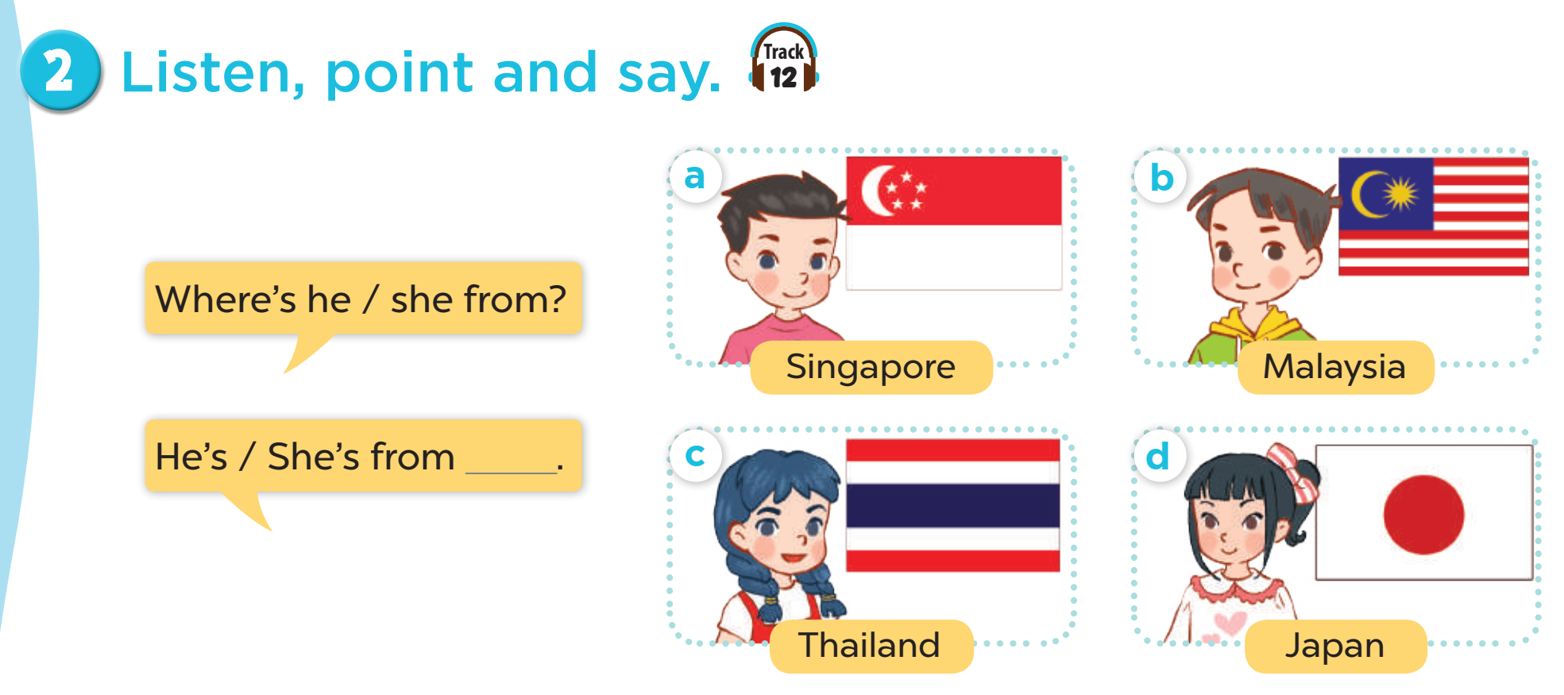



MsPham
0936082789
Where’s he/she from?
He’s/She’s from ________.
is = ’s
Thailand
Japan
MsPham
0936082789
Malaysia
Singapore

Slide 15
Practice
MsPham
0936082789

Slide 16
3
Read and tick True or False.
I’m Hello. I am Minh. I am nine years old. I am from Viet Nam. I have two new friends, Tony and Laura. Tony is from America. Laura is from Australia. They are friendly.
 | True | False
1. Minh is nine years old.
2. Minh is from Viet Nam.
3. Tony is from Australia.
4. Laura is from America.
✓
✓
✓
✓

Slide 17
5
Let’s write.
Hi. My name is _____________. I am __________ years old. I am from Viet Nam.
This is my friend, _________. He/She is from ____________.
And this is _____________. He/She is from _____________.

Slide 18
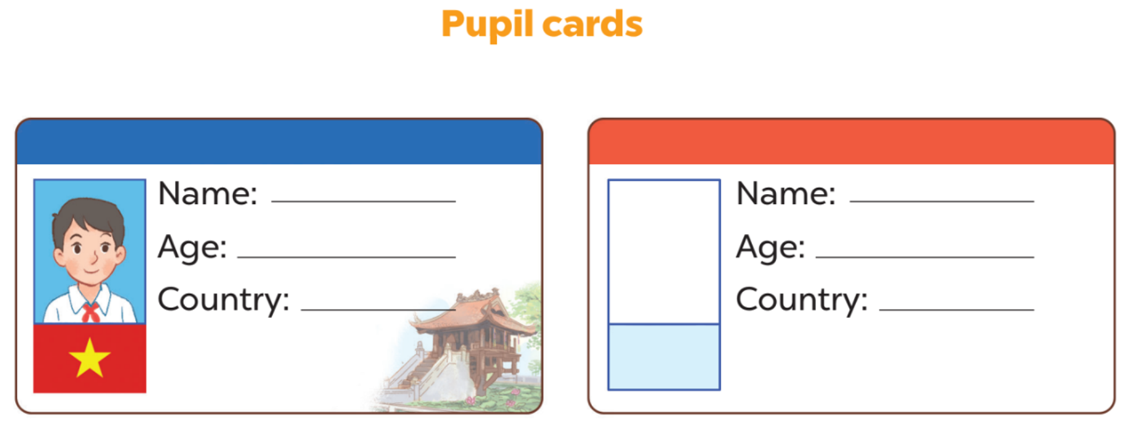
6
Project

Slide 19
MsPham Powerpoint
Thank you
Mspham
MsPham
0936082789
For joining!

