Slide 1







Unit 4
My Birthday
Party
Lesson 1 - Period 1

Slide 2


MsPham
0936082789
Warm-up

Slide 3
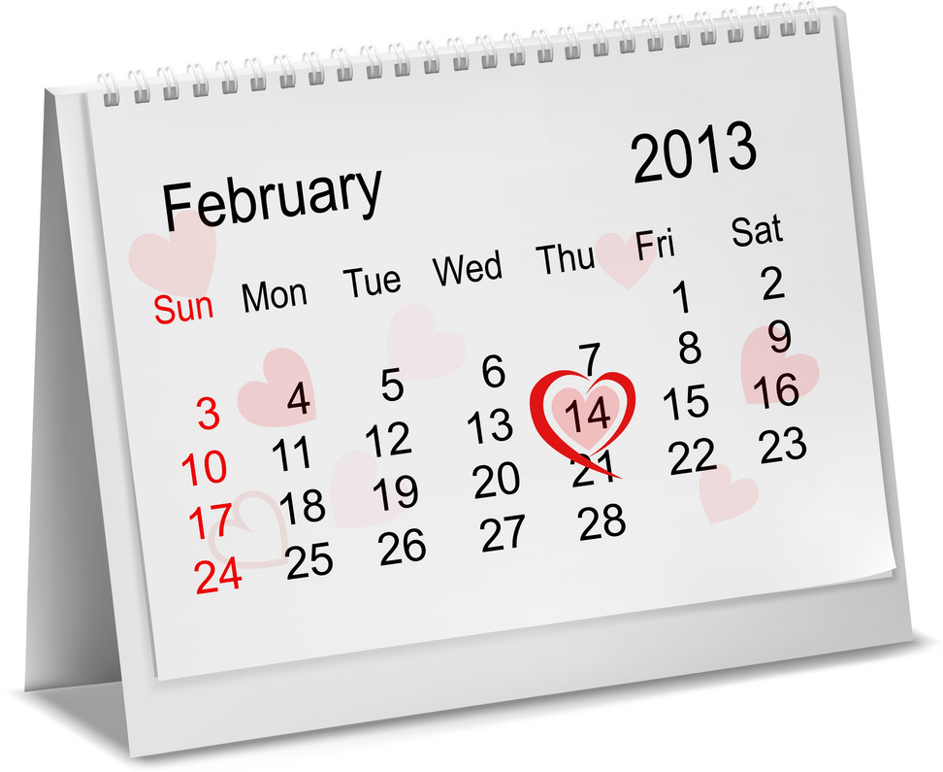
MsPham-9036082789
Calendar
Month
Days of the week
1. How many months in a years?
2. Can you say the name of months?
MsPham
0936082789

Slide 4


Slide 5
MsPham
0936082789
Vocabulary

Slide 6
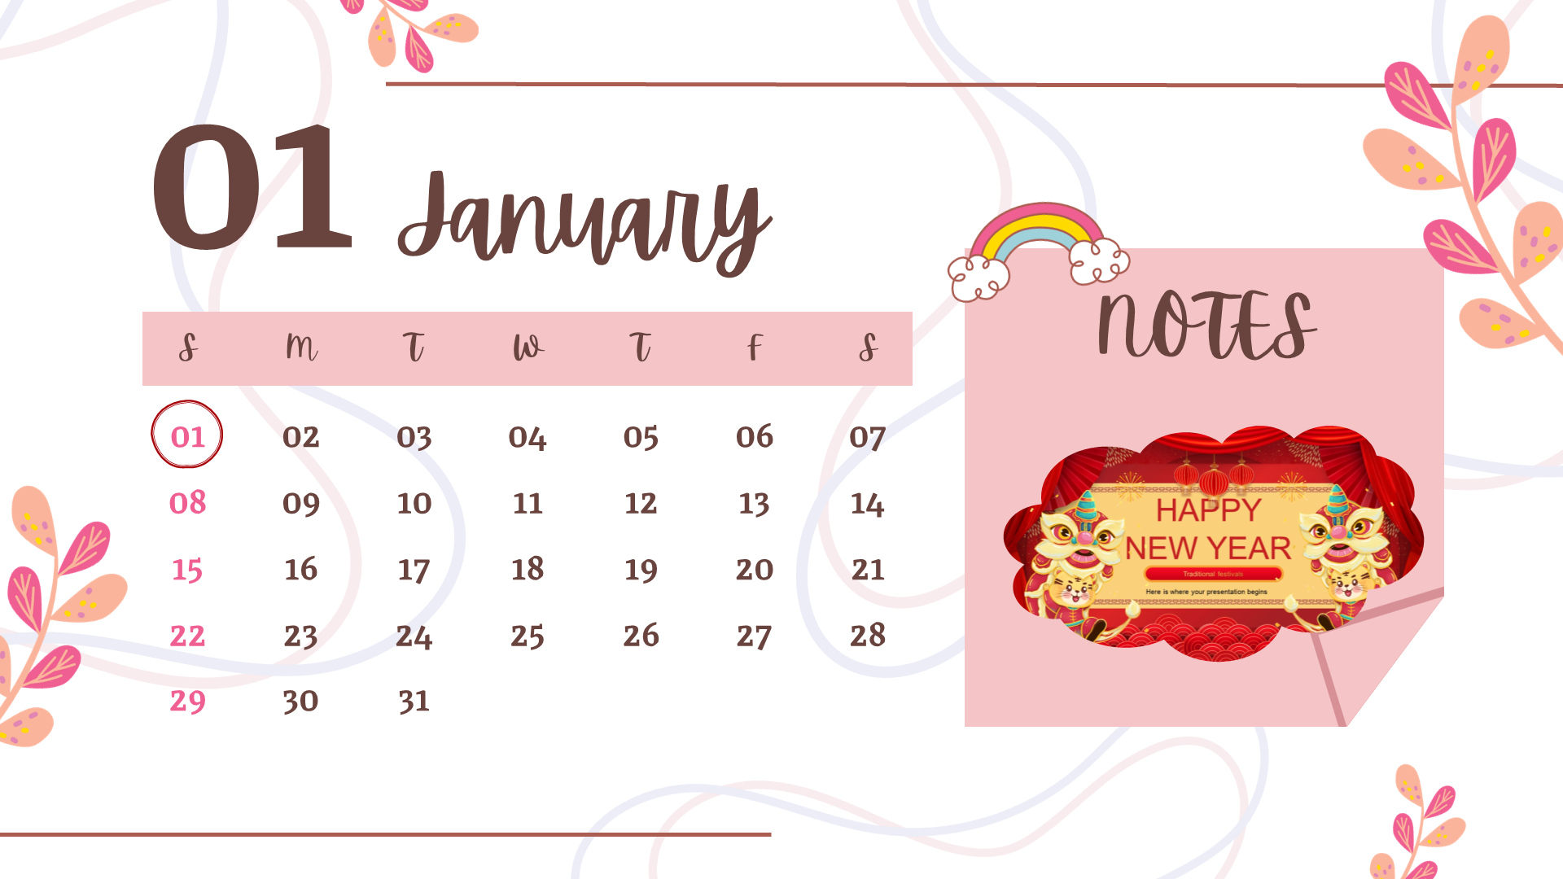
MsPham
0936082789
January
Tháng 1
/ˈdʒænjuəri/

Slide 7

MsPham
0936082789
February
Tháng 2
/ˈfebruəri/

Slide 8

MsPham
0936082789
March
Tháng 3
/mɑːtʃ/

Slide 9
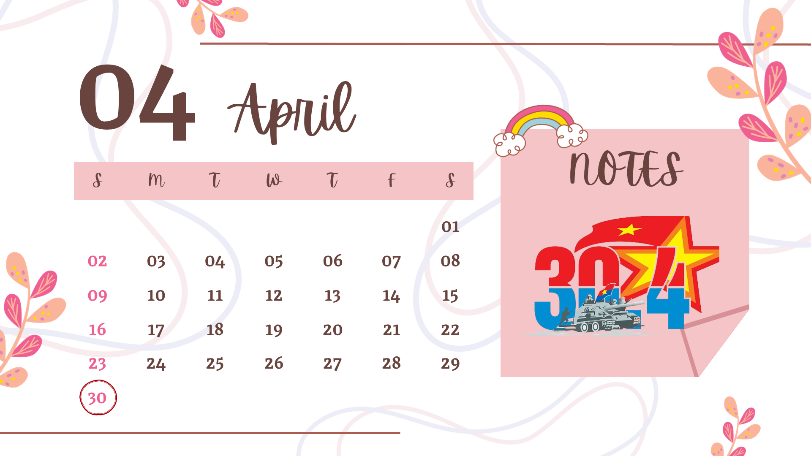
MsPham
0936082789
April
Tháng 4
/ˈeɪprəl/

Slide 10
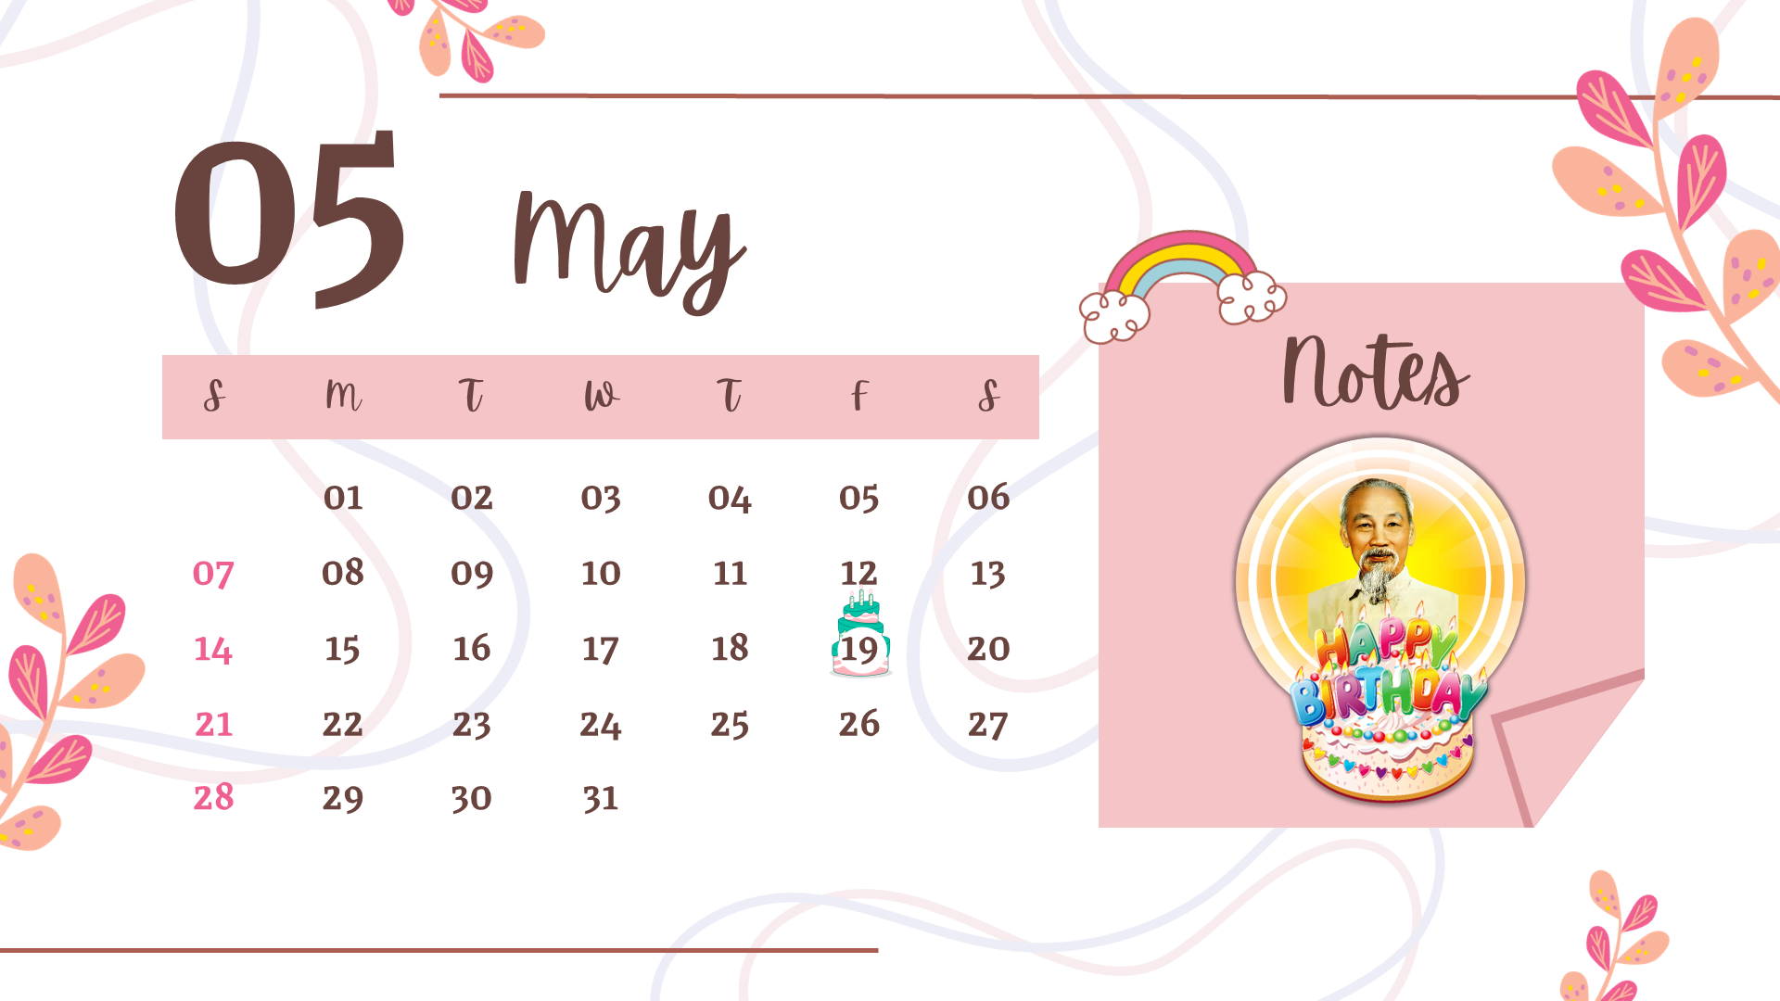
MsPham
0936082789
May
Tháng 5
/meɪ/

Slide 11
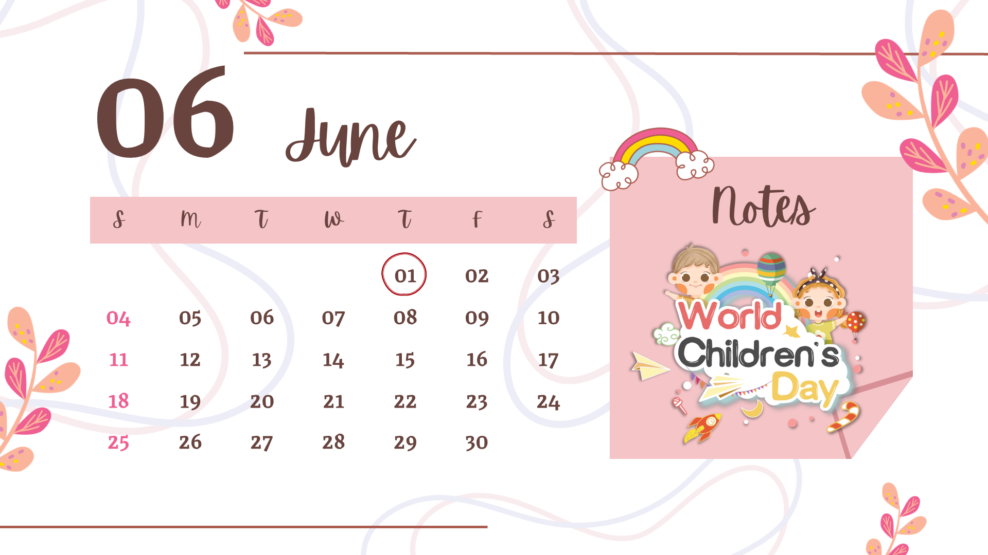
MsPham
0936082789
June
Tháng 6
/dʒuːn/

Slide 12

MsPham
0936082789
July
Tháng 7
/dʒuˈlaɪ/

Slide 13
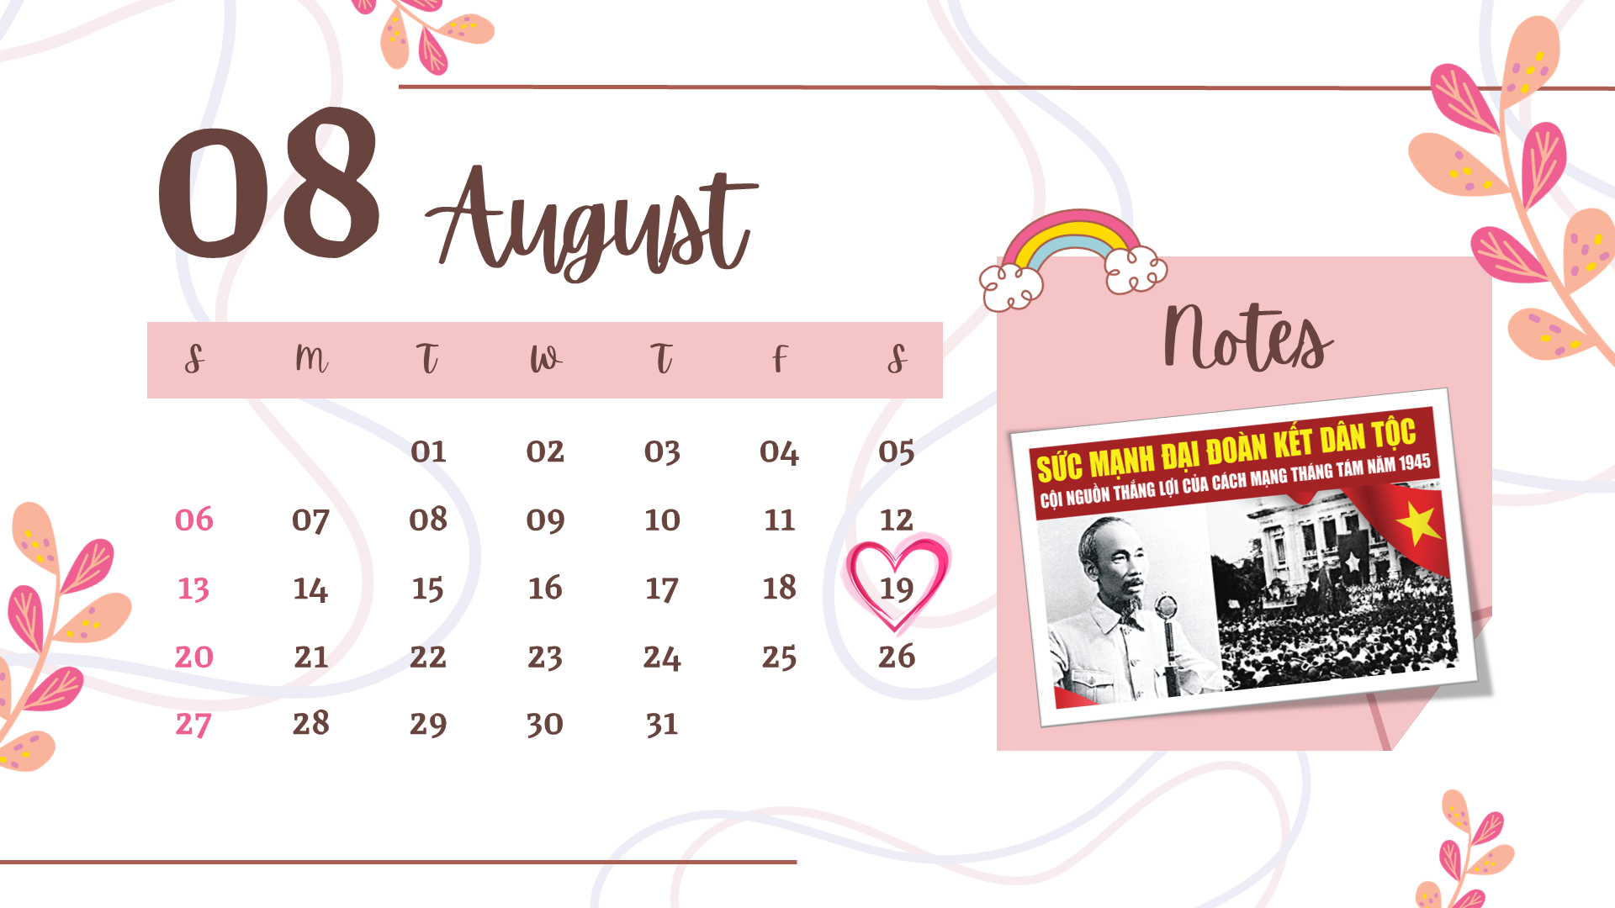
MsPham
0936082789
August
Tháng 8
/ɔːˈɡʌst/

Slide 14
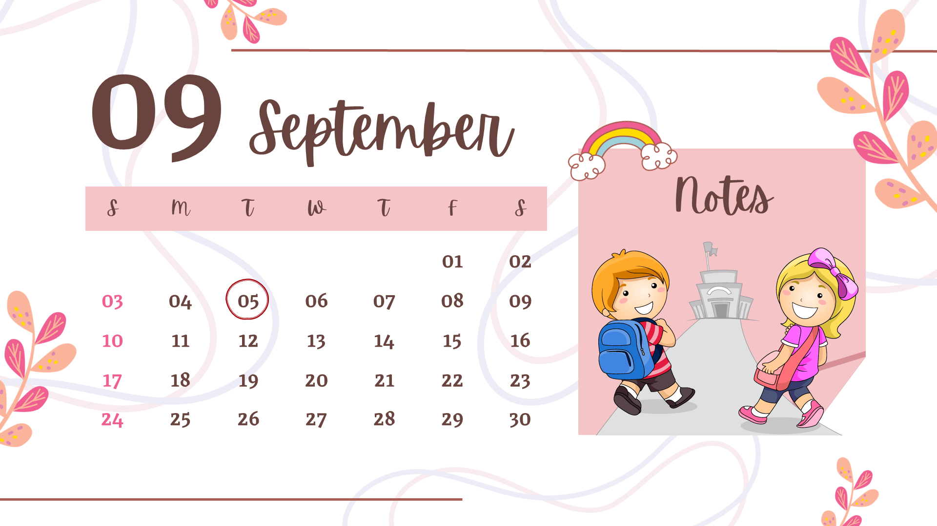
MsPham
0936082789
September
Tháng 9
/sepˈtembər/

Slide 15
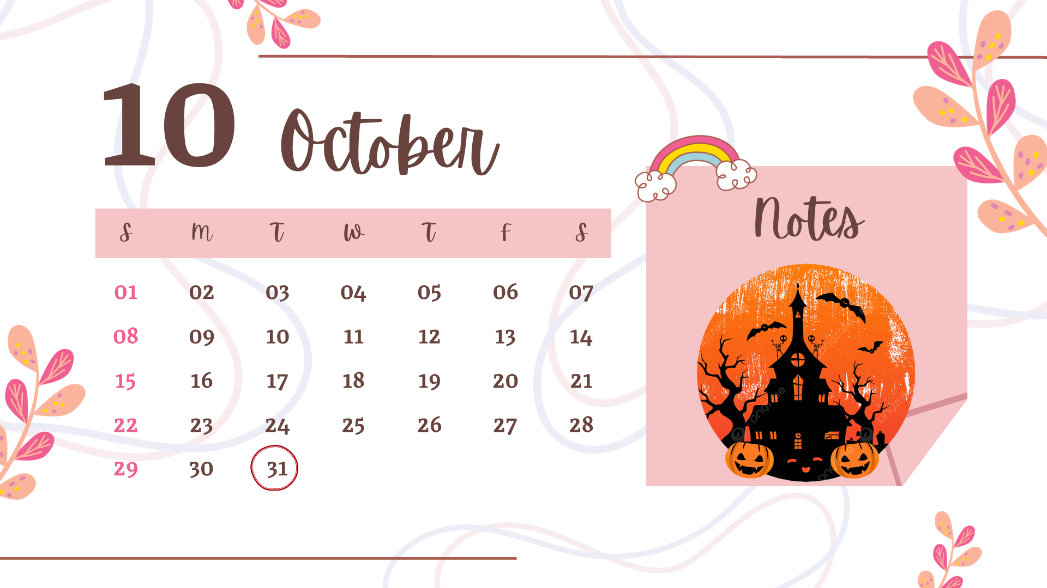
MsPham
0936082789
October
Tháng 10
/ɒkˈtəʊbə(r)/

Slide 16
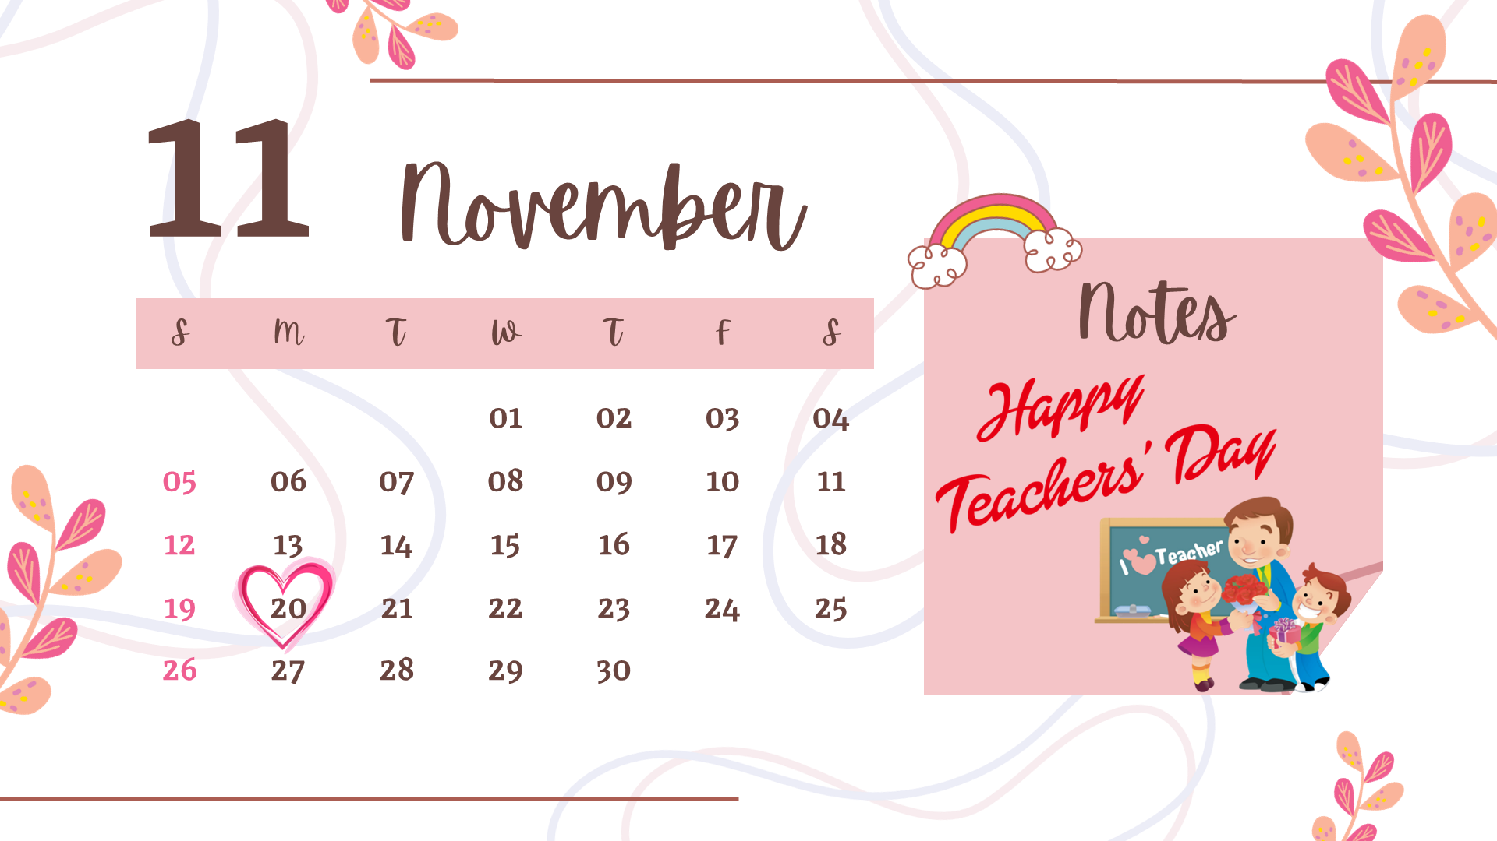
MsPham
0936082789
November
Tháng 11
/nəʊˈvembə(r)/

Slide 17
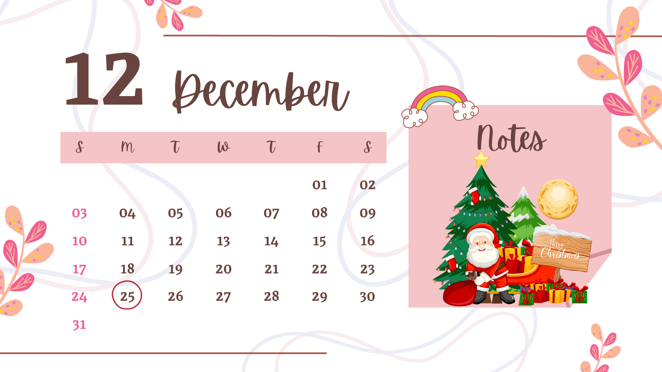
MsPham
0936082789
December
Tháng 12
/dɪˈsembə(r)/

Slide 18
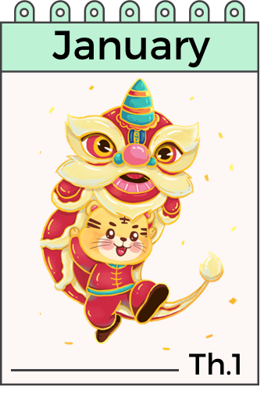



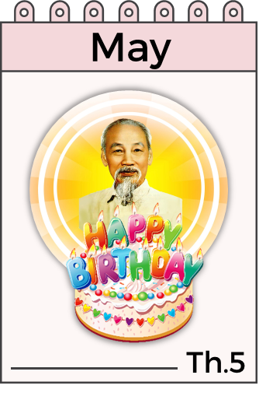

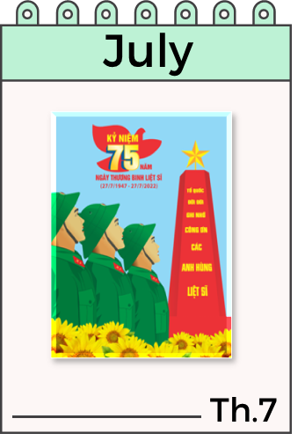

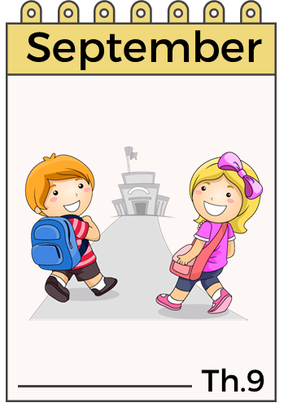
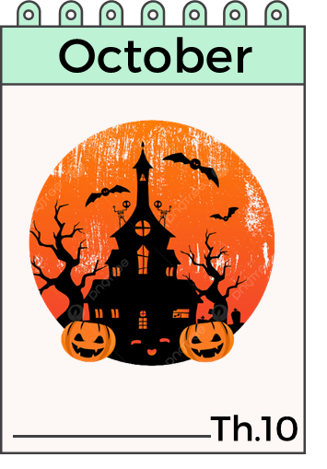

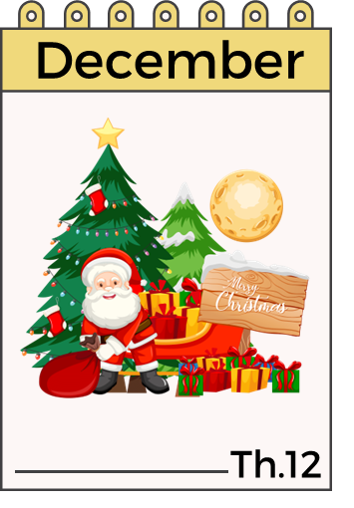
Months of a year.
MsPham
0936082789

Slide 19

What is the month missing?
MsPham
0936082789

Slide 20
What is the month missing?

Slide 21
What is the month missing?

Slide 22
What is the month missing?

Slide 23
I. Vocabulary
January
: Tháng 1
February
: Tháng 2
MsPham
0936082789
March
: Tháng 3
April
: Tháng 4
May
: Tháng 5
June
: Tháng 6

Slide 24
I. Vocabulary
July
: Tháng 7
August
: Tháng 8
MsPham
0936082789
September
: Tháng 9
October
: Tháng 10
November
: Tháng 11
December
: Tháng 12

Slide 25
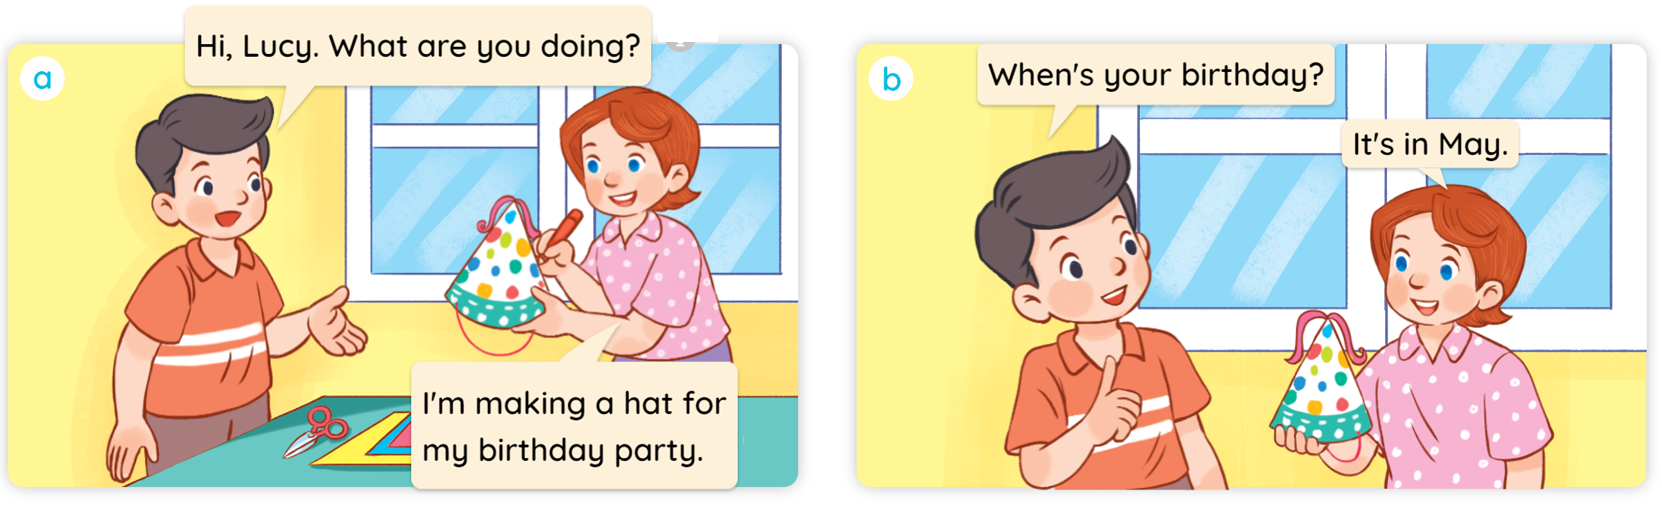

1
Look, listen and read.

Slide 26
MsPham
0936082789
Structure

Slide 27
1
Cách hỏi sinh nhật của bạn:
When’s your birthday?
(Khi nào là sinh nhật của bạn?)
It’s in _________.
(Vào tháng _____.)
(+ month)
Ex:
When’s your birthday?
MsPham
0936082789
It’s in June.

Slide 28
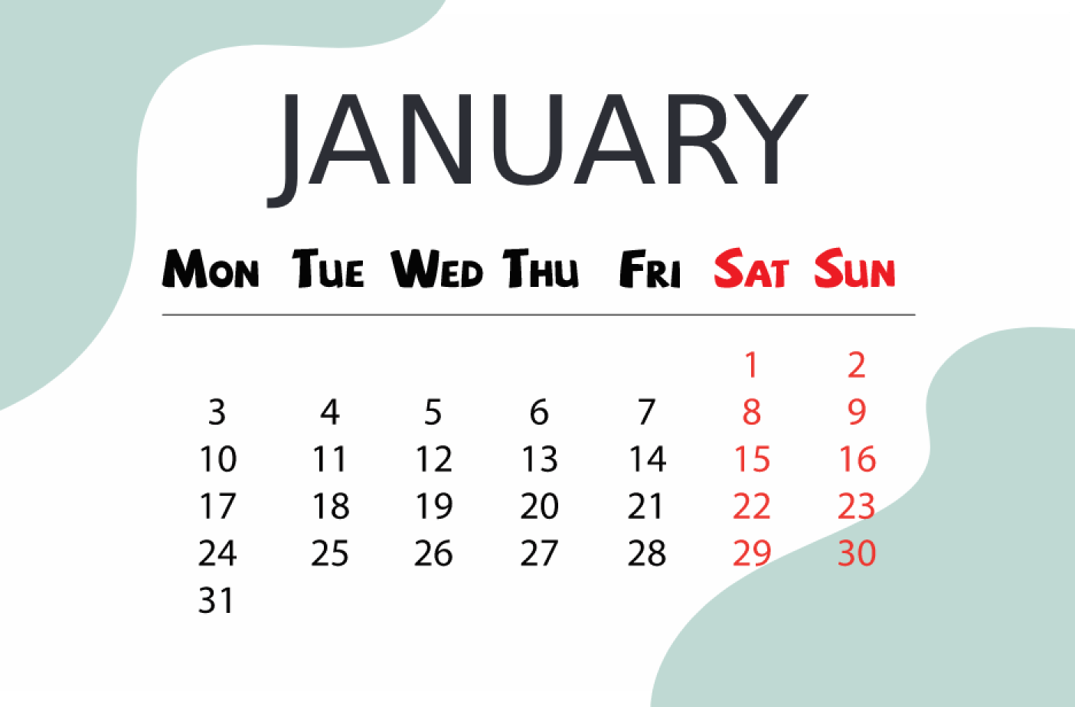
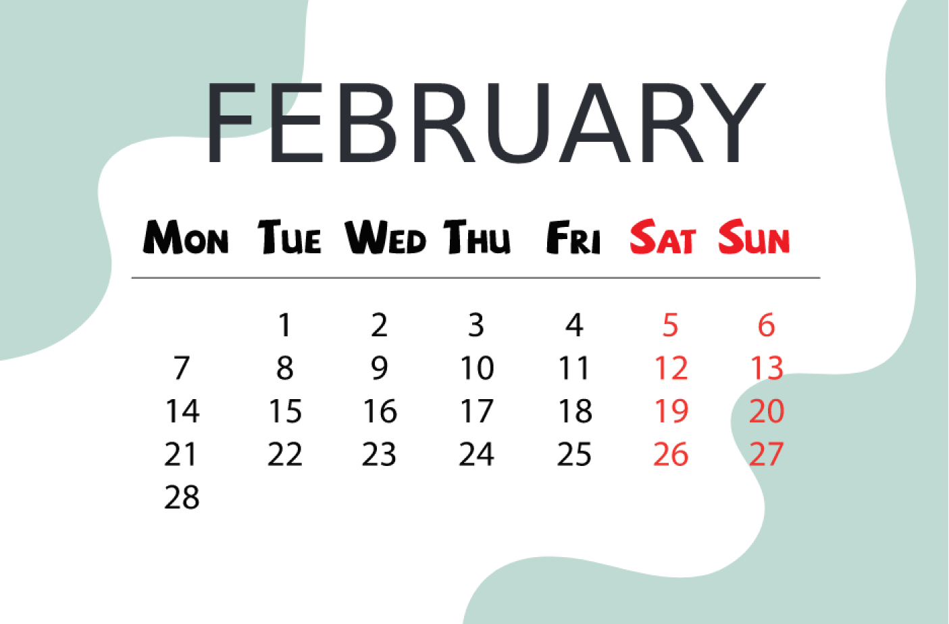
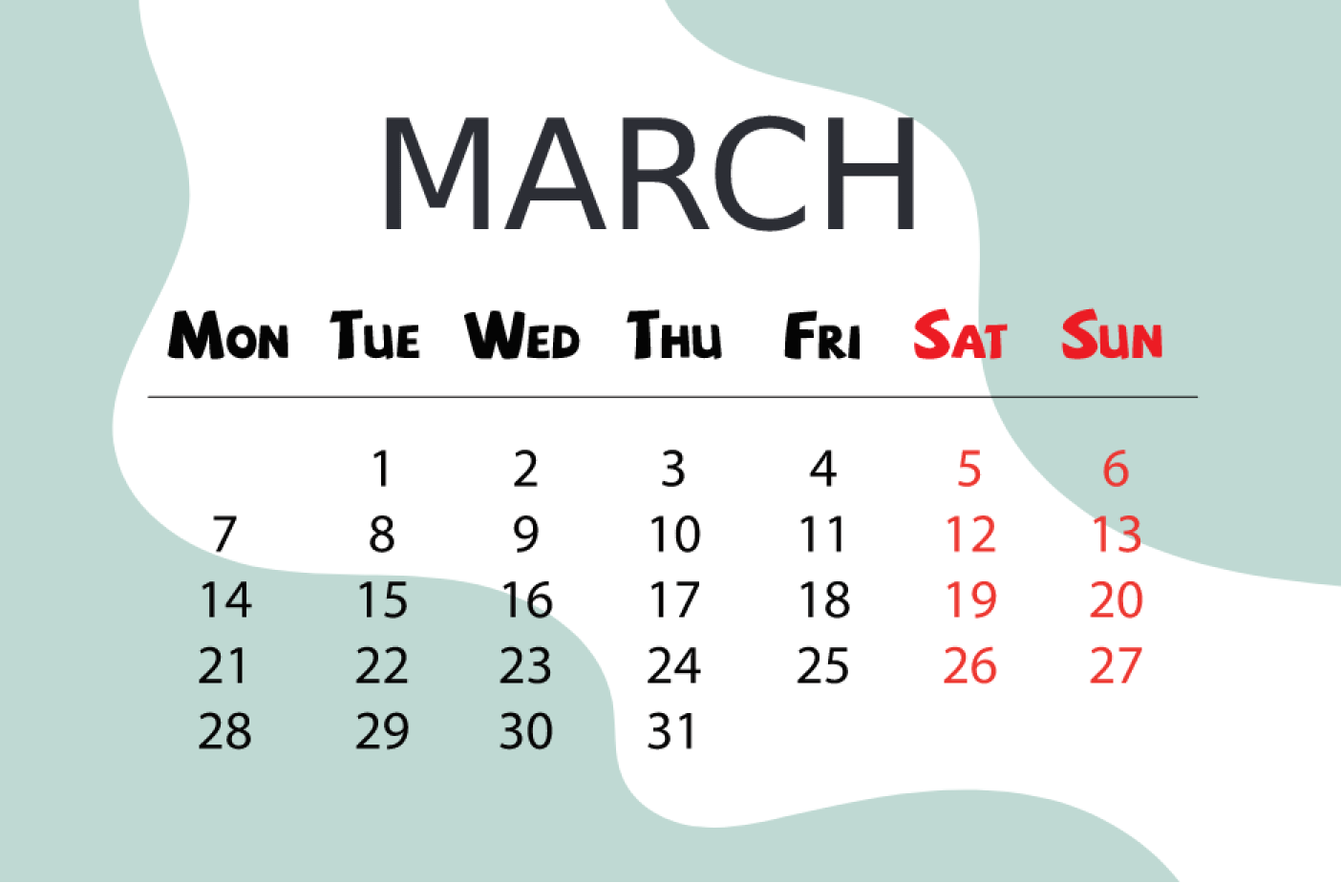
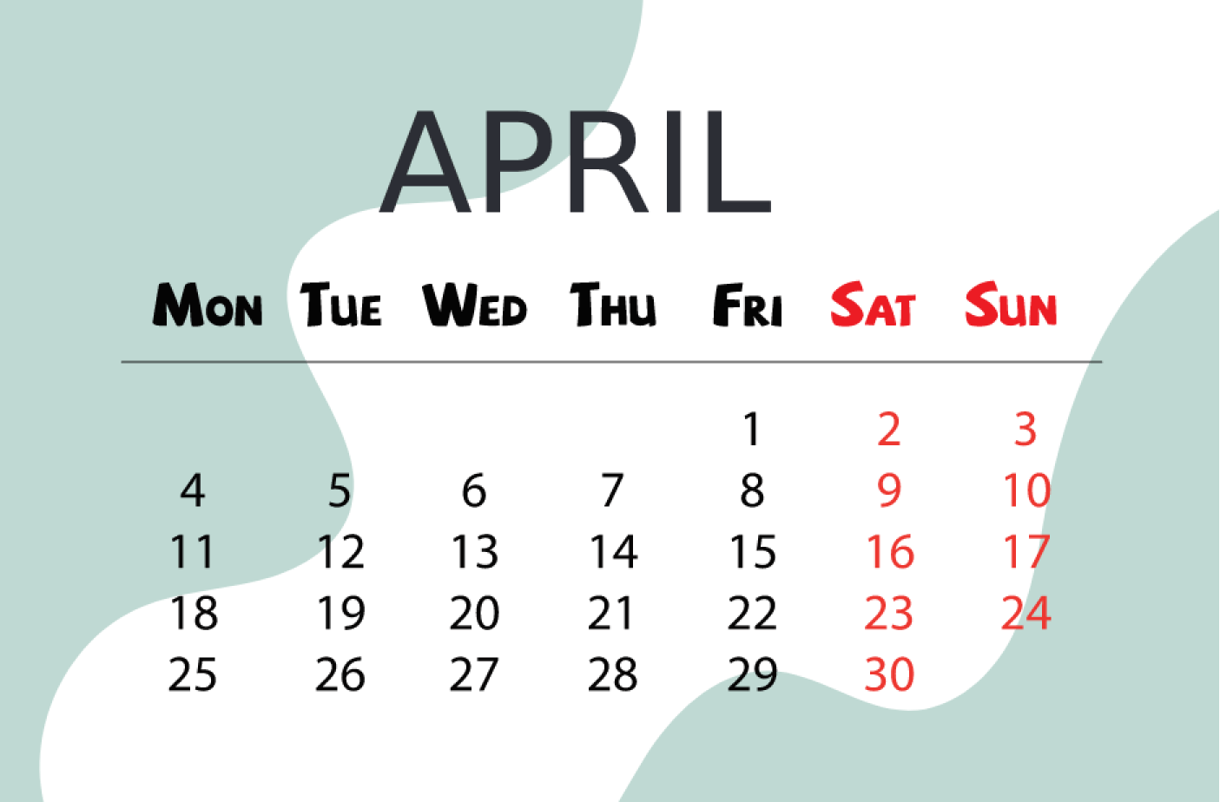
2
Listen, point and say.
When’s your birthday?
It’s _________.
a
b
January
February
MsPham
0936082789
c
d
March
April

Slide 29


2
Listen, point and say.
MsPham
0936082789
When’s your birthday?
It’s in January.

Slide 30


2
Listen, point and say.
MsPham
0936082789
When’s your birthday?
It’s in February.

Slide 31
2
Listen, point and say.
MsPham
0936082789
When’s your birthday?
It’s in March.

Slide 32
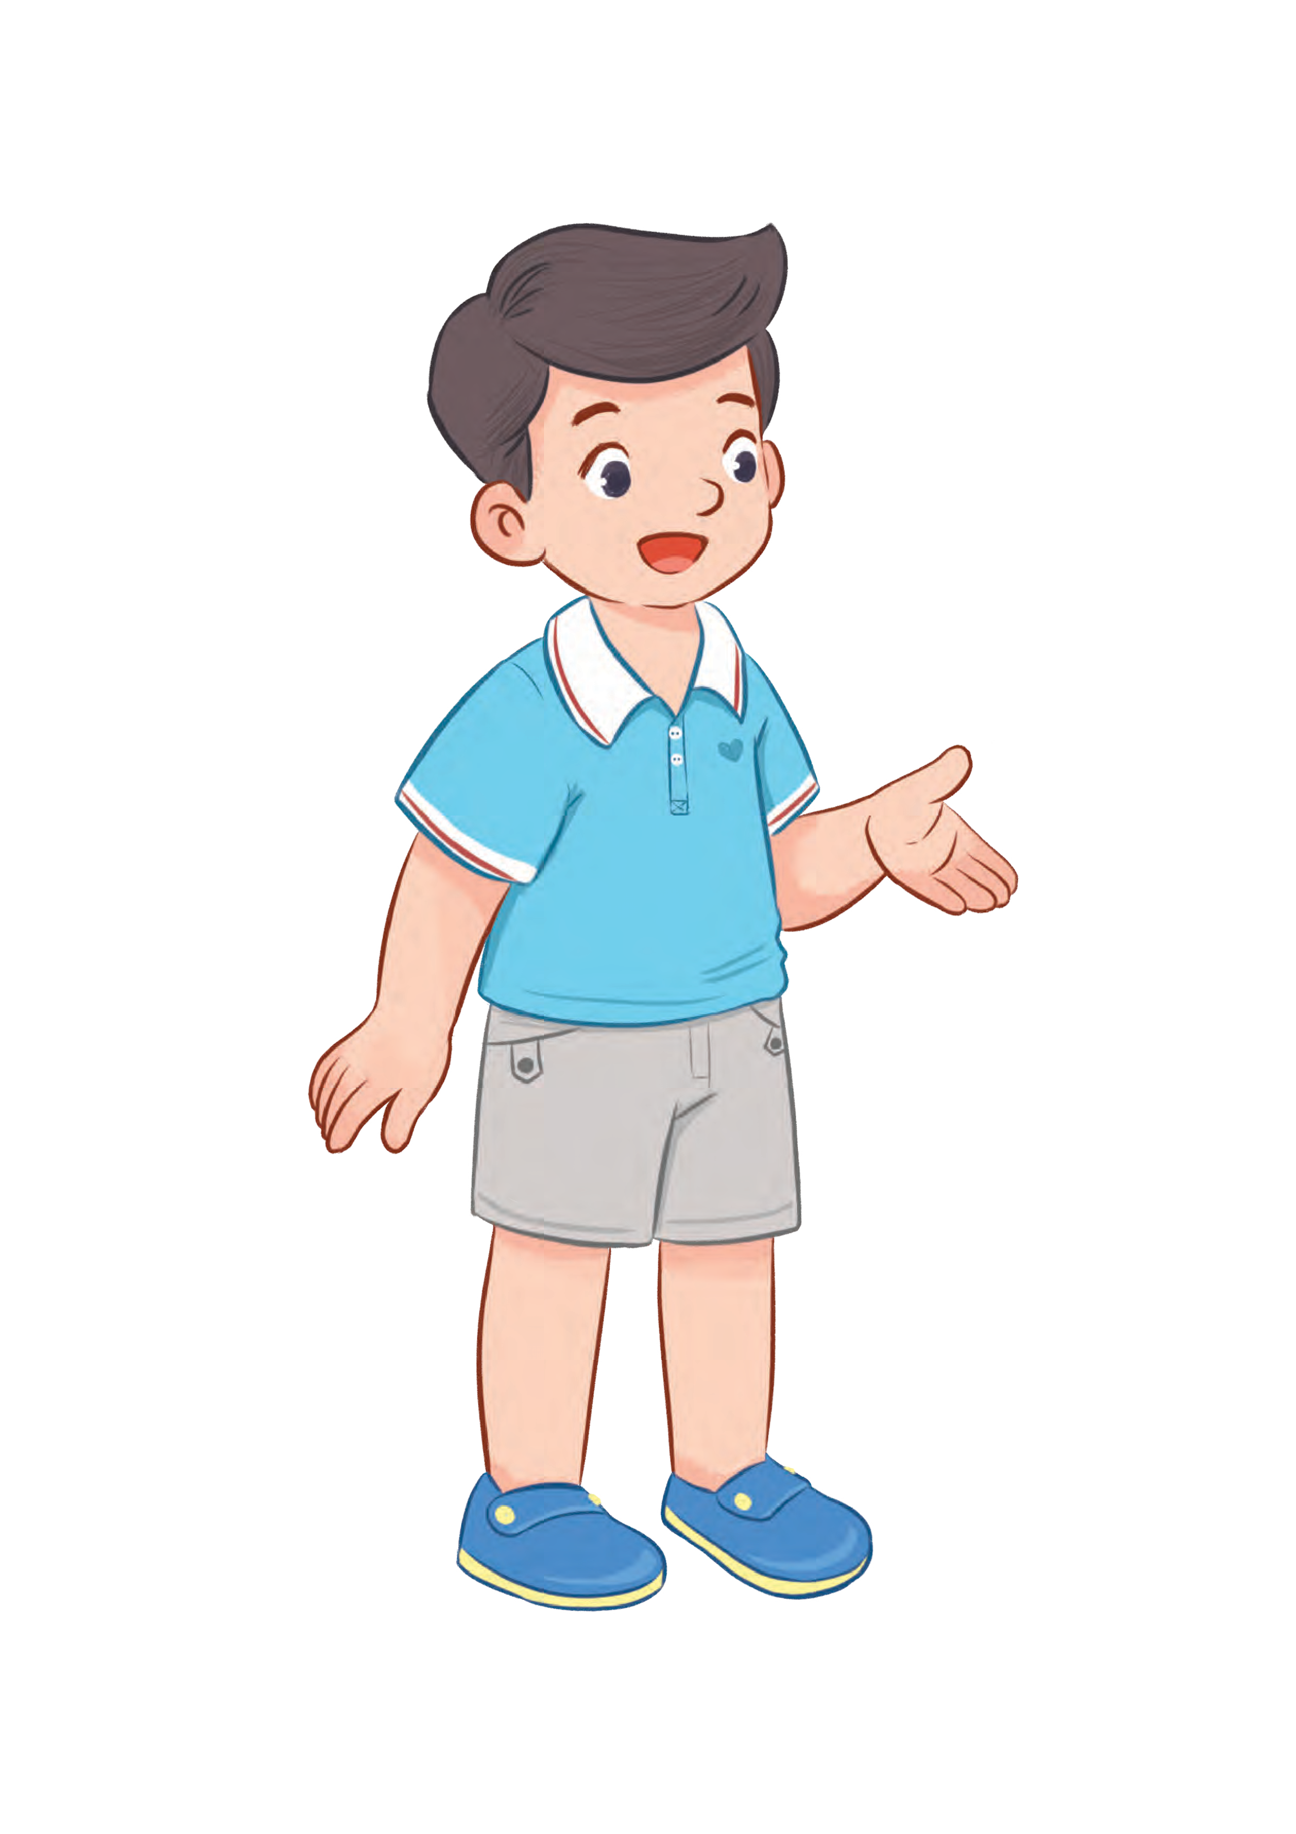
2
Listen, point and say.
MsPham
0936082789
When’s your birthday?
It’s in April.

Slide 33

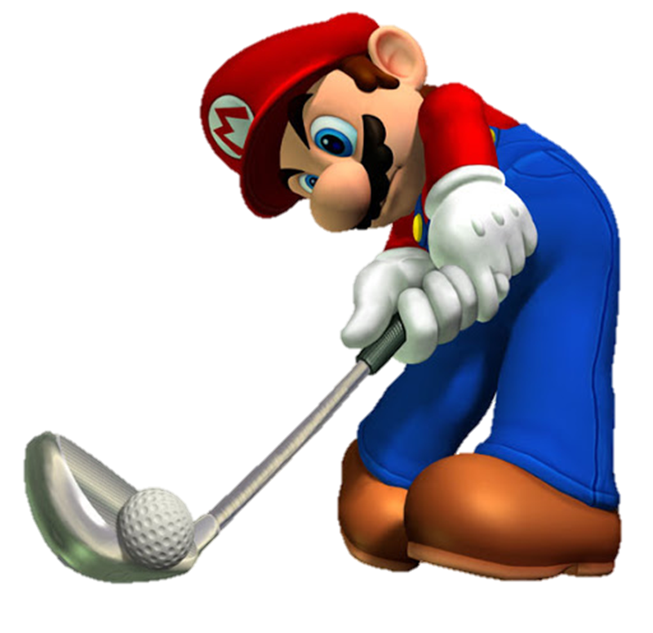
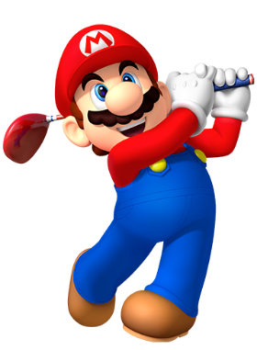

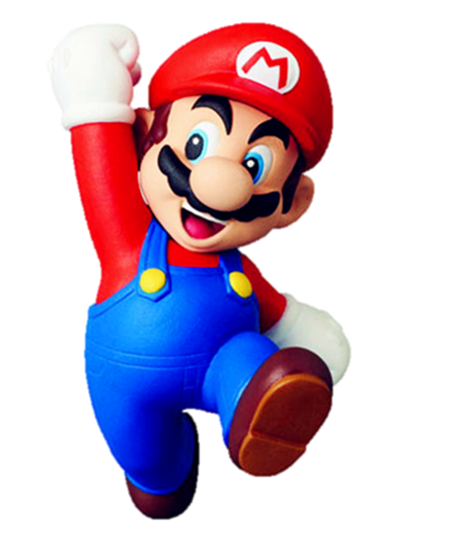


Slide 34




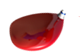





When’s your birthday?
It’s in
February
It’s in
March
It’s in
August

Slide 35

When’s your birthday?
It’s in
April
It’s in
July
It’s in
March

Slide 36

When’s your birthday?
It’s in
November
It’s in
October
It’s in
May

Slide 37
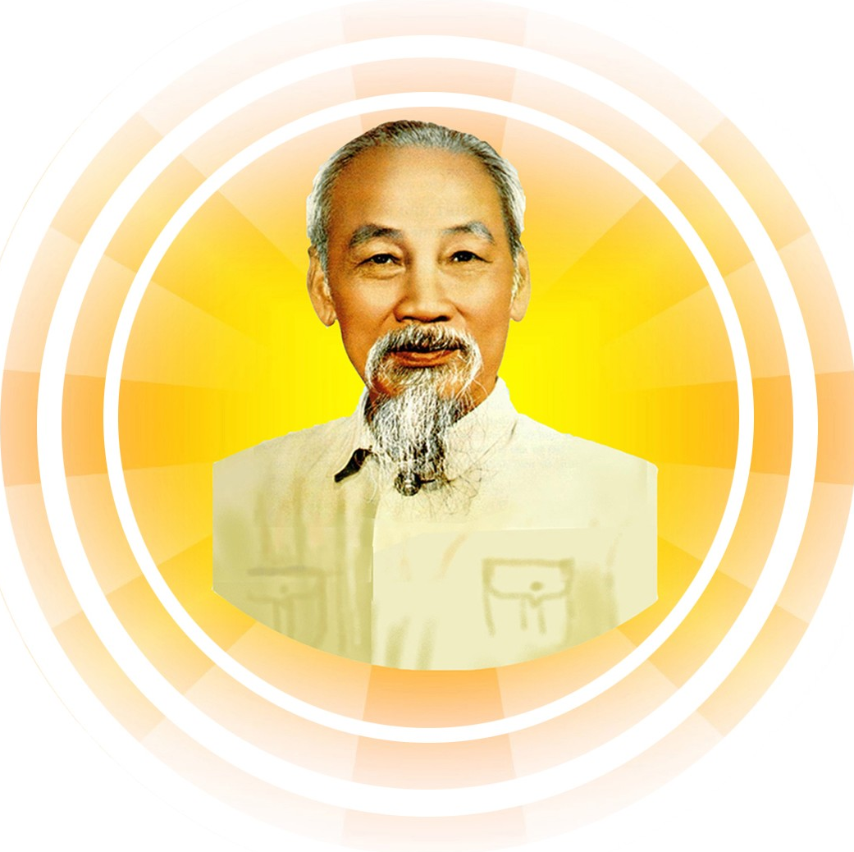

When’s your birthday?
It’s in
May
It’s in
June
It’s in
September

Slide 38

When’s your birthday?
It’s in
May
It’s in
September
It’s in
April

Slide 39

When’s your birthday?
It’s in
February
It’s in
January
It’s in
April

Slide 40

MsPham
0936082789
When’s your birthday?
It’s in
October
It’s in
July
It’s in
August

Slide 41

When’s your birthday?
It’s in
October
It’s in
June
It’s in
September

Slide 42

MsPham
0936082789
When’s your birthday?
It’s in
December
It’s in
January
It’s in
September

Slide 43

When’s your birthday?
It’s in
August
It’s in
February
It’s in
September

Slide 44

When’s your birthday?
It’s in
December
It’s in
January
It’s in
November

Slide 45

MsPham
0936082789
When’s your birthday?
It’s in
March
It’s in
November
It’s in
July

Slide 46

MsPham
0936082789
GOOD JOB!

Slide 47

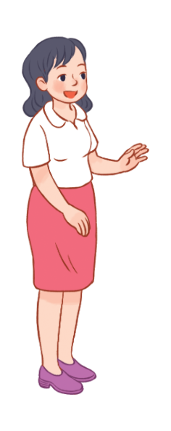
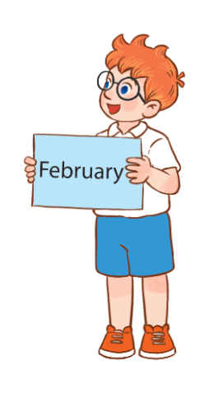
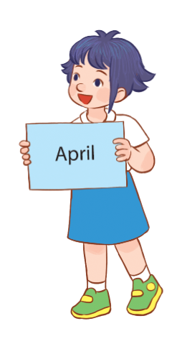
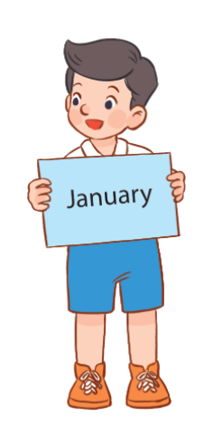
3
Let’s talk.
It’s in ___________.
When’s your birthday?

Slide 48
MsPham
0936082789
Review

Slide 49
When’s your birthday?
It’s in ___________.
MsPham
0936082789

Slide 50
Thank you
for joining!

