Slide 1







Unit 4
My Birthday
Party
Lesson 1 - Period 2

Slide 2


MsPham
0936082789
Warm-up

Slide 3


BRICK WALL GAME
PLAY

Slide 4

When’s your birthday?
_______________
It’s in April.
Open
Next
Check

Slide 5

When’s your birthday?
_______________
It’s in March.
Open
Next
Check

Slide 6

When’s your birthday?
_______________
It’s in February.
Open
Next
Check

Slide 7
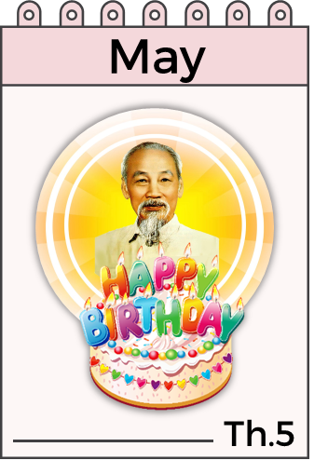
When’s your birthday?
_______________
It’s in May.
Open
Next
Check

Slide 8
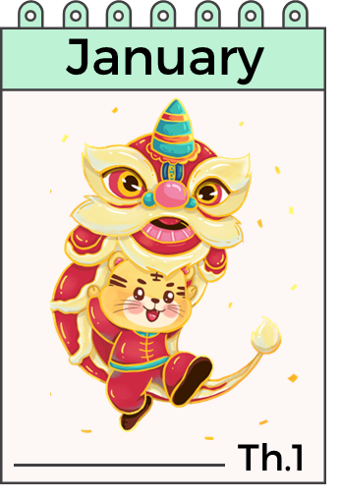
When’s your birthday?
___________
It’s in January.
Open
Next
Check

Slide 9


Next

Slide 10
MsPham
0936082789
Review

Slide 11


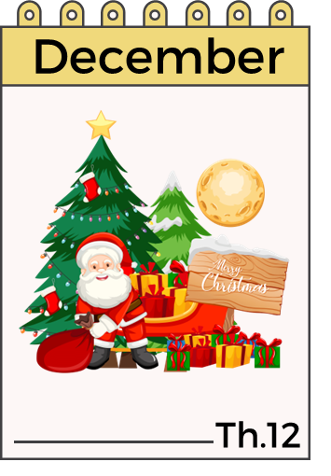


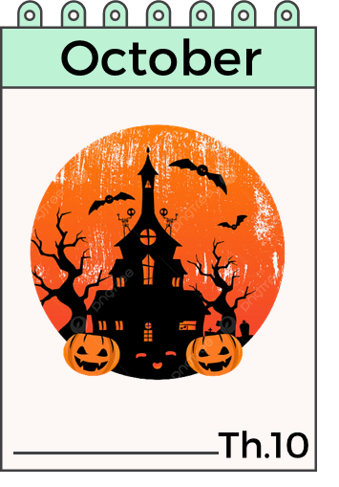

When’s your birthday?
It’s in ___________.
MsPham
0936082789

Slide 12
MsPham
0936082789
Practice

Slide 13
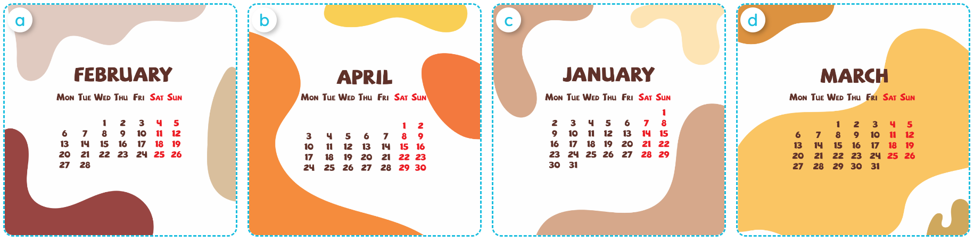

4
Listen and number.
MsPham
0936082789
2
1
4
3
1
2
3
4

Slide 14



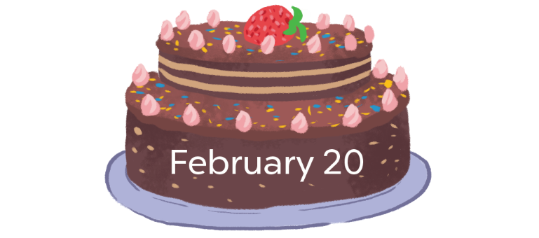
5
Look, complete and read.
1
2
MsPham
0936082789
A: When’s your birthday?
B: It’s in ___________.
A: When’s your birthday?
B: It’s in ___________.
March
May
3
4
birthday
When’s
A: When’s your _________?
B: It’s in ___________.
A: ________ your birthday?
B: It’s _______________.
February
in April

Slide 15


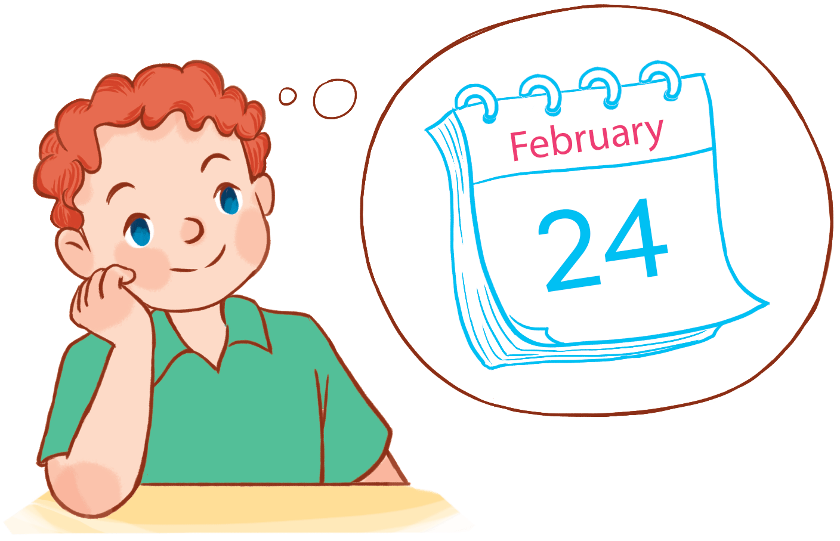
6
Let’s sing.
When's your birthday?
When's your birthday?
When's your birthday?
When's your birthday?
When's your birthday?
When's your birthday?
It's in January.
It's in January.
It's in January.
My birthday's in January.
My birthday's in January.
My birthday's in January.
When's your birthday?
When's your birthday?
When's your birthday?
When's your birthday?
When's your birthday?
When's your birthday?
It's in February.
It's in February.
It's in February.
MsPham
0936082789
My birthday's in February.
My birthday's in February.
My birthday's in February.
Hide

Slide 16

6
Let’s sing.
When's your birthday?
When's your birthday?
When's your birthday?
When's your birthday?
It's in January.
It's in January.
My birthday's in January.
My birthday's in January.
When's your birthday?
When's your birthday?
When's your birthday?
When's your birthday?
It's in February.
It's in February.
MsPham
0936082789
My birthday's in February.
My birthday's in February.

Slide 17
Thank you
for joining!

Slide 18
Mến gửi quý thầy cô!
MsPham xin gửi lời cảm ơn chân thành tới quý thầy cô đã tin tưởng và sử dụng bộ bài giảng Global Sucess 4 được soạn bởi MsPham.
Bài giảng là tâm huyết và công sức lao động của MsPham. Kính mong quý thầy cô trân trọng và sử dụng bài giảng đúng mục đích. Quý thầy cô được chỉnh sửa bài giảng theo ý đồ dạy học của mình. Tuy nhiên, mọi hình thức sao chép, mua bán, chia sẻ bộ bài giảng này đều là "ĂN CẮP". MsPham tin rằng quý thầy cô đều là những NGƯỜI LÀM GIÁO DỤC CHÂN CHÍNH.
Mọi thông tin phản hồi hoặc cần hỗ trợ vui lòng liên hệ với MsPham: 0936082789 (zalo).
Và xin kính chúc quý thầy cô sức khỏe để thắp lửa và lan tỏa tri thức tốt đẹp tới phụ huynh và học sinh của mình.
With love, MsPham.

