Slide 1







Unit 4
My Birthday
Party
Lesson 2

Slide 2


MsPham
0936082789
Warm-up

Slide 3
Memorising game

Slide 4
RULES OF THE GAME
Watch a video clip about some food and drinks.
Try to remember their names.
You have one minute to write them in English on the board.

Slide 5





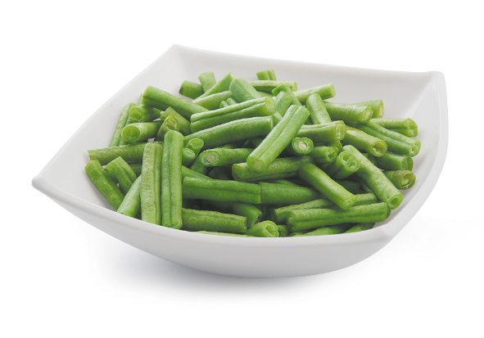

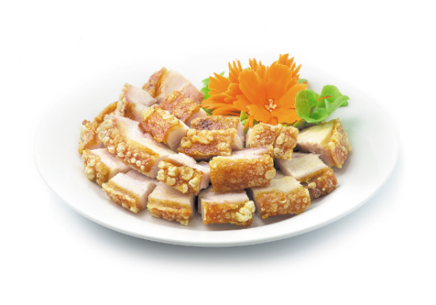
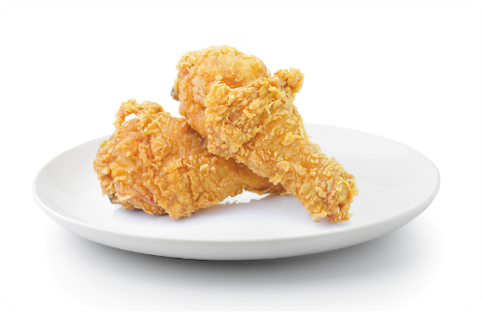
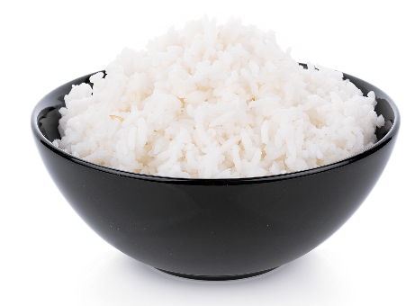
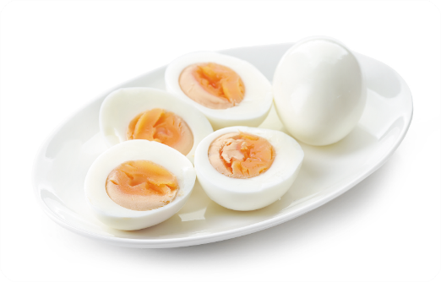
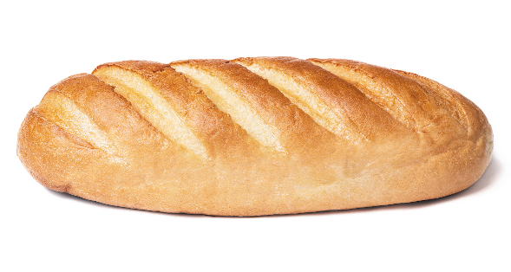

Slide 6
Write

Slide 7
MsPham
0936082789
Review

Slide 8
Some food and drinks.
eggs
chicken
beans
fish
meat
rice
/eɡz/
/ˈtʃɪkɪn/
/biːnz/
/fɪʃ/
/miːt/
/raɪs/
bread
eat
juice
water
milk
drink
/bred/
/iːt/
/dʒuːs/
/ˈwɔːtər/
/mɪlk/
/drɪŋk/

Slide 9
MsPham
0936082789
Vocabulary

Slide 10
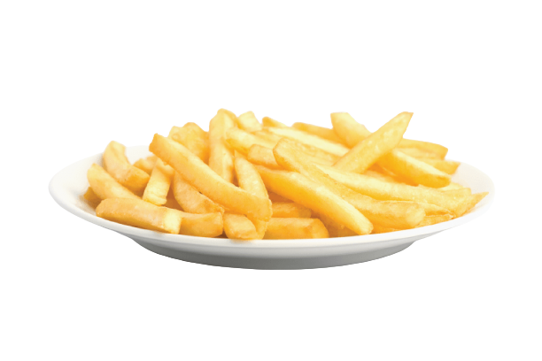
MsPham
0936082789
chips
Khoai tây chiên
/tʃɪps/

Slide 11
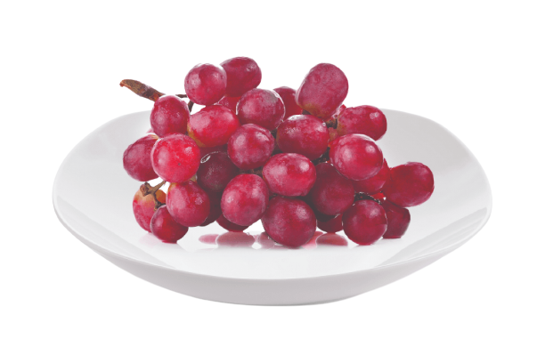
MsPham
0936082789
grapes
Quả nho
/ɡreɪps/

Slide 12

MsPham
0936082789
lemonade
Nước chanh
/ˌleməˈneɪd/

Slide 13

MsPham
0936082789
water
Nước
/ˈwɔːtər/

Slide 14

MsPham
0936082789
jam
Mứt
/dʒæm/

Slide 15
MsPham
0936082789
juice
Nước ép
/dʒuːs/

Slide 16




I. Vocabulary
chips
: Khoai tây chiên
grapes
: Quả nho
MsPham
0936082789
lemonade
: Nước chanh
water
: Nước
jam
: Mứt
juice
: Nước ép

Slide 17
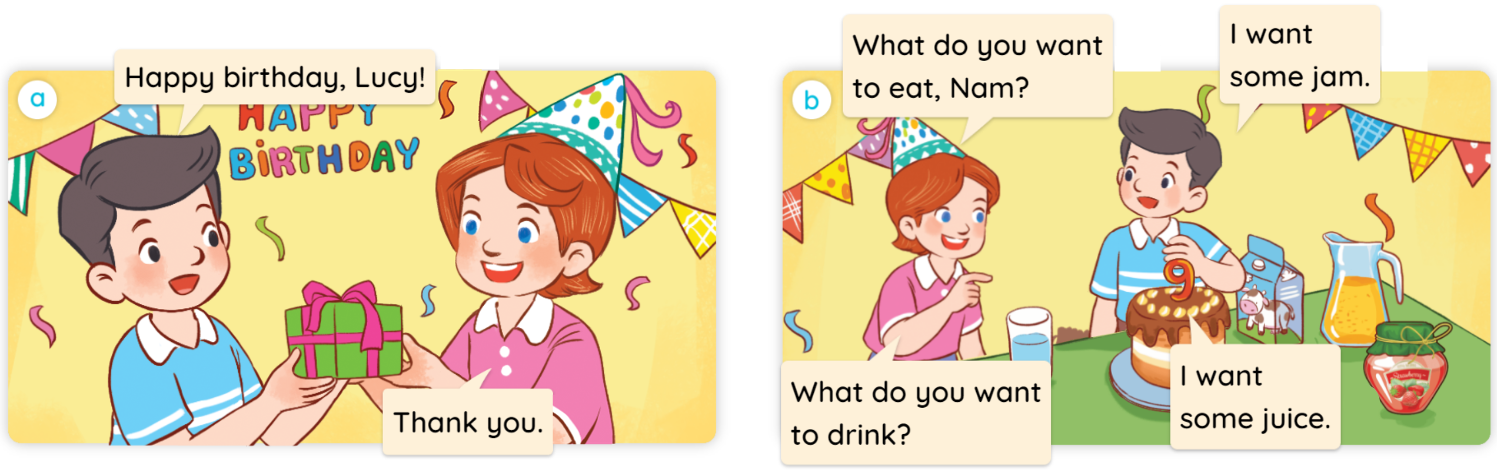

1
Look, listen and read.

Slide 18
MsPham
0936082789
Structure

Slide 19
2
Cách hỏi bạn muốn ăn/ uống gì:
What do you want to eat/drink?
(Bạn muốn ăn/ uống gì?)
I want some _________.
(Tớ muốn một ít/ một chút _____.)
Ex:
What do you want to drink?
I want some water.
MsPham
0936082789
What do you want to eat?
I want some jam.
MsPham
0936082789

Slide 20
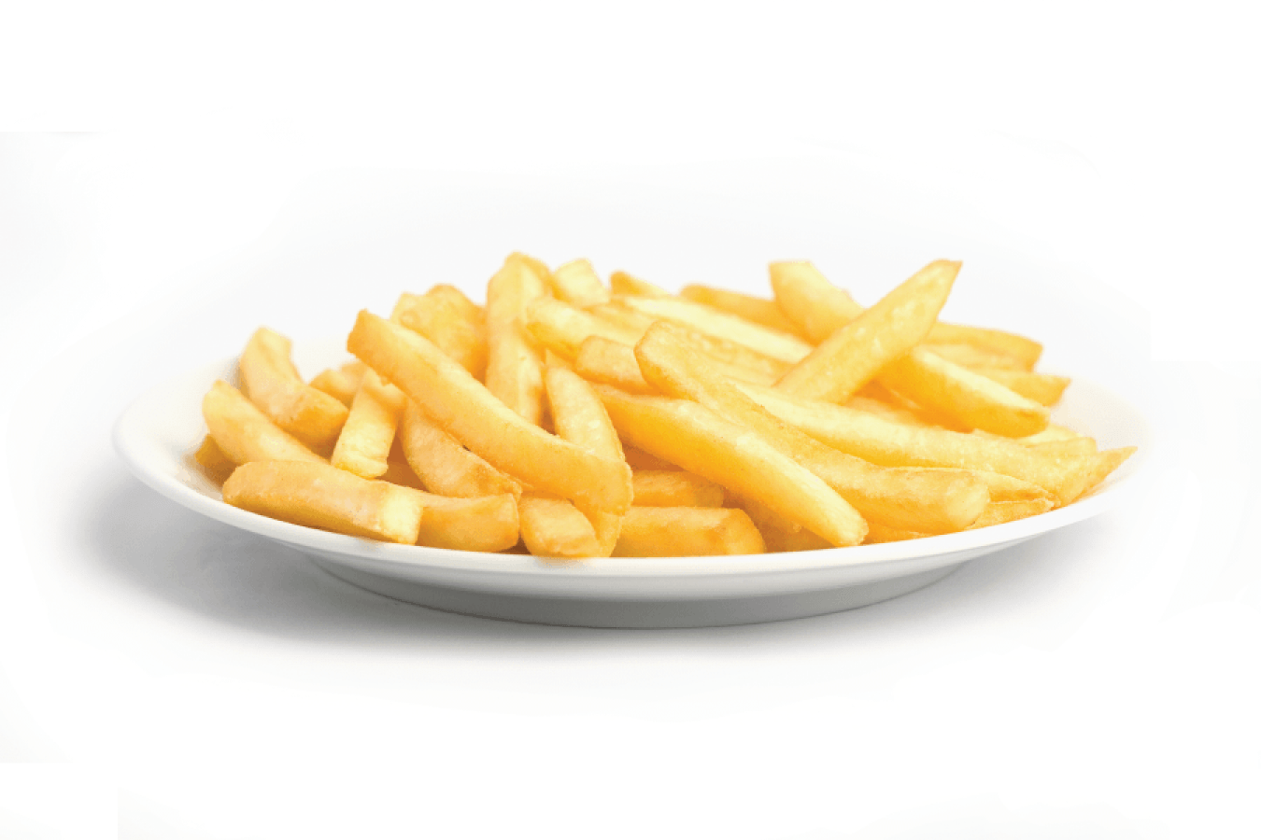



2
Listen, point and say.
What do you want to eat/drink?
I want ________________.
a
b
MsPham
0936082789
some chips
some grapes
c
d
some lemonade
some water

Slide 21
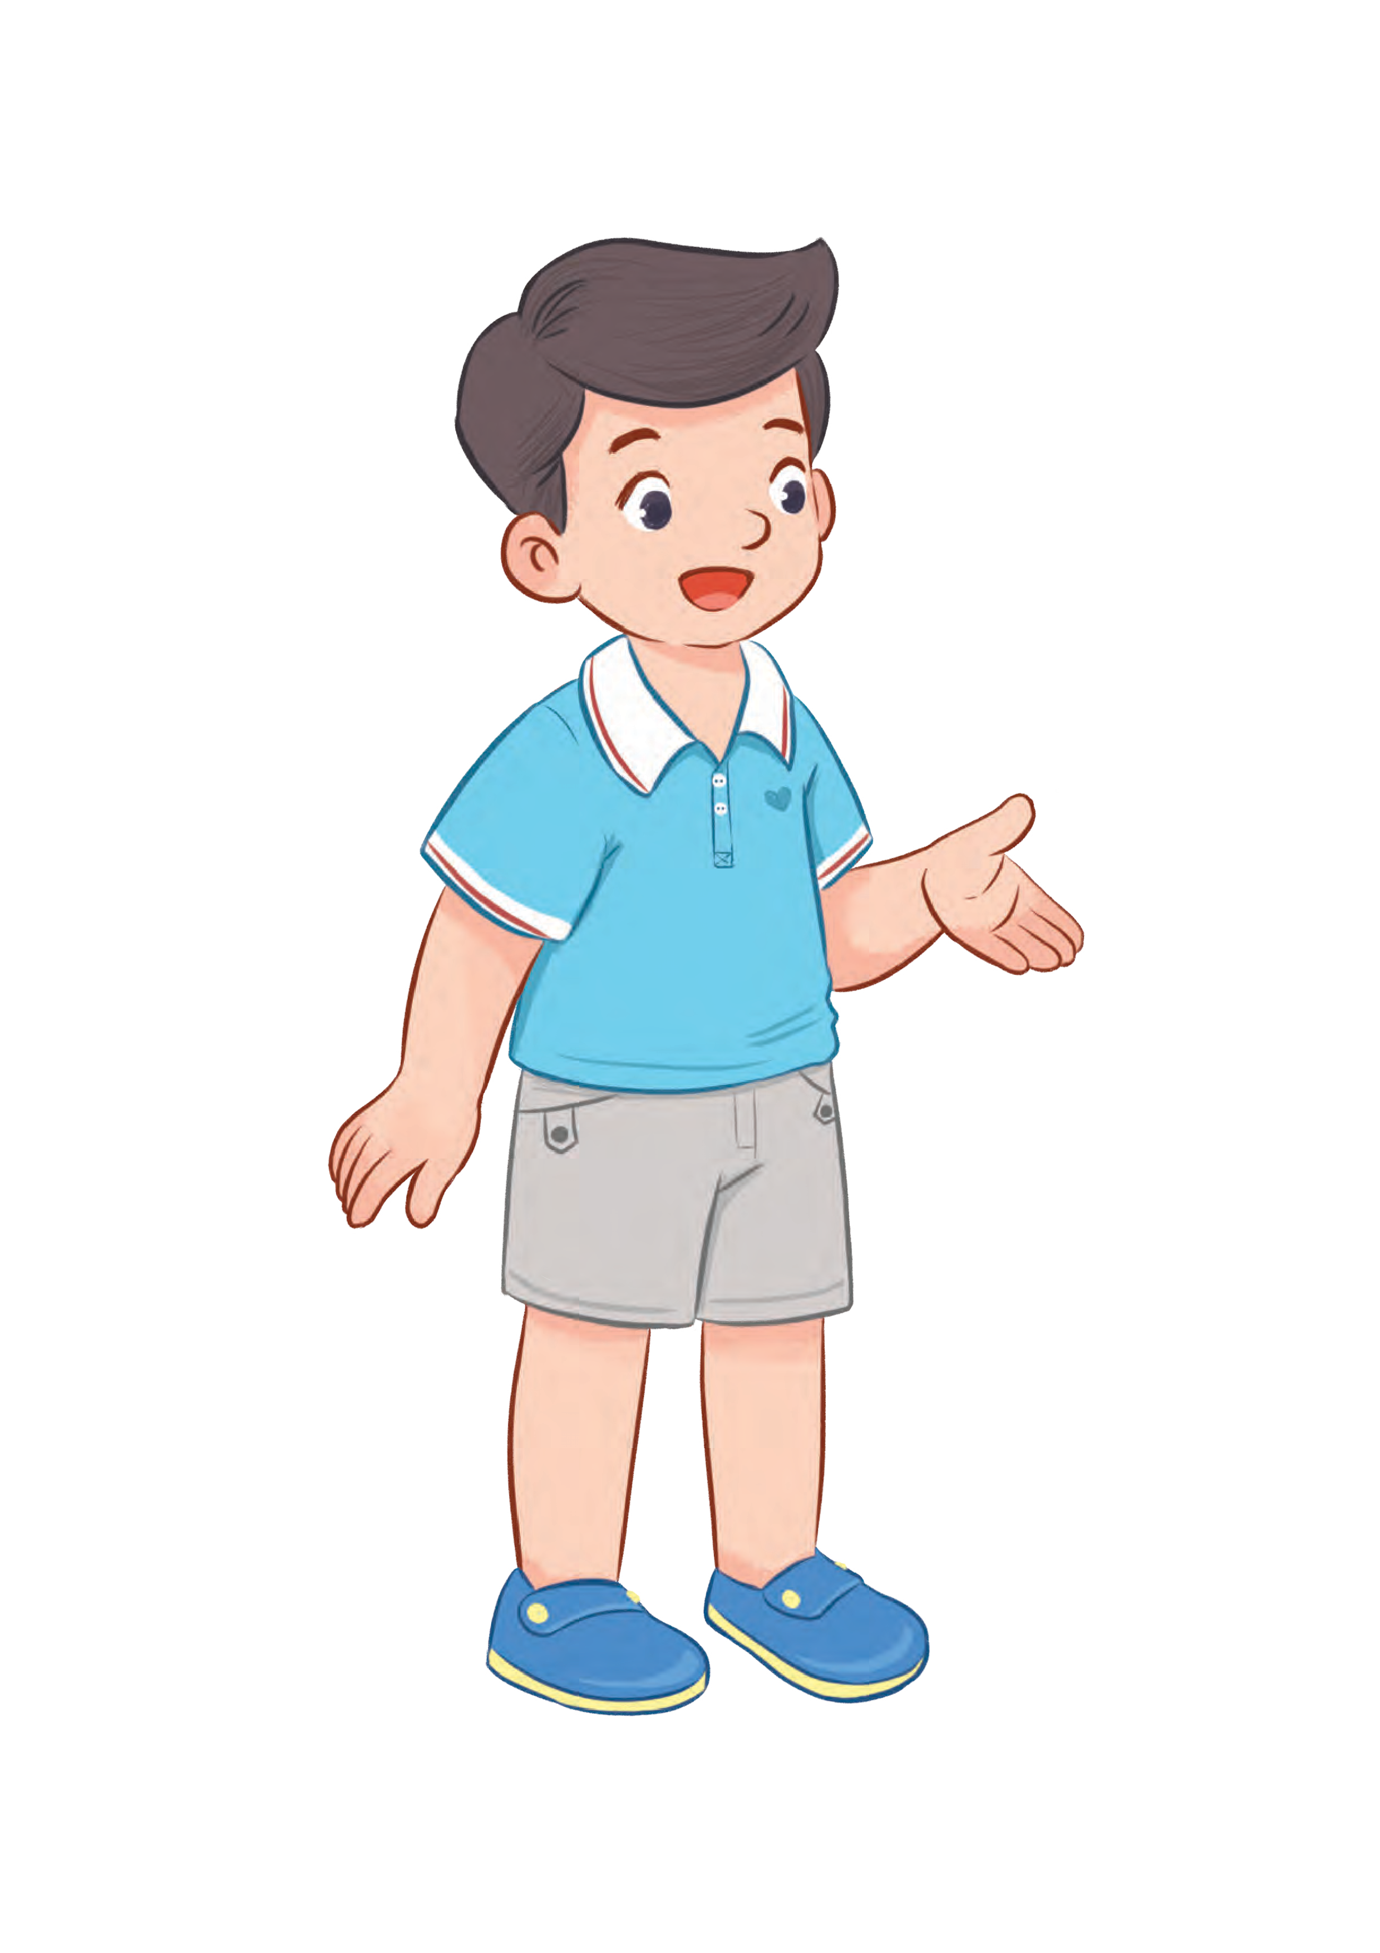

a
MsPham
0936082789
some chips
What do you want to eat?
I want some chips.

Slide 22
b
MsPham
0936082789
some grapes
What do you want to eat?
I want some grapes.

Slide 23
c
MsPham
0936082789
some lemonade
What do you want to drink?
I want some lemonade.

Slide 24
c
MsPham
0936082789
some water
What do you want to drink?
I want some water.

Slide 25
2
Listen, point and say.
What do you want to eat/drink?
I want ________________.
a
b
MsPham
0936082789
some chips
some grapes
c
d
some lemonade
some water

Slide 26




HATCHING EGGS
MsPham
0936082789
Start

Slide 27
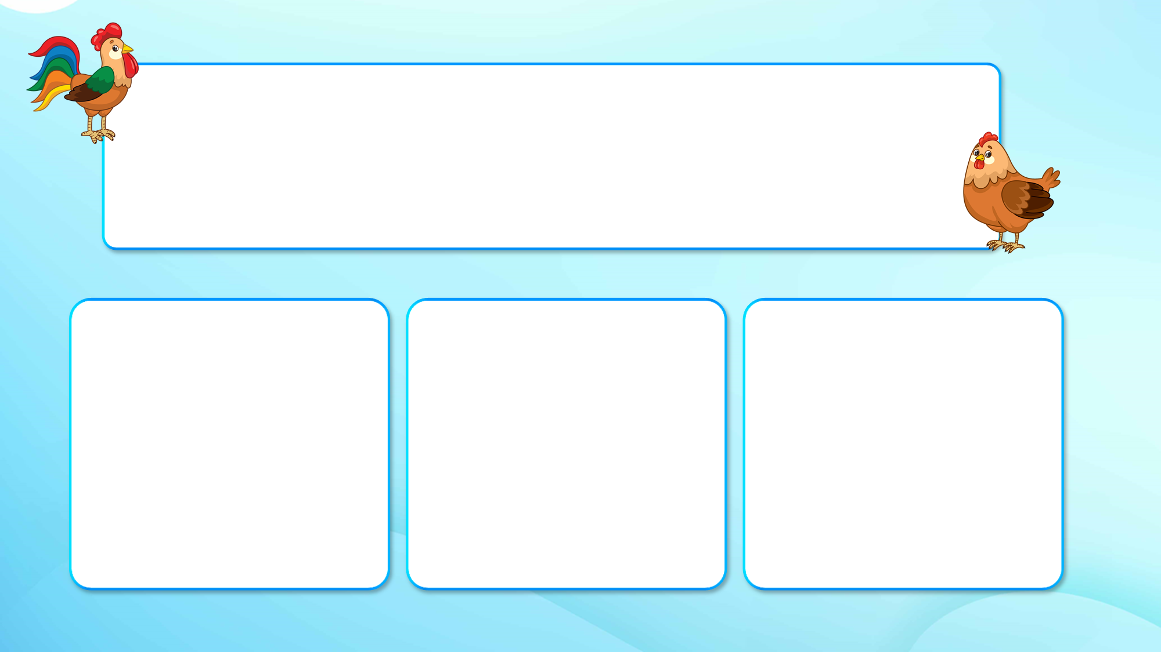
Choose the best option.
What do you want to drink?
I want some lemonade.
I want some juice.
I want some water.
A
B
C
Next

Slide 28
Choose the best option.
What do you want to eat?
I want some grapes.
I want some chips.
I want some jam.
A
B
C
Next

Slide 29
Choose the best option.
What do you want to drink?
MsPham-0936082789
I want some jam.
I want some lemonade.
I want some water.
A
B
C
Next

Slide 30
Choose the best option.
What do you want to drink?
MsPham-0936082789
I want some water.
I want some juice.
I want some lemonade.
A
B
C
Next

Slide 31
Choose the best option.
What do you want to eat?
I want some jam.
I want some grapes.
I want some chips.
A
B
C
Next

Slide 32
Choose the best option.
What do you want to eat?
I want some chips.
I want some jam.
I want some grapes.
A
B
C
Next

Slide 33
Choose the best option.
I want some grapes.
What do you want to drink?
What do you want to eat?
Next
A
B

Slide 34
Choose the best option.
I want some lemonade.
What do you want to drink?
What do you want to eat?
Next
A
B

Slide 35
Choose the best option.
I want some water.
What do you want to drink?
What do you want to eat?
Next
A
B

Slide 36
Choose the best option.
I want some juice.
What do you want to eat?
What do you want to drink?
Next
A
B

Slide 37
Choose the best option.
I want some chips.
What do you want to eat?
What do you want to drink?
Next
A
B

Slide 38
Choose the best option.
I want some jam.
What do you want to drink?
What do you want to eat?
Next
A
B

Slide 39
Good job!
MsPham-0936082789
MsPham-0936082789
End

Slide 40





3
Let’s talk.
It’s in ___________.
When’s your birthday?

Slide 41
MsPham
0936082789
Review

Slide 42
What do you want to eat/drink?
I want some _________.
MsPham
0936082789
chips
water
grapes
lemonade
jam
juice

Slide 43
Thank you
for joining!

Slide 44
Mến gửi quý thầy cô!
MsPham xin gửi lời cảm ơn chân thành tới quý thầy cô đã tin tưởng và sử dụng bộ bài giảng Global Sucess 4 được soạn bởi MsPham.
Bài giảng là tâm huyết và công sức lao động của MsPham. Kính mong quý thầy cô trân trọng và sử dụng bài giảng đúng mục đích. Quý thầy cô được chỉnh sửa bài giảng theo ý đồ dạy học của mình. Tuy nhiên, mọi hình thức sao chép, mua bán, chia sẻ bộ bài giảng này đều là "ĂN CẮP". MsPham tin rằng quý thầy cô đều là những NGƯỜI LÀM GIÁO DỤC CHÂN CHÍNH.
Mọi thông tin phản hồi hoặc cần hỗ trợ vui lòng liên hệ với MsPham: 0936082789 (zalo).
Và xin kính chúc quý thầy cô sức khỏe để thắp lửa và lan tỏa tri thức tốt đẹp tới phụ huynh và học sinh của mình.
With love, MsPham.

