Slide 1







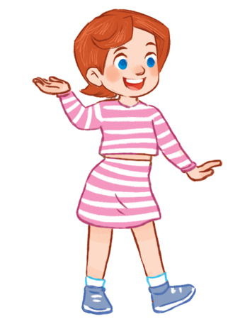


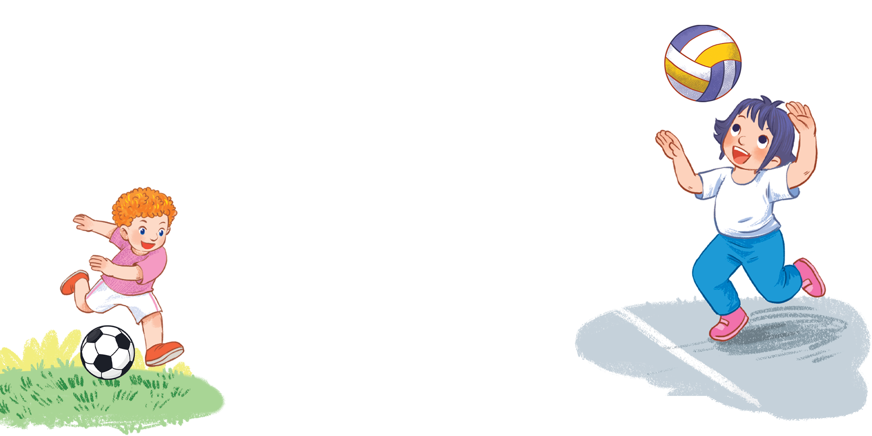



MsPham
0936082789
Unit 5
Things
we can do
Lesson 2 – Period 2

Slide 2



Warm-up
MsPham
0936082789

Slide 3

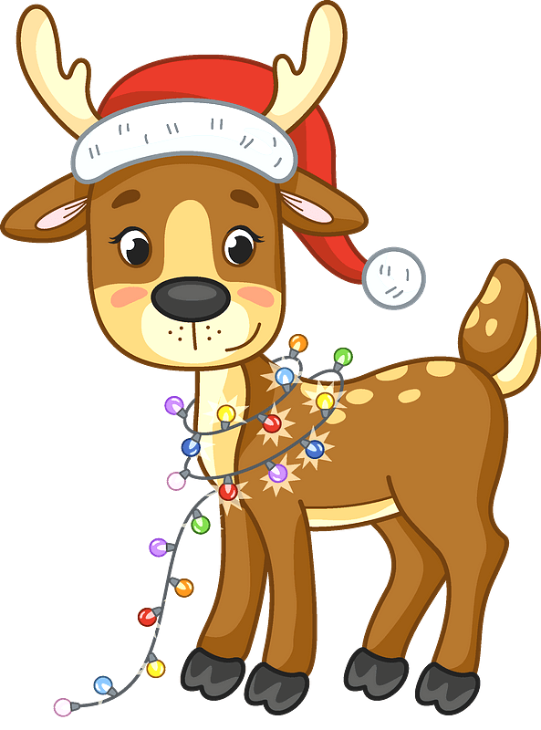
CHRISTMAS LIGHTS
START

Slide 4

Look and make question and answer.
no
she
Can
roller skate
Can she roller skate?
No, she can’t.
LIGHTS
CHECK

Slide 5
Look and make question and answer.
Yes
he
Can
swim
LIGHTS
Can he swim?
Yes, he can.
CHECK

Slide 6
Look and make question and answer.
Yes
she
Can
draw
LIGHTS
Can she draw?
Yes, she can.
CHECK

Slide 7
Look and make question and answer.
No
Tom
Can
cook
LIGHTS
Can Tom cook?
No, he can’t.
CHECK

Slide 8
Look and make question and answer.
No
Lucy
Can
skip
LIGHTS
Can Lucy skip?
No, she can’t.
CHECK

Slide 9
Look and make question and answer.
can’t
sister
Your
ride a bike
LIGHTS
Can your sister ride a bike?
No, she can’t.
CHECK

Slide 10
Look and make question and answer.
can
brother
play the guitar
Your
LIGHTS
Can your brother play the guitar?
Yes, he can.
CHECK

Slide 11
Good job!
END

Slide 12


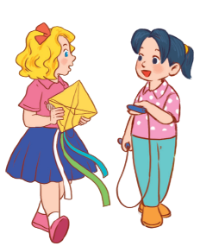

MsPham
0936082789
Review

Slide 13


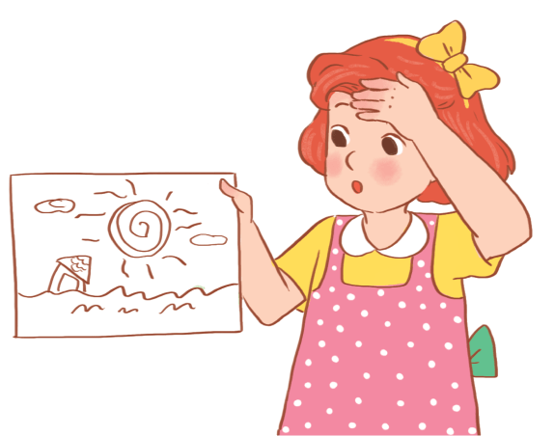
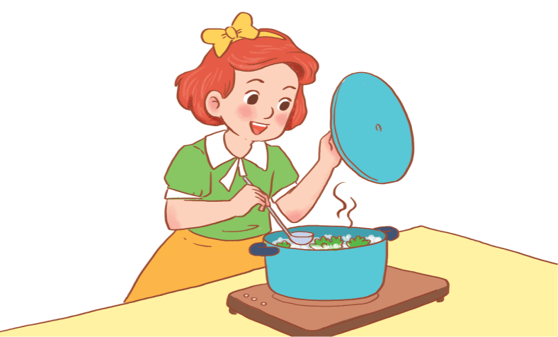
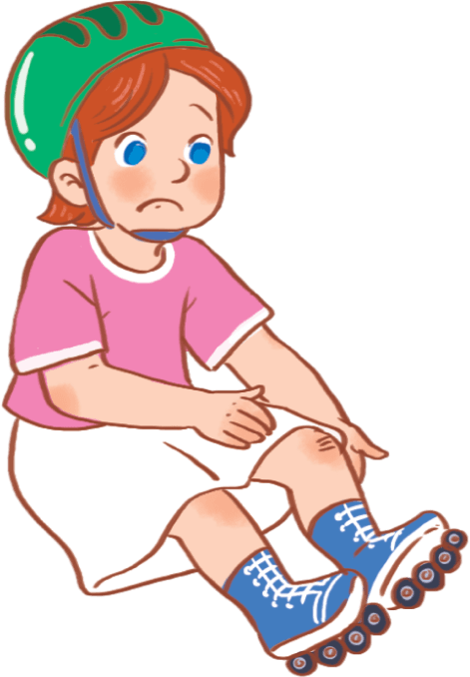
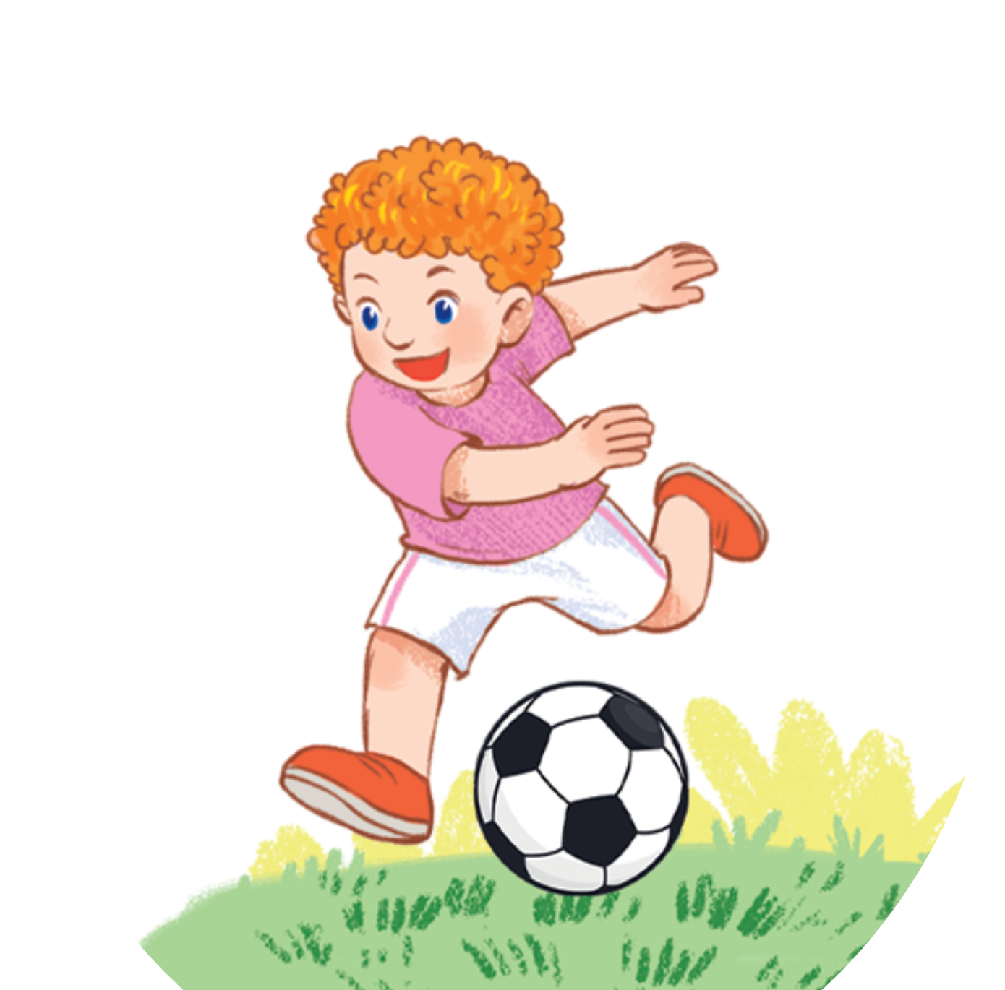
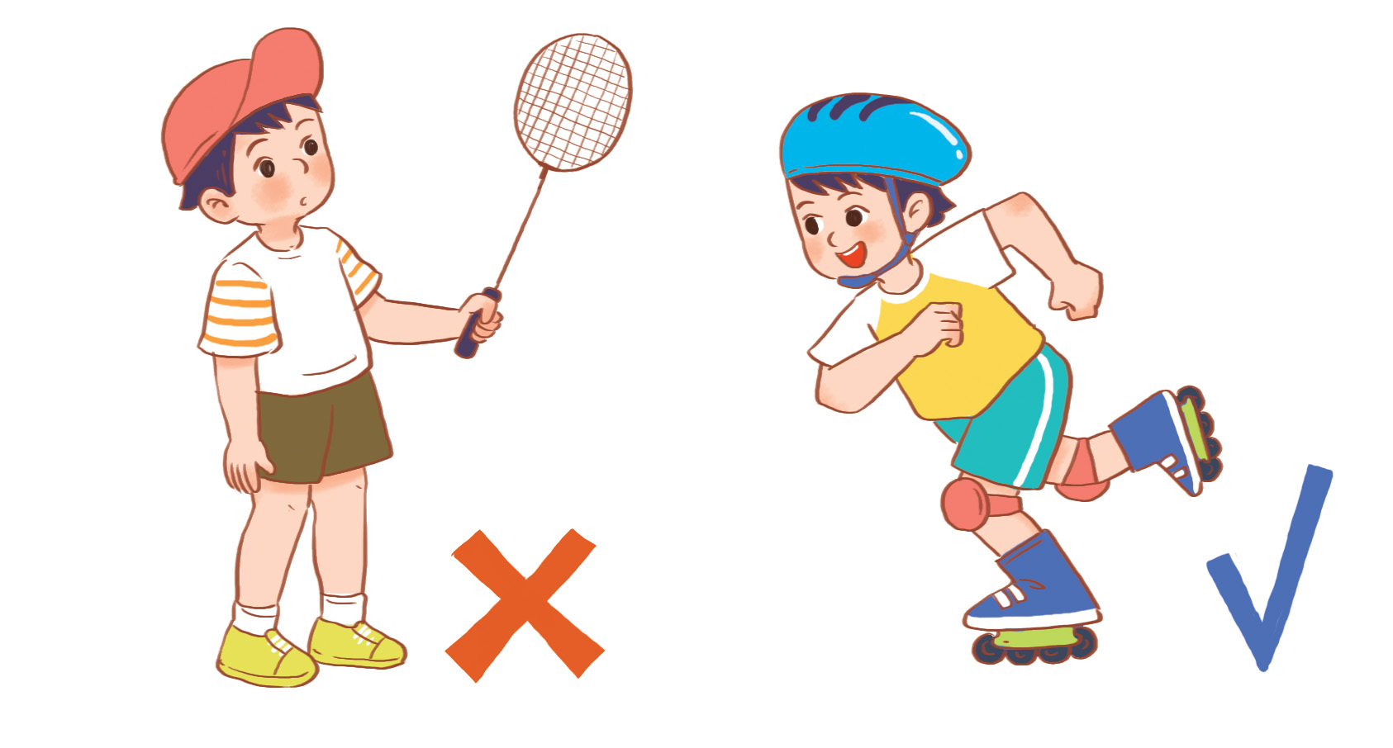
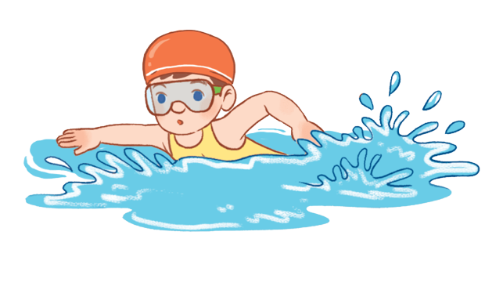
Yes, he/she can.
Can he/she + _________?
No, he/she can’t.
MsPham
0936082789
draw
cook
roller skate
swim
play
football
play
badminton

Slide 14
MsPham
0936082789
Practice

Slide 15

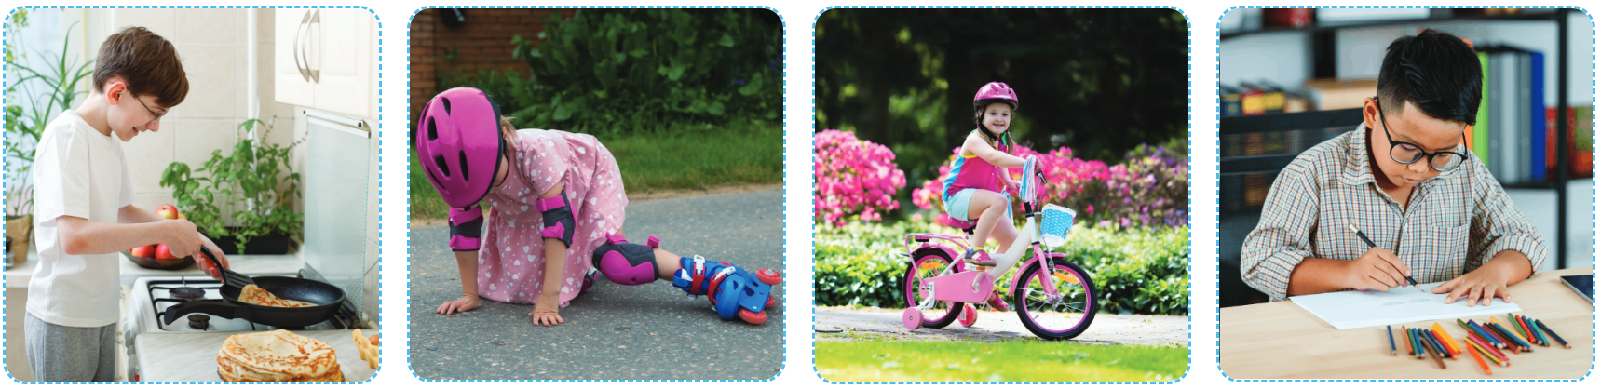
MsPham
0936082789
4
Listen and tick or cross.
1
2
3
4
MsPham
0936082789
✓
✗
✗
✓

Slide 16
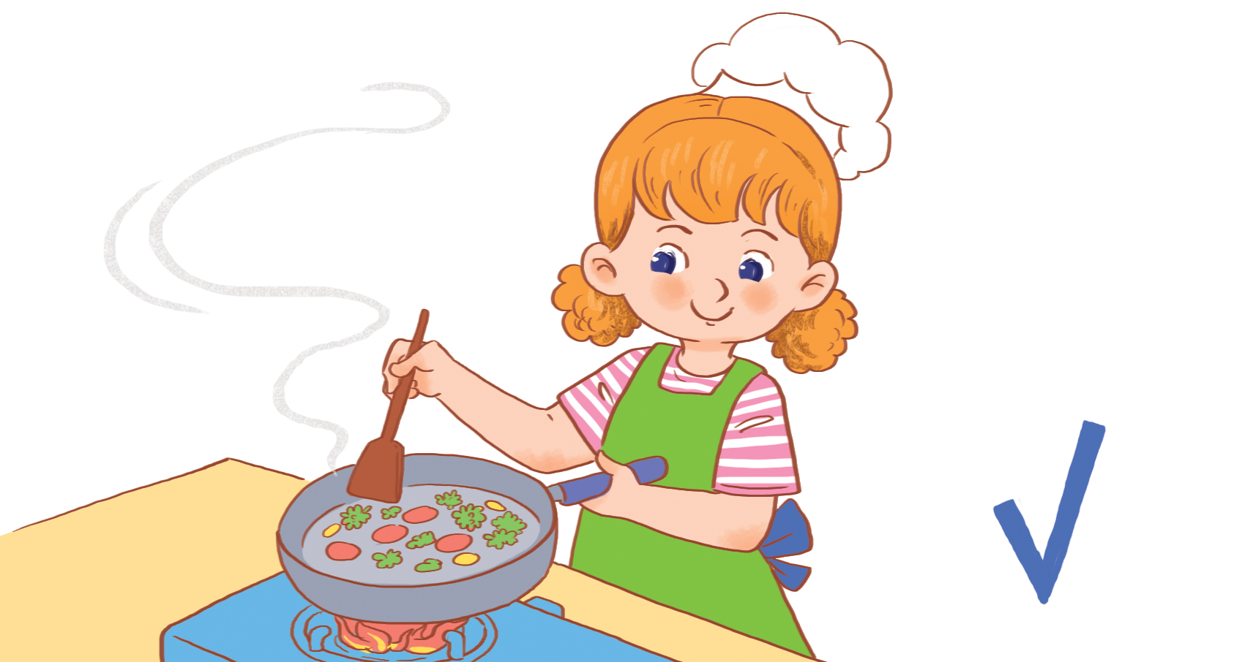
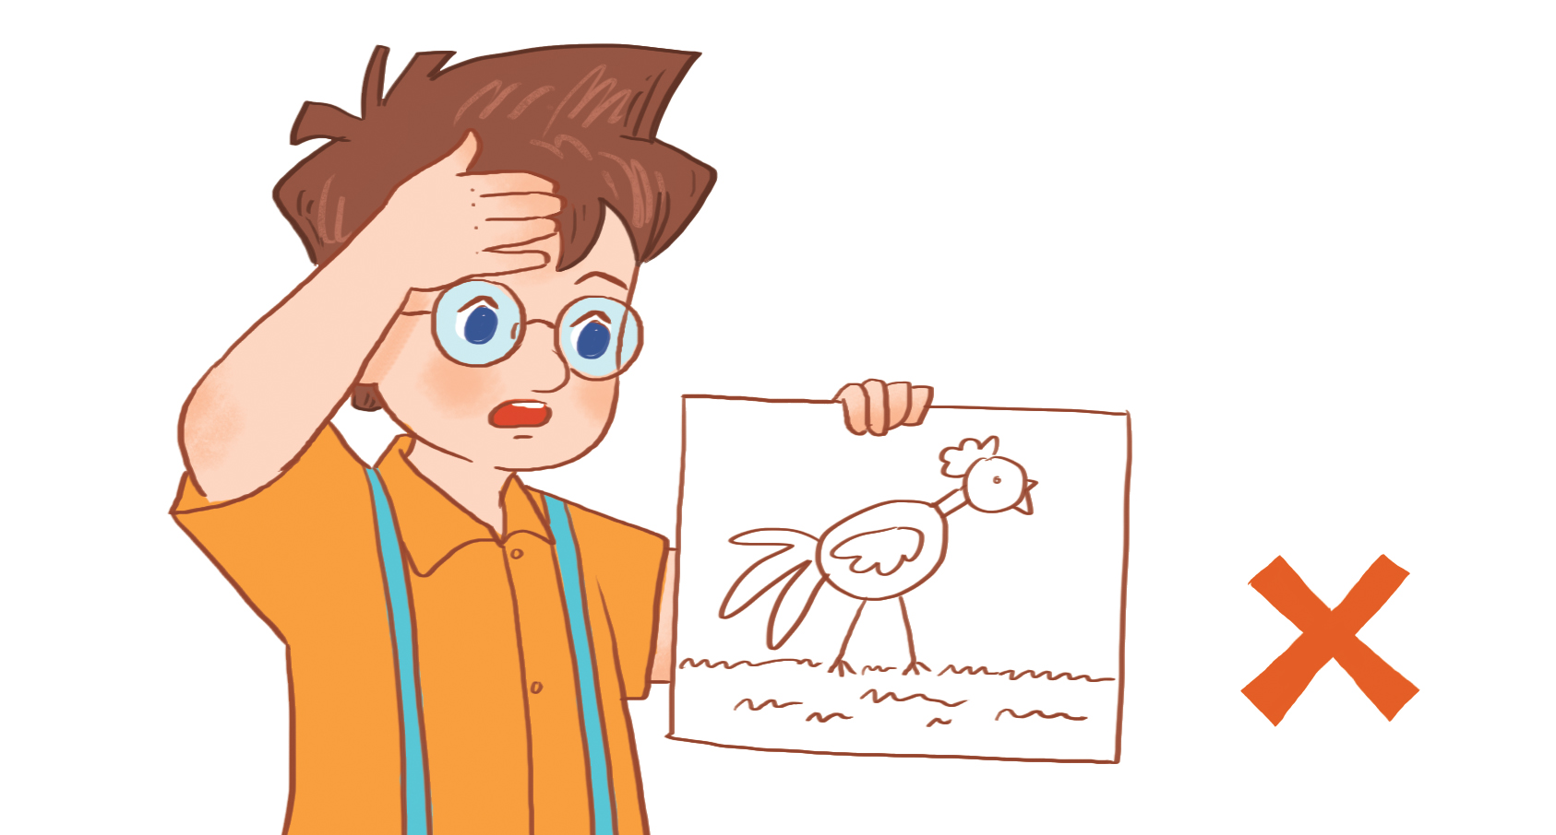
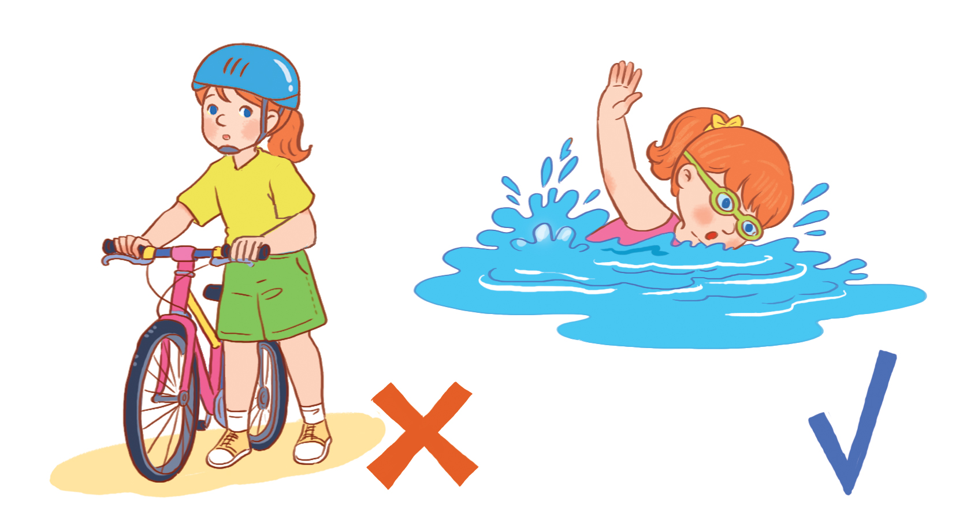
5
Look, complete and read.
1
A: Can she cook?
B: _______, she ____________.
MsPham
0936082789
Yes can
2
A: Can he draw?
B: _______, he ___________.
No can’t
3
bike
A: Can she ride ____________?
B: No, she can’t, but she ________ swim.
can
4
Can
A: ________ he play badminton?
B: No, he can’t, ________ he can roller skate.
but

Slide 17
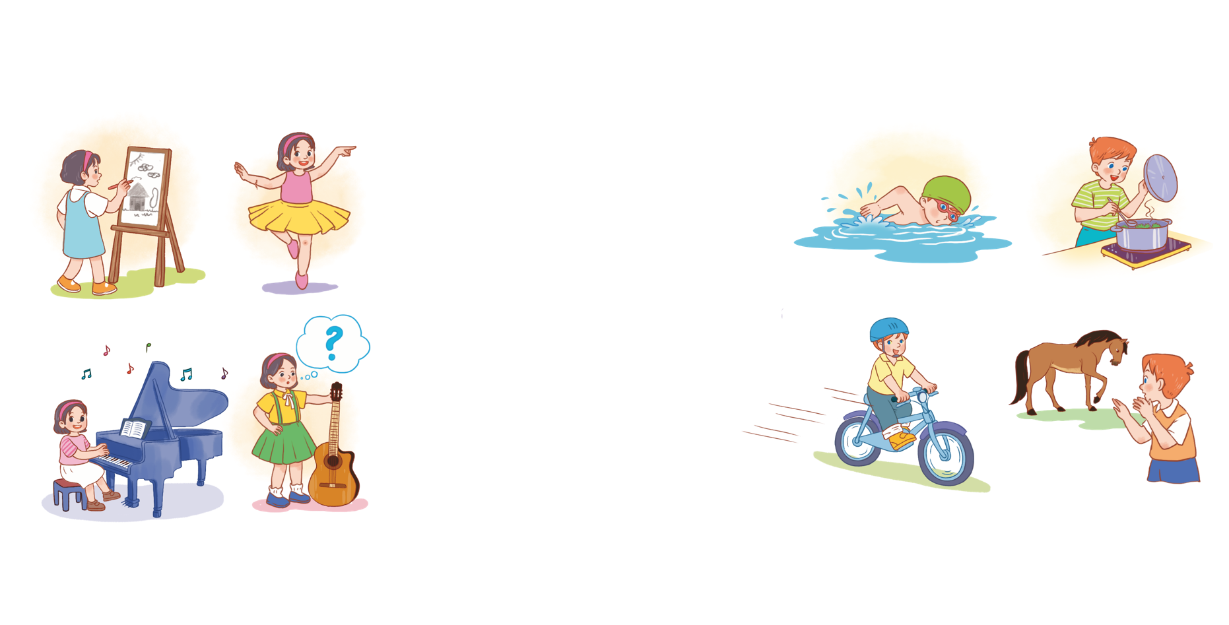
6
Let’s sing.
Things they can do
She can draw.
She can draw.
She can draw.
She can draw.
She can dance.
She can dance.
She can dance.
She can dance.
MsPham
0936082789
She can play the piano,
She can play the piano,
She can play the piano,
She can play the piano,
but she can’t play the guitar.
but she can’t play the guitar.
but she can’t play the guitar.
but she can’t play the guitar.
He can swim.
He can swim.
He can swim.
He can swim.
He can cook.
He can cook.
He can cook.
He can cook.
He can ride a bike,
He can ride a bike,
He can ride a bike,
He can ride a bike,
but he can’t ride a horse.
but he can’t ride a horse.
but he can’t ride a horse.
but he can’t ride a horse.
Hide

Slide 18

6
Let’s sing.
Things they can do
She can draw.
She can draw.
She can dance.
She can dance.
MsPham
0936082789
She can play the piano,
She can play the piano,
but she can’t play the guitar.
but she can’t play the guitar.
He can swim.
He can swim.
He can cook.
He can cook.
He can ride a bike,
He can ride a bike,
but he can’t ride a horse.
but he can’t ride a horse.
Hide

Slide 19
MsPham
0936082789
Thank you!

