Slide 1







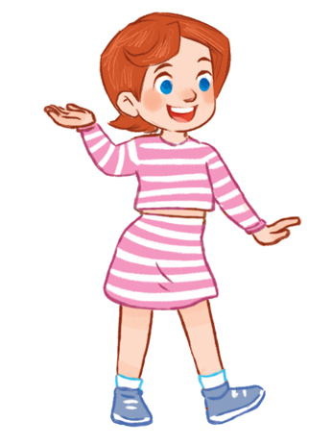

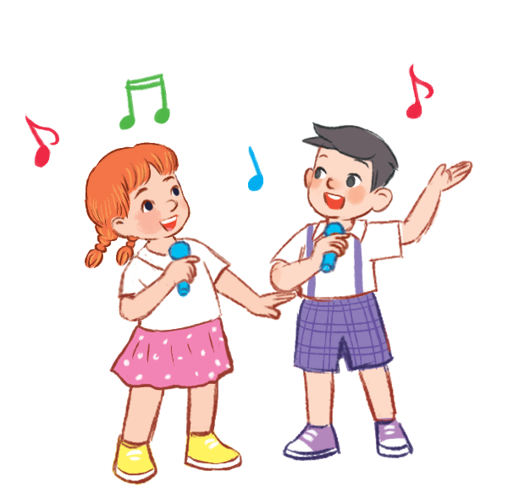
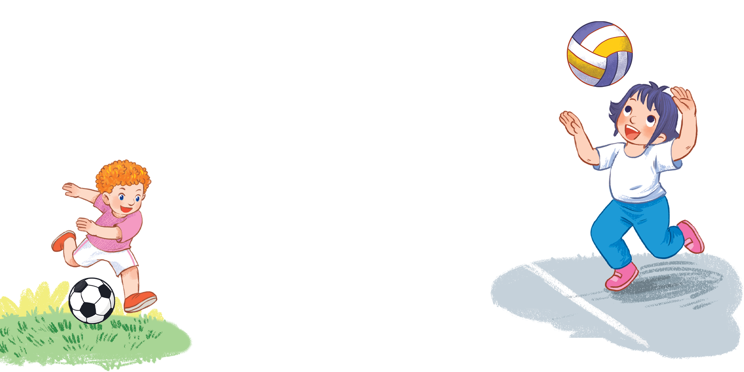



MsPham
0936082789
Unit 5
Things
we can do
Lesson 3 – Period 2

Slide 2



Warm-up
MsPham
0936082789

Slide 3
LADYBUG
WRITTING
START

Slide 4
Can
a
c
n
CHECK

Slide 5
Yes
Y
s
e
CHECK

Slide 6
Viet Nam
t
m
V
N
e
i
a
CHECK

Slide 7
your
y
u
o
r
CHECK

Slide 8
Viet Nam
o
r
g
y
u
t
CHECK

Slide 9
piano
a
i
p
n
o
CHECK

Slide 10
Well done!

Slide 11


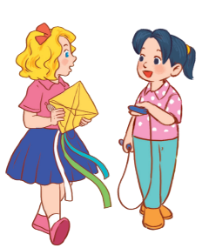

MsPham
0936082789
Review

Slide 12
MsPham
0936082789
Phonics
y
/j/
n
/n/
Notes:
https://www.youtube.com/watch?v=8z3E7OM43gY&list=PL8_ETpRL2xNbJTjsq6q8ex0yMu7g61wrf

Slide 13


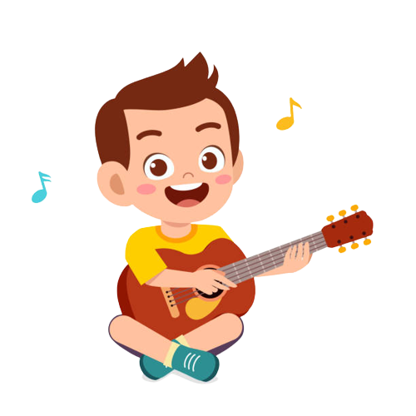
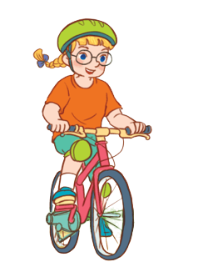
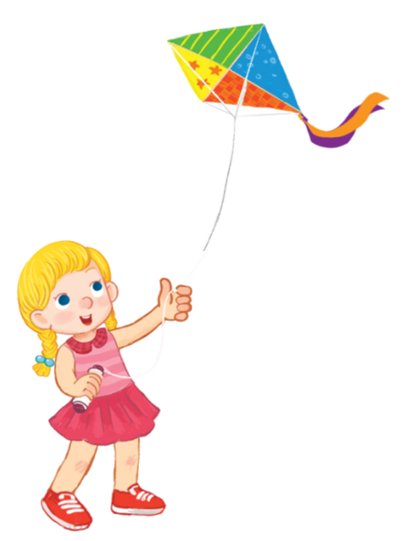
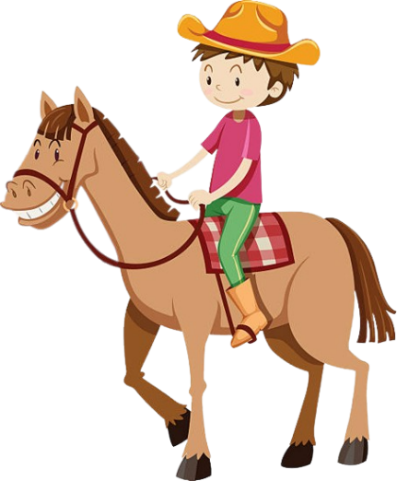
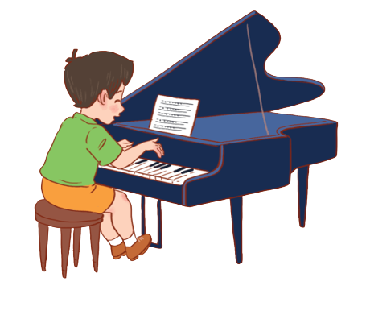
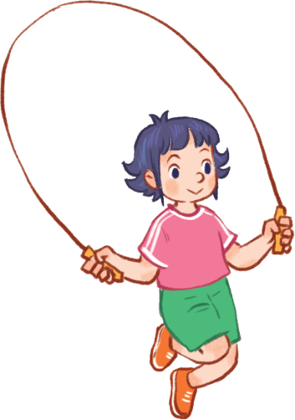
Yes, I can.
Can you + __________?
MsPham
0936082789
No, I can’t.
play the guitar
ride a bike
MsPham
0936082789
play the piano
ride a horse
skip
fly a kite

Slide 14
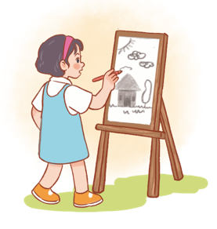
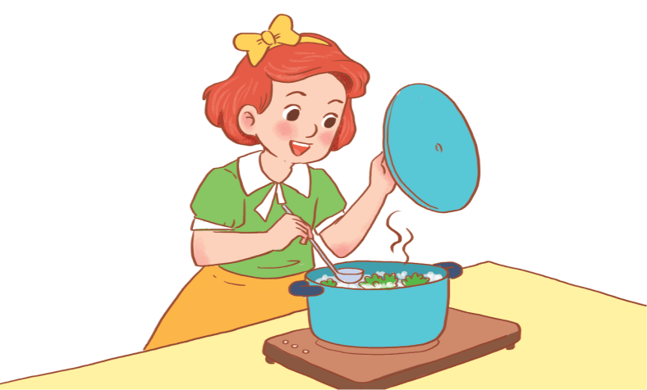
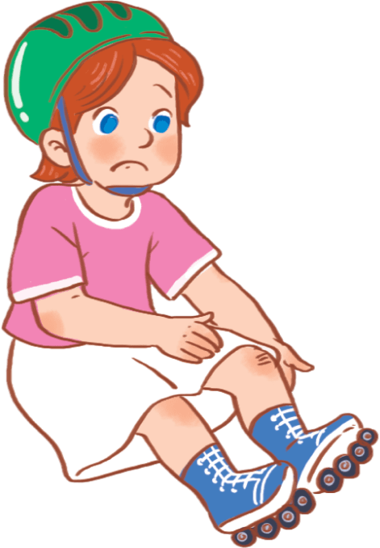
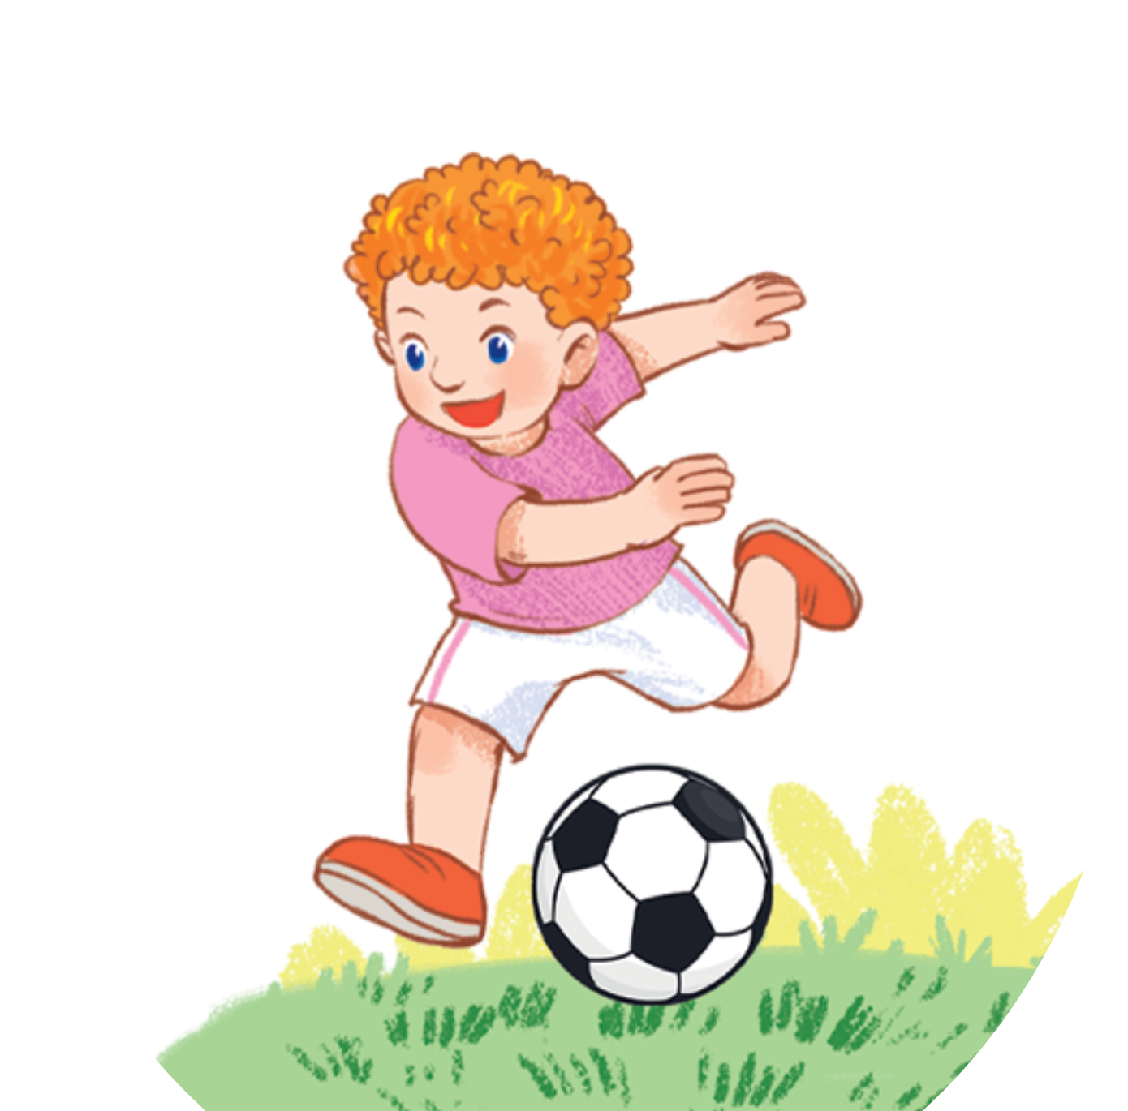
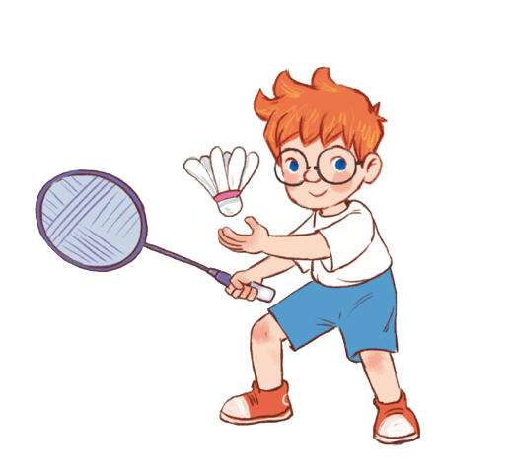
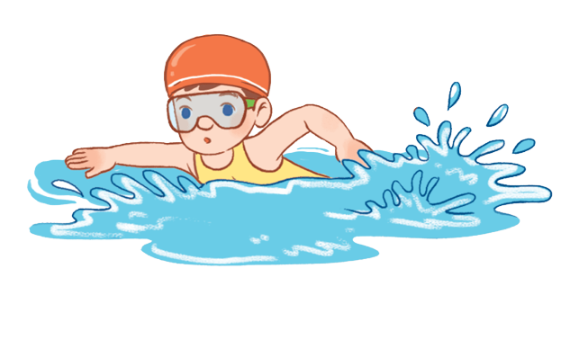
Yes, he/she can.
Can he/she + _________?
No, he/she can’t.
MsPham
0936082789
draw
cook
roller skate
swim
play
football
play
badminton

Slide 15
MsPham
0936082789
Practice

Slide 16
4
Read and tick true or false.
I have three friends, Ha, Khoa and Rosie. Ha can play badminton, but she can’t swim. Khoa can ride a bike, but he can’t ride a horse. Rosie can play the piano, but she can’t play the guitar. I can sing, but I can’t dance. We can all roller skate.
MsPham
0936082789
 | True | False
1. Ha can play swim.
2. Khoa can’t ride a horse.
3. Rosie can play the guitar.
4. They can all roller skate.
✓
I want some water.
✓
✓
✓

Slide 17
5
Let’s write
I have two friends, _______ and _______. ________ can ________________, but ________ can’t ______________. ______ can ______________, but _____ can’t _____________ ________. I can ______________________, but I can’t _____________________.
I like jam.
MsPham
0936082789

Slide 18

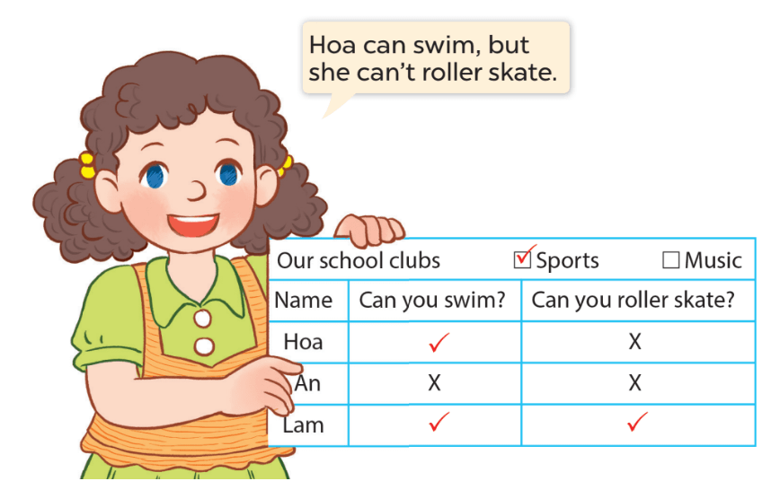
6
Project
MsPham
0936082789
I like jam.
I want some water.

Slide 19
MsPham
0936082789
Thank you!

