Slide 1








Unit 6
Our school
facilities
Lesson 1 – Period 1
MsPham
0936082789

Slide 2




Warm-up

Slide 3


Slide 4

MsPham
0936082789
Vocabulary

Slide 5

mountains
/ˈmaʊntənz/
MsPham
0936082789
Vùng núi

Slide 6

village
/ˈvɪlɪdʒ/
MsPham
0936082789
Ngôi làng

Slide 7

city
/ˈsɪti/
MsPham
0936082789
Thành phố

Slide 8

town
/taʊn/
MsPham
0936082789
Thị trấn

Slide 9
Vocabulary
mountains
: Vùng núi
village
: Ngôi làng
MsPham
0936082789
city
: Thành phố
town
: Thị trấn

Slide 10
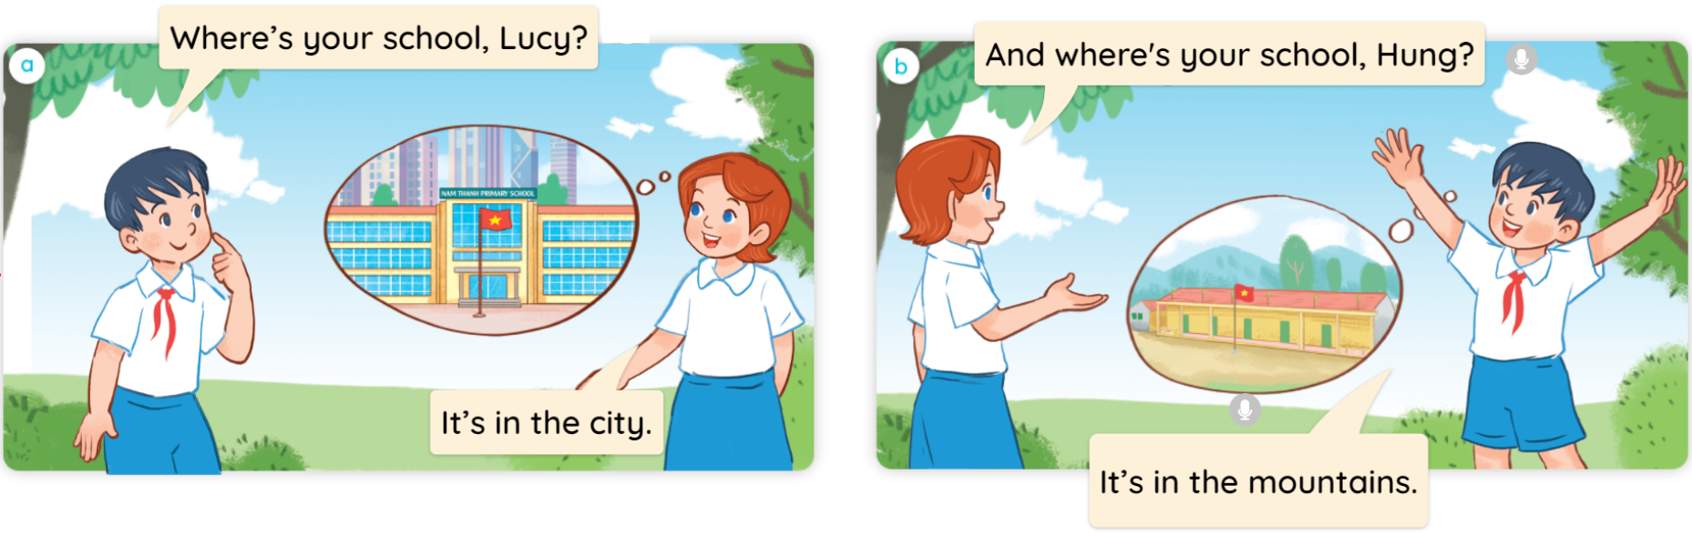

1
Look, listen and read.
MsPham
0936082789

Slide 11
MsPham
0936082789
Structure

Slide 12


1
Cách hỏi trường bạn (hoặc1 nơi nào đó) ở đâu:
Where’s your school?
(Trường của bạn ở đâu?)
It’s in the ________.
(Nó ở _________.)
Ex:
Where’s your school?
It’s in the mountains.
MsPham
0936082789

Slide 13
2
Listen, point and say.
Where’s your school?
It’s in the ________.
a
b
mountains
village
c
d
city
town

Slide 14

2
Listen, point and say.
a
MsPham
0936082789
mountains
Where’s your school?
It’s in the mountains.

Slide 15
2
Listen, point and say.
a
MsPham
0936082789
village
Where’s your school?
It’s in the village.

Slide 16

2
Listen, point and say.
a
MsPham
0936082789
city
Where’s your school?
It’s in the city.

Slide 17

2
Listen, point and say.
a
MsPham
0936082789
town
Where’s your school?
It’s in the town.

Slide 18
2
Listen, point and say.
Where’s your school?
It’s in the ________.
a
b
mountains
village
c
d
city
town

Slide 19






Click hình chú Thỏ hoặc chú Rùa khi chọn đáp án.
Notes:
Ms Huyền Phạm - 0936.082.789 – YOUTUBE: MsPham. Facebook: Dạy và học cùng công nghệ.

Slide 20

Where’s your school?
It’s in the village.
Notes:
Ms Huyền Phạm - 0936.082.789 – YOUTUBE: MsPham. Facebook: Dạy và học cùng công nghệ.

Slide 21
Where’s your school?
It’s in the city.
Notes:
Ms Huyền Phạm - 0936.082.789 – YOUTUBE: MsPham. Facebook: Dạy và học cùng công nghệ.

Slide 22
Where’s your school?
It’s in the mountains.
Notes:
Ms Huyền Phạm - 0936.082.789 – YOUTUBE: MsPham. Facebook: Dạy và học cùng công nghệ.

Slide 23
Where’s your school?
It’s in the town.
Notes:
Ms Huyền Phạm - 0936.082.789 – YOUTUBE: MsPham. Facebook: Dạy và học cùng công nghệ.

Slide 24
Where’s your school?
It’s in the _______.
town
mountains
Notes:
Ms Huyền Phạm - 0936.082.789 – YOUTUBE: MsPham. Facebook: Dạy và học cùng công nghệ.

Slide 25
Where’s your school?
It’s in the _______.
city
mountains
Notes:
Ms Huyền Phạm - 0936.082.789 – YOUTUBE: MsPham. Facebook: Dạy và học cùng công nghệ.

Slide 26
Where’s your school?
It’s in the _______.
town
village
Notes:
Ms Huyền Phạm - 0936.082.789 – YOUTUBE: MsPham. Facebook: Dạy và học cùng công nghệ.

Slide 27
Where’s your school?
It’s in the _______.
city
village
Notes:
Ms Huyền Phạm - 0936.082.789 – YOUTUBE: MsPham. Facebook: Dạy và học cùng công nghệ.

Slide 28

Notes:
Ms Huyền Phạm - 0936.082.789 – YOUTUBE: MsPham. Facebook: Dạy và học cùng công nghệ.

Slide 29
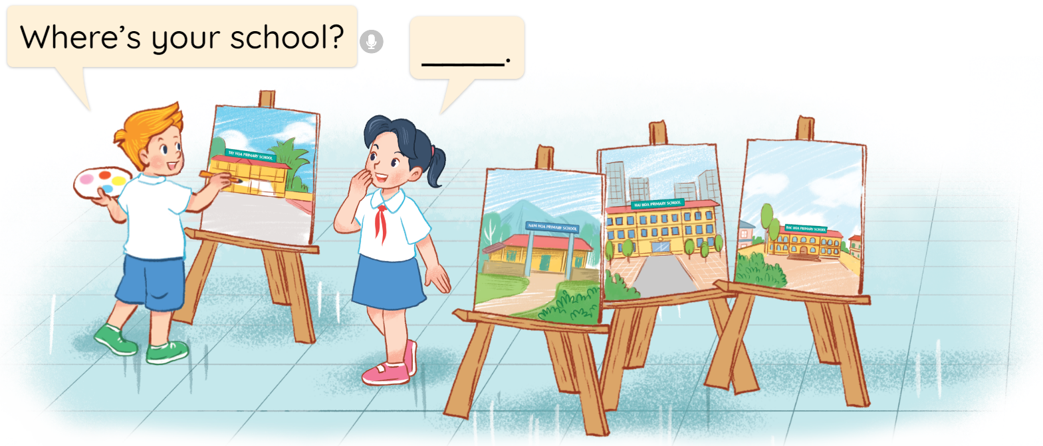
3
Let’s talk.

Slide 30
MsPham
0936082789
Review

Slide 31
Where’s your school?
MsPham
0936082789
It’s in the ________.
MsPham
0936082789
mountains
village
city
town

Slide 32
Thank you!
MsPham
0936082789

