Slide 1








Unit 6
Our school
facilities
Lesson 1 – Period 2
MsPham
0936082789

Slide 2
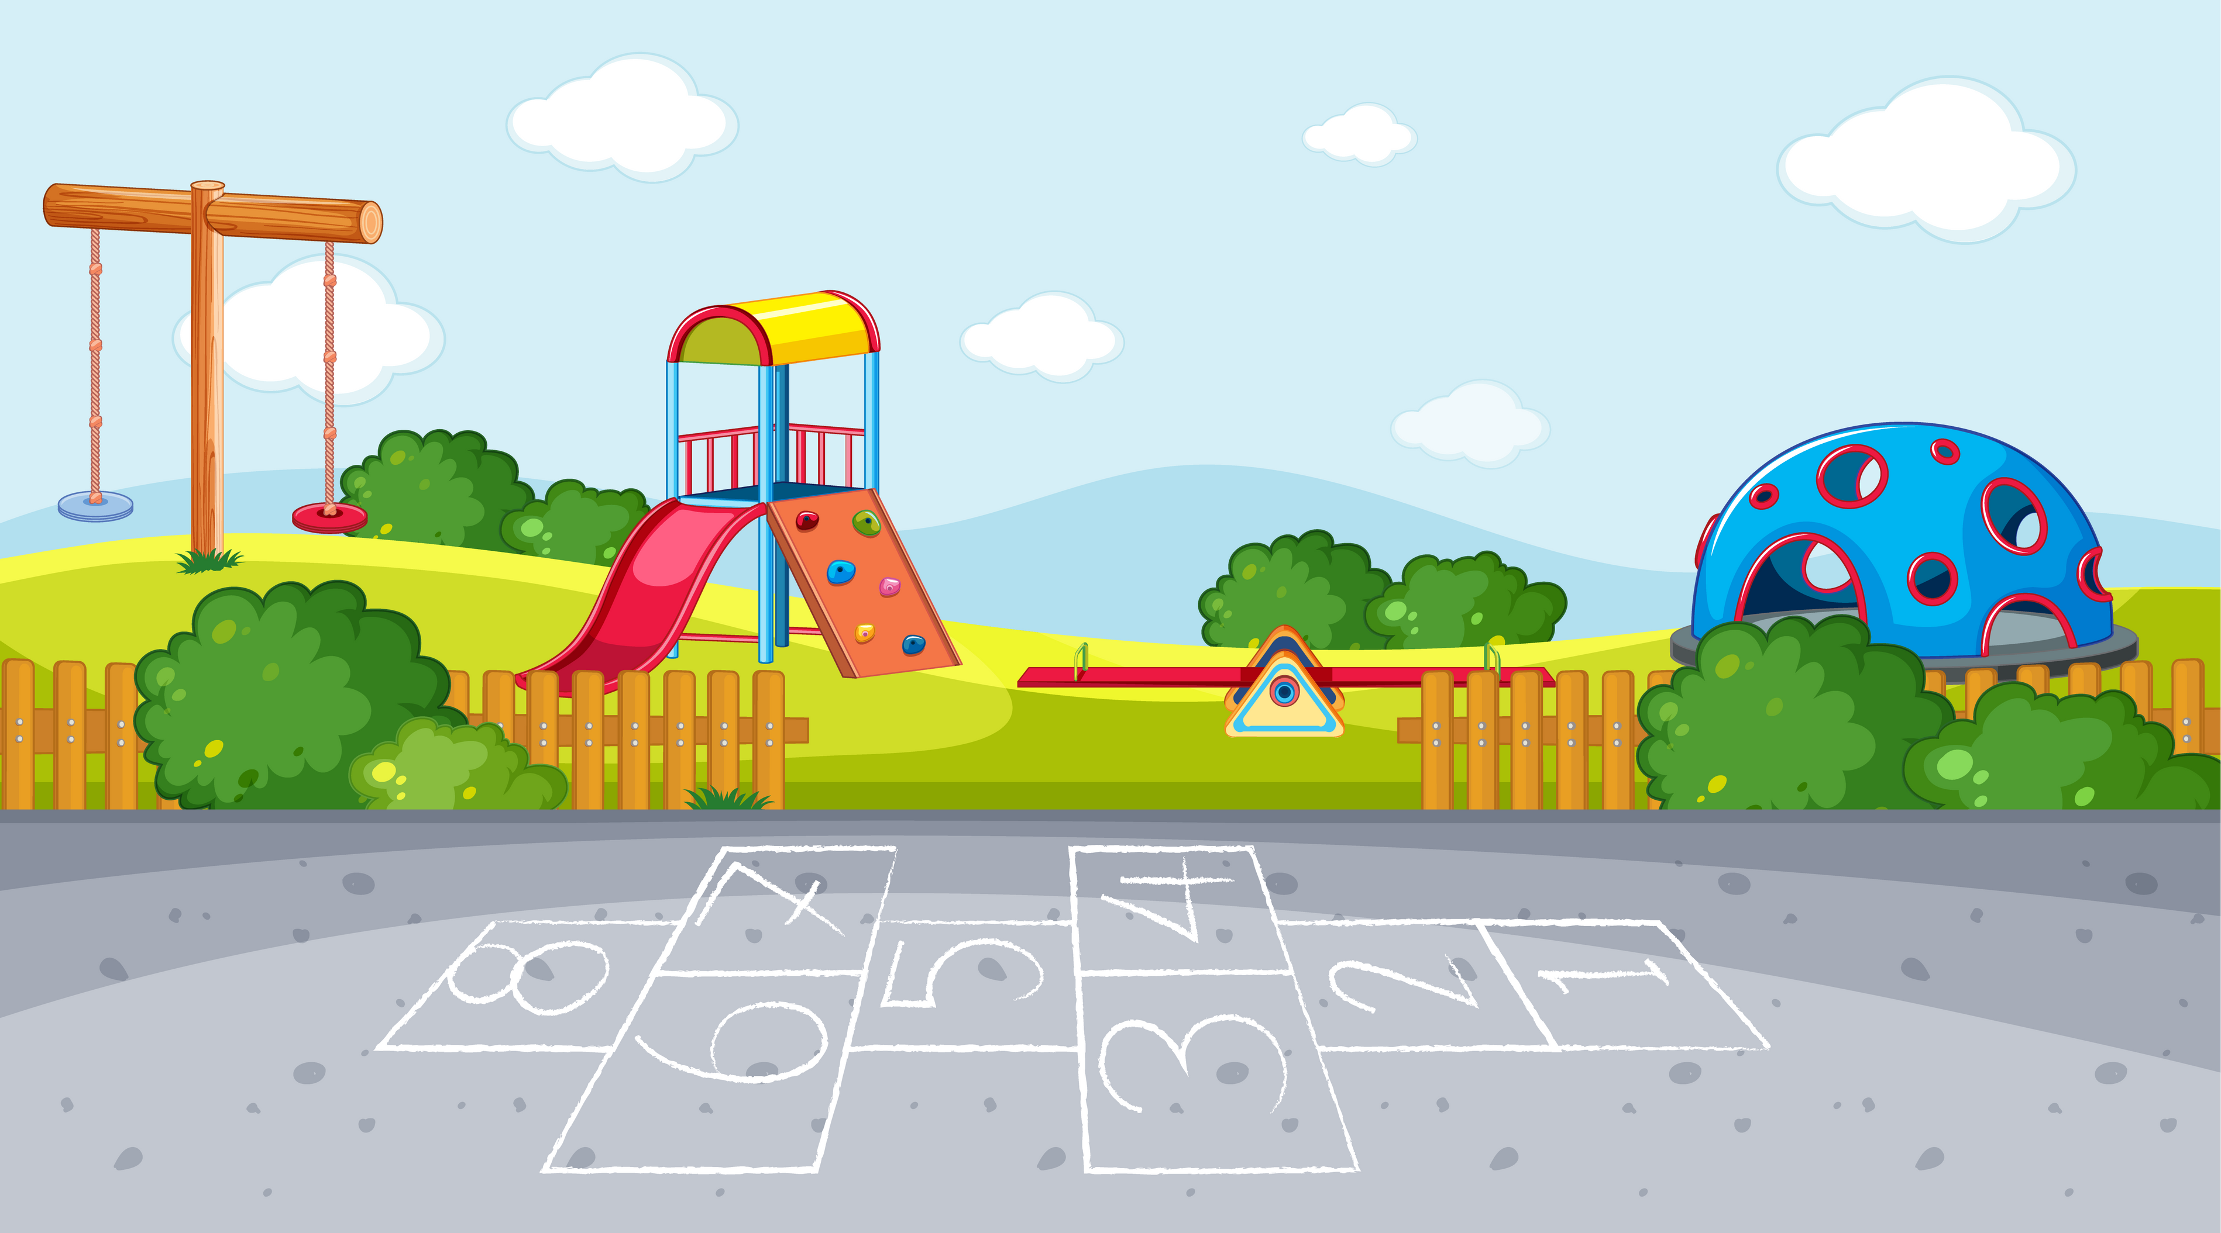



Warm-up

Slide 3


Slide 4
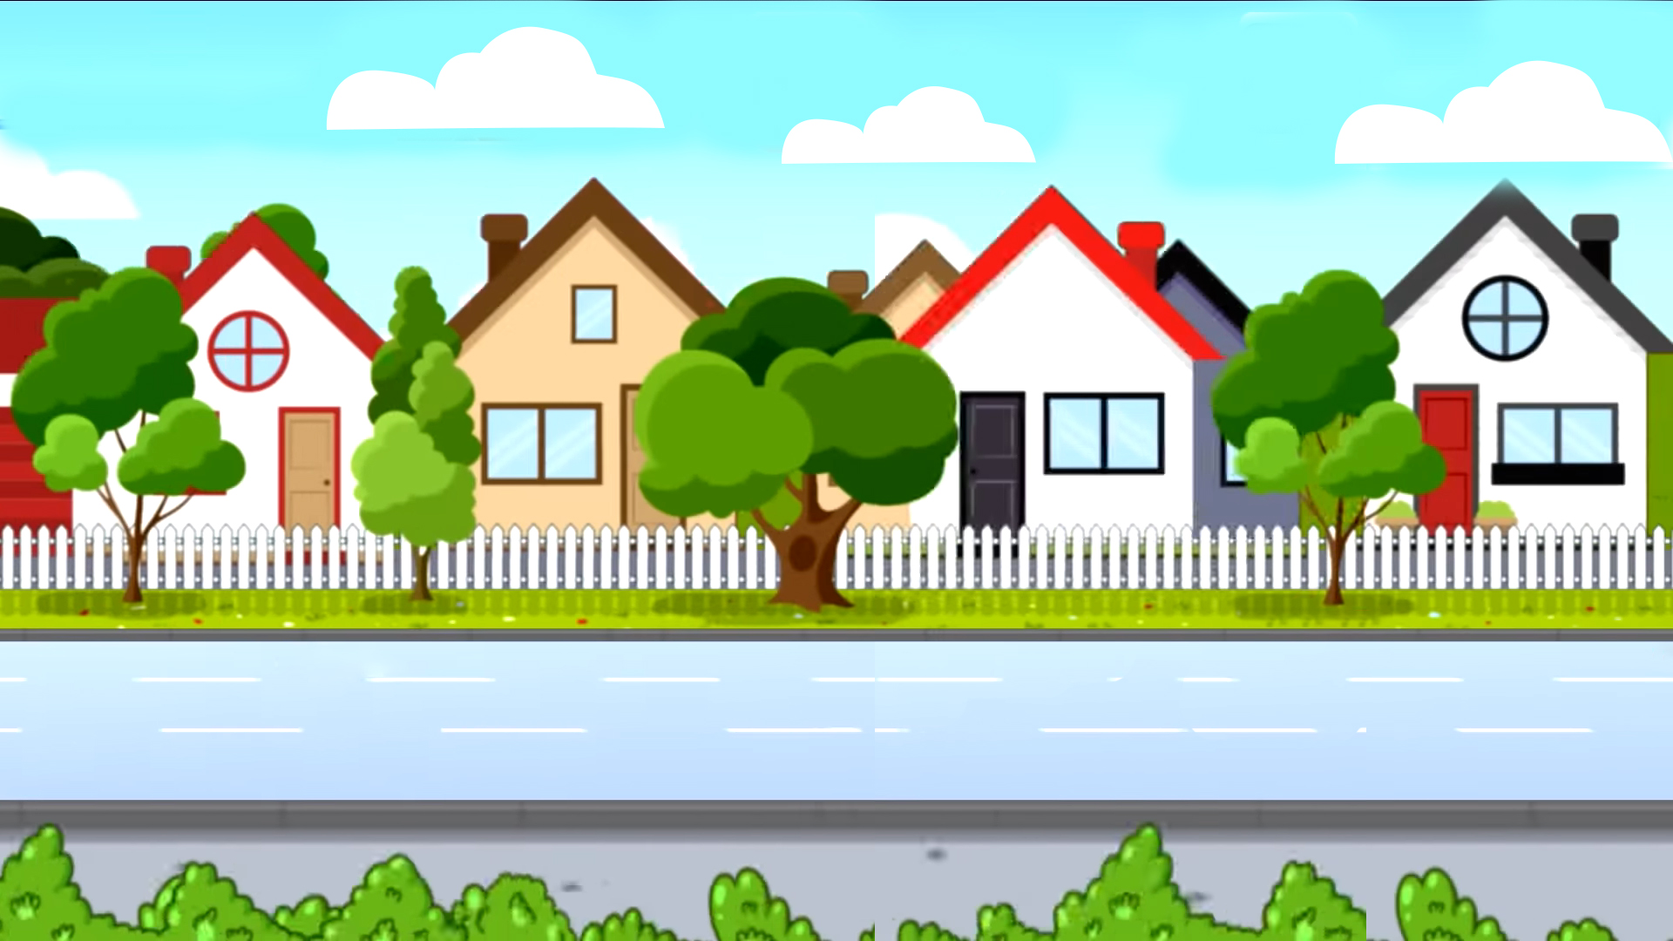






School bus
Play

Slide 5
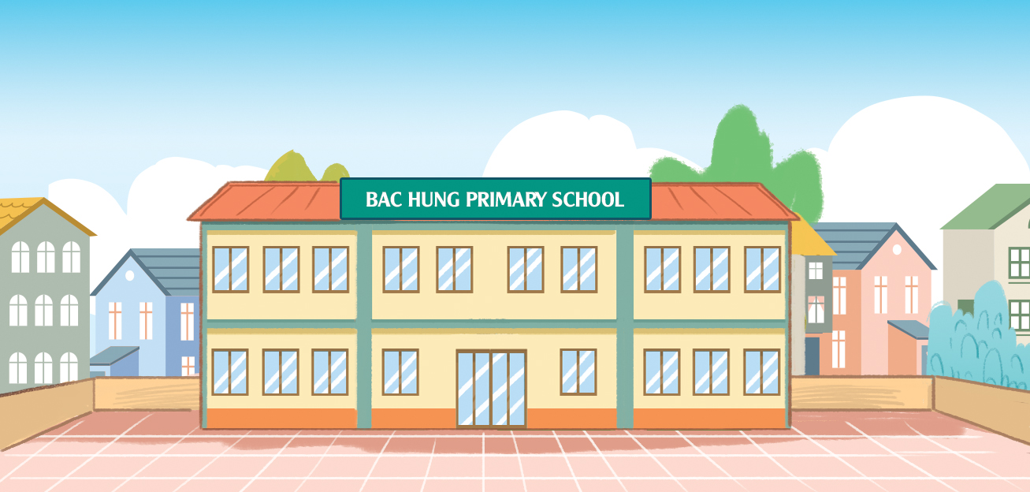

Where ___ your school?
is
Check
Next

Slide 6
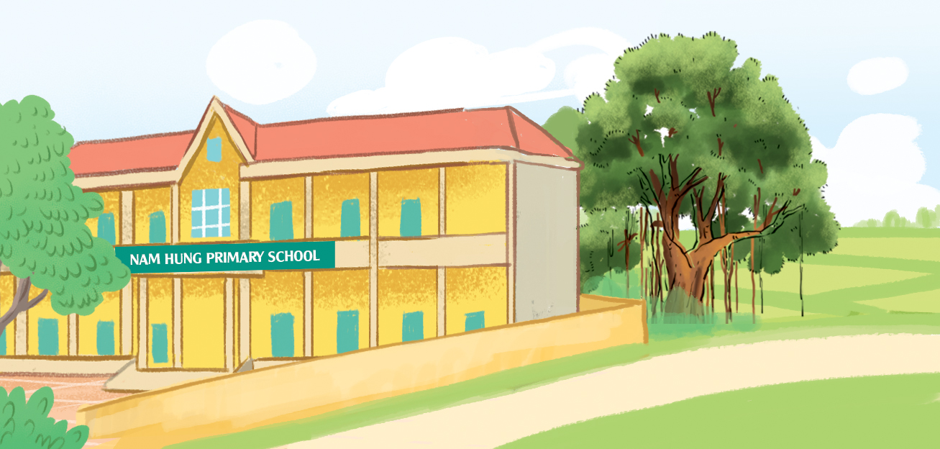
_____ your school?
Where’s.
Check
Next

Slide 7

It’s ___ the city.
in
Check
Next

Slide 8
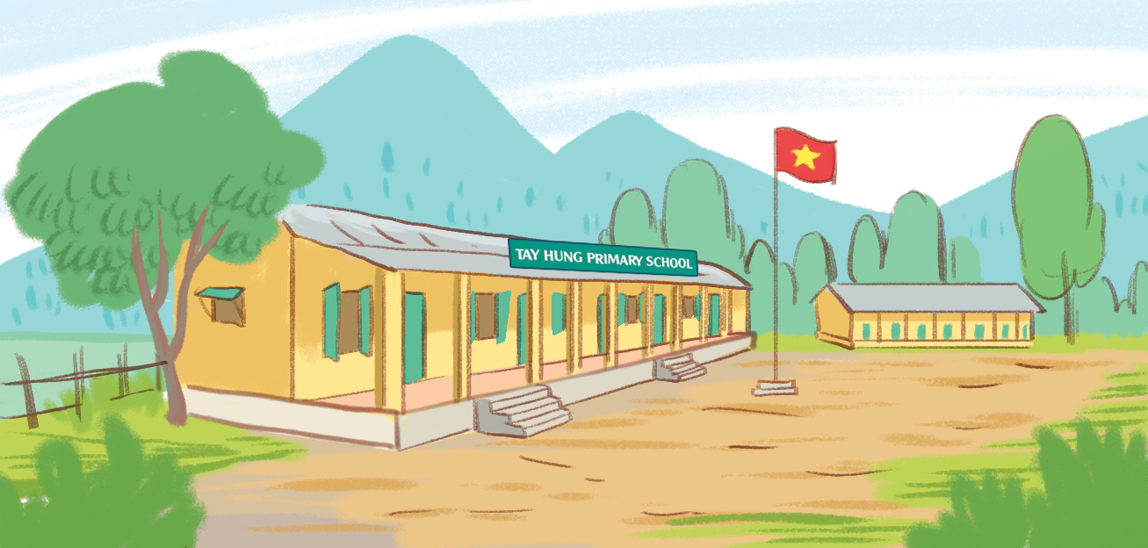
It’s in ___ mountains.
the
Check
Next

Slide 9
Where’s your school?
It’s in the village.
Check
Next

Slide 10
Where’s your school?
It’s in the town.
Check
Next

Slide 11
Where’s your school?
It’s in the mountains.
Check
Next

Slide 12
Where’s your school?
It’s in the city.
Check
Next

Slide 13


End

Slide 14

MsPham
0936082789
Review

Slide 15

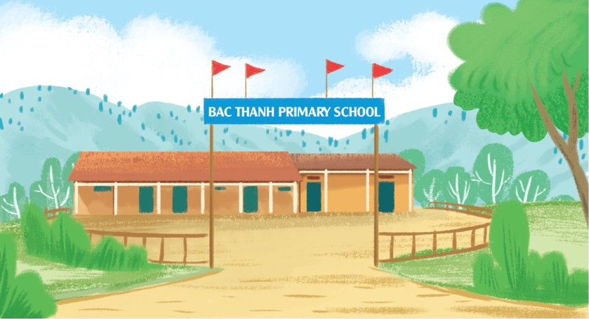
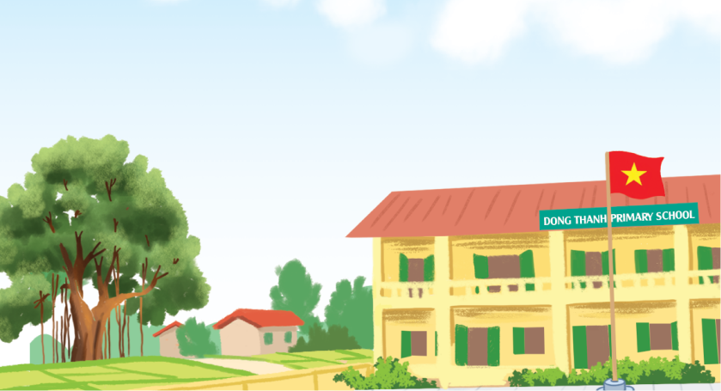
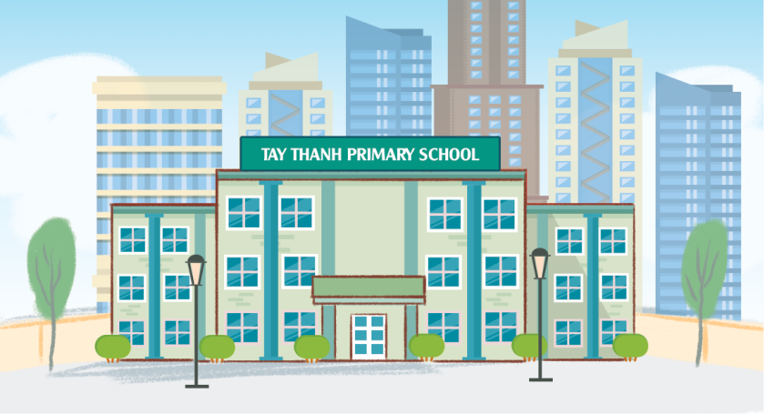

Where’s your school?
MsPham
0936082789
It’s in the ________.
MsPham
0936082789
mountains
village
city
town

Slide 16
MsPham
0936082789
Practice

Slide 17
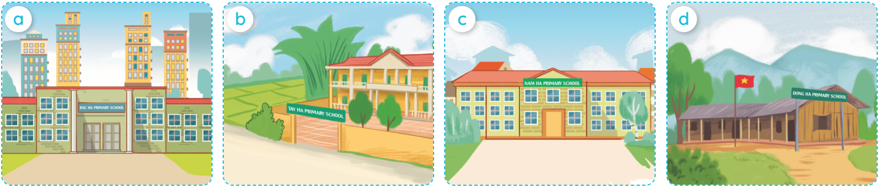

MsPham
0936082789
4
Listen and number.
MsPham
0936082789
3
4
1
2
1
2
3
4

Slide 18
MsPham
0936082789
5
Look, complete and read.
1
2
MsPham
0936082789
A: Where's your school?
B: It's in the __________.
A: Where's your school?
B: It’s ________________.
village
in the town
3
4
school
Where's
A: Where's your _________?
B: It’s in _____________.
A: ___________ your school?
B: It’s ___________________.
the town
in the mountains

Slide 19

MsPham
0936082789
6
Let’s play.

Slide 20
Thank you!
MsPham
0936082789

