Slide 1


UNIT 20:OUR SUMMER HOLIDAYS
LESSON 1 ( 1, 2, 3)
Notes:
MADE BY FACEBOOK :TRAN THI THANH TAM

Slide 2

CONTENTS
1
WARM -UP
2
LOOK, LISTEN AND REPEAT
3
VOCABULARY
4
LISTEN, POINT AND SAY
5
LET’S TALK
6
PLAY GAME
Notes:
MADE BY FACEBOOK :TRAN THI THANH TAM

Slide 3

Warm - up
Notes:
MADE BY FACEBOOK :TRAN THI THANH TAM

Slide 4




PLAY GAME
GUESSING GAME
Notes:
Step 2: Have groups put the posters on the desk and practice the presentation. Encourage all members in the group to present. Go around the classroom and offer help where necessary.

Slide 5
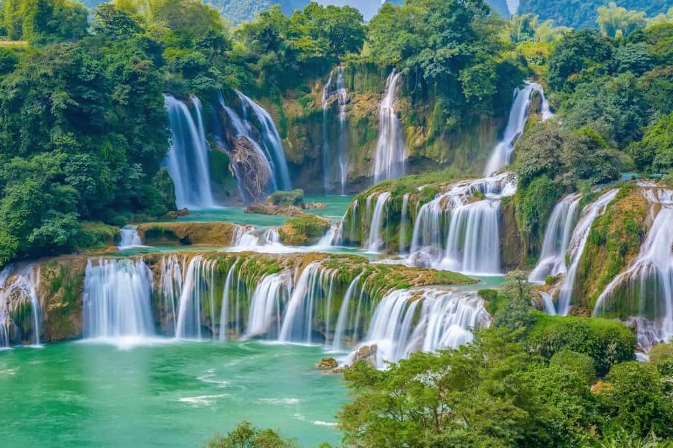
Ban Gioc Waterfall
SHOW

Slide 6
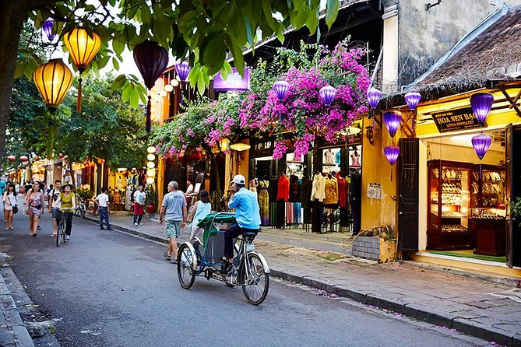
Hoi An Old Town
SHOW

Slide 7
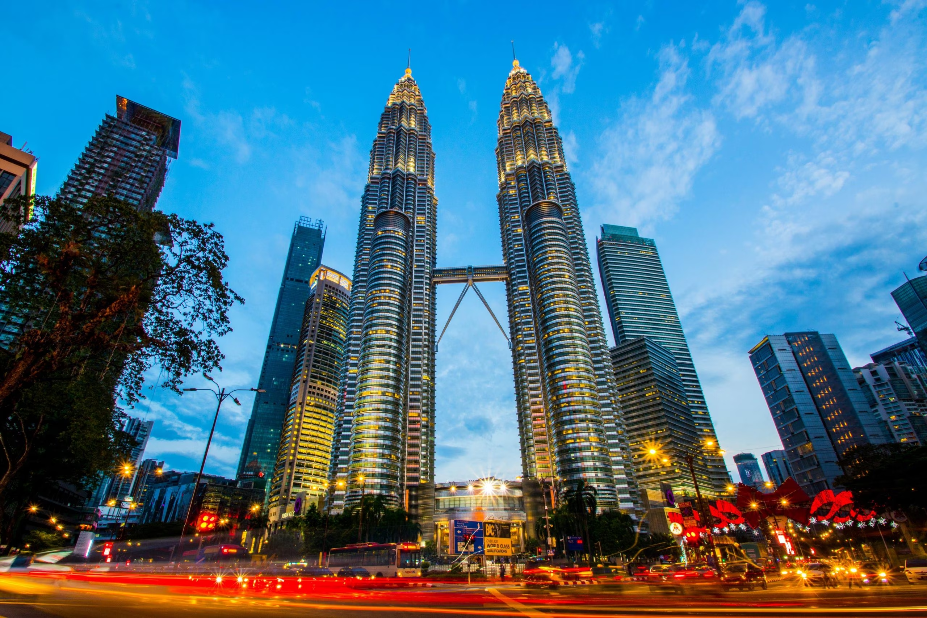
Petronas Twin Towers
SHOW

Slide 8
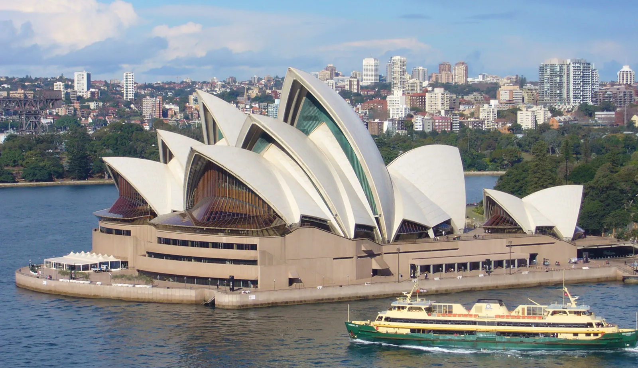
Sydney Opera House
SHOW

Slide 9
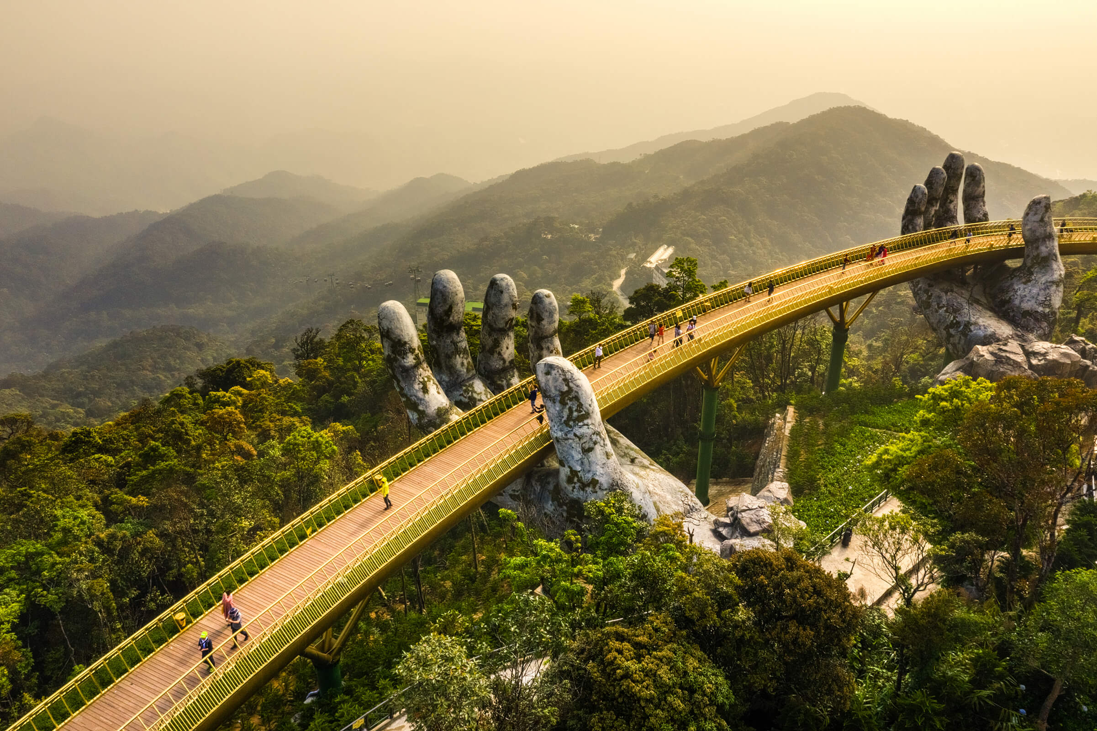
Ba Na Hills
SHOW

Slide 10
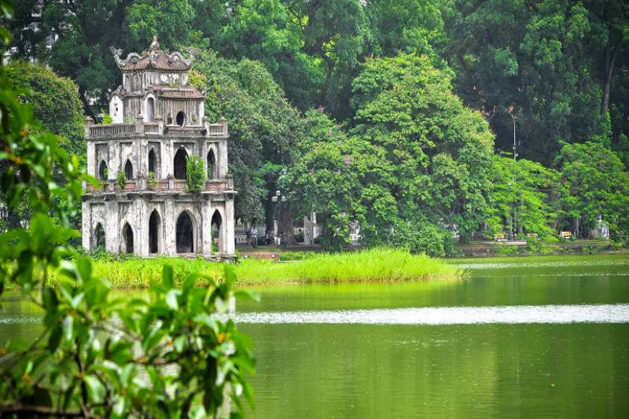
Hoan Kiem Lake
SHOW

Slide 11


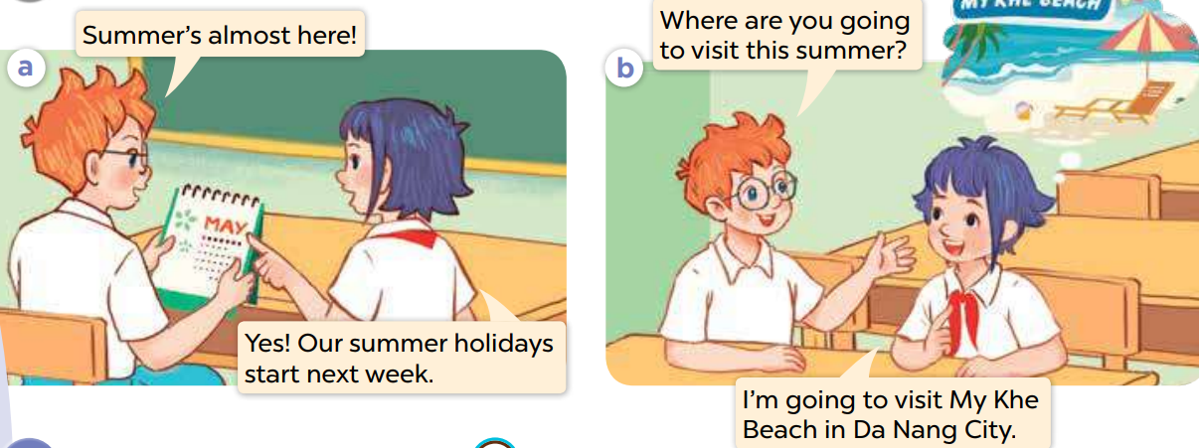
1.Look, listen and repeat
Notes:
MADE BY FACEBOOK :TRAN THI THANH TAM

Slide 12

Notes:
MADE BY FACEBOOK :TRAN THI THANH TAM

Slide 13

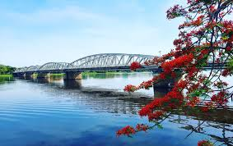
Huong River/hʊəŋ ˈrɪvə(r)/: Sông Hương
Notes:
MADE BY FACEBOOK :TRAN THI THANH TAM

Slide 14
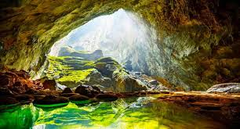
Phong Nha Cave/fɔŋ nha keɪv/
: Động Phong Nha
Notes:
MADE BY FACEBOOK :TRAN THI THANH TAM

Slide 15
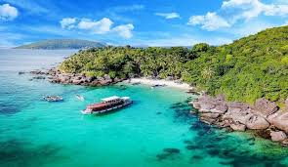
Phu Quoc Island/fʊ kwʊɔkˈaɪlənd/
: Đảo Phú Quốc
Notes:
MADE BY FACEBOOK :TRAN THI THANH TAM

Slide 16
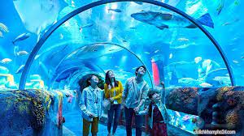
Dam Sen Aquarium/dam sen əˈkweəriəm/
: Thủy cung Đầm Sen
Notes:
MADE BY FACEBOOK :TRAN THI THANH TAM

Slide 17

VOCABULARY
Huong River: Sông Hương
Phu Quoc Island: đảo Phú Quốc
Dam Sen Aquarium: thủy cung Đầm Sen
Phong Nha Cave: động Phong Nha

Slide 18

Let's play
Check vocabulary
MATCHING
Notes:
Made by Facebook: TRAN THI THANH TAM

Slide 19
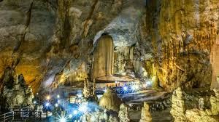
1.Phong Nha Cave
A
2.Dam sen Aquarium
B
3.Huong River
C
4. Phu Quoc Island
D
Notes:
MADE BY FACEBOOK :TRAN THI THANH TAM

Slide 20

SENTENCE PATTERN
Notes:
MADE BY FACEBOOK :TRAN THI THANH TAM

Slide 21
Hỏi và trả lời xem bạn dự định đi đâu vào mùa hè
Where are you going to visit this summer ?
( Bạn dự định đi thăm nơi nào mùa hè này?)
I’m going to visit Huong River
( Tôi dự định đi thăm sông Hương.)

Slide 22
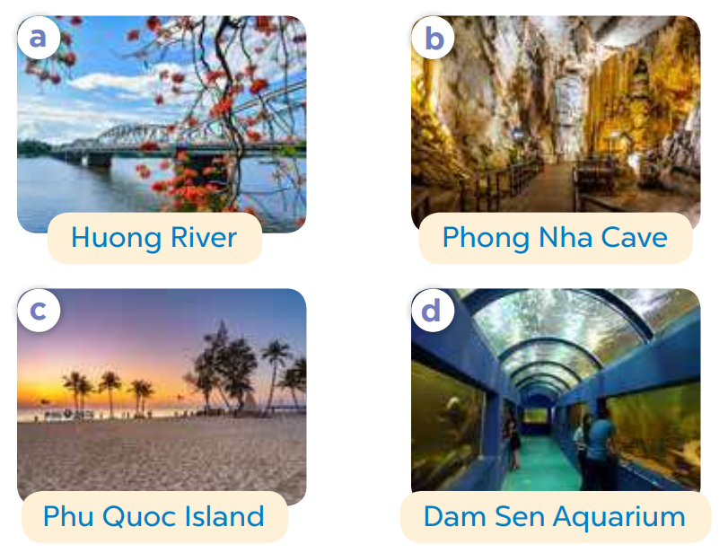
2.Listen, point and say
Where are you going to visit this summer?
Huong River
I’m going to visit.....…..................
Notes:
MADE BY FACEBOOK :TRAN THI THANH TAM

Slide 23

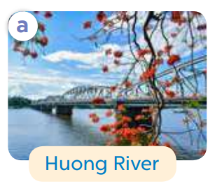
Where are you going to visit this summer?
Huong River
I’m going to visit…..................
Notes:
MADE BY FACEBOOK :TRAN THI THANH TAM

Slide 24
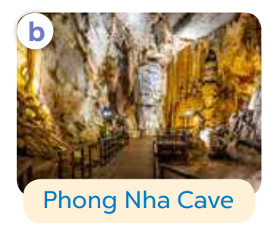
Where are you going to visit this summer?
Phong Nha Cave
I’m going to visit.......…..................
Notes:
MADE BY FACEBOOK :TRAN THI THANH TAM

Slide 25
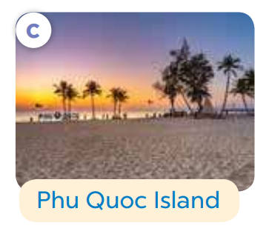
Where are you going to visit this summer?
Phu Quoc Island
I’m going to visit.........…..................
Notes:
MADE BY FACEBOOK :TRAN THI THANH TAM

Slide 26
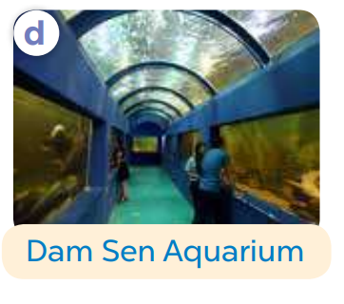
Where are you going to visit this summer?
Dam Sen Aquarium
I’m going to visit............…..................
Notes:
MADE BY FACEBOOK :TRAN THI THANH TAM

Slide 27
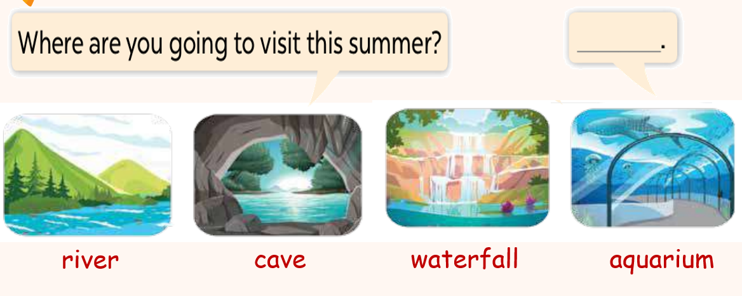
3. Let’s talk
Notes:
MADE BY FACEBOOK :TRAN THI THANH TAM

Slide 28

Let's play
LUCKY NUMBERS
Notes:
MADE BY FACEBOOK :TRAN THI THANH TAM

Slide 29

1
2
3
Next
4
5
6

Slide 30

Where are you going to visit this summer?
Well done
BACK
Phu Quoc Island
I’m going to visit.........…..................
Notes:
Teacher says the first sentence. Student replies using the new structure. Click the rabbit to go back to question slide.

Slide 31

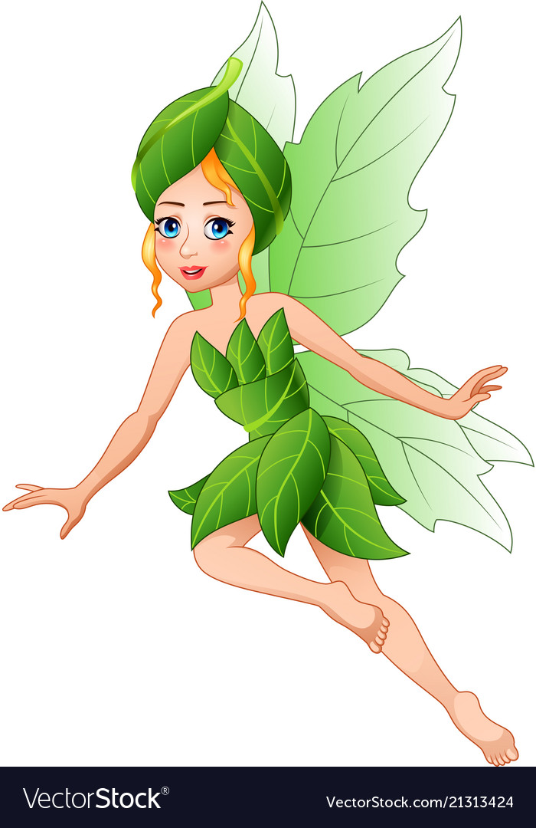
LUCKY NUMBER
BACK

Slide 32
Where are you going to visit this summer?
Well done
BACK
Dam Sen Aquarium
I’m going to visit............…..................
Notes:
Teacher says the first sentence. Student replies using the new structure. Click the rabbit to go back to question slide.

Slide 33
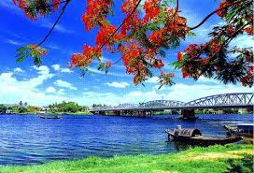
Where are you going to visit this summer?
Well done
BACK
Huong River
I’m going to visit…..................
Notes:
Teacher says the first sentence. Student replies using the new structure. Click the rabbit to go back to question slide.

Slide 34
LUCKY NUMBER
BACK

Slide 35
Where are you going to visit this summer?
Well done
BACK
Phong Nha Cave
I’m going to visit.......…..................
Notes:
Teacher says the first sentence. Student replies using the new structure. Click the rabbit to go back to question slide.

Slide 36

SUMMARY

Slide 37
SUMMARY
1.Vocabulary:
Huong River: Sông Hương
Phu Quoc Island: đảo Phú Quốc
Dam Sen Aquarium: thủy cung Đầm Sen
Phong Nha Cave: động Phong Nha
2. Sentence pattern:
-Where are you going to visit this summer?
(Bạn dự định đi thăm nơi nào mùa hè này?)
-> I’m going to visit Huong River.
(Tôi dự định thăm sông Hương.)

Slide 38

Homework:
- Learn by heart vocabulary and sentence pattern
- Prepare Unit 20- lesson 1 ( 4, 5, 6)

Slide 39
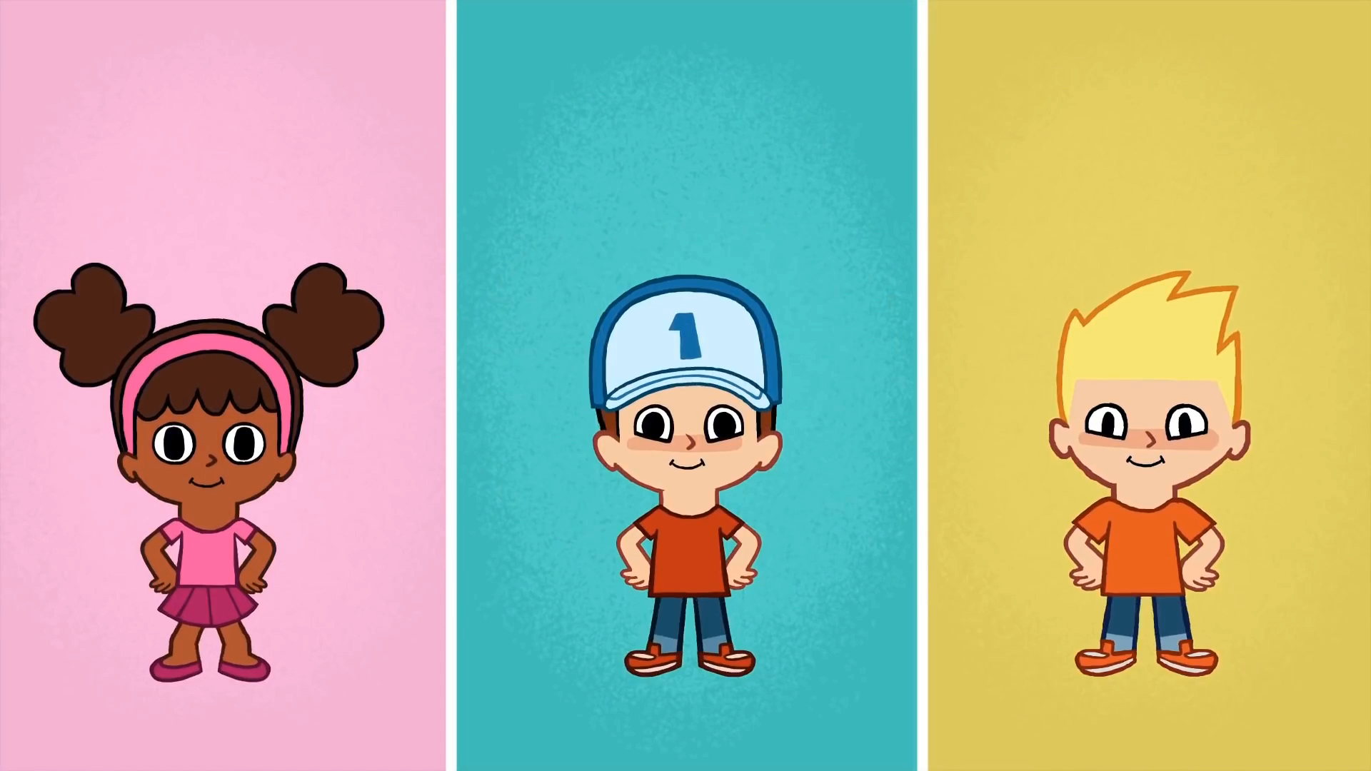
* SING AND DANCE: BYE BYE GOODBYE SONG

Slide 40

Notes:
MADE BY FACEBOOK :TRAN THI THANH TAM

