Slide 1
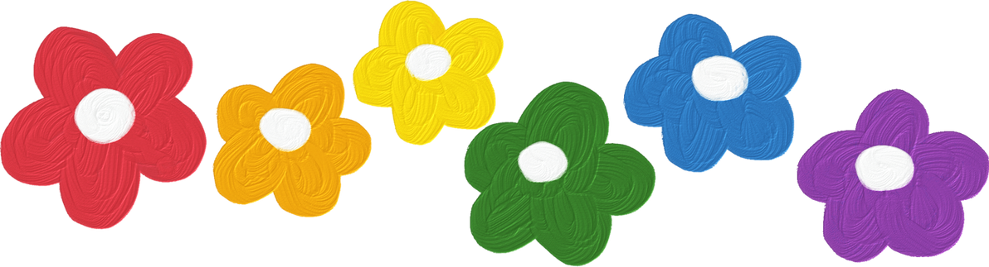




Fun time 3

Slide 2


FUN TIME 3
1
WARM -UP
2
DO THE PUZZLE
3
QUIZ TIME
4
CIRCLE THE HEALTHY FOODS
5
PLAY GAME

Slide 3
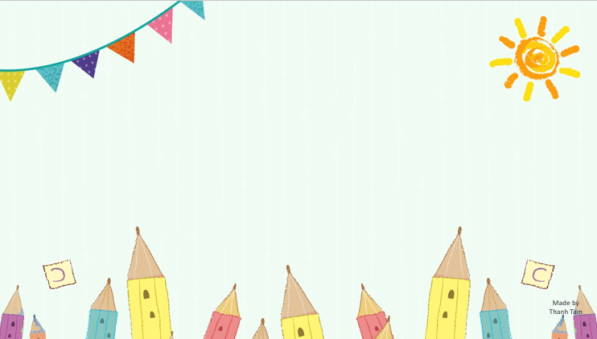
Warm -up

Slide 4

Let's play

Slide 5

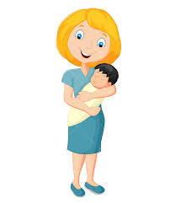
Guessing
Guessing?
mother
Notes:
MADE BY FACEBOOK :TRAN THI THANH TAM

Slide 6
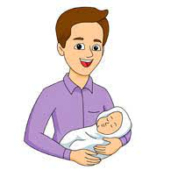
Guessing
Guessing?
father
Notes:
MADE BY FACEBOOK :TRAN THI THANH TAM

Slide 7
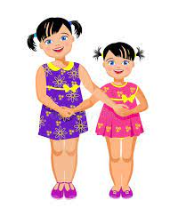
Guessing
Guessing?
sister
Notes:
MADE BY FACEBOOK :TRAN THI THANH TAM

Slide 8
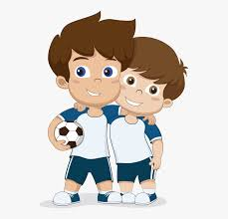
Guessing
Guessing?
brother
Notes:
MADE BY FACEBOOK :TRAN THI THANH TAM

Slide 9
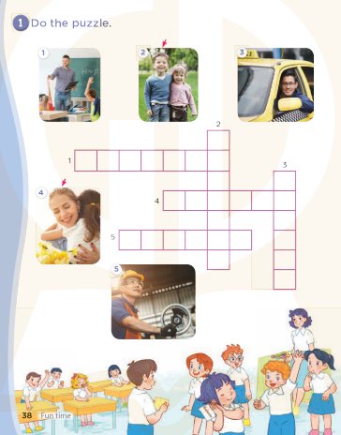

Slide 10
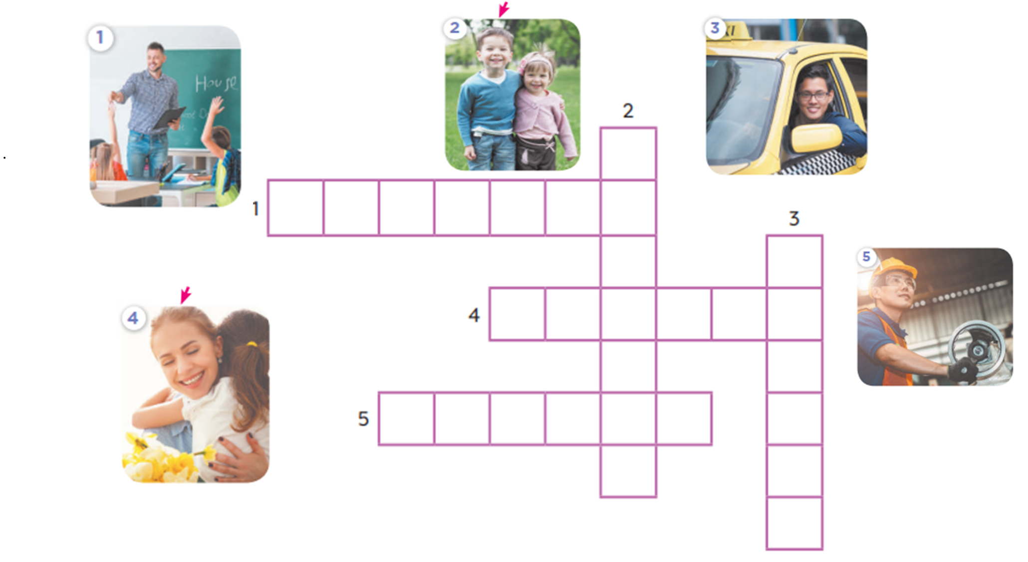





R

Slide 11
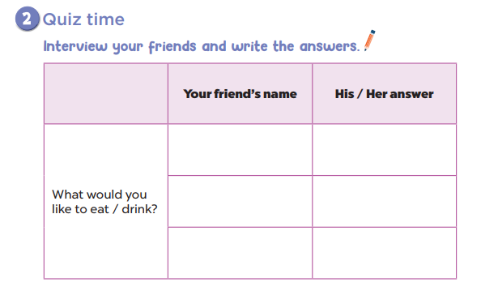

Slide 12
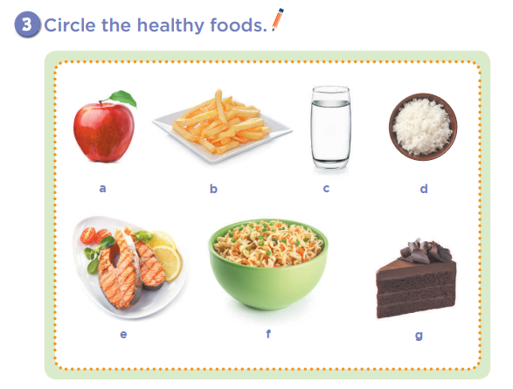

Slide 13
Let's play
Notes:
MADE BY FACEBOOK :TRAN THI THANH TAM

Slide 14

Choose a number
1
2
3
4
Next activity
Notes:
Step 1: Divide the class into 4 teams.
Step 2: Set rules: invite 1 pupil to choose 1 number and guess the job, then ask and answer about the job. The fastest one will have a chance to get a present.
Step 3: Encourage pupil to join in the game.
Step 4: Give points for pupils.

Slide 15
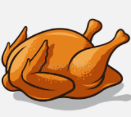
What would you like to eat?
I’d like some …………….
chicken
Get your present here

Slide 16

What would you like to drink?
I’d like some …………….
milk
Get your present here

Slide 17
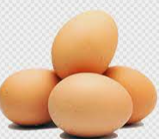
What would you like to eat?
I’d like some …………….
eggs
Get your present here

Slide 18

What would you like to drink?
I’d like some …………….
water
Get your present here

Slide 19
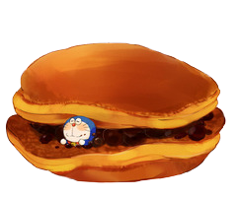

Slide 20

Homework:
- Practice more at home
- Prepare Unit 16- lesson 1 ( 1, 2, 3)

Slide 21

Made by Thanh Tam

Slide 22




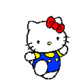



GOODBYE,
SEE YOU AGAIN !
Made by Thanh Tam

