Slide 1





FUN TIME 4

Slide 2


FUN TIME 4
1
WARM -UP
2
DO THE PUZZLE
3
QUIZ TIME
4
LOOK AND MATCH . THEN TALK
5
PLAY GAME

Slide 3
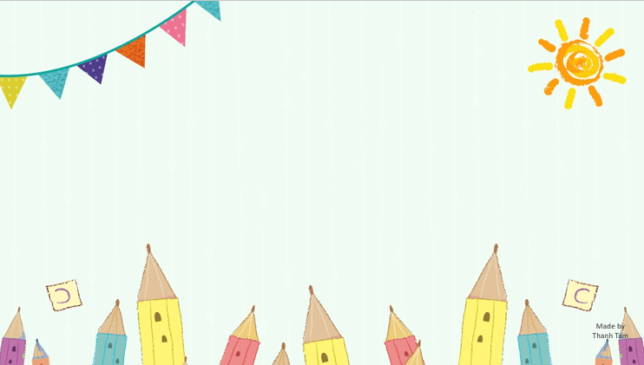
Warm -up

Slide 4


SING THE SONG: ZOO ANIMALS

Slide 5

Let's play
MATCHING

Slide 6
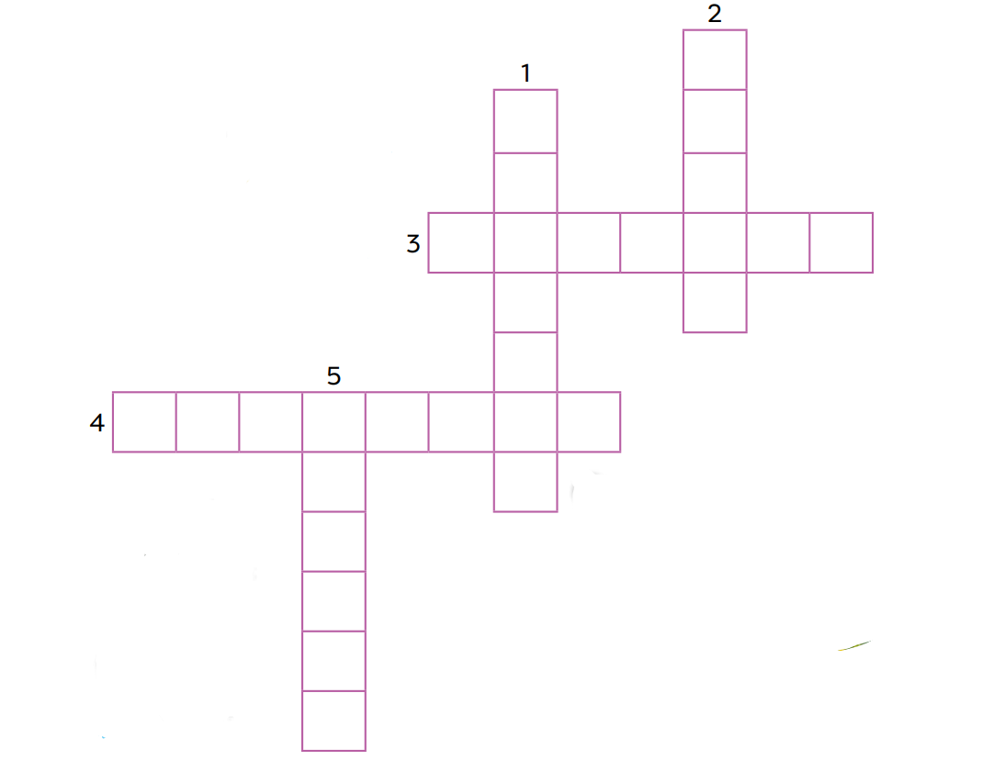
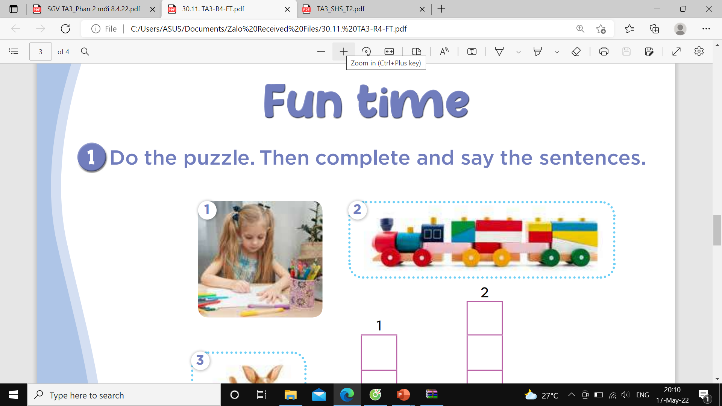
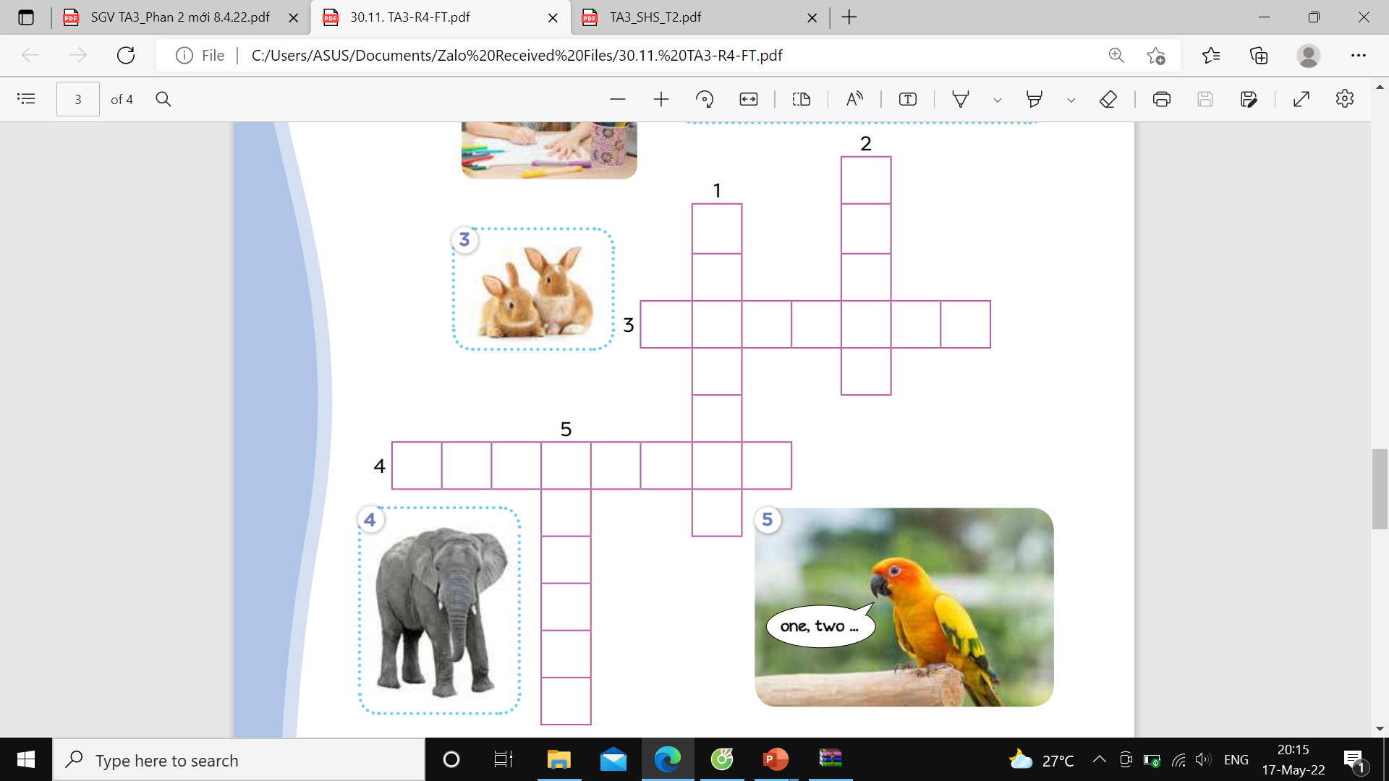
1.Do the puzzle

Slide 7
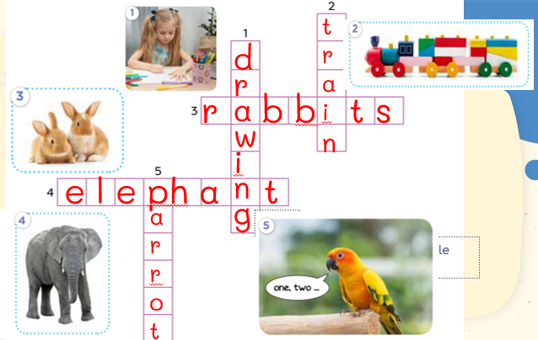
1.Do the puzzle

Slide 8
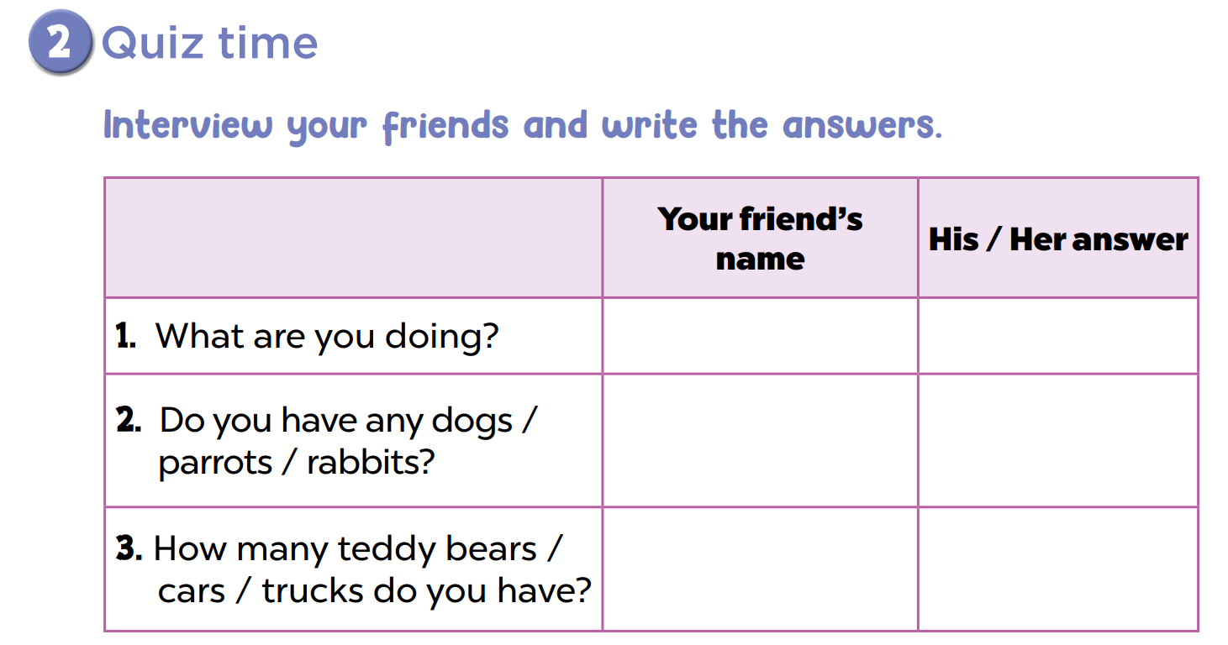

Slide 9
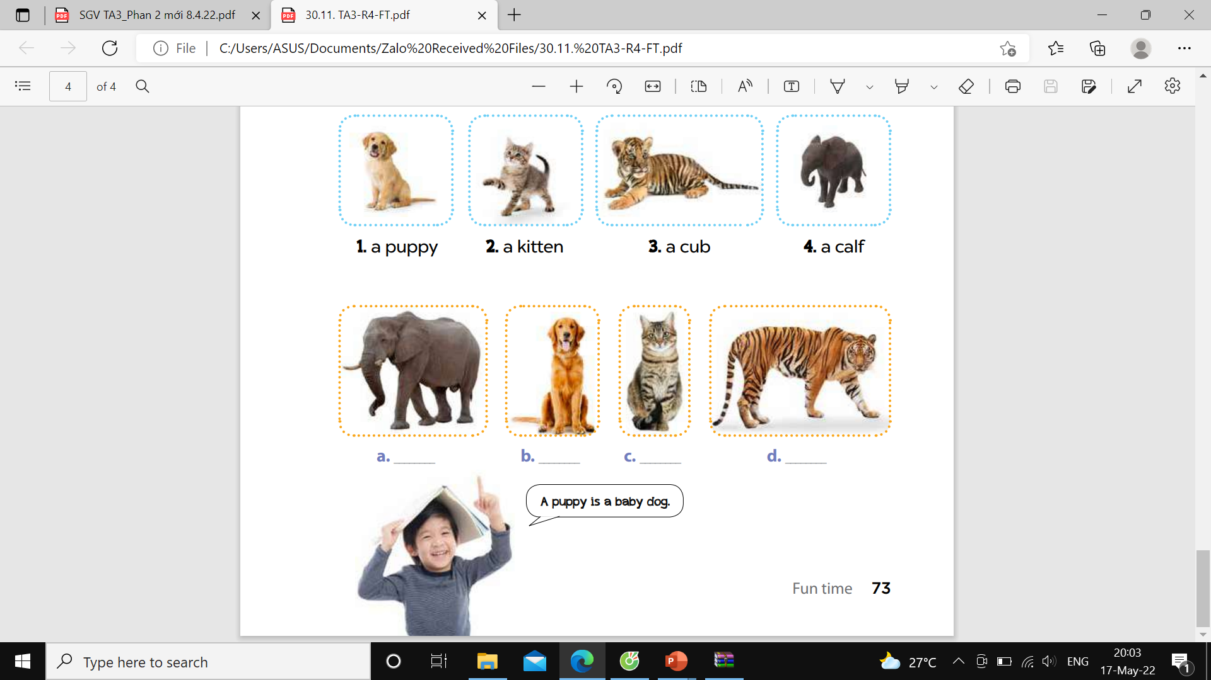
3.Look and match. Then talk

Slide 10

Let's play
I’m a fairy
Notes:
MADE BY FACEBOOK :TRAN THI THANH TAM

Slide 11



Notes:
MADE BY FACEBOOK :TRAN THI THANH TAM

Slide 12
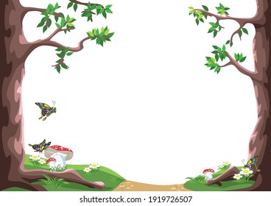

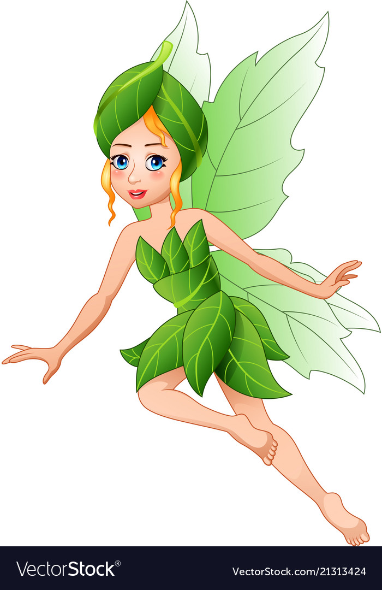
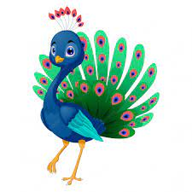
home
What can you see?
peacock
I can see a ………………....

Slide 13
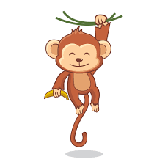
home
What can you see?
monkey
I can see a ………………....

Slide 14
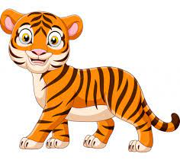
home
What can you see?
tiger
I can see a ………………....

Slide 15
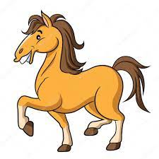
home
What can you see?
horse
I can see a ………………....

Slide 16

Homework:
- Practice more at home
- Prepare for the final test

Slide 17

Made by Thanh Tam

Slide 18








GOODBYE,
SEE YOU AGAIN !
Made by Thanh Tam

