Slide 1





REVIEW 3
PERIOD 1

Slide 2


REVIEW 3
1
WARM -UP
2
LISTEN AND TICK
3
READ AND NUMBER
4
READ AND MATCH
5
READ AND COMPLETE
6
ASK AND ANSWER
7
PLAY GAME

Slide 3
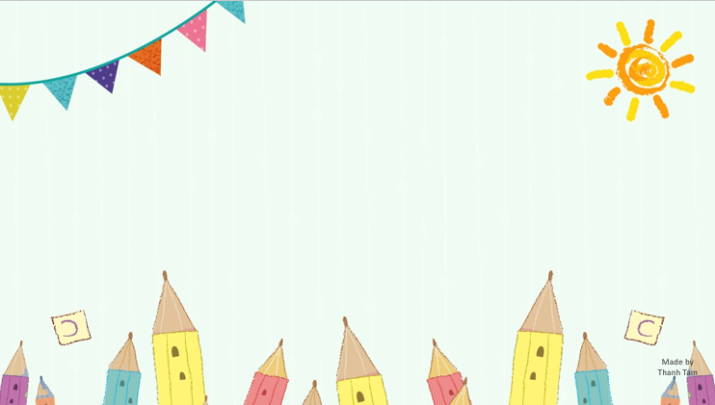
Warm -up

Slide 4

SING THE NUMBERS SONG

Slide 5

Let's play

Slide 6
Let's play
Notes:
MADE BY FACEBOOK :TRAN THI THANH TAM

Slide 7

Notes:
Step 1: Divide the class into 4 teams.
Step 2: Give each pupil one paper and draw a Bingo grid 3x3 on the board. Ask pupils to tell you the words they have learnt in their lessons. List them on the board. Each pupil chooses nine words from the list to copy into their grid. While they are doing this, copy each word onto a piece of paper, put the pieces of paper into a bag and mix them up. Nominate pupils one by one to pick out a piece of paper and call out the word. Pupils with that word in their grid can cross it out. Continue the game until there is a pupil who has all the words in their grid crossed out and calls out Bingo! That pupil is the winner.
Step 3: Encourage pupils to join in the game.
Step 4: Give candy/stickers for those who get Bingo.

Slide 8

Living room
job
farmer
milk
doctor
worker
cook
bedroom
teacher
Notes:
MADE BY FACEBOOK :TRAN THI THANH TAM

Slide 9
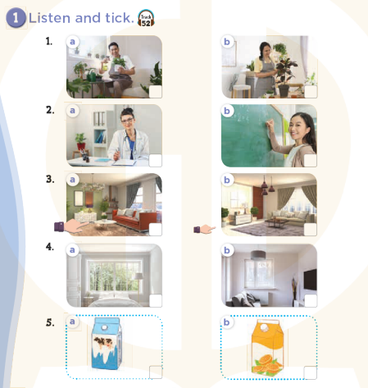

Slide 10

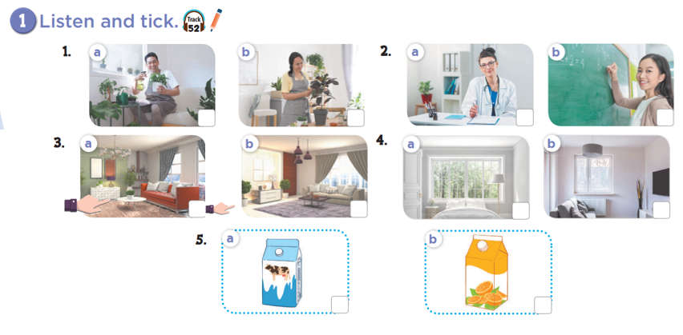




Slide 11
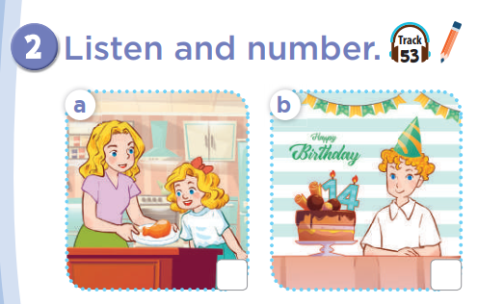
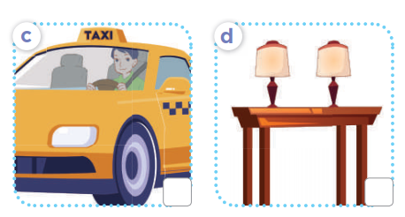
4
1
2
3

Slide 12
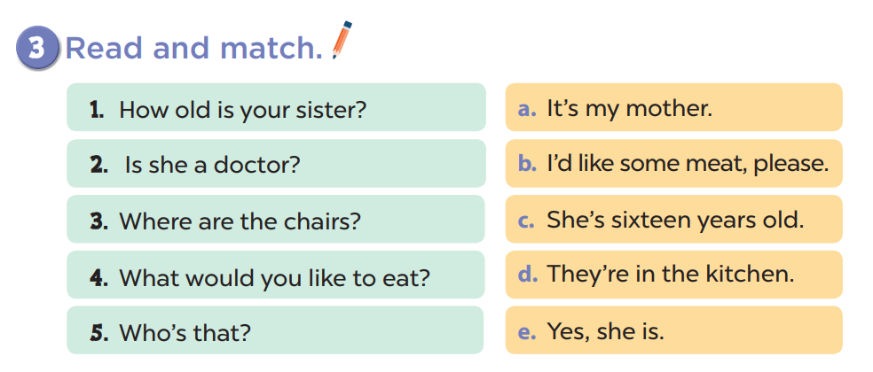

Slide 13
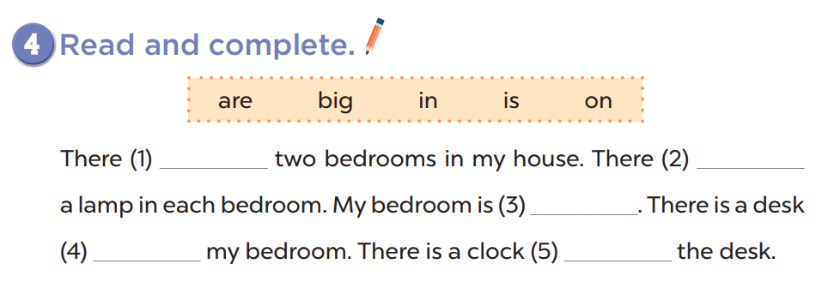
are
is
big
in
on

Slide 14
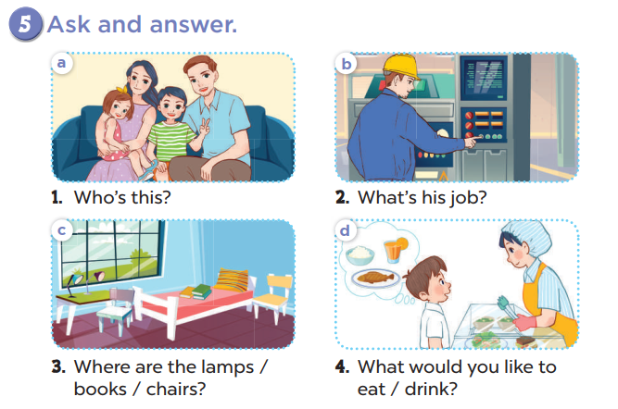

Slide 15


Let's play
Made by Thanh Tam
Notes:
MADE BY FACEBOOK :TRAN THI THANH TAM

Slide 16


RING THE GOLDEN BELL
Notes:
MADE BY FACEBOOK :TRAN THI THANH TAM

Slide 17

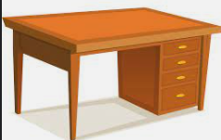
10
2
3
4
7
8
5
6
9
0
1
Game
RINGING THE GOLDEN BELL
desk
There is a…………... In the room
Notes:
MADE BY FACEBOOK :TRAN THI THANH TAM

Slide 18

10
2
3
4
7
8
5
6
9
0
1
Game
RINGING THE GOLDEN BELL
door
There is a…………...
Notes:
MADE BY FACEBOOK :TRAN THI THANH TAM

Slide 19
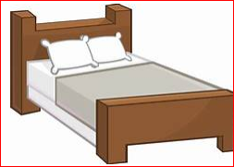
10
2
3
4
7
8
5
6
9
0
1
Game
RINGING THE GOLDEN BELL
beds
There are two…………... In the room
Notes:
MADE BY FACEBOOK :TRAN THI THANH TAM

Slide 20
10
2
3
4
7
8
5
6
9
0
1
Game
RINGING THE GOLDEN BELL
doors
There are three…………...
Notes:
MADE BY FACEBOOK :TRAN THI THANH TAM

Slide 21

Homework:
- Practice more at home
- Prepare FUN TIME 3

Slide 22

Made by Thanh Tam

Slide 23

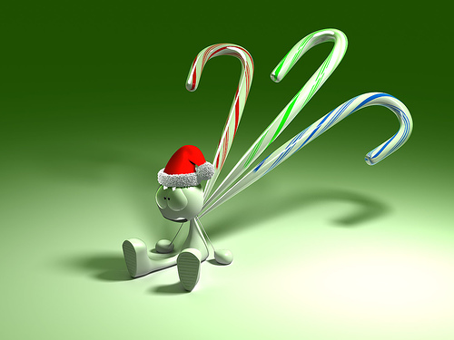

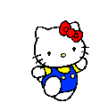



GOODBYE,
SEE YOU AGAIN !
Made by Thanh Tam

