Slide 1


REVIEW 4
1
WARM -UP
2
LISTEN AND TICK
3
READ AND NUMBER
4
READ AND MATCH
5
READ AND COMPLETE
6
ASK AND ANSWER
7
PLAY GAME

Slide 2

Warm -up

Slide 3

Let's play
Who’s the faster?
Notes:
MADE BY FACEBOOK :TRAN THI THANH TAM

Slide 4



reading
I’m _____________.

Slide 5

writing
I’m _____________.

Slide 6

reading
I’m _____________.

Slide 7

singing
I’m _____________.

Slide 8

Let's play
MATCHING

Slide 9


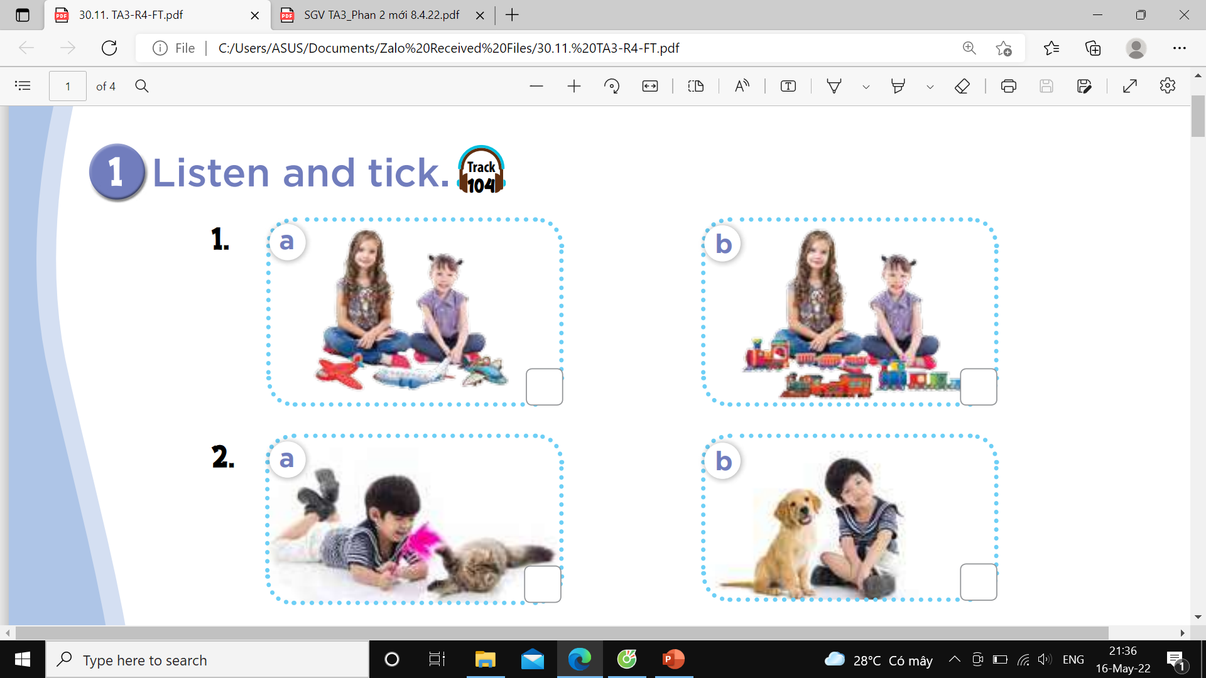

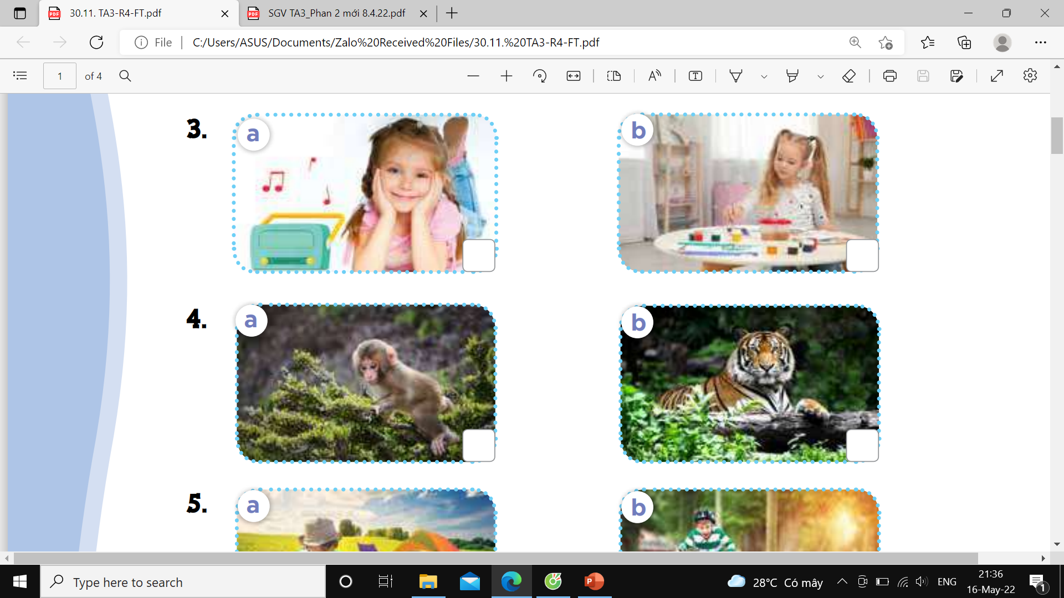
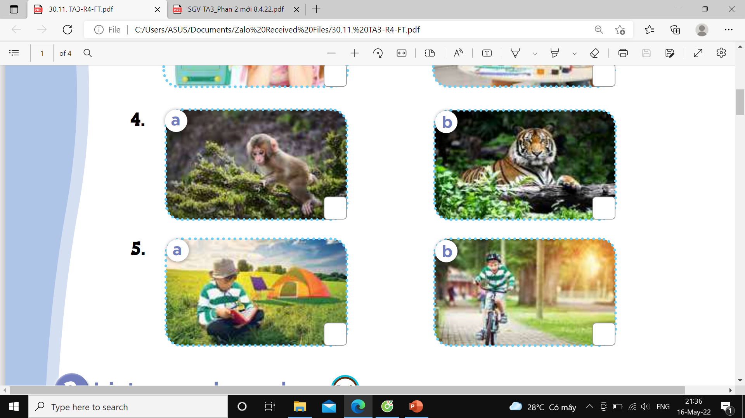

Slide 10
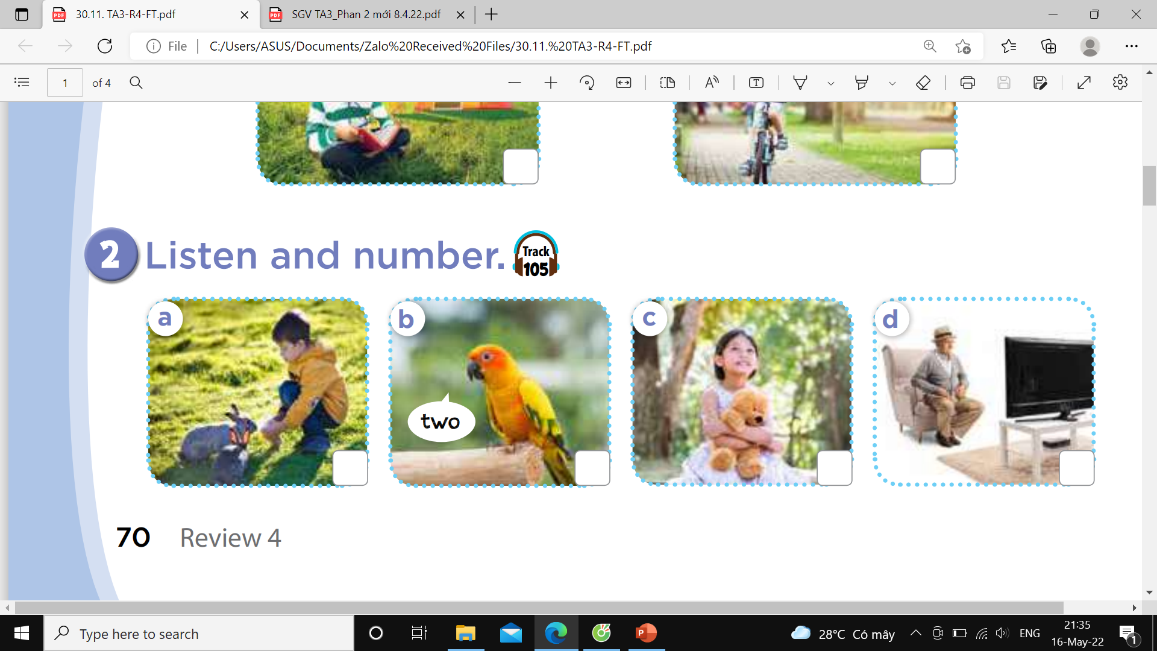
2
4
1
3

Slide 11
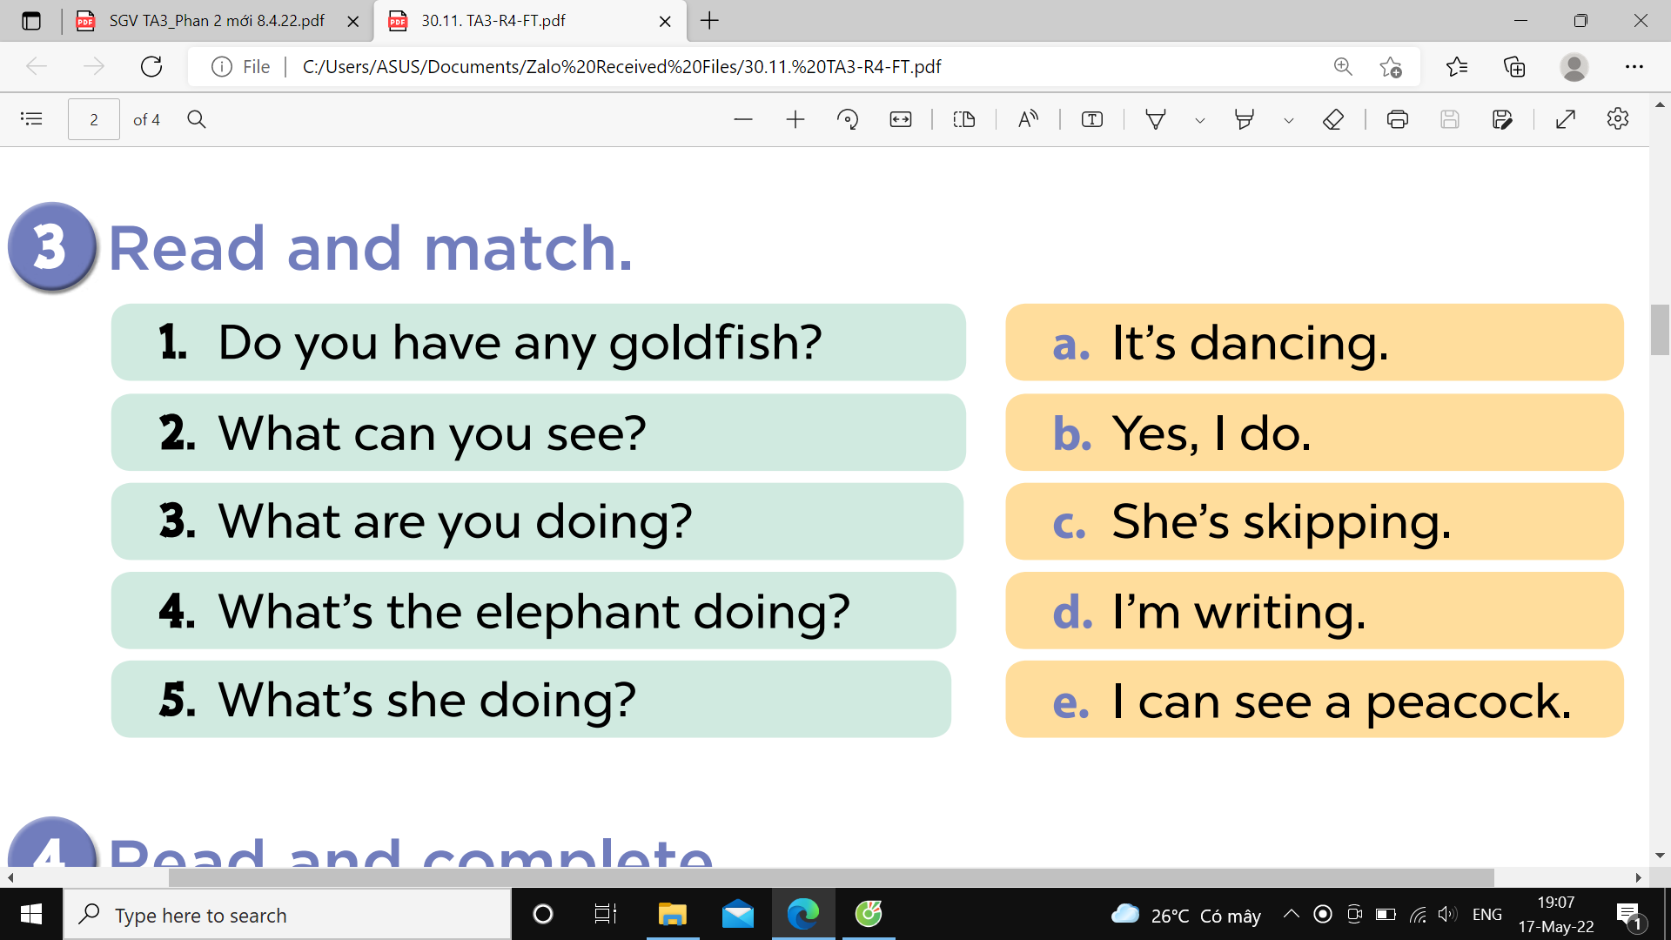

Slide 12
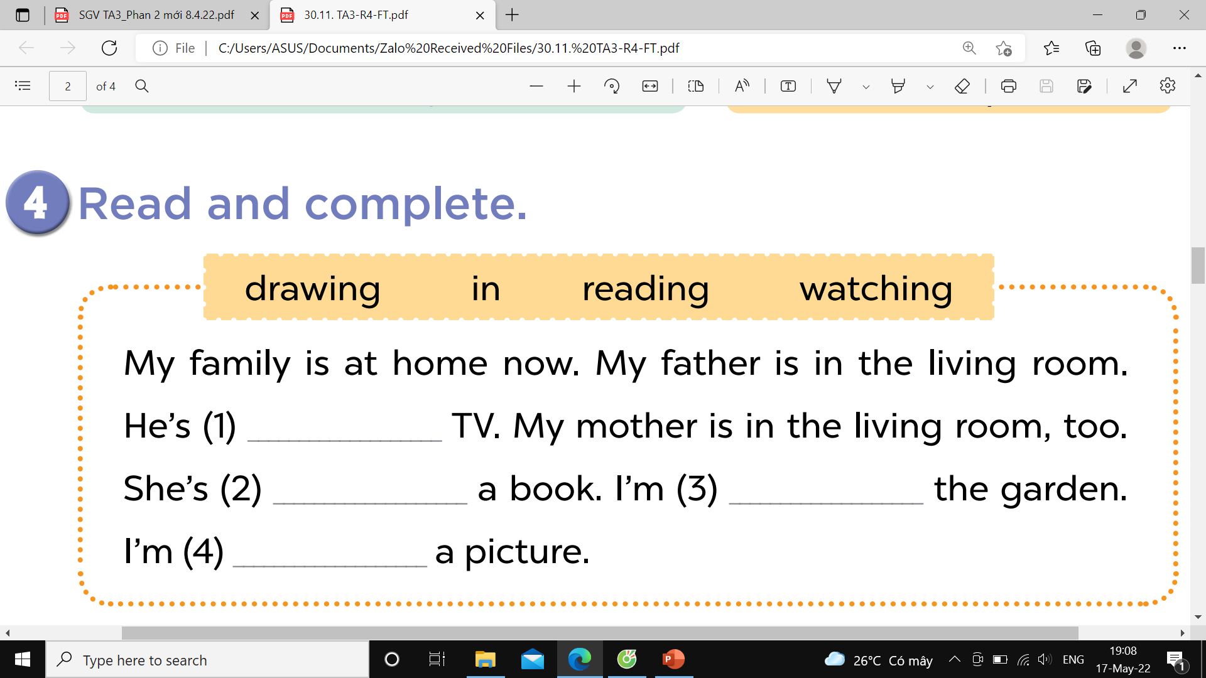
watching
reading
in
drawing

Slide 13
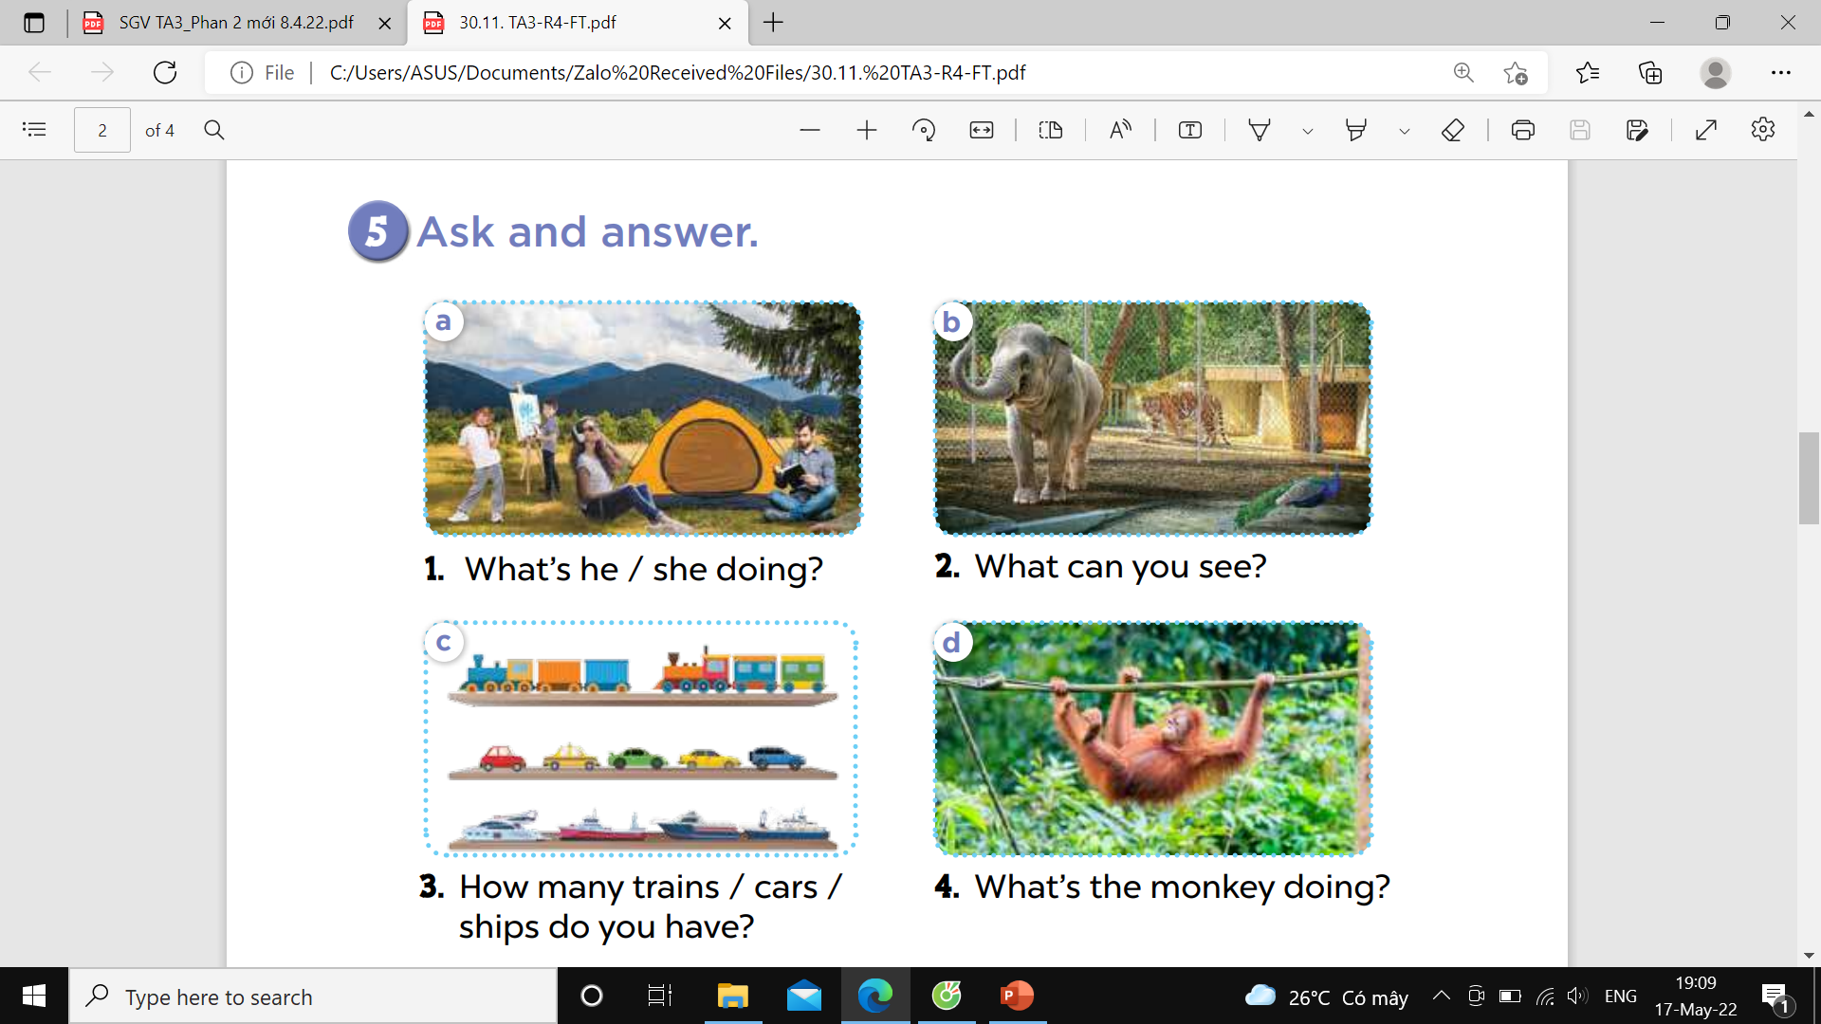

Slide 14


Let's play
Made by Thanh Tam

Slide 15












SNOW WHITE

Slide 16





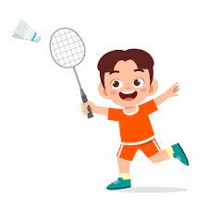





She’s painting
YES

Slide 17
He’s running
YES

Slide 18
She’s playing badminton
YES

Slide 19

She’s walking.
YES

Slide 20

Homework:
- Practice more at home
- Prepare FUN TIME 4

Slide 21

Made by Thanh Tam

Slide 22







GOODBYE,
SEE YOU AGAIN !
Made by Thanh Tam

