Slide 1


UNIT 11: MY FAMILY
LESSON 1 ( 1, 2, 3)

Slide 2

CONTENTS
1
WARM -UP
2
VOCABULARY
3
LOOK, LISTEN AND REPEAT
4
LISTEN, POINT AND SAY
5
LET’S TALK
6
PLAY GAME
Notes:
MADE BY FACEBOOK :TRAN THI THANH TAM

Slide 3
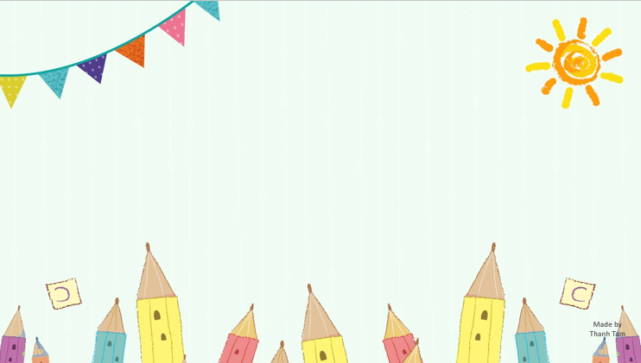
Warm - up

Slide 4

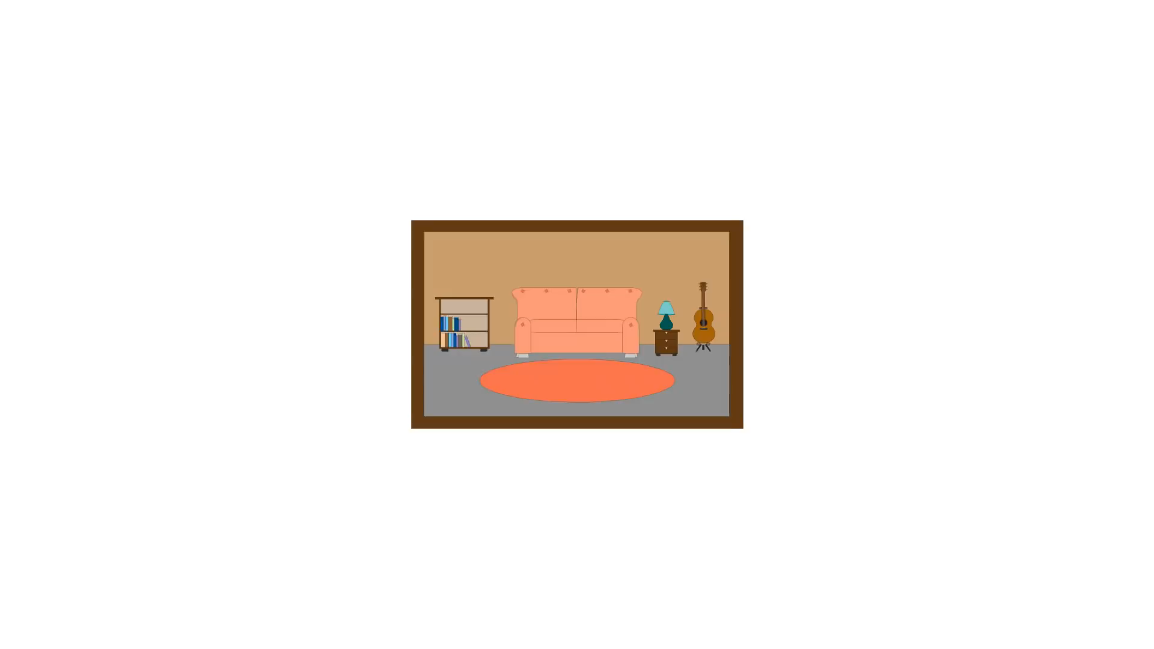
SING THE SONG: FAMILY MEMBERS
Notes:
Made by FACEBOOK: TRAN THI THANH TAM

Slide 5


Slide 6


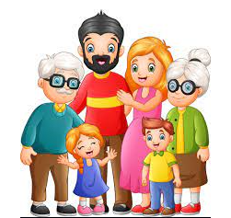
Family:/ˈfæməli/:gia đình

Slide 7
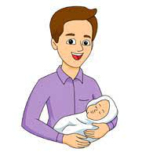
Father: /ˈfɑː.ðər/ bố

Slide 8
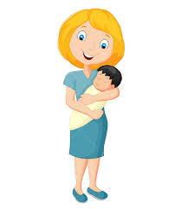
Mother: /ˈmʌð.ər/ mẹ

Slide 9
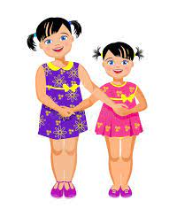
Sister: /ˈsɪs.tər/ chị(em) gái

Slide 10
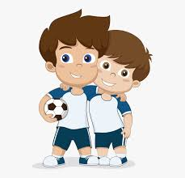
Brother: /ˈbrʌð.ər/:anh(em) trai

Slide 11
Let's play
MATCHING
Notes:
MADE BY FACEBOOK :TRAN THI THANH TAM

Slide 12
CHECK VOCABULARY:MATCHING
brother
sister
mother
father
family

Slide 13
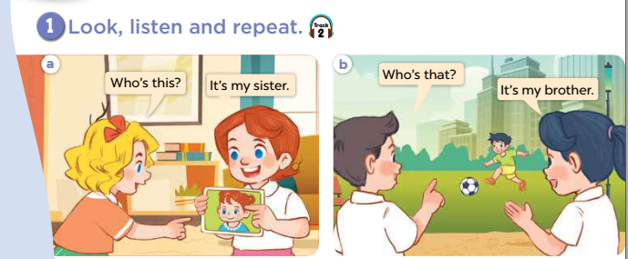

Slide 14
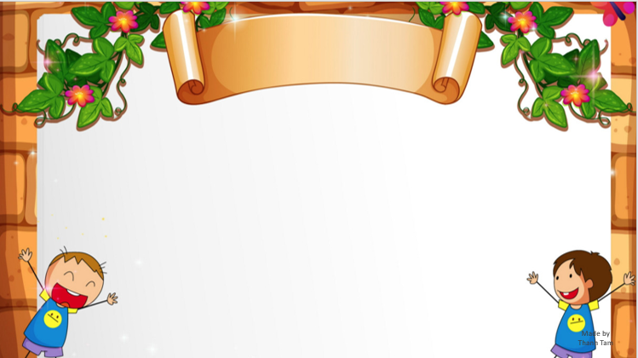
SENTENCE PATTERN

Slide 15
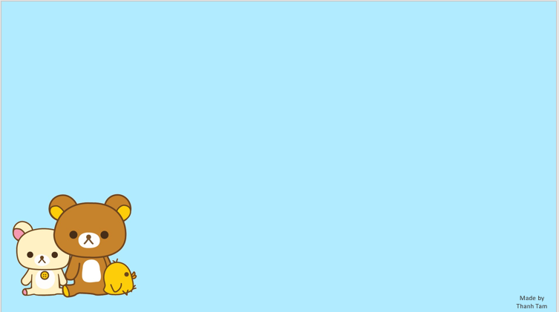
Hỏi về các thành viên trong gia đình
Who’s this?
(Đây là ai?)
She’s my mother.
(Bà ấy là mẹ của tôi.)

Slide 16
Hỏi về các thành viên trong gia đình
Who’s that?
(Kia là ai?)
He’s my father.
(Ông ấy là bố của tôi.)

Slide 17
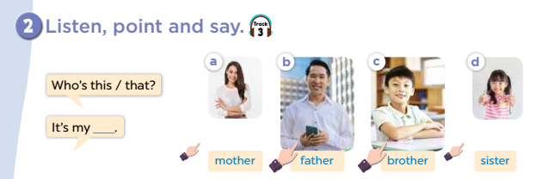

Slide 18
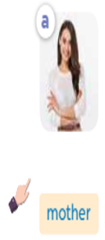
Who’s………….?
that
It’s my……….
mother
Notes:
MADE BY FACEBOOK :TRAN THI THANH TAM

Slide 19
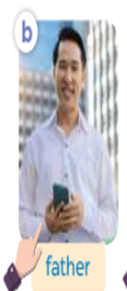
Who’s………….?
this
It’s my……….
father
Notes:
MADE BY FACEBOOK :TRAN THI THANH TAM

Slide 20
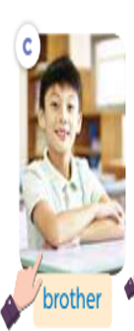
Who’s………….?
this
It’s my……….
brother
Notes:
MADE BY FACEBOOK :TRAN THI THANH TAM

Slide 21
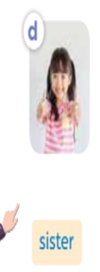
Who’s………….?
that
It’s my……….
sister
Notes:
MADE BY FACEBOOK :TRAN THI THANH TAM

Slide 22
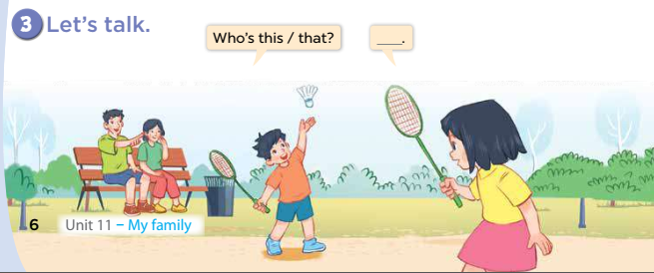

Slide 23


Let's play
Made by Thanh Tam
Notes:
MADE BY FACEBOOK :TRAN THI THANH TAM

Slide 24


RING THE GOLDEN BELL
Notes:
MADE BY FACEBOOK :TRAN THI THANH TAM

Slide 25

10
2
3
4
7
8
5
6
9
0
1
Game
RINGING THE GOLDEN BELL
Who’s that?
It’s my father.
Notes:
MADE BY FACEBOOK :TRAN THI THANH TAM

Slide 26
10
2
3
4
7
8
5
6
9
0
1
Game
RINGING THE GOLDEN BELL
Who’s that?
It’s my mother.
Notes:
MADE BY FACEBOOK :TRAN THI THANH TAM

Slide 27
10
2
3
4
7
8
5
6
9
0
1
Game
RINGING THE GOLDEN BELL
Who’s that?
It’s my brother.
Notes:
MADE BY FACEBOOK :TRAN THI THANH TAM

Slide 28
10
2
3
4
7
8
5
6
9
0
1
Game
RINGING THE GOLDEN BELL
Who’s that?
It’s my sister.
Notes:
MADE BY FACEBOOK :TRAN THI THANH TAM

Slide 29

SUMMARY
Notes:
MADE BY FACEBOOK :TRAN THI THANH TAM

Slide 30

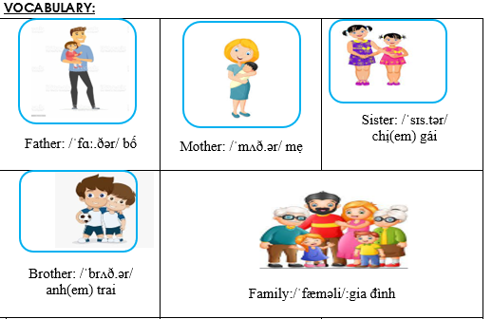
Notes:
Made by Facebook: TRAN THI THANH TAM

Slide 31
SENTENCE PATTERN
Notes:
MADE BY FACEBOOK :TRAN THI THANH TAM

Slide 32
Hỏi về các thành viên trong gia đình
Who’s this?
(Đây là ai?)
She’s my mother.
(Bà ấy là mẹ của tôi.)

Slide 33
Hỏi về các thành viên trong gia đình
Who’s that?
(Kia là ai?)
He’s my father.
(Ông ấy là bố của tôi.)

Slide 34

Homework:
- Learn vocabulary and sentence pattern by heart
- Prepare Unit 11- lesson 1 ( 4, 5, 6)
Notes:
MADE BY FACEBOOK :TRAN THI THANH TAM

Slide 35

Notes:
MADE BY FACEBOOK :TRAN THI THANH TAM

Slide 36



Thank you very much
Good bye! See you again!
Made by Thanh Tam

Slide 37
UNIT 11: MY FAMILY
LESSON 1 ( 1, 2, 3)

Slide 38
CONTENTS
1
WARM -UP
2
LISTEN AND TICK
3
LOOK, COMPLETE AND READ
4
LET’S SING
5
PLAY GAME
Notes:
MADE BY FACEBOOK :TRAN THI THANH TAM

Slide 39
Warm - up

Slide 40

Let's play
Guessing
Notes:
MADE BY FACEBOOK :TRAN THI THANH TAM

Slide 41
Guessing
Guessing?
mother
Notes:
MADE BY FACEBOOK :TRAN THI THANH TAM

Slide 42
Guessing
Guessing?
father
Notes:
MADE BY FACEBOOK :TRAN THI THANH TAM

Slide 43
Guessing
Guessing?
sister
Notes:
MADE BY FACEBOOK :TRAN THI THANH TAM

Slide 44
Guessing
Guessing?
brother
Notes:
MADE BY FACEBOOK :TRAN THI THANH TAM

Slide 45
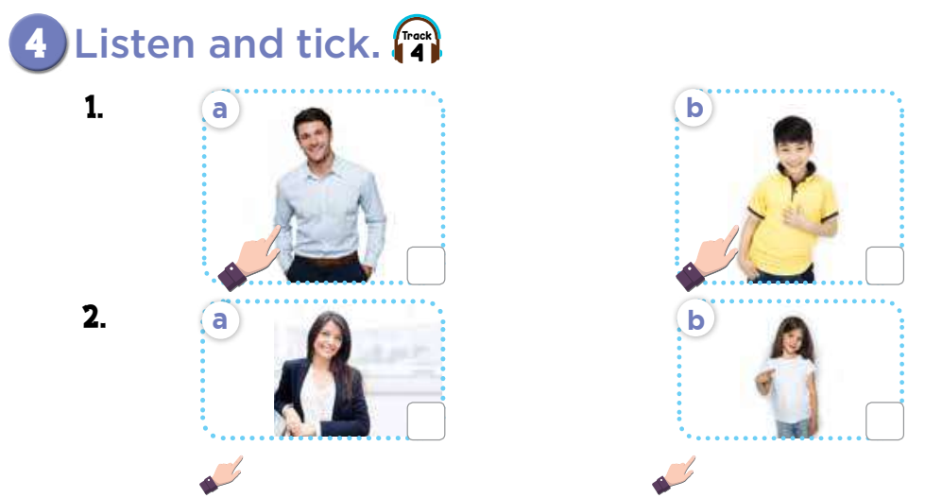

Slide 46
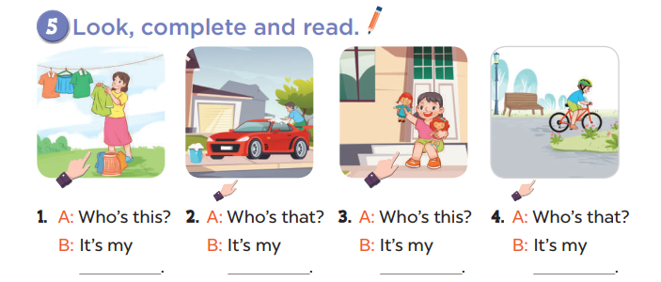
mother
father
sister
brother

Slide 47
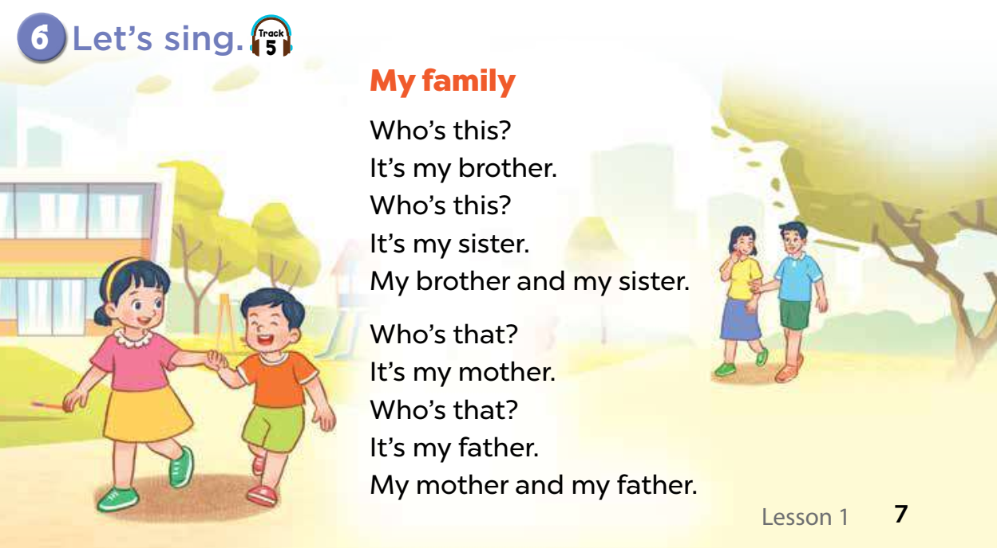

Slide 48
Let's play
Made by Thanh Tam

Slide 49
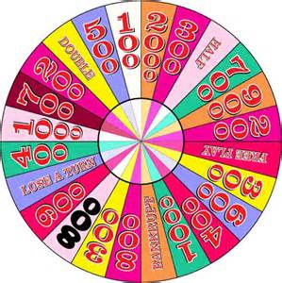
WHEEL FORTUNE

Slide 50
Fotune wheel
Question 1
Choose the best answer
A. sister
A. sister
B. brother
Spin
C. family
Answer
Next
Very Good!

Slide 51
Fotune wheel
Question 1
Choose the best answer
A. sister
B. brother
B. brother
Spin
C. mother
Answer
Next
Very Good!

Slide 52
Fotune wheel
Question 1
Choose the best answer
A. family
B. mother
Spin
C. father
C. father
Answer
Next
Very Good!

Slide 53
Fotune wheel
Question 1
Choose the best answer
A. mother
A. mother
B. father
Spin
C. family
Answer
Next
Very Good!

Slide 54

Homework:
- Practice more at home
- Prepare Unit 11- lesson 2 ( 1, 2, 3)

Slide 56




The bye bye song
Bye, bye.
See you tomorrow.
Bye, bye.
See you tomorrow.
Bye, bye.
See you tomorrow.
Bye, bye. Bye, bye.
The bye bye song
Made by Thanh Tam

