Slide 1


UNIT 11: MY FAMILY
LESSON 3 ( 1, 2, 3)

Slide 2
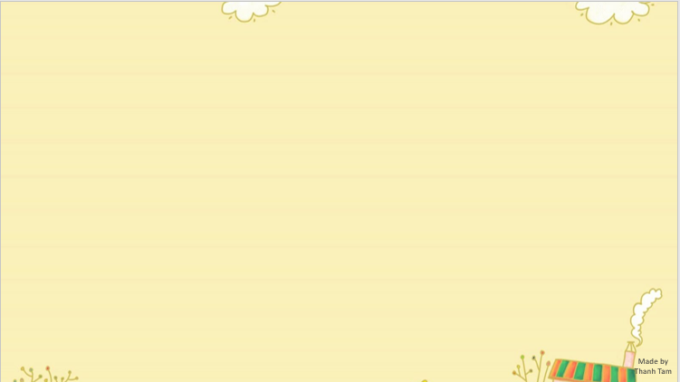

CONTENTS
1
WARM -UP
2
LISTEN AND REPEAT
3
LISTEN AND CIRCLE
4
LET’S CHANT
5
PLAY GAME
Notes:
MADE BY FACEBOOK :TRAN THI THANH TAM

Slide 3
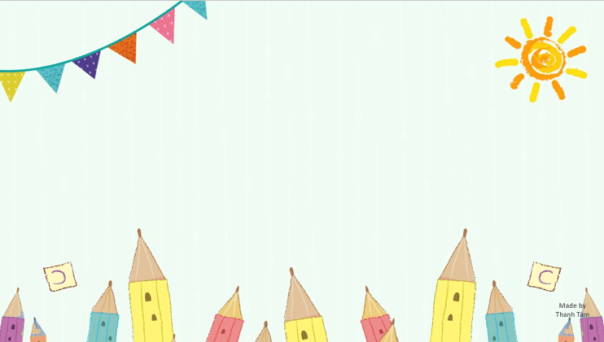
Warm - up

Slide 4

Let's play

Slide 5













SNOW WHITE

Slide 6



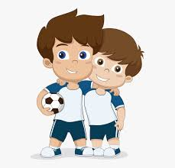
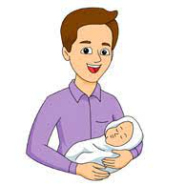
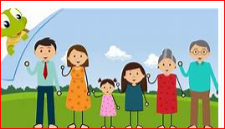





Who’s this?
It’s my father.
YES

Slide 7
Who’s this?
It’s my brother.
YES

Slide 8
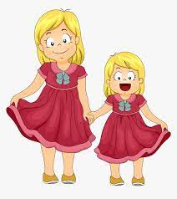
Who’s this?
It’s my sister.
YES

Slide 9

Who’s this?
It’s my mother.
YES

Slide 10

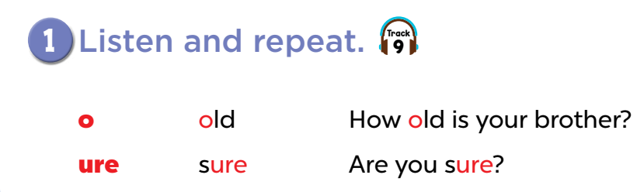

Slide 11
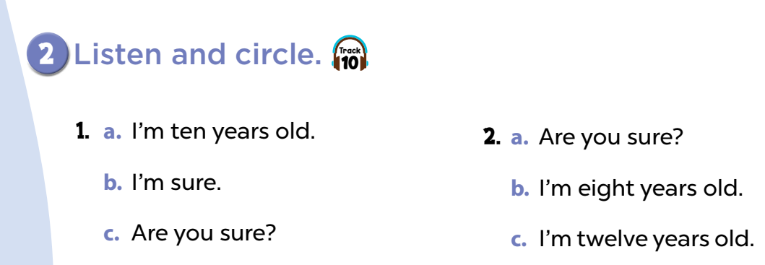

Slide 12
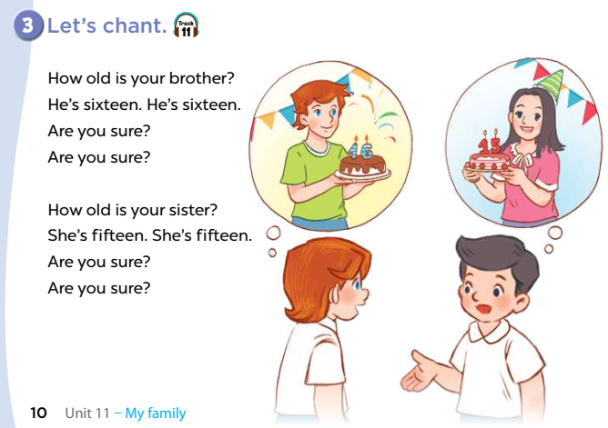

Slide 13
Let's play
Choose the correct answer
Notes:
MADE BY FACEBOOK :TRAN THI THANH TAM

Slide 14

This is my…..…….. .
father
mother
sister
Notes:
MADE BY FACEBOOK :TRAN THI THANH TAM

Slide 15
brother/ my/ is/ He/./
He is brother my.
He is my brother
Brother is my he.
Notes:
MADE BY FACEBOOK :TRAN THI THANH TAM

Slide 16
is/ fmy/ family/ This/./
This family is my.
This is my family.
This family my is.
Notes:
MADE BY FACEBOOK :TRAN THI THANH TAM

Slide 17
He is my…..……..
sister
brother
mother
Notes:
MADE BY FACEBOOK :TRAN THI THANH TAM

Slide 18

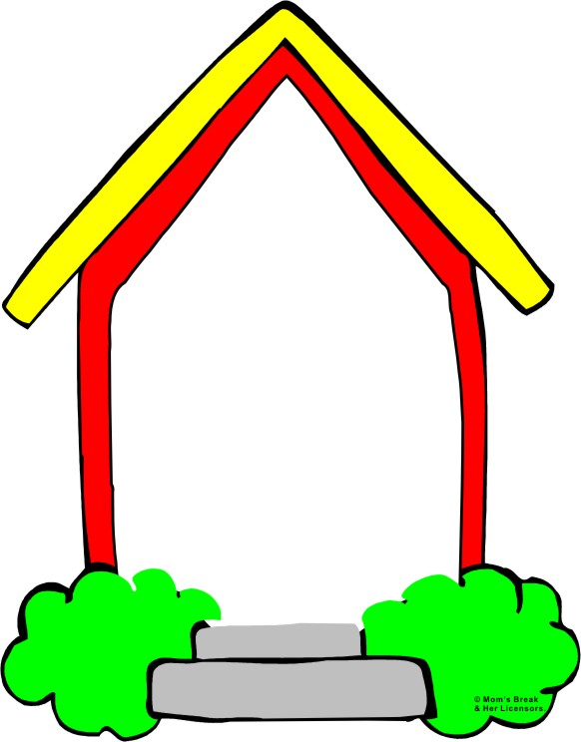
Homework:
- Practice more at home
- Prepare Unit 11- Lesson 3 ( 4, 5, 6)
Made by
Thanh Tam
Notes:
MADE BY FACEBOOK :TRAN THI THANH TAM

Slide 19
UNIT 11: MY FAMILY
LESSON 3 ( 1, 2, 3)

Slide 20
CONTENTS
1
WARM -UP
2
READ AND COMPLETE
3
LET’S WRITE
4
PROJECT
5
PLAY GAME
Notes:
MADE BY FACEBOOK :TRAN THI THANH TAM

Slide 21
Warm - up

Slide 22
Let's play
Slap the board
Notes:
MADE BY FACEBOOK :TRAN THI THANH TAM

Slide 23


SLAP THE BOARD
brother
seventeen
twenty
sister
eight
father
mother
Made by Thanh Tam
Notes:
MADE BY FACEBOOK :TRAN THI THANH TAM

Slide 24
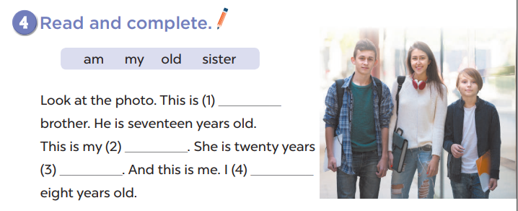
my
sister
old
am

Slide 25
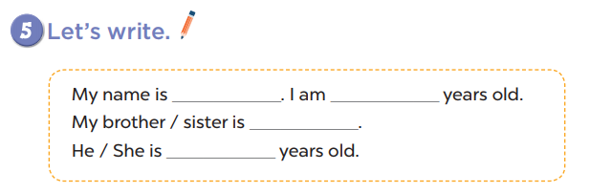

Slide 26
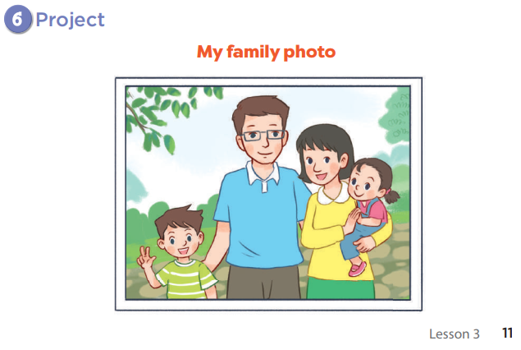

Slide 27

Let's play GAME
Who is fastest?
Notes:
MADE BY FACEBOOK :TRAN THI THANH TAM

Slide 28

How old is he?
fifteen.
He’s……………
Notes:
MADE BY FACEBOOK :TRAN THI THANH TAM

Slide 29

How old is he?
nineteen.
He’s……………
Notes:
MADE BY FACEBOOK :TRAN THI THANH TAM

Slide 30

How old is he?
sixteen.
He’s……………
Notes:
MADE BY FACEBOOK :TRAN THI THANH TAM

Slide 31

How old is he?
twelve.
He’s……………
Notes:
MADE BY FACEBOOK :TRAN THI THANH TAM

Slide 32

Homework:
- Practice more at home
- Prepare Unit 12- lesson 1 ( 1, 2, 3)

Slide 33

Let's play
Made by Thanh Tam

Slide 34


Slide 35



Thank you very much
Good bye! See you again!
Made by Thanh Tam

