Slide 1


UNIT 12: JOBS
LESSON 1( 1, 2, 3)

Slide 2

CONTENTS
1
WARM -UP
2
VOCABULARY
3
LOOK, LISTEN AND REPEAT
4
LISTEN, POINT AND SAY
5
LET’S TALK
6
PLAY GAME
Notes:
MADE BY FACEBOOK :TRAN THI THANH TAM

Slide 3

Warm - up

Slide 4

LET ’S PLAY
Chinese Whispers

Slide 5
Chinese Whispers
Group 1
Group 2
She’ s nineteen years old.
She’ s seventeen years old.
Notes:
Made by Facebook: TRAN THI THANH TAM

Slide 6
Chinese Whispers
Group 1
Group 2
He’ s eleven years old.
He’ s fifteen years old.
Notes:
Made by Facebook: TRAN THI THANH TAM

Slide 7


Slide 8



job: /dʒɒb/ nghề nghiệp

Slide 9

Doctor: /ˈdɒk.tər/ bác sĩ

Slide 10

Teacher: /ˈtiː.tʃər/ giáo viên

Slide 11
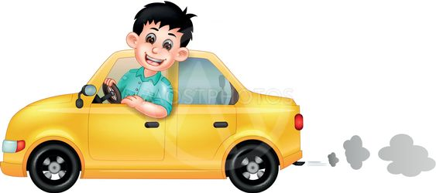
Driver: /ˈdraɪ.vər/ tài xế lái xe

Slide 12

Worker: /ˈwɜː.kər/ công nhân

Slide 13

Let's play

Slide 14
What and where
1
Jobs
2
worker
3
doctor
4
driver
5
teacher

Slide 15

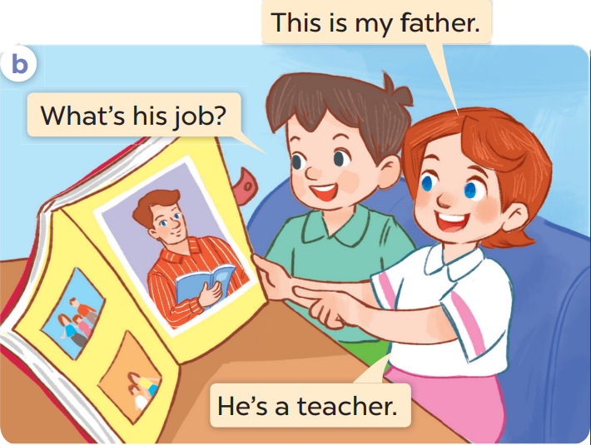
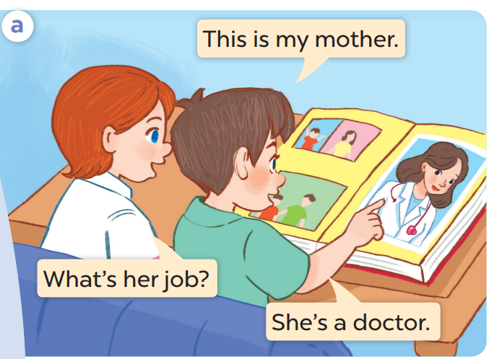
1. LOOK, LISTEN AND REPEAT

Slide 16

SENTENCE PATTERN

Slide 17
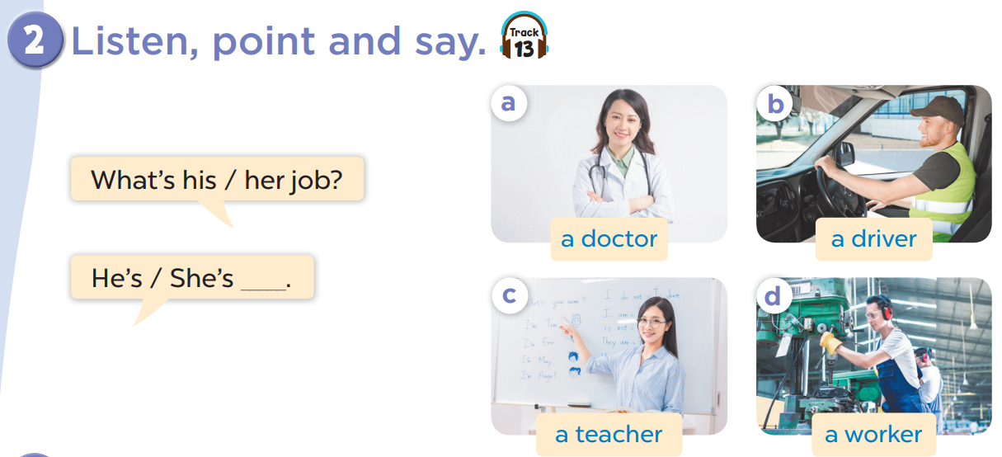

Slide 18


What’s ……… job?
her
She’s……………
a doctor
Notes:
MADE BY FACEBOOK :TRAN THI THANH TAM

Slide 19

What’s ……… job?
his
He’s……………
a driver
Notes:
MADE BY FACEBOOK :TRAN THI THANH TAM

Slide 20

What’s ……… job?
her
She’s……………
a teacher
Notes:
MADE BY FACEBOOK :TRAN THI THANH TAM

Slide 21

What’s ……… job?
his
He’s……………
a worker
Notes:
MADE BY FACEBOOK :TRAN THI THANH TAM

Slide 22
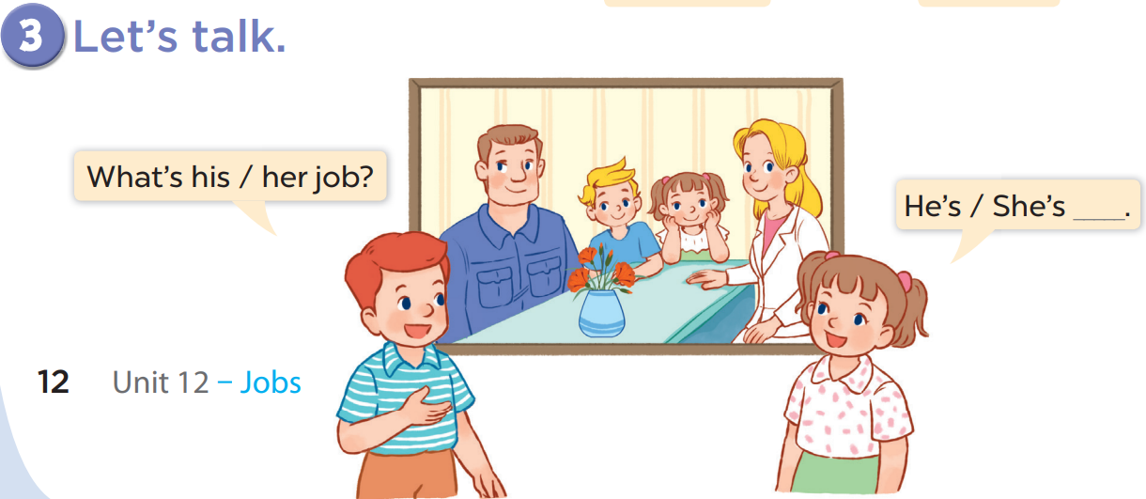

Slide 23



Let's play
Who’s a millionaire?
Notes:
MADE BY FACEBOOK :TRAN THI THANH TAM

Slide 24




Who's a millionaire?
What’s his job?
50:50
A. doctor
B. teacher
C. driver
C. driver
D. worker
Notes:
MADE BY FACEBOOK :TRAN THI THANH TAM

Slide 25
Who's a millionaire?
Who's a millionaire?
What’s her job?
50:50
A. doctor
B. teacher
B. teacher
C. driver
D. worker
Notes:
MADE BY FACEBOOK :TRAN THI THANH TAM

Slide 26
Who's a millionaire?
Who's a millionaire?
What’s his job?
50:50
A. doctor
B. teacher
C. driver
D. worker
D. worker
Notes:
MADE BY FACEBOOK :TRAN THI THANH TAM

Slide 27

Who's a millionaire?
Who's a millionaire?
What’s his job?
50:50
A. doctor
A. doctor
B. teacher
C. driver
D. worker
Notes:
MADE BY FACEBOOK :TRAN THI THANH TAM

Slide 28

SUMMARY
Notes:
MADE BY FACEBOOK :TRAN THI THANH TAM

Slide 29
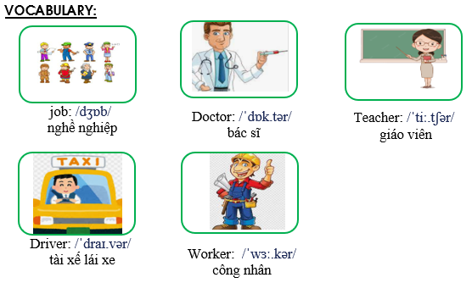
Notes:
Made by Facebook: TRAN THI THANH TAM

Slide 30
SENTENCE PATTERN
Notes:
MADE BY FACEBOOK :TRAN THI THANH TAM

Slide 31
Hỏi và trả lời về nghề nghiệp của một người.
What’s his job?
( Nghề nghiệp của ông ấy là gì? )
He’s a teacher.
( Ông ấy là một giáo viên.)

Slide 32
Hỏi và trả lời về nghề nghiệp của một người.
What’s her job?
( Nghề nghiệp của bà ấy là gì? )
She’s a doctor.
( Bà ấy là một bác sĩ.)

Slide 33

Homework:
- Learn vocabulary and sentence pattern by heart
- Prepare Unit 12- lesson 1 ( 4, 5, 6)
Notes:
MADE BY FACEBOOK :TRAN THI THANH TAM

Slide 34

Notes:
MADE BY FACEBOOK :TRAN THI THANH TAM

Slide 35



Thank you very much
Good bye! See you again!
Made by Thanh Tam

Slide 36
UNIT 12: JOBS
LESSON 1( 4, 5, 6)

Slide 37
CONTENTS
1
WARM -UP
2
LISTEN AND TICK
3
LOOK, COMPLETE AND READ
4
LET’S SING
5
PLAY GAME
Notes:
MADE BY FACEBOOK :TRAN THI THANH TAM

Slide 38

Warm - up
Notes:
Made by Facebook: TRAN THI THANH TAM

Slide 39
Let's play
WHAT’S MISSING?
Notes:
MADE BY FACEBOOK :TRAN THI THANH TAM

Slide 40

DOCTOR
?
Notes:
MADE BY FACEBOOK :TRAN THI THANH TAM

Slide 41

?
TEACHER
Notes:
MADE BY FACEBOOK :TRAN THI THANH TAM

Slide 42
?
WORKER
Notes:
MADE BY FACEBOOK :TRAN THI THANH TAM

Slide 43
DRIVER
?
Notes:
MADE BY FACEBOOK :TRAN THI THANH TAM

Slide 44


4.LISTEN AND TICK

Slide 45
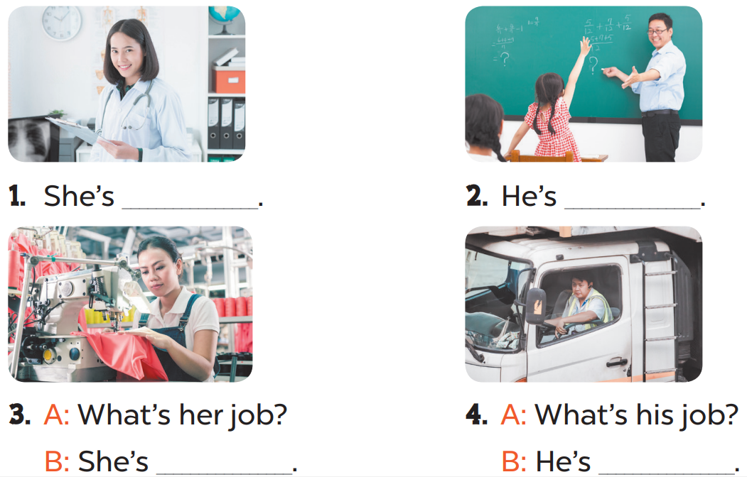
4.LOOK, COMPLETE AND READ
a doctor
a teacher
a worker
a driver

Slide 46
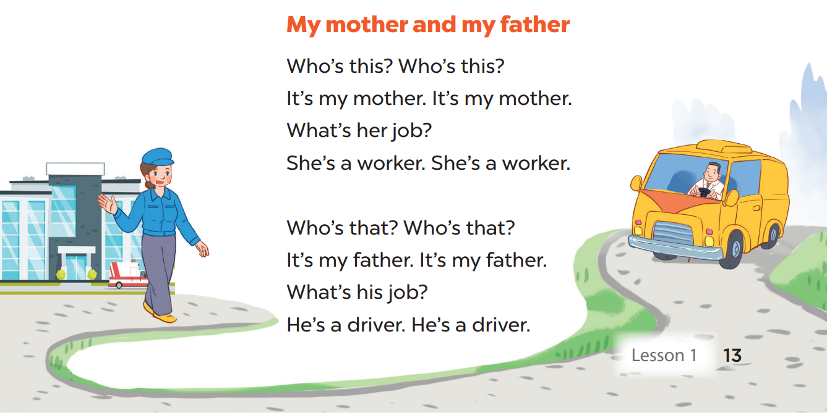
6.LET’S SING

Slide 47

Let's play
Made by Thanh Tam

Slide 48
Let's play GAME
Who is fastest?
Notes:
MADE BY FACEBOOK :TRAN THI THANH TAM

Slide 49


Choose the best answer
A. teacher
B. doctor
C. worker
Question 1
B
1
2
3
4
5
6
7
8
9
10
Notes:
MADE BY FACEBOOK :TRAN THI THANH TAM

Slide 50

Choose the best answer
A. teacher
B. doctor
C. driver
Question 1
C
1
2
3
4
5
6
7
8
9
10
Notes:
MADE BY FACEBOOK :TRAN THI THANH TAM

Slide 51
Choose the best answer
A. teacher
B. doctor
C. worker
Question 1
A
1
2
3
4
5
6
7
8
9
10
Notes:
MADE BY FACEBOOK :TRAN THI THANH TAM

Slide 52
Choose the best answer
A. teacher
B. doctor
C. worker
Question 1
C
1
2
3
4
5
6
7
8
9
10
Notes:
MADE BY FACEBOOK :TRAN THI THANH TAM

Slide 53

Homework:
- Practice more at home
- Prepare Unit 12- lesson 2 ( 1, 2, 3)

Slide 54




The bye bye song
Bye, bye.
See you tomorrow.
Bye, bye.
See you tomorrow.
Bye, bye.
See you tomorrow.
Bye, bye. Bye, bye.
The bye bye song
Made by Thanh Tam

Slide 55







GOODBYE,
SEE YOU AGAIN !
Made by Thanh Tam

