Slide 1


Nguyen Du Primary School
WELCOME TO
OUR CLASS 3
Teacher: Trần Thị Thanh Tâm
Notes:
Made by Facebook: TRAN THI THANH TAM

Slide 2

UNIT 12: JOBS
LESSON 2 ( 1, 2, 3)

Slide 3

CONTENTS
1
WARM -UP
2
VOCABULARY
3
LOOK, LISTEN AND REPEAT
4
LISTEN, POINT AND SAY
5
LET’S TALK
6
PLAY GAME
Notes:
MADE BY FACEBOOK :TRAN THI THANH TAM

Slide 4

Warm - up

Slide 5
PLAY GAME
Secet box
Notes:
MADE BY FACEBOOK :TRAN THI THANH TAM

Slide 6

JOBS
SHOW
Notes:
Game: What is this room?
-Pupils choose 1 color and guess the picture of 1 room hidden behind.
-Teacher shows the whole picture at the button SHOW and say out loud the name of the room.

Slide 7


Slide 8



Farmer: /ˈfɑː.mər/ nông dân

Slide 9

Singer: /ˈsɪŋ.ər/ ca sĩ

Slide 10
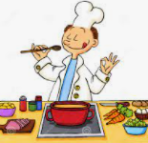
Cook: /kʊk/ đầu bếp

Slide 11

Nurse: /nɜːs/ y tá

Slide 12

Let's play
MATCHING
Notes:
MADE BY FACEBOOK :TRAN THI THANH TAM

Slide 13

CHECK VOCABULARY:MATCHING
nurse
farmer
cook
singer

Slide 14

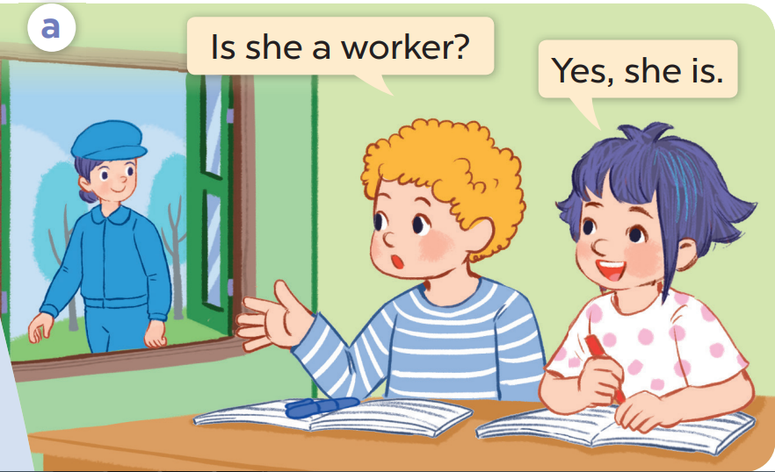
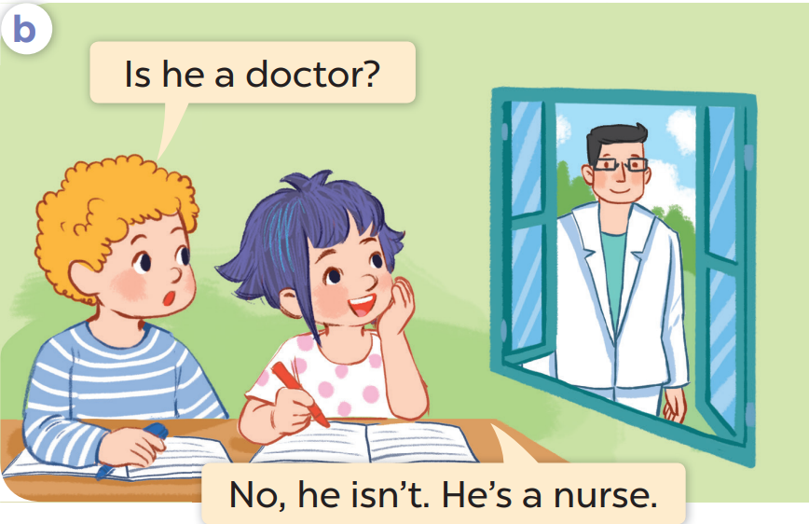
1. LOOK, LISTEN AND REPEAT

Slide 15

SENTENCE PATTERN

Slide 16
Hỏi xem có phải ai đó làm nghề gì hay không
Is he a farmer?
( Anh ấy có phải là nông dân không?)
- Yes, he is.
- No, he isn’t.

Slide 17
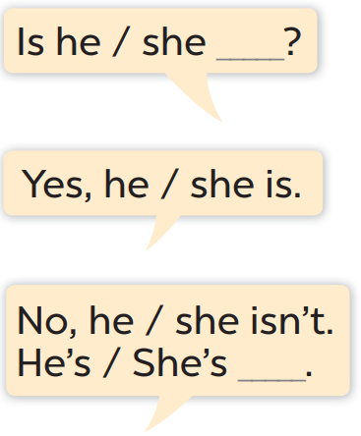
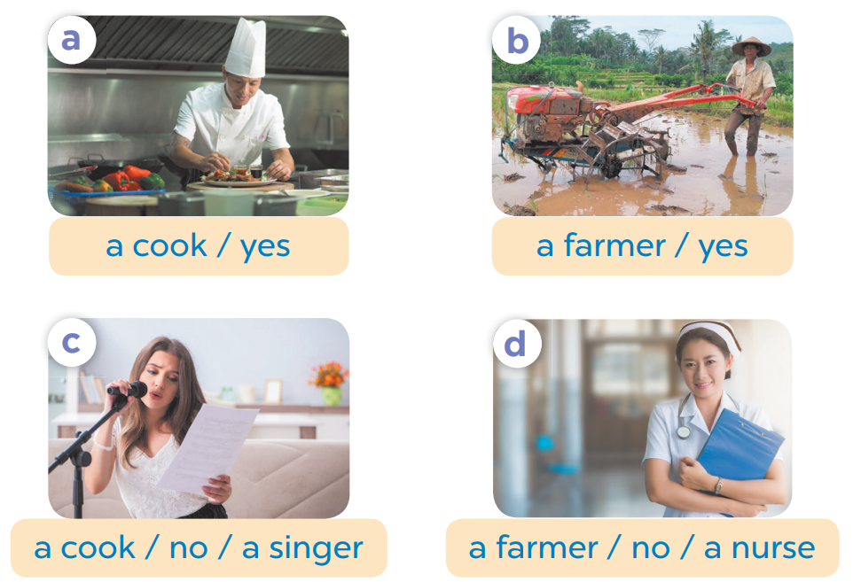
2. LISTEN , POINT AND SAY

Slide 18

cook
Is he a ……… ?
Yes, he is
Notes:
MADE BY FACEBOOK :TRAN THI THANH TAM

Slide 19
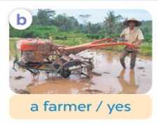
farmer
Is he a ……… ?
Yes, he is
Notes:
MADE BY FACEBOOK :TRAN THI THANH TAM

Slide 20
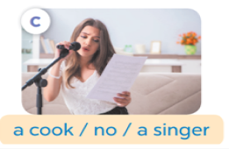
cook
Is she a ……… ?
singer
No, she isn’t. She’ a ………
Notes:
MADE BY FACEBOOK :TRAN THI THANH TAM

Slide 21

farmer
Is she a ……… ?
nurse
No, she isn’t. She’ a ………
Notes:
MADE BY FACEBOOK :TRAN THI THANH TAM

Slide 22



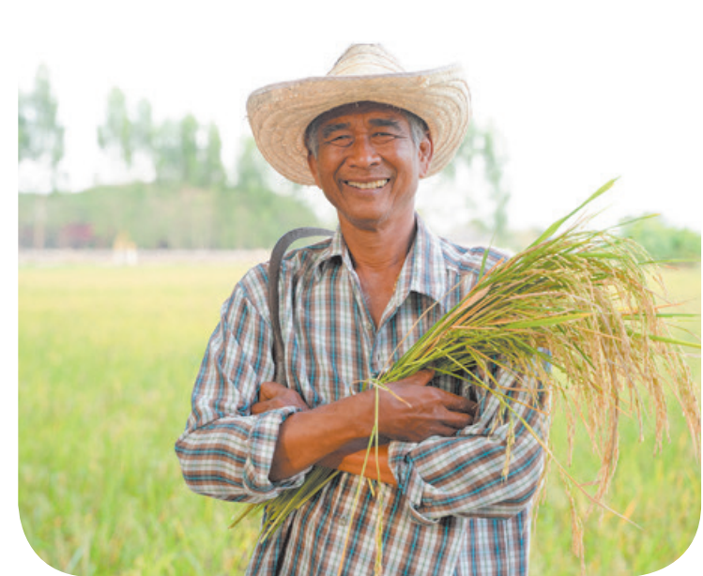
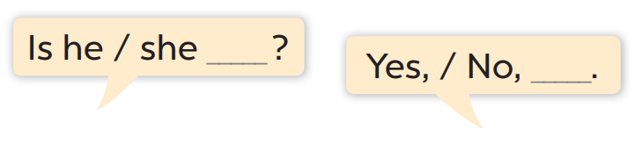
3. LET’S TALK

Slide 23

Let's play
Notes:
MADE BY FACEBOOK :TRAN THI THANH TAM

Slide 24



Notes:
MADE BY FACEBOOK :TRAN THI THANH TAM

Slide 25




home
Is he a farmer?
Yes, he is.

Slide 26

home
Is she a driver?
No, she isn’t. She’s a cook

Slide 27

home
Is she a nurse?
Yes, she is.

Slide 28

home
Is he a doctor?
No, he isn’t. He’s a singer.

Slide 29

SUMMARY
Notes:
MADE BY FACEBOOK :TRAN THI THANH TAM

Slide 30

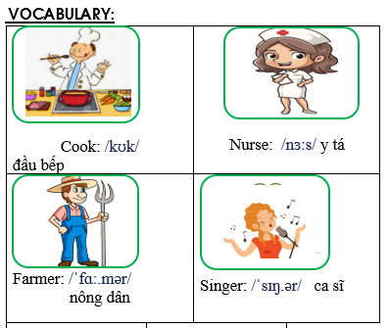
Notes:
Made by Facebook: TRAN THI THANH TAM

Slide 31
SENTENCE PATTERN
Notes:
MADE BY FACEBOOK :TRAN THI THANH TAM

Slide 32

Homework:
- Learn vocabulary and sentence pattern by heart
- Prepare Unit 12- lesson 2 ( 4, 5, 6)
Notes:
MADE BY FACEBOOK :TRAN THI THANH TAM

Slide 33

Notes:
MADE BY FACEBOOK :TRAN THI THANH TAM

Slide 34

Nguyen Du Primary School
WELCOME TO
OUR CLASS 3
Teacher: Trần Thị Thanh Tâm
Made by
Thanh Tam

Slide 35
UNIT 12: JOBS
LESSON 2 ( 4, 5, 6)

Slide 36
CONTENTS
1
WARM -UP
2
LISTEN AND NUMBER
3
READ AND MATCH
4
LET’S SING
5
PLAY GAME
Notes:
MADE BY FACEBOOK :TRAN THI THANH TAM

Slide 37
Warm - up

Slide 38
Let's play
Notes:
MADE BY FACEBOOK :TRAN THI THANH TAM

Slide 39

Notes:
Step 1: Divide the class into 4 teams.
Step 2: Give each pupil one paper and draw a Bingo grid 3x3 on the board. Ask pupils to tell you the words they have learnt in their lessons. List them on the board. Each pupil chooses nine words from the list to copy into their grid. While they are doing this, copy each word onto a piece of paper, put the pieces of paper into a bag and mix them up. Nominate pupils one by one to pick out a piece of paper and call out the word. Pupils with that word in their grid can cross it out. Continue the game until there is a pupil who has all the words in their grid crossed out and calls out Bingo! That pupil is the winner.
Step 3: Encourage pupils to join in the game.
Step 4: Give candy/stickers for those who get Bingo.

Slide 40

job
nurse
farmer
driver
doctor
worker
cook
singer
teacher
Notes:
MADE BY FACEBOOK :TRAN THI THANH TAM

Slide 41

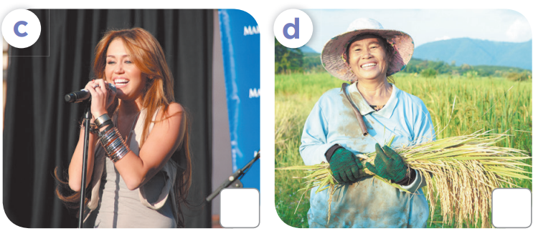
4. LISTEN AND NUMBER
3
2
4
1

Slide 42
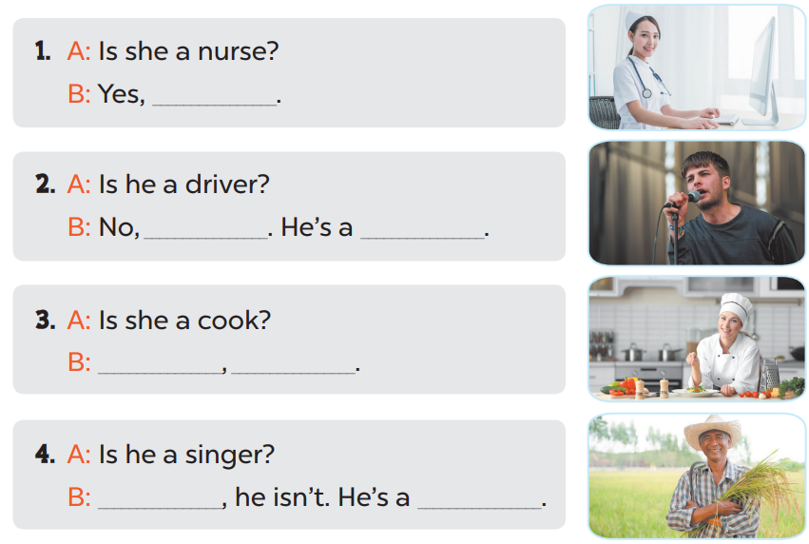
5. LOOK, COMPLETE AND READ
she is
he isn’t
a singer
Yes
she is
No
farmer

Slide 43
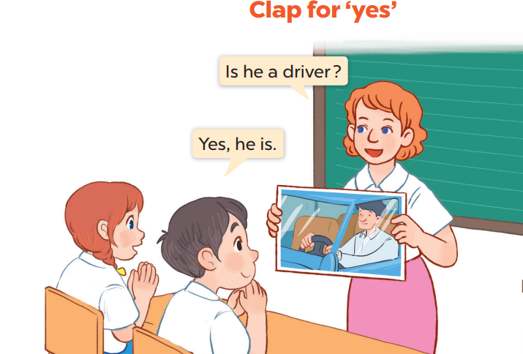
6. LET’S PLAY

Slide 44


Let's play
Made by Thanh Tam

Slide 45












SNOW WHITE

Slide 46









Is he a cook?
Yes, he is.
YES

Slide 47


Is she a singer?
No, she isn’t. She’s a teacher.
YES

Slide 48
Is he a farmer?
Yes, he is.
YES

Slide 49
Is she a teacher?
No, she isn’t. She’s a nurse.
YES

Slide 50
Homework:
- Practice more at home
- Prepare Unit 12- lesson 3 ( 1, 2, 3)

Slide 51




The bye bye song
Bye, bye.
See you tomorrow.
Bye, bye.
See you tomorrow.
Bye, bye.
See you tomorrow.
Bye, bye. Bye, bye.
The bye bye song
Made by Thanh Tam

Slide 52







GOODBYE,
SEE YOU AGAIN !
Made by Thanh Tam

