Slide 1


UNIT 12: JOBS
LESSON 3 ( 1, 2, 3)

Slide 2
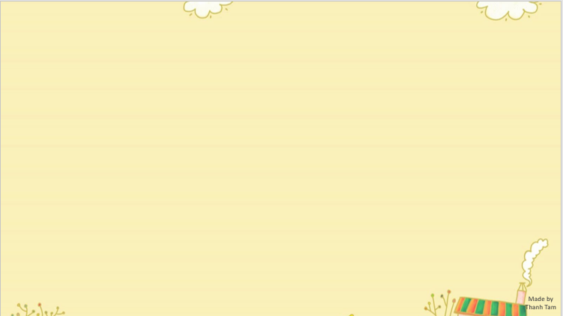

CONTENTS
1
WARM -UP
2
LISTEN AND REPEAT
3
LISTEN AND CIRCLE
4
LET’S CHANT
5
PLAY GAME
Notes:
MADE BY FACEBOOK :TRAN THI THANH TAM

Slide 3

Warm - up

Slide 4

Let's play
GUESSING GAME

Slide 5

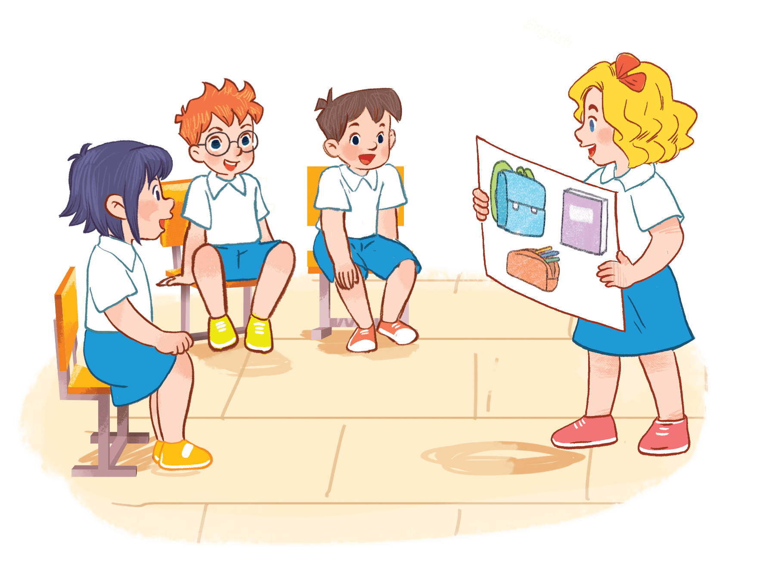
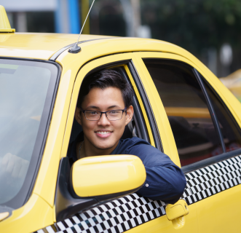
Guessing game
Is he a driver?
Yes, he is.
Excellent!
Notes:
MADE BY FACEBOOK :TRAN THI THANH TAM

Slide 6
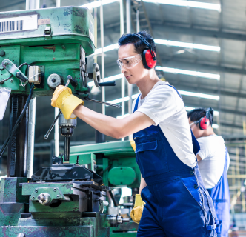
Guessing game
Is he a worker?
Yes, he is
Nice job!
Notes:
MADE BY FACEBOOK :TRAN THI THANH TAM

Slide 7

Guessing game
Is she a nurse?
No, she isn’t.
She’s a cook.
Great job!
Notes:
MADE BY FACEBOOK :TRAN THI THANH TAM

Slide 8

Guessing game
Is he a farmer?
No, he isn’t.
Great!
He’s a teacher.
Notes:
MADE BY FACEBOOK :TRAN THI THANH TAM

Slide 9

Guessing game
Is she a teacher?
No, she isn’t.
Bravo!
She’s a nurse.
Notes:
MADE BY FACEBOOK :TRAN THI THANH TAM

Slide 10
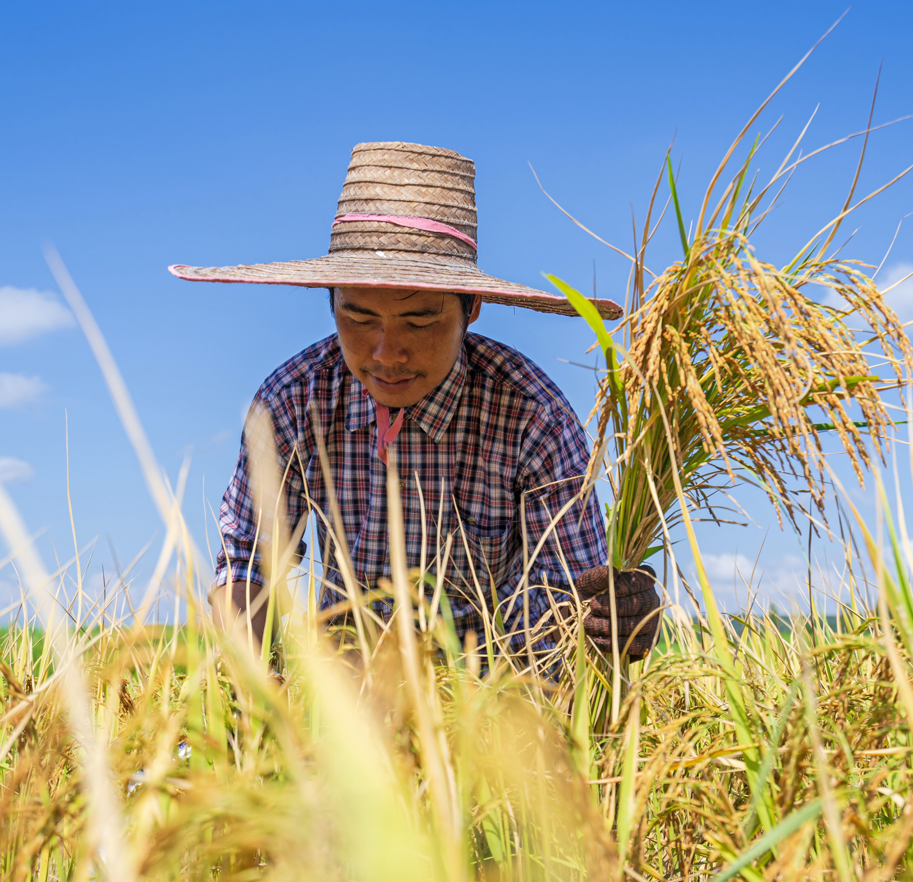
Guessing game
Is he a cook?
No, he isn’t.
Well done!
He’s a farmer.
Notes:
MADE BY FACEBOOK :TRAN THI THANH TAM

Slide 11

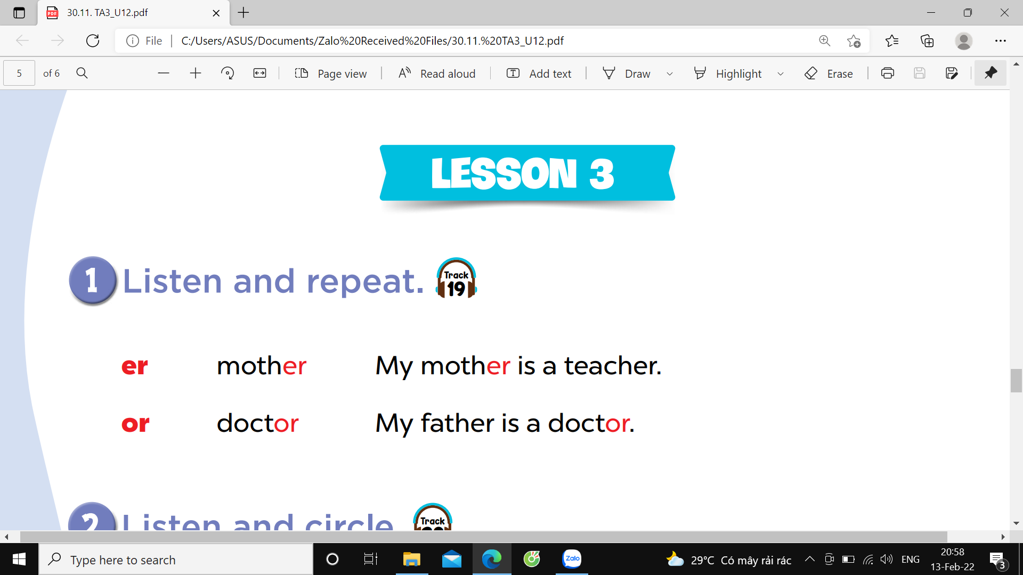


Slide 12
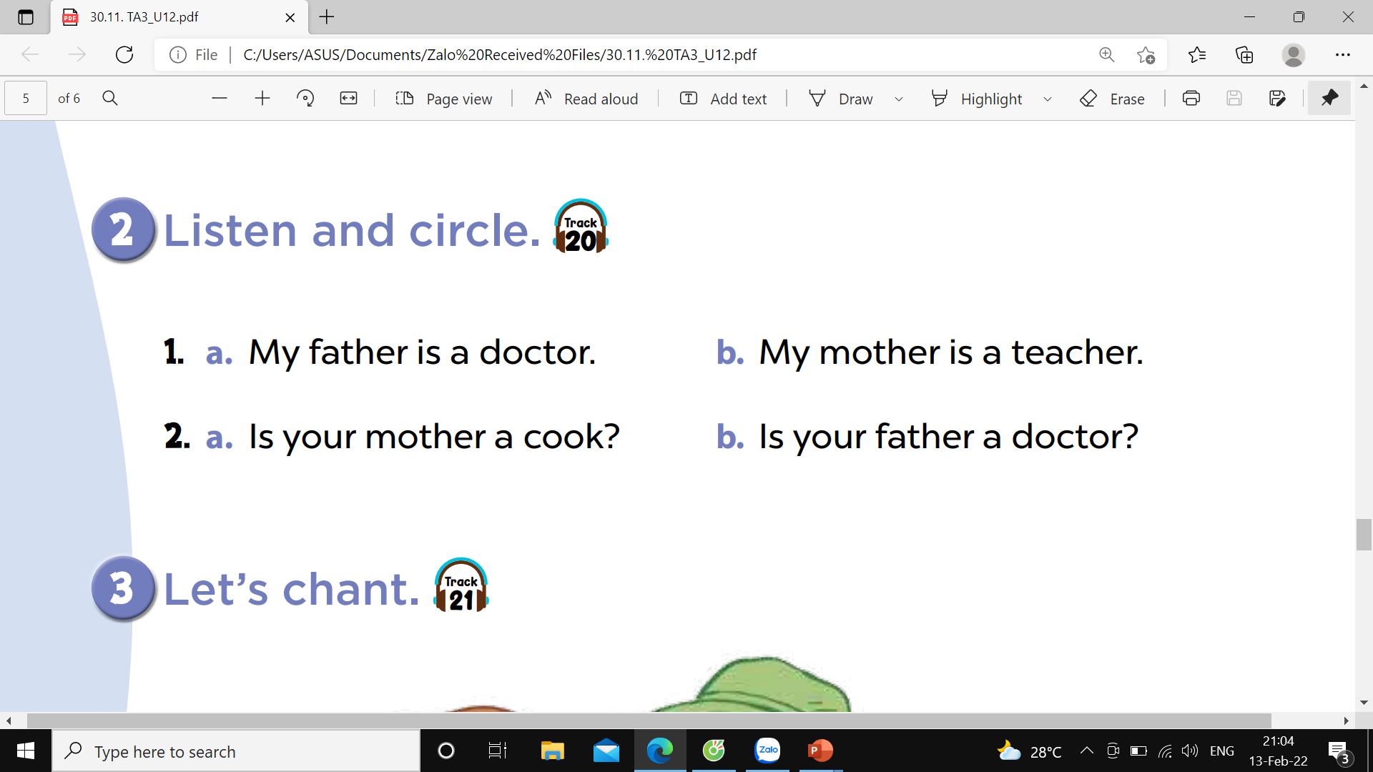

Slide 13
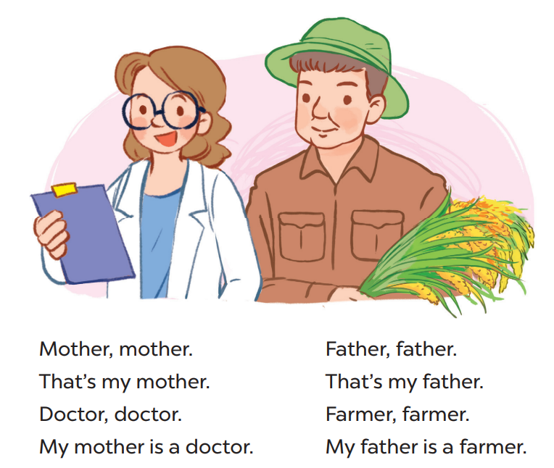
3.LET’S CHANT

Slide 14
Let's play

Slide 15



Choose the best answer
A. mother
B. doctor
C. father
Question 1
or
B
1
2
3
4
5
6
7
8
9
10
Notes:
MADE BY FACEBOOK :TRAN THI THANH TAM

Slide 16
Choose the best answer
A. actor
B. worker
C. teacher
Question 1
A
or
1
2
3
4
5
6
7
8
9
10
Notes:
MADE BY FACEBOOK :TRAN THI THANH TAM

Slide 17
Choose the best answer
A. actor
B. farmer
C. professor
Question 1
er
C
1
2
3
4
5
6
7
8
9
10
Notes:
MADE BY FACEBOOK :TRAN THI THANH TAM

Slide 18
Choose the best answer
A. actor
B. doctor
C. teacher
Question 1
er
C
1
2
3
4
5
6
7
8
9
10
Notes:
MADE BY FACEBOOK :TRAN THI THANH TAM

Slide 19


Homework:
- Practice more at home
- Prepare Unit 12- Lesson 3 ( 4, 5, 6)
Made by
Thanh Tam
Notes:
MADE BY FACEBOOK :TRAN THI THANH TAM

Slide 20
UNIT 12: JOBS
LESSON 3 ( 1, 2, 3)

Slide 21
CONTENTS
1
WARM -UP
2
READ AND COMPLETE
3
LET’S WRITE
4
PROJECT
5
PLAY GAME
Notes:
MADE BY FACEBOOK :TRAN THI THANH TAM

Slide 22
Warm - up

Slide 23

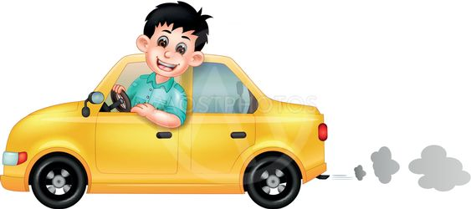
Let's play
Who’s a millionaire?
Notes:
MADE BY FACEBOOK :TRAN THI THANH TAM

Slide 24


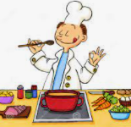


Who's a millionaire?
What’s his job?
50:50
A. cook
A. cook
B. teacher
C. driver
D. worker
Notes:
MADE BY FACEBOOK :TRAN THI THANH TAM

Slide 25

Who's a millionaire?
Who's a millionaire?
What’s her job?
50:50
A. doctor
B. teacher
B. teacher
C. driver
D. worker
Notes:
MADE BY FACEBOOK :TRAN THI THANH TAM

Slide 26

Who's a millionaire?
Who's a millionaire?
What’s his job?
50:50
A. doctor
B. farmer
B. farmer
C. driver
D. worker
Notes:
MADE BY FACEBOOK :TRAN THI THANH TAM

Slide 27

Who's a millionaire?
Who's a millionaire?
What’s his job?
50:50
A. doctor
A. doctor
B. teacher
C. driver
D. worker
Notes:
MADE BY FACEBOOK :TRAN THI THANH TAM

Slide 28


Slide 29


Pupils: /ˈpjuː.pəlz/ học sinh

Slide 30
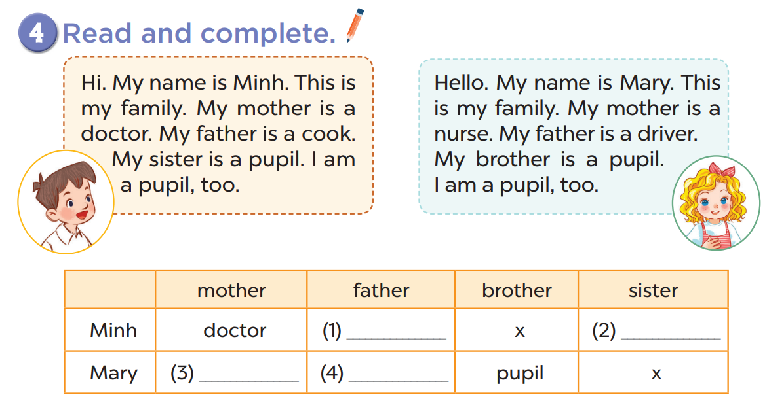

Slide 31
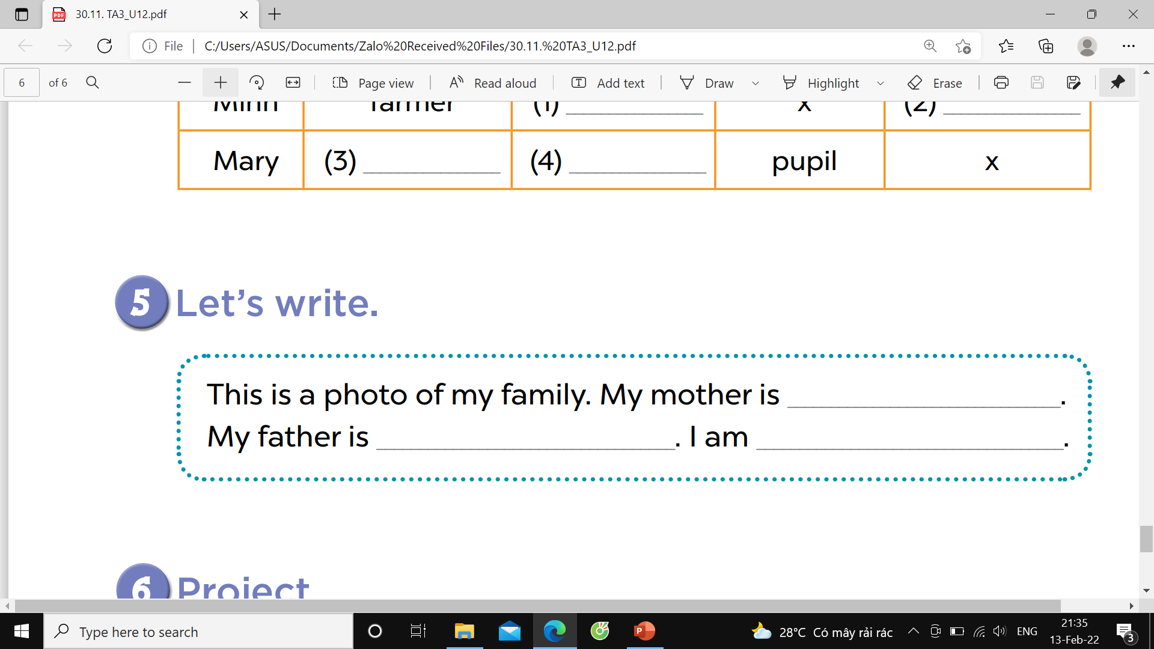
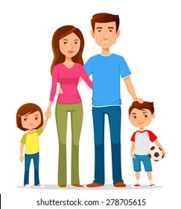

Slide 32
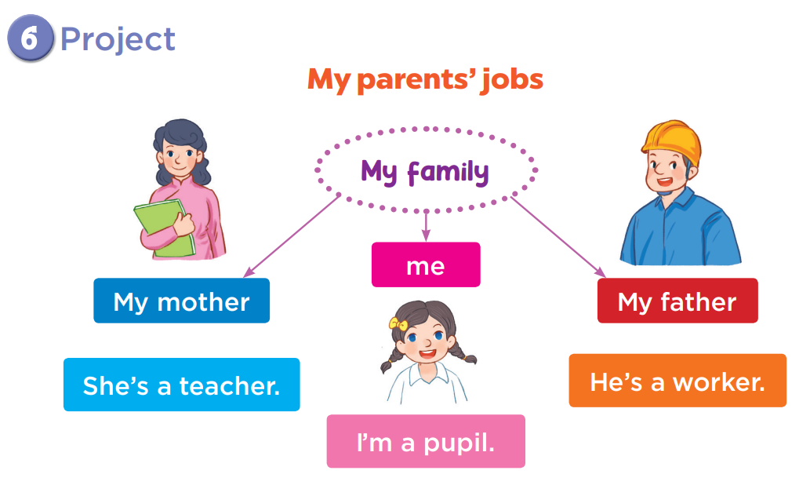

Slide 33
Let's play GAME
CHOOSE COCONUTS
Notes:
MADE BY FACEBOOK :TRAN THI THANH TAM

Slide 34


farmer
driver
doctor
driver
Choose the right coconut!

Slide 35

Choose the right coconut!
nurse
worker
driver
nurse

Slide 36
teacher
doctor
cook
cook
Choose the right coconut!

Slide 37

singer
teacher
doctor
teacher
Choose the right coconut!

Slide 38

nurse
farmer
teacher
farmer
Choose the right coconut!

Slide 39

worker
doctor
singer
singer
Choose the right coconut!

Slide 40

worker
cook
driver
worker
Choose the right coconut!

Slide 41

singer
doctor
worker
doctor
Choose the right coconut!

Slide 42

Homework:
- Practice more at home
- Prepare Unit 13- lesson 1 ( 1, 2, 3)

Slide 43


Slide 44



Thank you very much
Good bye! See you again!
Made by Thanh Tam

