Slide 1


UNIT 13: MY HOUSE
LESSON 1 ( 1, 2, 3)

Slide 2

CONTENTS
1
WARM -UP
2
VOCABULARY
3
LOOK, LISTEN AND REPEAT
4
LISTEN, POINT AND SAY
5
LET’S TALK
6
PLAY GAME
Notes:
MADE BY FACEBOOK :TRAN THI THANH TAM

Slide 3

Warm - up

Slide 4


Let's play
Made by Thanh Tam

Slide 5













SNOW WHITE

Slide 6




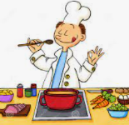






Is he a cook?
Yes, he is.
YES

Slide 7



Is she a singer?
No, she isn’t. She’s a teacher.
YES

Slide 8
Is he a farmer?
Yes, he is.
YES

Slide 9
Is she a teacher?
No, she isn’t. She’s a nurse.
YES

Slide 10


Slide 11


House: /ˌhaʊs /ngôi nhà

Slide 12

Living room: /ˈlɪv.ɪŋ ˌruːm/:
Phòng khách

Slide 13
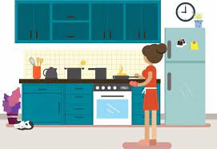
Kitchen: /ˈkɪtʃ.ən/ phòng bếp

Slide 14
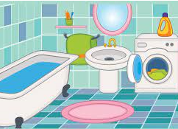
Bathroom: /ˈbɑːθ.ruːm/ phòng tắm

Slide 15

Bedroom: /ˈbed.ruːm/ Phòng ngủ

Slide 16
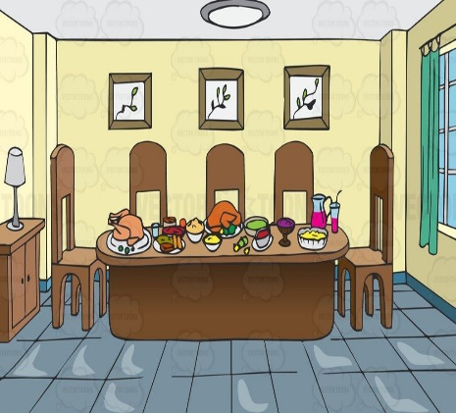
Dining room: /ˈdaɪ.nɪŋ ˌruːm/
phòng ăn

Slide 17

Here: /hɪər/ ở đây

Slide 18

There: /ðeər/ ở đó

Slide 19

Let's play

Slide 20
Let's play
Slap the board
Notes:
MADE BY FACEBOOK :TRAN THI THANH TAM

Slide 21


SLAP THE BOARD
house
Living room
kitchen
Dining room
there
bedroom
here
bathroom
Made by Thanh Tam
Notes:
MADE BY FACEBOOK :TRAN THI THANH TAM

Slide 22

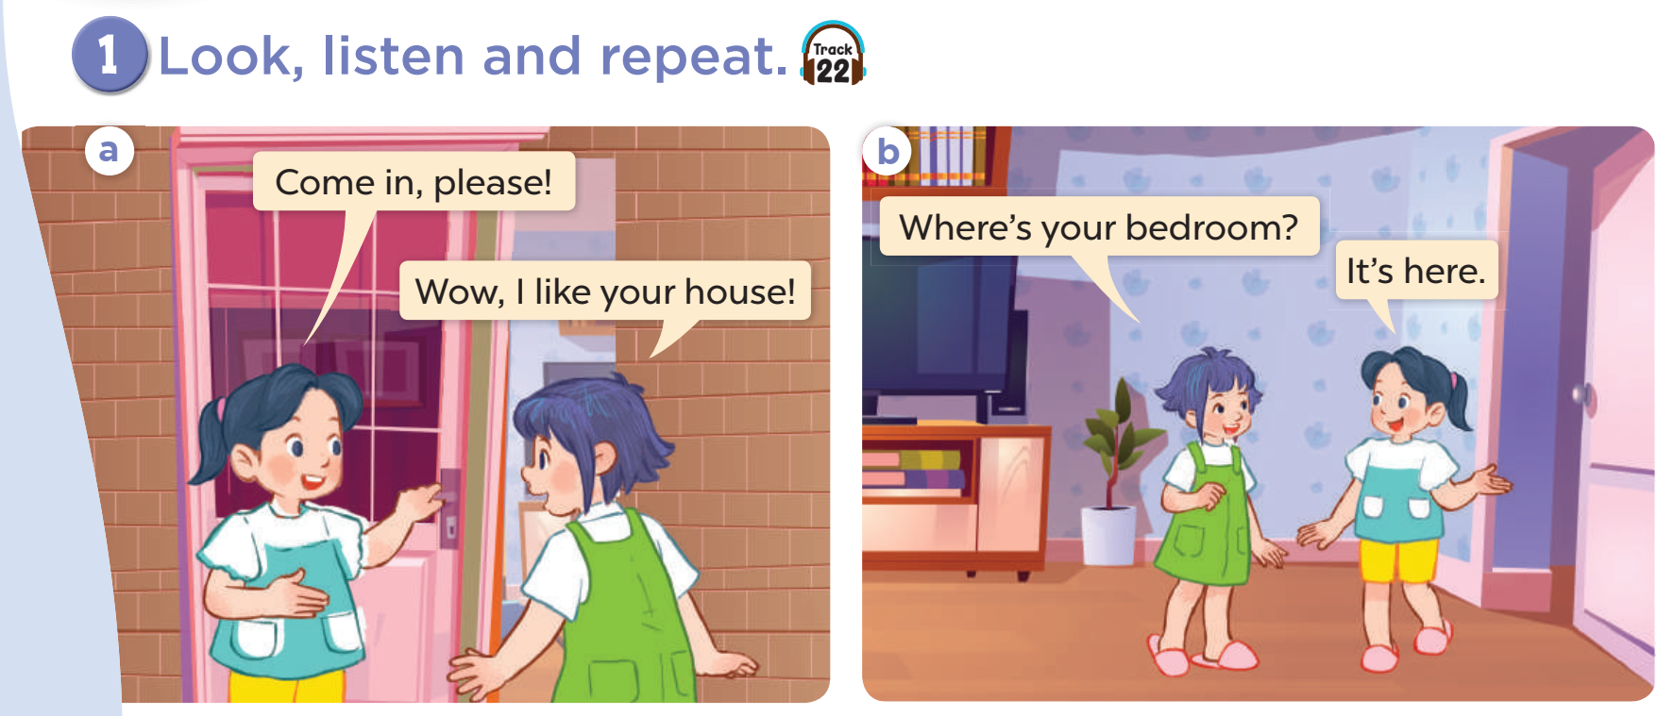

Slide 23

SENTENCE PATTERN

Slide 24

Hỏi và trả lời về các phòng trong nhà
Where’s the living room?
( Phòng khách ở đâu vậy?)
It’s here. ( Nó ở đây.)
It’s there. ( Nó ở kia.)

Slide 25
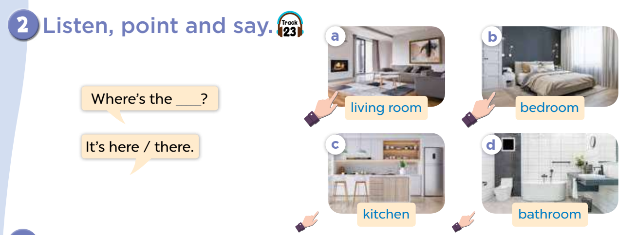

Slide 26
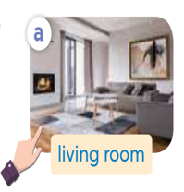
living room
Where’s the..…………. ?
It’s here.
Notes:
MADE BY FACEBOOK :TRAN THI THANH TAM

Slide 27
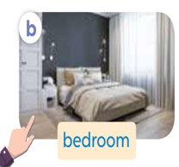
bedroom
Where’s the..…………. ?
It’s here.
Notes:
MADE BY FACEBOOK :TRAN THI THANH TAM

Slide 28
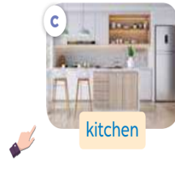
kitchen
Where’s the..…………. ?
It’s there.
Notes:
MADE BY FACEBOOK :TRAN THI THANH TAM

Slide 29
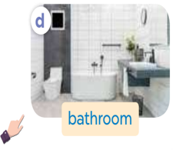
bathroom
Where’s the..…………. ?
It’s there.
Notes:
MADE BY FACEBOOK :TRAN THI THANH TAM

Slide 30
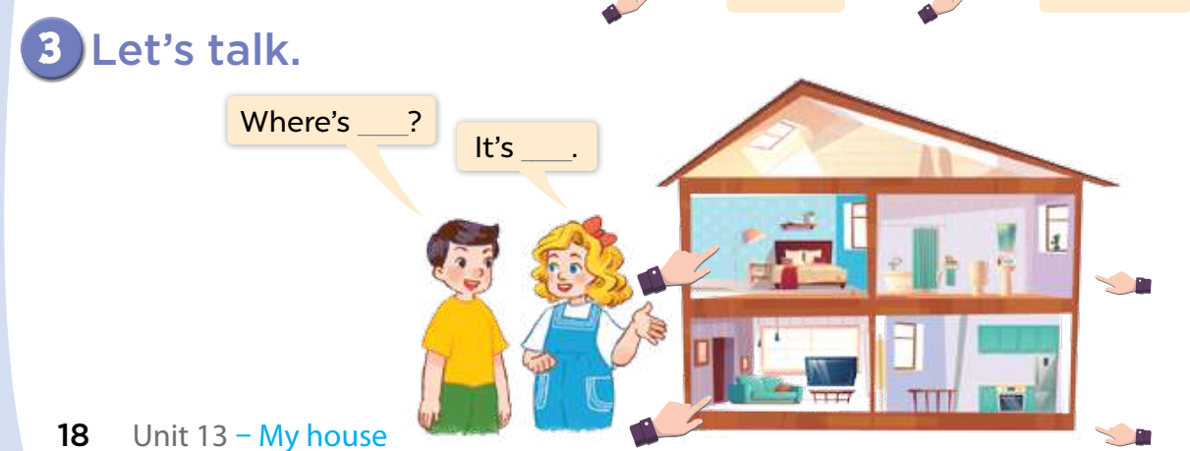

Slide 31
Let's play
Made by Thanh Tam

Slide 32
Let's play GAME
Who is fastest?
Notes:
MADE BY FACEBOOK :TRAN THI THANH TAM

Slide 33

kitchen.
Where is the ………………..
It’s here.
Notes:
MADE BY FACEBOOK :TRAN THI THANH TAM

Slide 34
dining room
Where is the ………………..
It’s there.
Notes:
MADE BY FACEBOOK :TRAN THI THANH TAM

Slide 35
bedroom.
Where is the ………………..
It’s here.
Notes:
MADE BY FACEBOOK :TRAN THI THANH TAM

Slide 36
bathroom.
Where is the ………………..
It’s here.
Notes:
MADE BY FACEBOOK :TRAN THI THANH TAM

Slide 37
house.
Where is the ………………..
It’s there.
Notes:
MADE BY FACEBOOK :TRAN THI THANH TAM

Slide 38

SUMMARY
Notes:
MADE BY FACEBOOK :TRAN THI THANH TAM

Slide 39

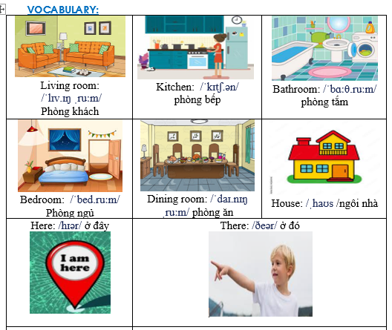
Notes:
Made by Facebook: TRAN THI THANH TAM

Slide 40
SENTENCE PATTERN
Notes:
MADE BY FACEBOOK :TRAN THI THANH TAM

Slide 41
Hỏi và trả lời về các phòng trong nhà
Where’s the living room?
( Phòng khách ở đâu vậy?)
It’s here. ( Nó ở đây.)
It’s there. ( Nó ở kia.)

Slide 42

Homework:
- Learn vocabulary and sentence pattern by heart
- Prepare Unit 13- lesson 1 ( 4, 5, 6)
Notes:
MADE BY FACEBOOK :TRAN THI THANH TAM

Slide 43

Notes:
MADE BY FACEBOOK :TRAN THI THANH TAM

Slide 44



Thank you very much
Good bye! See you again!
Made by Thanh Tam

Slide 45
UNIT 13: MY HOUSE
LESSON 1 ( 4, 5, 6)

Slide 46
CONTENTS
1
WARM -UP
2
LISTEN AND CIRCLE
3
LOOK, COMPLETE AND READ
4
LET’S SING
5
PLAY GAME
Notes:
MADE BY FACEBOOK :TRAN THI THANH TAM

Slide 47
Warm - up

Slide 48
Let's play GAME
CHOOSE COCONUTS
Notes:
MADE BY FACEBOOK :TRAN THI THANH TAM

Slide 49


here
bathroom
kitchen
bathroom
Choose the right coconut!

Slide 50
dining room
there
kitchen
kitchen
Choose the right coconut!

Slide 51
house
living room
dining room
Living room
Choose the right coconut!

Slide 52
bedroom
kitchen
house
bedroom
Choose the right coconut!

Slide 53
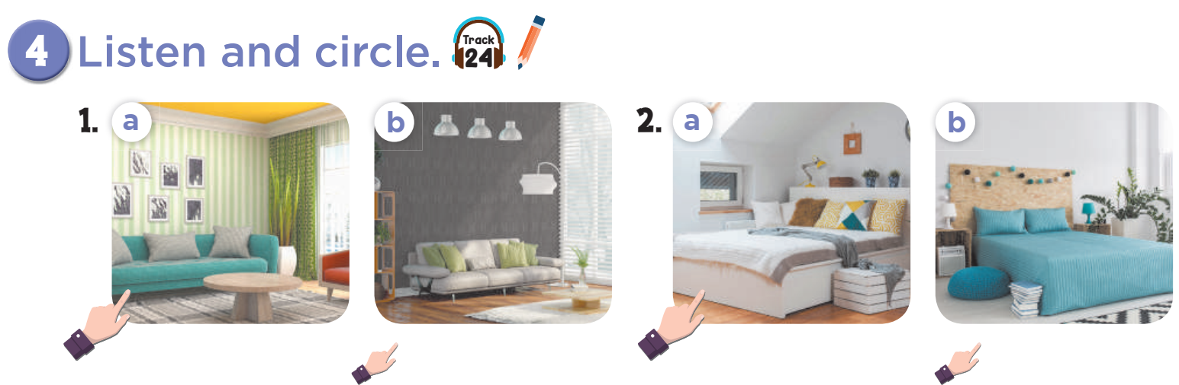

Slide 54
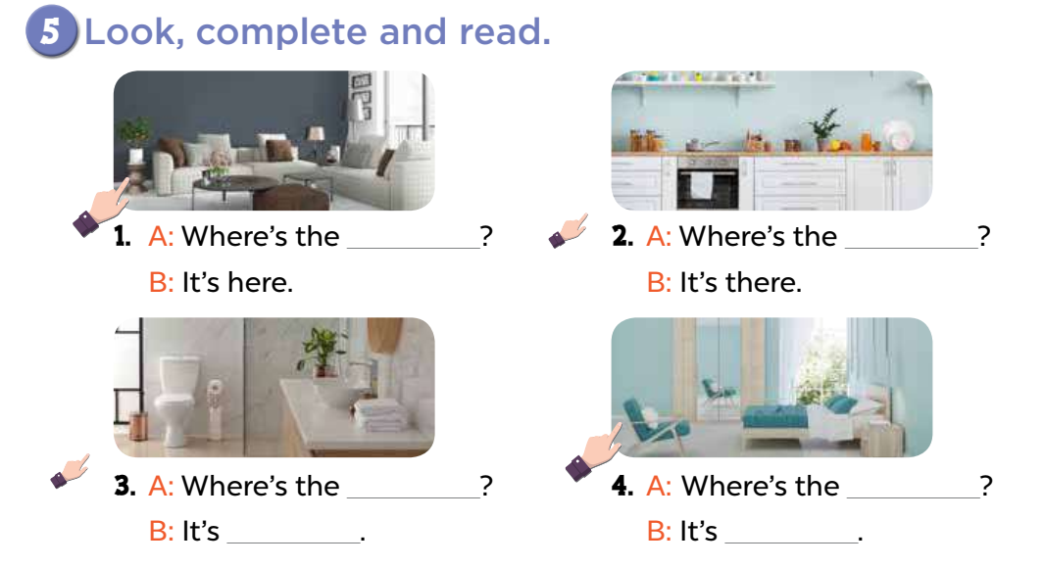

Slide 55
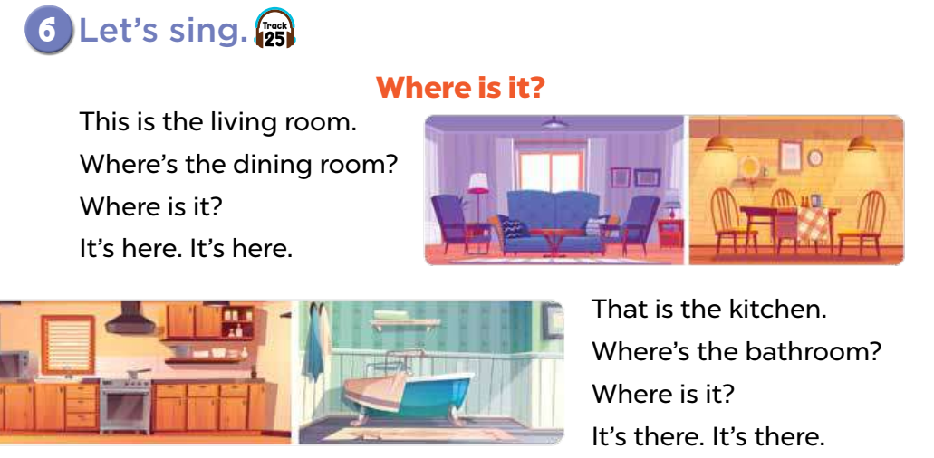

Slide 56
Let's play
Made by Thanh Tam

Slide 57
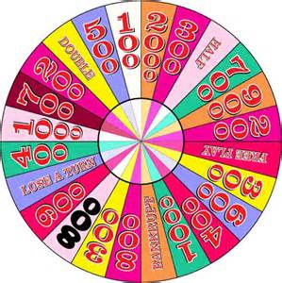

WHEEL FORTUNE

Slide 58
Fotune wheel
Question 1
Choose the best answer
A. bathroom
A. bathroom
B. bedroom
Spin
C. kitchen
Answer
Next
Very Good!

Slide 59
Fotune wheel
Question 1
Choose the best answer
A. bathroom
B. bedroom
B. bedroom
Spin
C. kitchen
Answer
Next
Very Good!

Slide 60

Fotune wheel
Question 1
Choose the best answer
A. bathroom
B. bedroom
Spin
C. house
C. house
Answer
Next
Very Good!

Slide 61
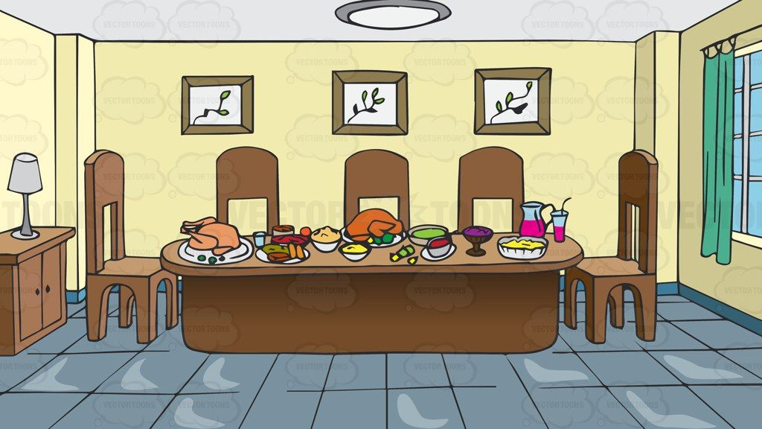
Fotune wheel
Question 1
Choose the best answer
A. bathroom
B. dining room
B. dining room
Spin
C. kitchen
Answer
Next
Very Good!

Slide 62

Homework:
- Practice more at home
- Prepare Unit 13- lesson 2 ( 1, 2, 3)

Slide 64
Thank you very much
Good bye! See you again!
Made by Thanh Tam

