Slide 1


UNIT 13: MY HOUSE
LESSON 3 ( 1, 2, 3)

Slide 2
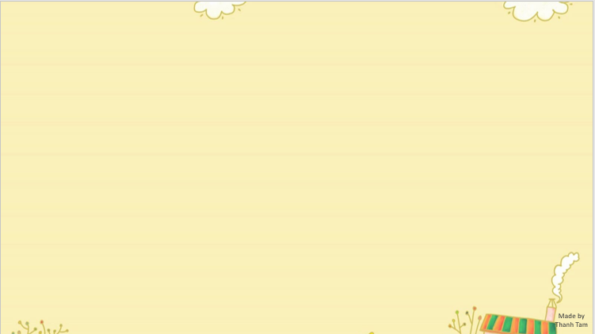

CONTENTS
1
WARM -UP
2
LISTEN AND REPEAT
3
LISTEN AND CIRCLE
4
LET’S CHANT
5
PLAY GAME
Notes:
MADE BY FACEBOOK :TRAN THI THANH TAM

Slide 3

Warm - up

Slide 4

Let's play

Slide 5

Let's play GAME
Who is fastest?
Notes:
MADE BY FACEBOOK :TRAN THI THANH TAM

Slide 6
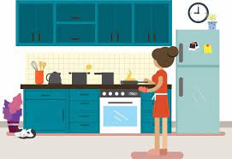

kitchen.
Where is the ………………..
It’s here.
Notes:
MADE BY FACEBOOK :TRAN THI THANH TAM

Slide 7
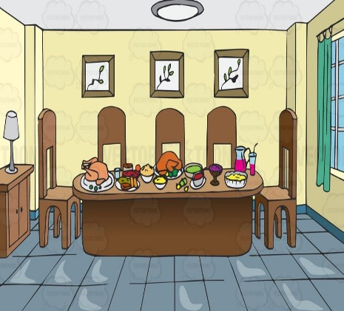
dining room
Where is the ………………..
It’s there.
Notes:
MADE BY FACEBOOK :TRAN THI THANH TAM

Slide 8

bedroom.
Where is the ………………..
It’s here.
Notes:
MADE BY FACEBOOK :TRAN THI THANH TAM

Slide 9
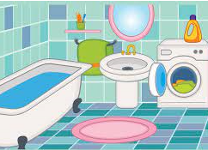
bathroom.
Where is the ………………..
It’s here.
Notes:
MADE BY FACEBOOK :TRAN THI THANH TAM

Slide 10

house.
Where is the ………………..
It’s there.
Notes:
MADE BY FACEBOOK :TRAN THI THANH TAM

Slide 11

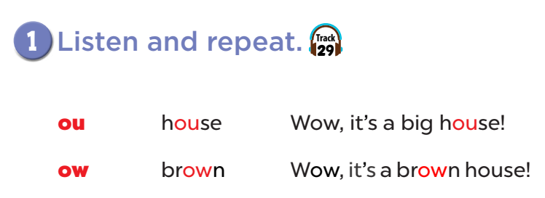


Slide 12
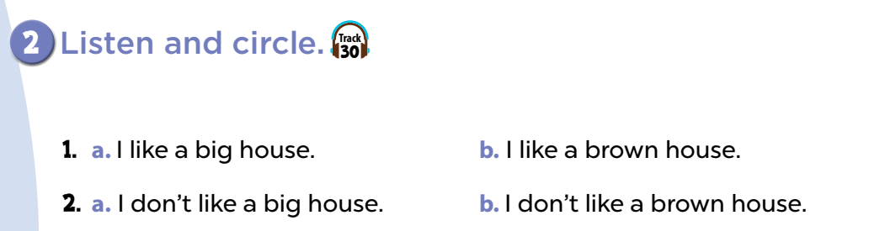

Slide 13
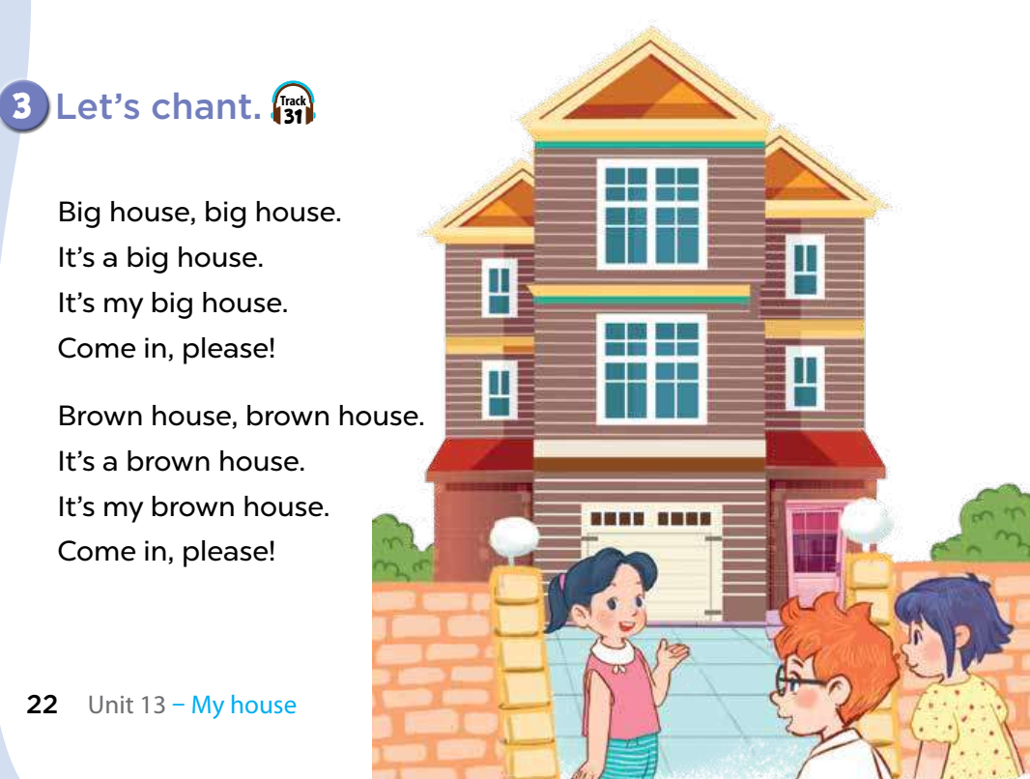

Slide 14
Let's play
Play game:
SECRET BOX

Slide 15





1
2
3
4
5
6
7
8
Next
tekhnologic

Slide 16
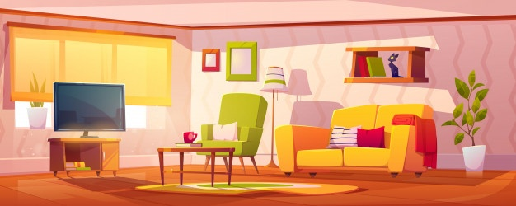

Where
………is the living room?
BACK
How
What

Slide 17
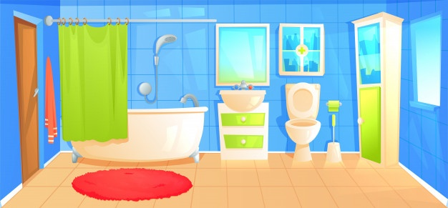
living room
Where is the………..?
BACK
kitchen
bathroom

Slide 18
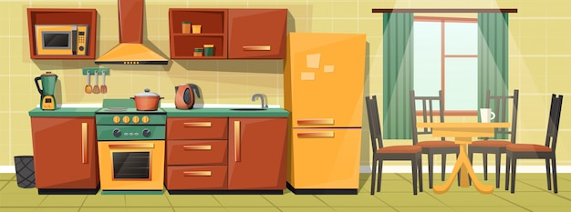

Where is the kitchen?
BACK
It’s there.
It’s here.

Slide 19
Where is the living room?
BACK
It’s there.
It’s here.

Slide 20
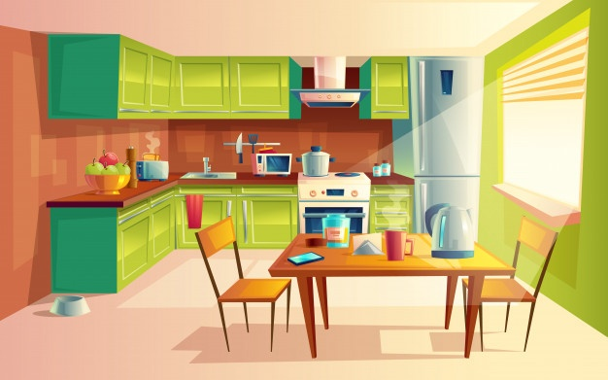
living room
Where is the………..?
BACK
kitchen
bathroom

Slide 21
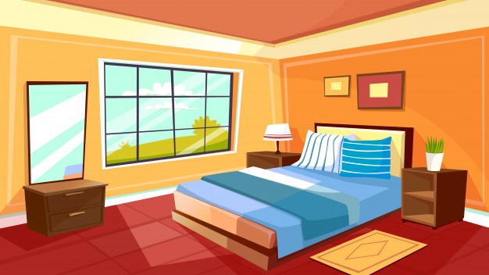
living room
Where is the………..?
BACK
bathroom
bedroom

Slide 22
Where is the kitchen?
BACK
It’s there.
It’s here.

Slide 23

Where is the kitchen?
BACK
It’s there.
It’s here.

Slide 24


Homework:
- Practice more at home
- Prepare Unit 14- Lesson 3 ( 4, 5, 6)
Made by
Thanh Tam
Notes:
MADE BY FACEBOOK :TRAN THI THANH TAM

Slide 25
UNIT 13: MY HOUSE
LESSON 3 ( 4, 5, 6)

Slide 26
CONTENTS
1
WARM -UP
2
READ AND COMPLETE
3
LET’S WRITE
4
PROJECT
5
PLAY GAME
Notes:
MADE BY FACEBOOK :TRAN THI THANH TAM

Slide 27
Warm - up

Slide 28

LET ’S PLAY
Chinese Whispers

Slide 29
Chinese Whispers
Group 1
Group 2
This is the bedroom
This is the bathroom
Notes:
Made by Facebook: TRAN THI THANH TAM

Slide 30
Chinese Whispers
Group 1
Group 2
That is the living room
That is the dining room
Notes:
Made by Facebook: TRAN THI THANH TAM

Slide 31
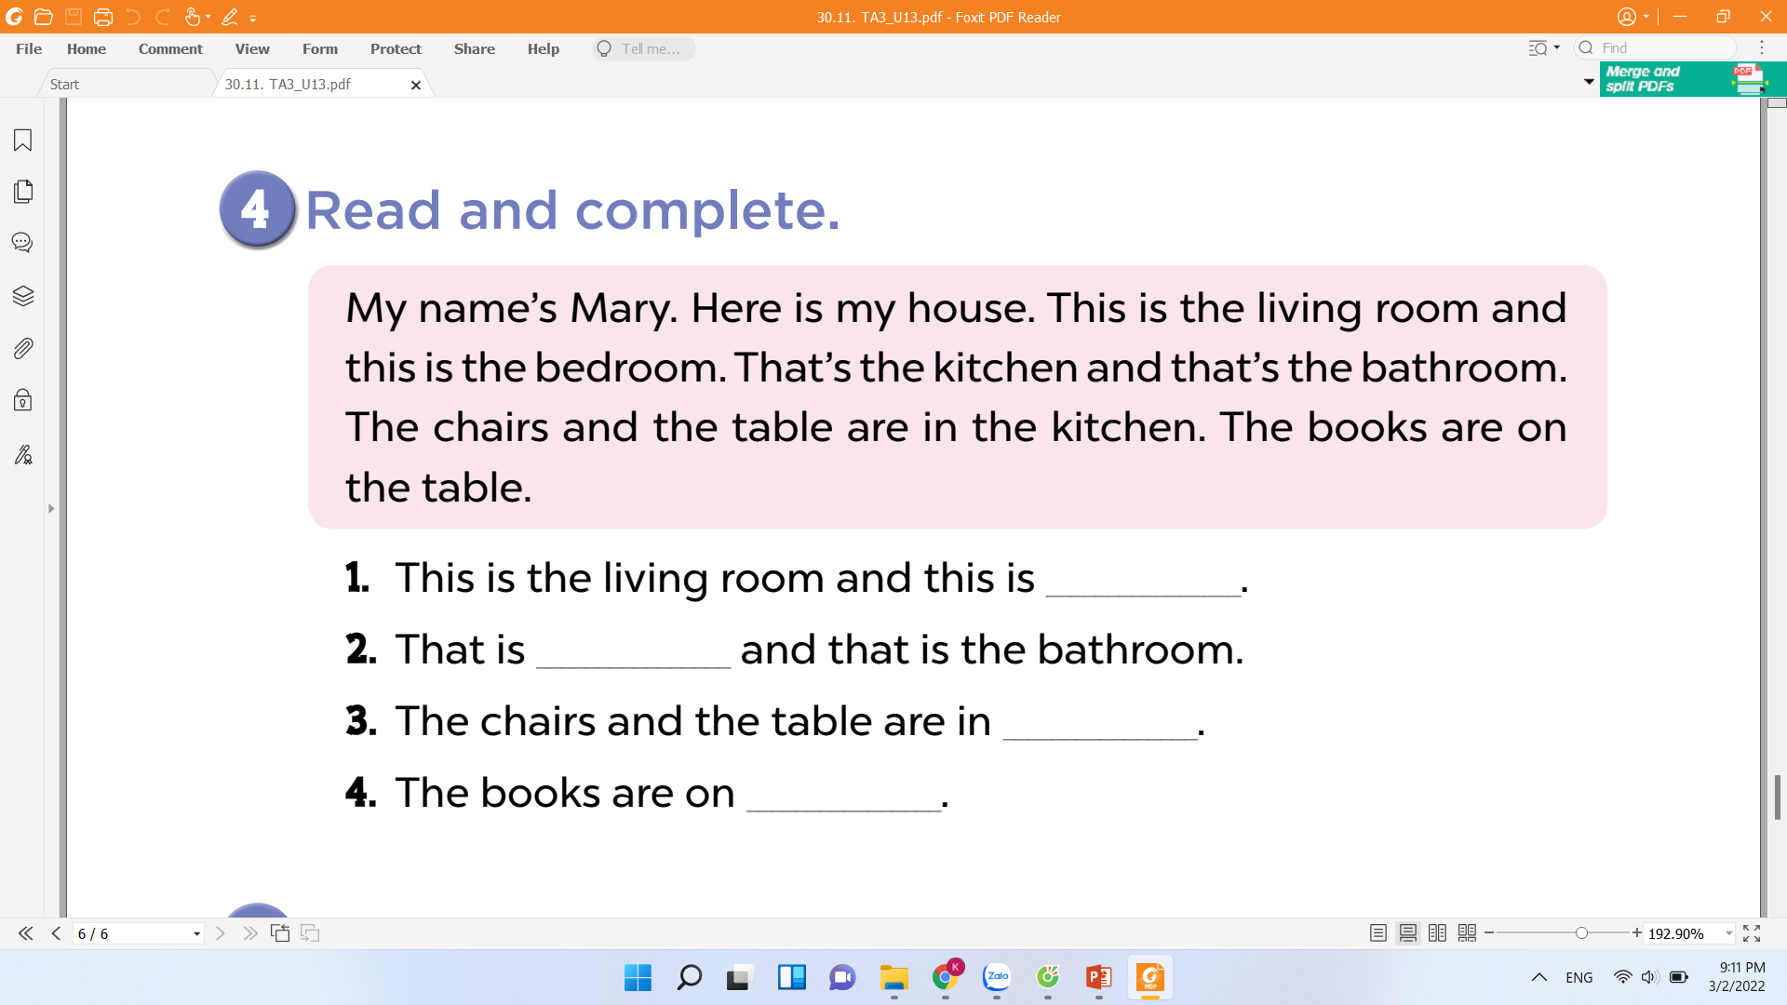

the bedroom
the kitchen
the kitchen
the table

Slide 32
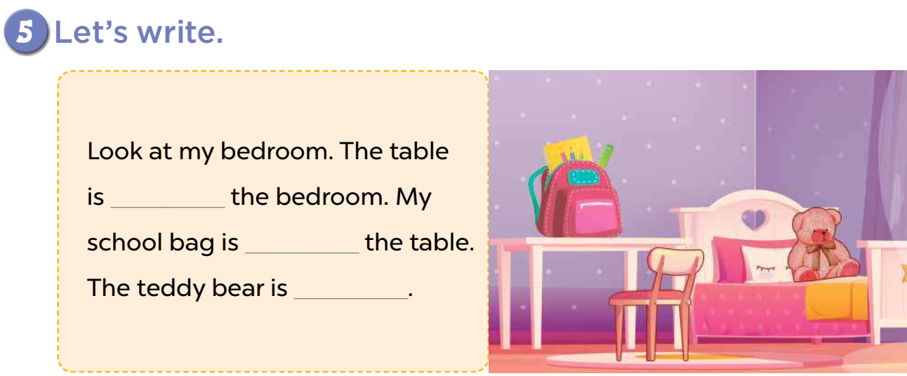
next to
on
in the bed.

Slide 33
next to
on
in the bed.

Slide 34
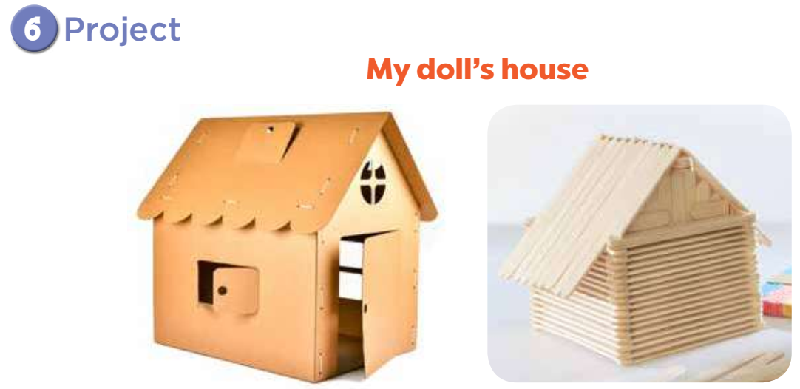

Slide 35
Let's play
CHOOSE THE BEST ANSWER
Notes:
MADE BY FACEBOOK :TRAN THI THANH TAM

Slide 36

Where is the…..……….? It’s here.
bedroom
bathroom
Living room
Notes:
MADE BY FACEBOOK :TRAN THI THANH TAM

Slide 37
is/ kitchen/ That/ the/./
The kitchen that is.
That the kitchen is.
That is the kitchen.
Notes:
MADE BY FACEBOOK :TRAN THI THANH TAM

Slide 38
living room/ the/ Where/ is/?/
Where living room the is.
Where is the living room?
Where the is living room.
Notes:
MADE BY FACEBOOK :TRAN THI THANH TAM

Slide 39

The book are on the…..……..
room
table
kitchen
Notes:
MADE BY FACEBOOK :TRAN THI THANH TAM

Slide 40

Homework:
- Practice more at home
- Prepare Unit 14- lesson 1 ( 1, 2, 3)

Slide 41



Thank you very much
Good bye! See you again!
Made by Thanh Tam

Slide 42




The bye bye song
Bye, bye.
See you tomorrow.
Bye, bye.
See you tomorrow.
Bye, bye.
See you tomorrow.
Bye, bye. Bye, bye.
The bye bye song
Made by Thanh Tam

