Slide 1


UNIT 14: MY BEDROOM
LESSON 1( 1, 2, 3)

Slide 2

CONTENTS
1
WARM -UP
2
VOCABULARY
3
LOOK, LISTEN AND REPEAT
4
LISTEN, POINT AND SAY
5
LET’S TALK
6
PLAY GAME
Notes:
MADE BY FACEBOOK :TRAN THI THANH TAM

Slide 3

Warm - up

Slide 4

PLAY GAME
Secet box
Notes:
MADE BY FACEBOOK :TRAN THI THANH TAM

Slide 5
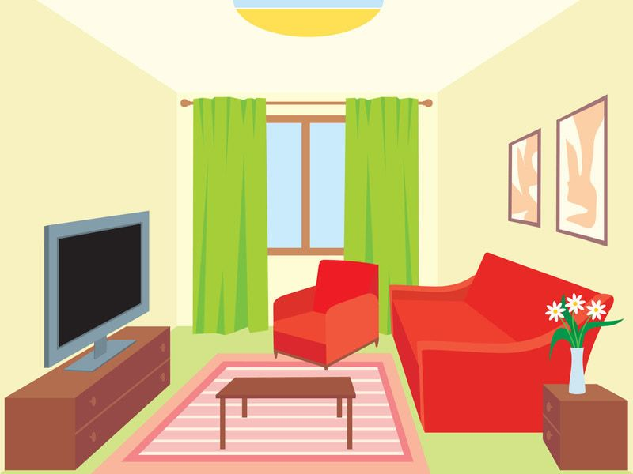
living room
SHOW
Notes:
Game: What is this room?
-Pupils choose 1 color and guess the picture of 1 room hidden behind.
-Teacher shows the whole picture at the button SHOW and say out loud the name of the room.

Slide 6
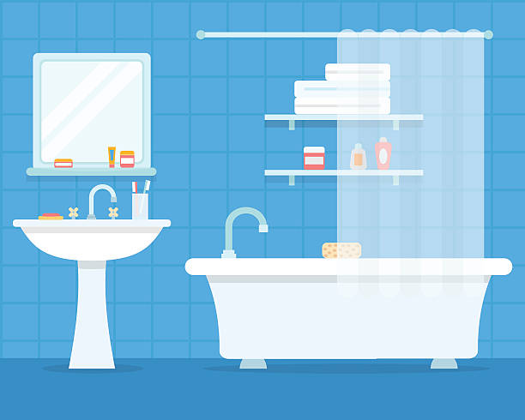
bathroom
SHOW
Notes:
Game: What is this room?
-Pupils choose 1 color and guess the picture of 1 room hidden behind.
-Teacher shows the whole picture at the button SHOW and say out loud the name of the room.

Slide 7
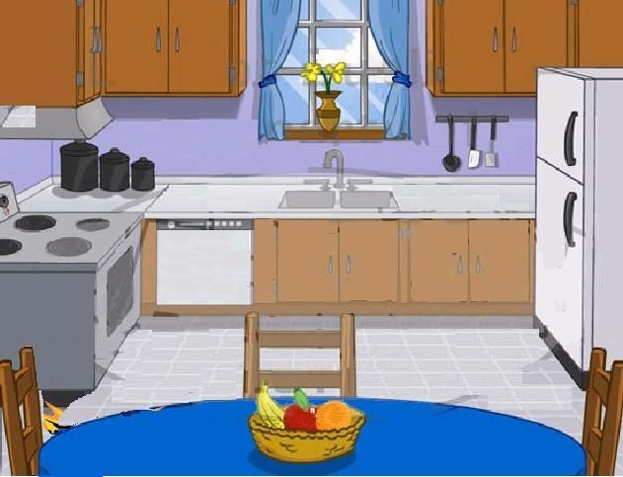
kitchen
SHOW
Notes:
Game: What is this room?
-Pupils choose 1 color and guess the picture of 1 room hidden behind.
-Teacher shows the whole picture at the button SHOW and say out loud the name of the room.

Slide 8
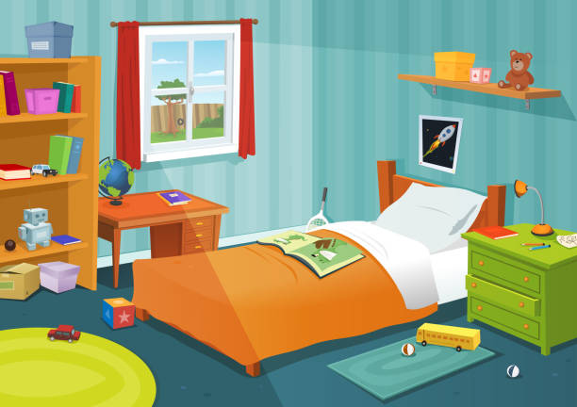
bedroom
SHOW
Notes:
Game: What is this room?
-Pupils choose 1 color and guess the picture of 1 room hidden behind.
-Teacher shows the whole picture at the button SHOW and say out loud the name of the room.

Slide 9


Slide 10


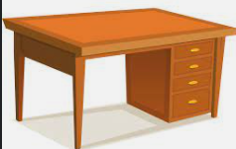
Desk: /desk/ bàn làm việc

Slide 11

Bed: /bed/ giường ngủ

Slide 12

Door: /dɔːr/ cửa ra vào

Slide 13

Window: /ˈwɪn.dəʊ/ cửa sổ

Slide 14

Let's play
MATCHING
Notes:
MADE BY FACEBOOK :TRAN THI THANH TAM

Slide 15
CHECK VOCABULARY:MATCHING
desk
bed
window
door

Slide 16

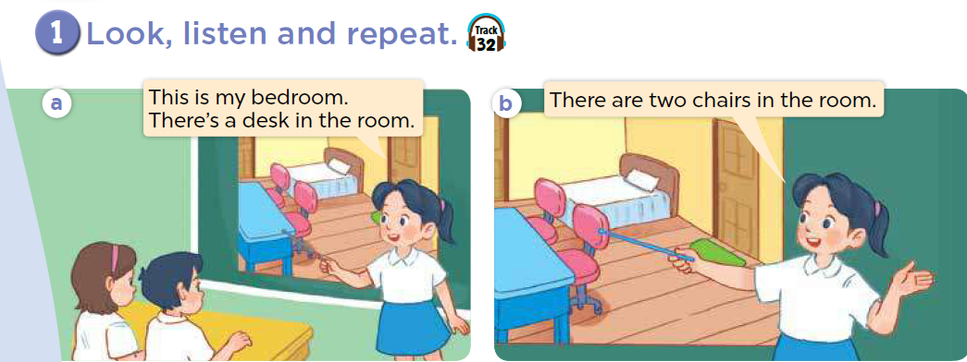

Slide 17
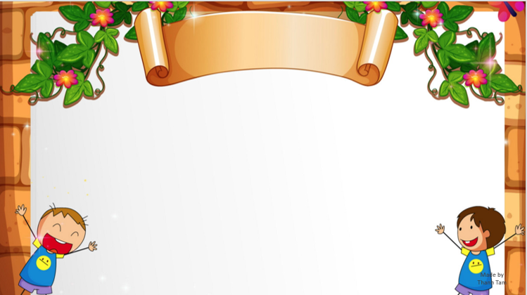
SENTENCE PATTERN

Slide 18

Nói về đồ vật ( Số ít và số nhiều)
There’s a desk in the room.
( Có 1 cái bàn ở trong phòng.)
There are two windows in the room.
(Có 2 cái cửa sổ ở trong phòng.)

Slide 19
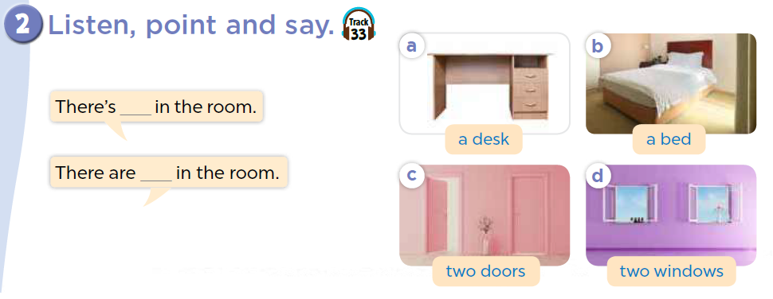

Slide 20
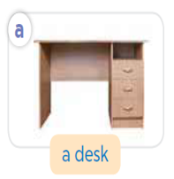
There’s _________ in the room
a desk
Notes:
MADE BY FACEBOOK :TRAN THI THANH TAM

Slide 21
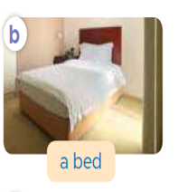
There’s _________ in the room
a bed
Notes:
MADE BY FACEBOOK :TRAN THI THANH TAM

Slide 22
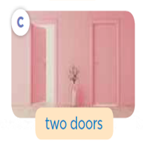
There are _________ in the room
two doors
Notes:
MADE BY FACEBOOK :TRAN THI THANH TAM

Slide 23
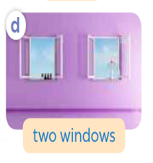
There are _____________ in the room
two windows
Notes:
MADE BY FACEBOOK :TRAN THI THANH TAM

Slide 24
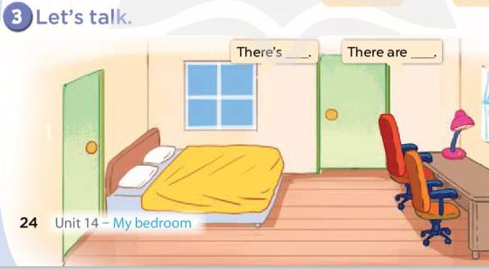

Slide 25

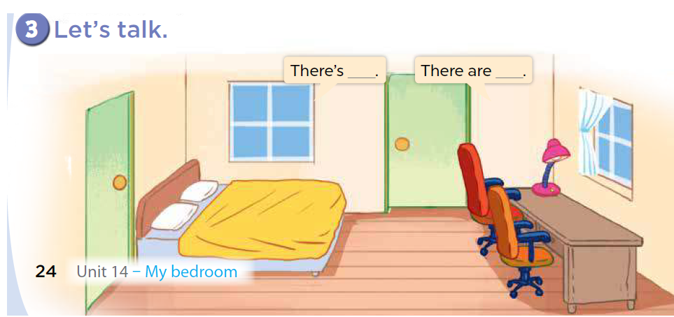
There is a bed.
There are
two windows.
Notes:
Step 1: Have pupils look at the things in the bedroom and elicit their names. Draw
pupils’ attention to the singular things (e.g. a bed, a desk) and multiple things (e.g. two
chairs, two windows).
Step 2: Model by getting pupils to point at the gapped sentence There’s _____. in the
first bubble. Then point at one thing in the bedroom (e.g. a bed), and say There’s a bed in
the room / bedroom.
Step 3: Repeat the same procedure with the gapped sentence There are _____. in the
second bubble and one plural thing (e.g. two chairs) and say There are two chairs in the
room / bedroom.
Step 4: Give pupils time to practise in pairs or groups. One pupil points at and says the
quantities of things in the room / bedroom and the others listen and make comments.
Step 5: Invite a few pupils to say the quantities of things in front of the class.
Extension: If time allows, encourage pupils to point at and say about the things in the
classroom. E.g. There is a board in the classroom.

Slide 26
There are
two doors.
There is a desk.
Notes:
Step 1: Have pupils look at the things in the bedroom and elicit their names. Draw
pupils’ attention to the singular things (e.g. a bed, a desk) and multiple things (e.g. two
chairs, two windows).
Step 2: Model by getting pupils to point at the gapped sentence There’s _____. in the
first bubble. Then point at one thing in the bedroom (e.g. a bed), and say There’s a bed in
the room / bedroom.
Step 3: Repeat the same procedure with the gapped sentence There are _____. in the
second bubble and one plural thing (e.g. two chairs) and say There are two chairs in the
room / bedroom.
Step 4: Give pupils time to practise in pairs or groups. One pupil points at and says the
quantities of things in the room / bedroom and the others listen and make comments.
Step 5: Invite a few pupils to say the quantities of things in front of the class.
Extension: If time allows, encourage pupils to point at and say about the things in the
classroom. E.g. There is a board in the classroom.

Slide 27
There are
two chairs.
There is a lamp.
Notes:
Step 1: Have pupils look at the things in the bedroom and elicit their names. Draw
pupils’ attention to the singular things (e.g. a bed, a desk) and multiple things (e.g. two
chairs, two windows).
Step 2: Model by getting pupils to point at the gapped sentence There’s _____. in the
first bubble. Then point at one thing in the bedroom (e.g. a bed), and say There’s a bed in
the room / bedroom.
Step 3: Repeat the same procedure with the gapped sentence There are _____. in the
second bubble and one plural thing (e.g. two chairs) and say There are two chairs in the
room / bedroom.
Step 4: Give pupils time to practise in pairs or groups. One pupil points at and says the
quantities of things in the room / bedroom and the others listen and make comments.
Step 5: Invite a few pupils to say the quantities of things in front of the class.
Extension: If time allows, encourage pupils to point at and say about the things in the
classroom. E.g. There is a board in the classroom.

Slide 28


Let's play
Made by Thanh Tam
Notes:
MADE BY FACEBOOK :TRAN THI THANH TAM

Slide 29


RING THE GOLDEN BELL
Notes:
MADE BY FACEBOOK :TRAN THI THANH TAM

Slide 30

10
2
3
4
7
8
5
6
9
0
1
Game
RINGING THE GOLDEN BELL
desk
There is a…………... In the room
Notes:
MADE BY FACEBOOK :TRAN THI THANH TAM

Slide 31
10
2
3
4
7
8
5
6
9
0
1
Game
RINGING THE GOLDEN BELL
door
There is a…………...
Notes:
MADE BY FACEBOOK :TRAN THI THANH TAM

Slide 32
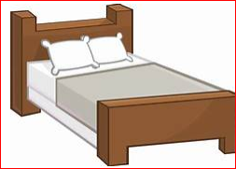
10
2
3
4
7
8
5
6
9
0
1
Game
RINGING THE GOLDEN BELL
beds
There are two…………... In the room
Notes:
MADE BY FACEBOOK :TRAN THI THANH TAM

Slide 33
10
2
3
4
7
8
5
6
9
0
1
Game
RINGING THE GOLDEN BELL
doors
There are three…………...
Notes:
MADE BY FACEBOOK :TRAN THI THANH TAM

Slide 34

SUMMARY
Notes:
MADE BY FACEBOOK :TRAN THI THANH TAM

Slide 35
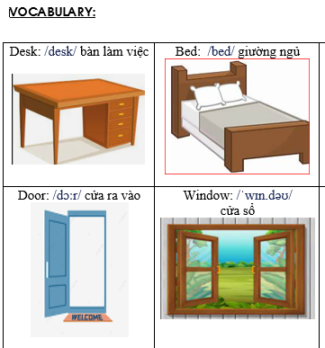
Notes:
Made by Facebook: TRAN THI THANH TAM

Slide 36
SENTENCE PATTERN
Notes:
MADE BY FACEBOOK :TRAN THI THANH TAM

Slide 37
Nói về đồ vật ( Số ít và số nhiều)
There’s a desk in the room.
( Có 1 cái bàn ở trong phòng.)
There are two windows in the room.
(Có 2 cái cửa sổ ở trong phòng.)

Slide 38
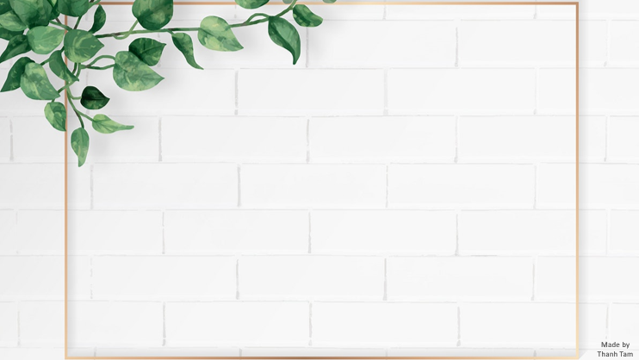
Homework:
- Learn vocabulary and sentence pattern by heart
- Prepare Unit 14- lesson 1 ( 4, 5, 6)
Notes:
MADE BY FACEBOOK :TRAN THI THANH TAM

Slide 39

Notes:
MADE BY FACEBOOK :TRAN THI THANH TAM

Slide 40



Thank you very much
Good bye! See you again!
Made by Thanh Tam

Slide 41
UNIT 14: MY BEDROOM
LESSON 1( 4, 5, 6)

Slide 42
CONTENTS
1
WARM -UP
2
LISTEN AND TICK
3
LOOK, COMPLETE AND READ
4
LET’S PLAY
5
SING A SONG
Notes:
MADE BY FACEBOOK :TRAN THI THANH TAM

Slide 43
Warm - up

Slide 44
Let's play GAME
CHOOSE COCONUTS
Notes:
MADE BY FACEBOOK :TRAN THI THANH TAM

Slide 45


windows
doors
chairs
doors
Choose the right coconut!

Slide 46
chairs
windows
beds
beds
Choose the right coconut!

Slide 47
bed
table
door
door
Choose the right coconut!

Slide 48
door
window
table
window
Choose the right coconut!

Slide 49
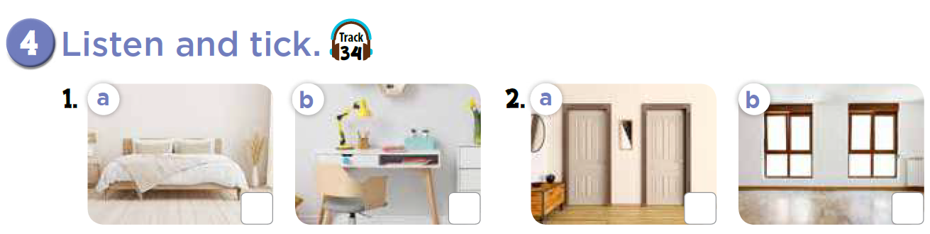


Slide 50
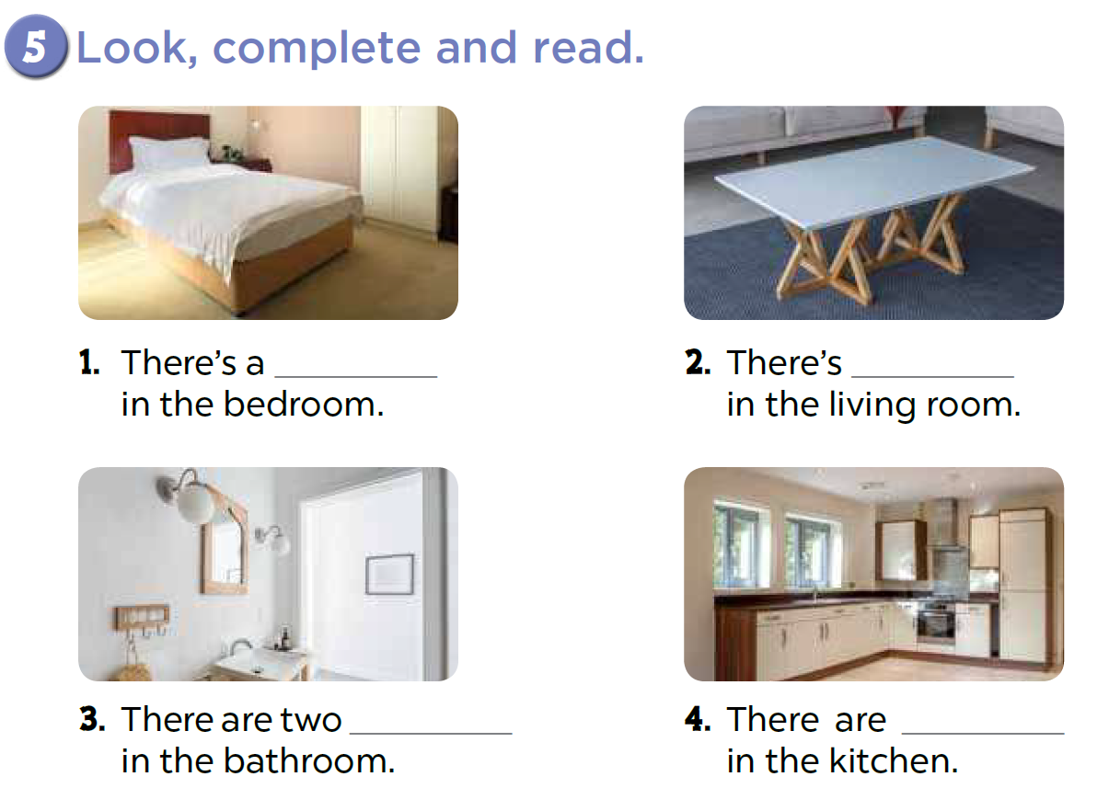
bed
a desk
lamps
two windows

Slide 51
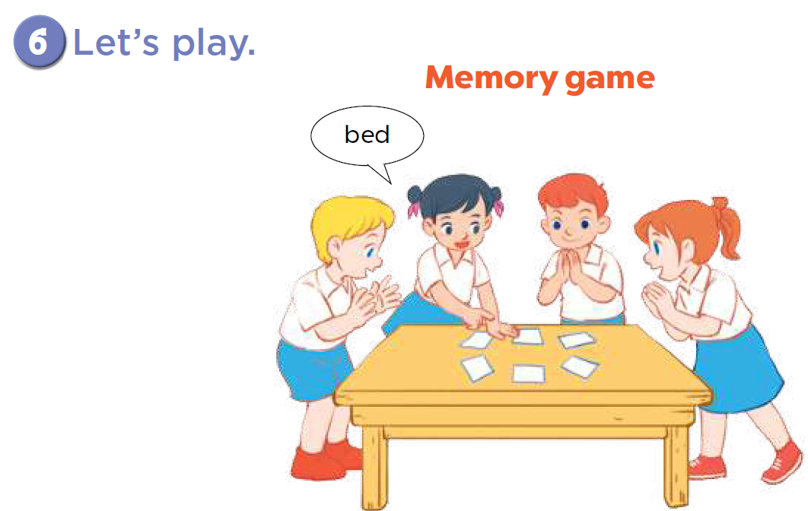

Slide 52

LET ’S PLAY
Chinese Whispers

Slide 53
Chinese Whispers
Group 1
Group 2
There’s a bed in the room.
There’s a table in the room.
Notes:
Made by Facebook: TRAN THI THANH TAM

Slide 54
Chinese Whispers
Group 1
Group 2
There are two windows.
There are six chairs.
Notes:
Made by Facebook: TRAN THI THANH TAM

Slide 55
Homework:
- Practice more at home
- Prepare Unit 14- lesson 2 ( 1, 2, 3)

Slide 56







GOODBYE,
SEE YOU AGAIN !
Made by Thanh Tam

Slide 57




The bye bye song
Bye, bye.
See you tomorrow.
Bye, bye.
See you tomorrow.
Bye, bye.
See you tomorrow.
Bye, bye. Bye, bye.
The bye bye song
Made by Thanh Tam

