Slide 1


UNIT 14 :MY BEDROOM
LESSON 2 ( 1, 2, 3)

Slide 2

CONTENTS
1
WARM -UP
2
VOCABULARY
3
LOOK, LISTEN AND REPEAT
4
LISTEN, POINT AND SAY
5
LET’S TALK
6
PLAY GAME
Notes:
MADE BY FACEBOOK :TRAN THI THANH TAM

Slide 3

Warm - up

Slide 4
What and where
1
small
big
2
3
bedroom
4
new
5
6
old
window

Slide 5


Slide 6

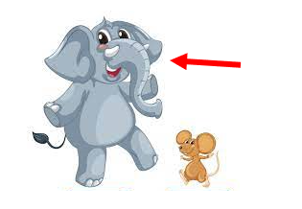

Big: /bɪɡ/ to

Slide 7
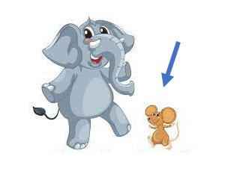
Small: /smɔːl/ nhỏ

Slide 8

New: /njuː/ mới

Slide 9

Old: /əʊld/ cũ

Slide 10

LET’S PLAY

Slide 11
 REORDER WORDS
1
D
L
O
O
L
D
2
N
W
E
N
E
W
3
I
B
G
B
I
G
4
A
M
L
L
S
S
M
A
L
L

Slide 12

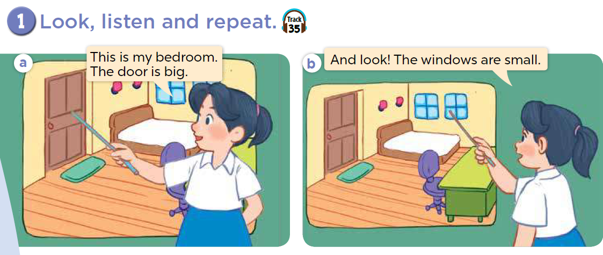

Slide 13

SENTENCE PATTERN

Slide 14

Mô tả về đồ vật ( Số ít và số nhiều)
The door is big.
( Cái cửa thì to.)
The chairs are old.
( Những cái ghế thì cũ.)

Slide 15
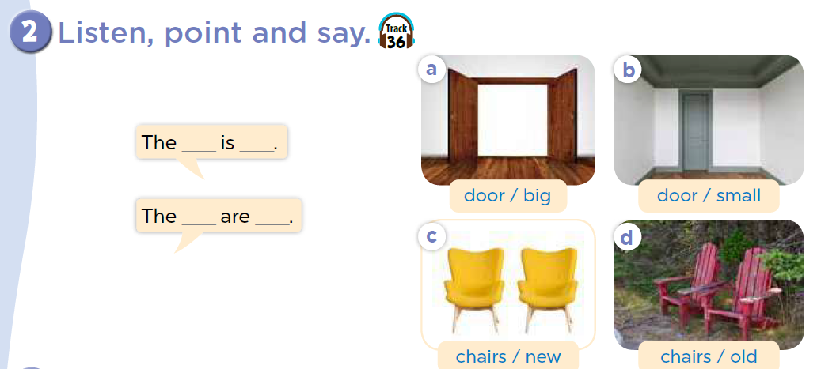

Slide 16

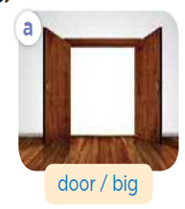
The _______ is ________
door
big
Notes:
MADE BY FACEBOOK :TRAN THI THANH TAM

Slide 17
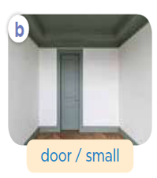
The _______ is ________
door
small
Notes:
MADE BY FACEBOOK :TRAN THI THANH TAM

Slide 18
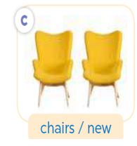
The _______ is ________
chairs
new
Notes:
MADE BY FACEBOOK :TRAN THI THANH TAM

Slide 19
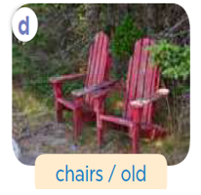
The _______ is ________
chairs
old
Notes:
MADE BY FACEBOOK :TRAN THI THANH TAM

Slide 20
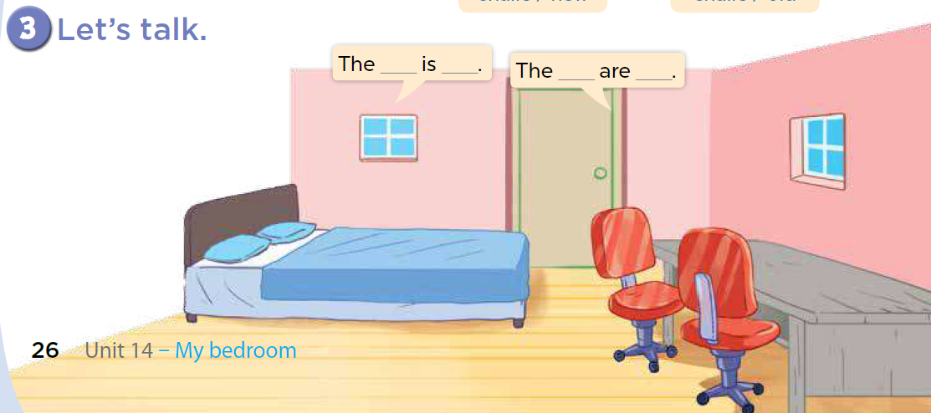

Slide 21

SING THE SONG : ROOMS IN THE HOUSE
Notes:
Made by Facebook: TRAN THI THANH TAM

Slide 22

SUMMARY
Notes:
MADE BY FACEBOOK :TRAN THI THANH TAM

Slide 23

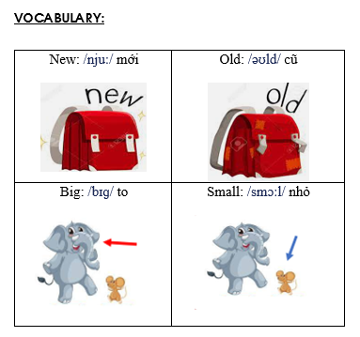
Notes:
Made by Facebook: TRAN THI THANH TAM

Slide 24
SENTENCE PATTERN
Notes:
MADE BY FACEBOOK :TRAN THI THANH TAM

Slide 25
Mô tả về đồ vật ( Số ít và số nhiều)
The door is big.
( Cái cửa thì to.)
The chairs are old.
( Những cái ghế thì cũ.)

Slide 26

Homework:
- Learn vocabulary and sentence pattern by heart
- Prepare Unit 14- lesson 2 ( 4, 5, 6)
Notes:
MADE BY FACEBOOK :TRAN THI THANH TAM

Slide 27

Notes:
MADE BY FACEBOOK :TRAN THI THANH TAM

Slide 28



Thank you very much
Good bye! See you again!
Made by Thanh Tam

Slide 29
UNIT 14 :MY BEDROOM
LESSON 2 ( 4, 5, 6)

Slide 30
CONTENTS
1
WARM -UP
2
LISTEN AND NUMBER
3
LOOK, COMPLETE AND READ
4
LET’S PLAY
5
SING A SONG
Notes:
MADE BY FACEBOOK :TRAN THI THANH TAM

Slide 31
Warm - up

Slide 32
LET ’S PLAY
Chinese Whispers

Slide 33
Chinese Whispers
Group 1
Group 2
There is a big door.
There is a small door
Notes:
Made by Facebook: TRAN THI THANH TAM

Slide 34
Chinese Whispers
Group 1
Group 2
There are new chairs.
There are old chairs.
Notes:
Made by Facebook: TRAN THI THANH TAM

Slide 35
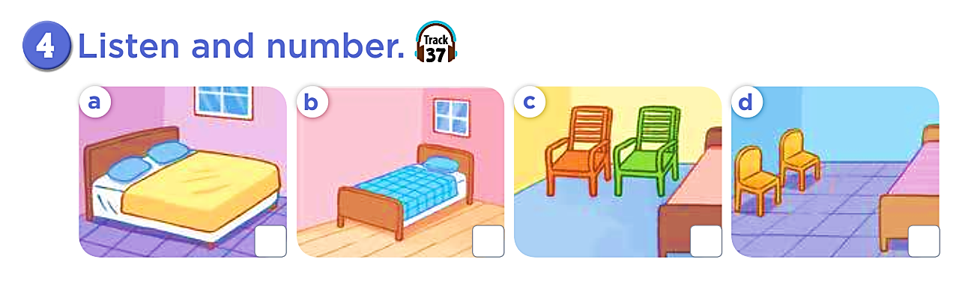
2
1
3
4

Slide 36
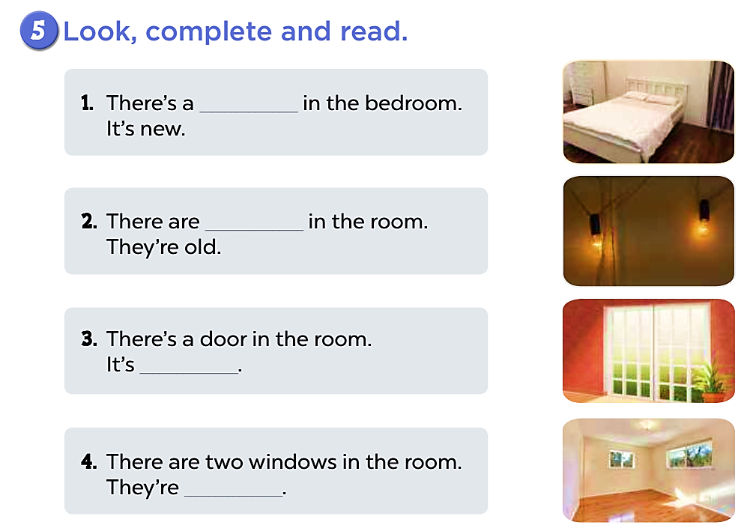
bed
two lamps

Slide 37
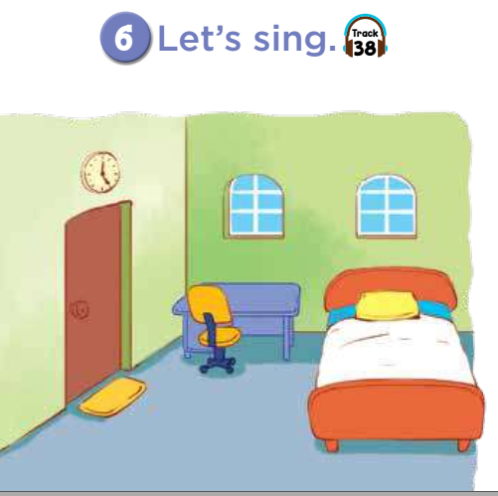
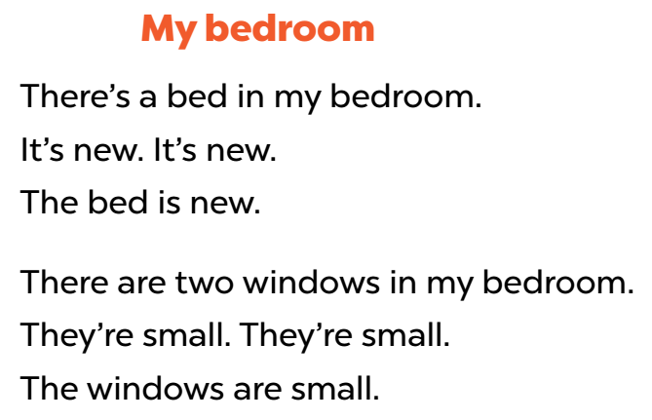


Slide 38

Let's play
Who’s the faster?
Notes:
MADE BY FACEBOOK :TRAN THI THANH TAM

Slide 39

HOME
There are two chairs.
HOME

Slide 40

HOME
There is a bed.
HOME

Slide 41

HOME
There is a door.
HOME

Slide 42

HOME
There are four Windows.
HOME

Slide 43
Homework:
- Practice more at home
- Prepare Unit 14- lesson 3 ( 1, 2, 3)

Slide 45
Thank you very much
Good bye! See you again!
Made by Thanh Tam

