Slide 1


UNIT 14: MY BEDROOM
LESSON 3 ( 1, 2, 3)

Slide 2
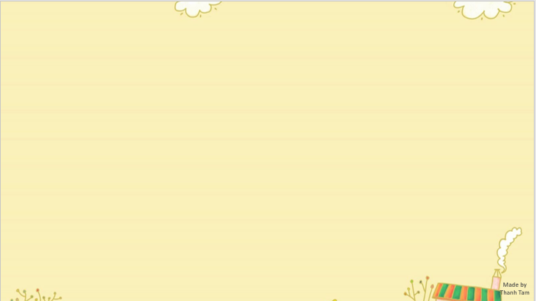

CONTENTS
1
WARM -UP
2
LISTEN AND REPEAT
3
LISTEN AND CIRCLE
4
LET’S CHANT
5
PLAY GAME
Notes:
MADE BY FACEBOOK :TRAN THI THANH TAM

Slide 3
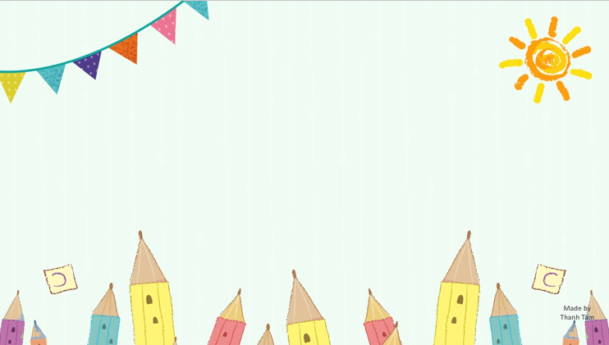
Warm - up

Slide 4

Let's play
brainstorming

Slide 5
room
door
look
oo
noon
school

Slide 6

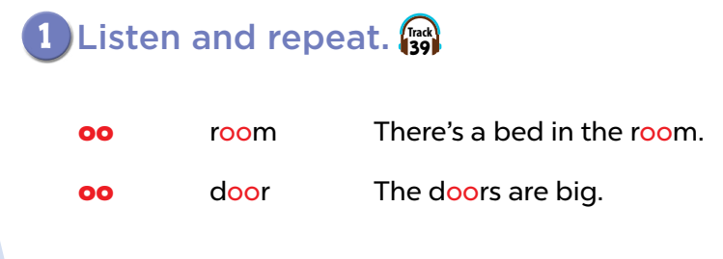


Slide 7
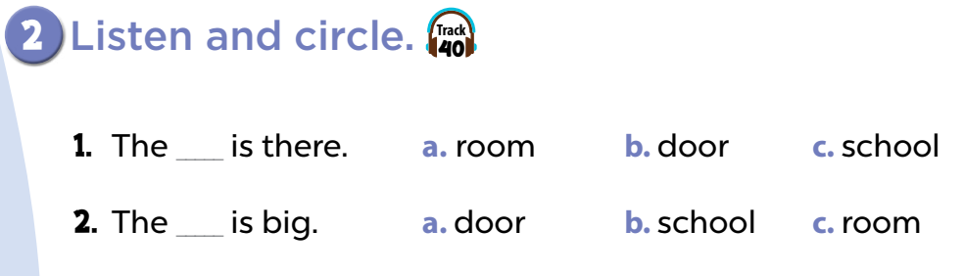

Slide 8
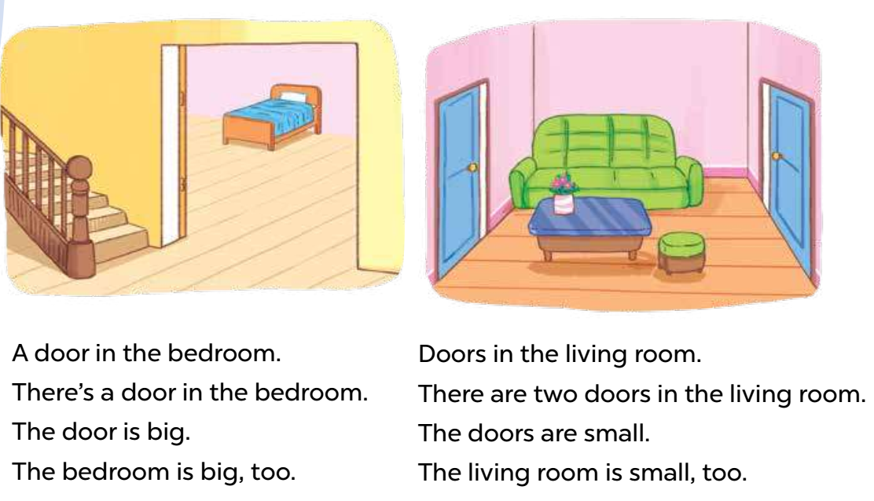
3. LET’S CHANT

Slide 9
Let's play
Who’s the faster?
Notes:
MADE BY FACEBOOK :TRAN THI THANH TAM

Slide 10


HOME
There are two chairs.
HOME

Slide 11
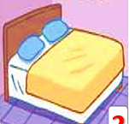
HOME
There is a bed.
HOME

Slide 12

HOME
There is a door.
HOME

Slide 13

HOME
There are four Windows.
HOME

Slide 14

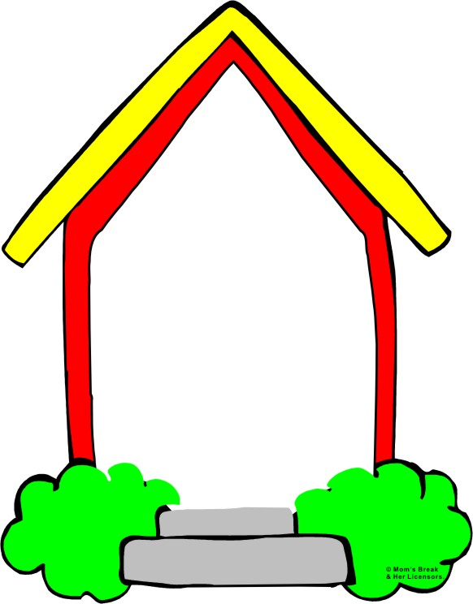
Homework:
- Practice more at home
- Prepare Unit 14- Lesson 3 ( 4, 5, 6)
Made by
Thanh Tam
Notes:
MADE BY FACEBOOK :TRAN THI THANH TAM

Slide 15
UNIT 14: MY BEDROOM
LESSON 3 ( 3, 4, 5)

Slide 16
CONTENTS
1
WARM -UP
2
READ AND COMPLETE
3
LET’S WRITE
4
PROJECT
5
PLAY GAME
Notes:
MADE BY FACEBOOK :TRAN THI THANH TAM

Slide 17
Warm - up

Slide 18

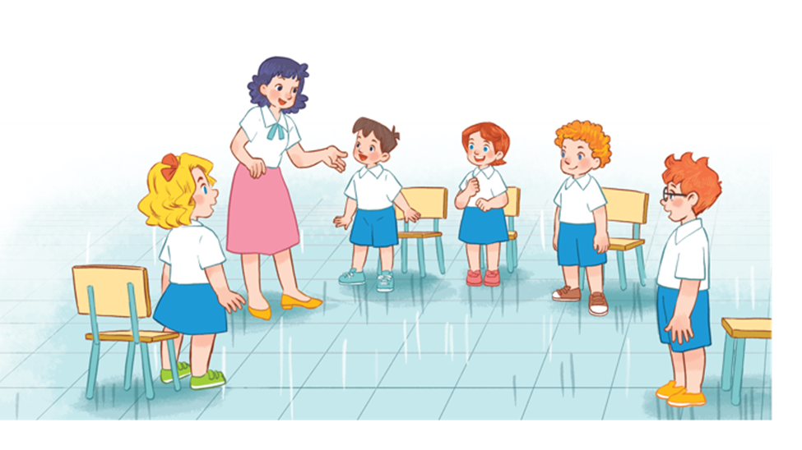

Notes:
Game: Pass the ball!
Goal: To practice asking and answering
Step 1: Divide class into 2 big groups, each group has a ball.
Step 2: While the music plays, pupils pass the ball around the class.
Step 3: When the music stops, the pupil in each group with the ball has to take turns to ask and answer: What’s this? (point to body part). It’s a ___.

Slide 19
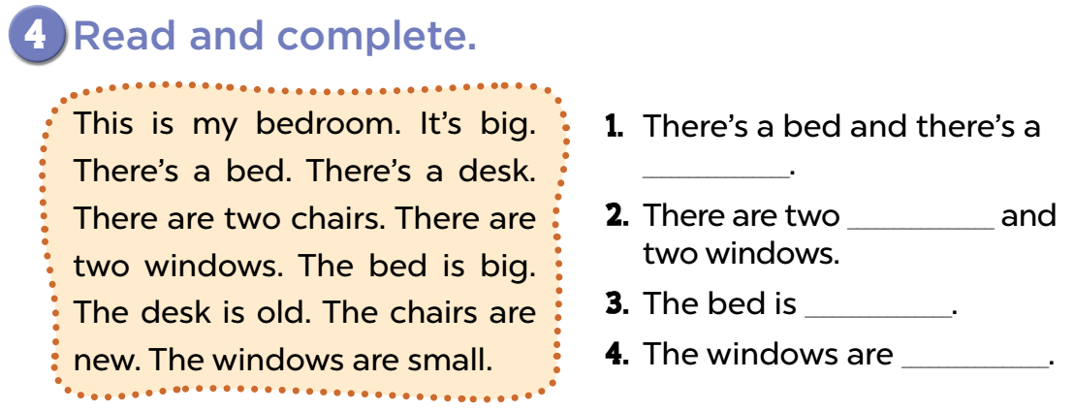
desk
chairs
big
small
Notes:
Step 1: Tell the class the goal of this activity. Tell pupils how to complete the task: They should read the text and find the information to fill the gaps in the sentences. Check comprehension and give feedback.
Step 2: Do Sentence 1 as an example. First, have pupils read the sentence, focusing on the gap. Ask them what word is missing (one thing in the bedroom). Then have them read the text and find the appropriate word (e.g. desk) to fill in the gap. Check
comprehension.
Step 3: Set a time limit for pupils to do the activity independently. Go around and oﬀer help if necessary.
Step 4: Let pupils swap and check their answers. Correct the answers if necessary.
Step 5: Select one or two pupils to read the completed sentences in front of the class. The class makes comments. You may ask one or two pupils to read the text aloud in front of the class and check pronunciation if needed.

Slide 20
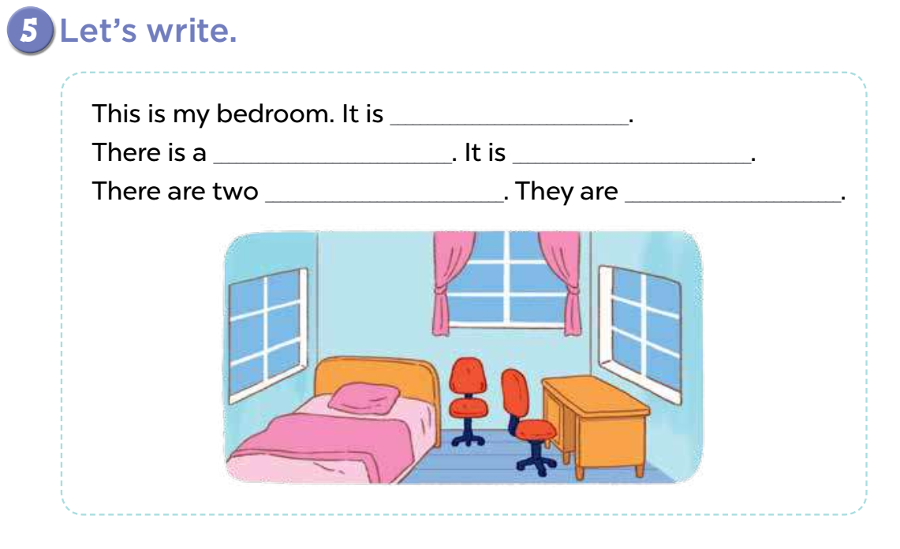
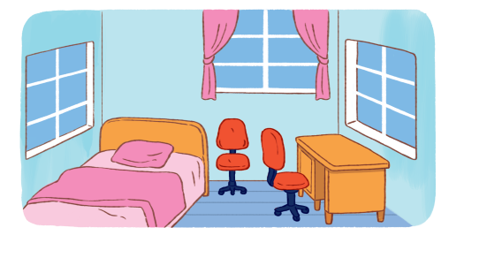
5. LET’S WRITE
small
bed/desk
small/old
chairs
old/new

Slide 21

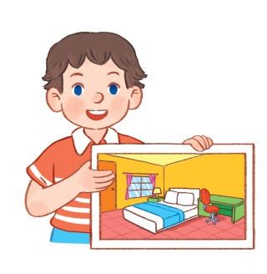
6. PROJECT

Slide 22

Let's play
MATCHING
Notes:
MADE BY FACEBOOK :TRAN THI THANH TAM

Slide 23

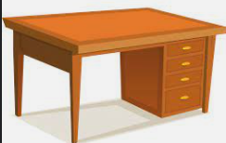
CHECK VOCABULARY:MATCHING
desk
bed
window
door

Slide 24

Homework:
- Practice more at home
- Prepare Unit 15- lesson 1 ( 1, 2, 3)

Slide 25



Thank you very much
Good bye! See you again!
Made by Thanh Tam

Slide 26




The bye bye song
Bye, bye.
See you tomorrow.
Bye, bye.
See you tomorrow.
Bye, bye.
See you tomorrow.
Bye, bye. Bye, bye.
The bye bye song
Made by Thanh Tam

