Slide 1


UNIT 15: AT THE DINING TABLE
LESSON 1 ( 1, 2, 3)

Slide 2

CONTENTS
1
WARM -UP
2
VOCABULARY
3
LOOK, LISTEN AND REPEAT
4
LISTEN, POINT AND SAY
5
LET’S TALK
6
PLAY GAME
Notes:
MADE BY FACEBOOK :TRAN THI THANH TAM

Slide 3

Warm - up

Slide 4

Let's play
Guessing
Notes:
MADE BY FACEBOOK :TRAN THI THANH TAM

Slide 5

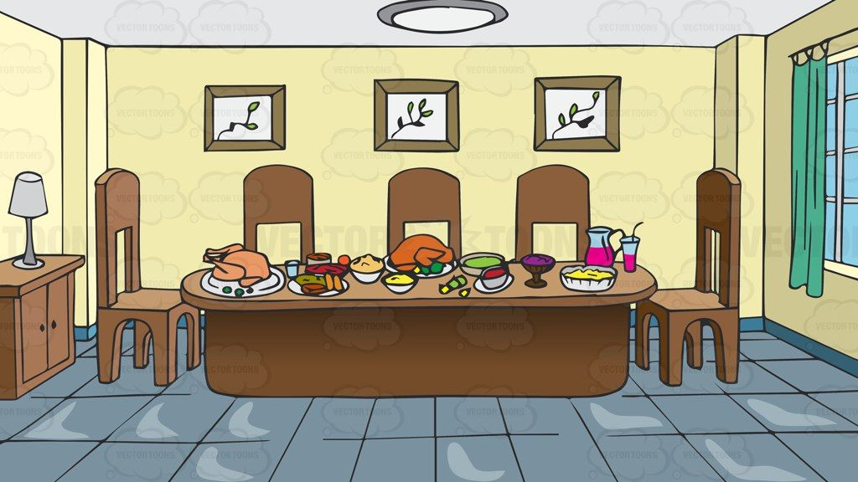
Guessing
Guessing?
DINING ROOM
Notes:
MADE BY FACEBOOK :TRAN THI THANH TAM

Slide 6


Slide 7



Rice: /raɪs/ cơm

Slide 8

Juice: /dʒuːs/ nước ép

Slide 9

Beans: /biːnz/ đậu

Slide 10

Meat: /miːt/ thịt

Slide 11
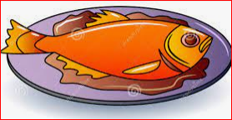
Fish: /fɪʃ/ cá

Slide 12

Like: /laɪk/ thích

Slide 13
Let's play
MATCHING
Notes:
MADE BY FACEBOOK :TRAN THI THANH TAM

Slide 14

CHECK VOCABULARY:MATCHING
like
rice
fish
juice
beans
meat

Slide 15
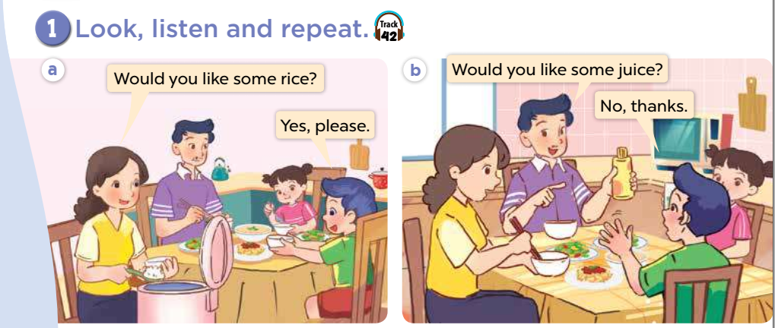

Slide 16

SENTENCE PATTERN

Slide 17

Đề nghị xem ai đó muốn ăn thứ gì không(một cách lịch sự)
Would you like some meat?
( Bạn có muốn dùng một ít thịt không?)
-Yes, please. ( Vâng, có.)
-No, thanks. ( Không, cảm ơn.)

Slide 18
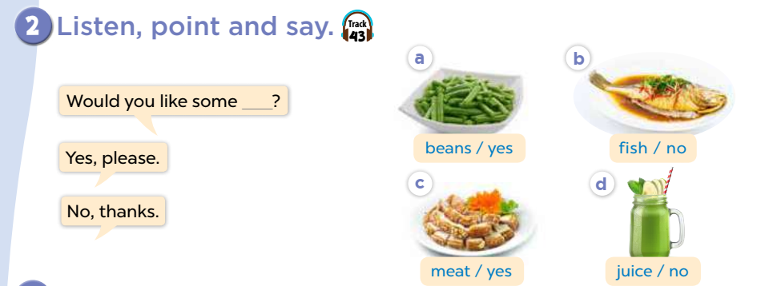

Slide 19
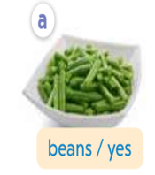
beans
Would you like some………?
Yes, please.
Notes:
MADE BY FACEBOOK :TRAN THI THANH TAM

Slide 20
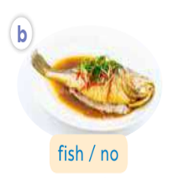
fish
Would you like some………?
No, thanks.
Notes:
MADE BY FACEBOOK :TRAN THI THANH TAM

Slide 21
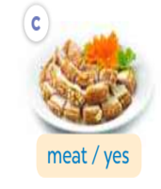
meat
Would you like some………?
Yes, please.
Notes:
MADE BY FACEBOOK :TRAN THI THANH TAM

Slide 22

juice
Would you like some………?
No, thanks.
Notes:
MADE BY FACEBOOK :TRAN THI THANH TAM

Slide 23
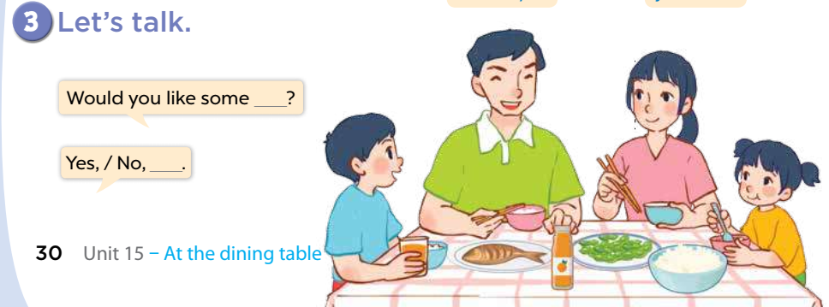

Slide 24
Let's play
Notes:
MADE BY FACEBOOK :TRAN THI THANH TAM

Slide 25



Notes:
MADE BY FACEBOOK :TRAN THI THANH TAM

Slide 26



home
Would you like some rice?
Yes, please.

Slide 27
home
Would you like some fish?
No, thanks.

Slide 28
home
Would you like some beans?
Yes, please.

Slide 29
home
Would you like some meat?
No,thanks.

Slide 30

SUMMARY
Notes:
MADE BY FACEBOOK :TRAN THI THANH TAM

Slide 31
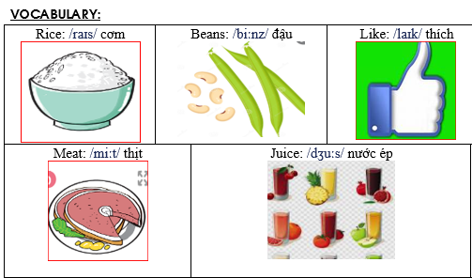
Notes:
Made by Facebook: TRAN THI THANH TAM

Slide 32
SENTENCE PATTERN
Notes:
MADE BY FACEBOOK :TRAN THI THANH TAM

Slide 33

Homework:
- Learn vocabulary and sentence pattern by heart
- Prepare Unit 15- lesson 1 ( 4, 5, 6)
Notes:
MADE BY FACEBOOK :TRAN THI THANH TAM

Slide 34

Notes:
MADE BY FACEBOOK :TRAN THI THANH TAM

Slide 35



Thank you very much
Good bye! See you again!
Made by Thanh Tam

Slide 36
UNIT 15: AT THE DINING TABLE
LESSON 1 ( 4, 5, 6)

Slide 37
CONTENTS
1
WARM -UP
2
LISTEN AND CIRCLE
3
LOOK, COMPLETE AND READ
4
LET’S SING
5
PLAY GAME
Notes:
MADE BY FACEBOOK :TRAN THI THANH TAM

Slide 38
Warm - up

Slide 39


Let's play
Made by Thanh Tam

Slide 40
Let's play GAME
Who is fastest?
Notes:
MADE BY FACEBOOK :TRAN THI THANH TAM

Slide 41
meat.
Would you like some……………
Yes, please.
Notes:
MADE BY FACEBOOK :TRAN THI THANH TAM

Slide 42
fish.
Would you like some……………
Yes, please.
Notes:
MADE BY FACEBOOK :TRAN THI THANH TAM

Slide 43
rice.
Would you like some……………
Yes, please.
Notes:
MADE BY FACEBOOK :TRAN THI THANH TAM

Slide 44
bean.
Would you like some……………
Yes, please.
Notes:
MADE BY FACEBOOK :TRAN THI THANH TAM

Slide 45
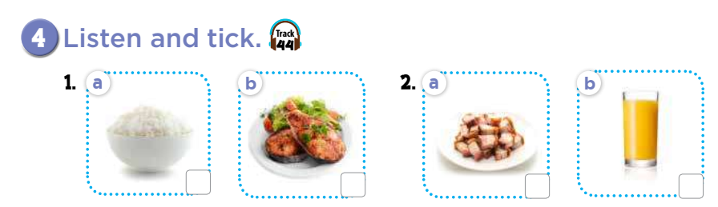
X
X

Slide 46
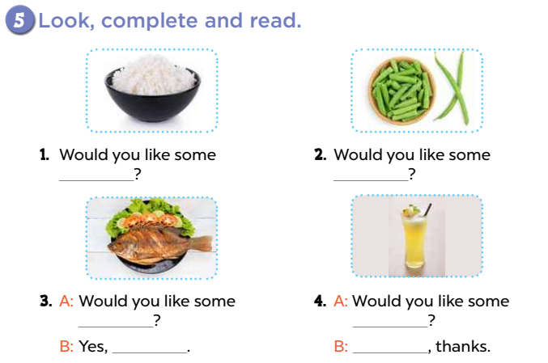
rice
beans
fish
juice
please
No

Slide 47
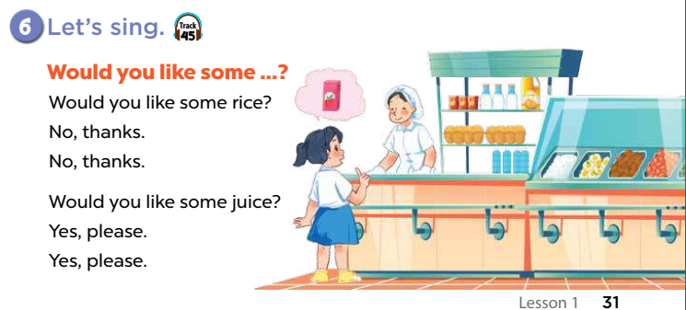

Slide 48
Let's play
Made by Thanh Tam

Slide 49
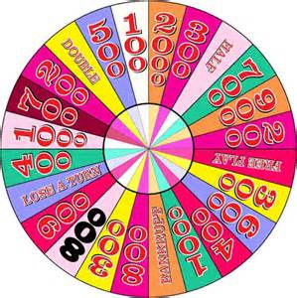
WHEEL FORTUNE

Slide 50
Fotune wheel
Question 1
Choose the best answer
A.bean
A. bean
B. rice
Spin
C. fish
Answer
Next
Very Good!

Slide 51
Fotune wheel
Question 1
Choose the best answer
A. bean
B. rice
Spin
C. fish
C. fish
Answer
Next
Very Good!

Slide 52
Fotune wheel
Question 1
Choose the best answer
A. bean
B. meat
B. meat
Spin
C. fish
Answer
Next
Very Good!

Slide 53
Fotune wheel
Question 1
Choose the best answer
A. bean
B. rice
B. rice
Spin
C. fish
Answer
Next
Very Good!

Slide 54

Homework:
- Practice more at home
- Prepare Unit 15- lesson 2 ( 1, 2, 3)

Slide 55




The bye bye song
Bye, bye.
See you tomorrow.
Bye, bye.
See you tomorrow.
Bye, bye.
See you tomorrow.
Bye, bye. Bye, bye.
The bye bye song
Made by Thanh Tam

Slide 56







GOODBYE,
SEE YOU AGAIN !
Made by Thanh Tam

