Slide 1


UNIT 15: AT THE DINING TABLE
LESSON 2 ( 1,2,3)

Slide 2

CONTENTS
1
WARM -UP
2
VOCABULARY
3
LOOK, LISTEN AND REPEAT
4
LISTEN, POINT AND SAY
5
LET’S TALK
6
PLAY GAME
Notes:
MADE BY FACEBOOK :TRAN THI THANH TAM

Slide 3

Warm - up

Slide 4


SING THE SONG : FOOD AND DRINK
Notes:
Made by Facebook: TRAN THI THANH TAM

Slide 5


Slide 6



Water: /ˈwɔː.tər/ nước

Slide 7

Milk: /mɪlk/ sữa

Slide 8

Eat: /iːt/ ăn

Slide 9

Drink: /drɪŋk/ uống

Slide 10

Bread:/bred/ bánh mì

Slide 11
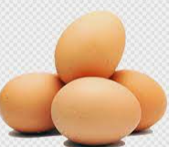
Eggs: /eɡz/ trứng

Slide 12

Chicken: /ˈtʃɪk.ɪn/ thịt gà

Slide 13

Let's play
WHAT’S MISSING?
Notes:
MADE BY FACEBOOK :TRAN THI THANH TAM

Slide 14


?
EAT
Notes:
MADE BY FACEBOOK :TRAN THI THANH TAM

Slide 15
DRINK
?
Notes:
MADE BY FACEBOOK :TRAN THI THANH TAM

Slide 16
EGGS
?
Notes:
MADE BY FACEBOOK :TRAN THI THANH TAM

Slide 17
CHICKEN
?
Notes:
MADE BY FACEBOOK :TRAN THI THANH TAM

Slide 18
MILK
?
Notes:
MADE BY FACEBOOK :TRAN THI THANH TAM

Slide 19

?
WATER
Notes:
MADE BY FACEBOOK :TRAN THI THANH TAM

Slide 20
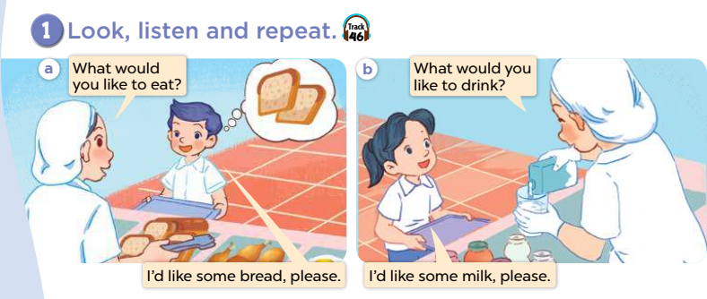

Slide 21

SENTENCE PATTERN

Slide 22
Hỏi và trả lời xem người khác muốn ăn thứ gì
What would you like to eat ?
( Bạn muốn ăn thứ gì? )
I’d like some chicken, please. (Tôi muốn 1 ít thịt gà.)

Slide 23

Hỏi và trả lời xem người khác muốn uống thứ gì
What would you like to drink?
( Bạn muốn uống thứ gì? )
I’d like some milk, please. (Tôi muốn 1 ít sữa.)

Slide 24
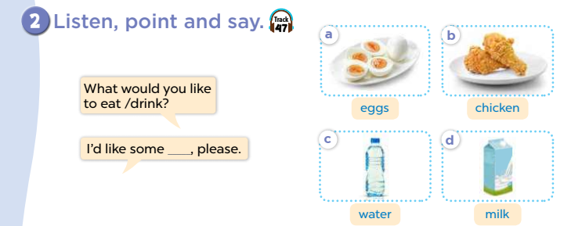

Slide 25

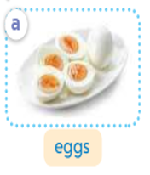
eat
What would you like to ………?
eggs
I like some …......... ,please.
Notes:
MADE BY FACEBOOK :TRAN THI THANH TAM

Slide 26
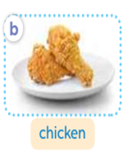
eat
What would you like to ………?
chicken
I like some …......... ,please.
Notes:
MADE BY FACEBOOK :TRAN THI THANH TAM

Slide 27
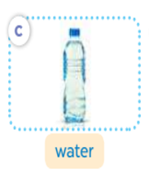
drink
What would you like to ………?
water
I like some …......... ,please.
Notes:
MADE BY FACEBOOK :TRAN THI THANH TAM

Slide 28
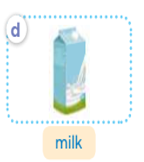
drink
What would you like to ………?
milk
I like some …......... ,please.
Notes:
MADE BY FACEBOOK :TRAN THI THANH TAM

Slide 29
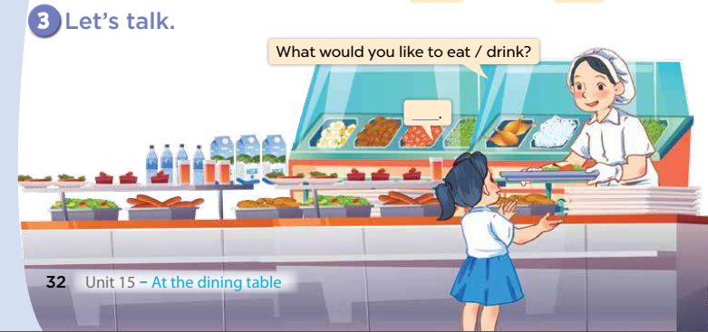

Slide 30
Let's play
Notes:
MADE BY FACEBOOK :TRAN THI THANH TAM

Slide 31

Choose a number
1
2
3
4
Next activity
Notes:
Step 1: Divide the class into 4 teams.
Step 2: Set rules: invite 1 pupil to choose 1 number and guess the job, then ask and answer about the job. The fastest one will have a chance to get a present.
Step 3: Encourage pupil to join in the game.
Step 4: Give points for pupils.

Slide 32
What would you like to eat?
I’d like some …………….
chicken
Get your present here

Slide 33
What would you like to drink?
I’d like some …………….
milk
Get your present here

Slide 34
What would you like to eat?
I’d like some …………….
eggs
Get your present here

Slide 35
What would you like to drink?
I’d like some …………….
water
Get your present here

Slide 36
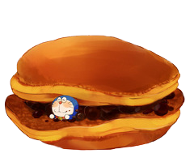

Slide 37

SUMMARY
Notes:
MADE BY FACEBOOK :TRAN THI THANH TAM

Slide 38

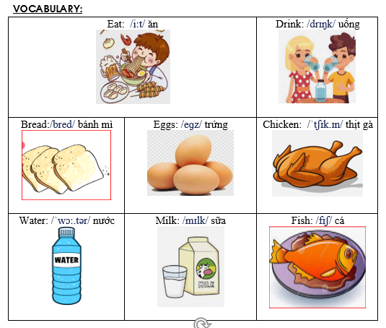
Notes:
Made by Facebook: TRAN THI THANH TAM

Slide 39
SENTENCE PATTERN
Notes:
MADE BY FACEBOOK :TRAN THI THANH TAM

Slide 40
Hỏi và trả lời xem người khác muốn ăn thứ gì
What would you like to eat ?
( Bạn muốn ăn thứ gì? )
I’d like some chicken, please. (Tôi muốn 1 ít thịt gà.)

Slide 41
Hỏi và trả lời xem người khác muốn uống thứ gì
What would you like to drink?
( Bạn muốn uống thứ gì? )
I’d like some milk, please. (Tôi muốn 1 ít sữa.)

Slide 42

Homework:
- Learn vocabulary and sentence pattern by heart
- Prepare Unit 15- lesson 2 ( 4, 5, 6)
Notes:
MADE BY FACEBOOK :TRAN THI THANH TAM

Slide 43



Thank you very much
Good bye! See you again!
Made by Thanh Tam

Slide 44
UNIT 15: AT THE DINING TABLE
LESSON 2 ( 4, 5, 6)

Slide 45
CONTENTS
1
WARM -UP
2
LISTEN AND NUMBER
3
LOOK, COMPLETE AND READ
4
LET’S SING
5
PLAY GAME
Notes:
MADE BY FACEBOOK :TRAN THI THANH TAM

Slide 46
Warm - up

Slide 47

Let's play GAME
CHOOSE COCONUTS
Notes:
MADE BY FACEBOOK :TRAN THI THANH TAM

Slide 48


meat
eggs
beans
eggs
Choose the right coconut!

Slide 49

milk
juice
water
water
Choose the right coconut!

Slide 50

beans
chicken
meat
meat
Choose the right coconut!

Slide 51
juice
milk
water
milk
Choose the right coconut!

Slide 52
bread
bean
eggs
bread
Choose the right coconut!

Slide 53
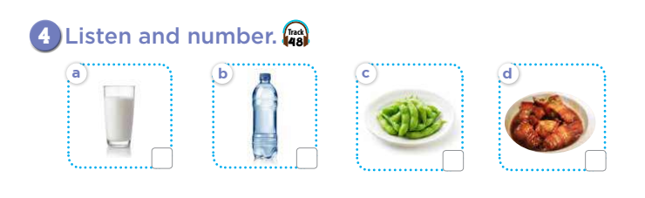

Slide 54
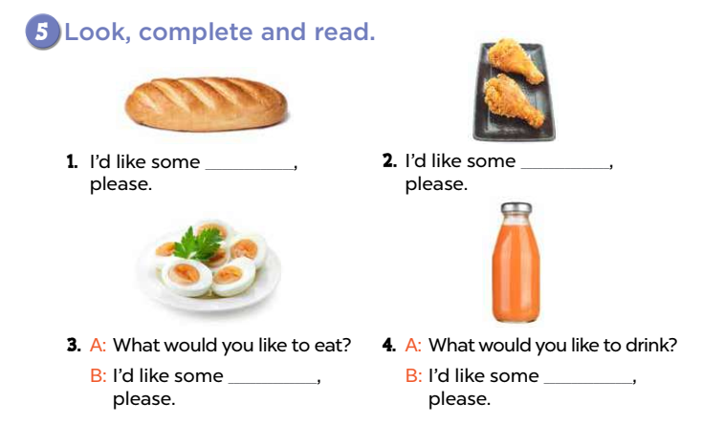
bread
chicken
eggs
juice

Slide 55
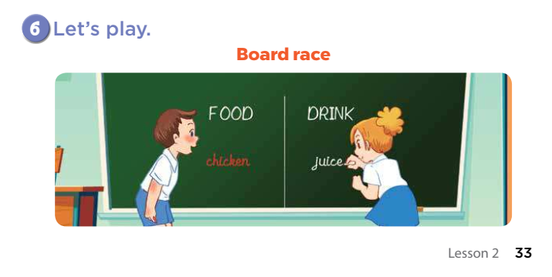

Slide 56

Let's play
Made by Thanh Tam

Slide 57
Let's play GAME
Who is fastest?
Notes:
MADE BY FACEBOOK :TRAN THI THANH TAM

Slide 58


Choose the best answer
A. eggs
B. bread
C. meat
Question 1
B
1
2
3
4
5
6
7
8
9
10
Notes:
MADE BY FACEBOOK :TRAN THI THANH TAM

Slide 59
Choose the best answer
A. eggs
B. bread
C. meat
Question 1
B
1
2
3
4
5
6
7
8
9
10
Notes:
MADE BY FACEBOOK :TRAN THI THANH TAM

Slide 60
Choose the best answer
A. eggs
B. bread
C. meat
Question 2
A
1
2
3
4
5
6
7
8
9
10
Notes:
MADE BY FACEBOOK :TRAN THI THANH TAM

Slide 61
Choose the best answer
A. eggs
B. bread
C. meat
Question 1
C
1
2
3
4
5
6
7
8
9
10
Notes:
MADE BY FACEBOOK :TRAN THI THANH TAM

Slide 62
Choose the best answer
A. eggs
B. chicken
C. meat
Question 1
B
1
2
3
4
5
6
7
8
9
10
Notes:
MADE BY FACEBOOK :TRAN THI THANH TAM

Slide 63
Homework:
- Practice more at home
- Prepare Unit 15- lesson 3 ( 1, 2, 3)

Slide 64




The bye bye song
Bye, bye.
See you tomorrow.
Bye, bye.
See you tomorrow.
Bye, bye.
See you tomorrow.
Bye, bye. Bye, bye.
The bye bye song
Made by Thanh Tam

Slide 65







GOODBYE,
SEE YOU AGAIN !
Made by Thanh Tam

