Slide 1


Warm - up

Slide 2

UNIT 15: AT THE DINIGN TABLE
LESSON 3 ( 1, 2, 3)

Slide 3
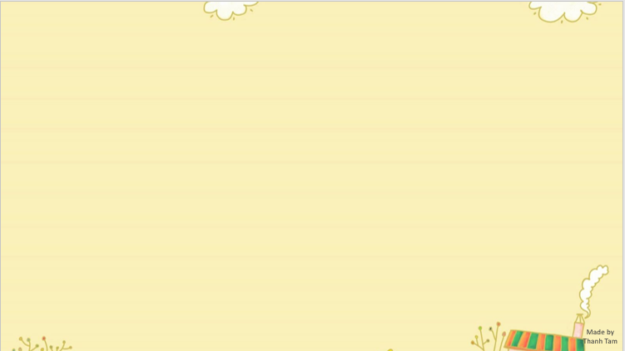

CONTENTS
1
WARM -UP
2
LISTEN AND REPEAT
3
LISTEN AND CIRCLE
4
LET’S CHANT
5
PLAY GAME
Notes:
MADE BY FACEBOOK :TRAN THI THANH TAM

Slide 4

Let's play
MATCHING
Notes:
MADE BY FACEBOOK :TRAN THI THANH TAM

Slide 5
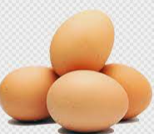

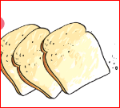



CHECK VOCABULARY:MATCHING
bread
rice
fish
milk
eggs
chicken

Slide 6

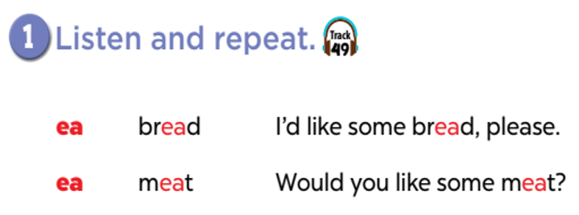


Slide 7
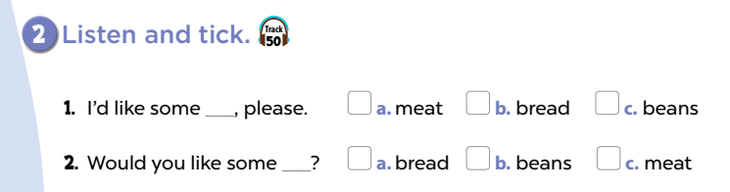

Slide 8
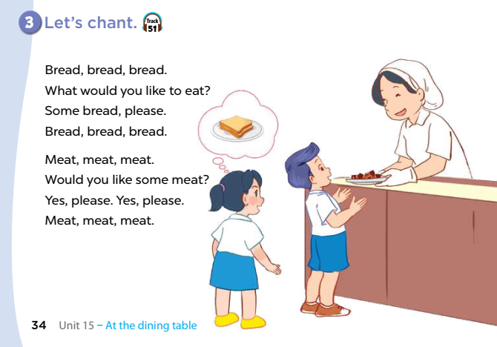

Slide 9

Let's play
CROSSWORDS
Notes:
MADE BY FACEBOOK :TRAN THI THANH TAM

Slide 10


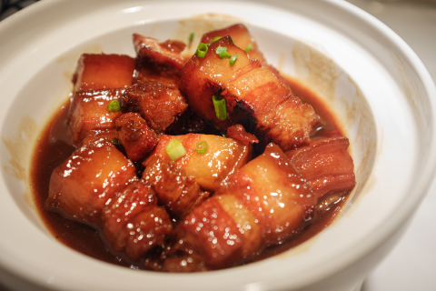
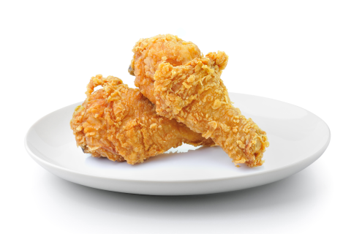
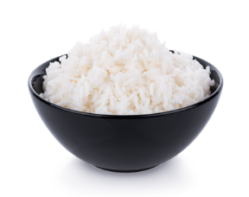
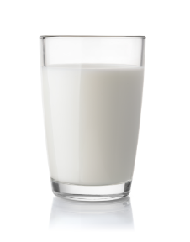
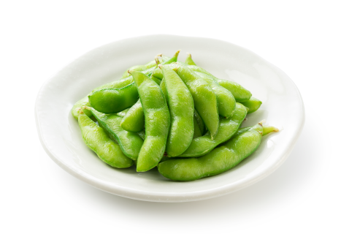
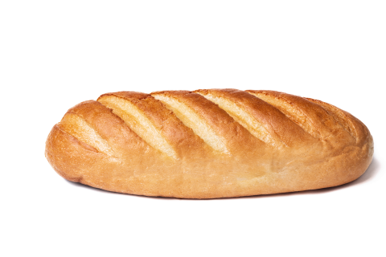
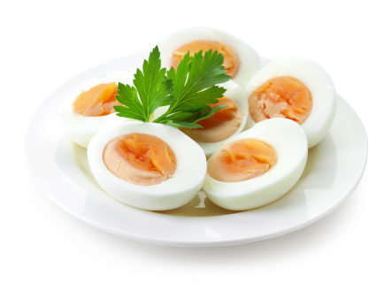
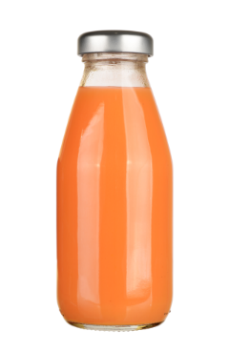

CROSSWORDS
A
W
A
T
E
R
B
M
M
J
U
I
C
E
R
I
E
C
H
I
C
K
E
N
A
R
I
C
E
P
A
M
T
F
I
S
H
Q
D
I
X
V
E
G
G
S
K
L
L
B
E
A
N
S
O
K

Slide 11


Homework:
- Practice more at home
- Prepare Unit 15- Lesson 3 ( 4, 5, 6)
Made by
Thanh Tam
Notes:
MADE BY FACEBOOK :TRAN THI THANH TAM

Slide 12
UNIT 15: AT THE DINIGN TABLE
LESSON 3 ( 4, 5, 6)

Slide 13
CONTENTS
1
WARM -UP
2
READ AND COMPLETE
3
LET’S WRITE
4
PROJECT
5
PLAY GAME
Notes:
MADE BY FACEBOOK :TRAN THI THANH TAM

Slide 14
Warm - up

Slide 15

Let's play GAME
CHOOSE COCONUTS
Notes:
MADE BY FACEBOOK :TRAN THI THANH TAM

Slide 16


meat
eggs
beans
eggs
Choose the right coconut!

Slide 17

milk
juice
water
water
Choose the right coconut!

Slide 18

beans
chicken
meat
meat
Choose the right coconut!

Slide 19
juice
milk
water
milk
Choose the right coconut!

Slide 20
bread
bean
eggs
bread
Choose the right coconut!

Slide 21
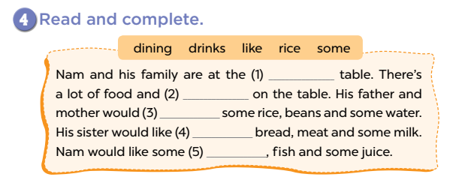
dining
drinks
like
some
rice

Slide 22
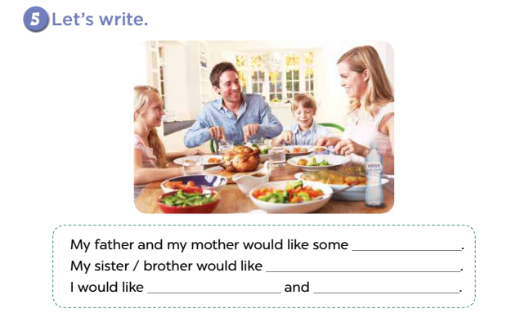

Slide 23
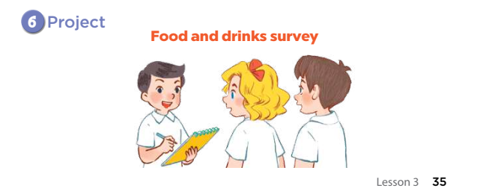

Slide 24
Let's play
NOUGHTS AND CROSSES?
Notes:
MADE BY FACEBOOK :TRAN THI THANH TAM

Slide 25
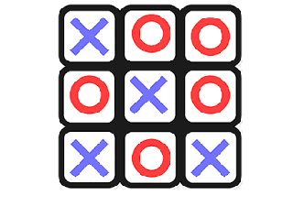
TIC TAC TOE

Slide 26

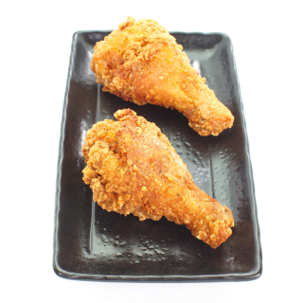




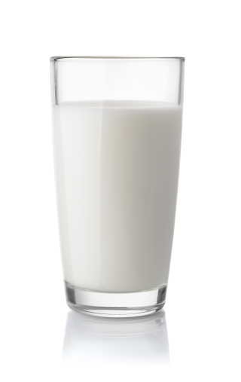


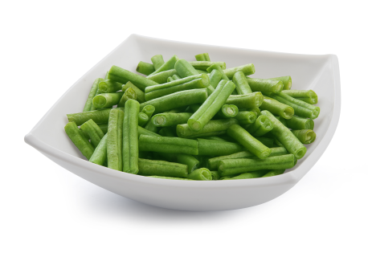
Choose and say!
Would you like some…….? – Yes, please.

Slide 27

Homework:
- Practice more at home
- Prepare REVIEW 3

Slide 28



Thank you very much
Good bye! See you again!
Made by Thanh Tam

Slide 29




The bye bye song
Bye, bye.
See you tomorrow.
Bye, bye.
See you tomorrow.
Bye, bye.
See you tomorrow.
Bye, bye. Bye, bye.
The bye bye song
Made by Thanh Tam

