Slide 1
MINDMAP
ENGLISH GRADE 3

Slide 2
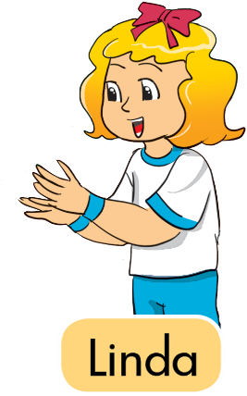

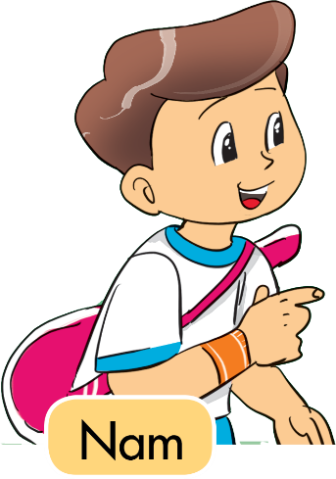
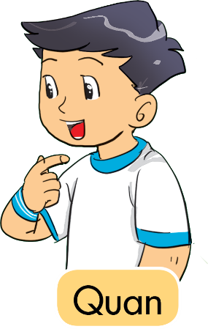
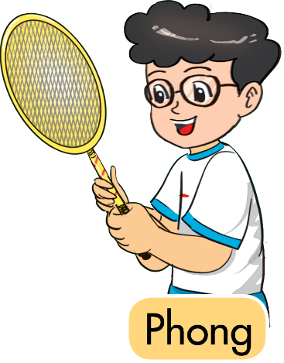
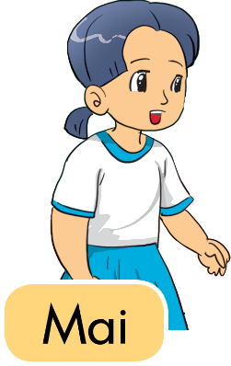
Unit 2
What's your name?
My name's ___________ .

Slide 3
Unit 2
What's ______ name?
______ name's ___________ .
her
his
his
his
his
her

Slide 4
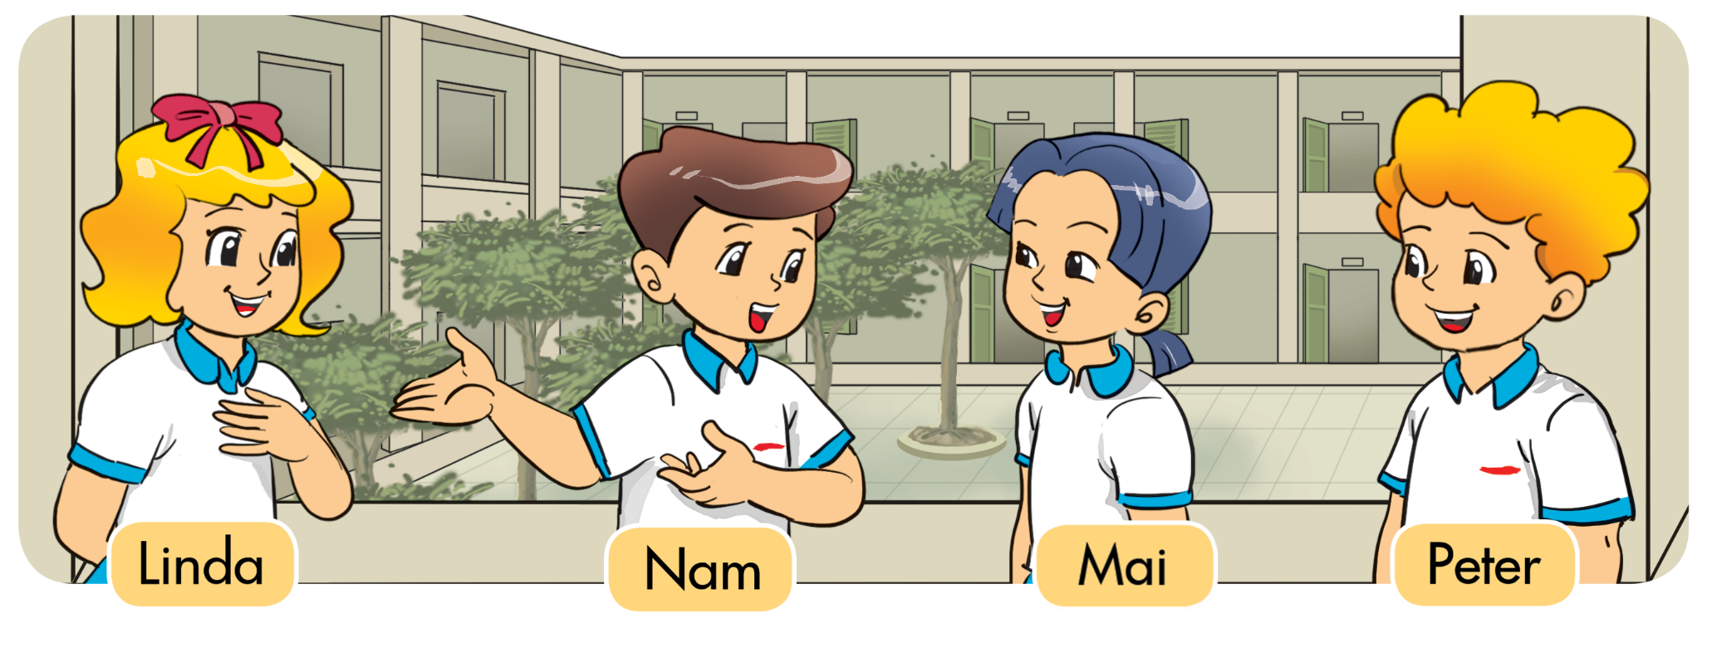
Unit 3
This is _____________.

Slide 5
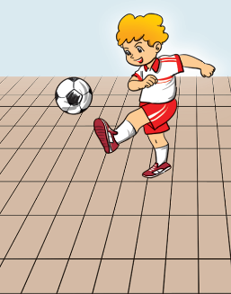
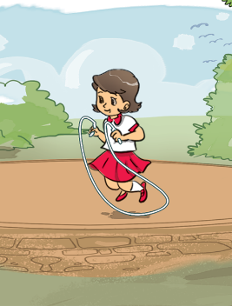
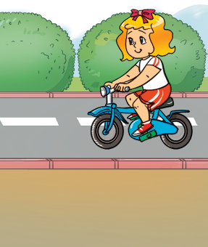
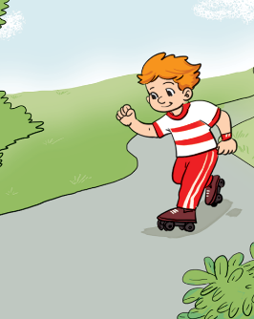
Unit 3
Is that + ______?
Yes, it is.
No, it isn’t.
Peter
Mai
Tony
Mary

Slide 6
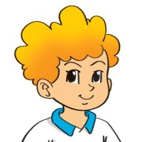

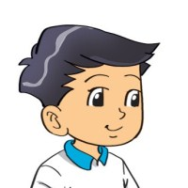
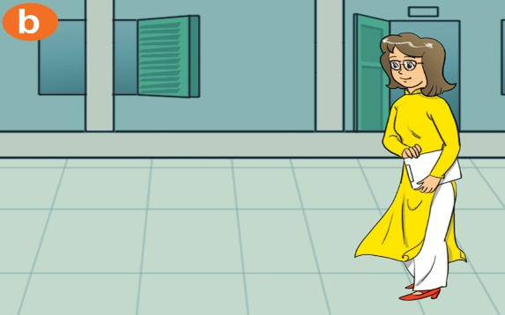

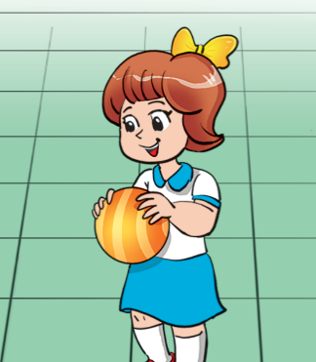
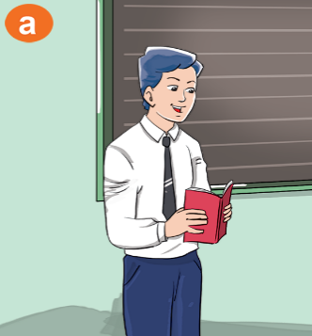
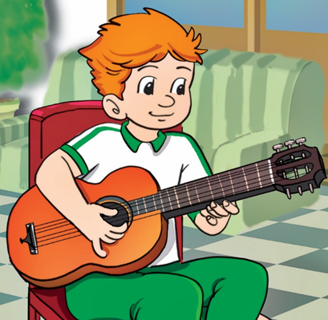
Unit 4
Who's that?
It’s ______.
Peter
Miss Hien
Tony
Mary
Mr. Loc

Slide 7
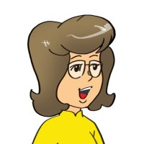
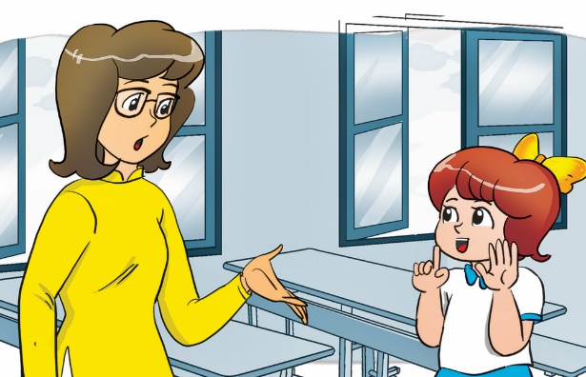
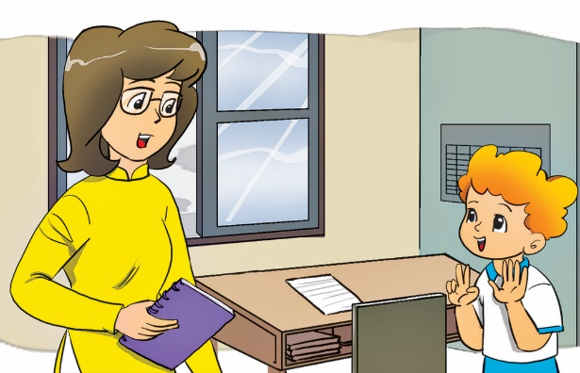
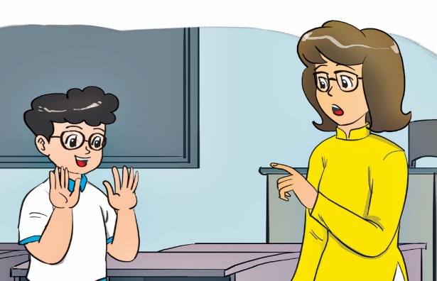
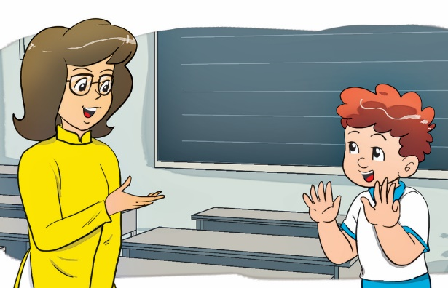
Unit 4
How old are you, ______?
I’m _____ years old.
Mary
Peter
Phong
Tom
six
seven
ten
nine

Slide 8
Unit 5
This is my friend, _______.

Slide 9
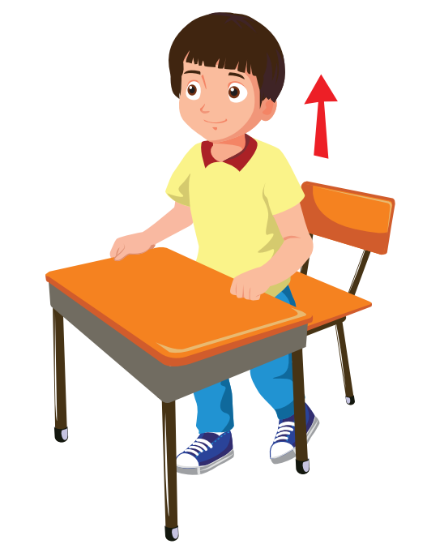

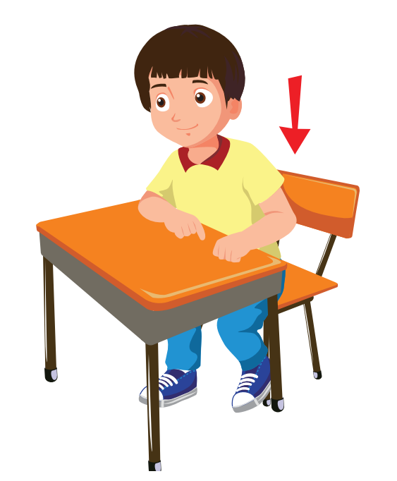


Unit 6
_______, please!
Open
your book
Stand up
Be quiet
Close your book
Sit down

Slide 10


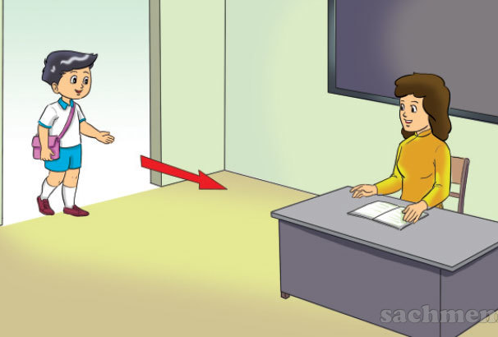

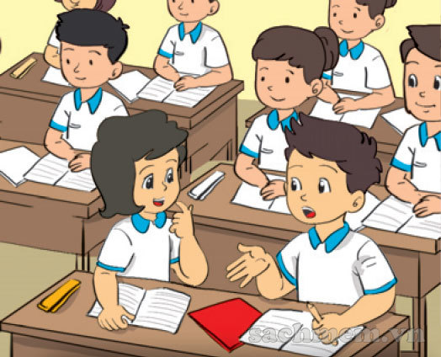
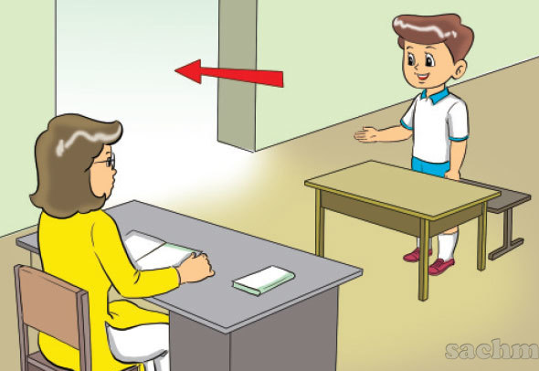
Unit 6
Yes, you can.
May I ______?
No, you can’t.
Come in
Write
Speak
Go out

Slide 11
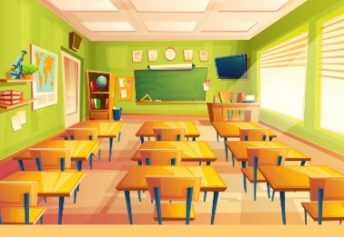


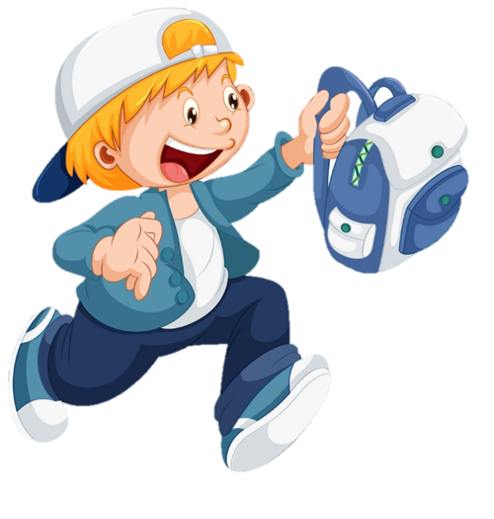
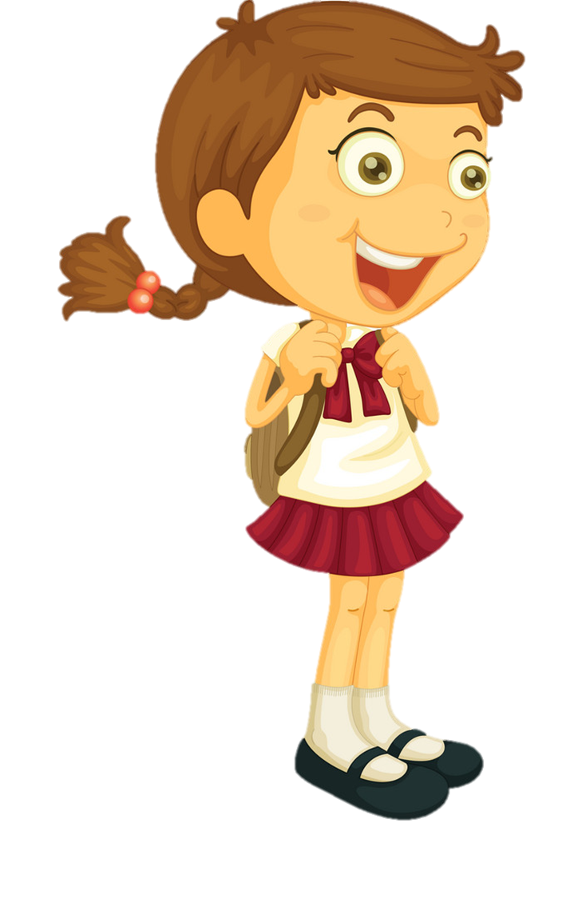


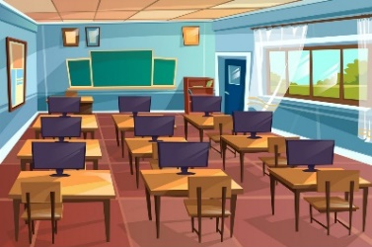
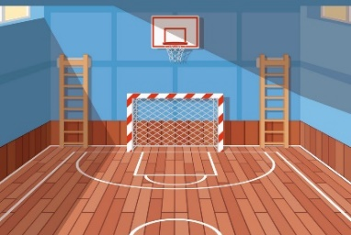


Unit 7
That’s the ___________.
(Kia là ____________.)
Classroom
School
Gym
Computer
room
Library
Playground

Slide 12

Unit 7
Yes, it is.
Is ______ ____?
(________ _______ có phải không?)
No, it isn’t.
Classroom
School
beautiful
big
Gym
Computer
room
small
Library
Playground
new
old
large

Slide 13



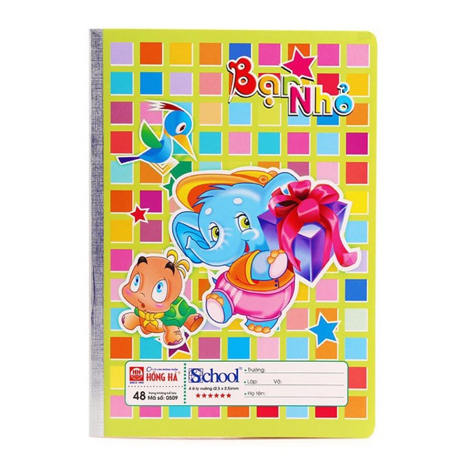
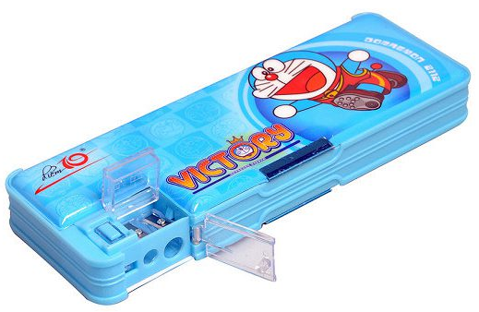

Unit 8
This is my _____.
pencil sharpener
pencil
pencil case
school bag
notebook

Slide 14
Unit 8
That is my _____.
pencil sharpener
pencil
pencil case
school bag
notebook

Slide 15
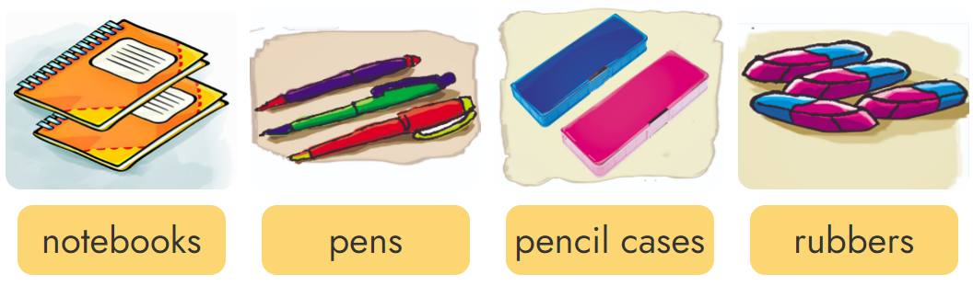
Unit 8
These are my _______.

Slide 16



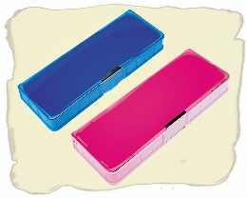
Unit 8
Those are my _______.

Slide 17
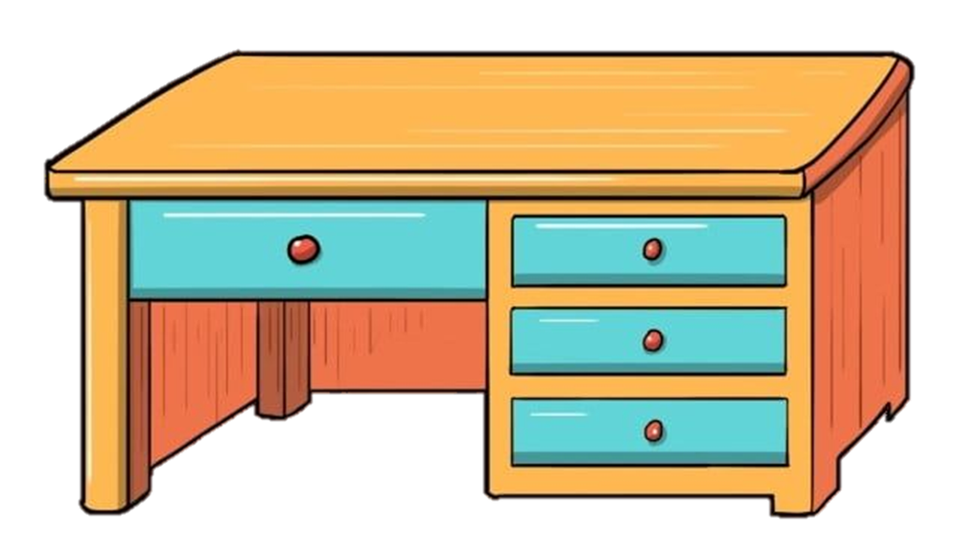

Unit 9
Yes, it is.
Is this/that your ____?
(Đây/kia là _______ của bạn có phải không?)
No, it isn’t.
pencil case
desk
pen
pencil
sharpener

Slide 18


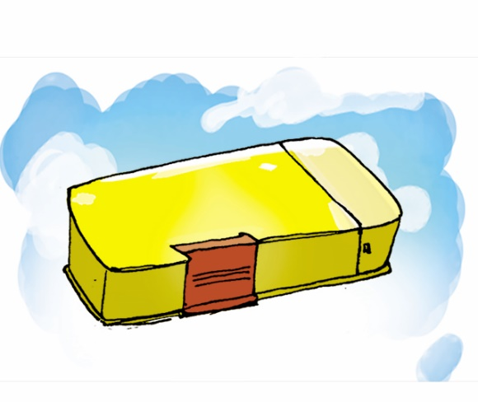
Unit 9
What colour is your ________?
It's ____________.
pencil case, yellow
pen, blue
ruler, white
Ms. Huyền Phạm

Slide 19
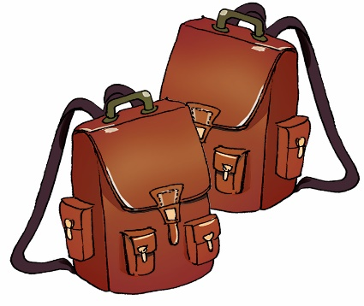
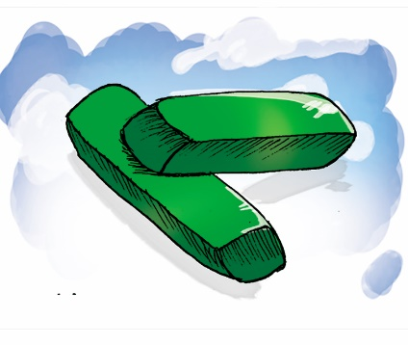

Unit 9
What colour are your ______?
They’re ____________.
school bags, brown
rubbers, green
notebooks, orange

Slide 20

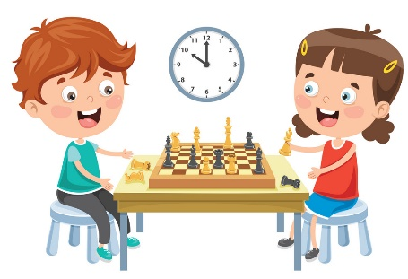
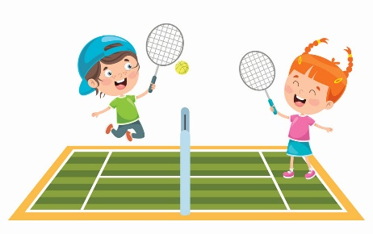
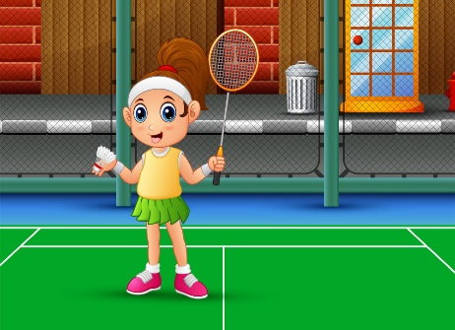
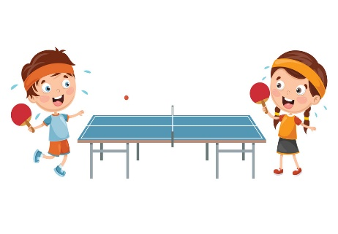

Unit 10
What do you do at break time?
(Bạn làm gì vào giờ ra chơi?)
I play _______.
(Tớ chơi _____.)
basketball
chess
tennis
badminton
table tennis
football

Slide 21
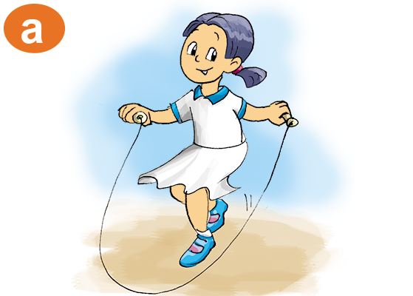
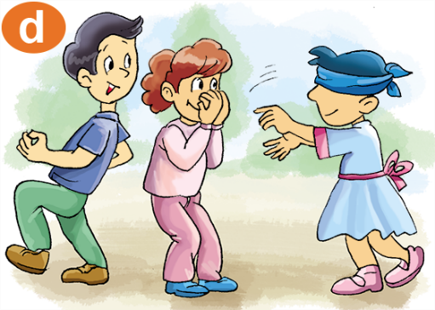
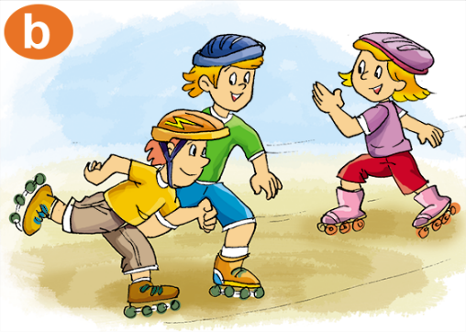
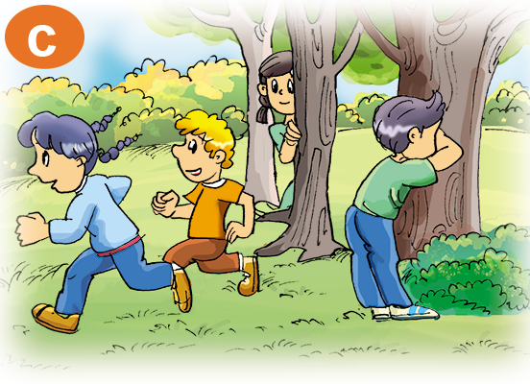
Unit 10
Yes, I do.
Do you like________?
(Bạn có thích ____ không?)
No, I don’t.
skipping
skating
hide-and-seek

Slide 22

THANK YOU!
Welcome to join with me!

