Slide 1
Unit 1
Hello
Lesson 2
Teacher: Ms.

Slide 2


Vocabulary
Goodbye
/ˌɡʊdˈbaɪ/
Bye
Class
/baɪ/
/klɑːs/

Slide 3


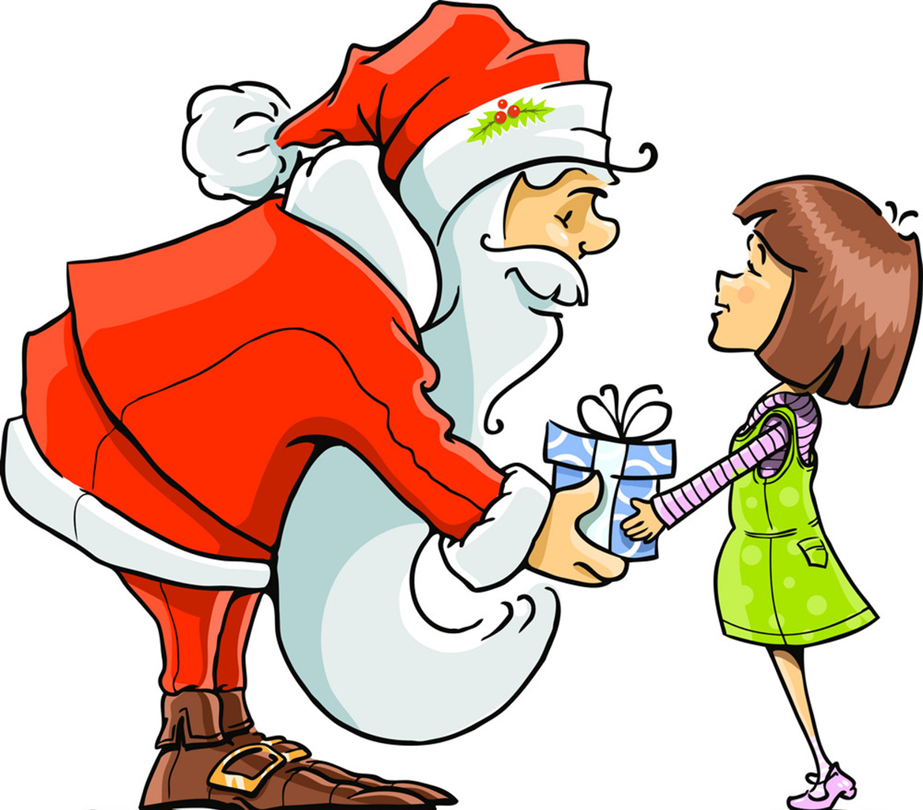
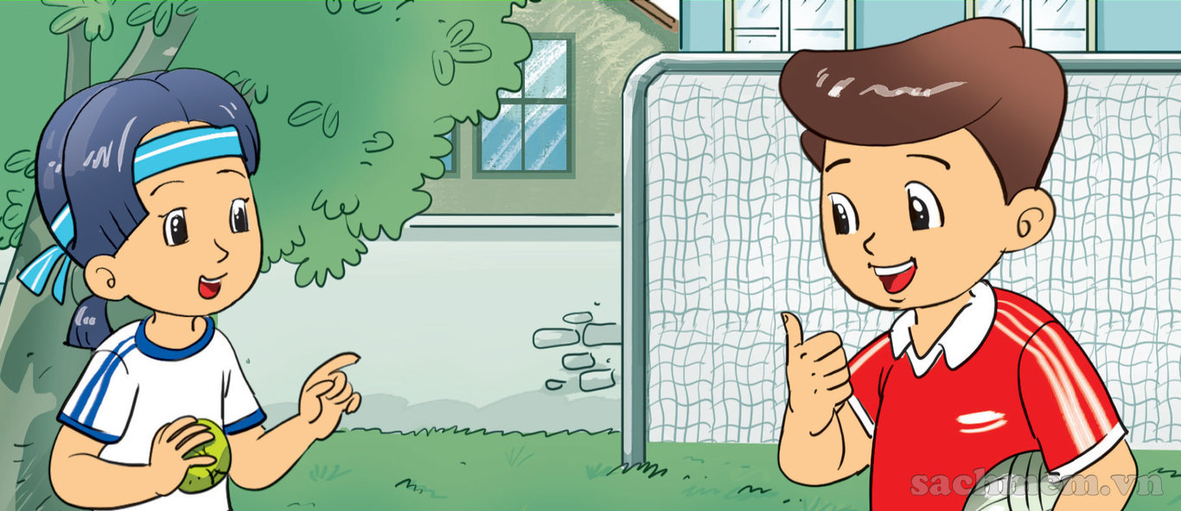


Vocabulary
Thank you
/ θæŋk juː/
Fine
/faɪn/
Thanks
/ θæŋks/
And
How are you?
ænd
/haʊ ɑː juː/

Slide 4
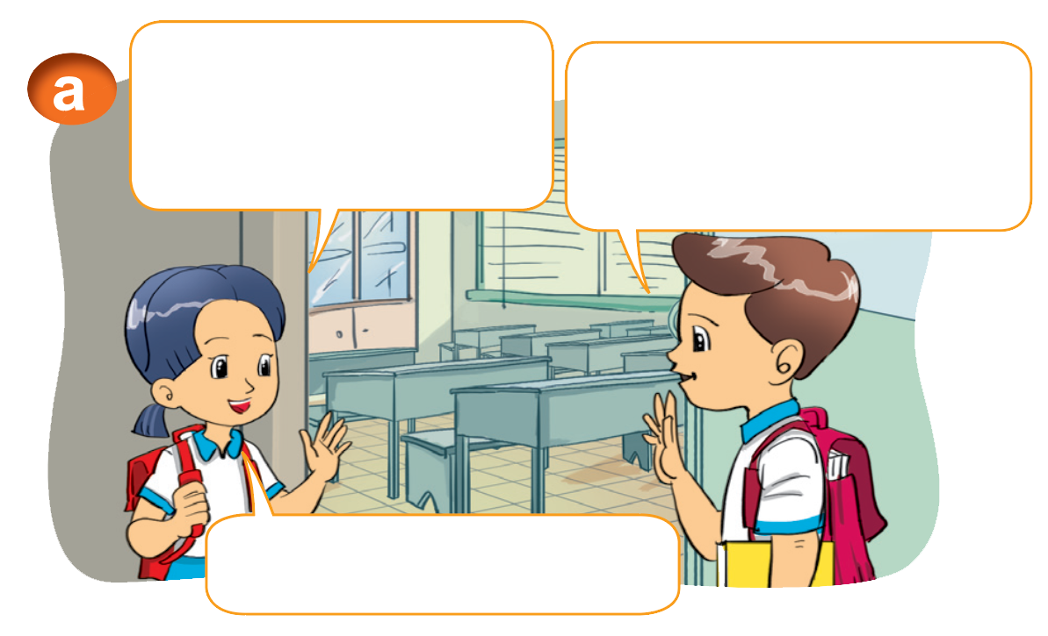

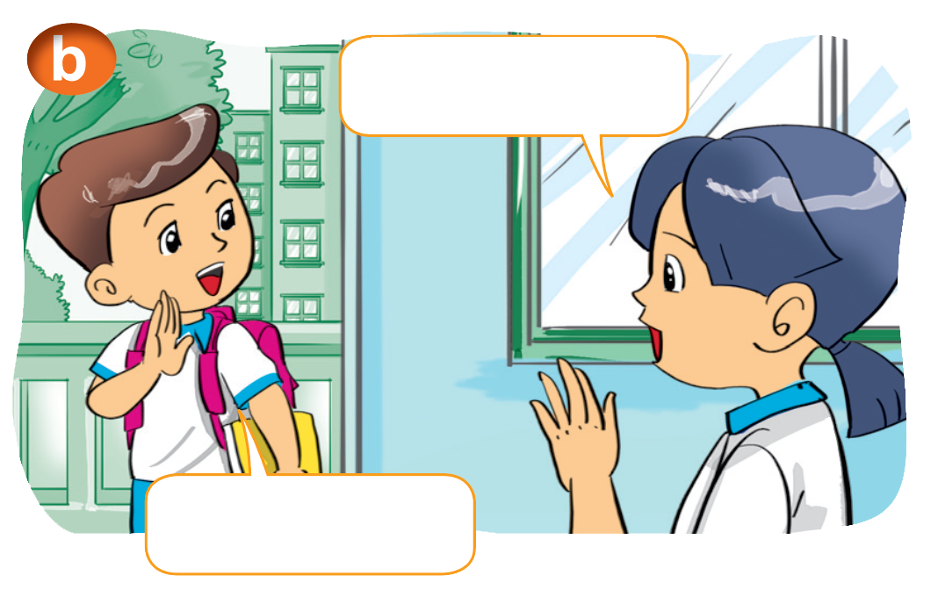
1. Look, listen and repeat
Hi, Nam. How are you?
I'm fine, thanks. And you?
Bye, Nam.
Fine, thank you.
Bye, Mai.

Slide 5



2. Point and say.
Fine, thanks. And you?
How are you, ______.
Nam
Fine, thank you.

Slide 6
Structure
Hỏi tình hình sức khỏe:
How are you? (Bạn có khỏe không?)
I'm fine. Thank you. And you?
(Mình khỏe. Cảm ơn. Còn bạn thì sao?)

Slide 7
Practise

Slide 8
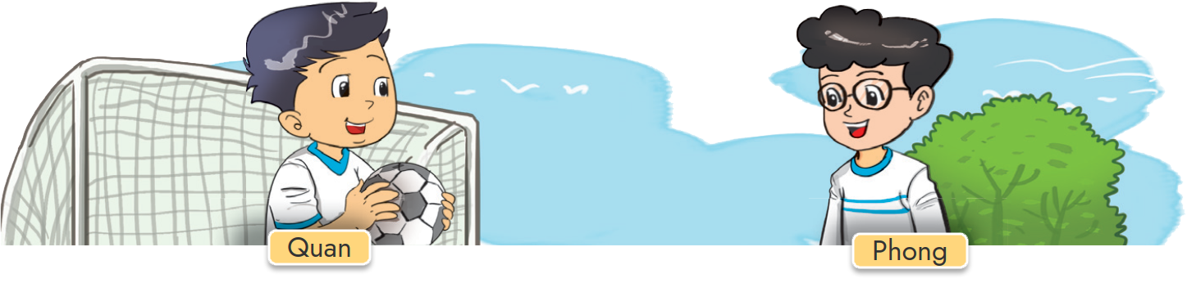
2. Point and say.
Fine, thanks. And you?
How are you, _______.
Phong
Fine, thank you.

Slide 9
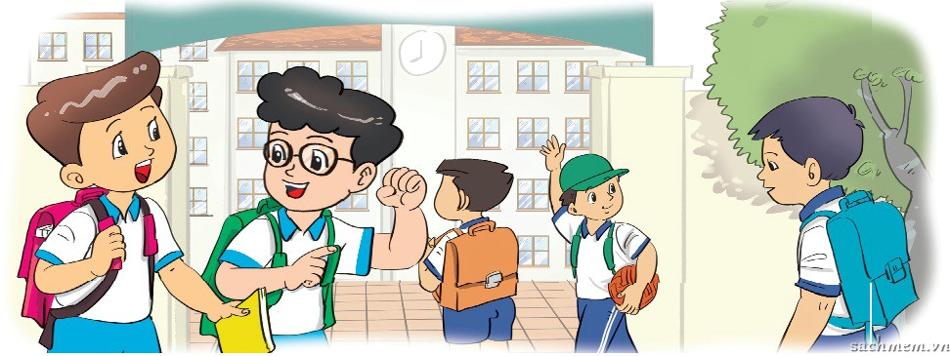
3. Let’s talk.
How are you, Phong?
I'm fine, thank you. And you?
I'm fine, thank you.

Slide 10
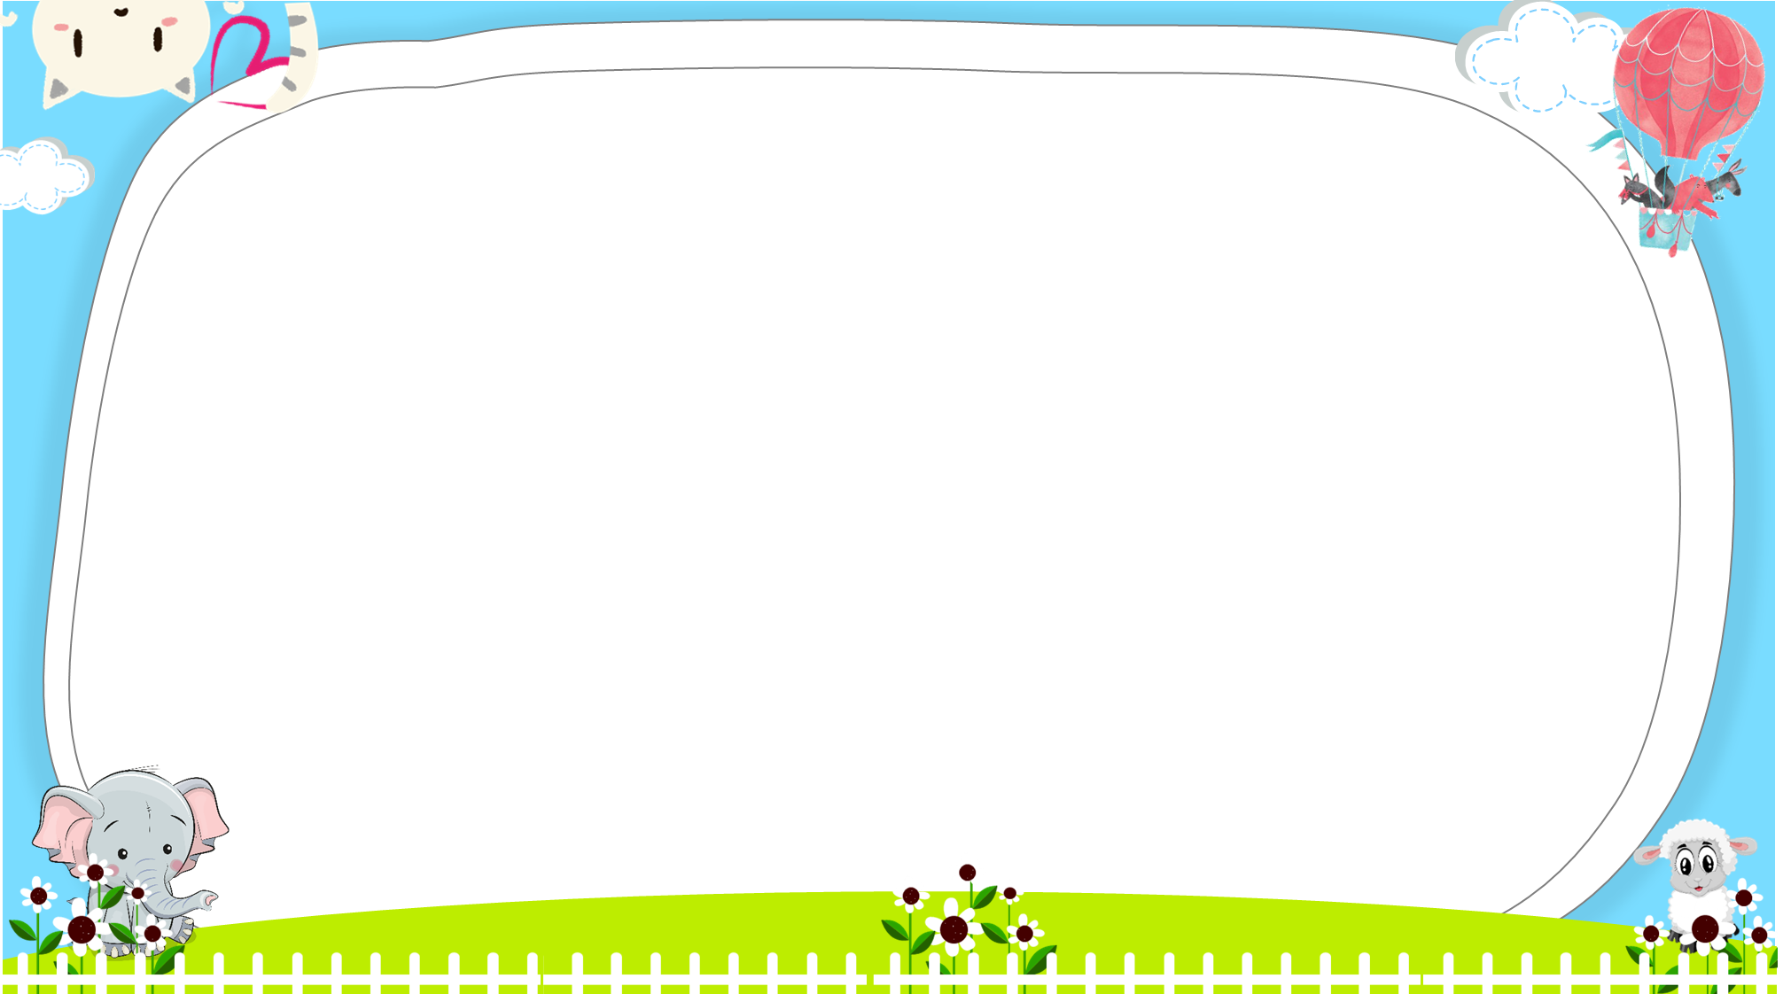





AND
GAME
PLAY
Notes:
Ms Huyền Phạm - 0936.082.789 – YOUTUBE: MsPham. Facebook: Dạy và học cùng công nghệ.

Slide 11



Look and tick
How are
you?
Thank you!
____
Next
Notes:
Ms Huyền Phạm - 0936.082.789 – YOUTUBE: MsPham. Facebook: Dạy và học cùng công nghệ.

Slide 12

Look and tick
Thank you
Goodbye
Next
Notes:
Ms Huyền Phạm - 0936.082.789 – YOUTUBE: MsPham. Facebook: Dạy và học cùng công nghệ.

Slide 13

Look and tick
Fine
Hello
Next
Notes:
Ms Huyền Phạm - 0936.082.789 – YOUTUBE: MsPham. Facebook: Dạy và học cùng công nghệ.

Slide 14


Look and tick
Thanks
And
_____
Next
Notes:
Ms Huyền Phạm - 0936.082.789 – YOUTUBE: MsPham. Facebook: Dạy và học cùng công nghệ.

Slide 15
Look and tick
Class
Bye
Next
Notes:
Ms Huyền Phạm - 0936.082.789 – YOUTUBE: MsPham. Facebook: Dạy và học cùng công nghệ.

Slide 16
Look and tick
five
fine
How are you, Miss Amy?
I'm ______, thank you. And you?
I'm fine, thank you.
Next
Notes:
Ms Huyền Phạm - 0936.082.789 – YOUTUBE: MsPham. Facebook: Dạy và học cùng công nghệ.

Slide 17
Look and tick
How are you
Hello
______________, Phong?
I'm fine, thank you. And you?
I'm fine, thank you.
Next
Notes:
Ms Huyền Phạm - 0936.082.789 – YOUTUBE: MsPham. Facebook: Dạy và học cùng công nghệ.

Slide 18
Look and tick
Nice
I’m
How are you, Quan?
______ fine, thank you. And you?
I'm fine, thank you.
Next
Notes:
Ms Huyền Phạm - 0936.082.789 – YOUTUBE: MsPham. Facebook: Dạy và học cùng công nghệ.

Slide 19
Look and tick
thanks
Hi
How are you, Miss Hien?
I'm fine, _______. And you?
I'm fine, thank you.
Next
Notes:
Ms Huyền Phạm - 0936.082.789 – YOUTUBE: MsPham. Facebook: Dạy và học cùng công nghệ.

Slide 20
Look and tick
And you
And
How are you, Miss Ha?
I'm fine, thank you. _______?
I'm fine, thank you.
Next
Notes:
Ms Huyền Phạm - 0936.082.789 – YOUTUBE: MsPham. Facebook: Dạy và học cùng công nghệ.

Slide 21


Notes:
Ms Huyền Phạm - 0936.082.789 – YOUTUBE: MsPham. Facebook: Dạy và học cùng công nghệ.

Slide 22
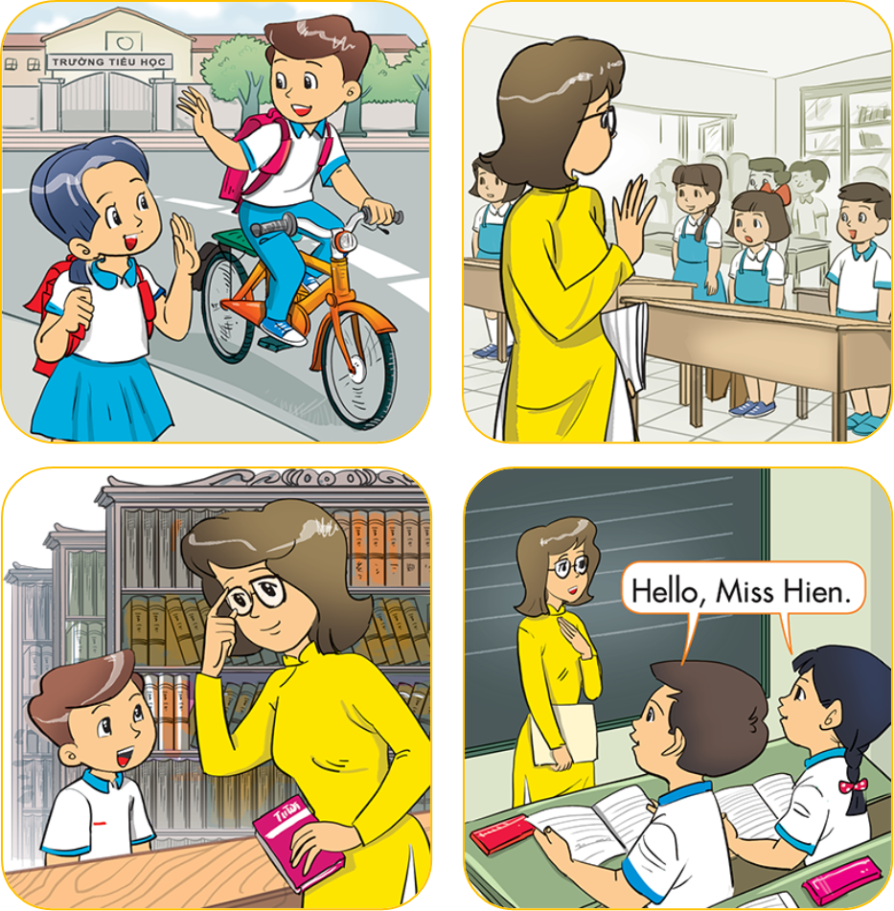
4. Listen and number
1
a
b
2
4
3
3
4
c
d
2
1

Slide 23
5. Read and complete
Miss Hien: Goodbye, class.
Class: (1) __________, Miss Hien.
Mai: Bye, Nam.
Nam: (2) _______________, Mai.
Nam: How are you, Quan?
Quan: (3) ______, thanks. And you?
Nam: Fine, (4) _____________.
1
goodbye
bye
fine
thank you
Goodbye
2
Bye
/ Goodbye
3
Fine
thank you

Slide 24
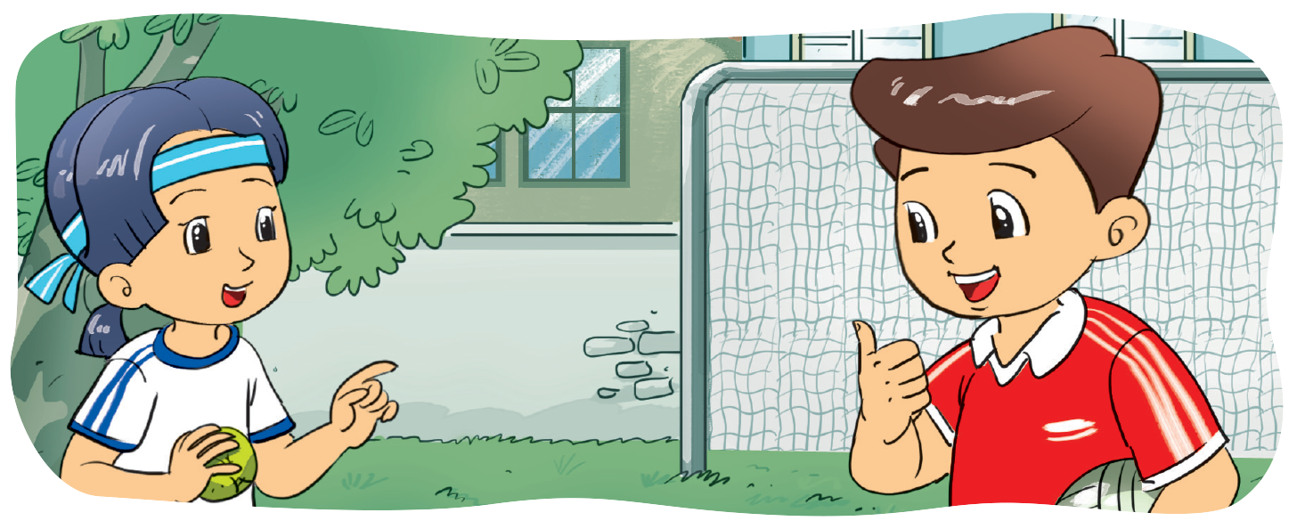
6. Let's write.
_____, ______. And you?
Fine
thanks
_____ are you?
How
Fine, thanks.

Slide 25

THANK YOU!
Welcome to join with me!

