Slide 1

Unit 2
What’s your name?
Lesson 2

Slide 2
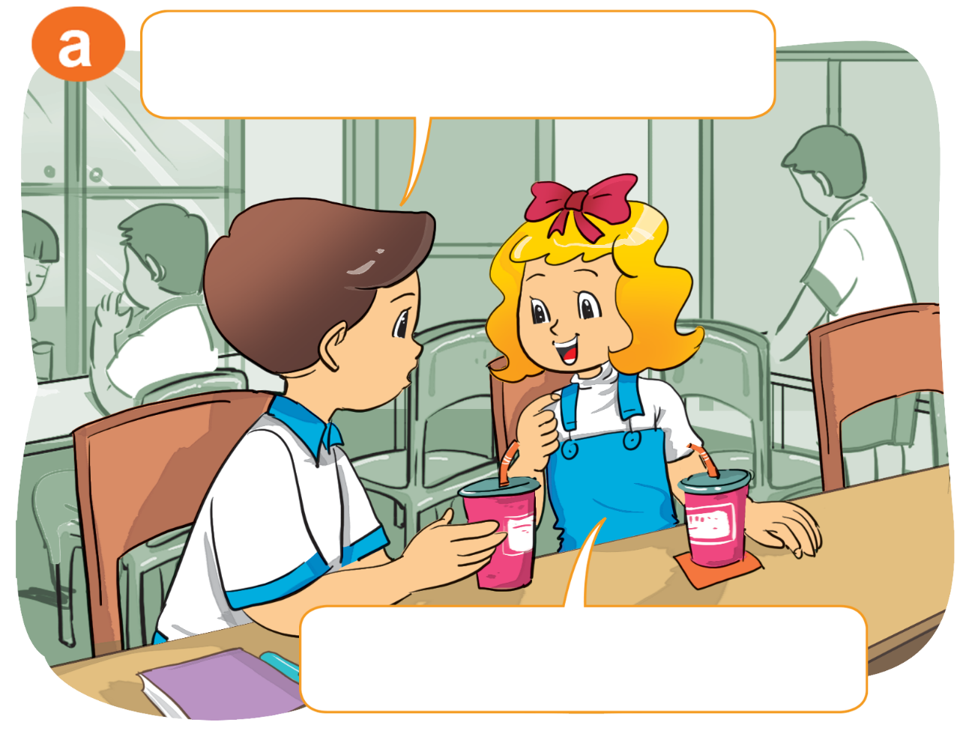
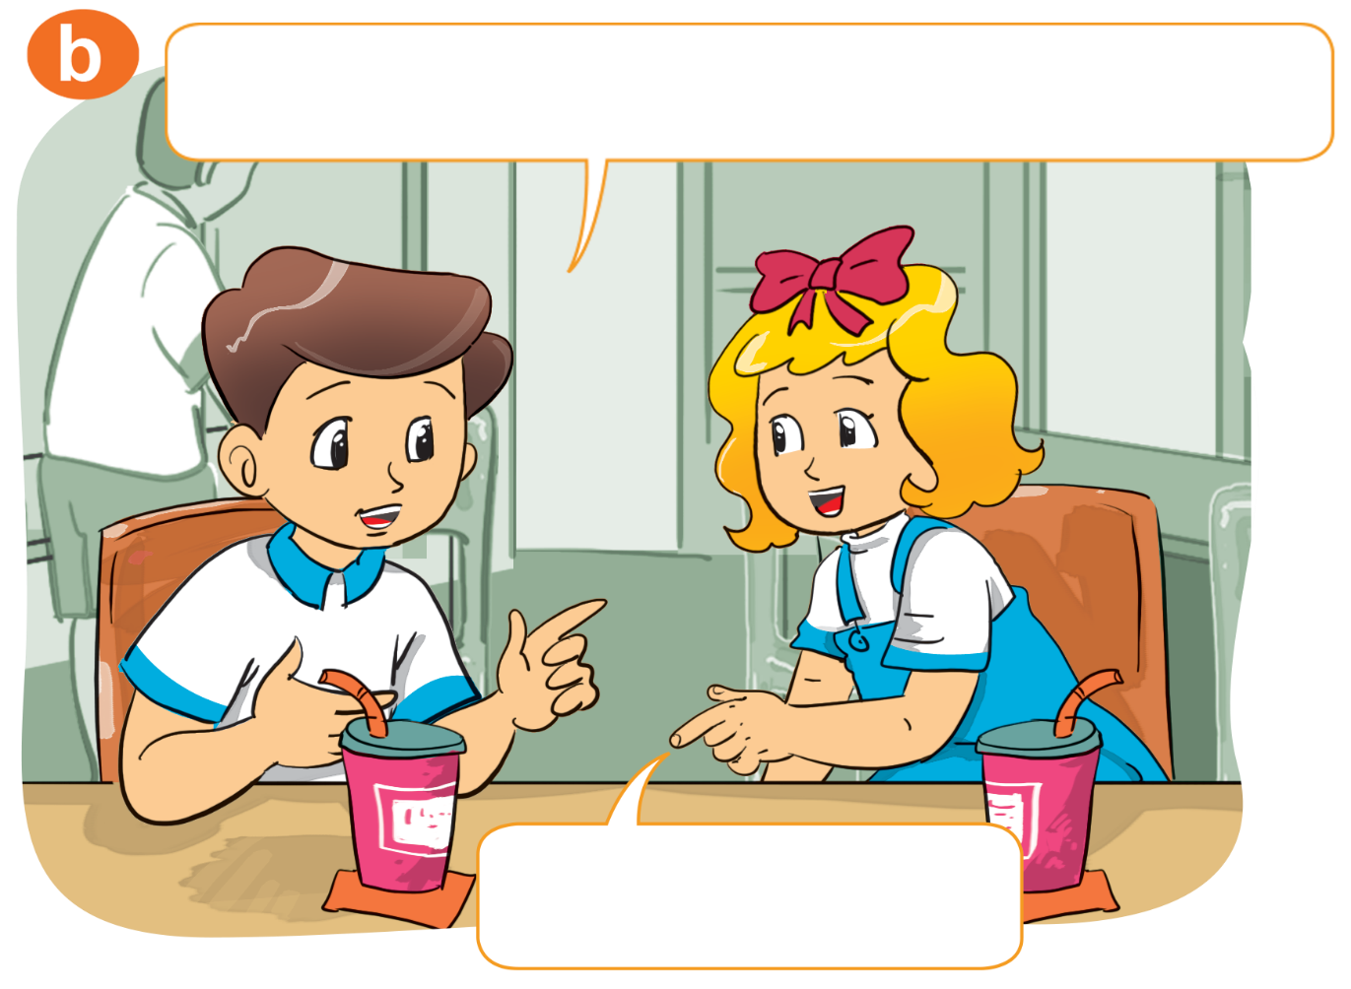

1. Look, listen and repeat
What's your name?
How do you spell your name?
My name's Linda.
L-I-N-D-A.

Slide 3
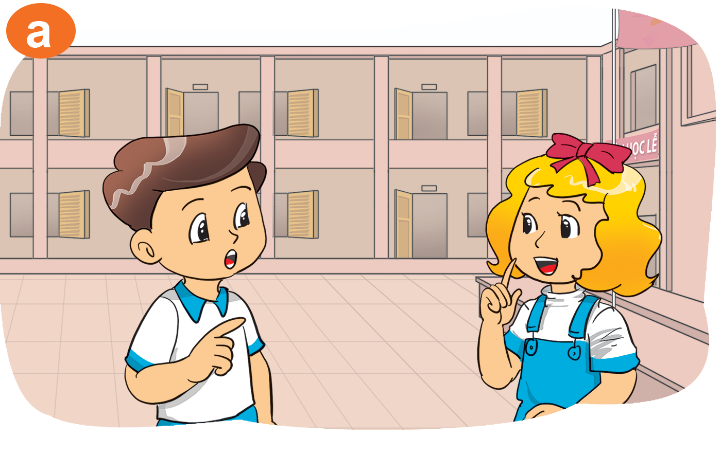


2. Point and say.
How do you spell your name?
____________
L-I-N-D-A

Slide 4
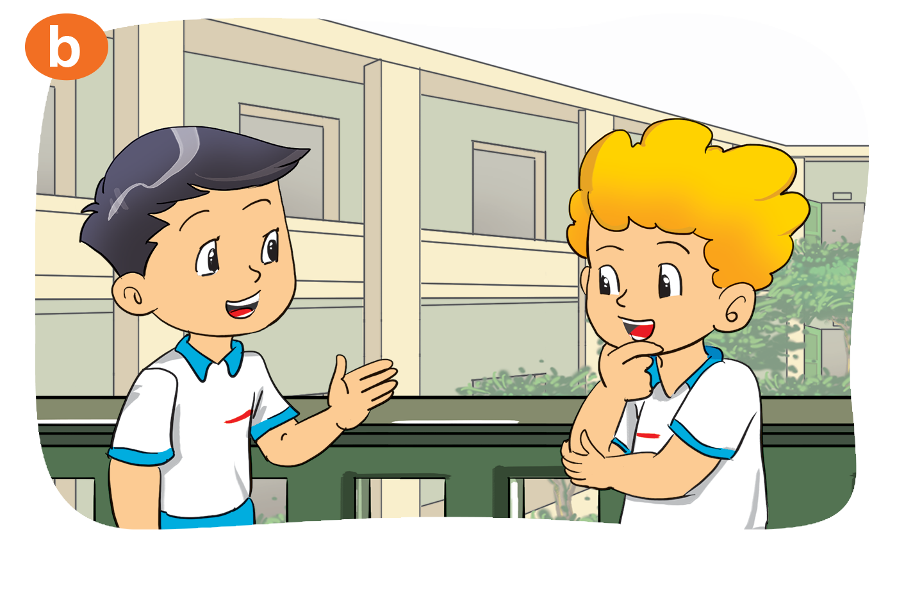
2. Point and say.
____________
P-E-T-E-R
How do you spell your name?

Slide 5
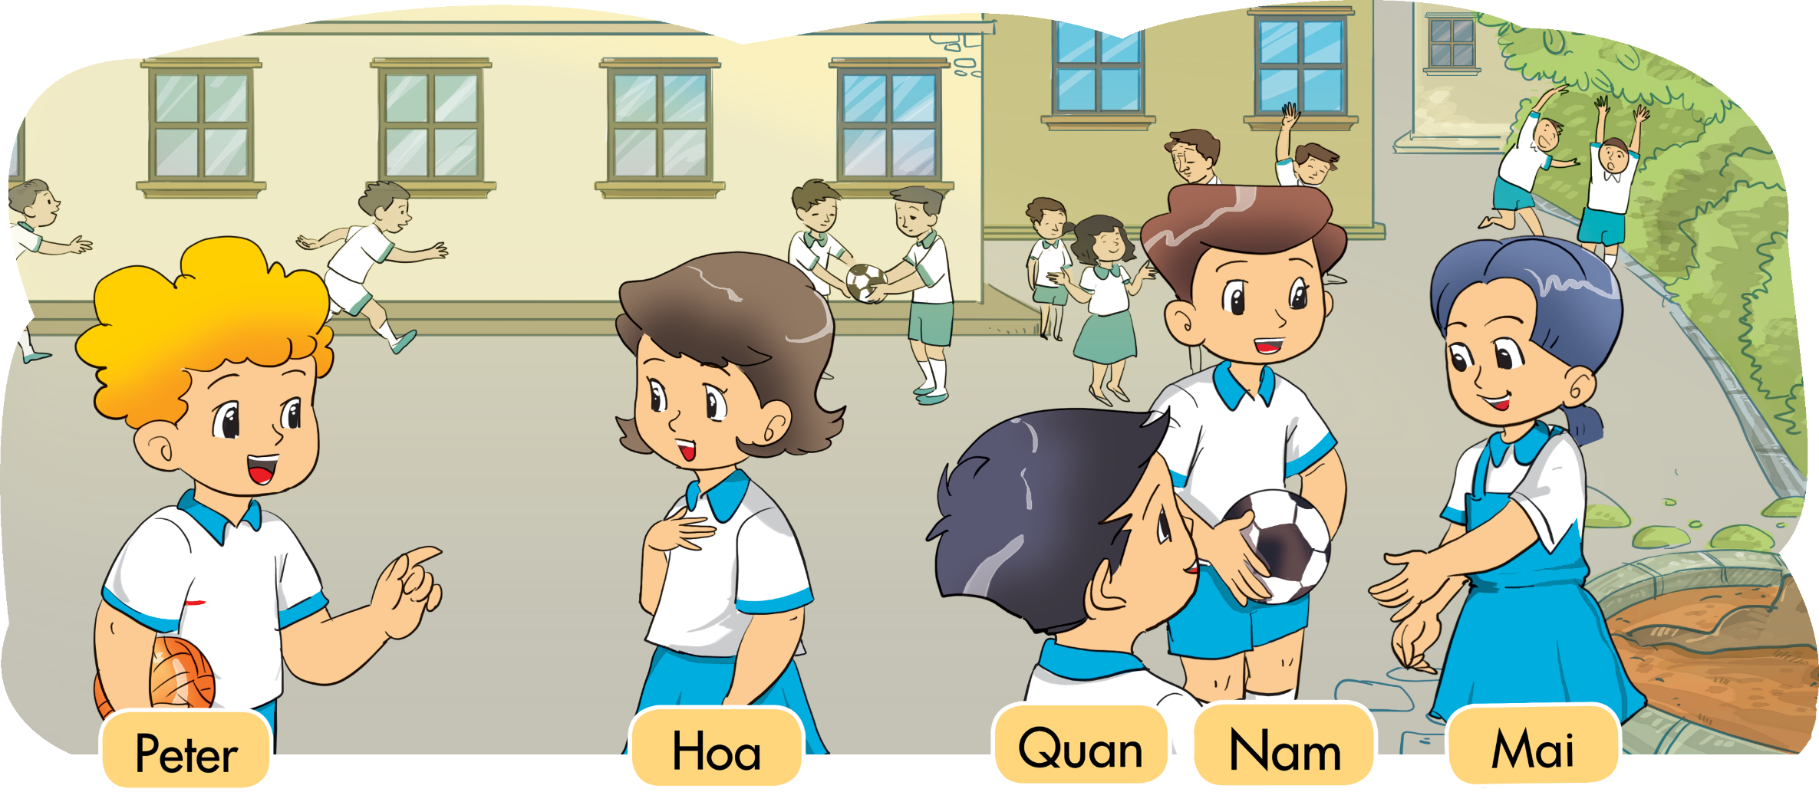
3. Let’s talk
What's your name?
My name's Hoa.
H-O-A.
How do you spell your name?

Slide 6
Structures
Hỏi cách đánh vần tên của ai đó
How do you spell your name?
N-A-M-E.
(Tên bạn đánh vần như thế nào?)
How do you spell his/her name?
N-A-M-E.
(Tên anh ấy/ chị ấy đánh vần thế nào?)

Slide 7
3. Let’s talk
My name's Quan.
What's your name?
Q-U-A-N
How do you spell your name?

Slide 8

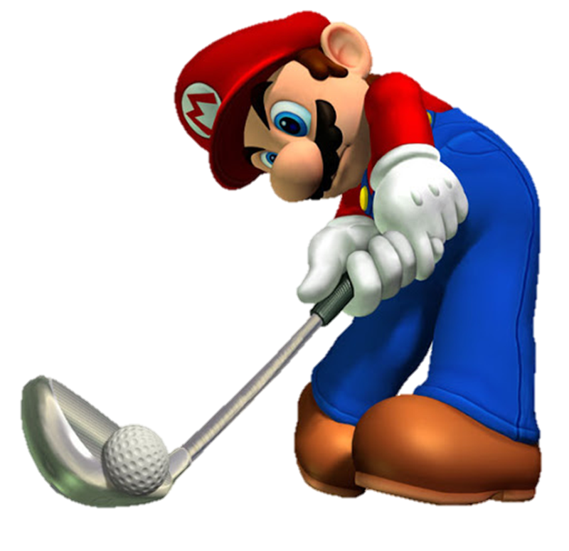
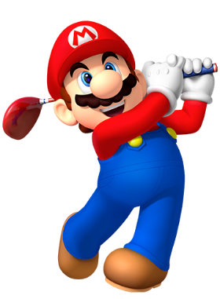




Slide 9



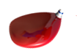


How do you spell your name?
Yes
Q-U-A-N
No

Slide 10
How do you spell your name?
Hello
My name’s Mai.
M-A-I

Slide 11
How do you spell your name?
T-O-M
thanks
Bye

Slide 12
___ do you spell you name?
P-H-O-N-G
What
How
Are

Slide 13
_____ your name?
M-I-K-E
What
How are you
How do you spell

Slide 14
How do you spell _________?
N-I-C-K
your name
name
my

Slide 15
How do you spell _____ name?
N-I-C-K
you
your
I

Slide 16
How do you spell _____ name?
Q-U-A-N
she
he
his

Slide 17
How do you spell _____ name?
A-K-I-K-O
her
his
she

Slide 18



Slide 19
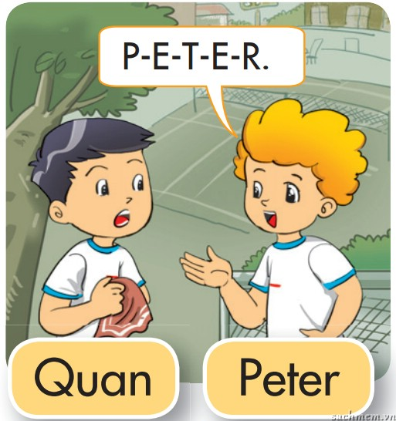
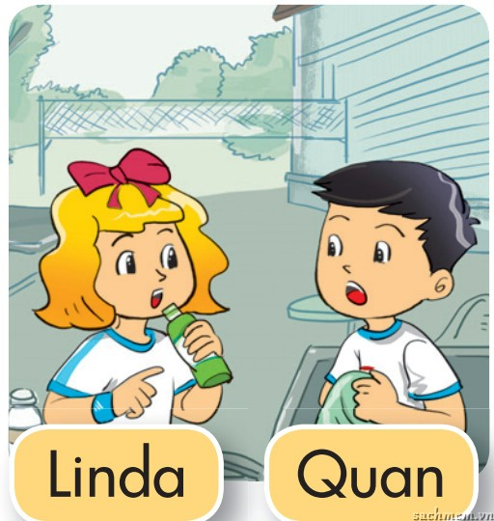
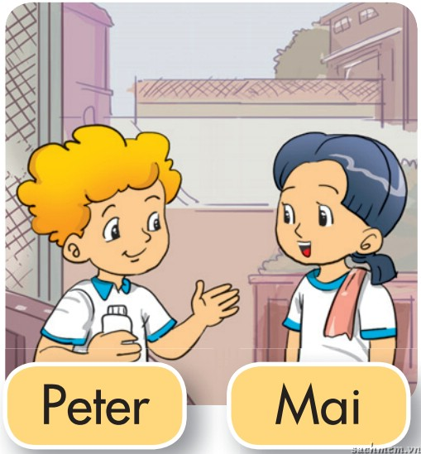
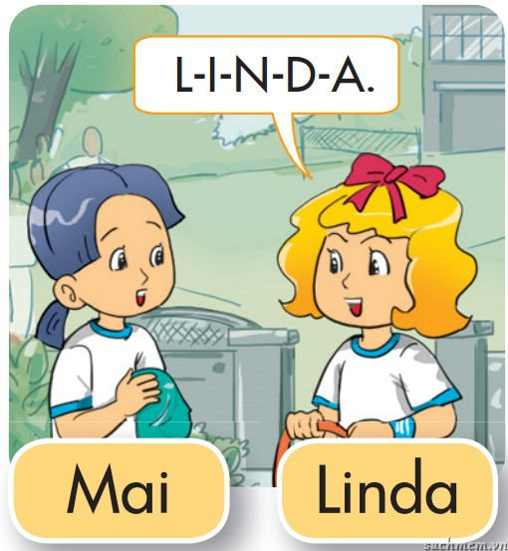
4. Listen and number.
a
4
b
2
c
1
d
3
1
2
3
4

Slide 20
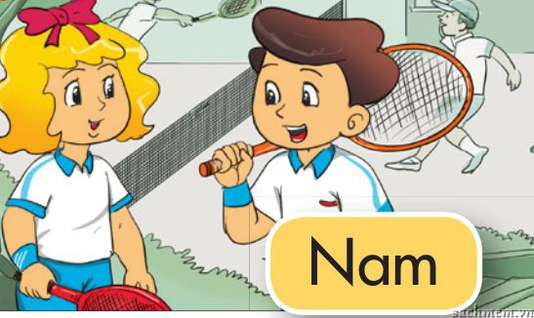
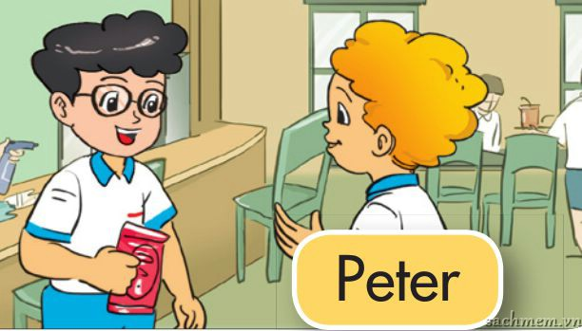
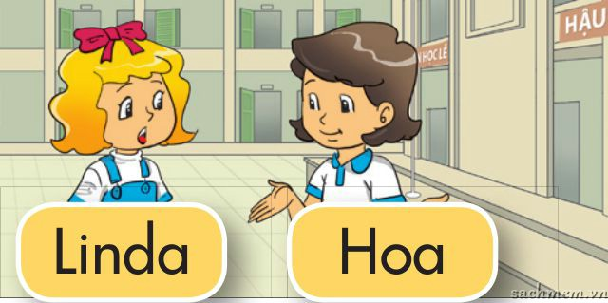
5. Read and match
A: Hi. My name's Linda.
B: Hi, Linda. I'm Hoa.
a
1
A: What's your name?
B: My name's Peter.
2
b
A: How do you spell your name?
B: N-A-M.
3
c

Slide 21
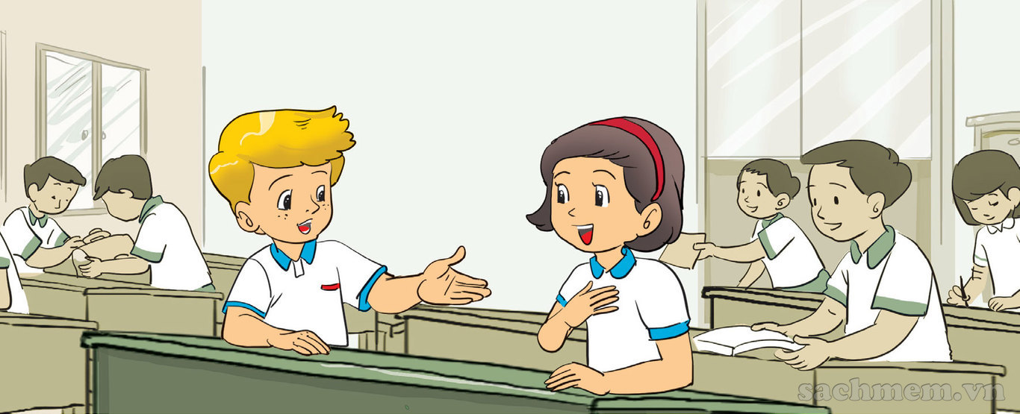

6. Let's write
What’s your name?
My name’s _______
How’s do you spell
your name?
____________

Slide 22

THANK YOU!
Welcome to join with me!

