Slide 1

Unit 2
What’s your name?
Lesson 3

Slide 2




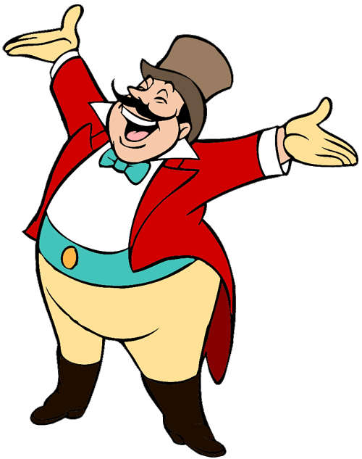
Ms Huyền Phạm
0936.082.789
START

Slide 3



My name’s _______
H-O-A
Hoa
teacher

Slide 4
How do you ________?
Spell your name
Your name
name?
Next

Slide 5
What's_____?
He name
She name
Your name

Slide 6
What's your name?
T-H-A-N-H
My name’s Miss Thanh.
Thank you.

Slide 7
How do you spell Linda?
L-I-N-D-A
I’m Linda.
Bye. Linda
Next

Slide 8
Hello.
My name is Peter.
P-E-T-E-R
I’m fine. Thank.
Hi, Peter. I’m Nam

Slide 9




Ms Huyền Phạm
0936.082.789

Slide 10

1. Listen and repeat
m | Mai | My name's Mai.
p | Peter | Hello, Peter.

Slide 11
2. Listen and write.
1. Hello,_________.
2. My name's _________.
Peter
Mai

Slide 12
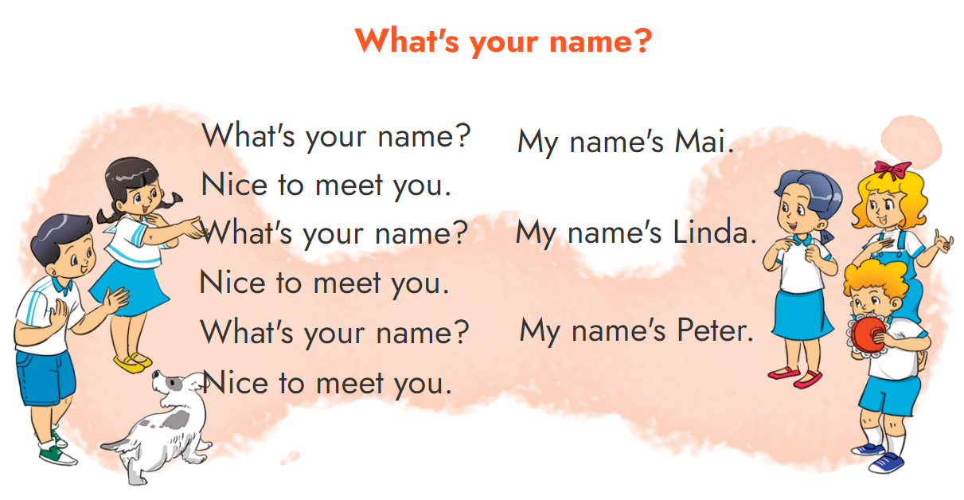
3. Let's chant.

Slide 13
4. Read and match
My name's Quan.
Nice to meet you.
a
c
P-E-T-E-R
b
d
My name's Linda.
Hi, Mai. I’m Peter.
1
Hello. I'm Mai.
b
Hi, Mai. I’m Peter.
2
What's your name?
d
My name's Linda.
What's your name?
Nice to meet you.
My name's Quan.
Nice to meet you.
3
a
How do you spell
your name?
4
c
P-E-T-E-R

Slide 14
5. Read and complete.
Peter: Hello. (1) ______ name's Peter.
Quan: (2) ______, Peter. My name's Quan.
Peter: Nice to meet you, Quan. (3) ______ do you
spell your name?
Quan: Q-U-A-N.
Linda: (4) ______ your name?
Phong: My (5) ______ Phong. And your name?
Linda: Linda. L-I-N-D-A.
1
My
Hi
How
2
What's
name's

Slide 15
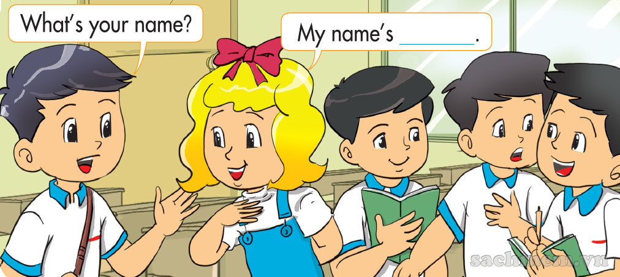
6. Project
Work in groups. Interview your classmates.

Slide 16

THANK YOU!
Welcome to join with me!

