Slide 1
Unit 3 – lesson 1
THIS IS TONY
Teacher:

Slide 2
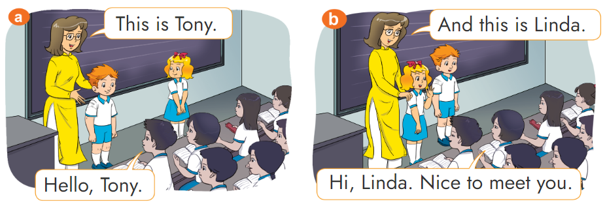

1. Look, listen and repeat

Slide 3

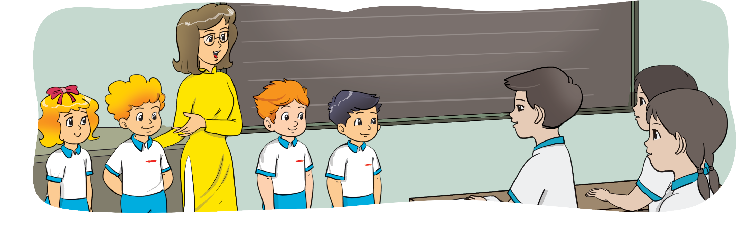

2. Look, listen and repeat
Hello,_________.
Nice to meet you.
Linda
This is _________.
Linda
Linda
Peter
Tony
Quan

Slide 4
2. Look, listen and repeat
Hello,_________.
Nice to meet you.
Peter
This is _________.
Peter
Linda
Peter
Tony
Quan

Slide 5
2. Look, listen and repeat
Hello,_________.
Nice to meet you.
Tony
This is _________.
Tony
Linda
Peter
Tony
Quan

Slide 6
2. Look, listen and repeat
Hello,_________.
Nice to meet you.
Quan
This is _________.
Quan
Linda
Peter
Tony
Quan

Slide 7
Structures
1. Giới thiệu MỘT NGƯỜI ở gần
This is + name.
(Đây là ….)

Slide 8
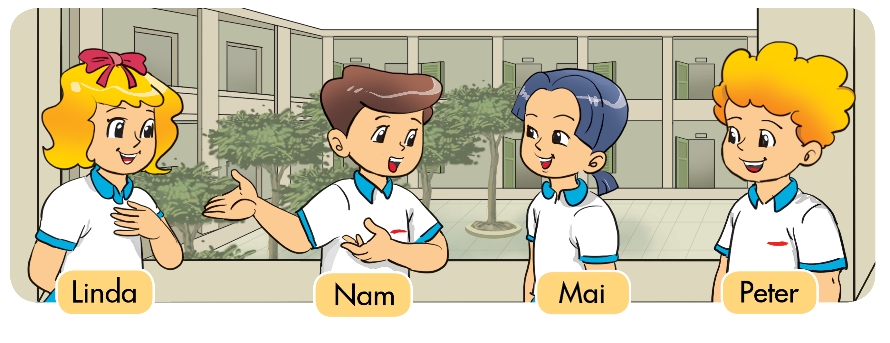

3. Let's talk.
Hello, Linda.
Nice to meet you.
This is _________.
Linda

Slide 9

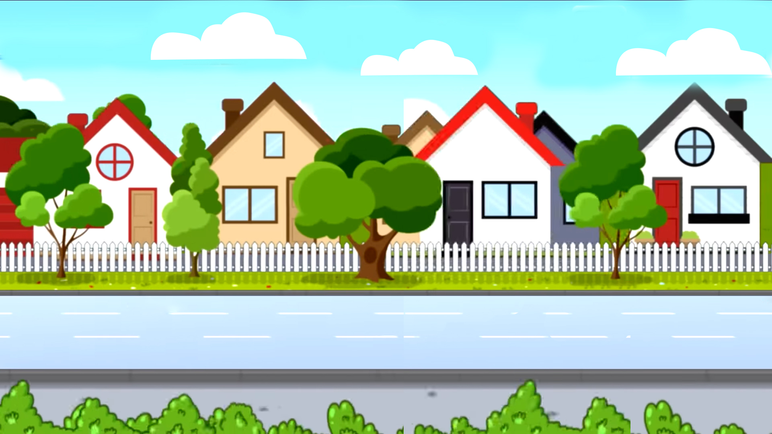

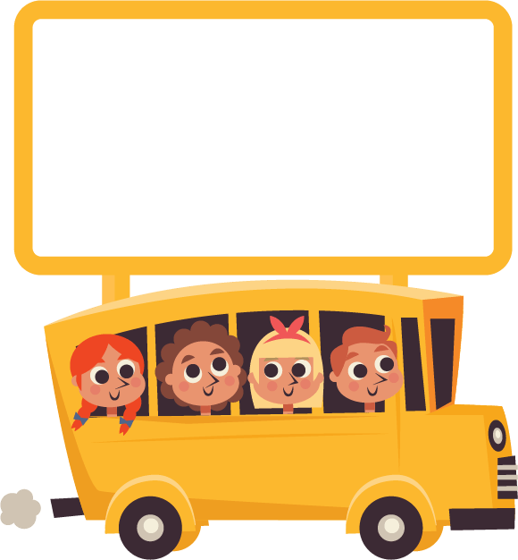




Play

Slide 10
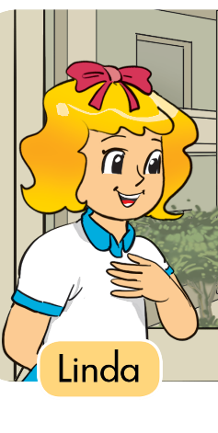

This is Linda.
Check
Next

Slide 11

This is Nam.
Check
Next

Slide 12

This is Mai.
Check
Next

Slide 13

This is Peter.
Check
Next

Slide 14
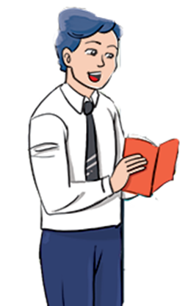
Mr.Loc
This is Mr.Loc.
Check
Next

Slide 15
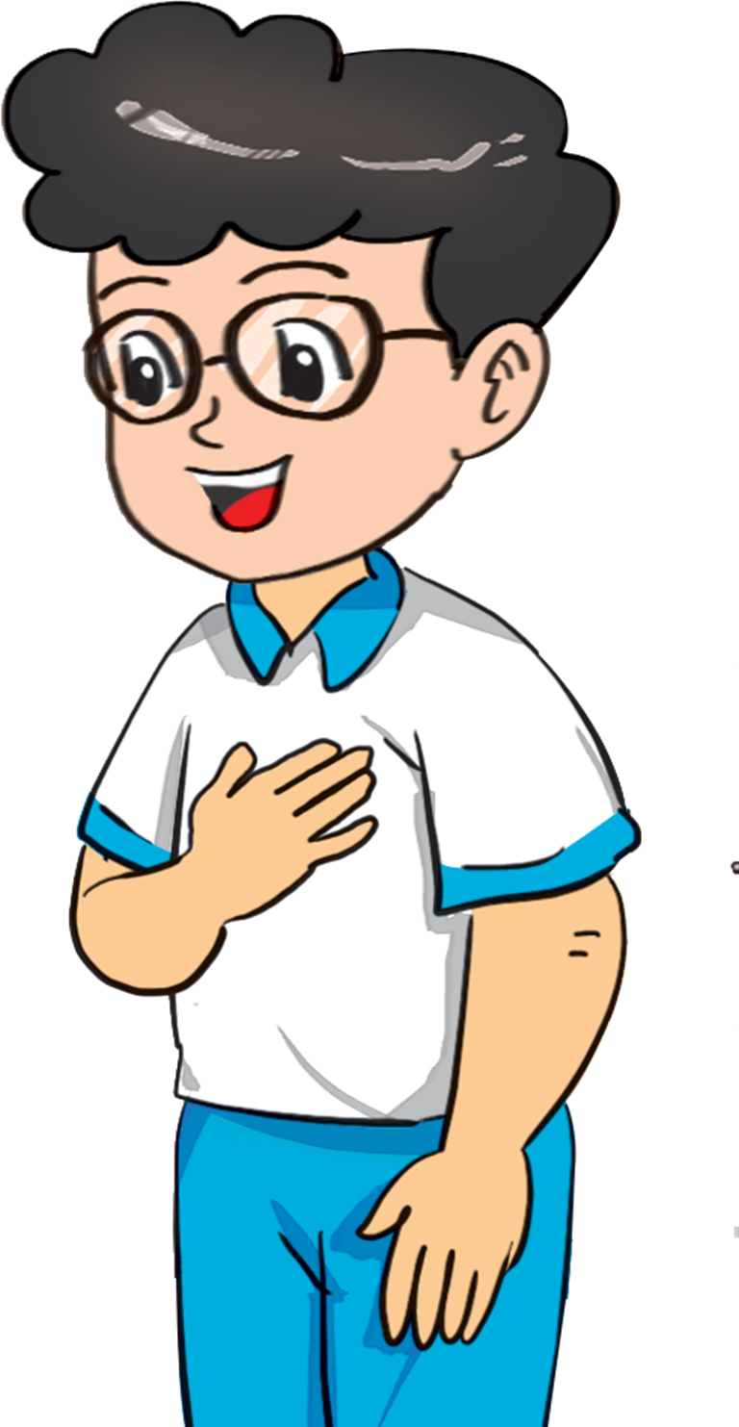
Phong
This is Phong.
Check
Next

Slide 16
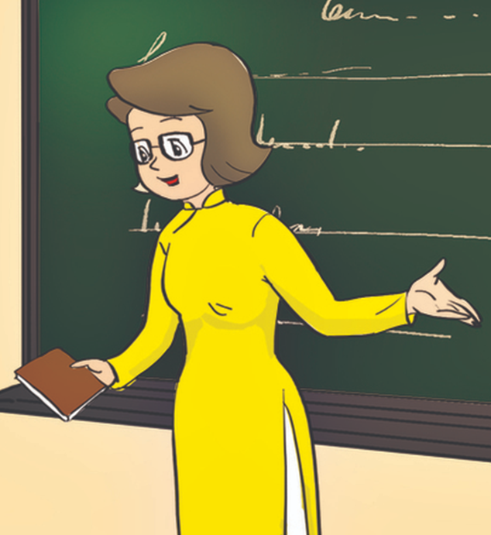
Miss Hien
This is Miss Hien.
Check
Next

Slide 17
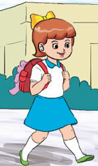
Mary
This is Mary.
Check
Next

Slide 18


End

Slide 19
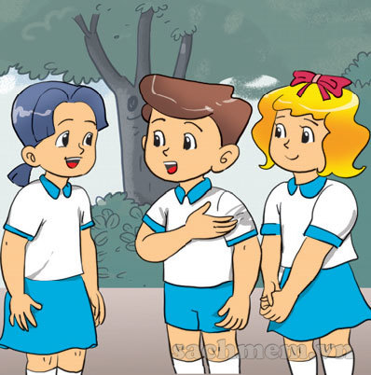
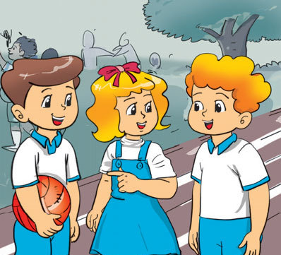

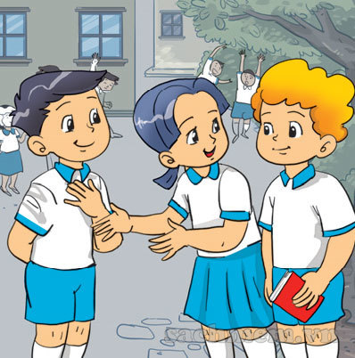
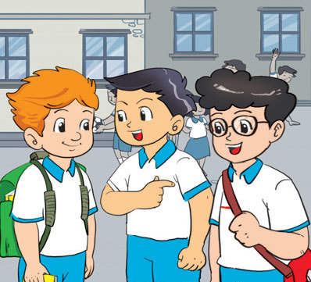
4. Listen and tick
1
a
b
2
a
b

Slide 20
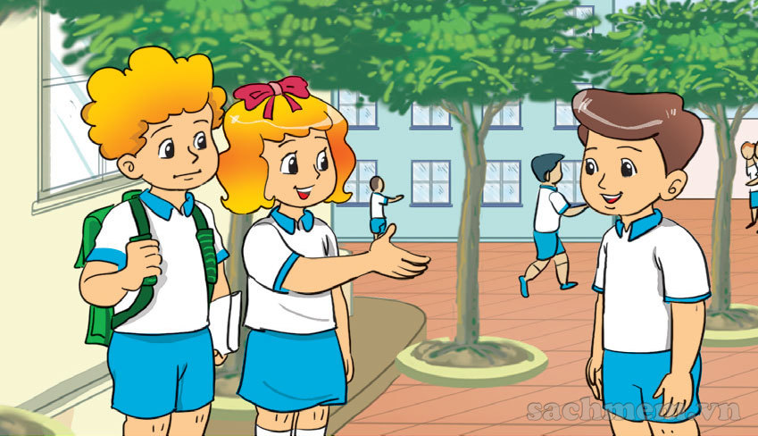
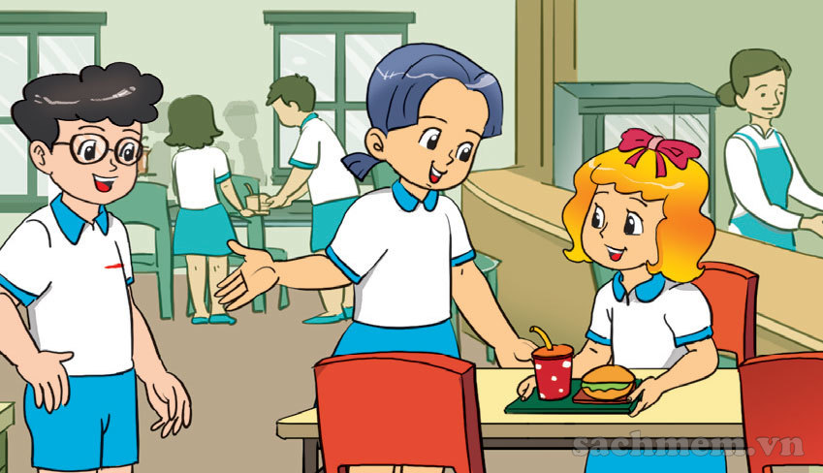
5. Read and write.
Linda: __________ Nam.
Peter: _____, _____.
Nice to meet you.
This is
Hello
Nam
1
Mai: __________ Phong.
Linda: ______, ________.
Nice to meet you.
This is
Hello
Phong
2

Slide 21
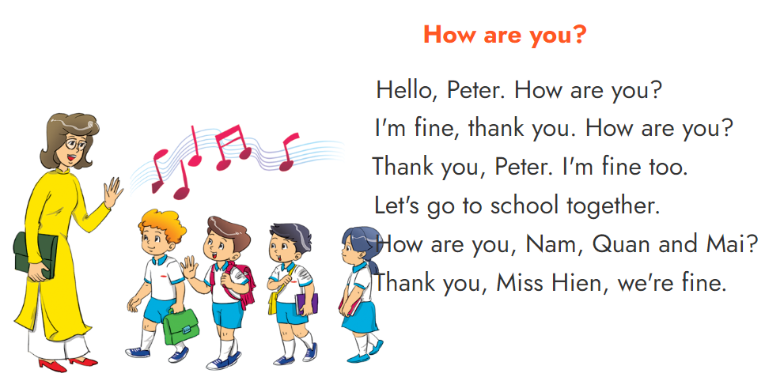
6. Let's sing

Slide 22

THANK YOU!
Welcome to join with me!

