Slide 1
Unit 3 – lesson 3
THIS IS TONY
Teacher:

Slide 2


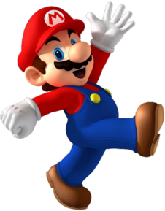


PLAY
Notes:
Ms Huyền Phạm - 0936.082.789 – YOUTUBE: MsPham. Facebook: Dạy và học cùng công nghệ.

Slide 3

Ms Huyền Phạm
0936.082.789
Notes:
Ms Huyền Phạm - 0936.082.789 – YOUTUBE: MsPham. Facebook: Dạy và học cùng công nghệ.

Slide 4

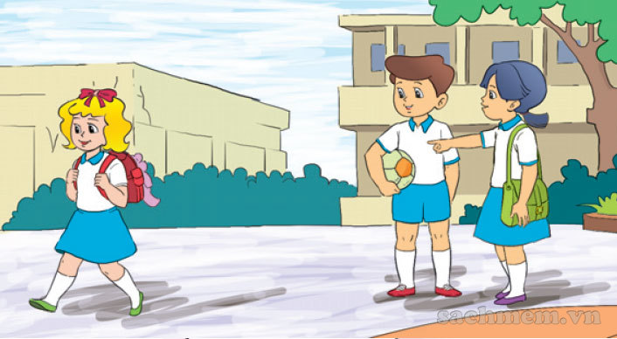

B. Is that
A. Is this
C. That is
_____ Linda?
Yes, it is.

Slide 5
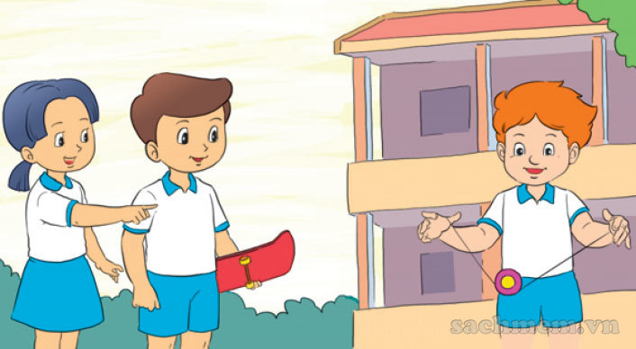
B. are
A. This
C. Is
__ that Peter?
No, it isn’t.

Slide 6
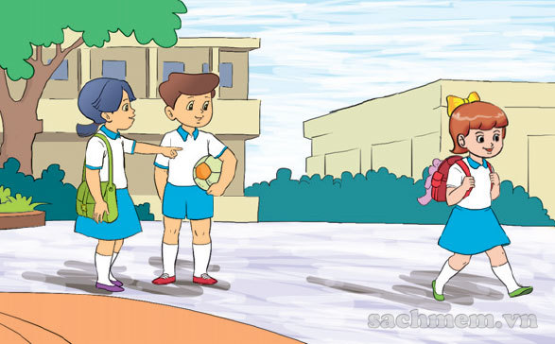
B. are
A. Is
C. Is this
__ that Mary?
Yes, it is.

Slide 7
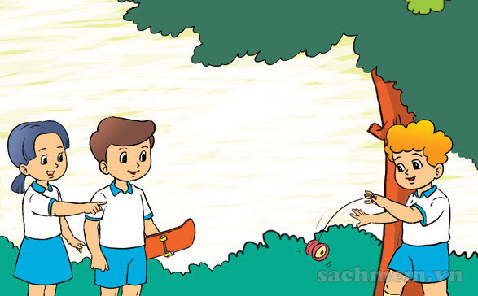
B. That is
Is that
C. Is this
_____ Peter?
Yes, it is.

Slide 8
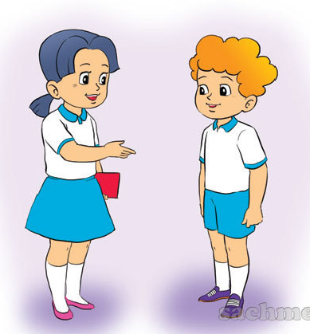
B. This is
A. Is that
C. Is this
_____ Peter.

Slide 9
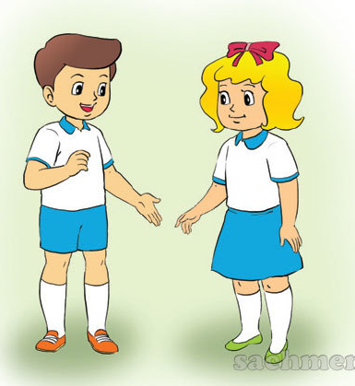
B. This is
A. Is this
C. That is
_____ Linda.

Slide 10
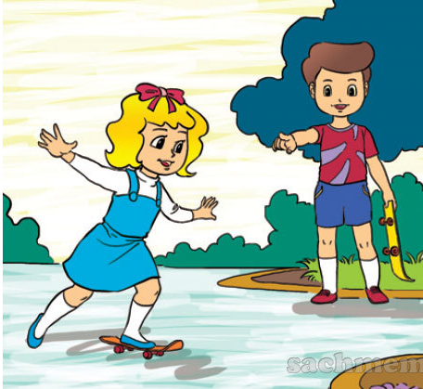
B. L-I-N-D-A
A. No, it isn’t.
C. Yes, it is.
Is that Linda?

Slide 11
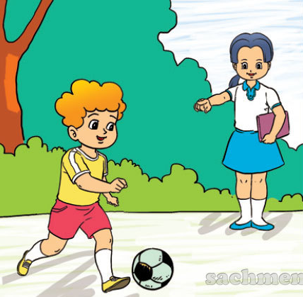
B. His name’s Peter.
A. Yes, it is.
C. No, it isn’t.
Is that Tom?

Slide 12
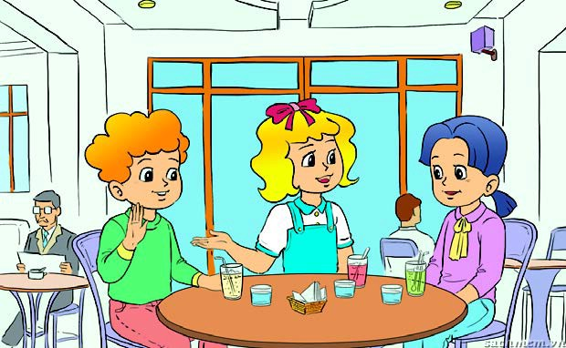
B. That is
This is
C. Is that
Linda: Mai, ____ Peter.
Mai: Hello, Peter. Nice to meet you.
Peter: Hi, Mai. Nice to meet
you too.

Slide 13



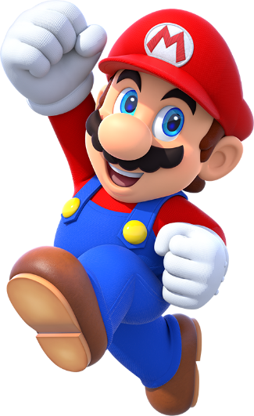
EXIT
Notes:
Ms Huyền Phạm - 0936.082.789 – YOUTUBE: MsPham. Facebook: Dạy và học cùng công nghệ.

Slide 14

1. Listen and repeat
t | Tony | Is that Tony?
y | yes | Yes, it is.

Slide 15
2. Listen and write
1. That is ________.
2. ______, it is.
Tony
Yes

Slide 16
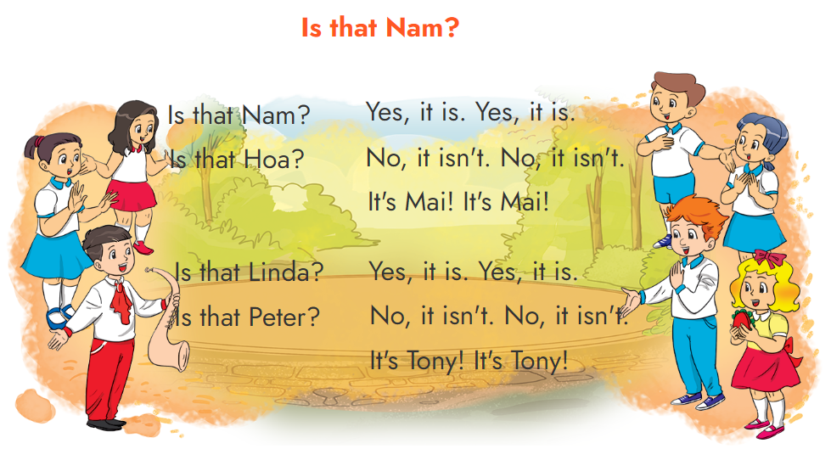
3. Let’s chant

Slide 17
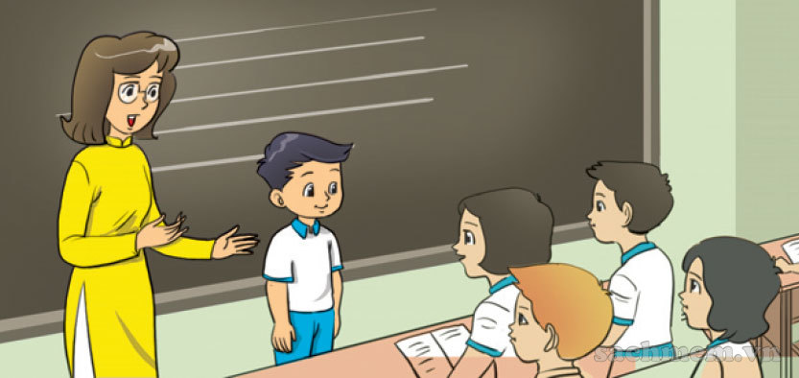
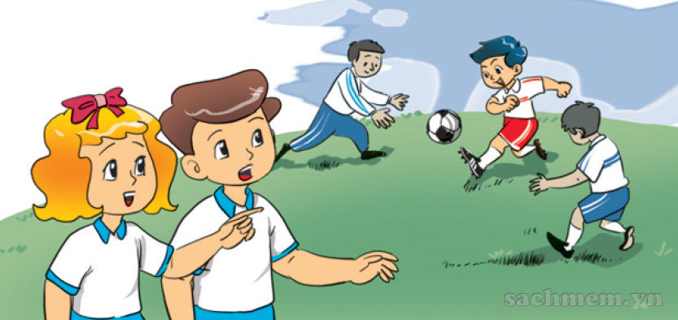
4. Read and complete
isn't
that
Hello
This
Miss Hien: (1) ______ is Quan.
Class: (2) _____, Quan.
This
Hello
Linda: Is (3) ______ Phong?
Nam: No, it (4) ______.
It's Quan.
that
isn't

Slide 18
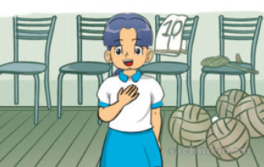
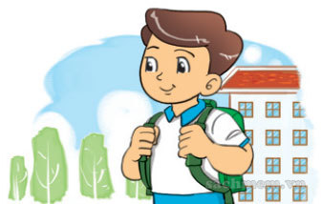
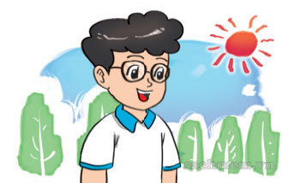
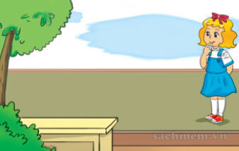
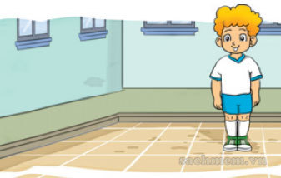
5. Look, read and write.
Mai
Nam
1. Hi! I'm ________.
2. This is ________.
3. And this is _______.
Phong
4. That's ________.
5. And that's ________.
Linda
Peter

Slide 19
6. Project
Draw your best friend

Slide 20

THANK YOU!
Welcome to join with me!

