Slide 1







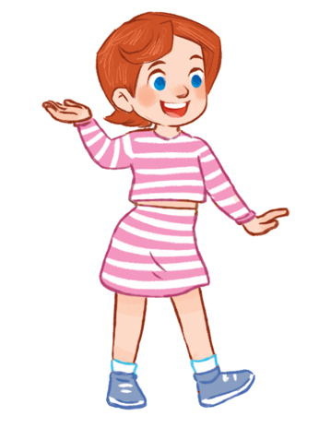

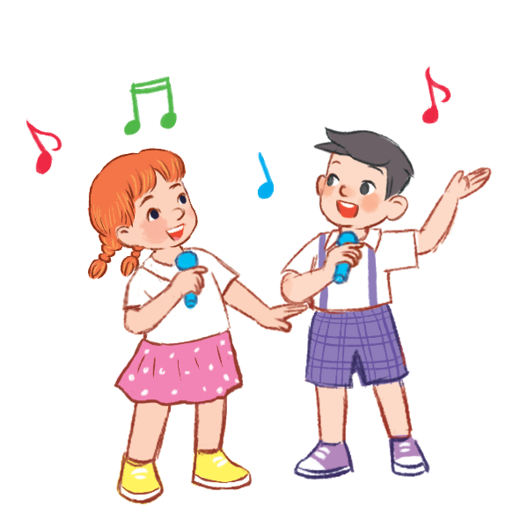
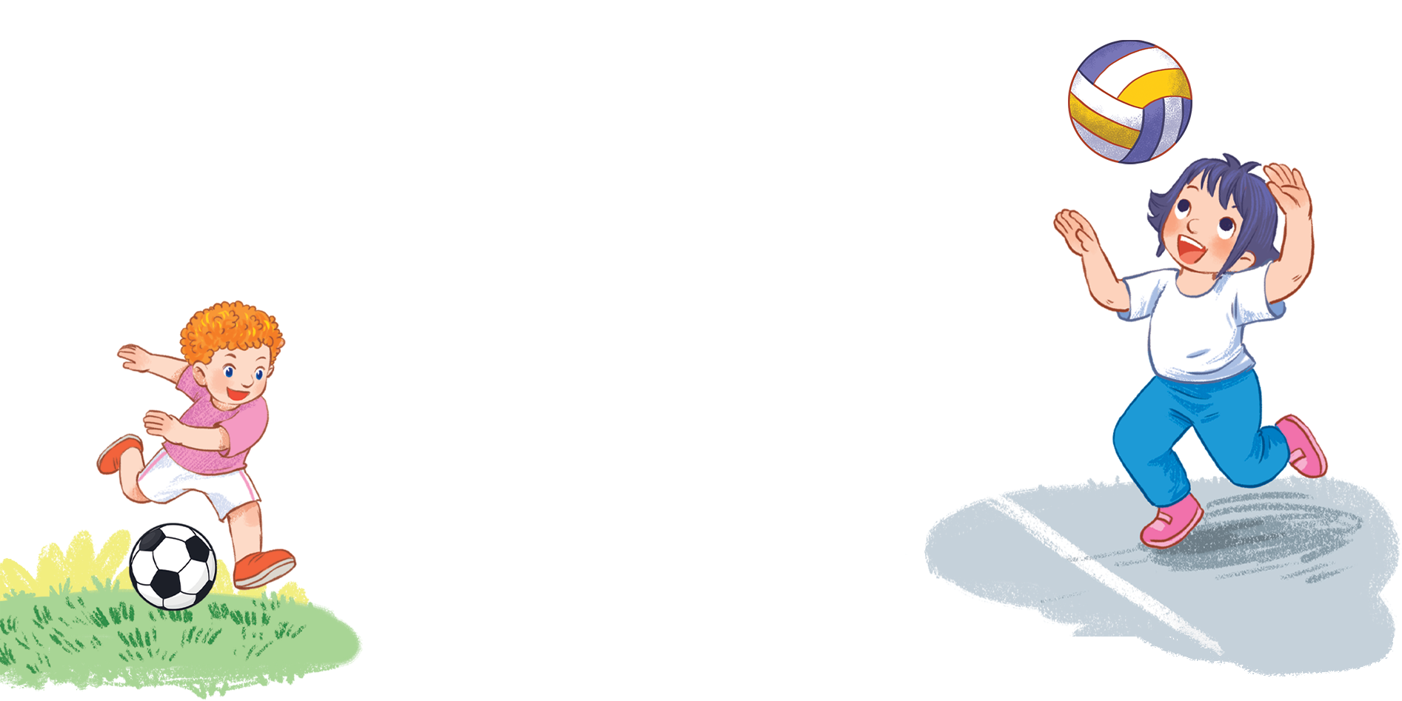



MsPham
0936082789
Unit 5
Things
we can do
Lesson 1 – Period 2

Slide 2



Warm-up
MsPham
0936082789

Slide 3








MsPham
0936082789

Slide 4
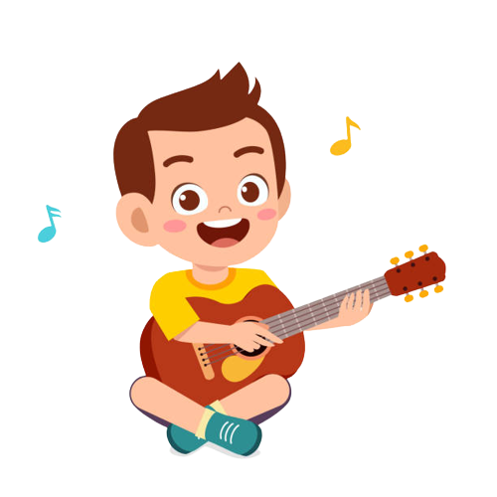

Make a question:
__________________________?
Yes, I can.
Can you play the guitar
MsPham
0936082789
5
check
Next

Slide 5
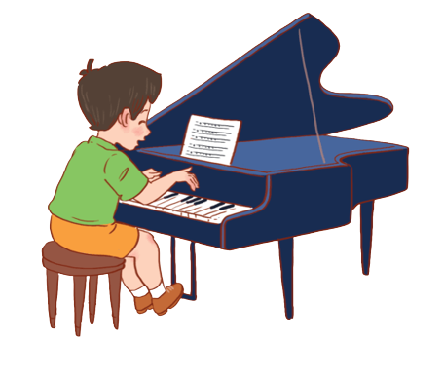

Make a question:
__________________________?
No, I can’t.
Can you play the piano
MsPham
0936082789
2
check
Next

Slide 6
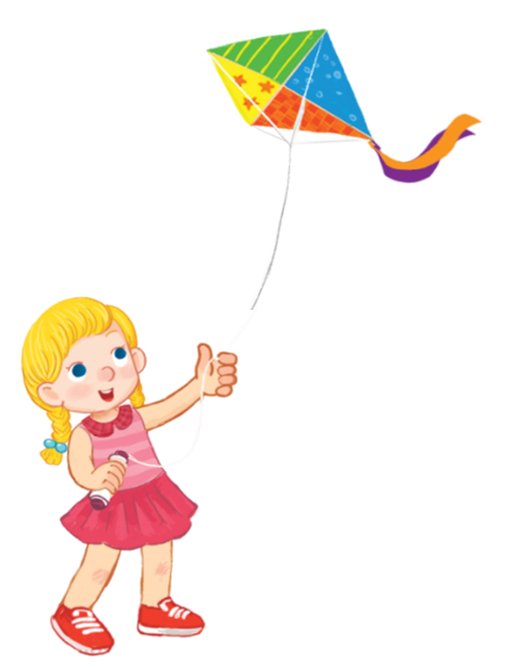

Make a question:
__________________________?
Yes, I can.
Can you fly a kite
MsPham
0936082789
1
check
Next

Slide 7
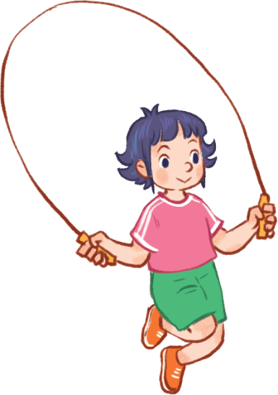
Make a question:
__________________________?
Yes, I can.
Can you skip
MsPham
0936082789
2
check
Next

Slide 8
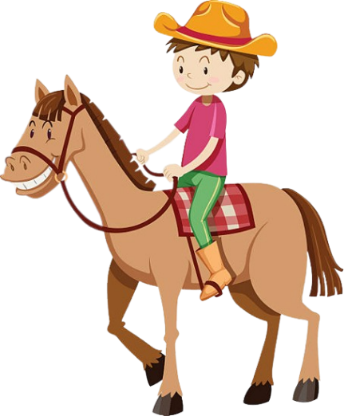
Make a question:
__________________________?
No, I can’t.
Can you ride a horse
MsPham
0936082789
10
check
Next

Slide 9
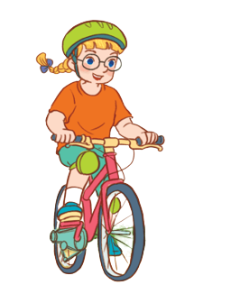
Make a question:
__________________________?
No, I can’t.
Can you ride a bike
MsPham
0936082789
2
check
Next

Slide 10

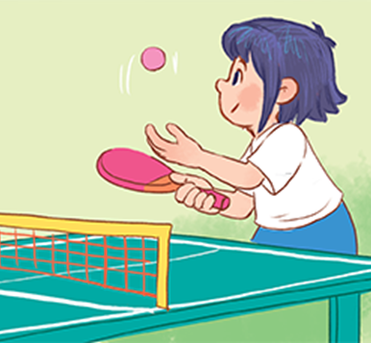

Answer the question:
Can you play table tennis?
____________________
Yes, I can.
5
check
Next

Slide 11

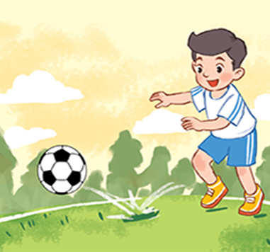

Answer the question:
Can you play football?
____________________
No, I can’t.
MsPham
0936082789
2
check
Next

Slide 12
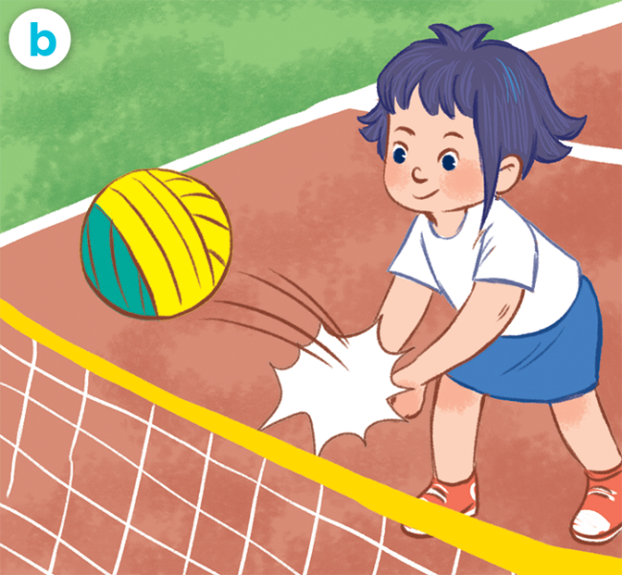

Answer the question:
Can you play volleyball?
____________________
Yes, I can.
MsPham
0936082789
5
check
Next

Slide 13
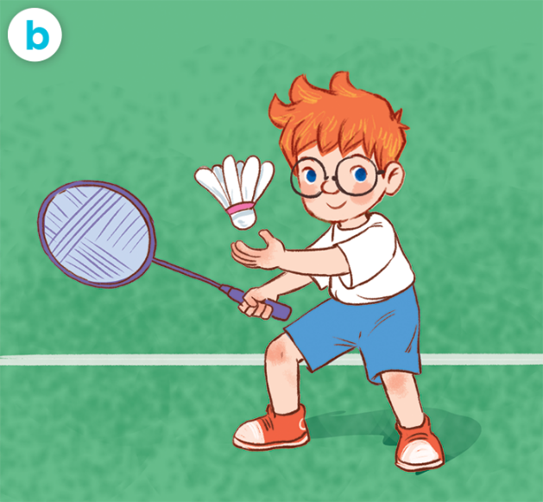

Answer the question:
Can you play badminton?
____________________
Yes, I can.
MsPham
0936082789
5
check
Next

Slide 14
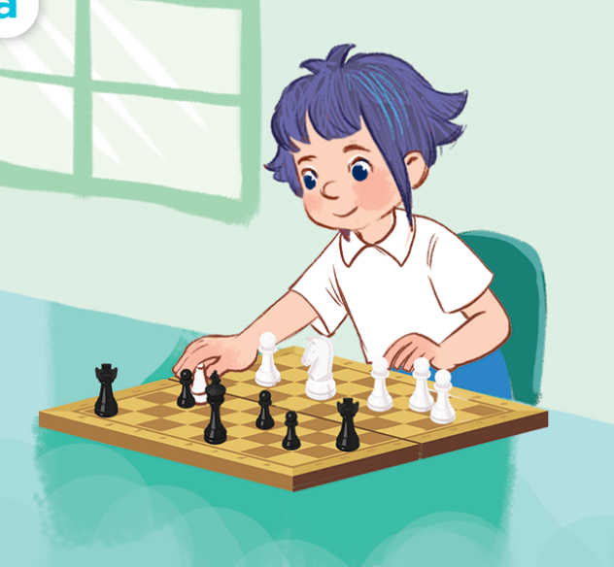
Answer the question:
Can you play chess?
____________________
No, I can’t.
MsPham
0936082789
3
check
Next

Slide 15
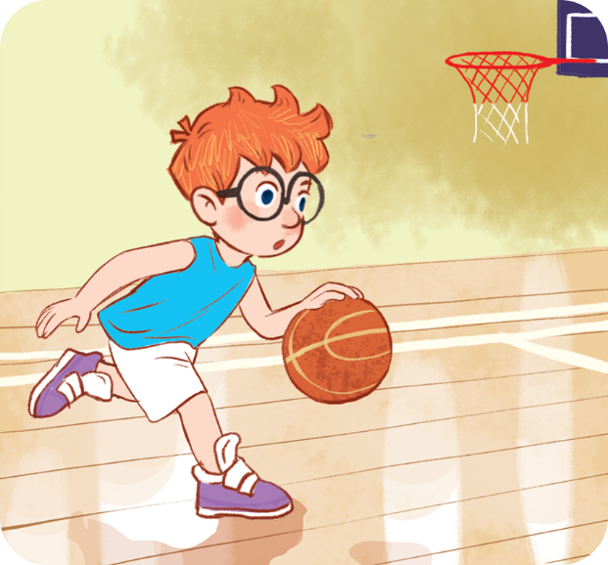
Answer the question:
Can you?
____________________
No, I can’t.
MsPham
0936082789
10
check
Next

Slide 16
Welldone!
MsPham
0936082789
Next

Slide 17


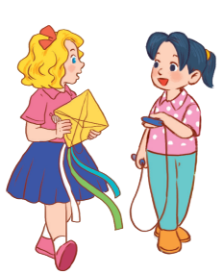

MsPham
0936082789
Review

Slide 18
Yes, I can.
Can you + __________?
MsPham
0936082789
No, I can’t.
play the guitar
ride a bike
MsPham
0936082789
play the piano
ride a horse
skip
fly a kite

Slide 19

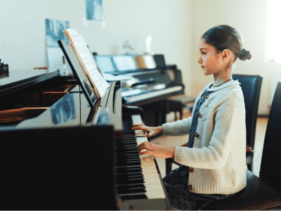
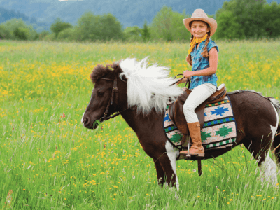
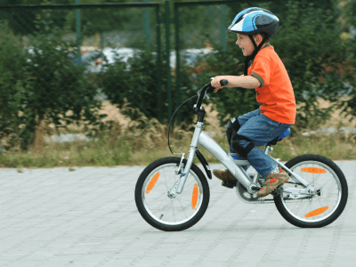
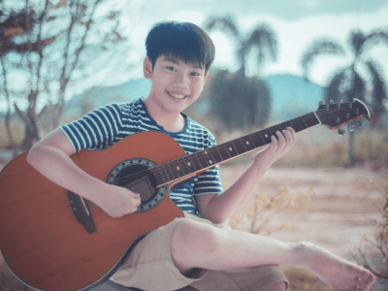
4
Listen and tick.
a
b
1
✓
a
b
2
✓

Slide 20
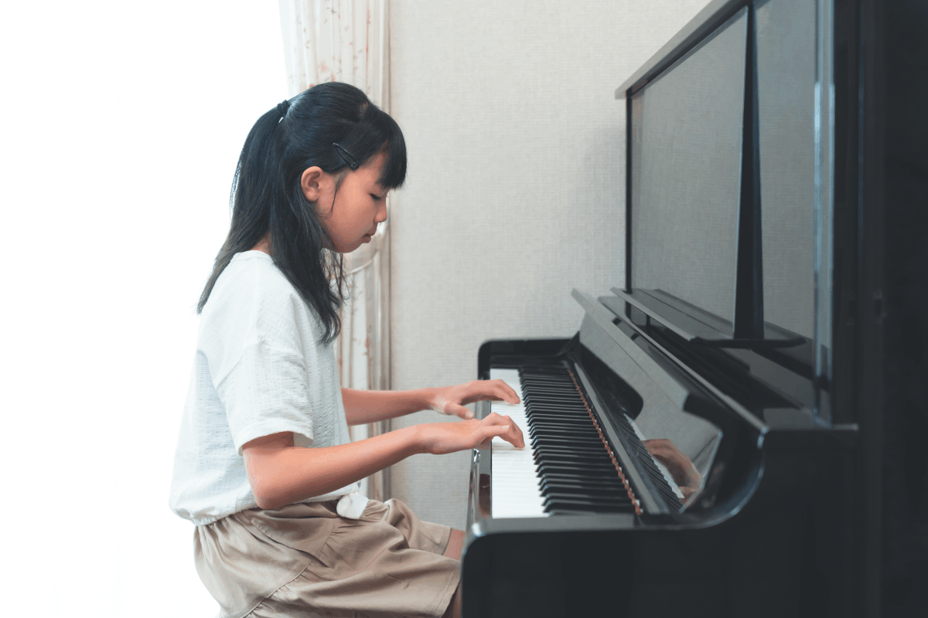
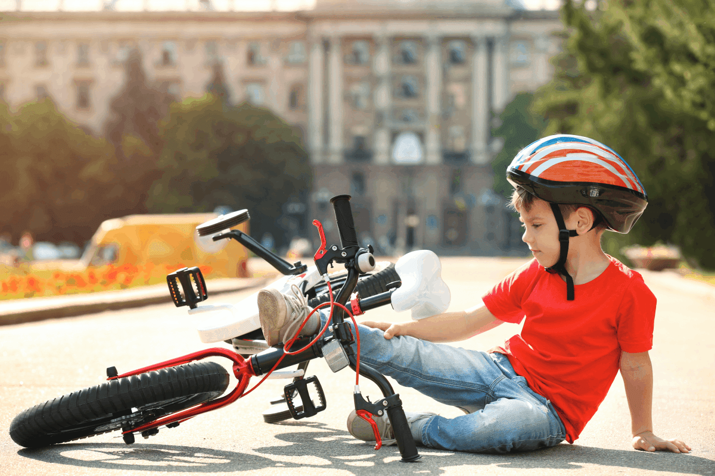
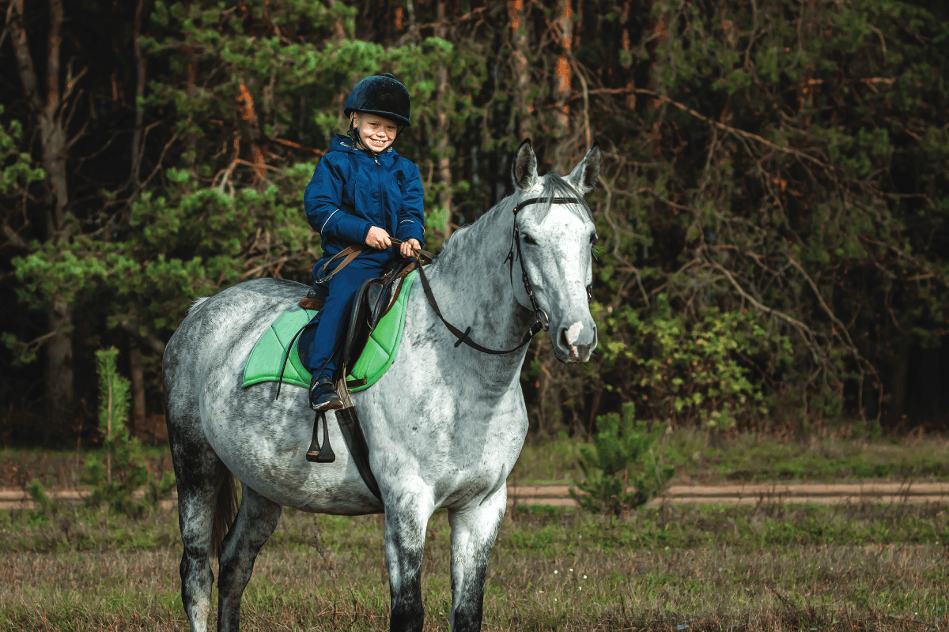
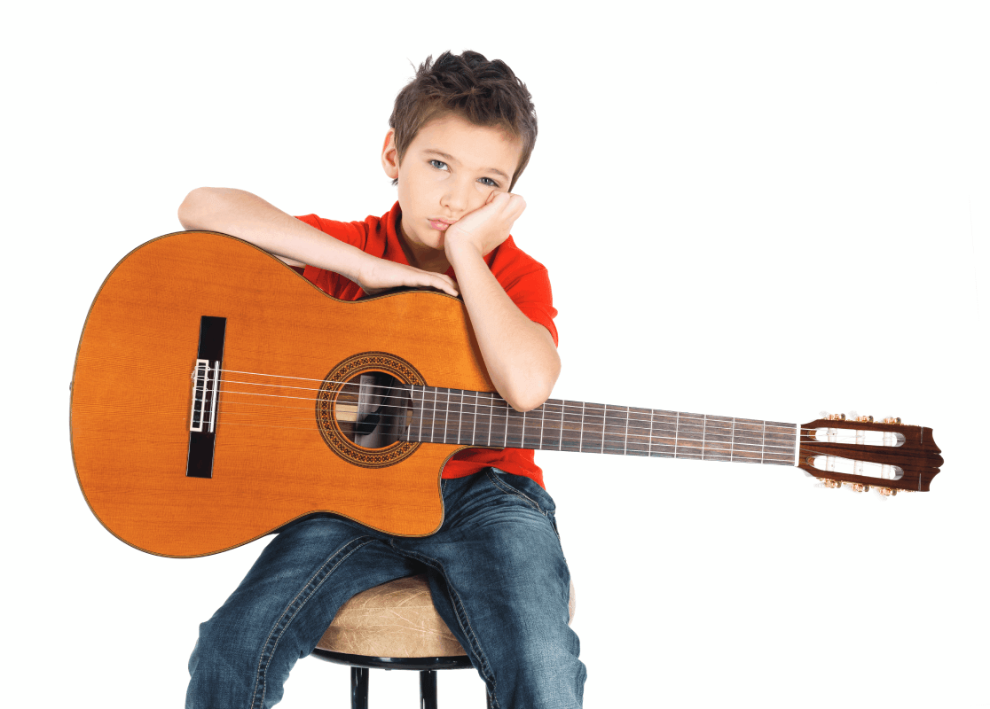
5
Look, complete and read.
1
2
A: Can you play the piano?
B: ___________________.
A: Can you play the piano?
B: ___________________.
Yes, I can
No, I can’t
3
4
ride a horse
play the guitar
A: Can you _______________?
B: _________, I can.
A: Can you _____________?
B: _________, I can’t.
Yes
No

Slide 21
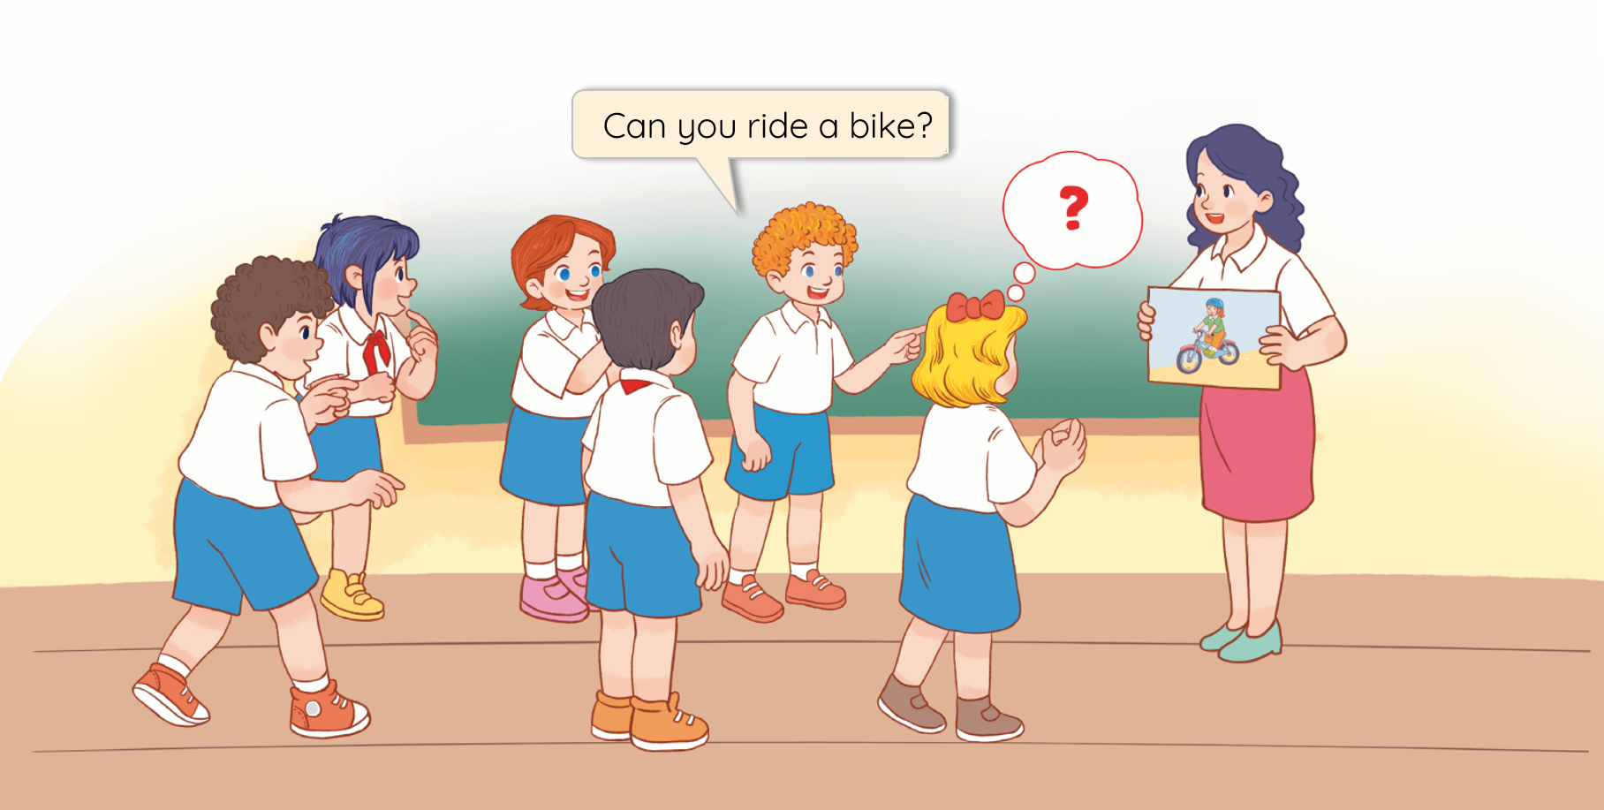
6
Let’s play.
Can you ……..?

Slide 22
MsPham
0936082789
Thank you!

