Slide 1







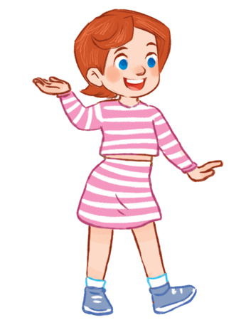


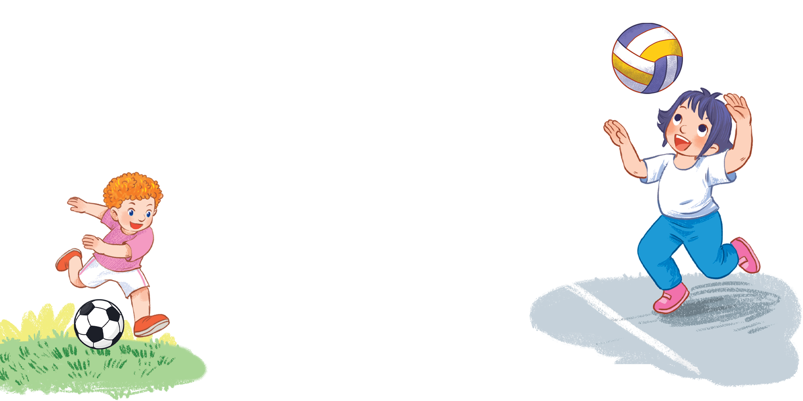



MsPham
0936082789
Unit 5
Things
we can do
Lesson 3 – Period 1

Slide 2



Warm-up
MsPham
0936082789

Slide 3





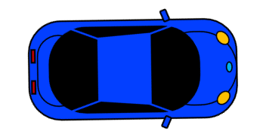

MsPham 0936082789
RACING CAR
START
MsPham
0936082789

Slide 4


Question
1
2
3
4
5
6
7
8
End
MsPham
0936082789

Slide 5

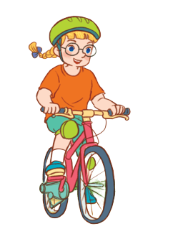



________________?
Yes, I can.
Can you
ride a bike?
Can you
ride a horse?
Can she
ride a bike?
Back

Slide 6
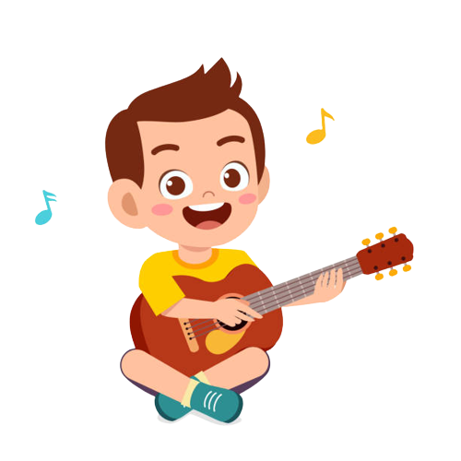

________________?
No, he can’t.
Can she play the guitar?
Can he play the guitar?
Can you play the guitar?
Back
MsPham
0936082789

Slide 7
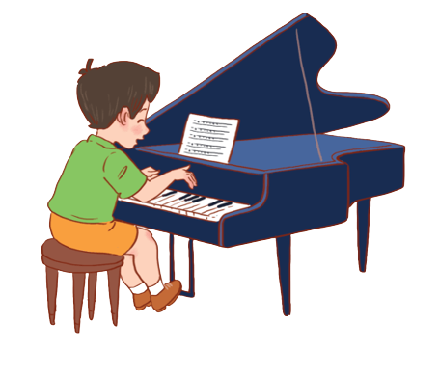
________________?
Yes, he can.
Can you play the guitar?
Can she play the piano?
Can he play the piano?
Back
MsPham
0936082789

Slide 8
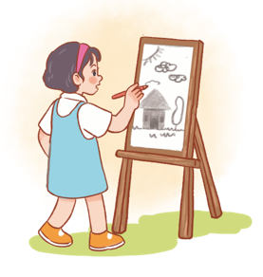
________________?
Yes, she can.
Can you swim?
Can she draw?
Can he skip?
Back
MsPham
0936082789

Slide 9
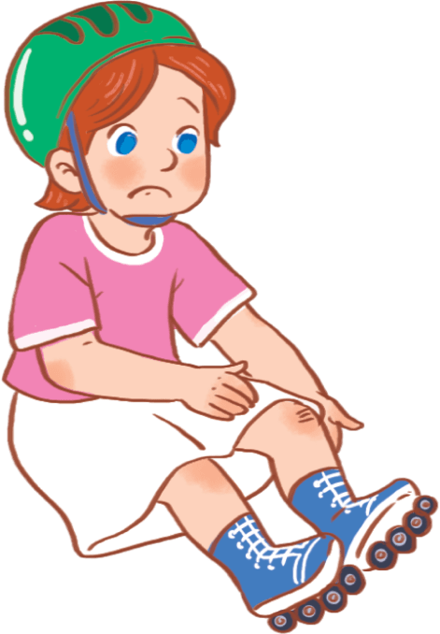
________________?
No, I can’t.
Can she roller skate?
Can she fly
a kite?
Can you ride a horse?
Back
MsPham
0936082789

Slide 10
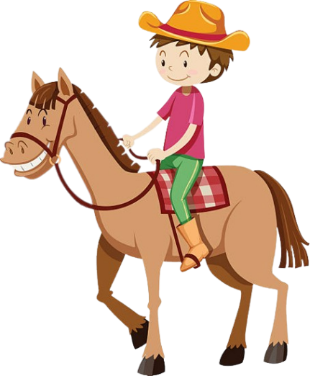
________________?
No, he can’t.
Can she ride a horse?
Can he ride a bike?
Can he ride a horse?
Back
MsPham
0936082789

Slide 11
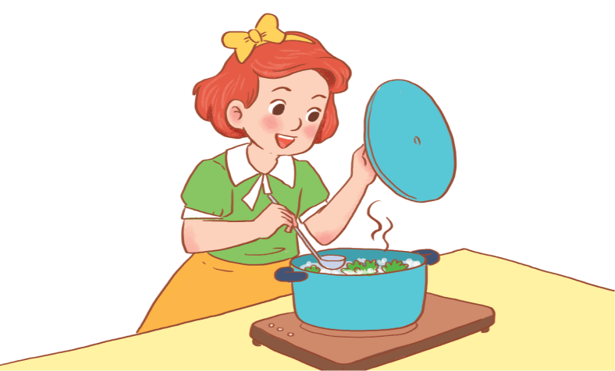
________________?
No, she can’t.
Can you cook?
Can he cook?
Can she cook?
Back
MsPham
0936082789

Slide 12
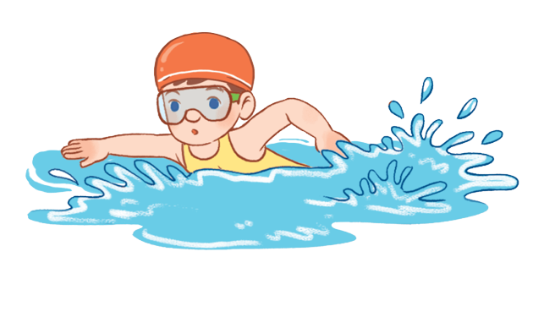
________________?
Yes, he can.
Can he swim?
Can you swim?
Can she swim?
Back
MsPham
0936082789

Slide 13


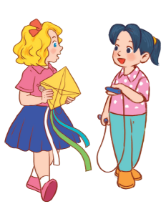

MsPham
0936082789
Review

Slide 14
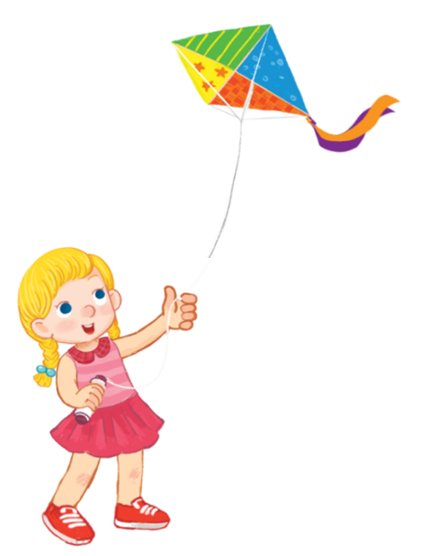
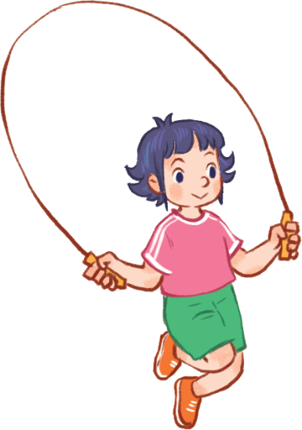
Yes, I can.
Can you + __________?
MsPham
0936082789
No, I can’t.
play the guitar
ride a bike
MsPham
0936082789
play the piano
ride a horse
skip
fly a kite

Slide 15
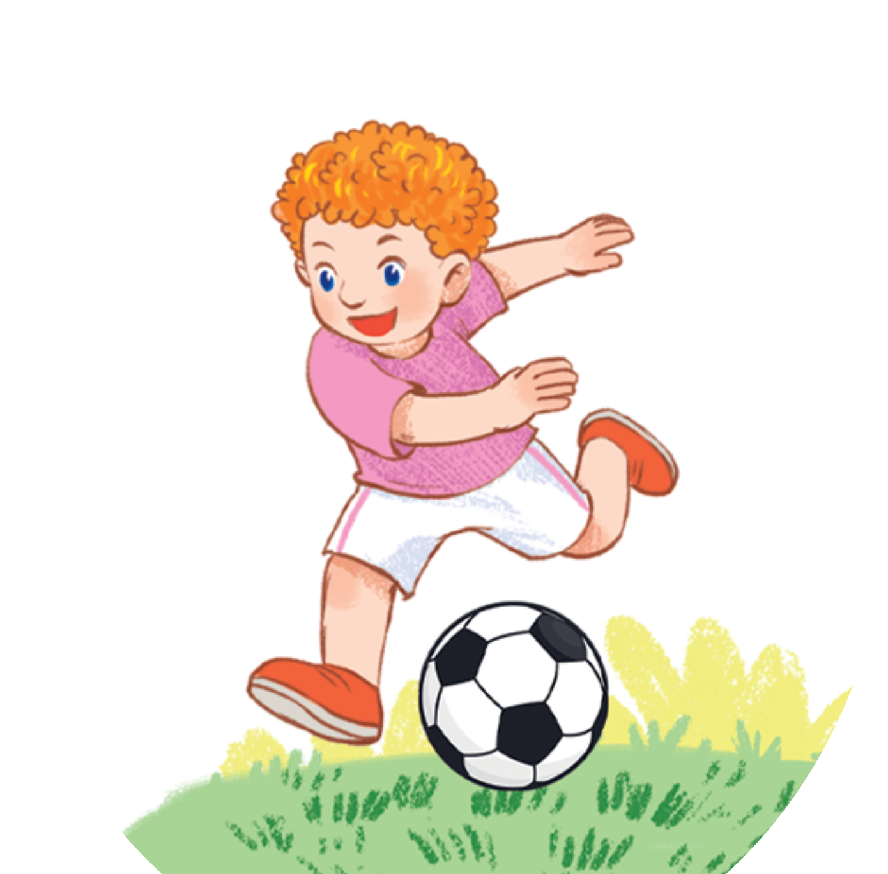
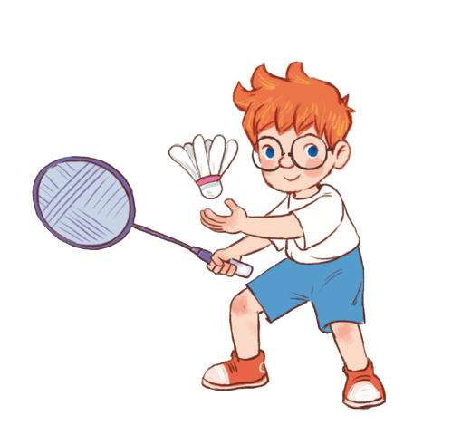
Yes, he/she can.
Can he/she + _________?
No, he/she can’t.
MsPham
0936082789
draw
cook
roller skate
swim
play
football
play
badminton

Slide 16
MsPham
0936082789
Phonics

Slide 17


Slide 18

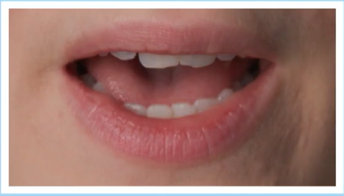

Phonics
yes
y
/j/
/jes/
your
MsPham
0936082789
/jɔːr/
yogurt
/ˈjɒɡət/
Notes:
https://www.youtube.com/watch?v=8z3E7OM43gY&list=PL8_ETpRL2xNbJTjsq6q8ex0yMu7g61wrf

Slide 20
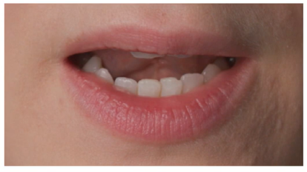

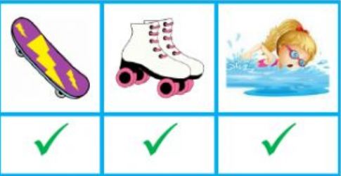
Phonics
No
n
/n/
/nəʊ/
Viet Nam
/ˌviːetˈnɑːm/
MsPham
0936082789
can
/kæn/
Notes:
https://www.youtube.com/watch?v=8z3E7OM43gY&list=PL8_ETpRL2xNbJTjsq6q8ex0yMu7g61wrf

Slide 21
MsPham
0936082789
Practice

Slide 22

1
Listen and repeat.
y
yes
Can you draw? – Yes, I can.
MsPham
0936082789
n
no
Can she swim? – No, she can’t.

Slide 23
2
Listen and circle.
1. Can he swim?
a. Yes, he can. b. No, he can’t.
MsPham
0936082789
MsPham
0936082789
2. Can they draw?
a. Yes, they can. b. No, they can’t.

Slide 24
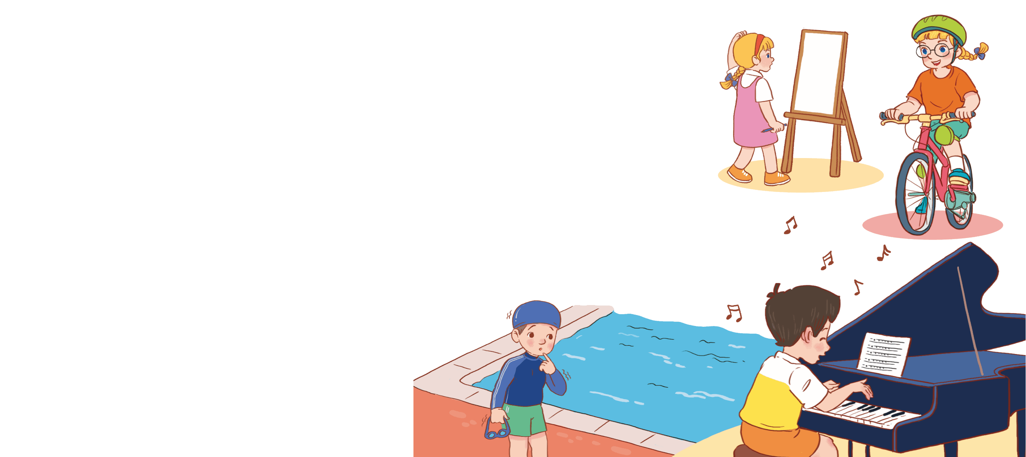
3
Let’s chant.
Can she draw?
Can she draw?
Can she draw?
Can she draw?
No, she can’t.
No, she can’t.
No, she can’t.
No, she can’t.
No, she can’t. No, she can’t.
No, she can’t.
No, she can’t.
Can she draw ride a bike?
Can she draw ride a bike?
Can she draw ride a bike?
Can she draw ride a bike?
Yes, she can.
Yes, she can.
Yes, she can.
Yes, she can.
Yes, she can. Yes, she can.
Yes, she can.
Yes, she can.
Can he swim?
Can he swim?
Can he swim?
Can he swim?
No, he can’t.
No, he can’t.
No, he can’t.
No, he can’t.
No, he can’t. No, he can’t.
No, he can’t.
No, he can’t.
Can he play the piano?
Can he play the piano?
Can he play the piano?
Can he play the piano?
Yes, he can.
Yes, he can.
Yes, he can.
Yes, he can. Yes, he can.
Yes, he can.
Yes, he can.
Yes, he can.
Hide
MsPham
0936082789

Slide 25
3
Let’s chant.
Can she draw?
Can she draw?
No, she can’t.
No, she can’t.
No, she can’t. No, she can’t.
Can she draw ride a bike?
Can she draw ride a bike?
Yes, she can.
Yes, she can.
Yes, she can. Yes, she can.
Can he swim?
Can he swim?
No, he can’t.
No, he can’t.
No, he can’t. No, he can’t.
Can he play the piano?
Can he play the piano?
Yes, he can.
Yes, he can. Yes, he can.
Yes, he can.
MsPham
0936082789

Slide 26
MsPham
0936082789
Review

Slide 27
MsPham
0936082789
Phonics
y
/j/
n
/n/
Notes:
https://www.youtube.com/watch?v=8z3E7OM43gY&list=PL8_ETpRL2xNbJTjsq6q8ex0yMu7g61wrf

Slide 28
MsPham
0936082789
Thank you!

